Slide 1

Intro to Databases
Session 2

Slide 2

Welcome Back! Girl Develop It is here to provide affordable and accessible programs to learn software through mentorship and hands-on instruction.
We are here for you
Every question is important
Help each other
Have fun

Slide 3
Today…
Brief review of concepts from last class
Install our sample database – products
Look at the ER diagram for the sample database
Start with Queries!

Slide 4
Relational Databases
If you want your application to:
Handle a lot of complicated querying
Reliably enact transactions
Conduct routine analysis of data
you’ll probably want to stick with a relational database

Slide 5
Relational Databases
ACID Properties
A – Atomicity: an atomic transaction is either fully completed or not done at all
C – Consistency: Ensures that only valid data following all rules and constraints is written in the database and all users have the same view of the data.
I – Isolation: A transaction in process and not yet committed must remain isolated from any other transaction.
D – Durability: All changes made to the system are permanent and can be recovered if necessary
Notes:
Atomic transaction – think of a bank account transfer, money is taken from A and put into B, if the system fails after removing money from A a good system will put it back, reversing it to its original state
Isolation -- Changes occurring in a particular transaction will not be visible to any other transaction until that particular change in that transaction is written to memory or has been committed.

Slide 6
Quick Review:
Entity – person, place, thing or concept about which data can be collected.
Attribute – a fact that characterizes or describes an entity -- the data that we want to keep about each entity
Primary key - the attribute used to identify a specific entity, must be unique and not change!
Foreign key - is a field (or collection of fields) in one table that refers to the primary key in another table and is used to link the two tables together

Slide 7
Intro to PostgreSQL
PostgreSQL is a general purpose and object-relational database management system
Developed based on POSTGRES 4.2 at Berkeley Computer Science department, University of California.
Free and open source, no associated licensing costs

Slide 8
Benefits of PostgreSQL
• Good data integrity (security)
Complex custom procedures
Good documentation
Integration with lots of other tools
Extensible: If you require your database to perform custom procedures PostgreSQL is a good choice.

Slide 9
Cons
Speed
Install and configuration can be challenging
Replication

Slide 10
PostgreSQL
Companies like Apple, Fujitsu, Red Hat, Cisco, Skype, and Instagram use PostgreSQL for their databases

Slide 11
Let’s install PostgreSQL and our sample database! Navigate to the instructions on Google drive: http://bit.ly/2uojVQs or Github: https://github.com/ebollwerk/GDI_IntroDatabasesPostgreSQL

Slide 12
Quick Review of Relationships:
One-to-One: A car model is made by one company.
One-to-Many: One mother can have many children.
Many-to-One: Many employees work in one department.
Many-to-Many: Many orders have many products.

Slide 13
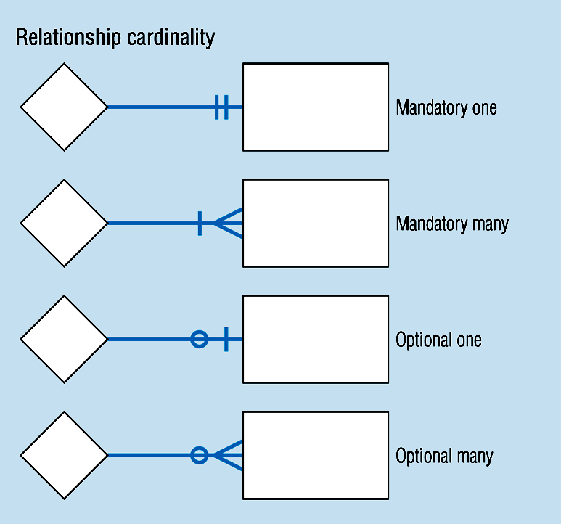
Cardinality
Notes:
Cardinality expresses the number of entities to which another entity can be associated via a relationship set.
Cardinality Constraints - the number of instances of one entity that can or must be associated with each instance of another entity.

Slide 14
Cardinality Constraints Example (Contd.)
Notes:
Because you can have multiple copies of films at each store, created an inventory table that assigns a unique inventory number to each combo of video/store, then use that in the rental table

Slide 15
Database Schemas
A structure described in a formal language
Acts as a blueprint for how the database is constructed
In a relational database, the schema defines:
tables
fields
relationships
views
indexes
functions
and other elements

Slide 16
SELECT Statement Syntax
We use the SELECT command to show data from a database
The output from a SELECT statement is always a grid of rows and columns.
The most simple SELECT statement retrieves all values from a single table
To query data from all rows and all columns from a table, you use the following query:
SELECT * FROM table_name;

Slide 17
SELECT Statement Syntax
To query data from all rows and all columns from the products table, you use the following query:
SELECT * FROM products;

Slide 18
SELECT Column Example
The following SQL statement selects the ”first name” and “address” columns from the ”user" table:
SELECT firstname, address
FROM users;
The semicolon is not a part of SQL statement. It is only for PostgreSQL to specify the end of an SQL statement.

Slide 19
WHERE Clause
You can have only a subset of rows returned by using the WHERE clause:
SELECT firstname, address
FROM users
WHERE firstname = ‘John’;

Slide 20
WHERE clause operators
Operator | Description
= | Equal
<> | Not equal Note this can be != in some versions of SQL
> | Greater than
< | Less than
>= | Greater than or equal
<= | Less than or equal
BETWEEN | Between an inclusive range
LIKE | Search for a pattern
In | To specify multiply values in a column

Slide 21
Not Equal
SELECT firstname
FROM users
WHERE firstname <> ‘John’;

Slide 22
Greater than
﻿SELECT *
FROM products
WHERE price > 38;

Slide 23
Less than
﻿SELECT *
FROM products
WHERE price < 45;

Slide 24
Between
﻿﻿SELECT *
FROM carts
WHERE last_updated BETWEEN '2017-03-17 14:16:29.35096' AND '2017-05-17 14:16:29.35096'

Slide 25
Like
﻿﻿﻿SELECT *
FROM product_types
WHERE name LIKE '%clothing%’;

Slide 26
In
﻿﻿﻿﻿SELECT *
FROM users
WHERE firstname in (’John', ’Mary');

Slide 27
Order By
﻿﻿SELECT *
FROM orders
WHERE created_at BETWEEN '2017-03-18 00:01:46.003891' AND '2017-07-17 00:01:46.003891’
ORDER BY created_at ASC
The ORDER BY clause allows you to sort the rows returned from the SELECT statement in ascending or descending order based on criteria specified by different criteria.

Slide 28
LET’S DEVELOP IT!
Spend the rest of class writing SELECT statements with WHERE clauses
For example:
Bring back all the rows in the orders table where the status is shipped
Bring back all the rows in the orders table where the address begins with 4
Bring back all the rows in the products table where the name contains the word software
Bring back all the rows in the products table where the price is greater than $20
Bring back all the rows in the user table where the last name begins with D and list them in ascending order
Use PgAdmin Manager and the ER diagram to get ideas of how the data is structured, and what you might query
Feel free to work with a neighbor!

