Slide 1

Intro to Databases
Session 3

Slide 2

Welcome Back! Girl Develop It is here to provide affordable and accessible programs to learn software through mentorship and hands-on instruction.
We are here for you
Every question is important
Help each other
Have fun

Slide 3
Today…
JOINING TABLES
Finally, the real power of SQL!
BUT before we get to joins we need to go over one more thing…
Primary keys and foreign keys

Slide 4
Keys
Primary Key – the attribute used to identify a specific entity
Consists of one or more columns whose data contained within is used to uniquely identify each row in the table.
Data within the rows must be unique (e.g. can’t duplicate numbers)
No value in the columns can be blank or NULL

Slide 5
Keys
FOREIGN Key – a set of one or more columns in a table that refers to the primary key in another table
Unlike primary keys can contain duplicate values
Also ok for them to contain NULL values

Slide 6
Now onto joins…
The SQL JOIN clause combines records from two or more tables in a database. You will primarily use two types of joins, with some variations on these:
Inner Join
Outer Join
Notes:
Add a slide – why do we query? What do we want to know? What tables do we need?

Slide 7
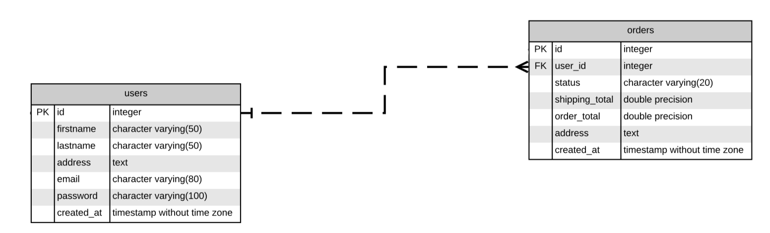
Our Tables
To illustrate these joins, let's turn to our sample database. We have two tables: users and orders. We want to join these tables in a variety of ways.
Notes:
Remember: Each user may have zero or many carts. Each cart belongs to one customer.

Slide 8
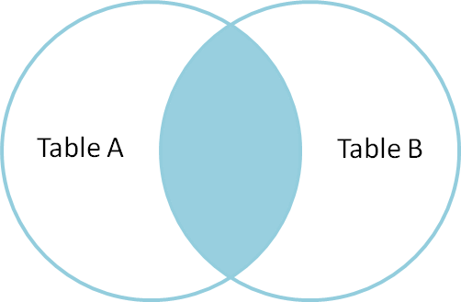
Inner Join
The Inner Join is the most common type of join.
Selects only records that are common in both of the tables you are joining.
Notes:
intersection

Slide 9
Inner Join
Selects only the records that match both Users and Orders
To join the Users Table to the Orders table:
First, you specify the column(s) in both tables from which you want to select data in the SELECT clause
Second, you specify the main table (i.e. User) in the FROM clause.
Third, you specify the table that the main table joins to (i.e., Orders) in the INNER JOIN clause. In addition, you put a join condition after the ON i.e, A.primarykey = B.foreignkey or Users.user_id = Orders.user_id

Slide 10
Let’s Develop It!
Write a SQL Query that returns the following from the sample database:
users.id
orders.id
user’s first and last name
email
shipping_total
address
One thing to keep in mind:
If tables have the same column name we have to refer to the column as table_name.column_name to avoid ambiguity.
Notes:
First example, join tables and use * to bring back all the information in the tables to see what there is

Slide 11
Solution
﻿﻿SELECT
users.id,
orders.id,
firstname,
lastname,
email,
shipping_total,
orders.address
FROM users
INNER JOIN orders ON users.id = orders.user_id;

Slide 12
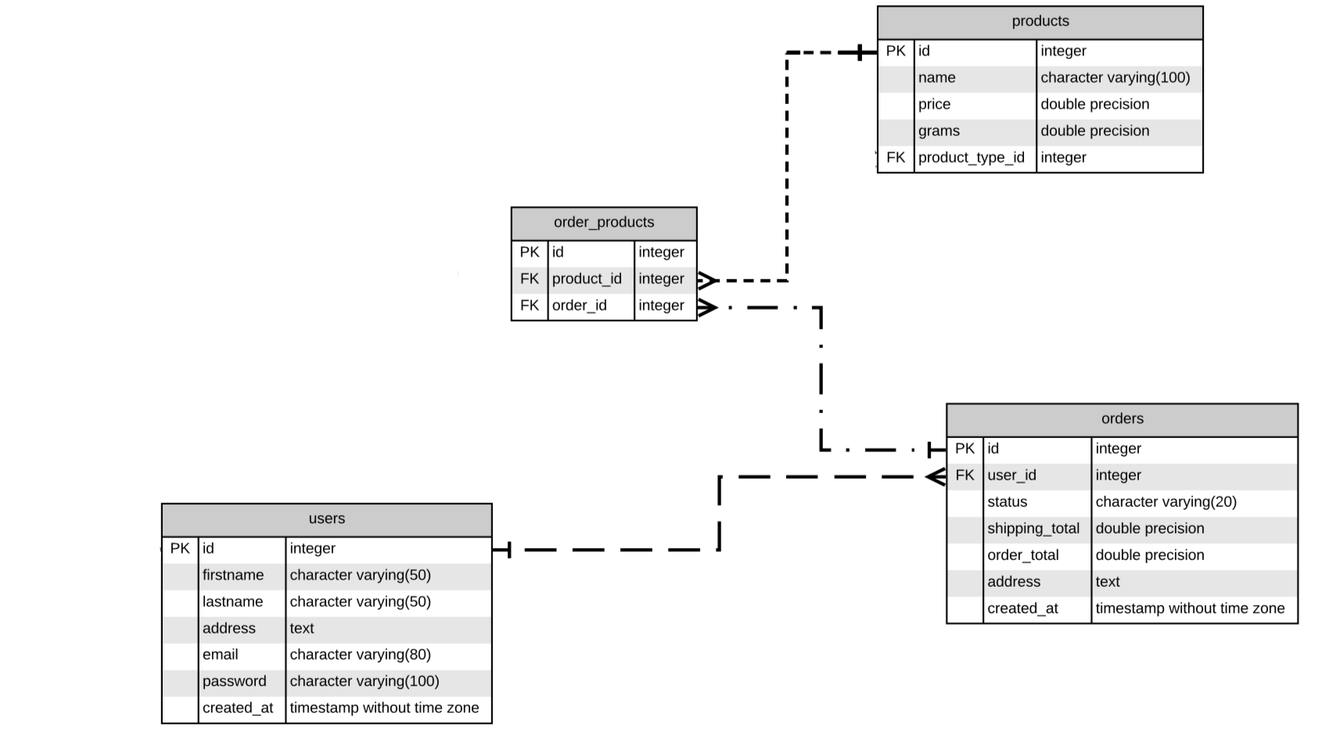
Joining many tables
Notes:
Remember: Each order relates to one or many products. Each product has zero or many orders. Each order product belongs to one and only customer.

Slide 13
LET'S DEVELOP IT!
Write a SQL Query that returns the following from the sample database:
user id
order id
user first name
user last name
user email
shipping total
order address
products name
products price
One thing to keep in mind:
If tables have the same column name we have to refer to the column as table_name.column_name to avoid ambiguity.

Slide 14
Solution
﻿﻿SELECT
users.id as users,
orders.id as orders,
firstname,
lastname,
email,
shipping_total,
orders.address,
products.name,
products.price
FROM users
INNER JOIN orders ON users.id = orders.user_id
INNER JOIN order_products ON orders.id = order_products.order_id
INNER JOIN products ON products.id = order_products.product_id
Notes:
You can rename a table or a column temporarily by giving another name, which is known as ALIAS. The use of table aliases means to rename a table in a particular PostgreSQL statement. Renaming is a temporary change and the actual table name does not change in the database.
The column aliases are used to rename a table's columns for the purpose of a particular PostgreSQL query.

Slide 15
OUTER JOINS:
An outer join returns a set of records (or rows) that include what an inner join would return but also include other rows for which no corresponding match is found in the other table.
There are three types of outer joins:
Left Outer Join (or Left Join)
Right Outer Join (or Right Join)
Full Outer Join (or Full Join)

Slide 16
OUTER JOINS:
Each of these outer joins refers to the part of the data that is being compared, combined, and returned.
Sometimes nulls will be produced in this process as some data is shared while other data is not.

Slide 17
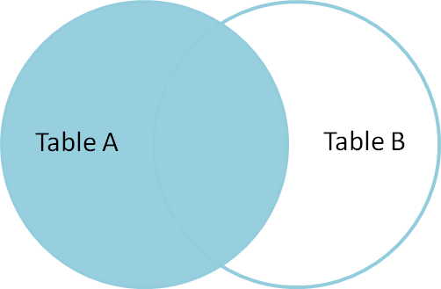
LEFT Outer Join
A left outer join will return all the data in Table A with matching records from Table B if available
If there is no matching record in B, the right side will have a null value
Notes:
Useful when you have a relationship that is one to many where the many is optional, may have entries in Table B but may not, can use this to return those null values, for example, if looking whether there are customers who haven’t made any orders
In a LEFT JOIN, the table in the FROM clause is the primary table; the result will contain every row selected from this table, while rows named in the LEFT JOIN table can be missing (these columns will be NULL in the result).

Slide 18
Let’s revisit our first join…
﻿﻿SELECT
users.id,
orders.id,
firstname,
lastname,
email,
shipping_total,
orders.address
FROM users
LEFT JOIN orders ON orders.user_id = users.id;
Notes:
Can use this to return those null values, for example, if looking whether there are users who haven’t made any orders

Slide 19

RIGHT Outer Join
A right outer join returns Table B's data with matching records from Table A if available
If there is no matching record in A, the left side, (the table named in the FROM clause) will have a null value
Table B
Notes:
RIGHT JOIN is similar but the reverse: rows can be missing in the table named in FROM.

Slide 20
Let’s revisit our first join…
﻿﻿SELECT
users.id,
orders.id,
firstname,
lastname,
email,
shipping_total,
orders.address
FROM users
RIGHT JOIN orders ON orders.user_id = users.id;
Notes:
No

Slide 21
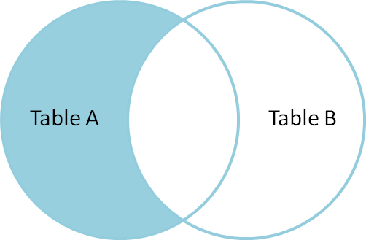
RECORDS IN TABLEA, BUT NOT TABLEB
Remember that the left outer join gave us null values for the right side if there was no corresponding record in TableB.
We can now use this information to isolate the records we want.

Slide 22
RECORDS IN TABLEA, BUT NOT TABLEB
We can use the WHERE clause to isolate the records we are interested in:
SELECT * from TableA
LEFT OUTER JOIN TableB
ON TableA.id = TableB.id
WHERE TableB.id IS NULL;

Slide 23
Solution
﻿﻿﻿﻿SELECT *
FROM users
LEFT OUTER JOIN orders
ON orders.user_id = users.id
WHERE orders.id IS NULL;

Slide 24
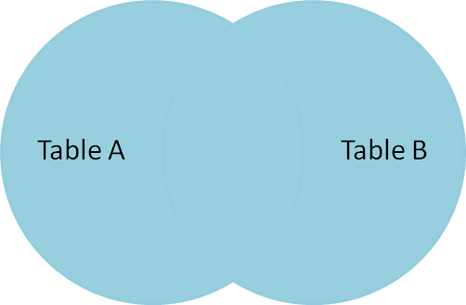
FULL Outer Join
A full outer join, or full join, combines and returns all data from two or more tables, regardless of whether there is shared information.
Think of a full join as simply duplicating all the specified information, but in one table, rather than multiple tables. Where matching data is missing, nulls will be produced.
Notes:
Only really shows you something new if you use it to join tables that have many to many relationships, if you only have one to many, LEFT JOIN and RIGHT JOIN will get you the same as a FULL JOIN

Slide 25
Group By
Data can also be grouped by identical values using the GROUP BY clause.
SELECT user_id
FROM order
GROUP BY
user_id;
This query will return all orders grouped by user.
In this case the GROUP BY removes duplicate rows
Make sure to run this one both with and without the GROUP BY to see the difference in the number of returns
Notes:
DO THIS FIRST!!

Slide 26
Functions
PostgreSQL has four types of functions:
Aggregate functions – An aggregate function computes a single result from multiple input rows.
Conditional functions
String functions
Date/Time functions
Functions give you built-in functionality that allow you to do more with your data. See more details about functions here: http://www.postgresqltutorial.com/postgresql-functions/
Notes:
GROUP BY is often very useful when combined with aggregate functions

Slide 27
Aggregate Functions
count(*) | Returns the number of rows matching the query
count(id) | Returns the numbers of rows matching the query where the given column is not null
avg() | Returns the average value of all non-null values
sum() | Returns the sum of all non-null values
max | Gets the maximum value of a set of values
min | Gets the minimum value of a set of values

Slide 28
Let’s Develop It!
Write PostgreSQL queries to answer the following questions about the sample database:
How much a user has paid per order (added challenge, include each customer’s first and last name)
What is the average order price per user?
What is the number of products per order?
User id, first and last name and order id for all orders of motherboards or monitors
Return the user id, orderid, firstname, lastname for which the shipping_total is null.

Slide 29
Solution – #1
﻿﻿﻿﻿﻿SELECT
users.id as users,
orders.id as orders,
firstname,
lastname,
email,
shipping_total,
orders.address,
sum(products.price)
FROM users
INNER JOIN orders ON users.id = orders.user_id
LEFT JOIN order_products ON orders.id = order_products.order_id
LEFT JOIN products ON order_products.product_id = products.id
GROUP BY users.id, orders.id, firstname, lastname, email, shipping_total, orders.address
ORDER BY users.id

Slide 30
Solution – #2
﻿﻿﻿﻿﻿﻿SELECT
users.id as users,
firstname,
lastname,
email,
avg(orders.order_total)
FROM users
INNER JOIN orders ON users.id = orders.user_id
LEFT JOIN order_products ON orders.id = order_products.order_id
LEFT JOIN products ON order_products.product_id = products.id
GROUP BY
users.id, firstname, lastname, email
ORDER BY users.id

Slide 31
Solution – #3
﻿﻿﻿﻿﻿﻿﻿SELECT
orders.id,
count(order_products.product_id)
FROM orders
INNER JOIN order_products ON orders.id = order_products.order_id
INNER JOIN products ON order_products.product_id = products.id
GROUP BY orders.id
ORDER BY orders.id

Slide 32
Solution – #4
﻿﻿SELECT
users.id as users,
firstname,
lastname,
orders.id as orders
FROM users
INNER JOIN orders ON users.id = orders.user_id
INNER JOIN order_products ON orders.id = order_products.order_id
INNER JOIN products ON order_products.product_id = products.id
WHERE products.name in ('motherboard', 'monitor')
ORDER BY users.id

Slide 33
Solution – #5
﻿﻿﻿SELECT
users.id as users,
orders.id as orders,
firstname,
lastname,
shipping_total,
orders.address
FROM users
LEFT JOIN orders ON orders.user_id = users.id
WHERE shipping_total IS NULL

Slide 34
LET'S DEVELOP IT!
Write a SQL Query that returns the following from the sample database
User ID
User First and Last Name
Order ID
Product Name
Product Type Name
Where the order is a motherboard or monitor

Slide 35
Solution
﻿﻿SELECT
users.id as users,
firstname,
lastname,
orders.id as orders,
products.name,
product_types.name
FROM users
INNER JOIN orders ON users.id = orders.user_id
LEFT JOIN order_products ON orders.id = order_products.order_id
LEFT JOIN products ON order_products.product_id = products.id
LEFT JOIN product_types ON products.product_type_id = product_types.id
WHERE products.name in ('motherboard', 'monitor')
ORDER BY
users.id

