Slide 1
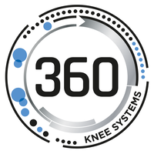
Automation of Post-market Surveillance Reports
Team Members: Yang, Christale, Donna, Alex, Tristan

Slide 2
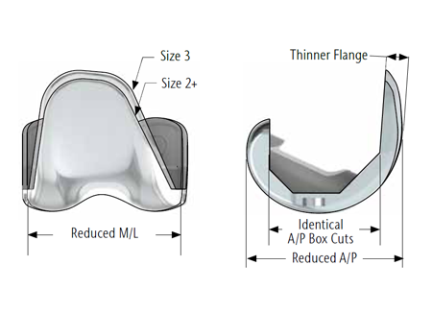
The Problem
Pre-operative planning in TKR is used to plan component sizes of the femur, tibia and patella prior to surgery to assist intra-operative decisions.
Simulation testing of the knee kinematics
TKR relieves pain and improves quality of life BUT why is there still around 20-25% of dissatisfied patients? (1,2,3)
New Zealand Orthopaedic Association. The New Zealand Joint Registry Ten-year Report: January 1999 to December 2008. October 2009.
Baker PN, van der Meulen JH, Lewsey J, Gregg PJ National Joint Registry for England and Wales. The role of pain and function in determining patient satisfaction after total knee replacement. Data from the National Joint Registry for England and Wales. J Bone Joint Surg Br. 2007; 89(7):893–900.
Bourne RB, Chesworth BM, Davis AM, Mahomed NN, Charron KD. Patient satisfaction after total knee arthroplasty: who is satisfied and who is not? Clin Orthop Relat Res. 2010; 468(1):57–63.

Slide 3
360 Knee Systems Goal
To create an automated way to generate the PMS report as a PDF, Powerpoint or word document from a database export (as a CSV).
Better prepare surgeons
Avoid lengthy and manual process
Optimise pre-operative processes
Better patient-specific care

Slide 4


Aim To assess the efficacy of the pre-operation plan
Solution Python and Latex which is a great direction to follow since they are open-source programs which are easily accessible and customizable.

Slide 5
Procedure
1
Examine the CSV files to obtain a good understanding on what to code
2
Create the code to import and sort the data from the CSV files into a summarised excel sheet with Python
3
Convert the summarised data into graphical representations in a PDF report with Latex
Notes:
Isolated the case numbers which contained the current information regarding the implant sizes before surgery.
Matched it to the Case ID of the patient obtaining the surgery
Correlated it with post-op results and the corresponding surgeon

Slide 6
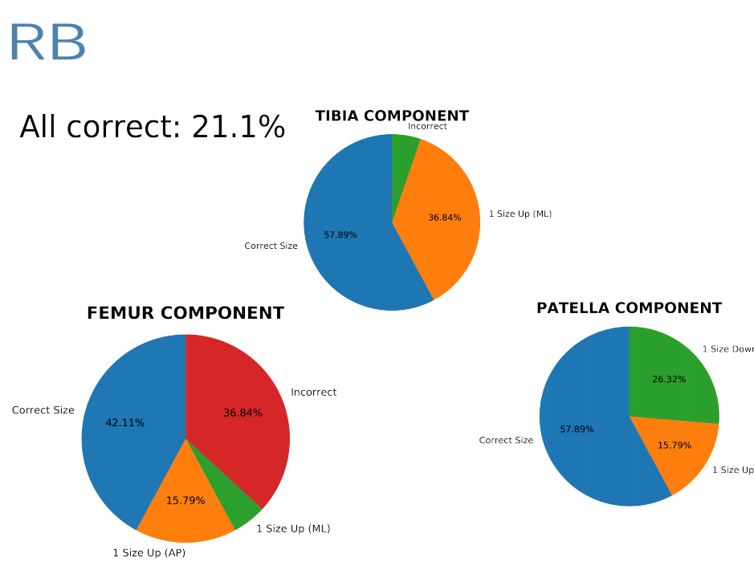
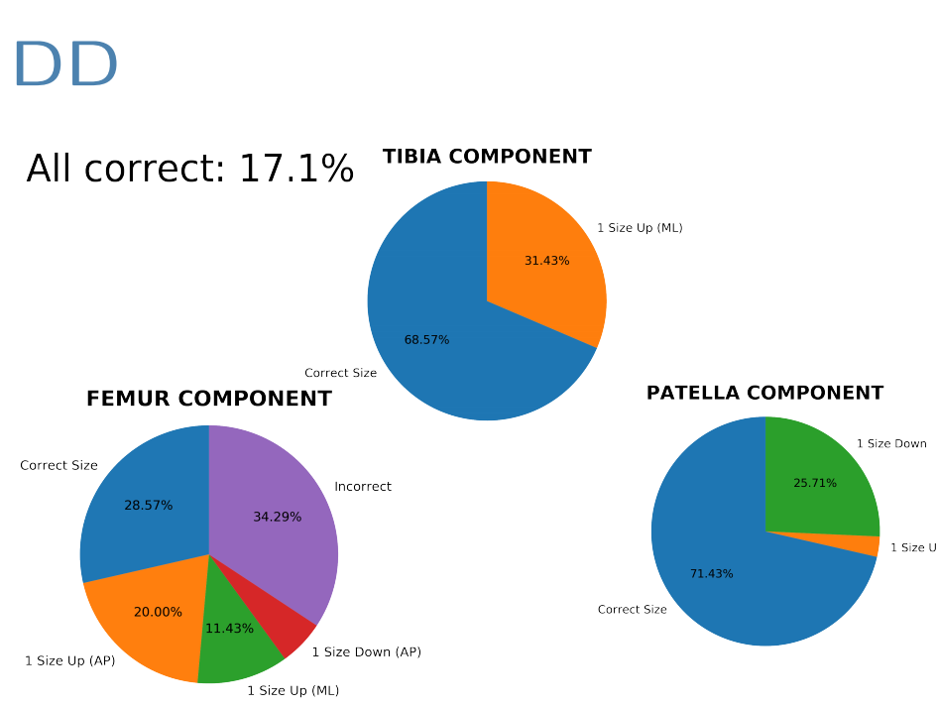

Slide 7
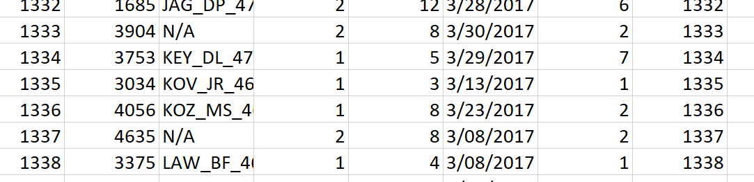
Limitations
Gaps in data including overlapped and not defined data will be ignored in the code
Doesn’t account for patients who came in for more than one knee surgery
The code produced is only specific to the data variables with 360 Knee Systems
Python and Latex can always be upgraded with new updates. Latex is slightly inflexible

Slide 8
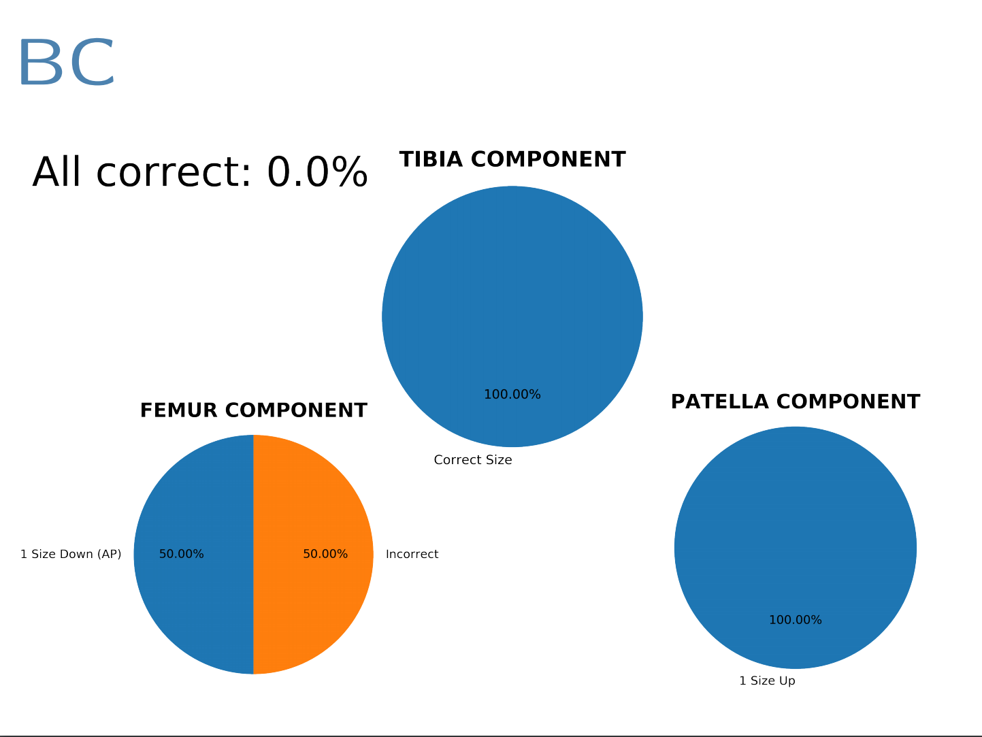

Slide 9
Business Case
Market Any biomedical engineering company that requires ISO13485 certification
Replace interns manually input this data which would take 1-2 weeks to complete
Automation
Saving money
Accuracy

Slide 10
GMP
Testing procedure – V&V
Verifiable and validated because it is corresponds to the manual data already produced
Risk Analysis – what if you select the wrong column?

Slide 11
Future application
Can be applied to many other biomedical engineering companies for specific needs
Enable better patient care and monitoring through a more efficient PMS report
Enables biomedical companies to re-evaluate their methods and products
Increase probability of surgery success
Better pre-operative profiling for better patient care

