Slide 1

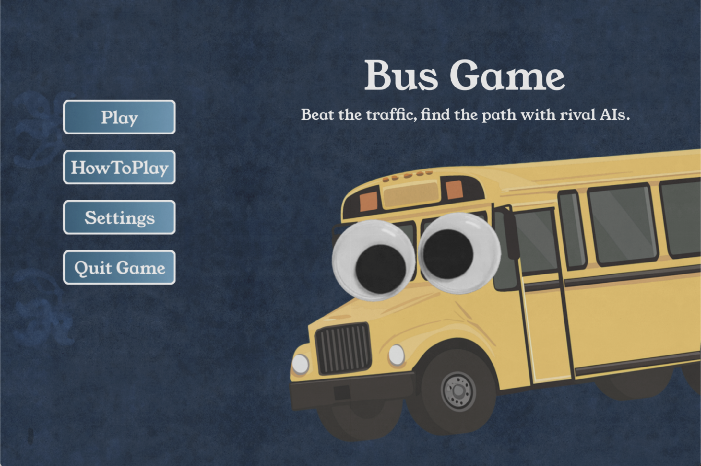
Bus Game
A Competitive Pathfinding Game
Beat rival AIs across a weighted road network
using the lowest-cost route.
CPSC 481 Project · Spring 2026
Emily Bongiorno, Kurtis Volker

Slide 2
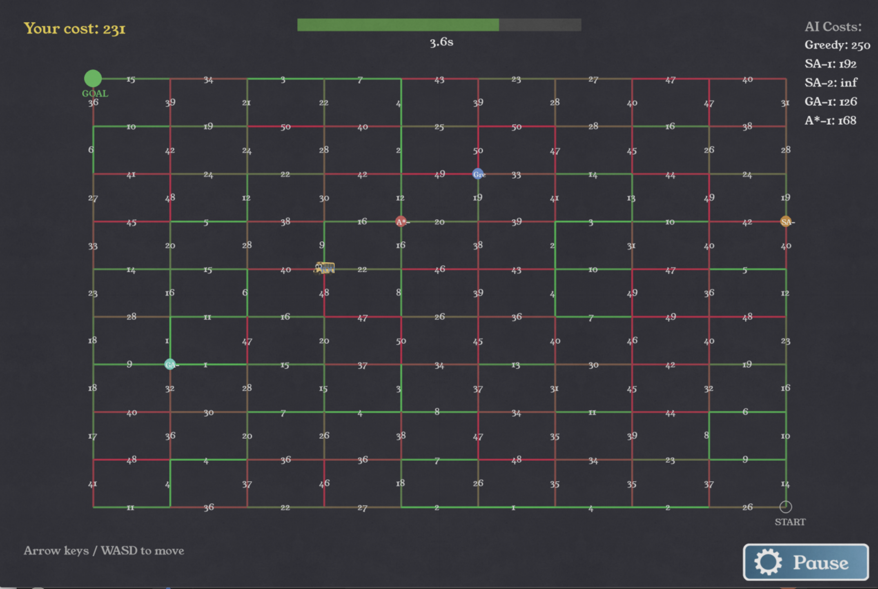
Problem Overview
Question
How do different AI pathfinding strategies compare when competing on the same randomized cost graph? Can the a human find a better path?
Setup
A 10×10 grid of nodes. Every edge has a random cost from 1–50. One human player, five AI agents. Race from bottom-right to top-left. Lowest total edge cost wins.
Why it matters
Route optimization is a real-world CS problem.
This game was based on the idea of a real world traffic pathing app. Can be used to study algorithm tradeoffs.
Depicted Gameplay: The Player vs the 5 opposing AI agents

Slide 3


Approach & Design
Graph
Player
Agents
Win Condition
10×10 grid, bidirectional edges with random weights [1–50]. Stored as adjacency dict + edge-cost lookup.
WASD / Arrow keys. Each move costs the edge weight. 5-second timer — miss it and agents advance.
All 4 AI agents compute full paths before the game starts, then execute them step-by-step each turn.
Reach the goal. Your total cost must be ≤ the best AI cost. A* sets the optimal benchmark.

Slide 4
AI Agents
Four algorithms, four strategies — all compete on the same board
Greedy
Genetic Algorithm
Fast · Myopic
Population-based · Evolutionary
Picks the neighbor with the lowest Manhattan distance to goal each step. Edge cost is only a tiebreaker. Never revisits nodes. Reaches the goal quickly but often via expensive edges.
Maintains 30 complete paths per generation. Tournament selection picks parents; crossover splices at shared nodes; SA mutation perturbs offspring. Seeded from 60 warm-up SA runs so it starts board-aware. Elitism preserves the top 2 paths each generation.
Simulated Annealing ×2
A*
Probabilistic · Escape-capable
Optimal · Guaranteed
Starts from a random path and iteratively mutates sub-segments. Accepts worse solutions early (high temperature) to escape local minima. Two agents with different seeds and temperature schedules — one explores widely, one refines a cost-aware seed.
Priority queue on f(n) = g(n) + h(n). g(n) is true accumulated cost; h(n) is Manhattan distance (admissible heuristic). Guaranteed to find the true minimum-cost path. Serves as the gold-standard benchmark.

Slide 5
Inside SA & GA
Simulated Annealing
Genetic Algorithm
1. Start
SA-1 from a random path (temp 400). SA-2 from a cheapest-neighbor path (temp 150).
2. Mutate
Pick two points on the path, re-route the segment between them randomly.
3. Accept?
Always accept improvements. Accept worse solutions with probability e^(−Δcost/temp).
4. Cool down
temp × 0.997 each iteration × 10,000 iterations. Converges from exploration to exploitation.
Key design
Different seeds ensure the two agents genuinely explore different regions — not just re-running the same search twice.
1. Warm-up pool
60 short SA runs at staggered temperatures build a board-aware population before GA begins.
2. Selection
Tournament (k=4): randomly sample 4 paths, keep the cheapest. Repeat for two parents.
3. Crossover
Find a node shared by both parents. Splice the first half of parent1 with the second half of parent2 from that node.
4. Mutation
40% → 10% mutation rate decay. Uses the SA mutation function — reroutes a sub-segment.
Elitism
Top 2 paths survive every generation unchanged. 80 generations, population size 30.

Slide 6
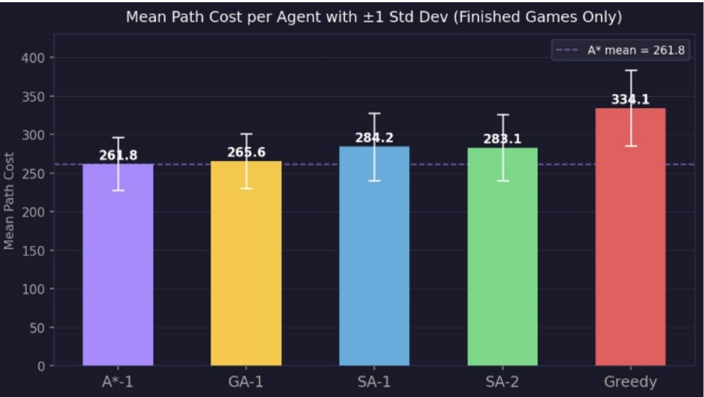
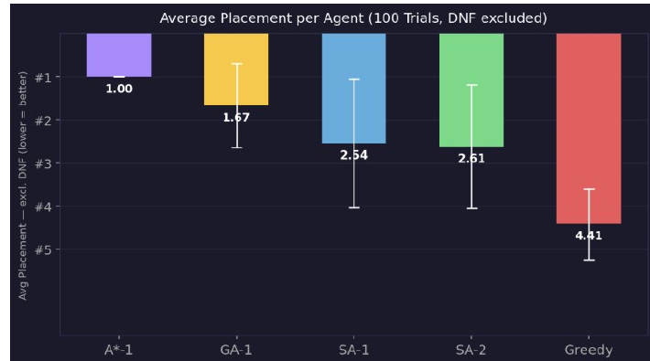
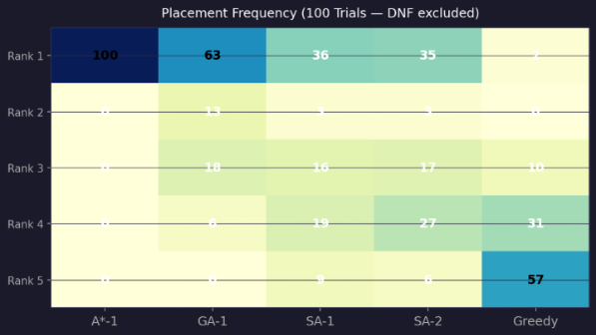
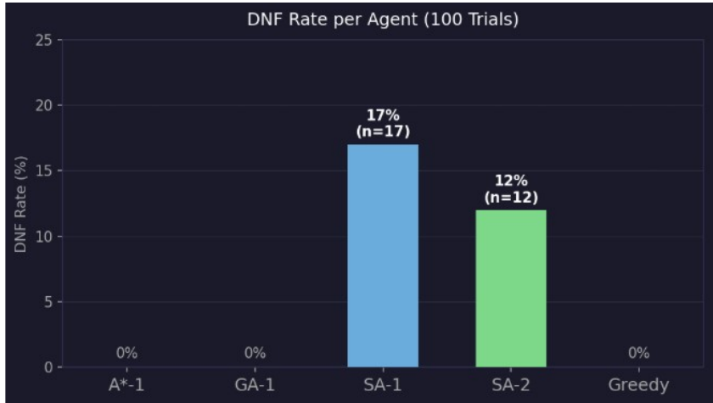
Graphs & Metrics
100 randomized boards · lower rank and lower cost are better

Slide 7
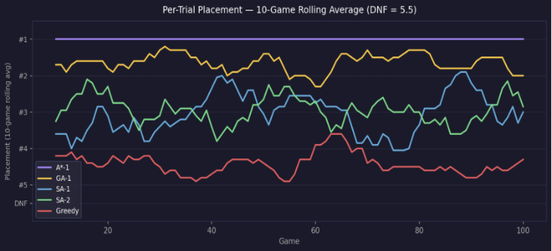
Demo & Results
Live race — agents diverge noticeably
Greedy finished every trial, but had the worst average rank and about 29% higher cost than A*.
The SA agents were competitive when they worked, only ~8% above optimal, but failed to finish 17% and 12% of trials.
GA was the best probabilistic agent. It never failed to finish (DNF) and had paths only ~1.4% above A* on average.
A* won all 100 trials with zero DNFs and always found the true optimal path.

Slide 8
Key Lessons Learned
01
A* sets the ceiling
03
SA needs repair logic
As expected A* is optimal. The 100/100 1st place record on the trial dataset confirms there are no edge cases where A* fails on this graph.
SA-1 and SA-2 were competitive when they finished, but failed in 17% and 12% of trials respectively. Its mutation step is teleporting to non-adjacent nodes when it runs out of legal moves (trying not to retread ground, it stalls).
A greedy fallback guaranteeing adjacency is a promising fix.
02
Warm-Start GA works shockingly well
04
Greedy is Safe but Costy
GA averaged a 1.014 cost ratio with no DNFs. Seeding with 60 SA plans, along with elitism, made it consistently near optimal.
Greedy’s strength is in small graphs where short term guesses have less time to backfire. This makes it useful for finishing the incomplete paths computed by SA/GA, but on this graph, the Manhattan heuristic provides no useful information about which edges are cheap. It’s blind gambles proved costly.

Slide 9
Work Distribution
AI / Algorithms
Game Engine & Loop
Board & Graph
SA, GA, A*, Greedy agents
Hyperparameter tuning
Path correctness
Simplistic Initial builds for all agents and finalized and GA, SA, handled by Kurtis
Optimized Greedy and A* by Emily
Main game loop
Turn timer & player movement
Win / loss detection
Event logic
Handled by Kurtis with some reused code from an old project.
Graph generation
Edge weight assignment
Adjacency structures
Initial 6x6 grid built by Kurtis, expanded 10x10 and helper functions by Emily
Rendering & UI
Testing & Evaluation
Draw pipeline & HUD
Win screen & menus
Sprite / image loading
Handled by Kurtis with some reused code from a previous project
Playtesting & Bug squashing
Game Trials Data and Graphs
Project Proposal handled by Emily, Technical Report handled by both
Note: responsibilities overlapped in practice — all members contributed across areas.

Slide 10
Thank You
Questions?

