Slide 1
Subgraph Isomorphism-based QCT algorithm
Sanjiang Li

Slide 2
g
The mapped nodes have already corresponded 1-1
For the candidate node v, we should have
it degree is not larger than that of u
it cannot have more predecessors than u
it cannot have more nghbrs in the nghbrhood of the gMap
it cannot have more successors than u
The neighborhood of the subMap should be not larger than that of gMap
other nghbrs of v1
v
f
e
d
unmapped
nghbr. nodes
b
c
a
mapped nodes

Slide 3
VF2 Procedure
Construct a mapping: subMap vs. gMap step by step
Construct the neighborhoods subN and gN of subMap and gMap
Construct a set of candidate pairs (v, u) from subN x gN
For each pair (v,u), test if v
has more predecessors (in subMap) than u
has more successors than u
has more neighbours in the neighbourhood subN than u
if any is true, then we cannot map v to u. We test the next pair.
If no pair left, there is no embedding. Otherwise, we have constructed one.

Slide 4
Select the candidate set
In the beginning, the mapping is empty.
Select a node v = argmax deg_{g}(v’)
Pair v with it any node u in G s.t. deg_{G}(u) ≥ deg_{g}(v)

Slide 5
When g has empty neighborhood?
In any step, g has an empty neighborhood if and only if
the mapping is complete or empty; or
g is disconnected and we have mapped all nodes in some components and at least one component has not been touched yet
Select the node in g with max deg as the next node to extend

Slide 6
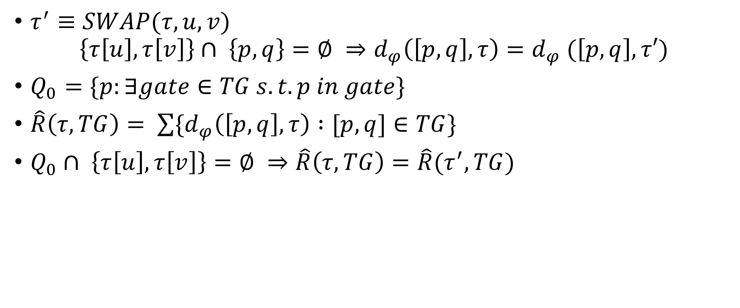
gate physical distance
$τ^{′}≡SWAP(τ,u,v)$
$$\left\{τ\left[u\right],τ\left[v\right]\right\}∩ \left\{p,q\right\}=∅ ⇒d_{φ}\left(\left[p,q\right], τ\right)=d_{φ} (\left[p,q\right], τ′)$$
$Q_{0}=\{p:∃gate∈TG s.t. p in gate\}$
$\hat{R}\left(τ,TG\right)= \sum{\{d_{φ}\left(\left[p,q\right], τ\right) :[p,q]∈TG\} }$
$Q_{0}∩ \left\{τ\left[u\right],τ\left[v\right]\right\}=∅ ⇒\hat{R}\left(τ,TG\right)=\hat{R}(τ^{′}, TG)$

Slide 7
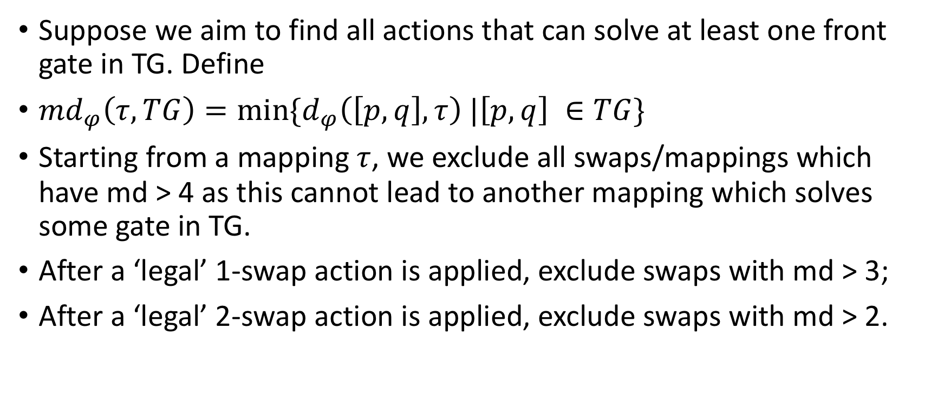
minimum gate distance
Suppose we aim to find all actions that can solve at least one front gate in TG. Define
${md}_{φ}\left(τ, TG\right)=\min{{\{d}_{φ}\left(\left[p,q\right], τ\right) |\left[p,q\right] ∈TG\}}$
Starting from a mapping $τ$, we exclude all swaps/mappings which have md > 4 as this cannot lead to another mapping which solves some gate in TG.
After a ‘legal’ 1-swap action is applied, exclude swaps with md > 3;
After a ‘legal’ 2-swap action is applied, exclude swaps with md > 2.

Slide 8
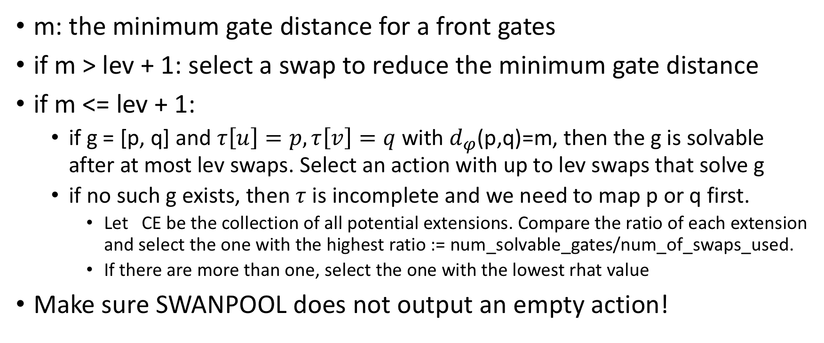
the good next mapping
m: the minimum gate distance for a front gates
if m > lev + 1: select a swap to reduce the minimum gate distance
if m <= lev + 1:
if g = [p, q] and $τ\left[u\right]=p,τ\left[v\right]=q$ with $d_{φ}$(p,q)=m, then the g is solvable after at most lev swaps. Select an action with up to lev swaps that solve g
if no such g exists, then $τ$ is incomplete and we need to map p or q first.
Let CE be the collection of all potential extensions. Compare the ratio of each extension and select the one with the highest ratio := num_solvable_gates/num_of_swaps_used.
If there are more than one, select the one with the lowest rhat value
Make sure SWANPOOL does not output an empty action!

Slide 9
rochester very different from sycamore
how this difference in AG structures affect the performance?

