Slide 1
Subgraph Isomorphism-based QCT algorithm
Sanjiang Li
2023

Slide 2
The mapped nodes have already corresponded 1-1
For the candidate node v, we should have
it degree is not larger than that of u
it cannot have more predecessors than u
it cannot have more nghbrs in the nghbrhood of the gMap
it cannot have more successors than u
The neighborhood of the subMap should be not larger than that of gMap
g
other nghbrs of v
v
f
e
d
unmapped
nghbr. nodes
b
c
a
mapped nodes

Slide 3
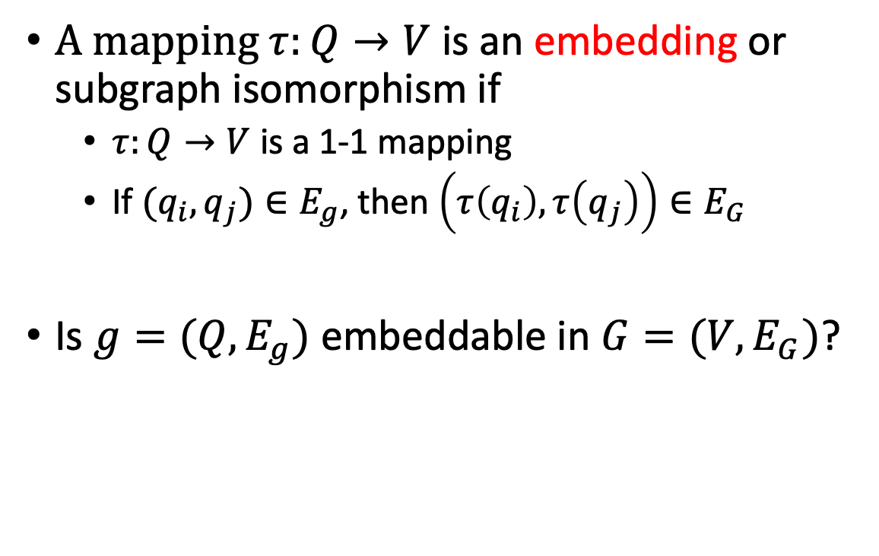
Subgraph Isomorphism
4
2
6
1
A mapping $τ:Q→V$ is an embedding or subgraph isomorphism if
$τ:Q→V$ is a 1-1 mapping
If $(q_{i},q_{j})∈E_{g}$, then $\left(τ\left(q_{i}\right),τ\left(q_{j}\right)\right)∈E_{G}$
Is $g=(Q,E_{g})$ embeddable in $G=(V,E_{G})$?
3
5
2
1
3
4
6
5

Slide 4
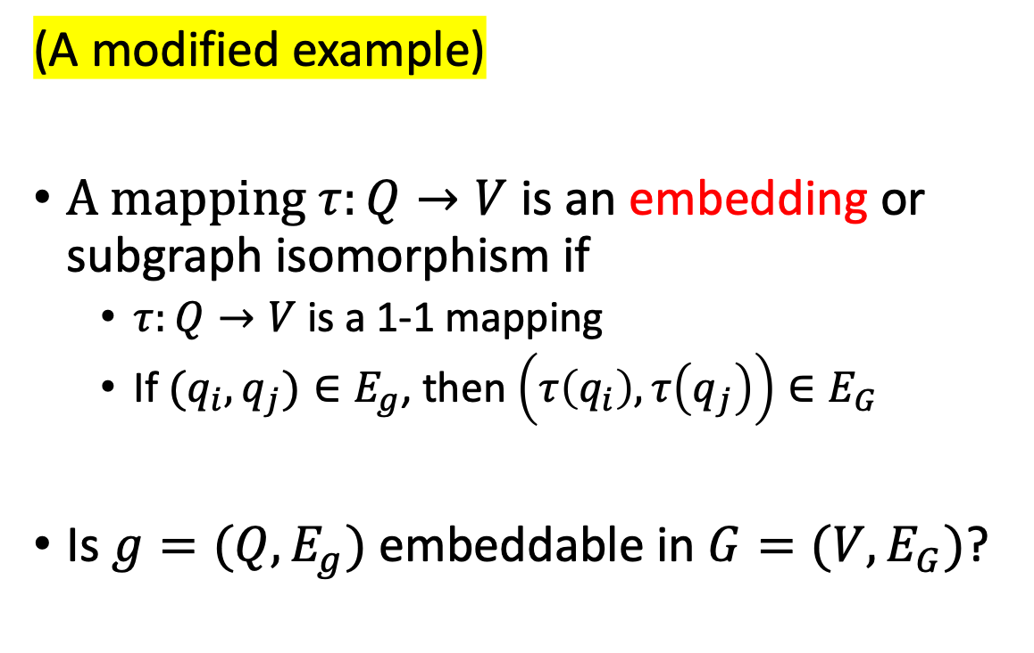
Subgraph Isomorphism
(A modified example)
A mapping $τ:Q→V$ is an embedding or subgraph isomorphism if
$τ:Q→V$ is a 1-1 mapping
If $(q_{i},q_{j})∈E_{g}$, then $\left(τ\left(q_{i}\right),τ\left(q_{j}\right)\right)∈E_{G}$
Is $g=(Q,E_{g})$ embeddable in $G=(V,E_{G})$?

Slide 5
Subgraph Isomorphism
1
We start with a node g with the largest degree (3) and
map it to a node in G with degree 3 (or higher).
1

Slide 6
Subgraph Isomorphism
4
2
1
The node set of g is decomposed into 3 parts
node 4
nodes in the map, i.e., nodes 1,2,3
nodes outside the map ecxept 4
we are also interested in the map neighbourhood
node 4 in g has 1 neighbour in the map, 1 neighbour outside the map; it has 0 neighbour which is in the map neighbourhood
the candidate node ? in G has 2 neighbours in the map and 0 neighbour outside the map; it has no neighbour in the neighbourhood of the map
3
3
1
?
2
Can we map 4 to ?

Slide 7
Subgraph Isomorphism
4
2
1
The node set of g is decomposed into 3 parts
those nodes in the map, i.e., nodes 1,2,3
those nodes outside the map but not 4
node 4 in g has 1 neighbour in the map, 1 neighbour outside the map; it has 0 neighbour which is in the map neighbourhood
the candidate node ? in G has 1 neighbour in the map and 1 neighbour outside the map; it has 1 neighbour in the neighbourhood of the map
3
3
1
2
?

Slide 8
Subgraph Isomorphism
4
2
6
1
5
The node set of g is decomposed into 3 parts
those nodes in the map, i.e., nodes 1,2,3
those nodes outside the map but not 4
node 6 in g has 1 neighbour (4) in the map, 0 neighbour outside the map; it has 0 neighbour which is in the map neighbourhood
the candidate node ? in G has 2 neighbours in the map and 0 neighbour outside the map; it has 0 neighbour in the neighbourhood of the map
But, the neighbour of node ? in G is 3, which does not correspond to a neighbour of 6 in g
3
3
1
5
?
2
4

Slide 9
Subgraph Isomorphism
4
2
6
1
5
node 4 in g has 1 neighbour in the map, 1 neighbour outside the map; it has 0 neighbour which is in the map neighbourhood
the candidate node ? in G has 1 neighbour in the map and 1 neighbour outside the map; it has 1 neighbour in the neighbourhood of the map
Actually, g is not embeddable in G.
(G has two nodes (? and 4) which has
distance 2 with node 1, and they are
on the two different sides.)
3
3
1
5
?
2
4

Slide 10
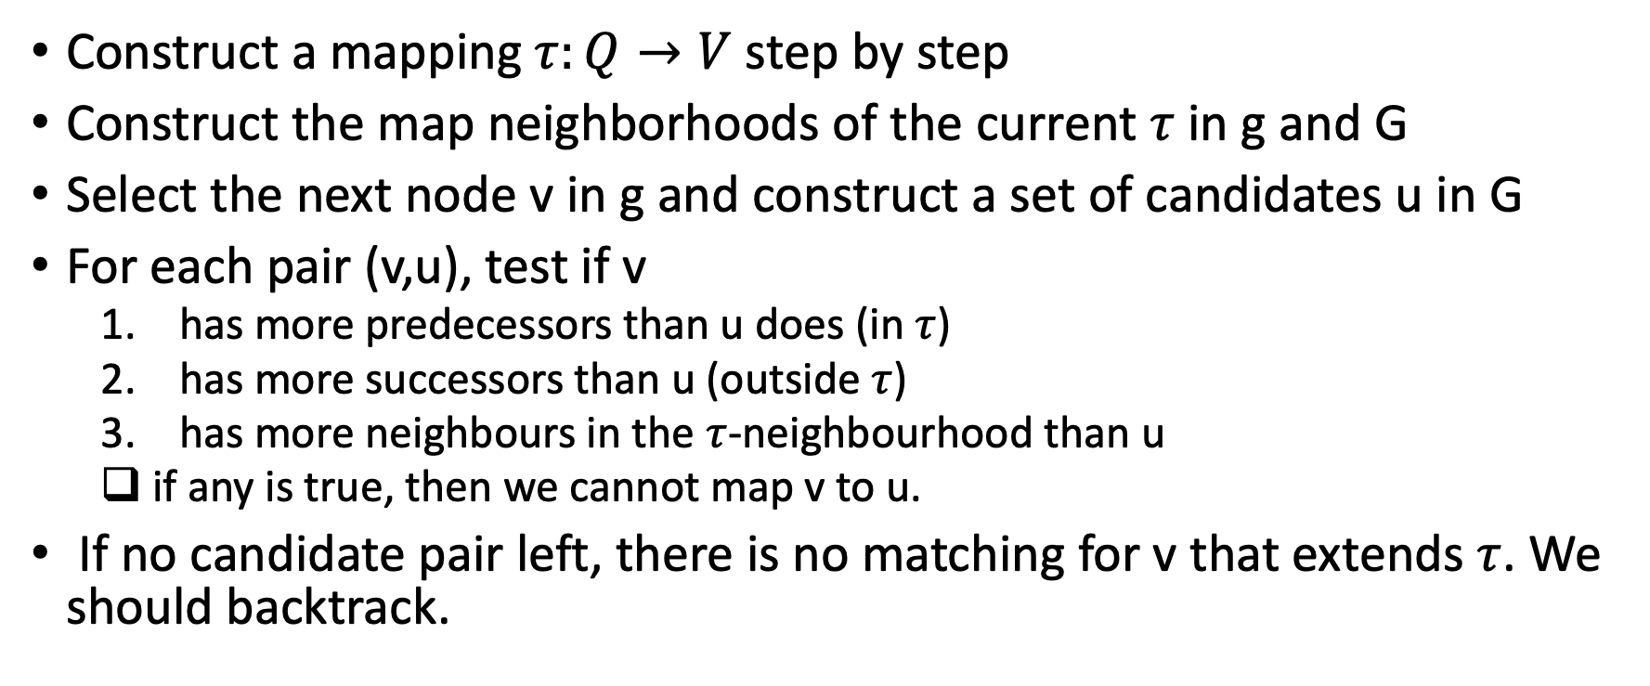
VF2 Procedure
Construct a mapping $τ:Q→V$ step by step
Construct the map neighborhoods of the current $τ$ in g and G
Select the next node v in g and construct a set of candidates u in G
For each pair (v,u), test if v
has more predecessors than u does (in $τ$)
has more successors than u (outside $τ$)
has more neighbours in the $τ$-neighbourhood than u
if any is true, then we cannot map v to u.
If no candidate pair left, there is no matching for v that extends $τ$. We should backtrack.

Slide 11
Select the candidate set
In the beginning, the mapping is empty.
Select a node v = argmax deg_{g}(v’)
Pair v with it any node u in G s.t. deg_{G}(u) ≥ deg_{g}(v)
Note this choice can be further optimized, see VF2++

Slide 12


When $g$ has empty neighborhood?
In any step, $g$ has an empty neighborhood iff
the mapping is complete or empty; or
g is disconnected and we have mapped all nodes in some components and at least one component has not been touched yet
Select the node in g with max deg as the next node to extend

Slide 13
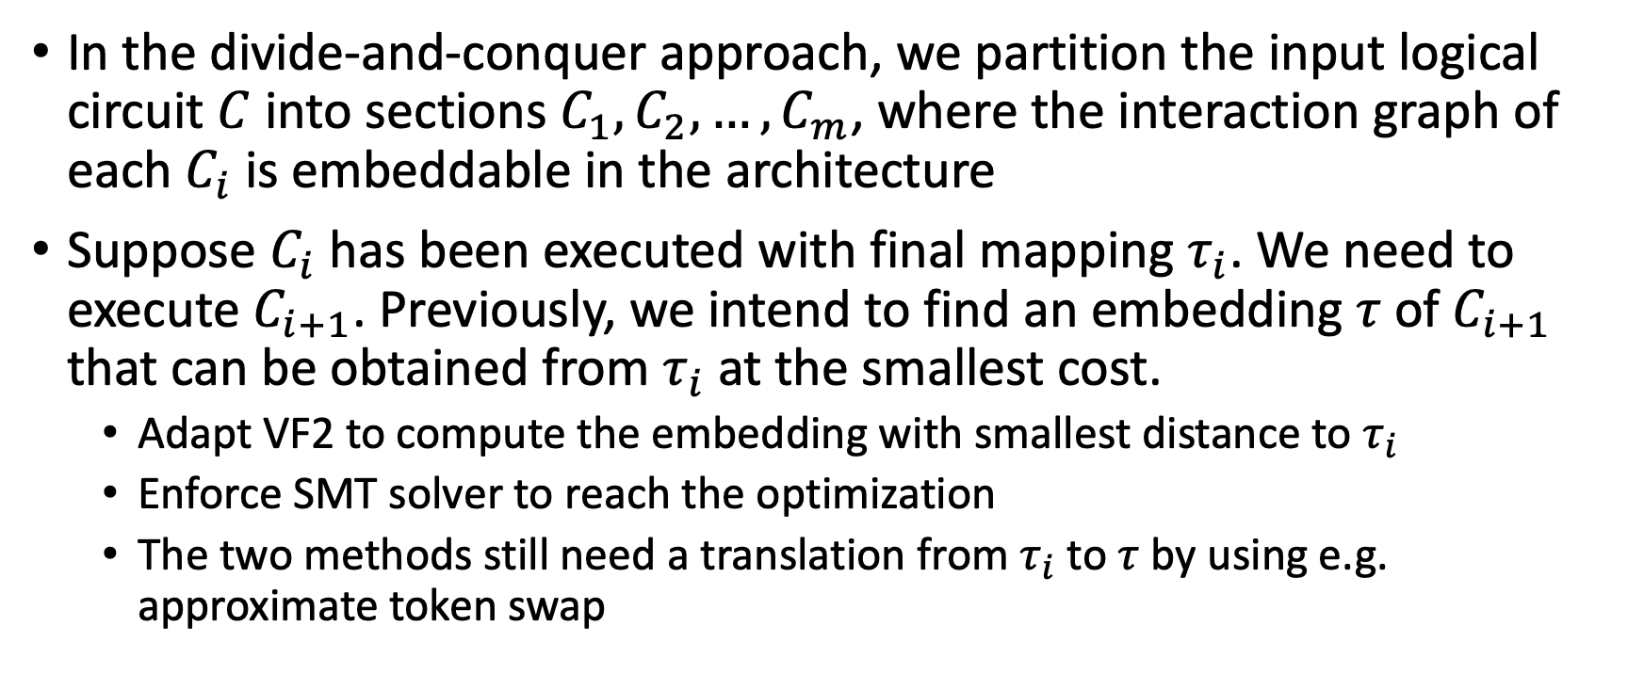
The Good Next Mapping
In the divide-and-conquer approach, we partition the input logical circuit $C$ into sections $C_{1},C_{2},…, C_{m}$, where the interaction graph of each $C_{i}$ is embeddable in the architecture
Suppose $C_{i}$ has been executed with final mapping $τ_{i}$. We need to execute $C_{i+1}$. Previously, we intend to find an embedding $τ$of $C_{i+1}$ that can be obtained from $τ_{i}$ at the smallest cost.
Adapt VF2 to compute the embedding with smallest distance to $τ_{i}$
Enforce SMT solver to reach the optimization
The two methods still need a translation from $τ_{i}$ to $τ$ by using e.g. approximate token swap

Slide 14

Token Swapping
$G=(V, E)$ undirected graph, $V=\{1,2,…,n\}$
5
4
1
1
2
3
1
2
3
1
2
3
6
5
4
6
5
4
6
2
3
6
5
4

Slide 15
Token Swapping
$G=(V, E)$ undirected graph, $V=\{1,2,…,n\}$
5
4
1
4
5
1
1
2
3
1
2
3
6
5
4
6
5
4
6
2
3
6
2
3

Slide 16


Token Swapping
Let $d\left(i\right)$ be the distance of token $i$ to the target vertex
Every swap $e=(i,j)$ changes only $d\left(i\right)$ and $d\left(j\right)$ by 1, 0, or -1
$L=\sum_{i=1}^{n}{d(i)}$
$$i$$
5
4
1
4
5
1
1
2
3
1
2
3
6
5
4
6
5
4
6
2
3
6
2
3

Slide 17

Unhappy Swap
A swap $e=(i,j)$ is unhappy if one node is already in its target position, while the distance of the other can be reduced by 1 after the swap
5
4
1
6
4
1
1
2
3
1
2
3
6
5
4
6
5
4
6
2
3
5
2
3

Slide 18
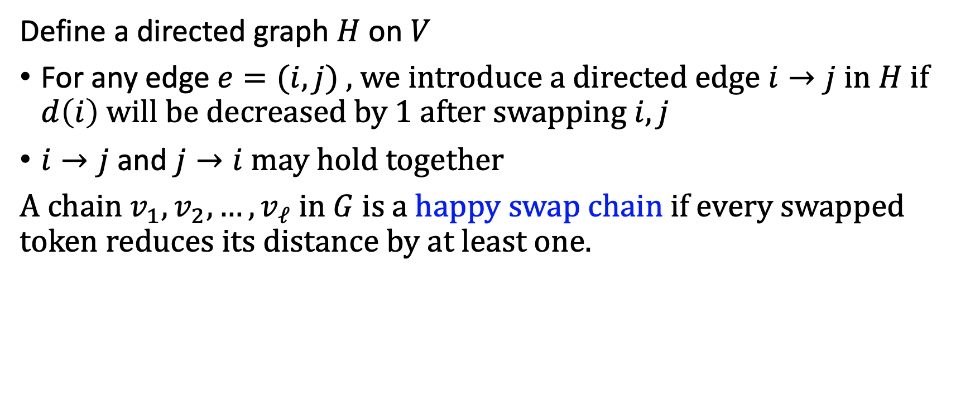

The Happiness Directed Graph $H$
Define a directed graph $H$ on $V$
For any edge $e=(i,j)$ , we introduce a directed edge $i→j$ in $H$ if $d\left(i\right)$ will be decreased by 1 after swapping $i,j$
$i→j$ and $j→i$ may hold together
A chain $v_{1},v_{2},…, v_{ℓ}$ in $G$ is a happy swap chain if every swapped token reduces its distance by at least one.

Slide 19
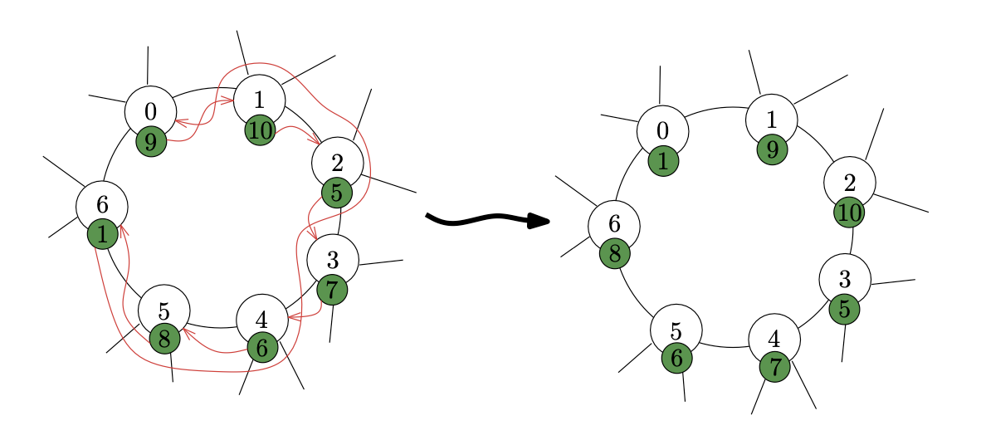

Slide 20
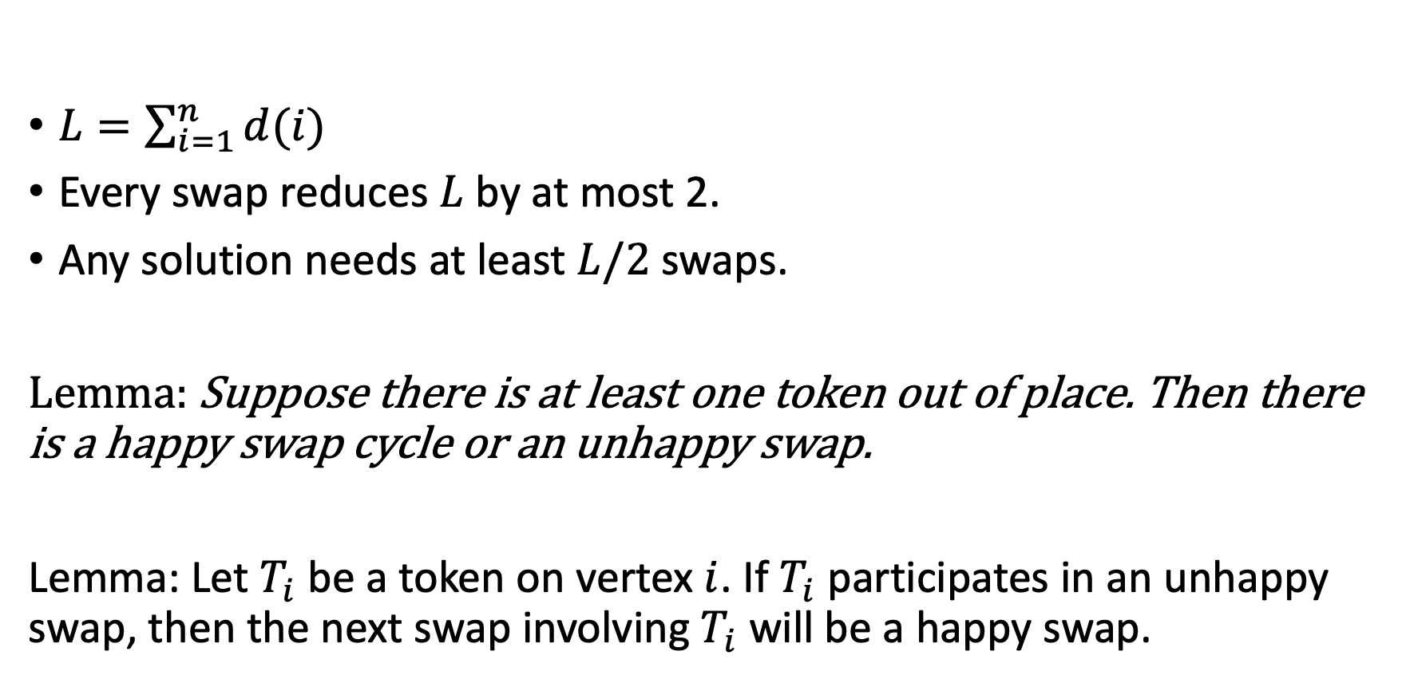
Lemmas and Facts
$L=\sum_{i=1}^{n}{d(i)}$
Every swap reduces $L$ by at most 2.
Any solution needs at least $L/2$swaps.
Lemma: Suppose there is at least one token out of place. Then there is a happy swap cycle or an unhappy swap.
Lemma: Let $T_{i}$ be a token on vertex $i$. If $T_{i}$ participates in an unhappy swap, then the next swap involving $T_{i}$ will be a happy swap.

Slide 21
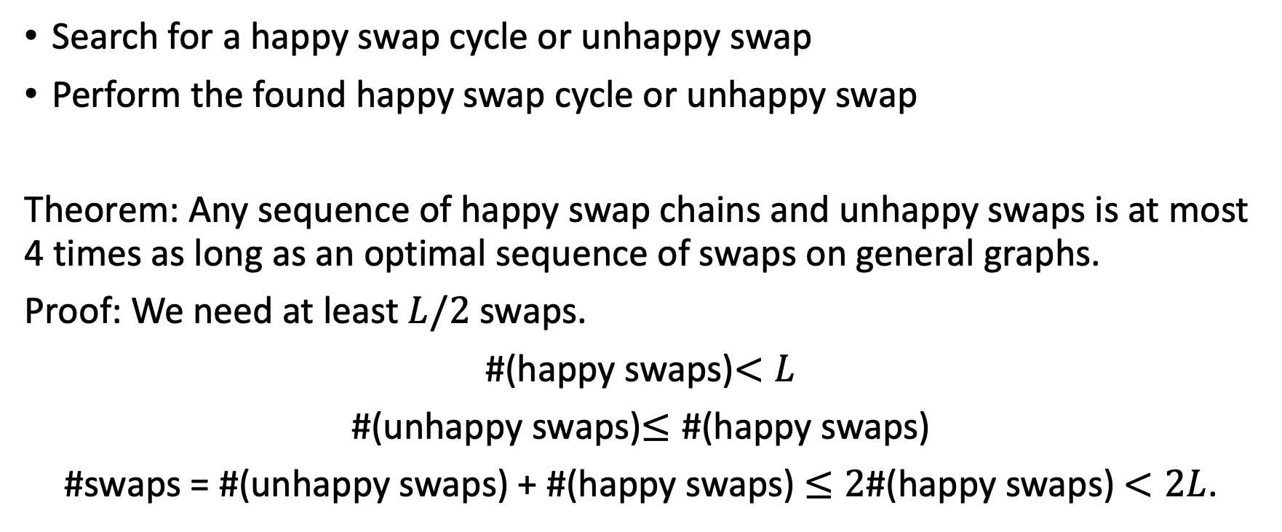
The 4-Approximate Token Swapping Algorithm
Search for a happy swap cycle or unhappy swap
Perform the found happy swap cycle or unhappy swap
Theorem: Any sequence of happy swap chains and unhappy swaps is at most 4 times as long as an optimal sequence of swaps on general graphs.
Proof: We need at least $L/2$swaps.
#(happy swaps)$<L$
#(unhappy swaps)$≤\text{\#(}\text{happy} \text{swaps}\text{)}$
#swaps = #(unhappy swaps) + #(happy swaps) $≤2\text{\#(}\text{happy} \text{swaps}\text{)}$ $<2L$.

Slide 22
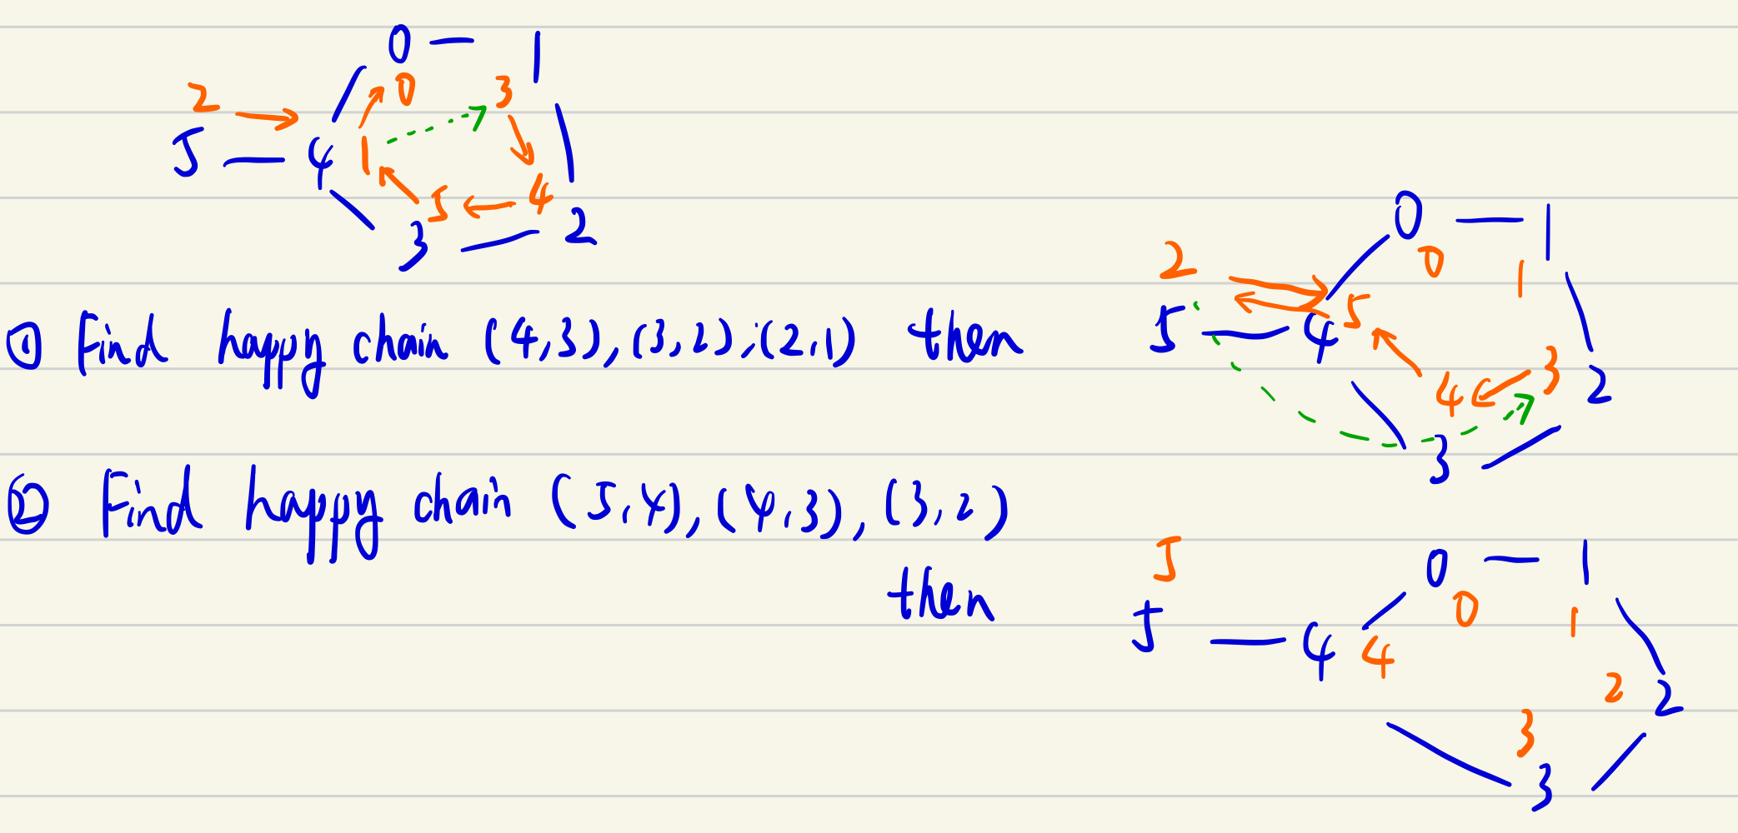
A happy chain that is not a part of a happy cycle

Slide 23
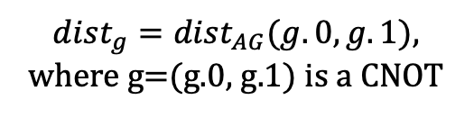
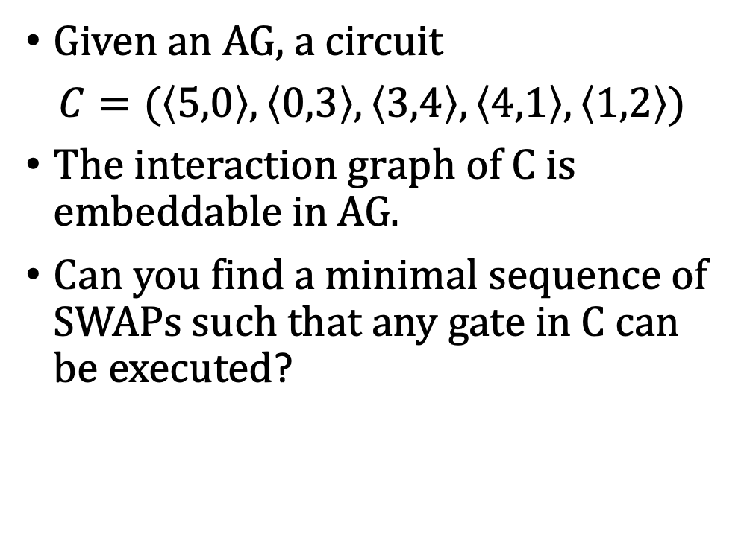
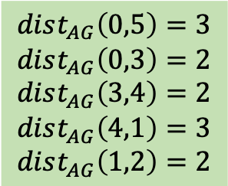
Token Swapping without a fixed target mapping
The interaction graph of C
$dist_{g}=dist_{AG}(g.0,g.1)$,
where g=(g.0, g.1) is a CNOT
Given an AG, a circuit
$C=(\left\langle 5,0\right\rangle ,\left\langle 0,3\right\rangle ,\left\langle 3,4\right\rangle ,\left\langle 4,1\right\rangle ,\left\langle 1,2\right\rangle )$
The interaction graph of C is embeddable in AG.
Can you find a minimal sequence of SWAPs such that any gate in C can be executed?
0
3
$$dist_{AG}\left(0,5\right)=3$$
$$dist_{AG}\left(0,3\right)=2$$
$$dist_{AG}\left(3,4\right)=2$$
$$dist_{AG}\left(4,1\right)=3$$
$$dist_{AG}\left(1,2\right)=2$$
5
4
1
2
0
2
4
The
Architecture
Graph
1
3
5

Slide 24
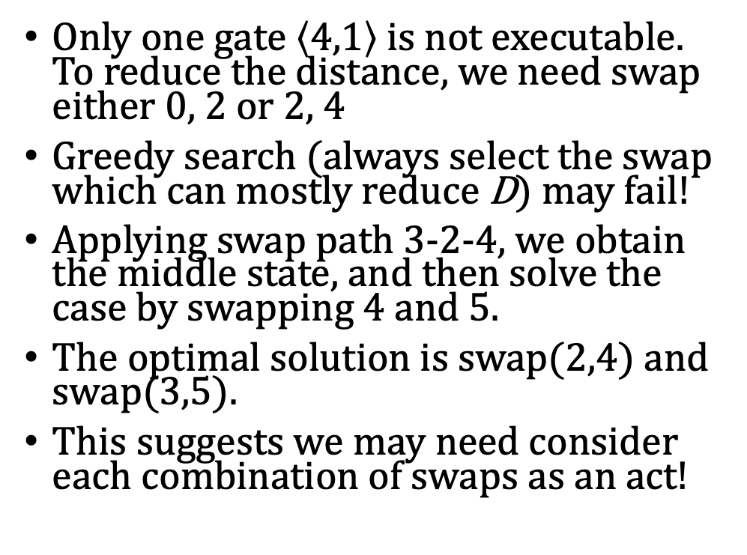
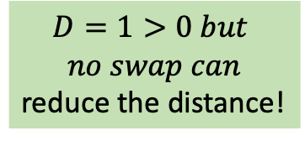
Greedy Search
1
3
4
0
2
4
Only one gate $\left\langle 4,1\right\rangle$ is not executable. To reduce the distance, we need swap either 0, 2 or 2, 4
Greedy search (always select the swap which can mostly reduce D) may fail!
Applying swap path 3-2-4, we obtain the middle state, and then solve the case by swapping 4 and 5.
The optimal solution is swap(2,4) and swap(3,5).
This suggests we may need consider each combination of swaps as an act!
$$D=1>0 but$$
$$no swap can$$
reduce the distance!
1
2
3
5
5
0
1
4
0
0
2
4
0
3
1
2
3
5
5
3
5
4
1
4
5
0
2
4
2
1
1
2
3
5
0
3
Notes:
{0: 3, 1: 0, 2: 1, 3: 2, 4: 4, 5: 5} D=1
{0: 2, 1: 0, 2: 1, 3: 3, 4: 4, 5: 5} D=3
{0: 4, 1: 0, 2: 1, 3: 3, 4: 2, 5: 5} D=1
{0: 5, 1: 0, 2: 1, 3: 3, 4: 2, 5: 4} D=0

Slide 25
Prepare Benchmarks
Generate a circuit C as follows
Select an architecture, e.g., G2x3
Randomly generate a permutation on AG
For each edge (p,q) of the permuted AG, put it randomly in C
Generate 10 circuits and compare with approximate token swapping and the Z3 algorithm
-> We could also adapt the Z3 algorithm directly to find the swaps
-> Vf2 algorithm?

Slide 26
Why the previous approach may be not good?
In the previous divide-and-conquer approach, we partition the circuit C into sections C1, C2, …, Ck and find a mapping for each section and then link them with either Qiskit’s ATS or Z3
We could do this directly! Starting from the mapping for Ci, construct a mapping for C(i+1) with minimal SWAP insertions

Slide 27
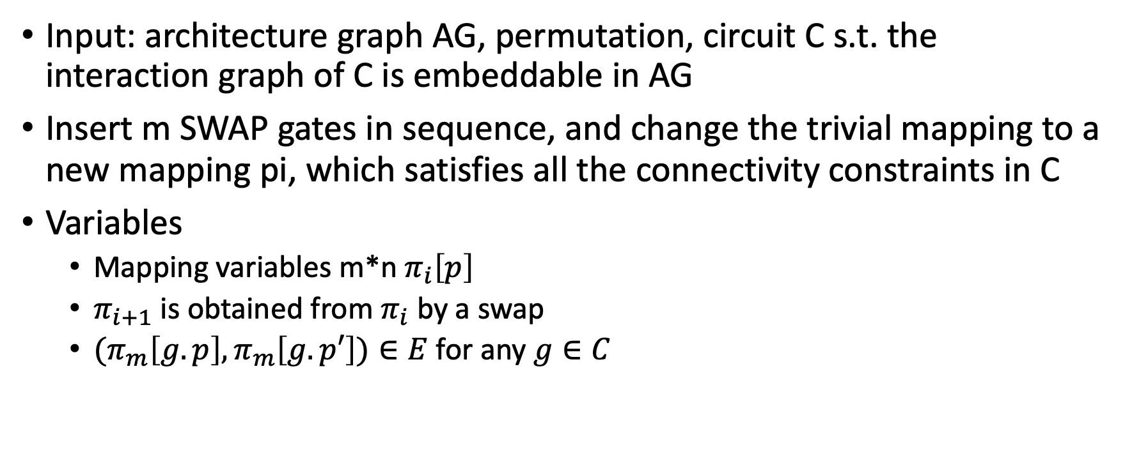
A Z3 Solver for Token Swapping
Input: architecture graph AG, permutation, circuit C s.t. the interaction graph of C is embeddable in AG
Insert m SWAP gates in sequence, and change the trivial mapping to a new mapping pi, which satisfies all the connectivity constraints in C
Variables
Mapping variables m*n $π_{i}\left[p\right]$
$π_{i+1}$ is obtained from $π_{i}$ by a swap
${(π}_{m}\left[g.p\right],π_{m}\left[g.p′\right])∈E$ for any $g∈C$

Slide 28
A SABRE Style Subgraph Isomorphism-based Initial Mapping
we can select an initial mapping that takes the full circuit into account
start from a random initial mapping f0 = f (this f0 could be selected by Sabre)
calculate the next good mapping f1 for section C1 …
calculate the next good mapping fm for section Cm
calculate the next good mapping gm for the reverse of section Cm
calculate the next good mapping g1 for the reverse of section C1
use g1 as the refined initial mapping

Slide 29
Graph Profile of Quantum Circuits
Given a quantum circuit, investigate its graph profile
connectivity
pattern

