Slide 1
Non-Tuberculous Mycobacteria Lung Disease
Edward Bosko
June 11, 2025
Notes:
Welcome

Slide 2
Introduction

Slide 3
Research Question

Slide 4
Methods

Slide 5
Methods - Data

Slide 6
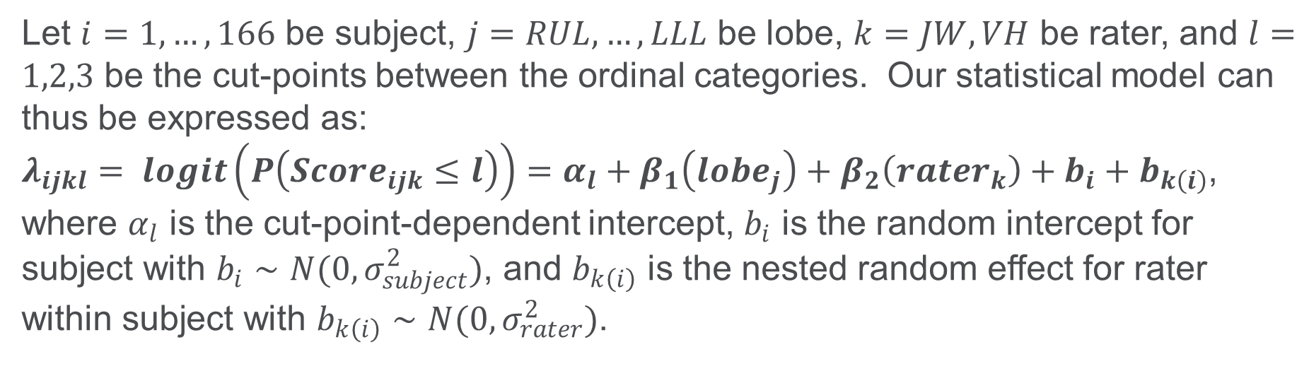
Methods - Modeling
Modeling Approach 1 – Proportional Odds Ordinal Logistic Regression (Full)
Let $i=1, …, 166$ be subject, $j=RUL, …, LLL$ be lobe, $k=JW, VH$ be rater, and $l=1,2,3$ be the cut-points between the ordinal categories. Our statistical model can thus be expressed as:
$λ_{ijkl}= logit\left(P\left(Score_{ijk}≤l\right)\right)=α_{l}+β_{1}\left(lobe_{j}\right)+β_{2}\left(rater_{k}\right)+b_{i}+b_{k\left(i\right)}$,
where $α_{l}$ is the cut-point-dependent intercept, $b_{i}$ is the random intercept for subject with $b_{i}∼N(0,σ_{subject}^{2})$, and $b_{k\left(i\right)}$ is the nested random effect for rater within subject with $b_{k\left(i\right)}∼N(0,σ_{rater}^{2})$.

Slide 7
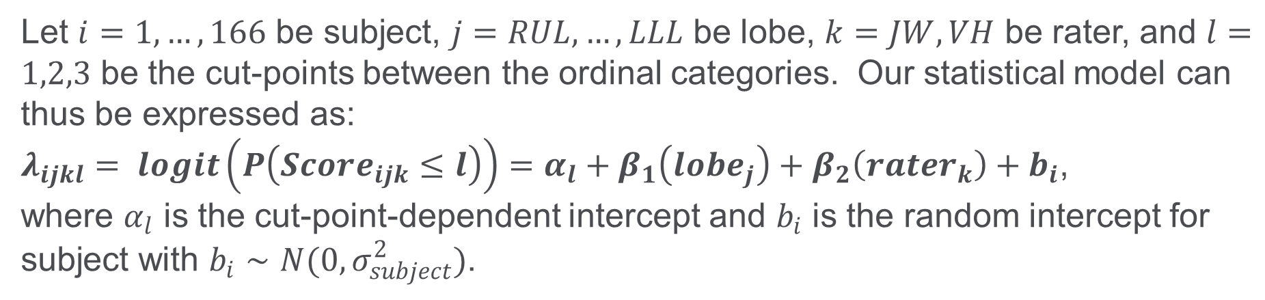
Methods - Modeling
Modeling Approach 2 – Proportional Odds Ordinal Logistic Regression (Reduced)
Let $i=1, …, 166$ be subject, $j=RUL, …, LLL$ be lobe, $k=JW, VH$ be rater, and $l=1,2,3$ be the cut-points between the ordinal categories. Our statistical model can thus be expressed as:
$λ_{ijkl}= logit\left(P\left(Score_{ijk}≤l\right)\right)=α_{l}+β_{1}\left(lobe_{j}\right)+β_{2}\left(rater_{k}\right)+b_{i}$,
where $α_{l}$ is the cut-point-dependent intercept and $b_{i}$ is the random intercept for subject with $b_{i}∼N(0,σ_{subject}^{2})$.

Slide 8
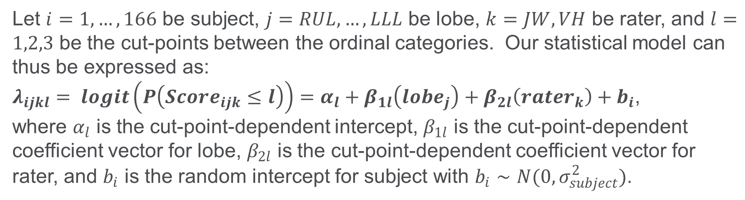
Methods - Modeling
Modeling Approach 3 – Non-Proportional Odds Ordinal Logistic Regression
Let $i=1, …, 166$ be subject, $j=RUL, …, LLL$ be lobe, $k=JW, VH$ be rater, and $l=1,2,3$ be the cut-points between the ordinal categories. Our statistical model can thus be expressed as:
$λ_{ijkl}= logit\left(P\left(Score_{ijk}≤l\right)\right)=α_{l}+β_{1l}\left(lobe_{j}\right)+β_{2l}\left(rater_{k}\right)+b_{i}$,
where $α_{l}$ is the cut-point-dependent intercept, $β_{1l}$ is the cut-point-dependent coefficient vector for lobe, $β_{2l}$ is the cut-point-dependent coefficient vector for rater, and $b_{i}$ is the random intercept for subject with $b_{i}∼N(0,σ_{subject}^{2})$.

Slide 9
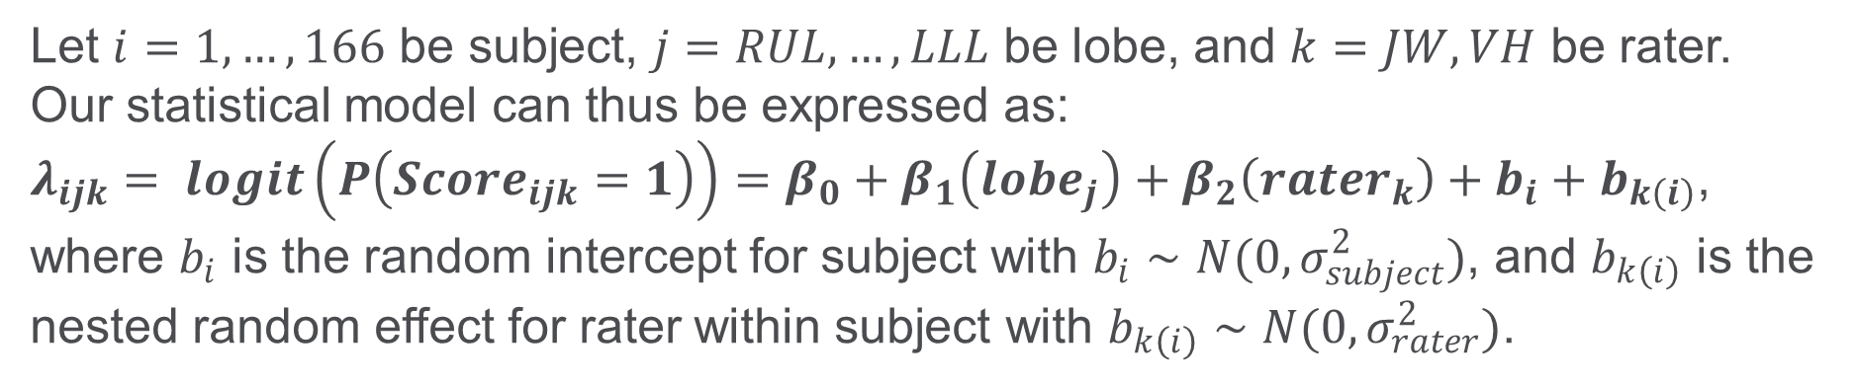
Methods - Modeling
Modeling Approach 4 – Logistic Regression (Full)
Let $i=1, …, 166$ be subject, $j=RUL, …, LLL$ be lobe, and $k=JW, VH$ be rater. Our statistical model can thus be expressed as:
$λ_{ijk}= logit\left(P\left(Score_{ijk}=1\right)\right)=β_{0}+β_{1}\left(lobe_{j}\right)+β_{2}\left(rater_{k}\right)+b_{i}+b_{k\left(i\right)}$,
where $b_{i}$ is the random intercept for subject with $b_{i}∼N(0,σ_{subject}^{2})$, and $b_{k\left(i\right)}$ is the nested random effect for rater within subject with $b_{k\left(i\right)}∼N(0,σ_{rater}^{2})$.

Slide 10
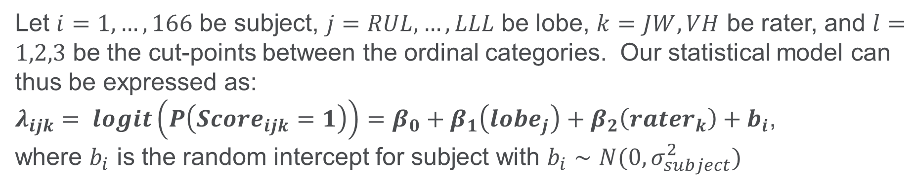
Methods - Modeling
Modeling Approach 5 – Logistic Regression (Reduced)
Let $i=1, …, 166$ be subject, $j=RUL, …, LLL$ be lobe, $k=JW, VH$ be rater, and $l=1,2,3$ be the cut-points between the ordinal categories. Our statistical model can thus be expressed as:
$λ_{ijk}= logit\left(P\left(Score_{ijk}=1\right)\right)=β_{0}+β_{1}\left(lobe_{j}\right)+β_{2}\left(rater_{k}\right)+b_{i}$,
where $b_{i}$ is the random intercept for subject with $b_{i}∼N(0,σ_{subject}^{2})$

Slide 11
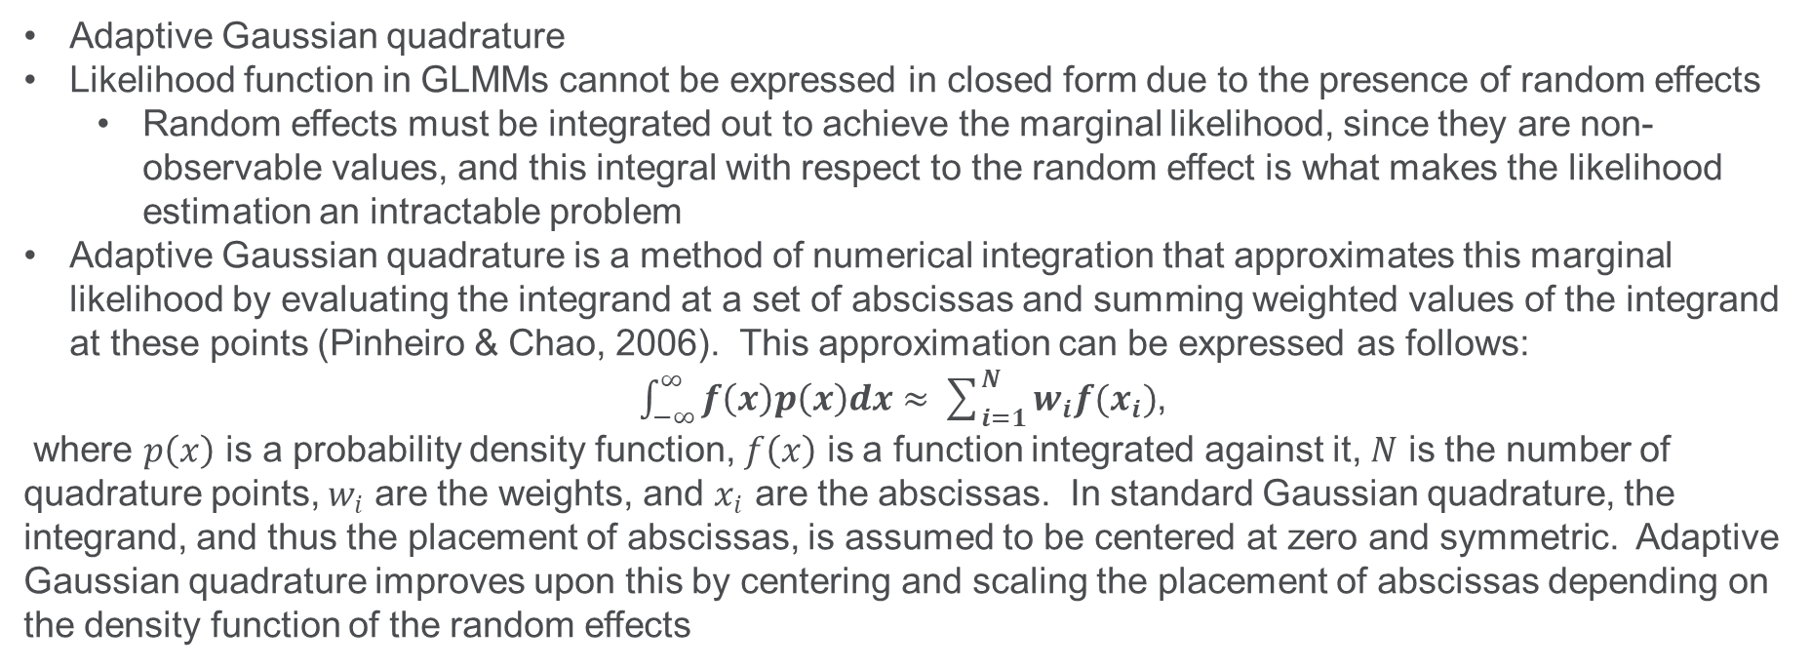
Methods – Estimation Method
Adaptive Gaussian quadrature
Likelihood function in GLMMs cannot be expressed in closed form due to the presence of random effects
Random effects must be integrated out to achieve the marginal likelihood, since they are non-observable values, and this integral with respect to the random effect is what makes the likelihood estimation an intractable problem
Adaptive Gaussian quadrature is a method of numerical integration that approximates this marginal likelihood by evaluating the integrand at a set of abscissas and summing weighted values of the integrand at these points (Pinheiro & Chao, 2006). This approximation can be expressed as follows:
$\int_{−∞}^{∞}{f\left(x\right)p\left(x\right)dx}≈\sum_{i=1}^{N}{w_{i}f(x_{i})}$,
where $p\left(x\right)$ is a probability density function, $f\left(x\right)$ is a function integrated against it, $N$ is the number of quadrature points, $w_{i}$ are the weights, and $x_{i}$ are the abscissas. In standard Gaussian quadrature, the integrand, and thus the placement of abscissas, is assumed to be centered at zero and symmetric. Adaptive Gaussian quadrature improves upon this by centering and scaling the placement of abscissas depending on the density function of the random effects

Slide 12
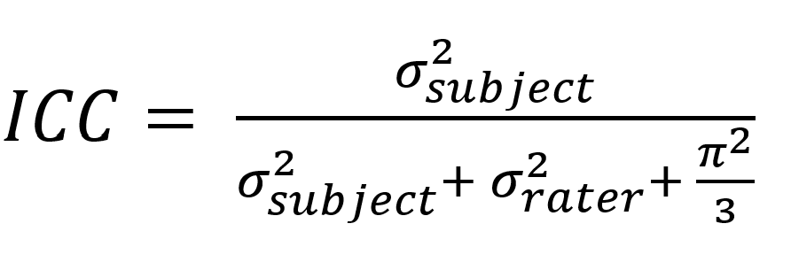
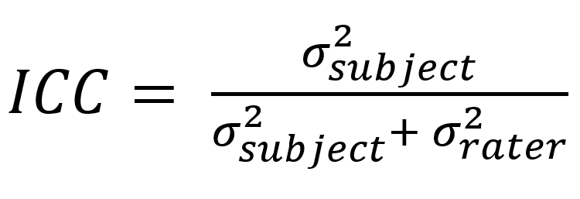
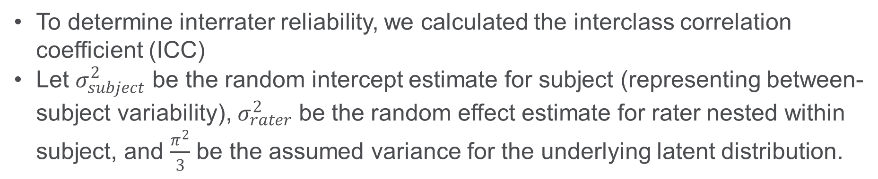
Methods - ICC
To determine interrater reliability, we calculated the interclass correlation coefficient (ICC)
Let $σ_{subject}^{2}$ be the random intercept estimate for subject (representing between-subject variability), $σ_{rater}^{2}$ be the random effect estimate for rater nested within subject, and $\frac{π^{2}}{3}$ be the assumed variance for the underlying latent distribution.

Slide 13
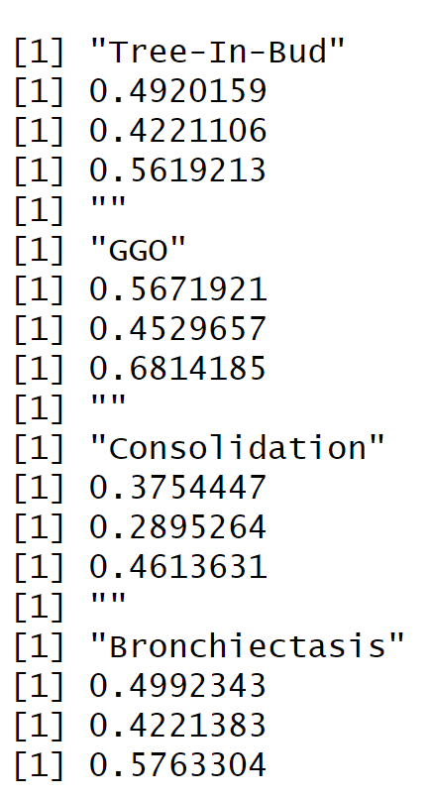
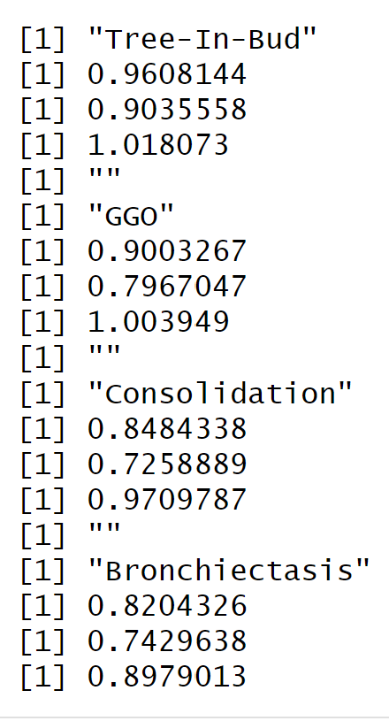
Methods - ICC

Slide 14
Results

Slide 15
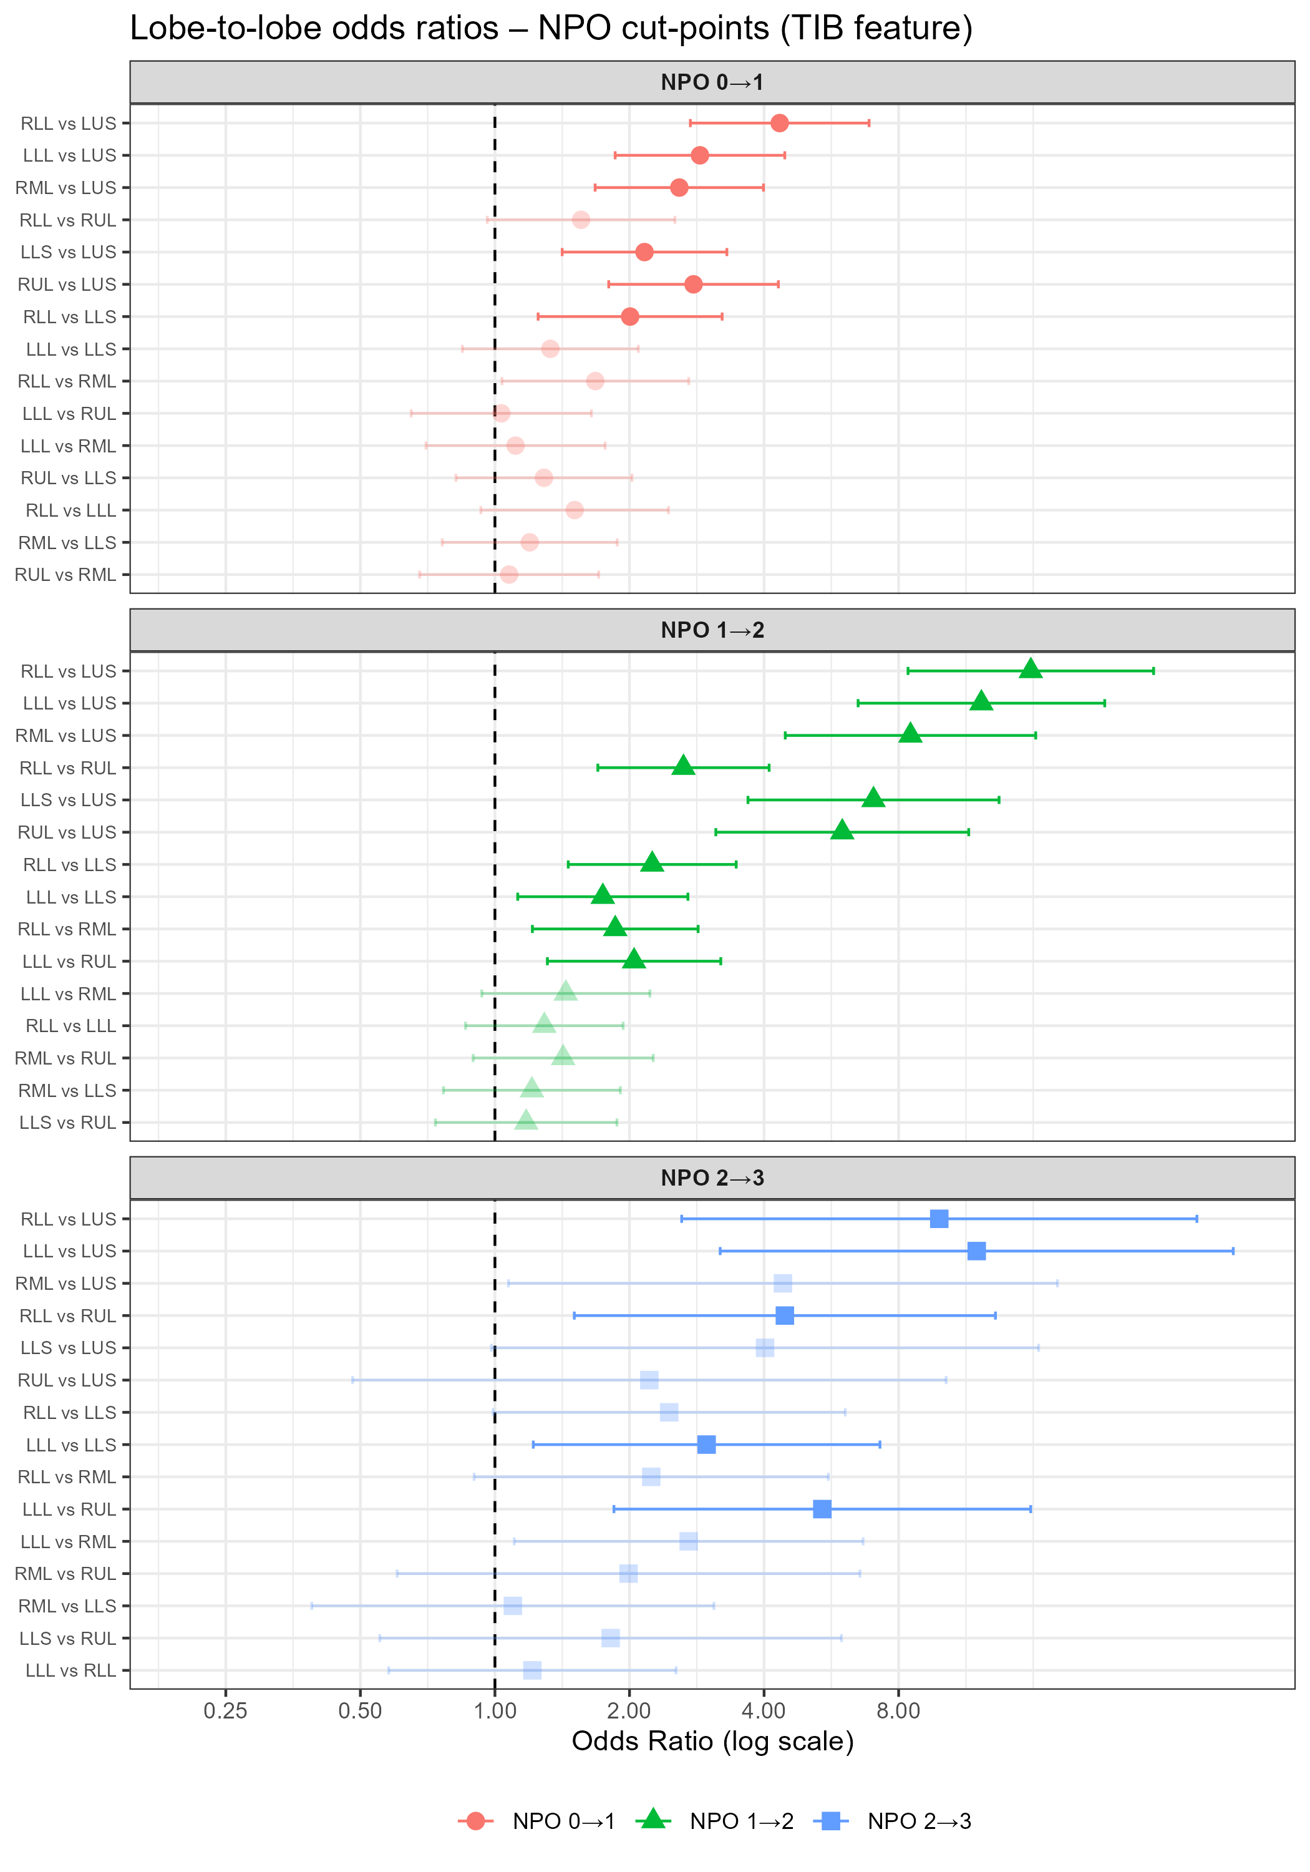
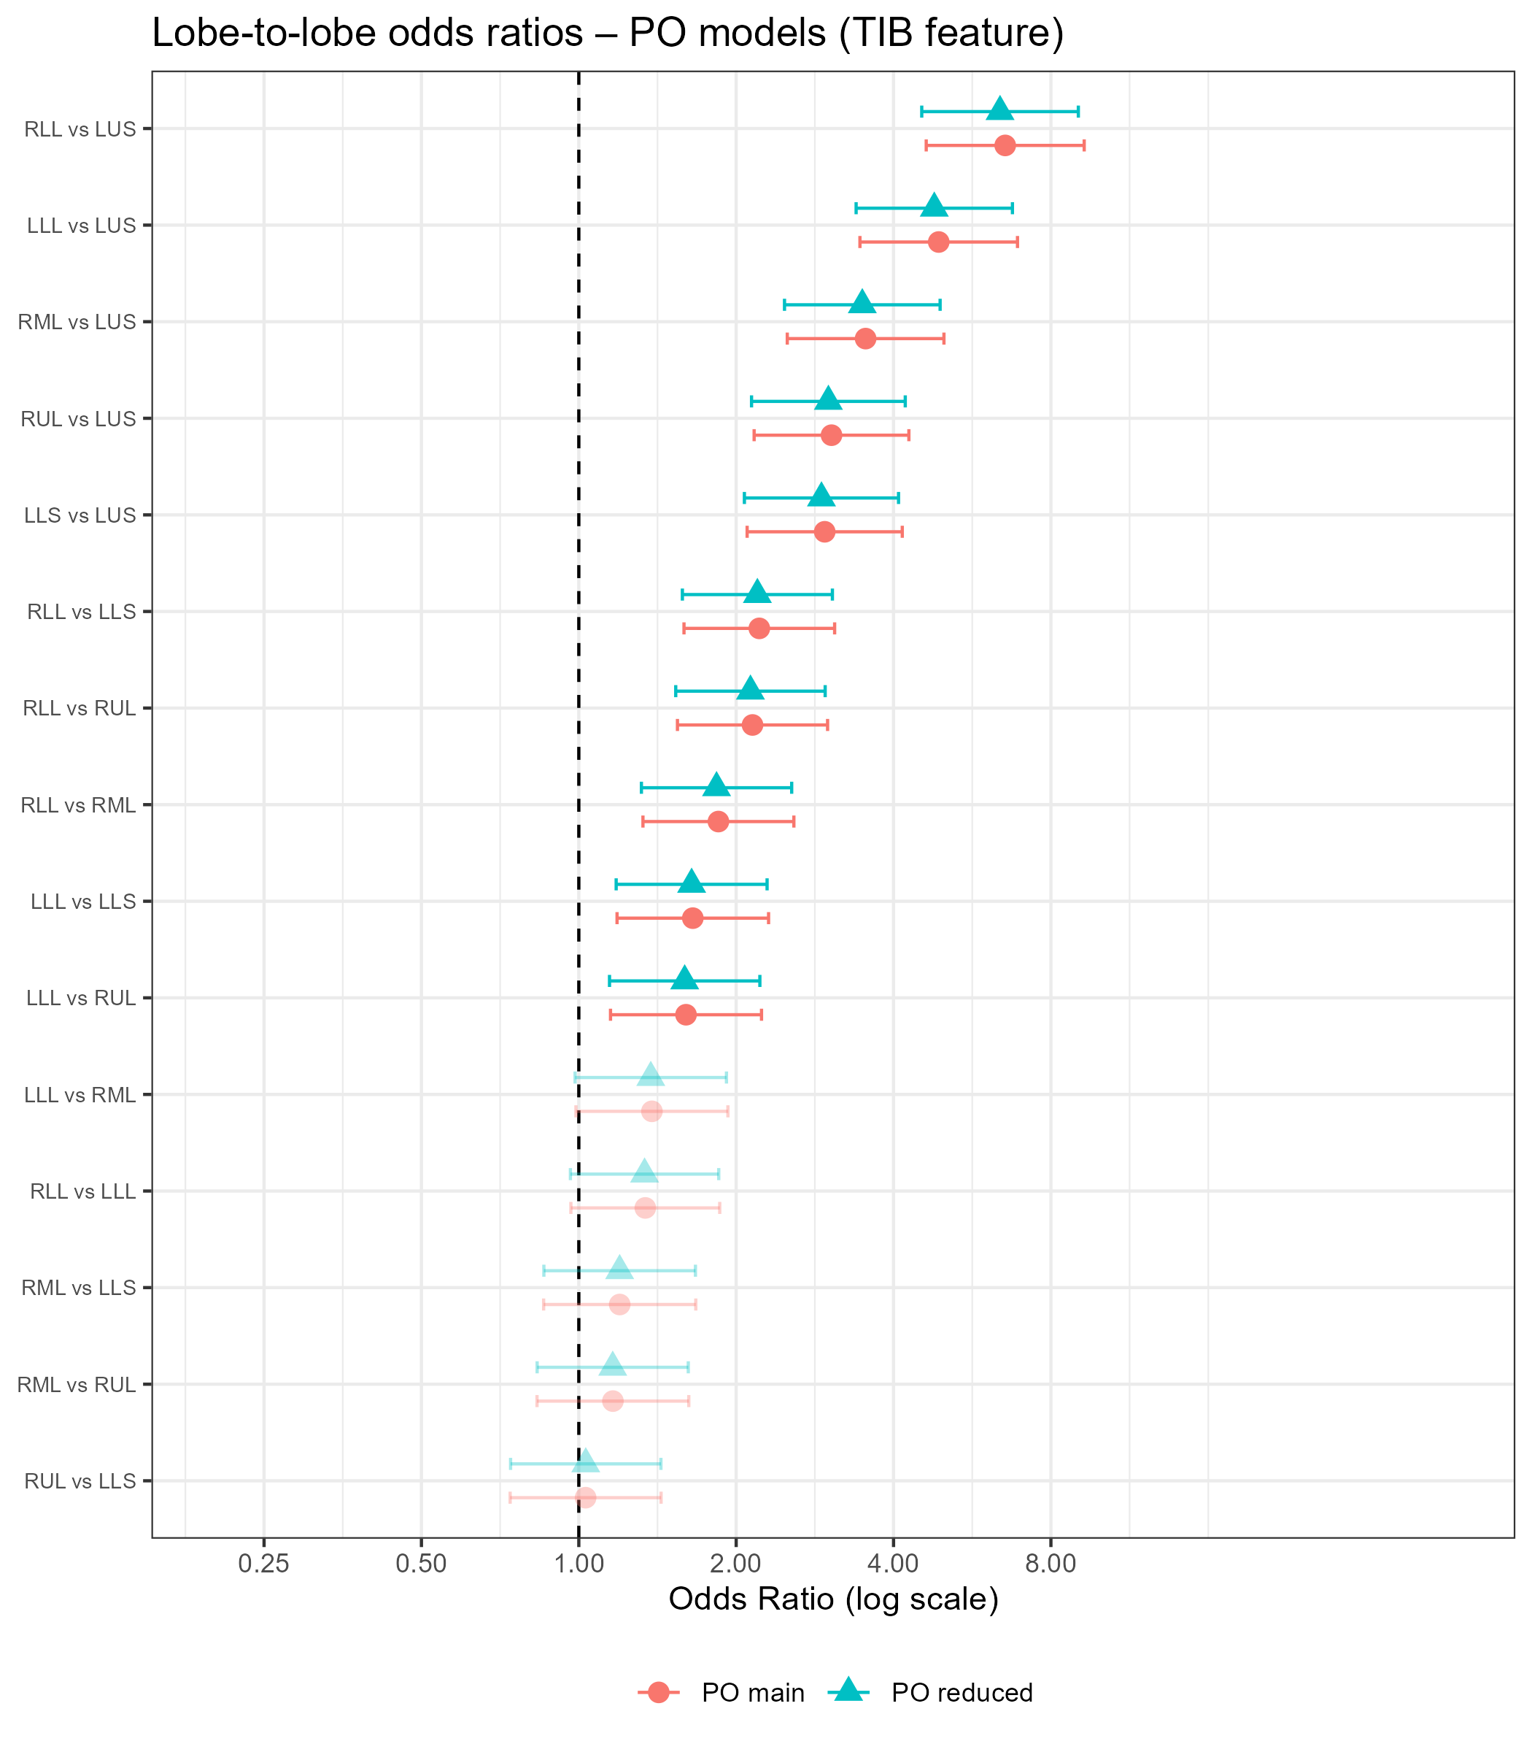
Results

Slide 16
Discussion

Slide 17
Questions?
51

Slide 18
References

