Slide 1
Logistic and Ordinal Logistic Modeling of Computed Tomography Features Associated with Non-Tuberculous Mycobacteria Lung Disease
Edward Bosko
July 22, 2025
Notes:
Welcome

Slide 2
Introduction

Slide 3
Intro – Disease Overview
Non-tuberculous mycobacteria lung disease (NTM-LD)
Chronic infection of the lungs
Caused by inhalation of non-tuberculous mycobacteria (NTM)
Most NTM exposures do not lead to disease
More than 200 species
Mycobacterium avium complex
Mycobacterium abscessus group
Associated with several radiographic features
Atelectasis, bronchiectasis, cavities, consolidation, ground-glass opacities, nodules, and tree-in-bud opacities

Slide 4
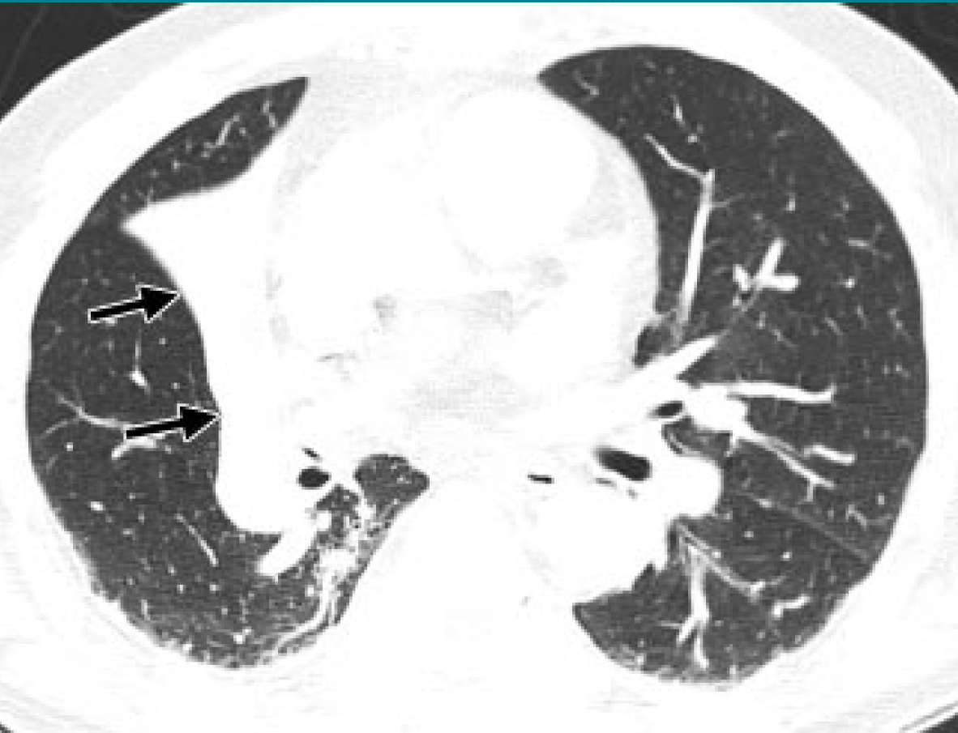
Intro – Disease Overview
Atelectasis
Collapse or reduction in inflation of lung
Identified by a reduction in volume and increase in opacity
CT scan on the right shows atelectasis of right middle lobe
Hansell DM, Bankier AA, MacMahon H, McLoud TC, Müller NL, Remy J. Fleischner Society: Glossary of Terms for Thoracic Imaging. Radiology. 2008 Mar;246(3):697–722

Slide 5
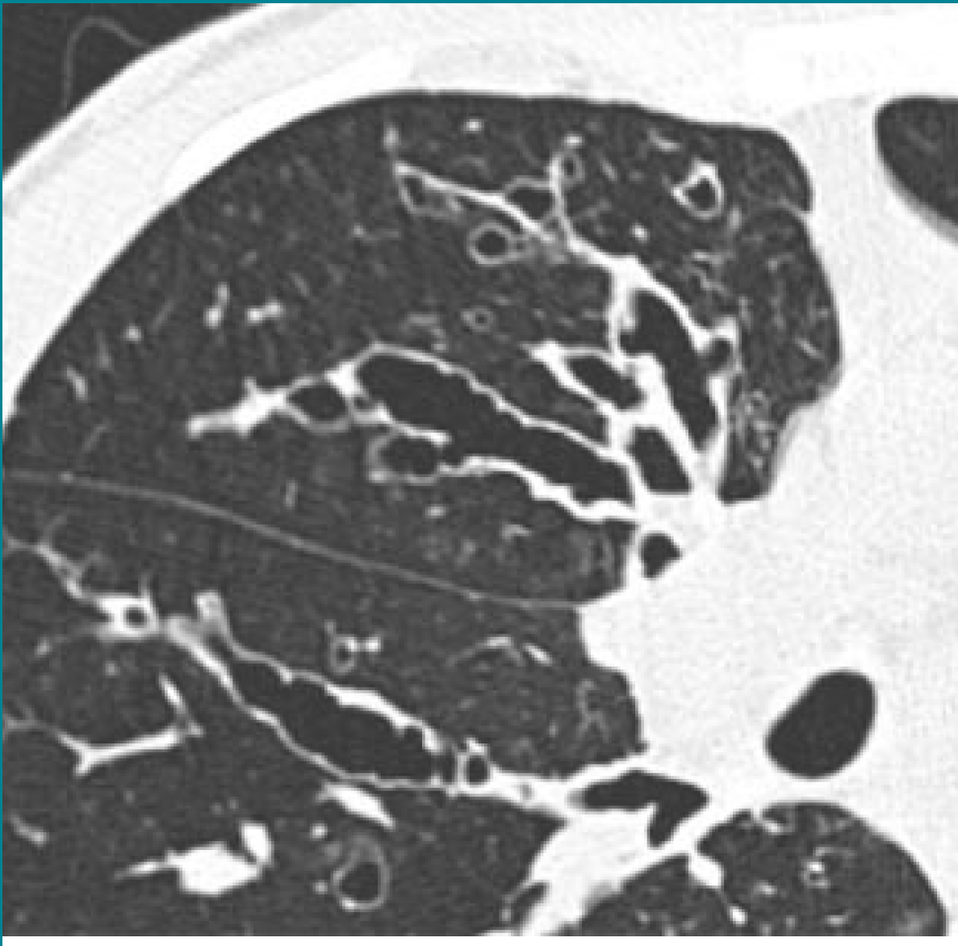
Intro – Disease Overview
Bronchiectasis
Permanent dilation of airways
Identified by widening and lack of tapering of airways
CT scan on the right shows varicose bronchiectasis
Hansell DM, Bankier AA, MacMahon H, McLoud TC, Müller NL, Remy J. Fleischner Society: Glossary of Terms for Thoracic Imaging. Radiology. 2008 Mar;246(3):697–722

Slide 6
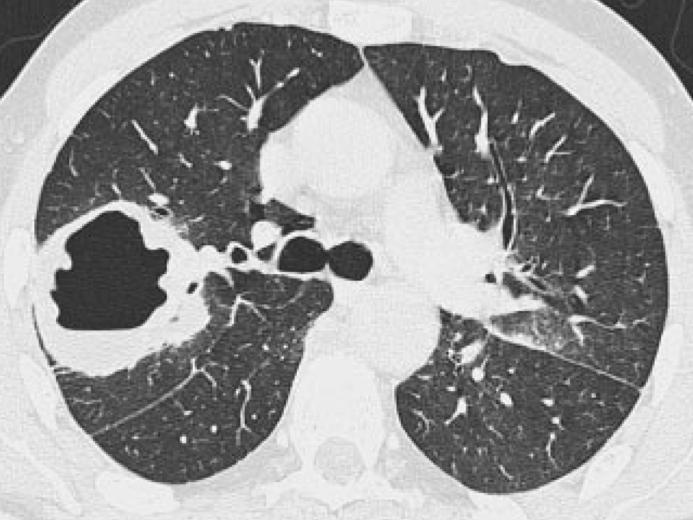
Intro – Disease Overview
Cavities
Gas-filled spaces within areas of consolidation, masses, or nodules
CT scan on right shows cavitating mass in right upper lobe
Hansell DM, Bankier AA, MacMahon H, McLoud TC, Müller NL, Remy J. Fleischner Society: Glossary of Terms for Thoracic Imaging. Radiology. 2008 Mar;246(3):697–722

Slide 7
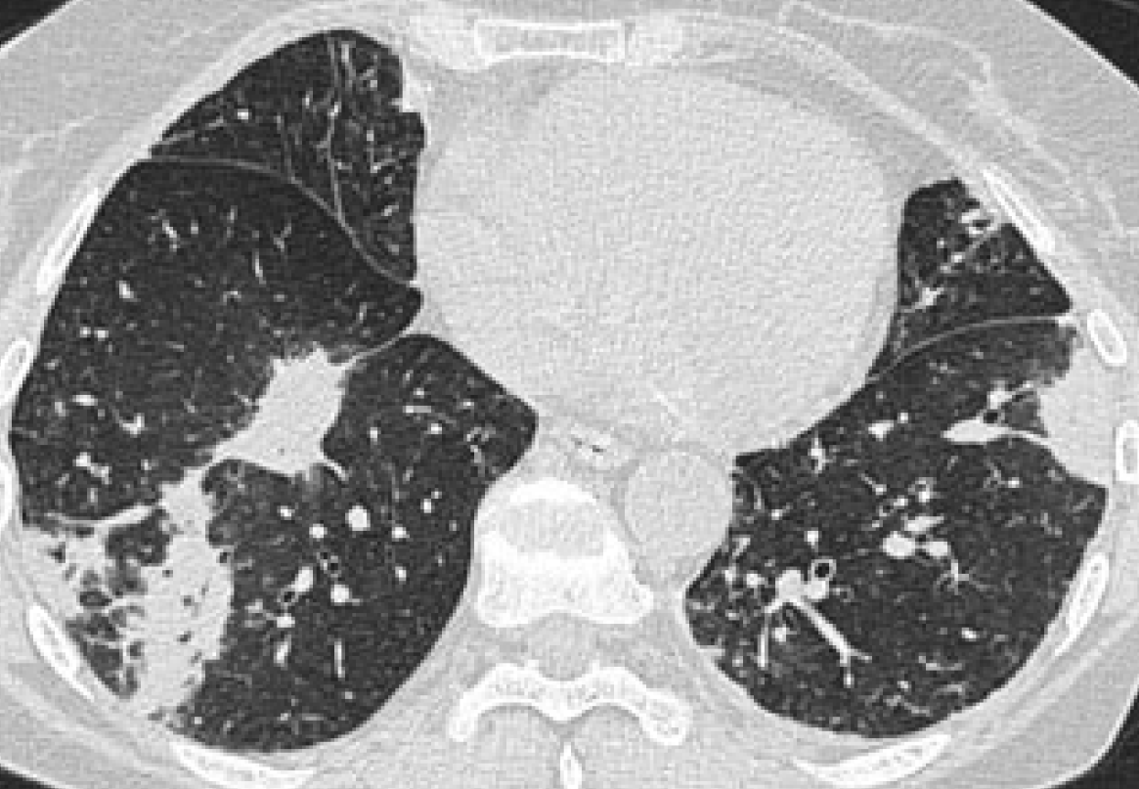
Intro – Disease Overview
Consolidation
Air in lung replaced by fluid or other disease byproduct
Renders lung “solid” looking
Appears as opaque areas in CT images
Hansell DM, Bankier AA, MacMahon H, McLoud TC, Müller NL, Remy J. Fleischner Society: Glossary of Terms for Thoracic Imaging. Radiology. 2008 Mar;246(3):697–722

Slide 8
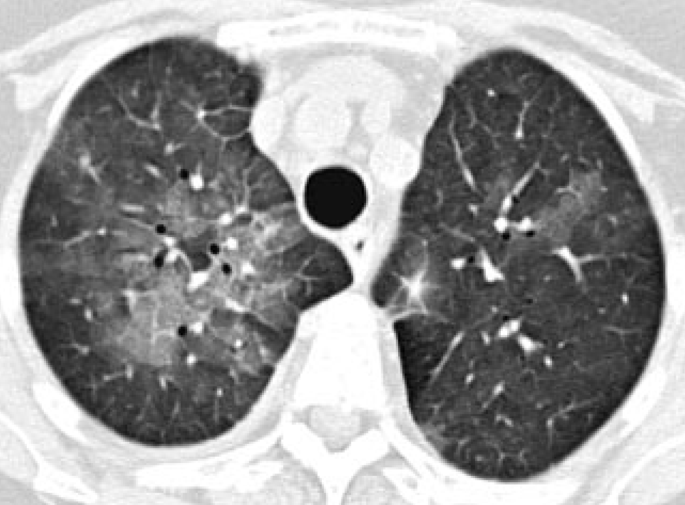
Intro – Disease Overview
Ground-glass opacities
Caused by fluid in airspaces or thickening of lung tissue
Appear as hazy opacities
Not as opaque as consolidation
Hansell DM, Bankier AA, MacMahon H, McLoud TC, Müller NL, Remy J. Fleischner Society: Glossary of Terms for Thoracic Imaging. Radiology. 2008 Mar;246(3):697–722

Slide 9
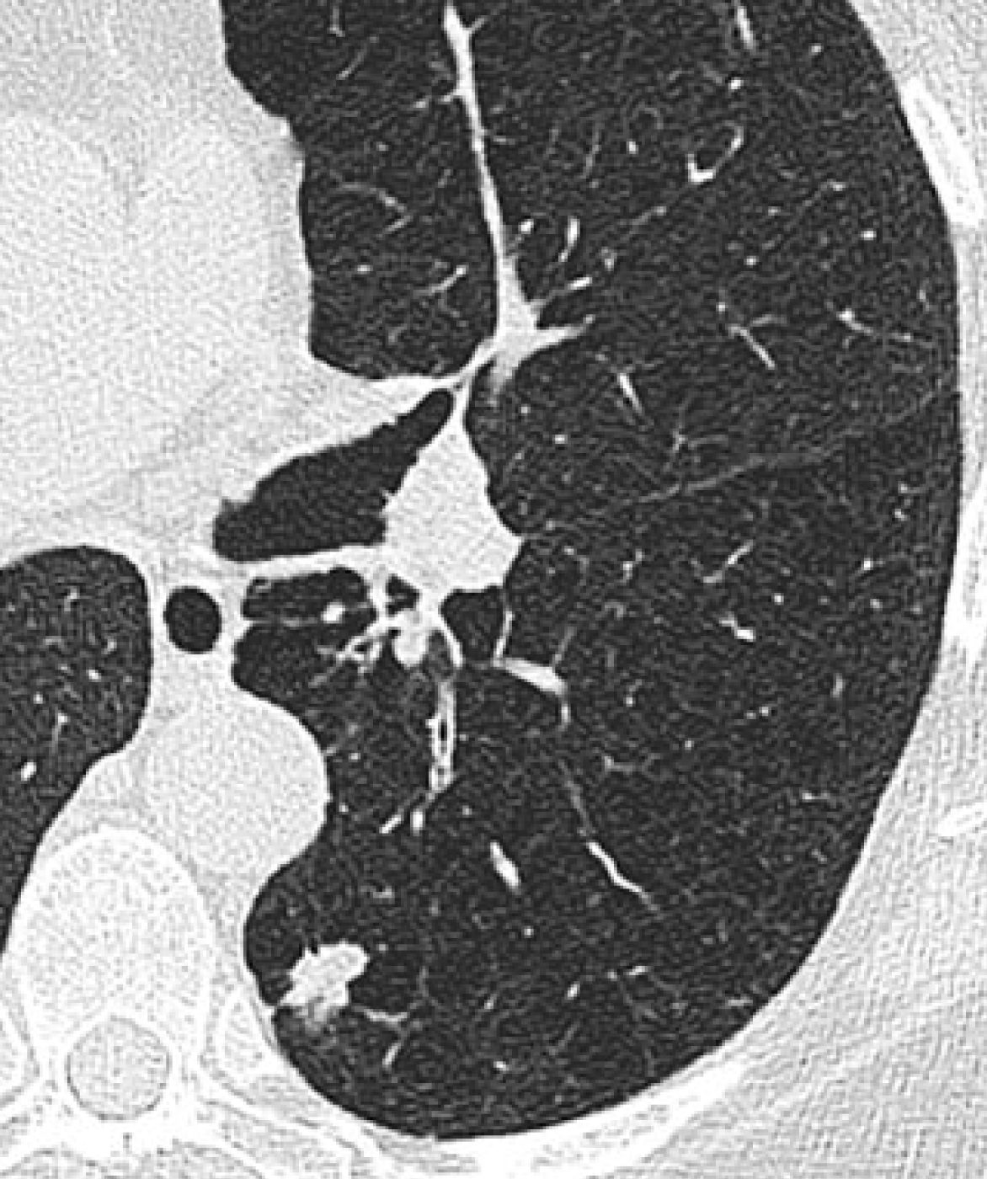
Intro – Disease Overview
Nodules
Round opacities measuring up to 3cm in diameter
CT scan on right shows irregular nodule in left lower lobe
Hansell DM, Bankier AA, MacMahon H, McLoud TC, Müller NL, Remy J. Fleischner Society: Glossary of Terms for Thoracic Imaging. Radiology. 2008 Mar;246(3):697–722

Slide 10
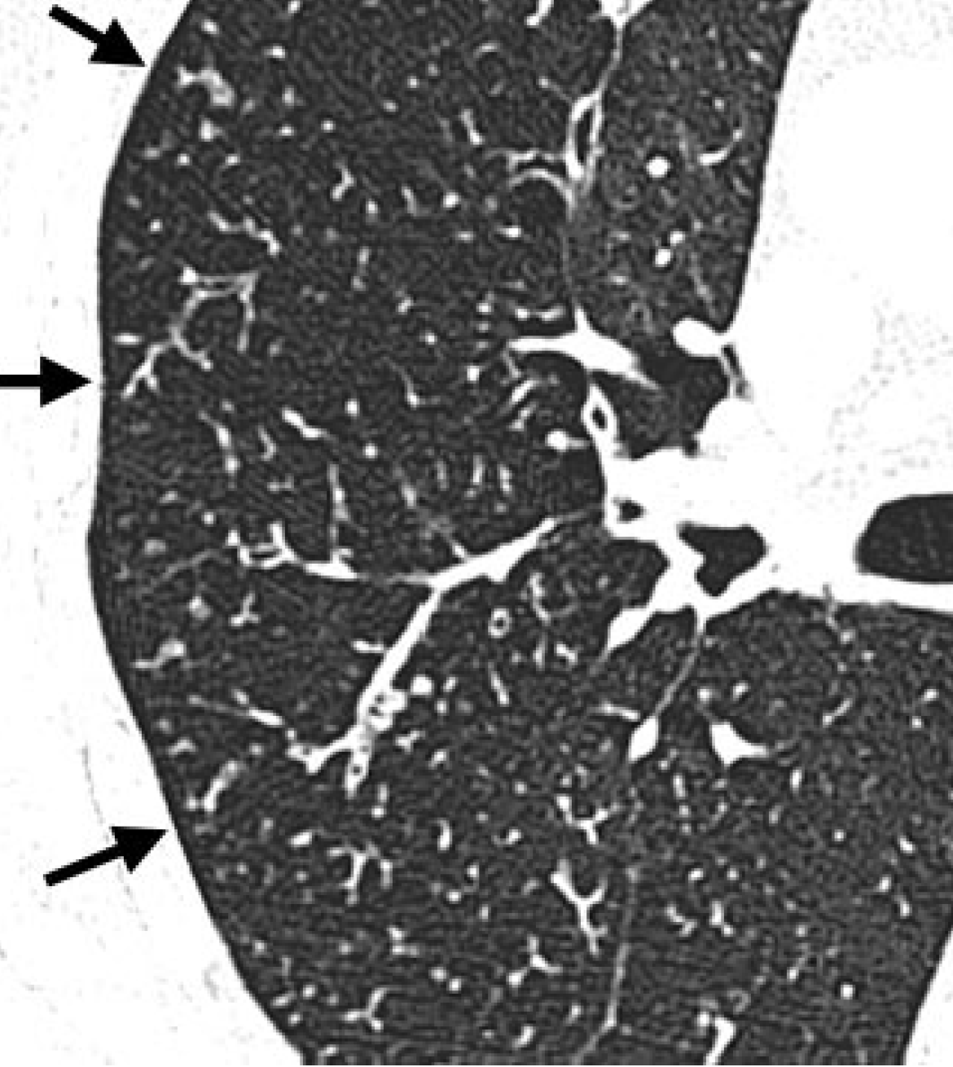
Intro – Disease Overview
Tree-in-bud Opacities
Small branching nodular opacities that resemble a budding tree
Caused by mucus impaction and inflammation
Hansell DM, Bankier AA, MacMahon H, McLoud TC, Müller NL, Remy J. Fleischner Society: Glossary of Terms for Thoracic Imaging. Radiology. 2008 Mar;246(3):697–722

Slide 11
Intro – Disease Overview
Indications in medical literature that certain areas of the lung are more severely affected than others
Reich & Johnson (1992): Studied 29 patients with NTM-LD, identified 6 elderly women with greater disease in right middle lobe and lingula
Moore et al. (1993): Studied 40 NTM-LD patients, found bronchiectasis was more severe in right middle lobe and lingula, ground-glass opacities and consolidation in lower lobes, and nodules evenly distributed
Hazelton et al. (2000): Studied 14 NTM-LD patients; bronchiectasis and nodules present in 13; 2 had greater severity of bronchiectasis in right middle lobe and lingula
Lee et al. (2013): Compared severity among 24 immunocompromised vs 24 immunocompetent NTM-LD patients; no predominance in the lobar distribution of any of the features (bronchiectasis, cavities, nodules, opacities)

Slide 12
Research Question
Are there differences in the frequencies and severities for each of the specific CT features among the lung lobes in NTM-LD?

Slide 13
Methods

Slide 14
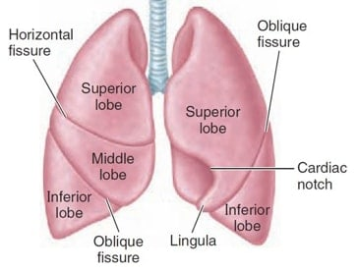
Methods – Lung Regions Studied
“Fissures & Lobes of Lungs.” Medico Apps, 17 Aug. 2020, medicoapps.org/fissures-lobes-of-lungs-2/.

Slide 15
Methods - Data
Data is comprised of scores for the radiographic features for subjects’ 6 lobes
Subjects scored by a pulmonologist and radiologist
Features with ordinal scores: atelectasis, bronchiectasis, consolidation, ground-glass opacities, tree-in-bud opacities
0: No involvement of lobe with given feature
1: <25% involvement
2: 25-50% involvement
3: >50% involvement
Features with binary scores: large nodules, thin wall cavities, thick wall cavities
0: Absence of feature from lobe
1: Presence of feature in lobe
166 subjects: 6 lobes scored with 2 raters scoring for each subject
Variables in analysis: subject ID, lobe, score of given lobe, rater
Data provided in an excel document
Data Cleaning
Minimal, mostly converting to long format

Slide 16
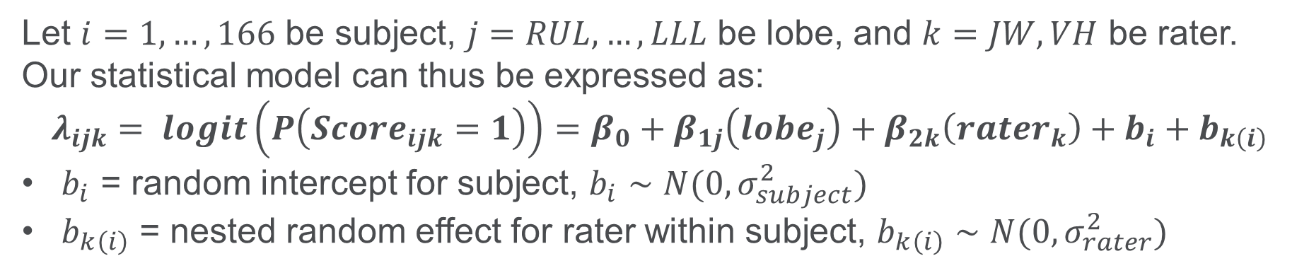
Methods - Modeling
Modeling Approach 1 – (Binary) Logistic Regression (Full)
Let $i=1, …, 166$ be subject, $j=RUL, …, LLL$ be lobe, and $k=JW, VH$ be rater. Our statistical model can thus be expressed as:
$$λ_{ijk}= logit\left(P\left(Score_{ijk}=1\right)\right)=β_{0}+β_{1j}\left(lobe_{j}\right)+β_{2k}\left(rater_{k}\right)+b_{i}+b_{k\left(i\right)}$$
$b_{i}$ = random intercept for subject, $b_{i}∼N(0,σ_{subject}^{2})$
$b_{k\left(i\right)}$ = nested random effect for rater within subject, $b_{k\left(i\right)}∼N(0,σ_{rater}^{2})$

Slide 17
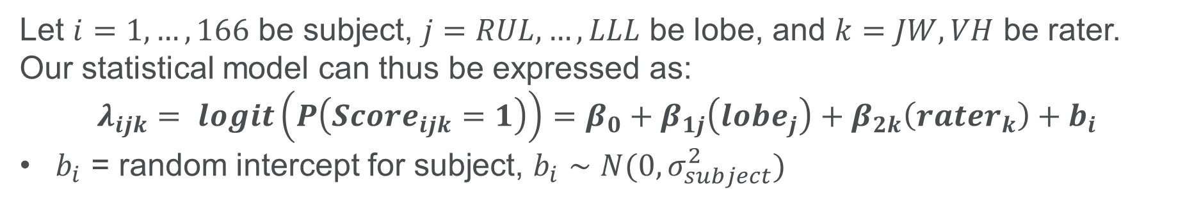
Methods - Modeling
Modeling Approach 2 – Logistic Regression (Reduced)
Let $i=1, …, 166$ be subject, $j=RUL, …, LLL$ be lobe, and $k=JW, VH$ be rater. Our statistical model can thus be expressed as:
$$λ_{ijk}= logit\left(P\left(Score_{ijk}=1\right)\right)=β_{0}+β_{1j}\left(lobe_{j}\right)+β_{2k}\left(rater_{k}\right)+b_{i}$$
$b_{i}$ = random intercept for subject, $b_{i}∼N(0,σ_{subject}^{2})$

Slide 18
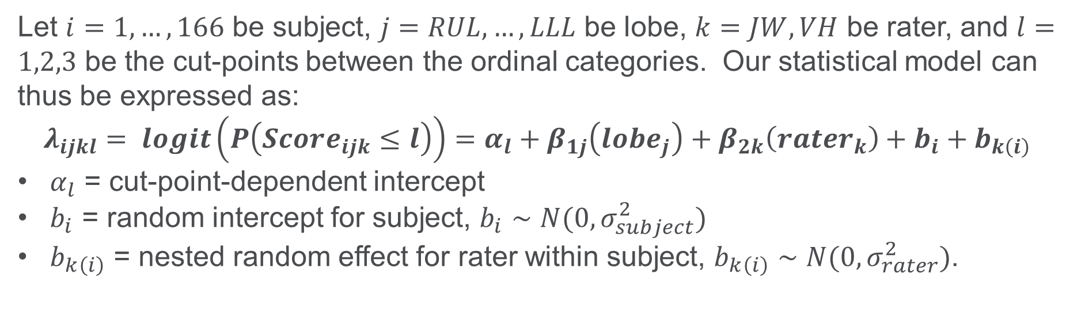
Methods - Modeling
Modeling Approach 3 – Proportional Odds Ordinal Logistic Regression (Full)
Let $i=1, …, 166$ be subject, $j=RUL, …, LLL$ be lobe, $k=JW, VH$ be rater, and $l=1,2,3$ be the cut-points between the ordinal categories. Our statistical model can thus be expressed as:
$$λ_{ijkl}= logit\left(P\left(Score_{ijk}≤l\right)\right)=α_{l}+β_{1j}\left(lobe_{j}\right)+β_{2k}\left(rater_{k}\right)+b_{i}+b_{k\left(i\right)}$$
$α_{l}$ = cut-point-dependent intercept
$b_{i}$ = random intercept for subject, $b_{i}∼N(0,σ_{subject}^{2})$
$b_{k\left(i\right)}$ = nested random effect for rater within subject, $b_{k\left(i\right)}∼N(0,σ_{rater}^{2})$.

Slide 19
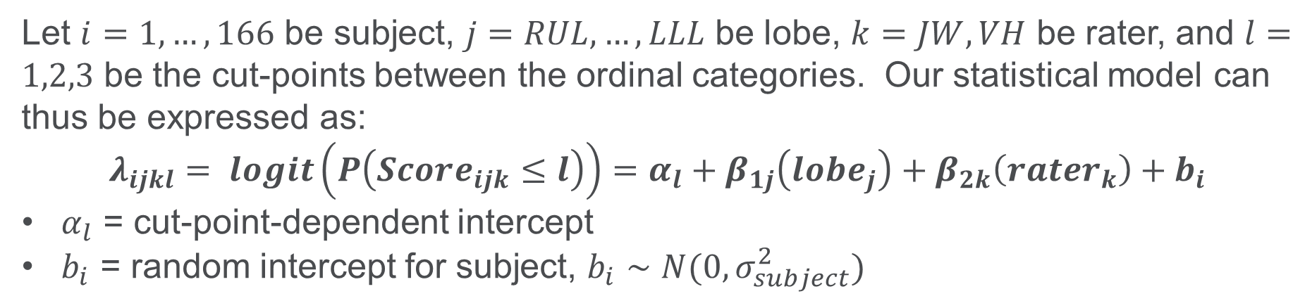
Methods - Modeling
Modeling Approach 4 – Proportional Odds Ordinal Logistic Regression (Reduced)
Let $i=1, …, 166$ be subject, $j=RUL, …, LLL$ be lobe, $k=JW, VH$ be rater, and $l=1,2,3$ be the cut-points between the ordinal categories. Our statistical model can thus be expressed as:
$$λ_{ijkl}= logit\left(P\left(Score_{ijk}≤l\right)\right)=α_{l}+β_{1j}\left(lobe_{j}\right)+β_{2k}\left(rater_{k}\right)+b_{i}$$
$α_{l}$ = cut-point-dependent intercept
$b_{i}$ = random intercept for subject, $b_{i}∼N(0,σ_{subject}^{2})$

Slide 20
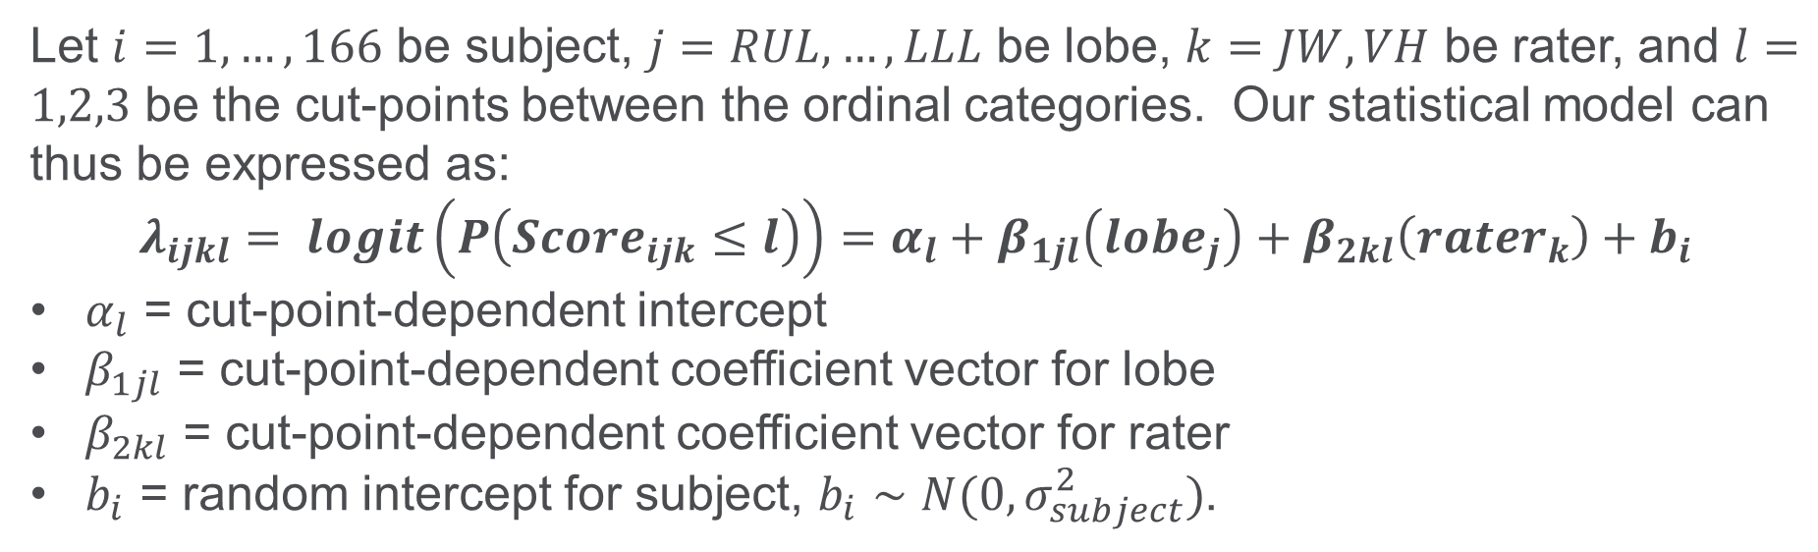
Methods - Modeling
Modeling Approach 5 – Non-Proportional Odds Ordinal Logistic Regression
Let $i=1, …, 166$ be subject, $j=RUL, …, LLL$ be lobe, $k=JW, VH$ be rater, and $l=1,2,3$ be the cut-points between the ordinal categories. Our statistical model can thus be expressed as:
$$λ_{ijkl}= logit\left(P\left(Score_{ijk}≤l\right)\right)=α_{l}+β_{1jl}\left(lobe_{j}\right)+β_{2kl}\left(rater_{k}\right)+b_{i}$$
$α_{l}$ = cut-point-dependent intercept
$β_{1jl}$ = cut-point-dependent coefficient vector for lobe
$β_{2kl}$ = cut-point-dependent coefficient vector for rater
$b_{i}$ = random intercept for subject, $b_{i}∼N(0,σ_{subject}^{2})$.

Slide 21
Methods – Lobe Comparisons
Constructed pairwise contrasts of fixed-effect estimates for lobe
First flipped sign for estimates in ordinal models
Exponentiated to get odds of higher disease severity
Confidence intervals (CIs) determined by exponentiating 95% confidence limits from GLIMMIX
Contrasts formed within each cut-point for NPO models
Applied False Discovery Rate (FDR) multiple testing correction

Slide 22
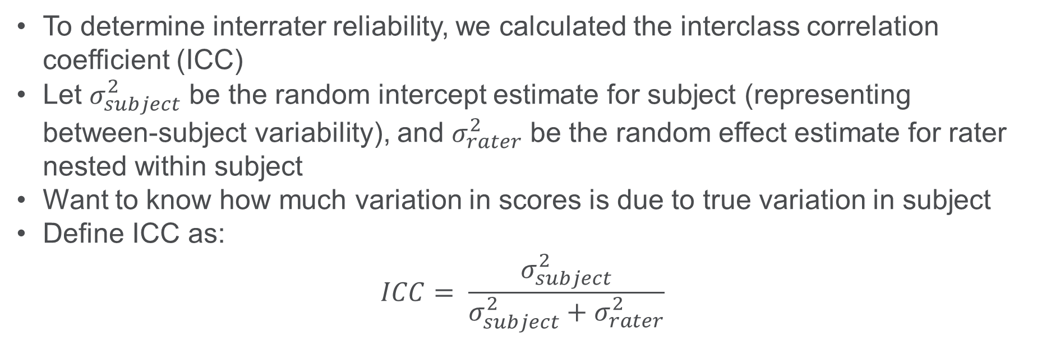
Methods – Interrater Reliability
To determine interrater reliability, we calculated the interclass correlation coefficient (ICC)
Let $σ_{subject}^{2}$ be the random intercept estimate for subject (representing between-subject variability), and $σ_{rater}^{2}$ be the random effect estimate for rater nested within subject
Want to know how much variation in scores is due to true variation in subject
Define ICC as:
$$ICC= \frac{σ_{subject}^{2}}{σ_{subject}^{2}+σ_{rater}^{2}}$$

Slide 23
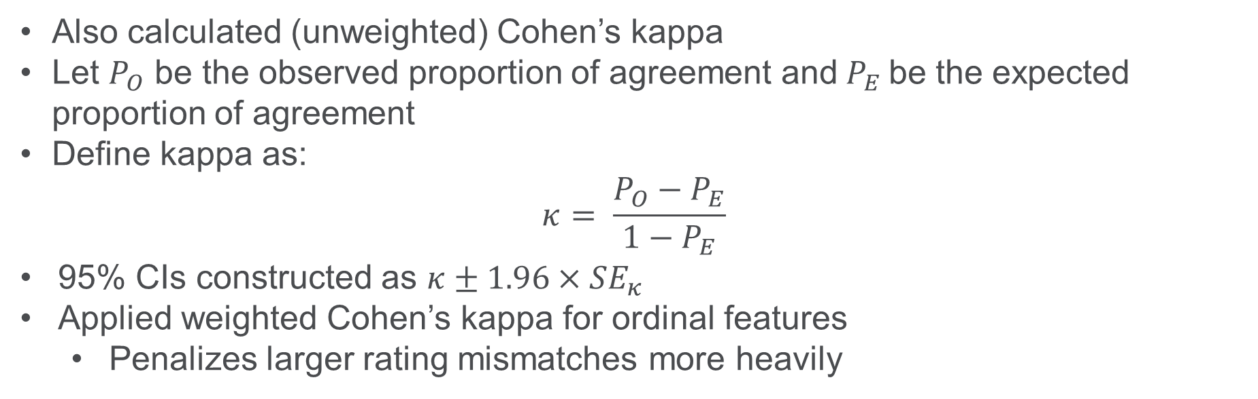
Methods – Interrater Reliability
Also calculated (unweighted) Cohen’s kappa
Let $P_{O}$ be the observed proportion of agreement and${ P}_{E}$be the expected proportion of agreement
Define kappa as:
$$κ= \frac{P_{O}−P_{E}}{1−P_{E}}$$
95% CIs constructed as $κ±1.96×SE_{κ}$
Applied weighted Cohen’s kappa for ordinal features
Penalizes larger rating mismatches more heavily

Slide 24
Results

Slide 25
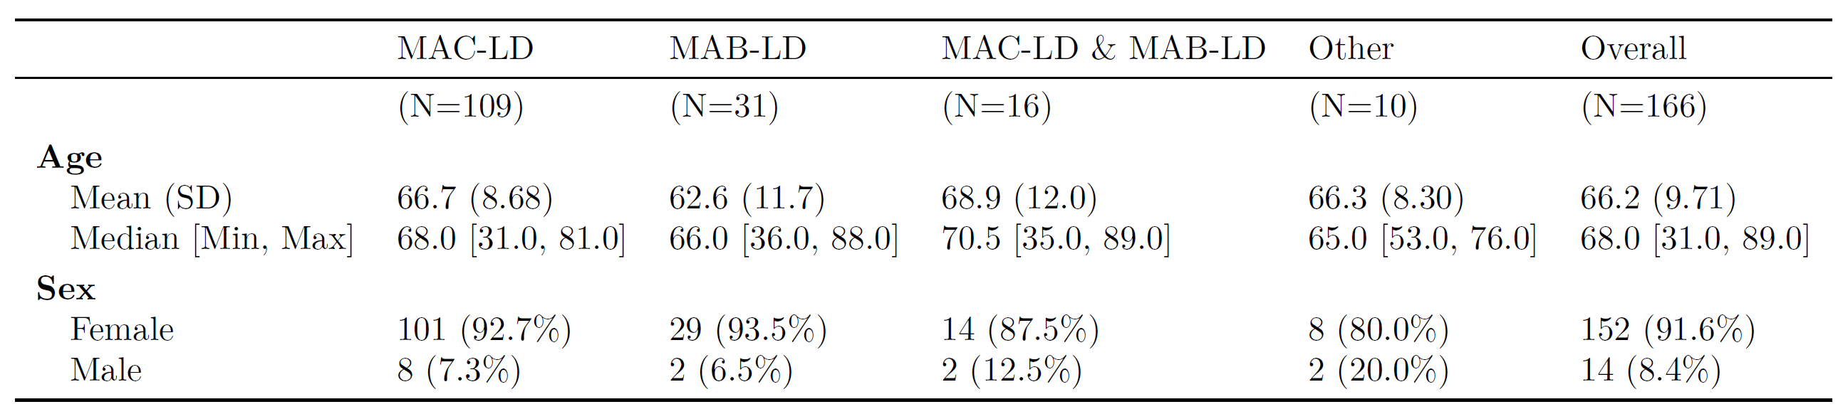
Results – Cohort Demographics
MAC-LD = Mycobacterium avium complex lung disease, MAB-LD = Mycobacterium abscessus lung disease

Slide 26
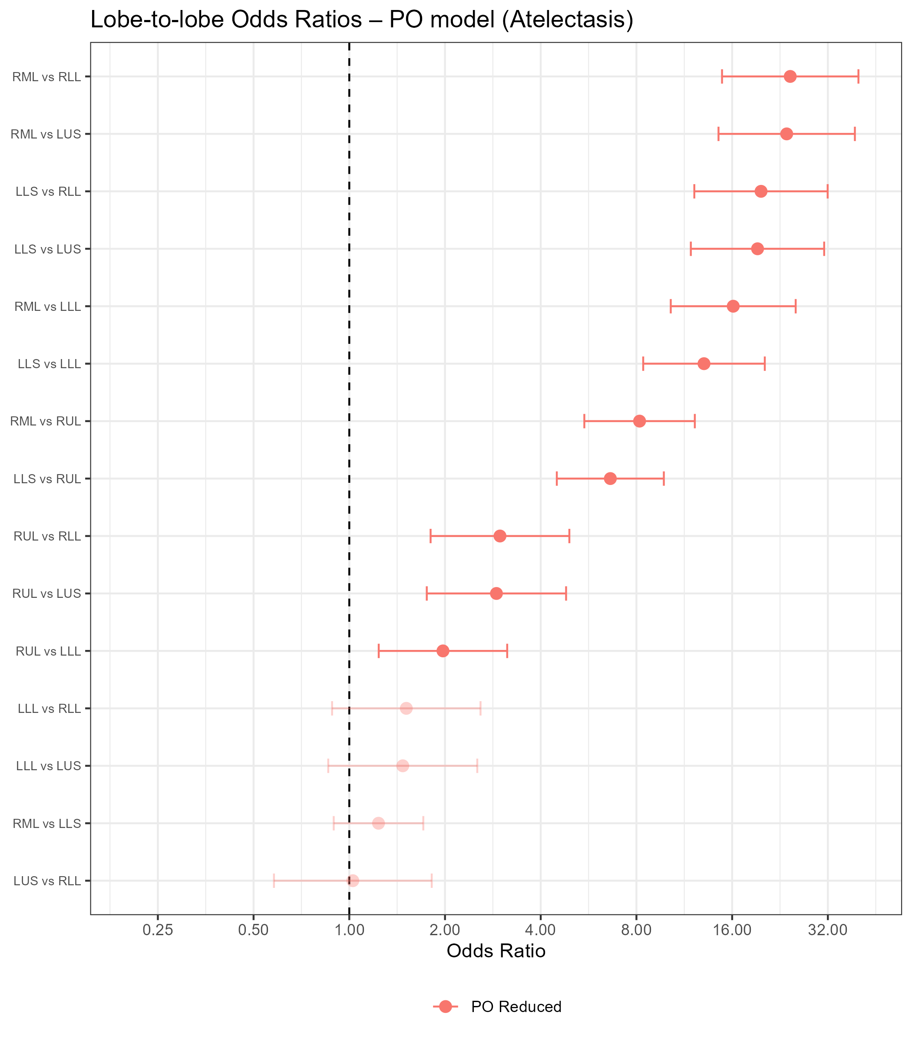
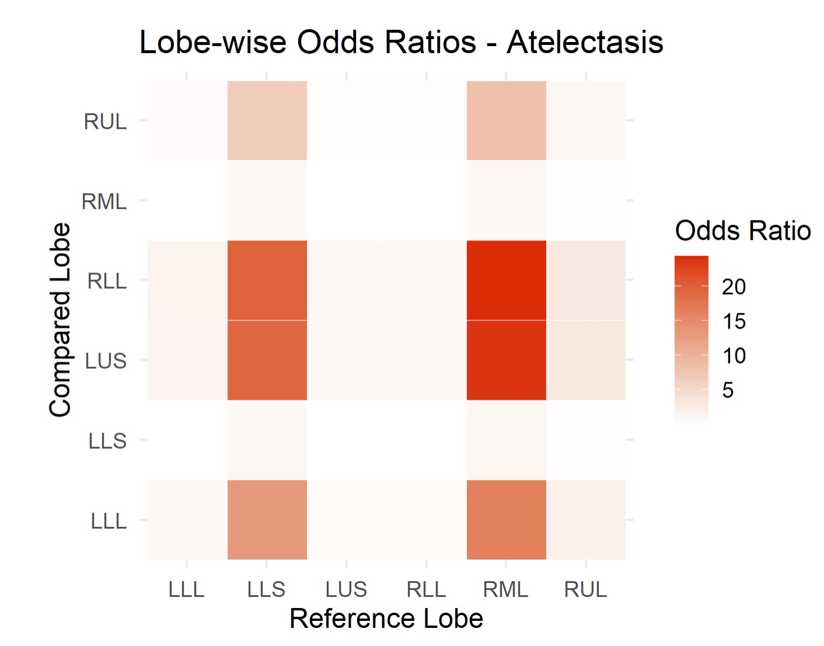
Results – Lobe Comparisons
Atelectasis
RML and lingula significantly greater severity than RLL, LUS, LLL, and RUL

Slide 27
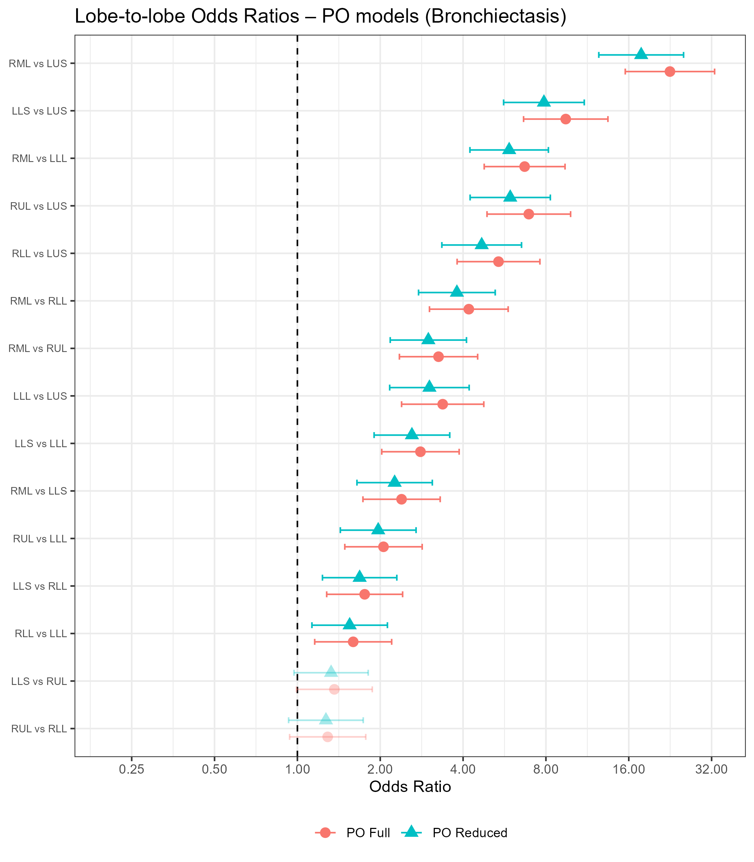
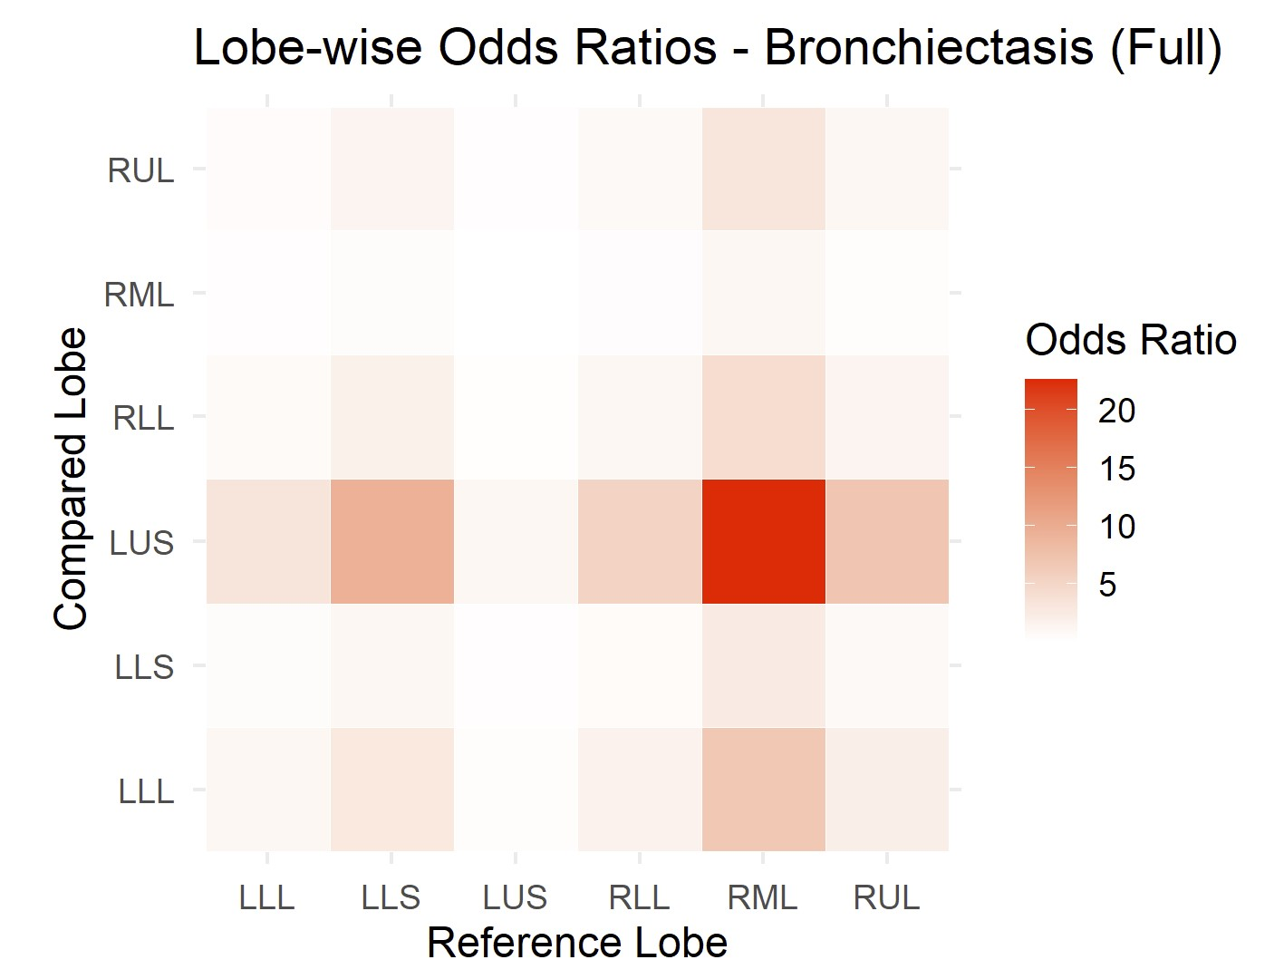
Results – Lobe Comparisons
Bronchiectasis
RML significantly greater severity than all other lobes
Lingula significantly greater severity than LUS, LLL, and RLL

Slide 28
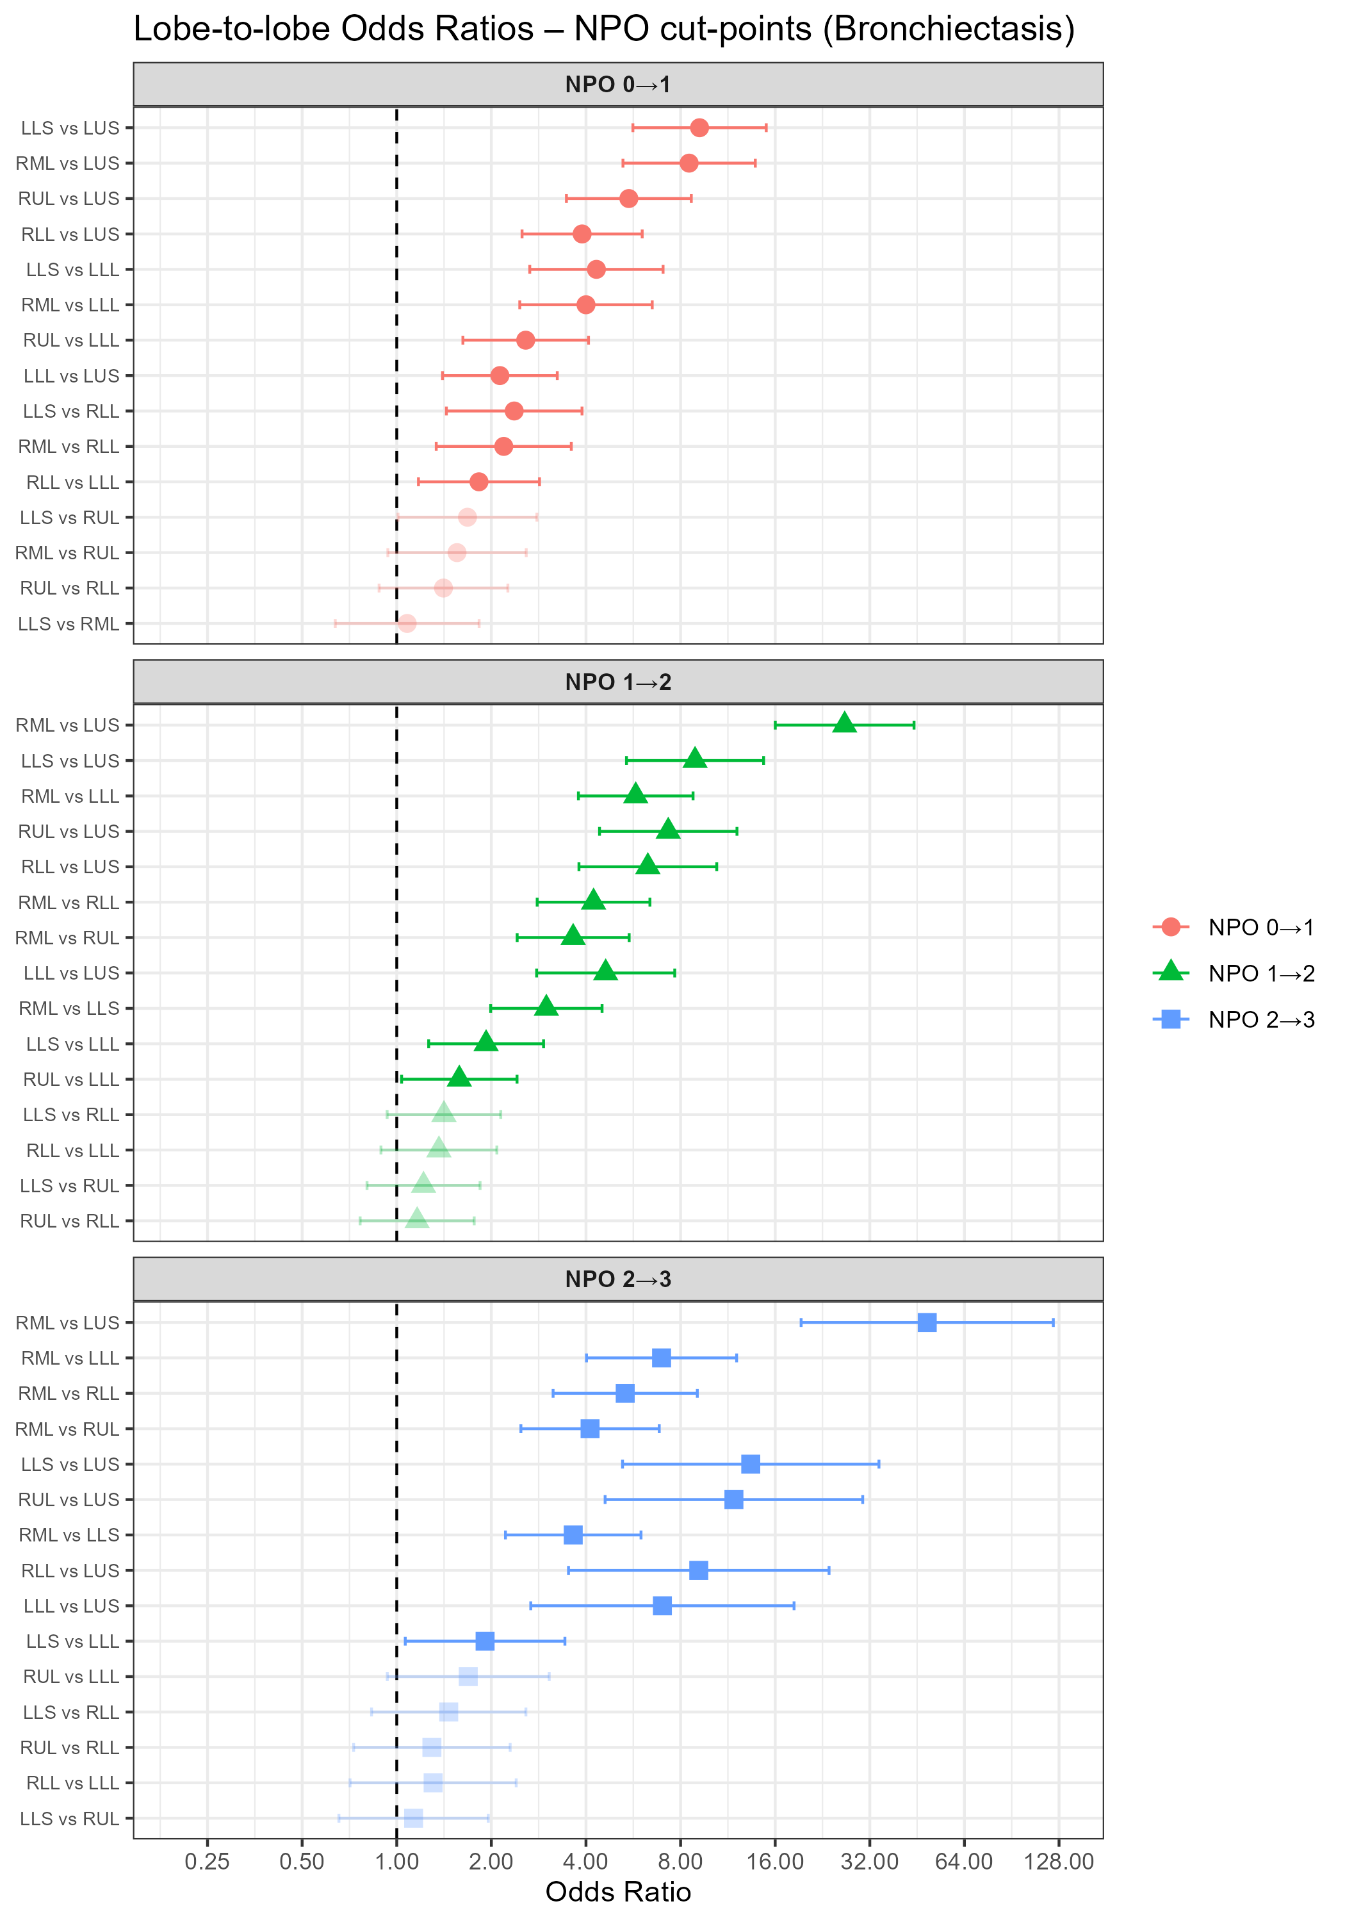
Results – Lobe Comparisons
Bronchiectasis
RML and lingula remain most significantly affected
OR CIs for 0|1 vs 1|2 and 0|1 vs 2|3 cut-points do not overlap for RML vs LUS
AIC for PO model lower than NPO model

Slide 29
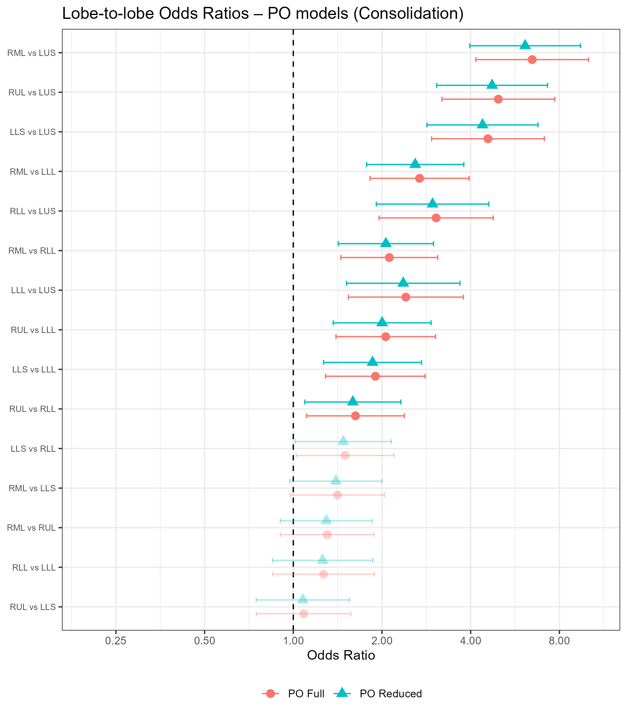
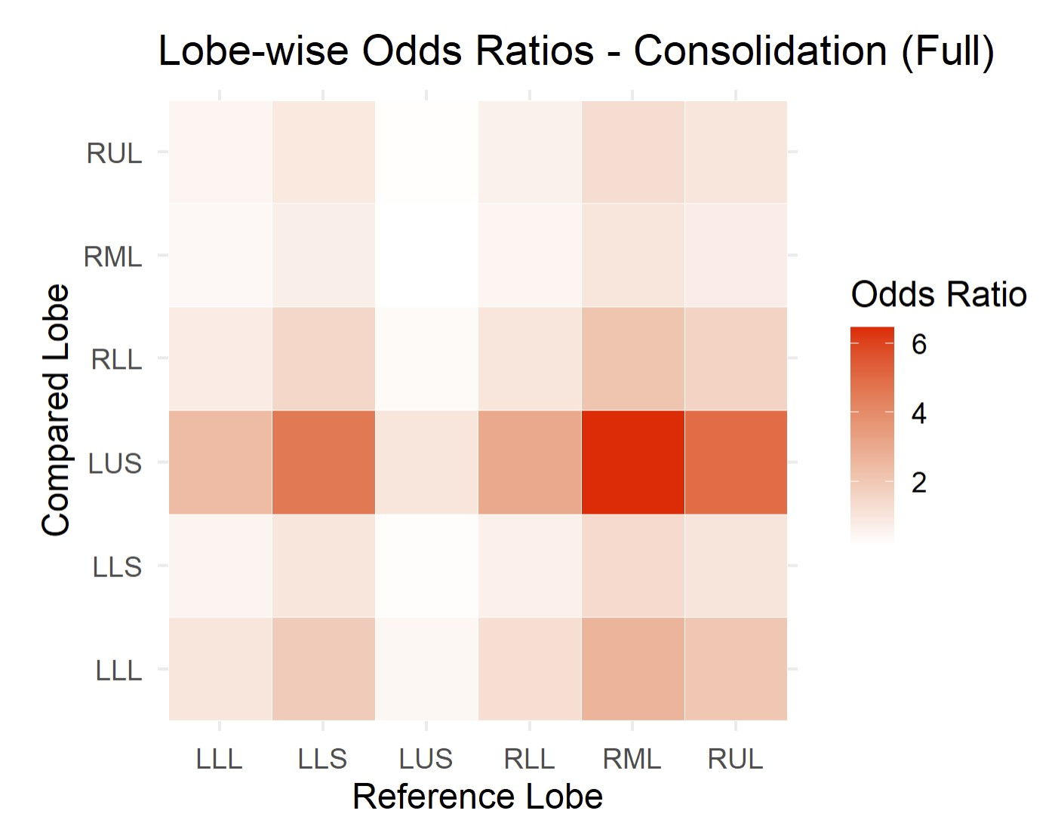
Results – Lobe Comparisons
Consolidation
RML and RUL significantly greater severity than LUS, LLL, and RLL

Slide 30
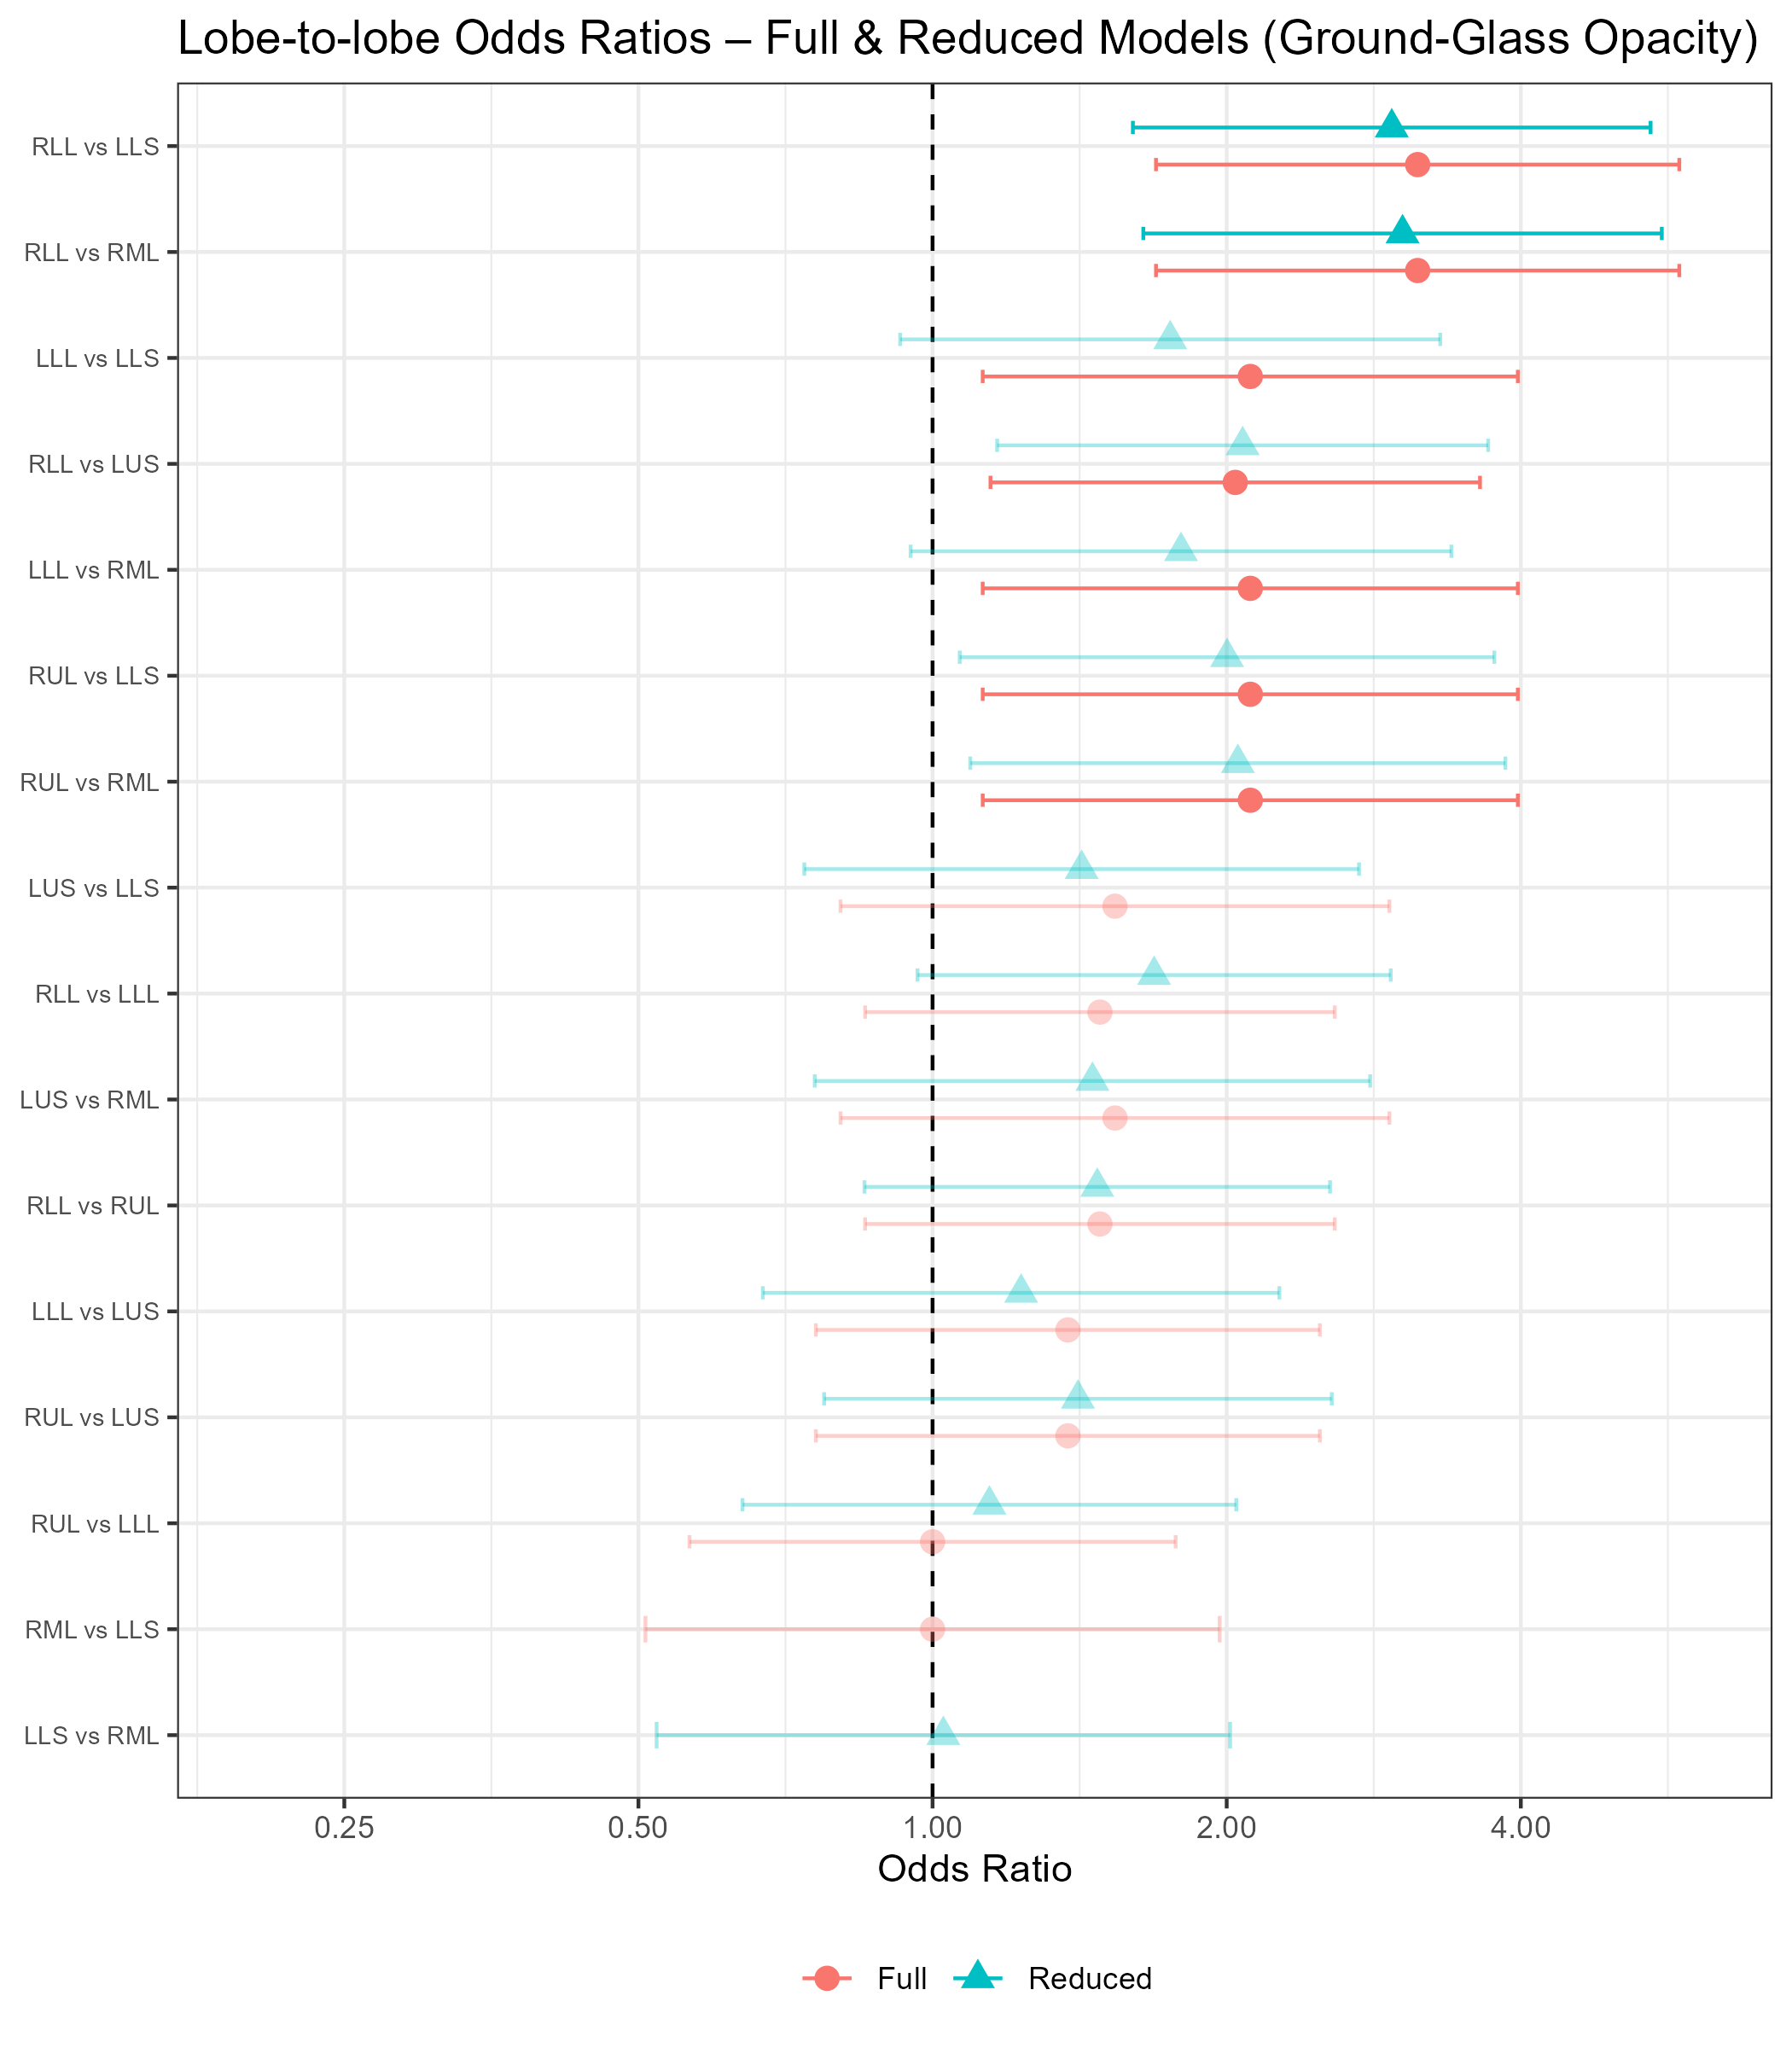
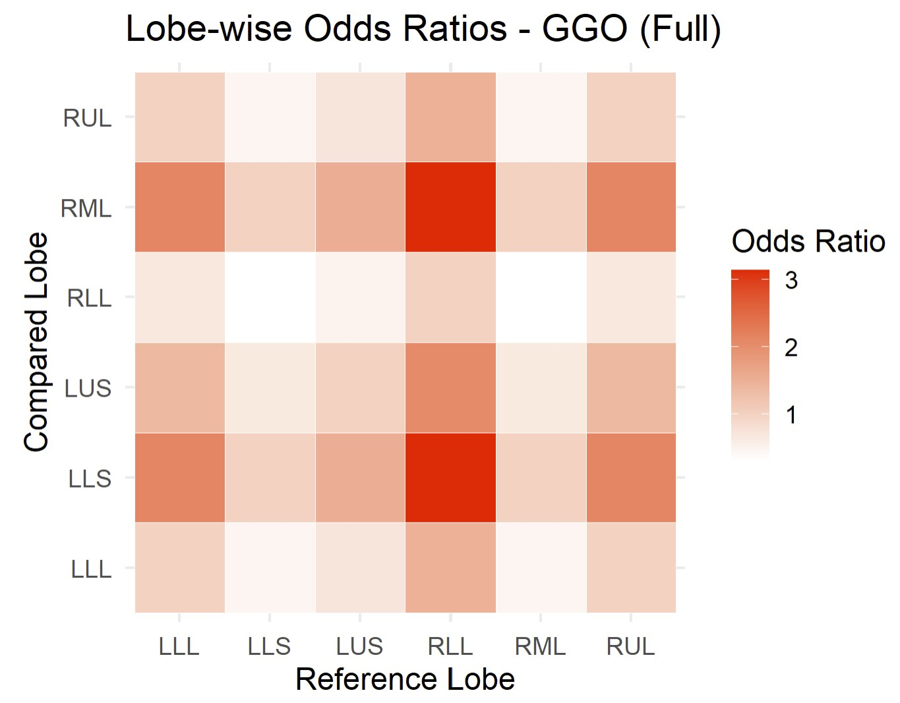
Results – Lobe Comparisons
Ground-glass opacities
Had to dichotomize outcome
RLL, RUL, and LLL significantly greater severity than lingula and RML
Only RLL remains significant in reduced model

Slide 31
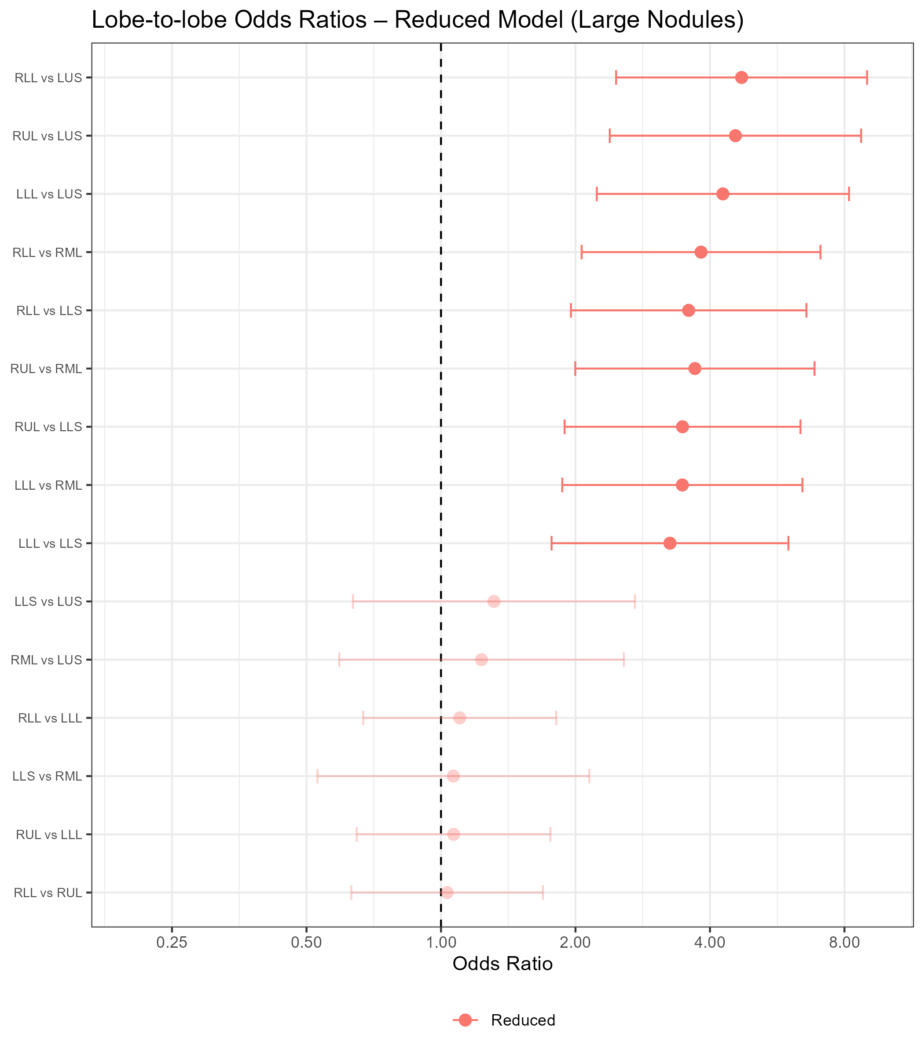
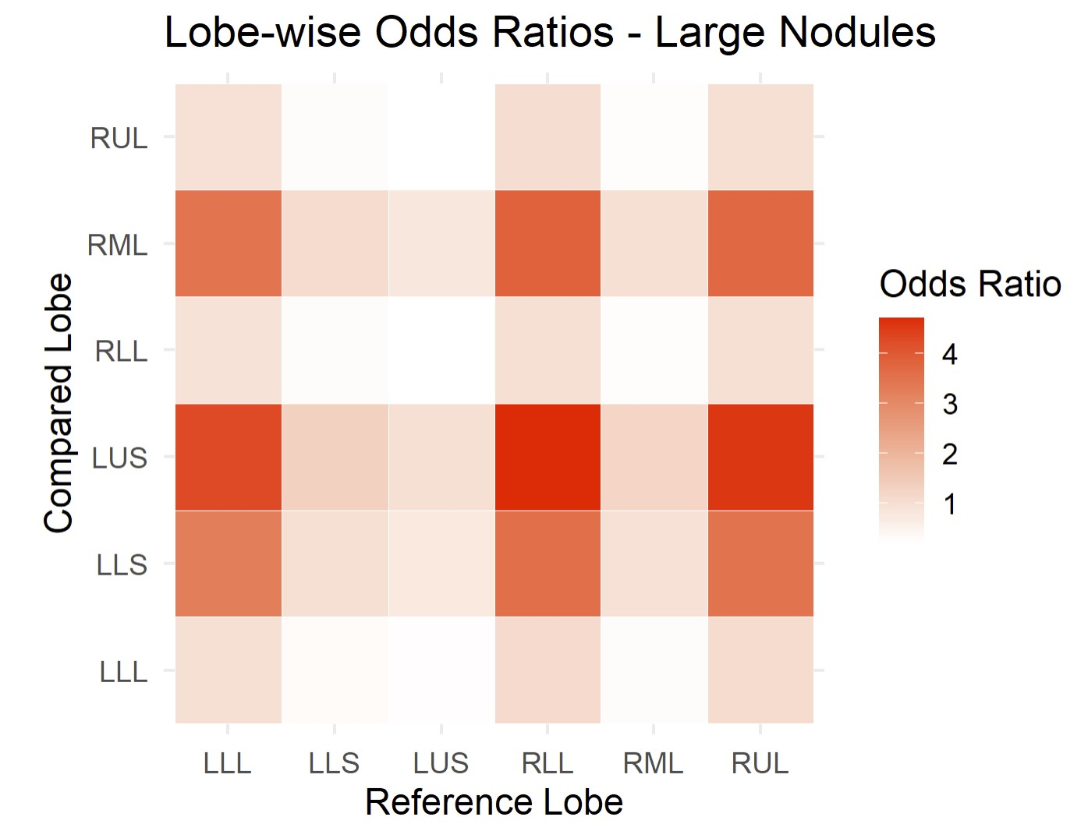
Results – Lobe Comparisons
Large Nodules
RLL, RUL, and LLL significantly greater severity than LUS, RML, lingula

Slide 32
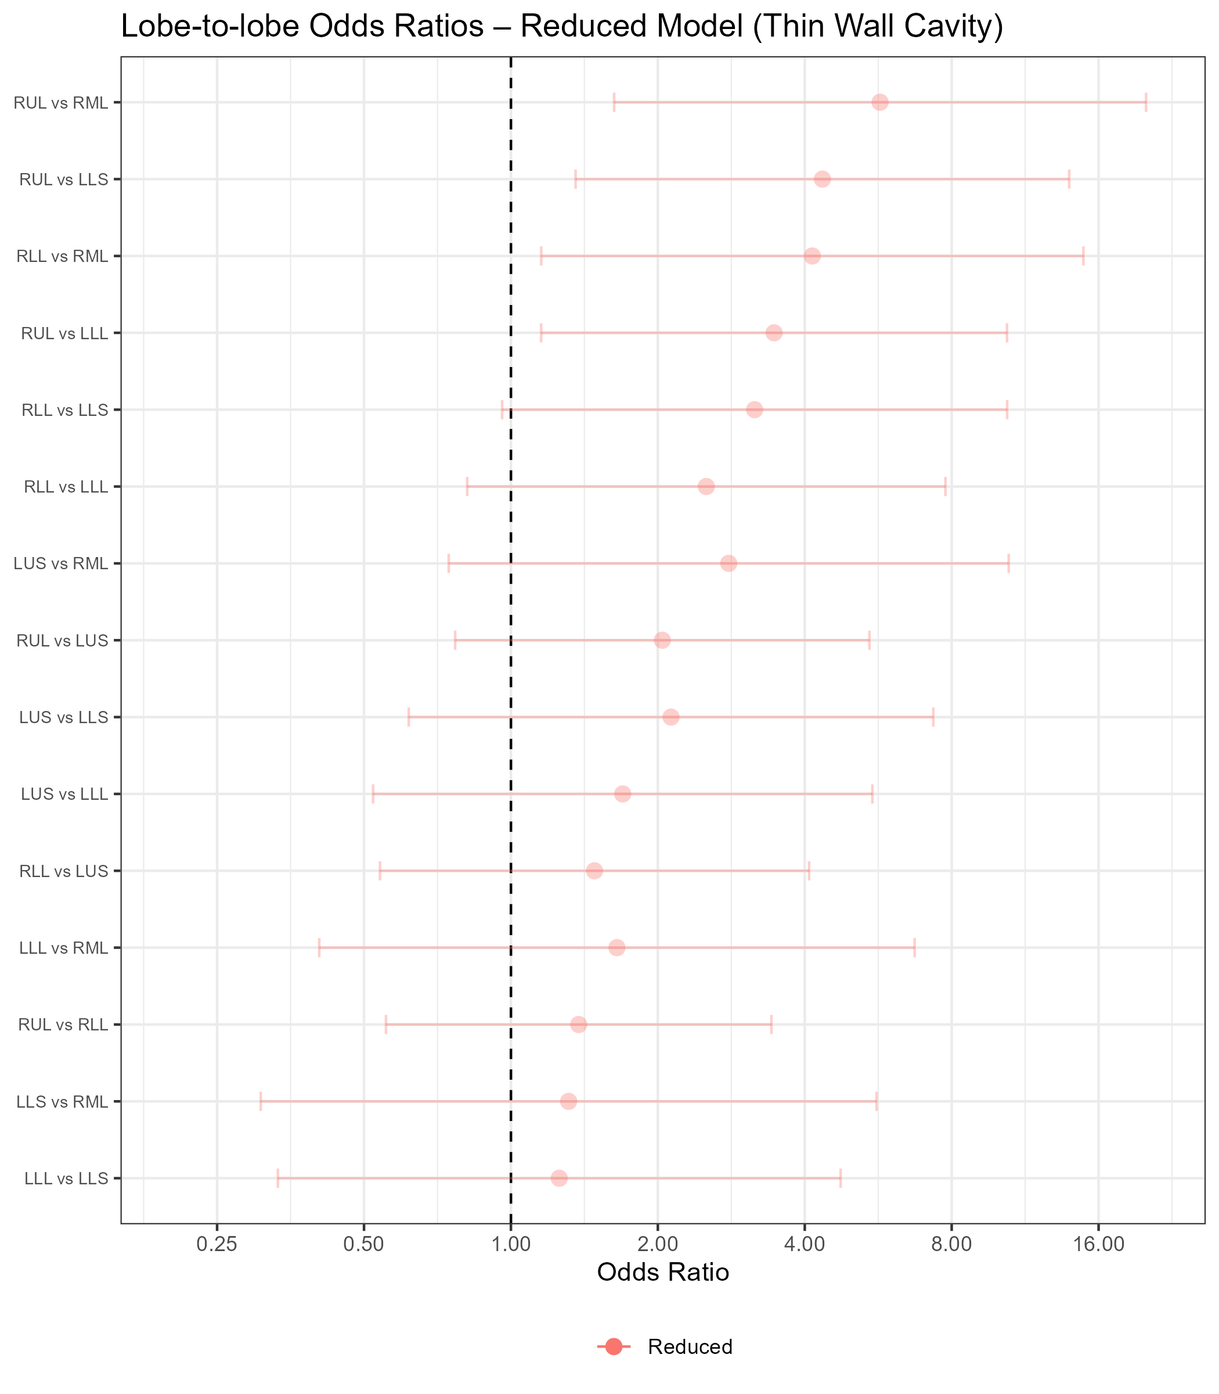
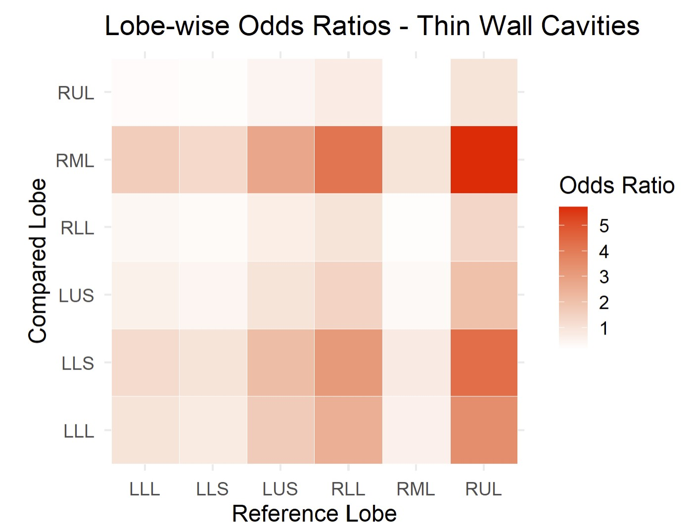
Results – Lobe Comparisons
Thin Wall Cavities
No significant differences in severity by lobe

Slide 33
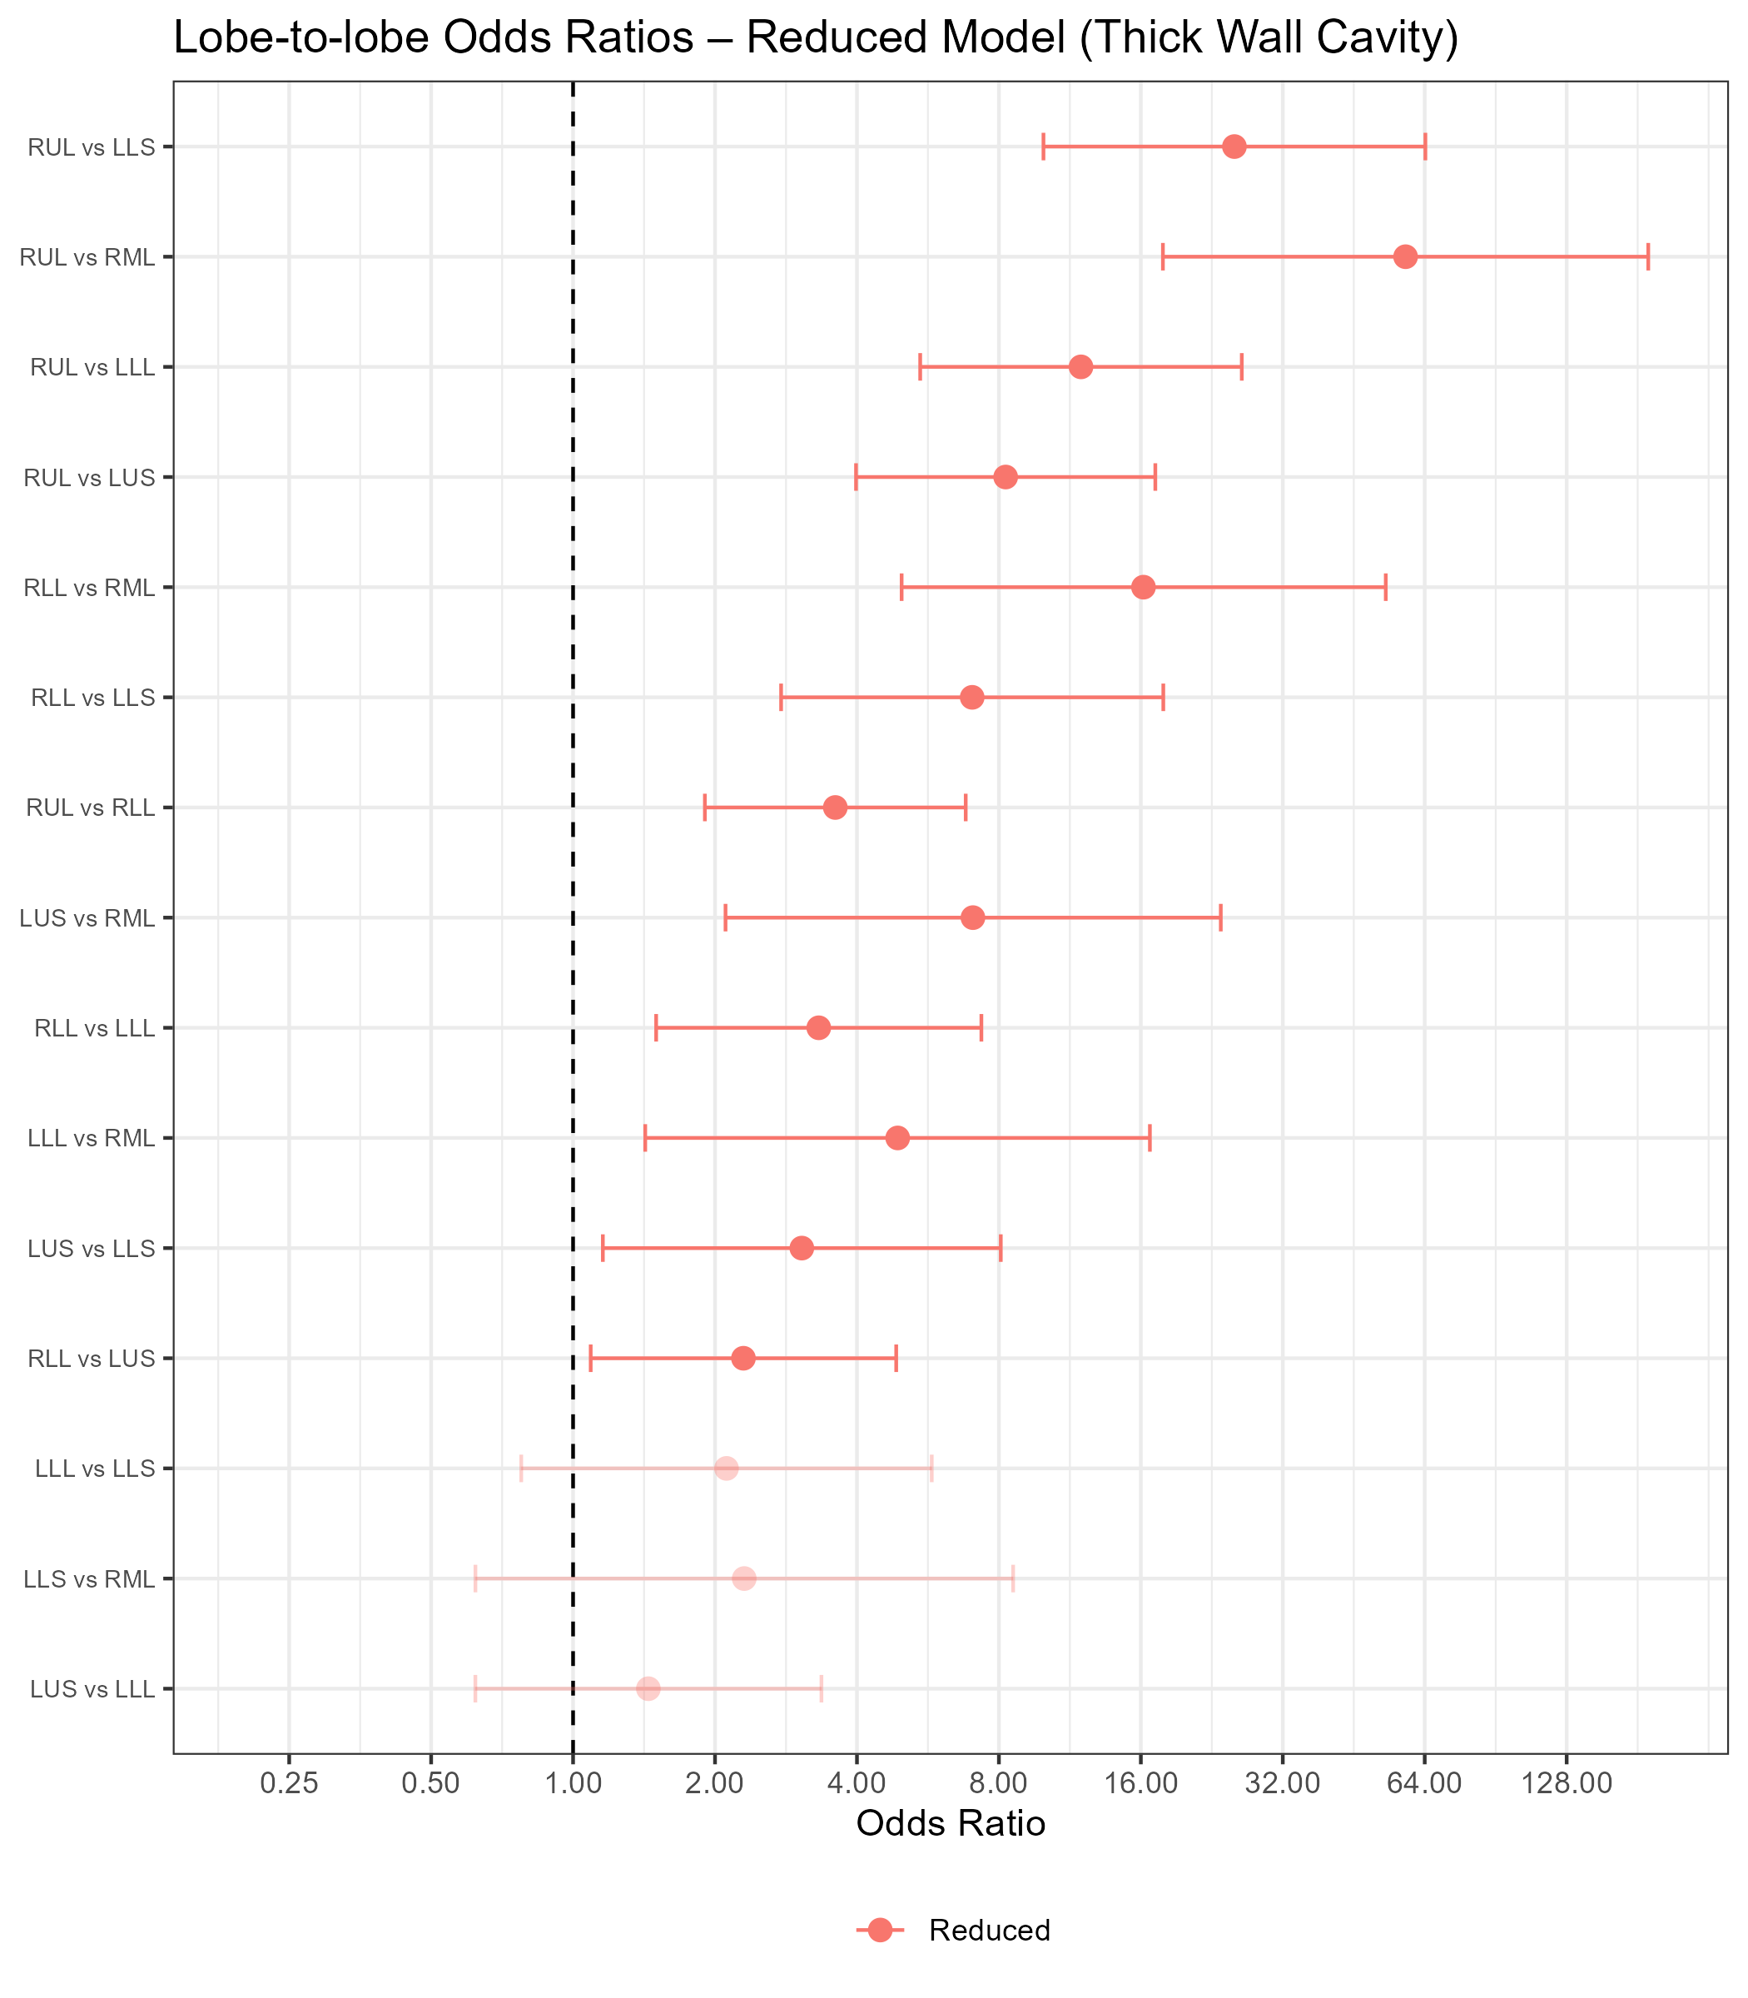
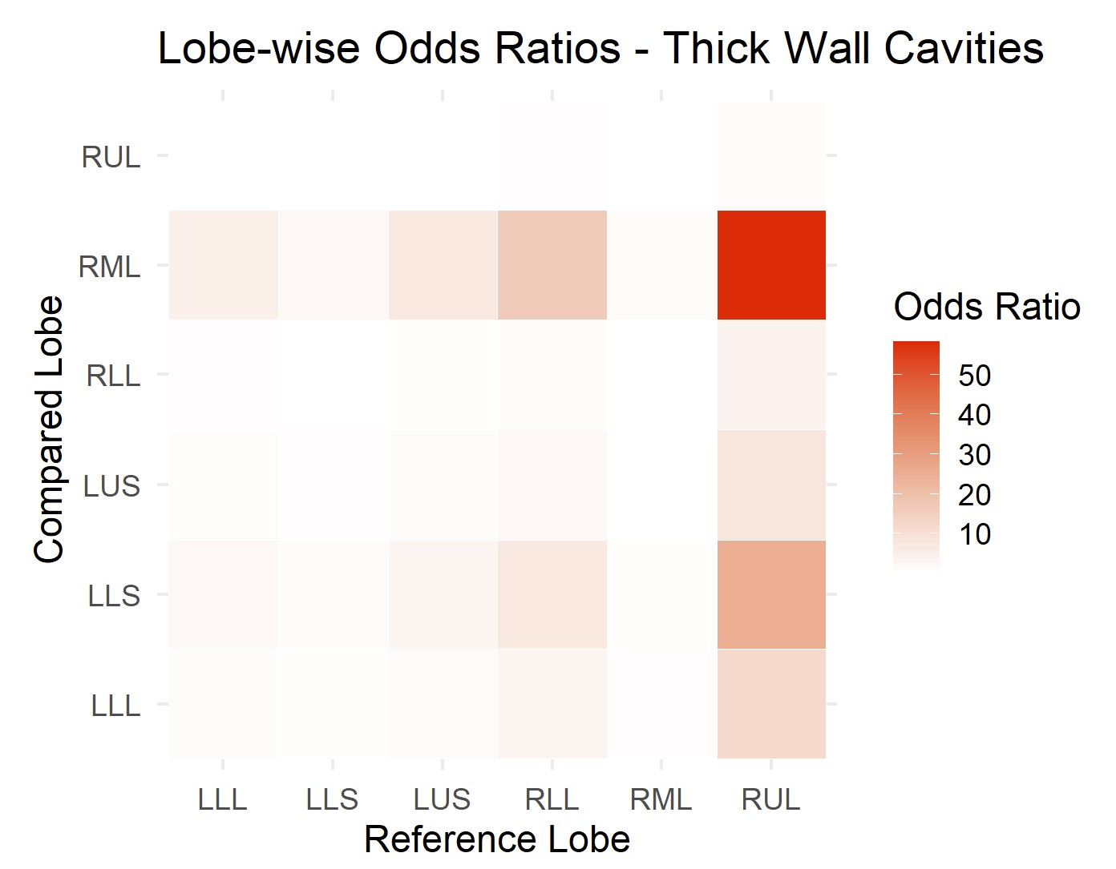
Results – Lobe Comparisons
Thick Wall Cavities
RUL significantly greater severity than all other lobes, RLL significantly greater severity than all but RUL

Slide 34
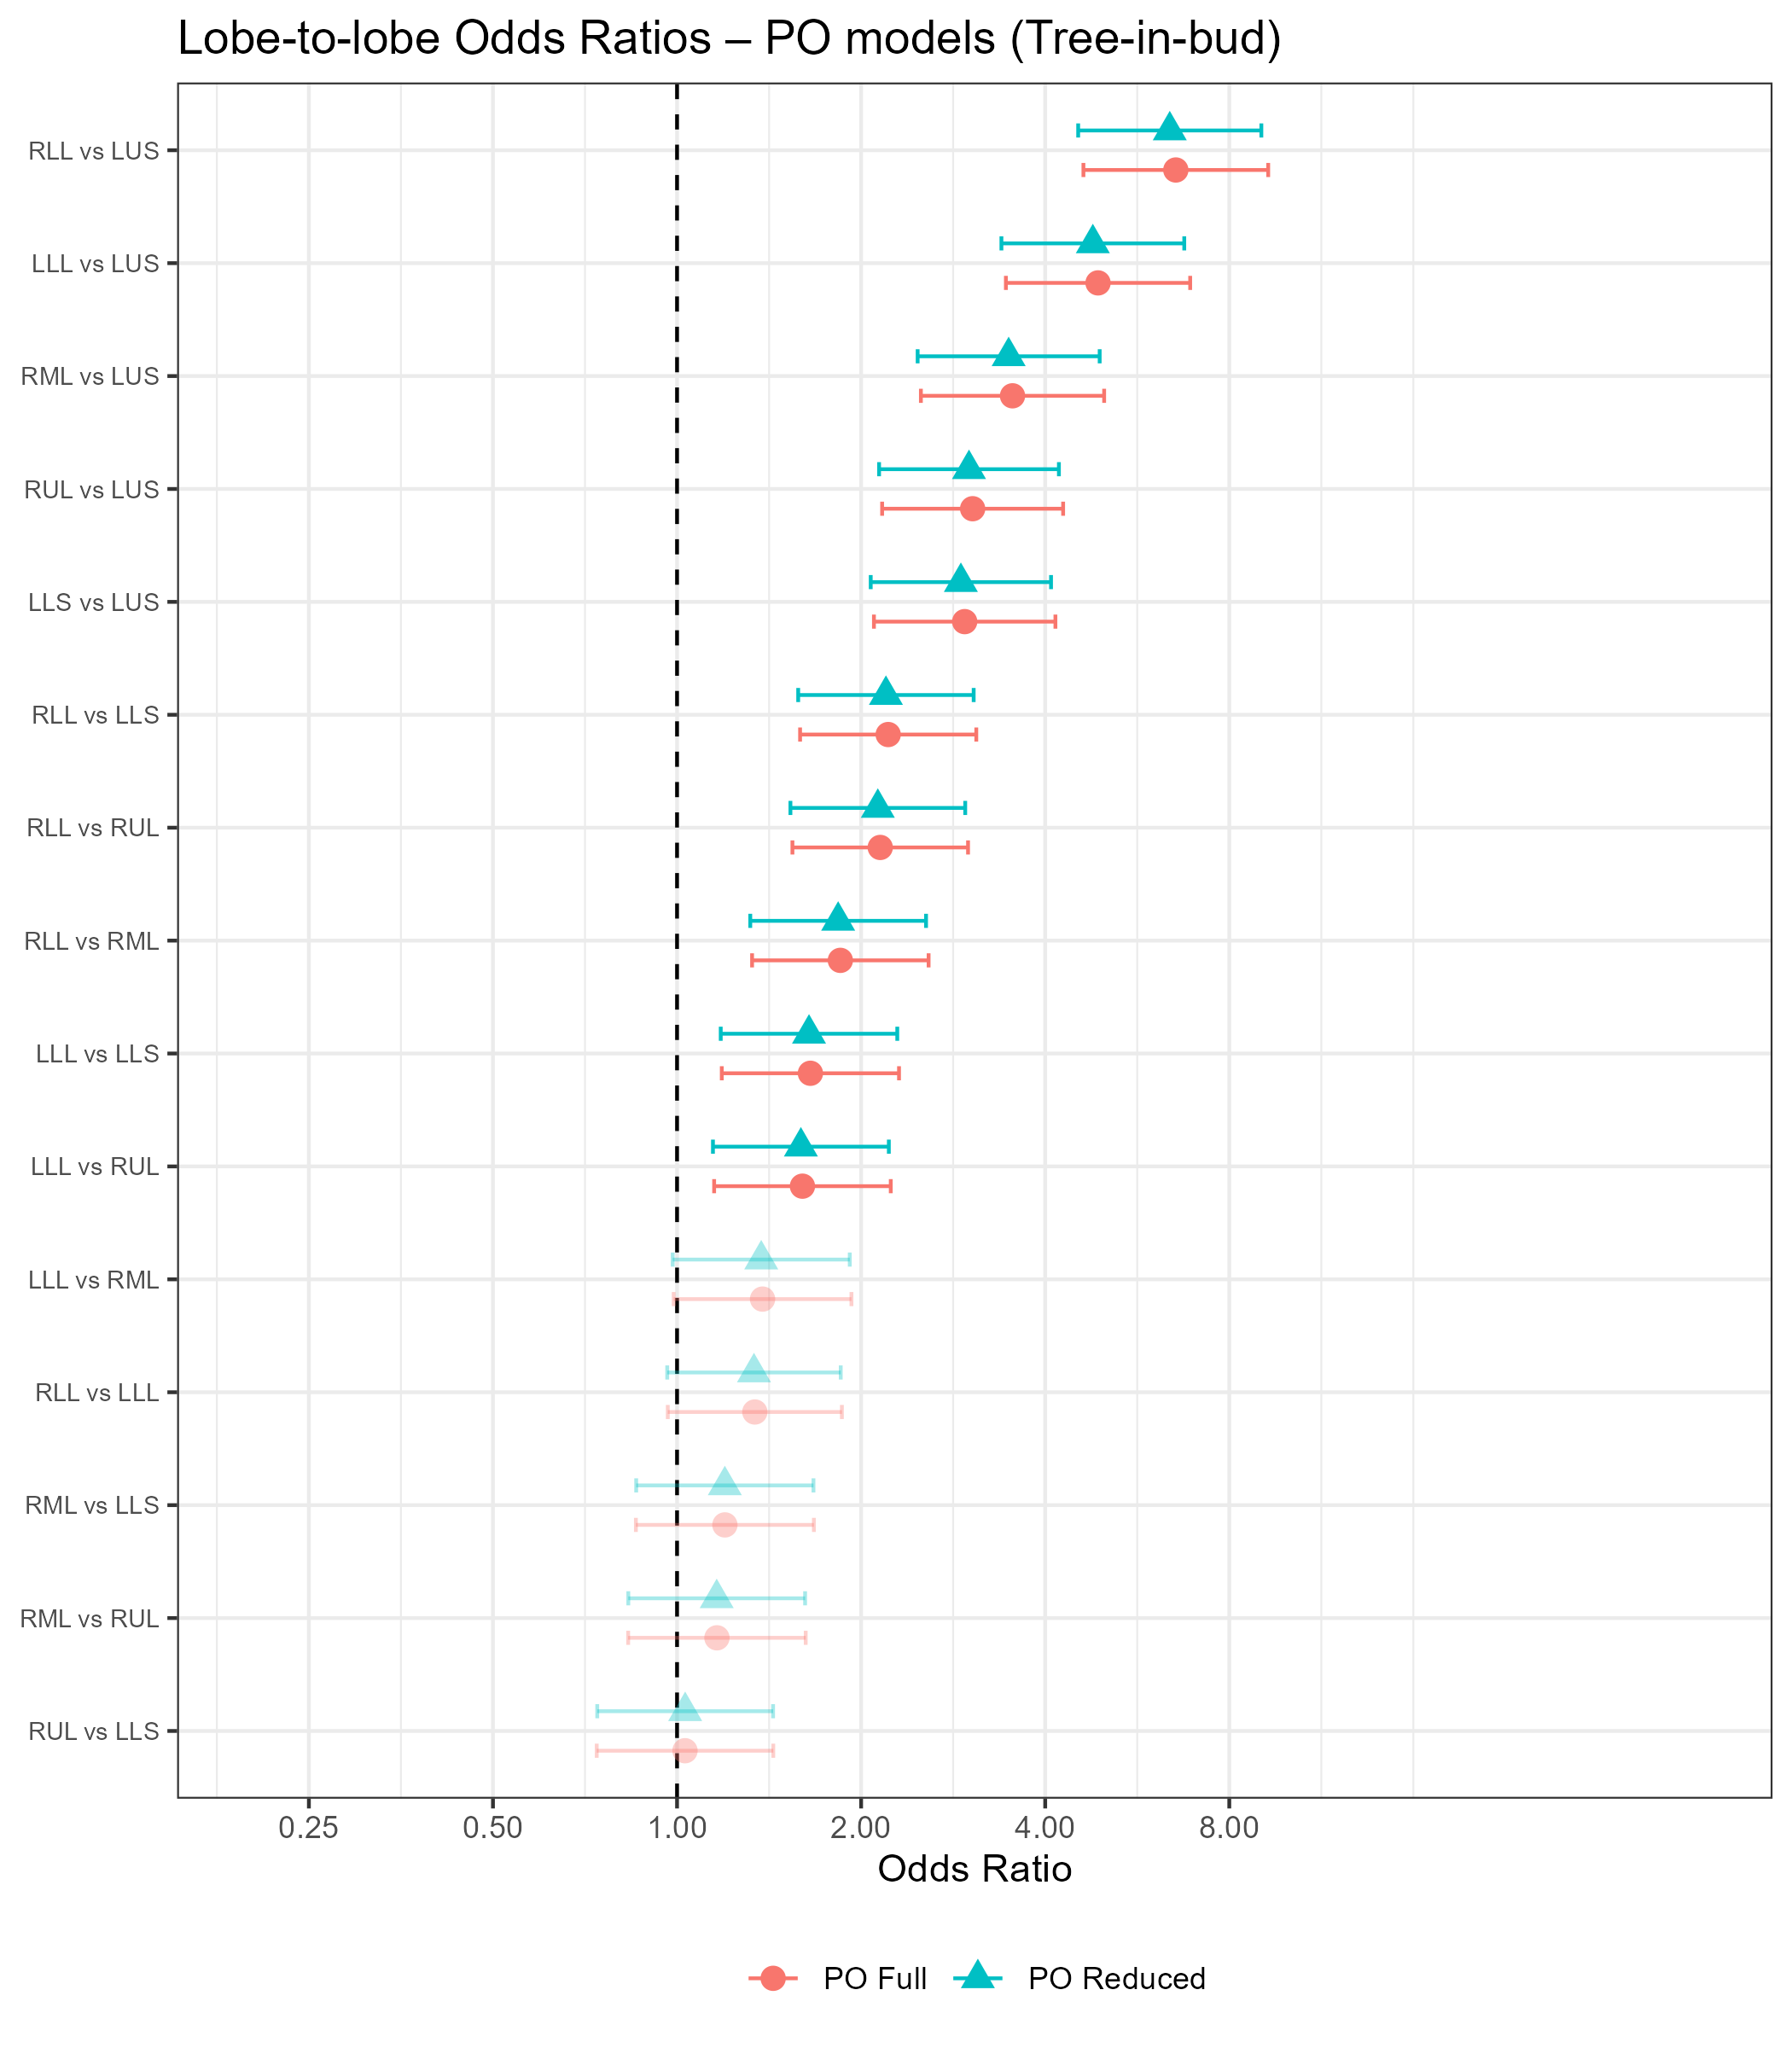
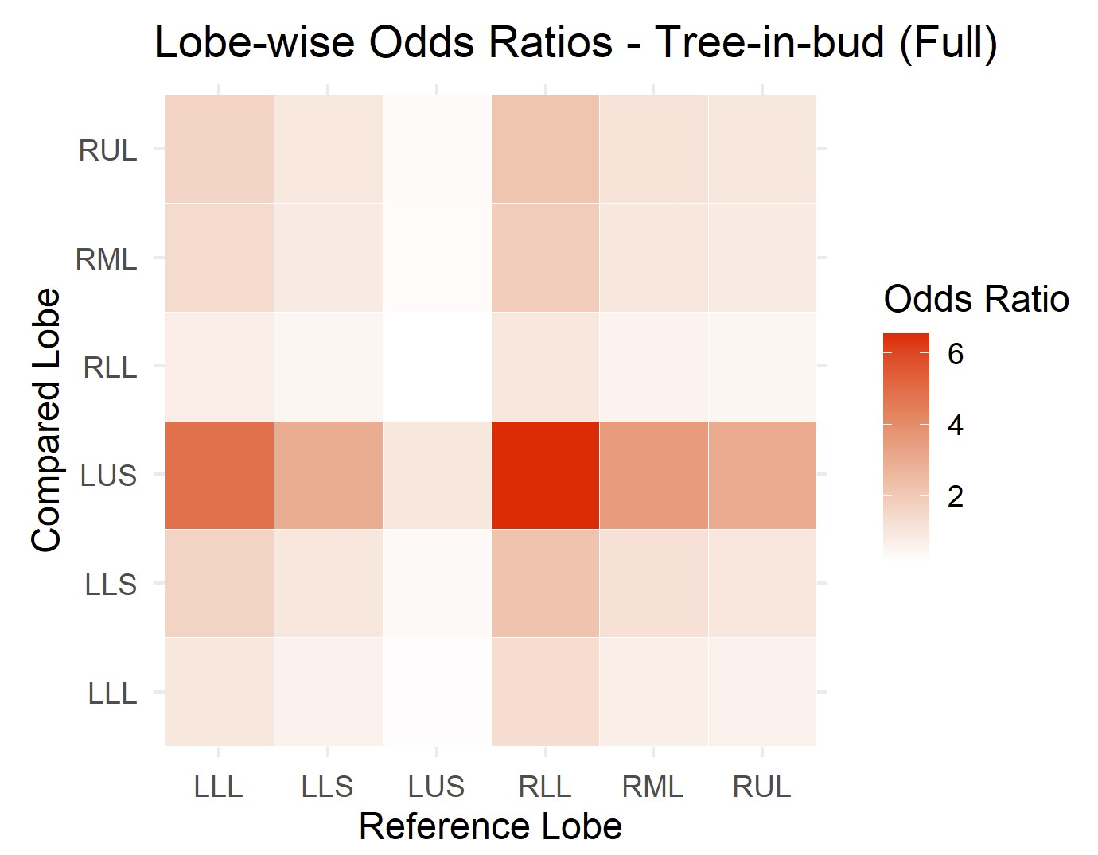
Results – Lobe Comparisons
Tree-in-bud Opacities
RLL and LLL significantly greater severity than LUS, lingula, RUL

Slide 35
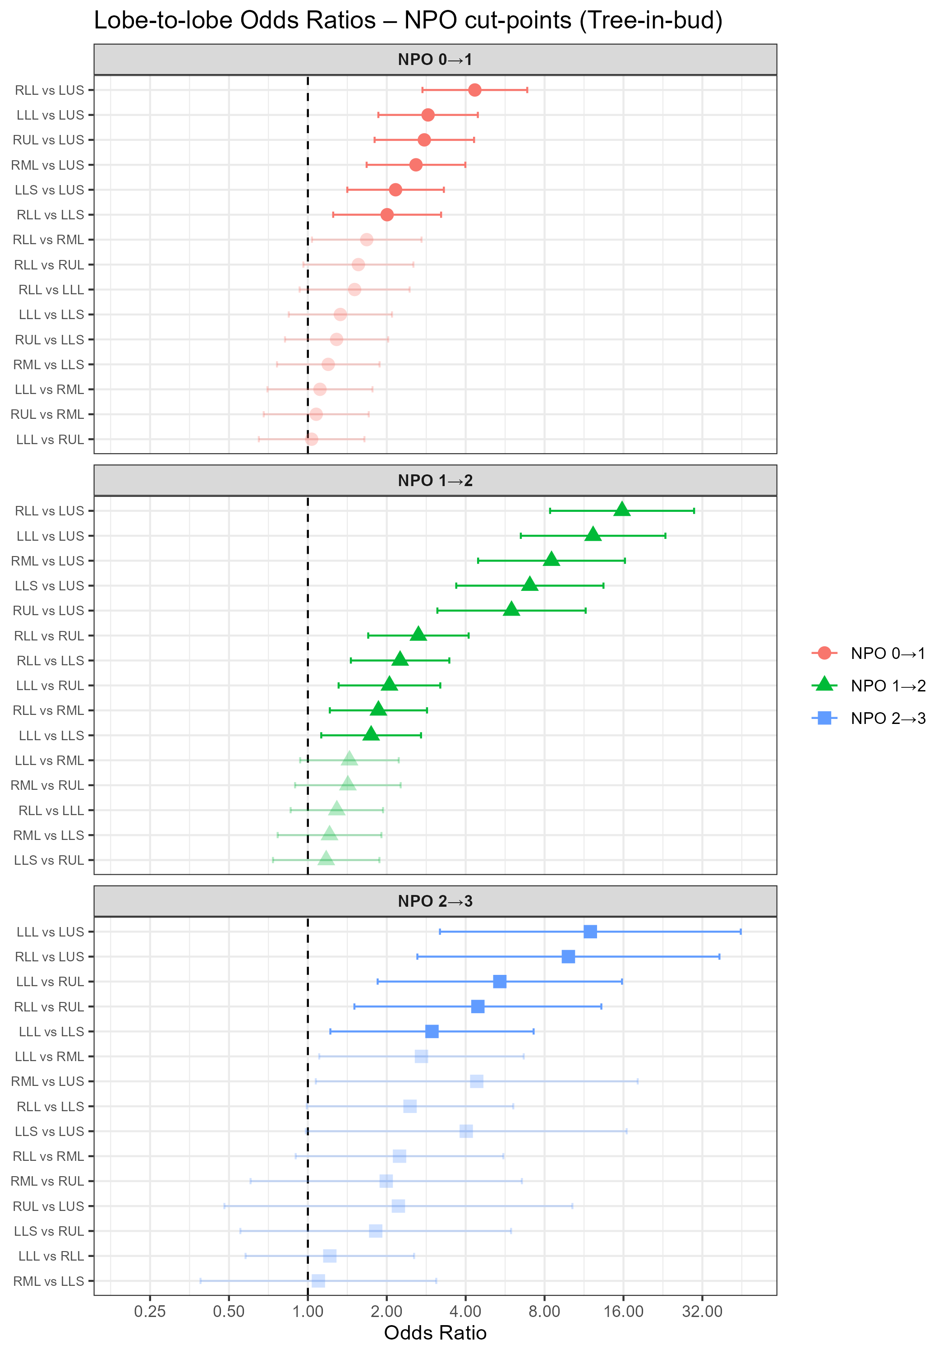
Results – Lobe Comparisons
Tree-in-bud Opacities
RLL and LLL remain most significantly affected
OR CIs for 0|1 vs 1|2 cut-points do not overlap for RLL vs LUS, LLL vs LUS, and RML vs LUS
AIC for NPO model lower than PO model

Slide 36
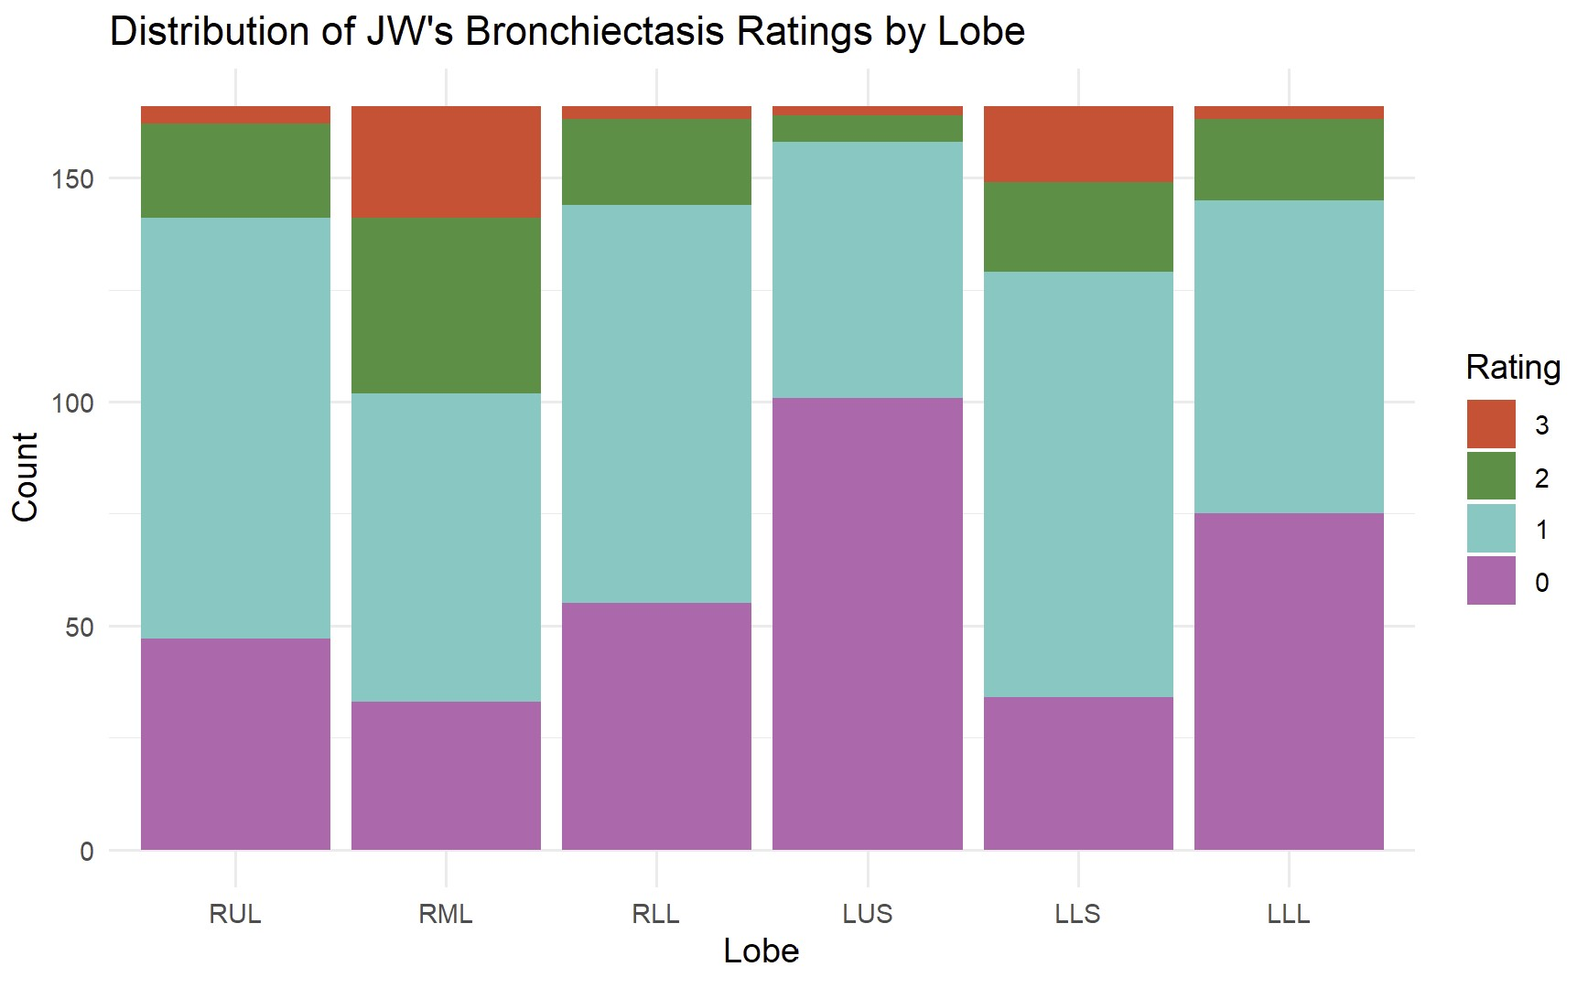
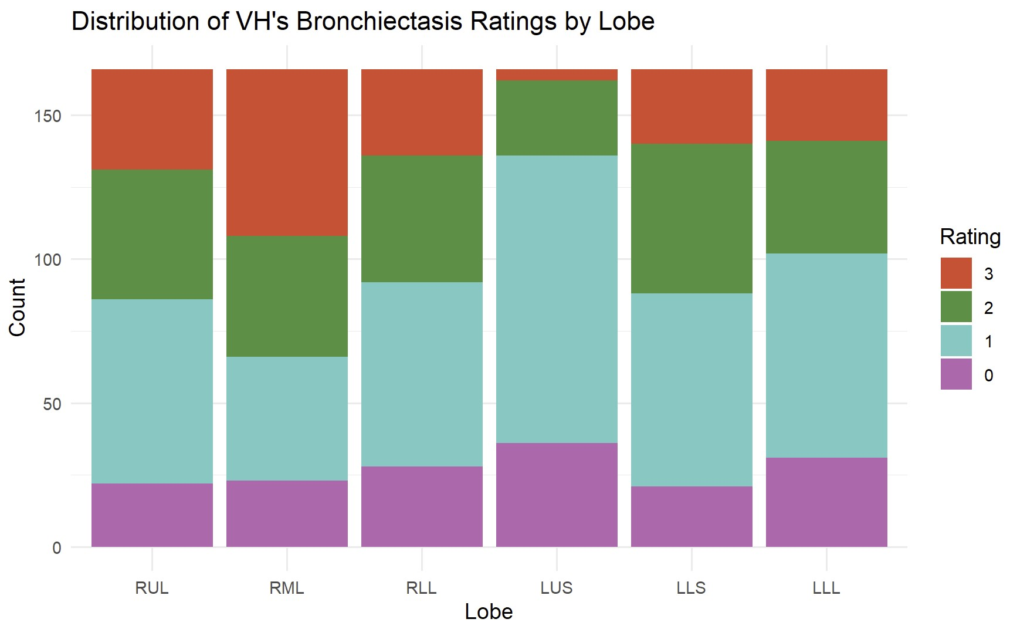
Results – Interrater Reliability
Feature | ICC (95% CI)
Bronchiectasis | 0.82 (0.74-0.90)
Consolidation | 0.85 (0.73-0.97)
Ground-Glass Opacities | 0.90 (0.80-1.00)
Tree-in-bud Opacities | 0.96 (0.90-1.00)

Slide 37
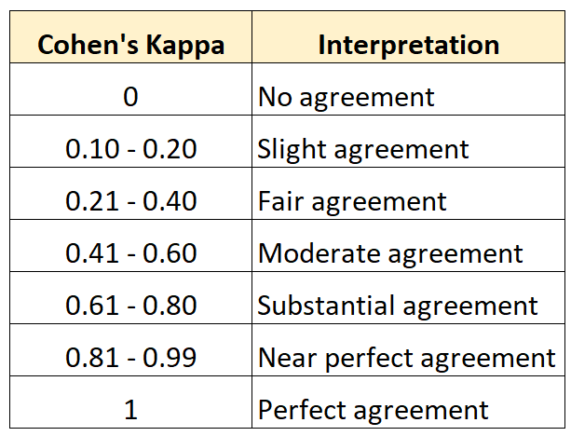
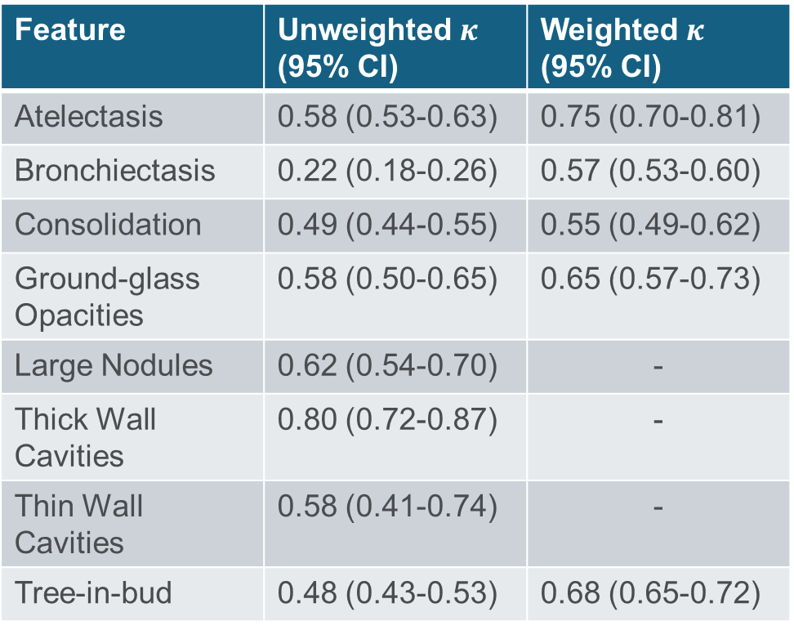
Results – Interrater Reliability
Feature | Unweighted $κ$ (95% CI) | Weighted $κ$ (95% CI)
Atelectasis | 0.58 (0.53-0.63) | 0.75 (0.70-0.81)
Bronchiectasis | 0.22 (0.18-0.26) | 0.57 (0.53-0.60)
Consolidation | 0.49 (0.44-0.55) | 0.55 (0.49-0.62)
Ground-glass Opacities | 0.58 (0.50-0.65) | 0.65 (0.57-0.73)
Large Nodules | 0.62 (0.54-0.70) | -
Thick Wall Cavities | 0.80 (0.72-0.87) | -
Thin Wall Cavities | 0.58 (0.41-0.74) | -
Tree-in-bud | 0.48 (0.43-0.53) | 0.68 (0.65-0.72)
Bobbitt, Zach. “Cohen’s Kappa Statistic: Definition & Example.” Statology, 10 May 2022, www.statology.org/cohens-kappa-statistic/.

Slide 38
Discussion

Slide 39
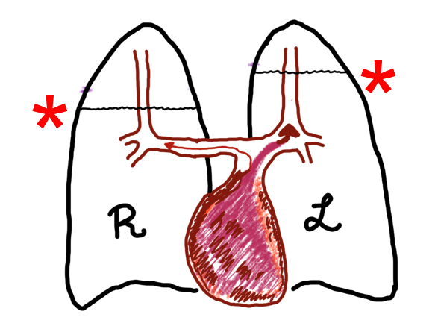
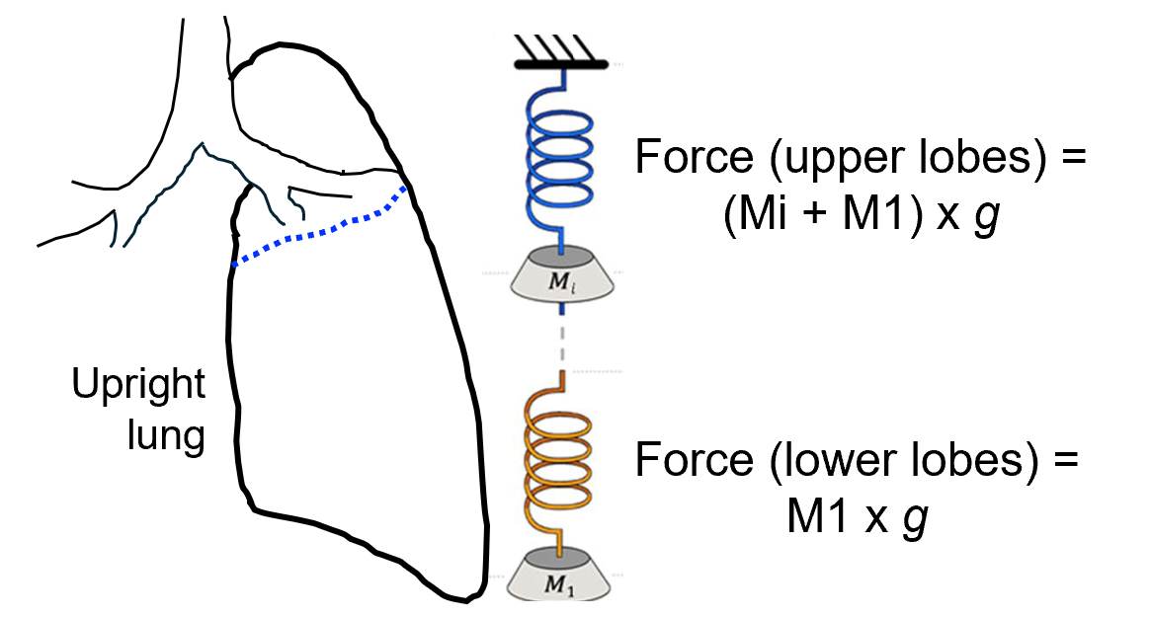
Discussion – Health Implications
Our results indicate that the RUL has greater severity of thick wall cavities than all other lobes
Dr. Edward Chan’s hypotheses/suggestions:
Upper lobes have decreased blood perfusion
Decreased flow of immune cells/antibiotics
Greater stress on lung tissue of upper lobes during inspiration
Weight of lower lobes
Refraining from intense exercise
Lying down when resting and receiving antibiotics
Lyu, Jiwon et al. Computed tomographic analysis of NTM lung disease reveals a surprising finding…but not for old-timer tuberculosis clinicians [poster]. Presented at: Colorado State University’s Nontuberculous Mycobacteria Conference; 2025 May; Fort Collins, CO.

Slide 40
Discussion – Limitations
Couldn’t fit full random effects structure for all models
Not fully accounting for all repeated measures per subject
Separate models fit for each feature
May not account for correlated scores between features
Low rater agreement for bronchiectasis
May require further examination
Referral bias
Patients were referred to the study by their primary care physicians
Results may not be generalizable to broader NTM-LD population

Slide 41
Acknowledgements
Thank you to Dr. Matthew Strand, Dr. Nichole Carlson, and Dr. Edward Chan!
This work would not have been possible without your guidance

Slide 42
Questions?

Slide 43
References
Bobbitt, Zach. “Cohen’s Kappa Statistic: Definition & Example.” Statology, 10 May 2022, www.statology.org/cohens-kappa-statistic/.
“Fissures & Lobes of Lungs.” Medico Apps, 17 Aug. 2020, medicoapps.org/fissures-lobes-of-lungs-2/.
Hansell DM, Bankier AA, MacMahon H, McLoud TC, Müller NL, Remy J. Fleischner Society: Glossary of Terms for Thoracic Imaging. Radiology. 2008 Mar;246(3):697–722
Hazelton TR, Newell JD, Cook JL, Huitt GA, Lynch DA. CT Findings in 14 Patients with Mycobacterium chelonae Pulmonary Infection. American Journal of Roentgenology. 2000 Aug;175(2):413–6.
Lee Y, Song JW, Chae EJ, Lee HJ, Lee CW, Do KH, et al. CT findings of pulmonary non-tuberculous mycobacterial infection in non-AIDS immunocompromised patients: a case-controlled comparison with immunocompetent patients. BJR. 2013 Apr;86(1024):20120209.
Moore EH. Atypical mycobacterial infection in the lung: CT appearance. Radiology. 1993 Jun;187(3):777–82.
Reich JM, Johnson RE. Mycobacterium avium Complex Pulmonary Disease Presenting as an Isolated Lingular or Middle Lobe Pattern. Chest. 1992 Jun;101(6):1605–9.

Slide 44
Appendix – Supplementary Information

Slide 45
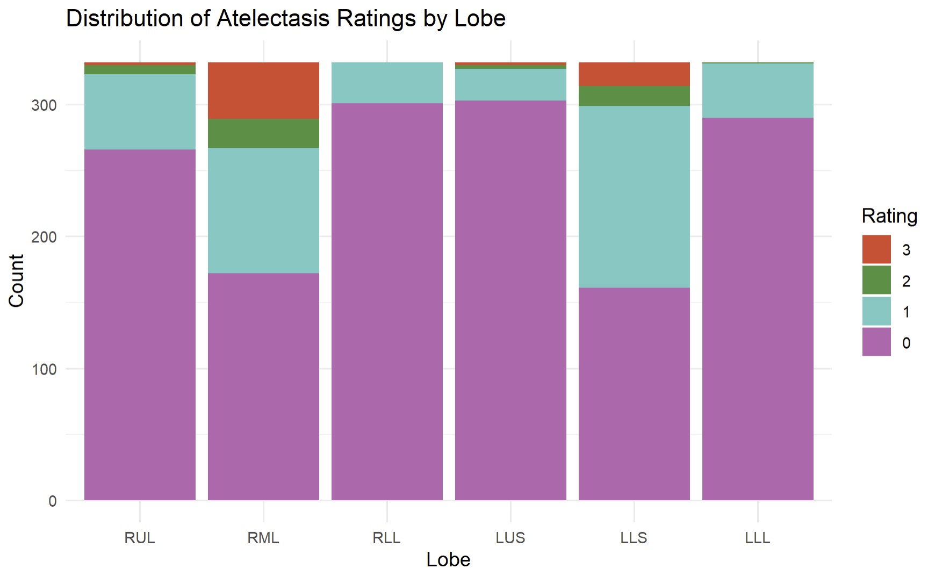
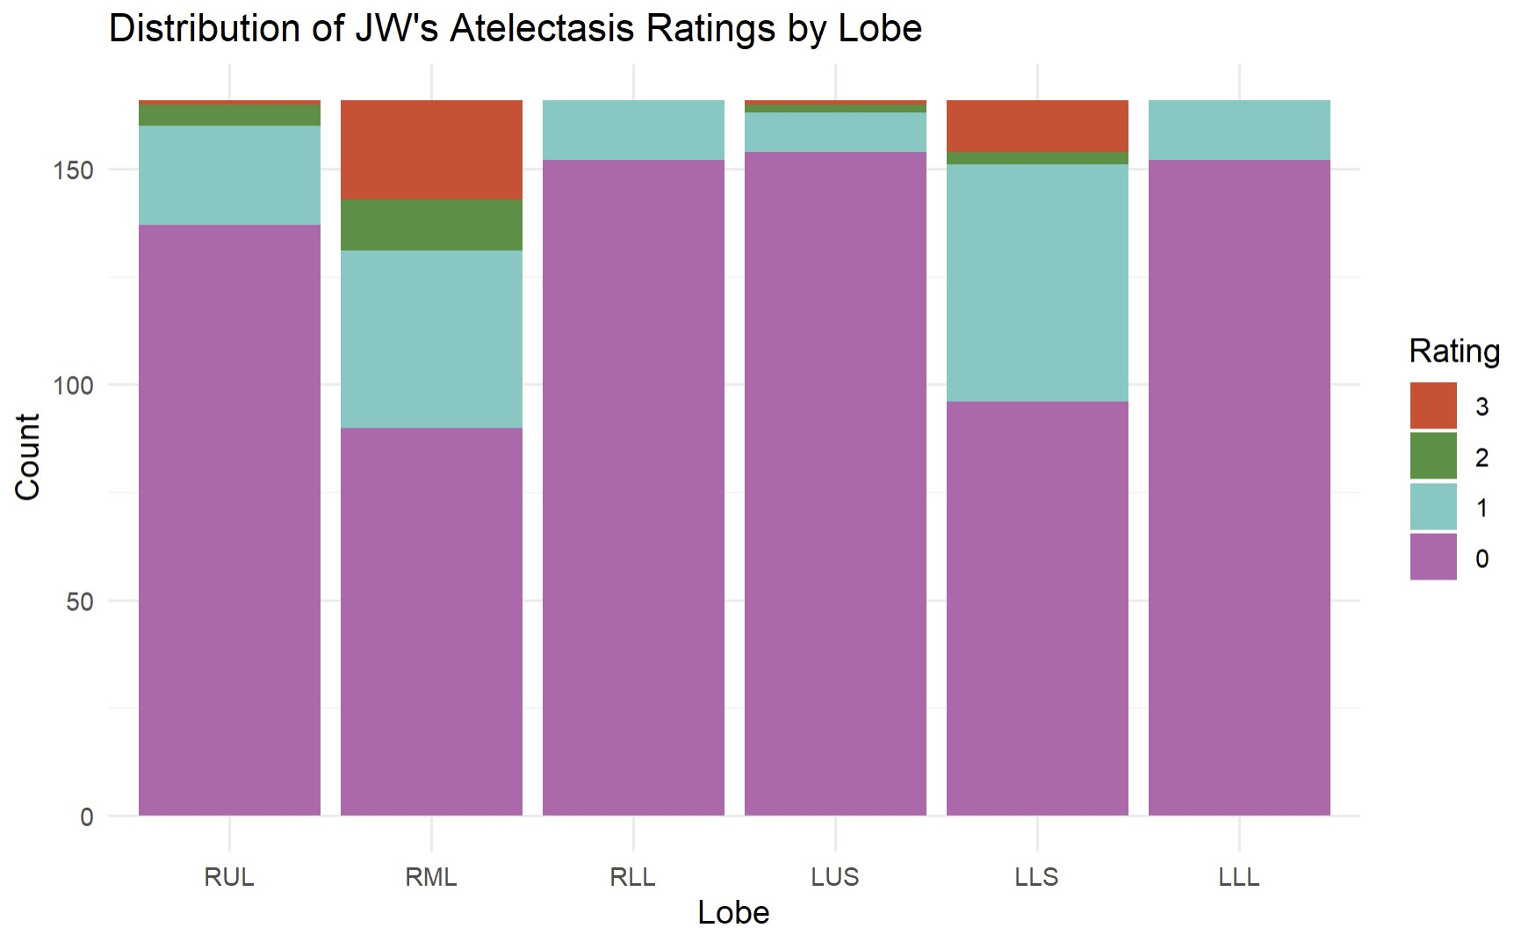
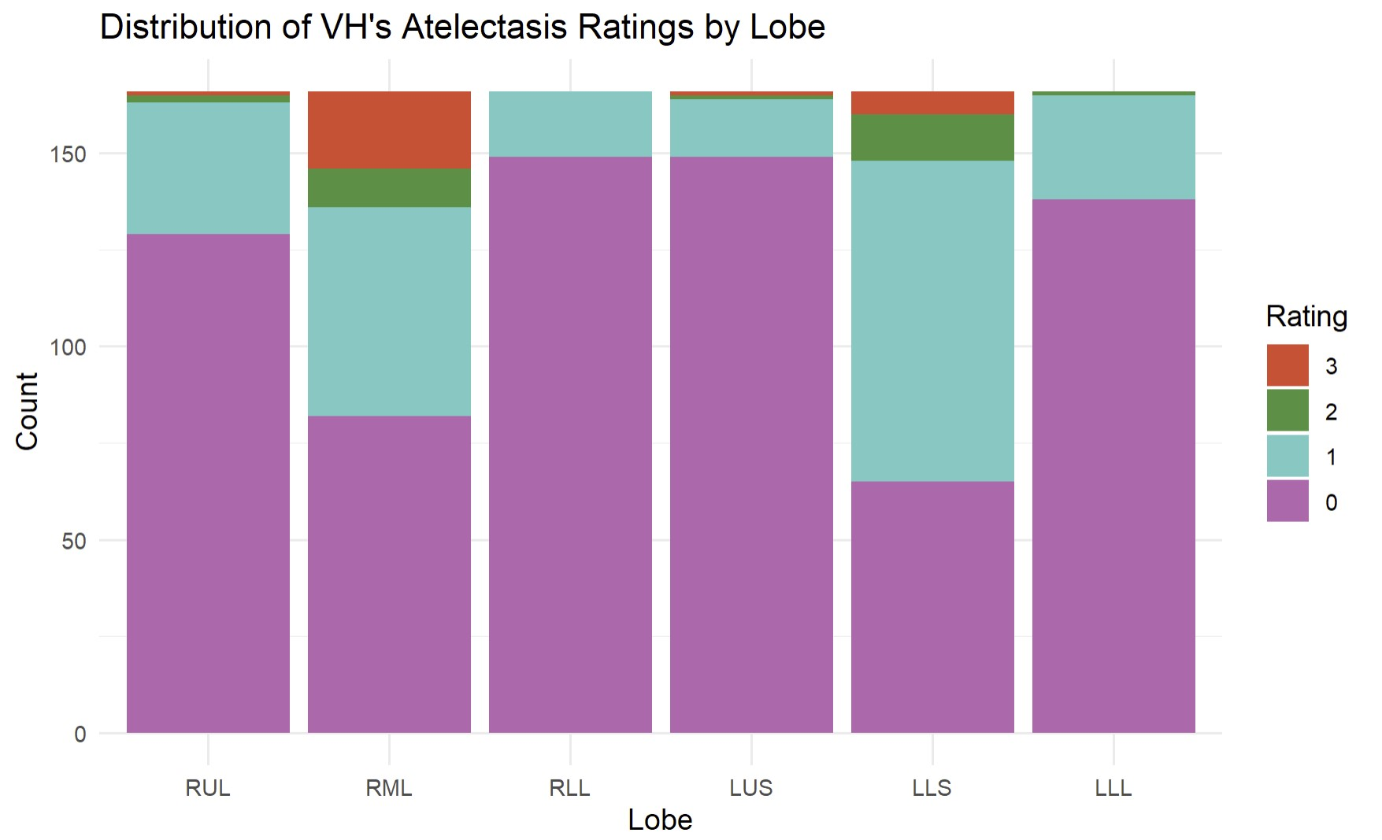
Raw Scores – Atelectasis

Slide 46
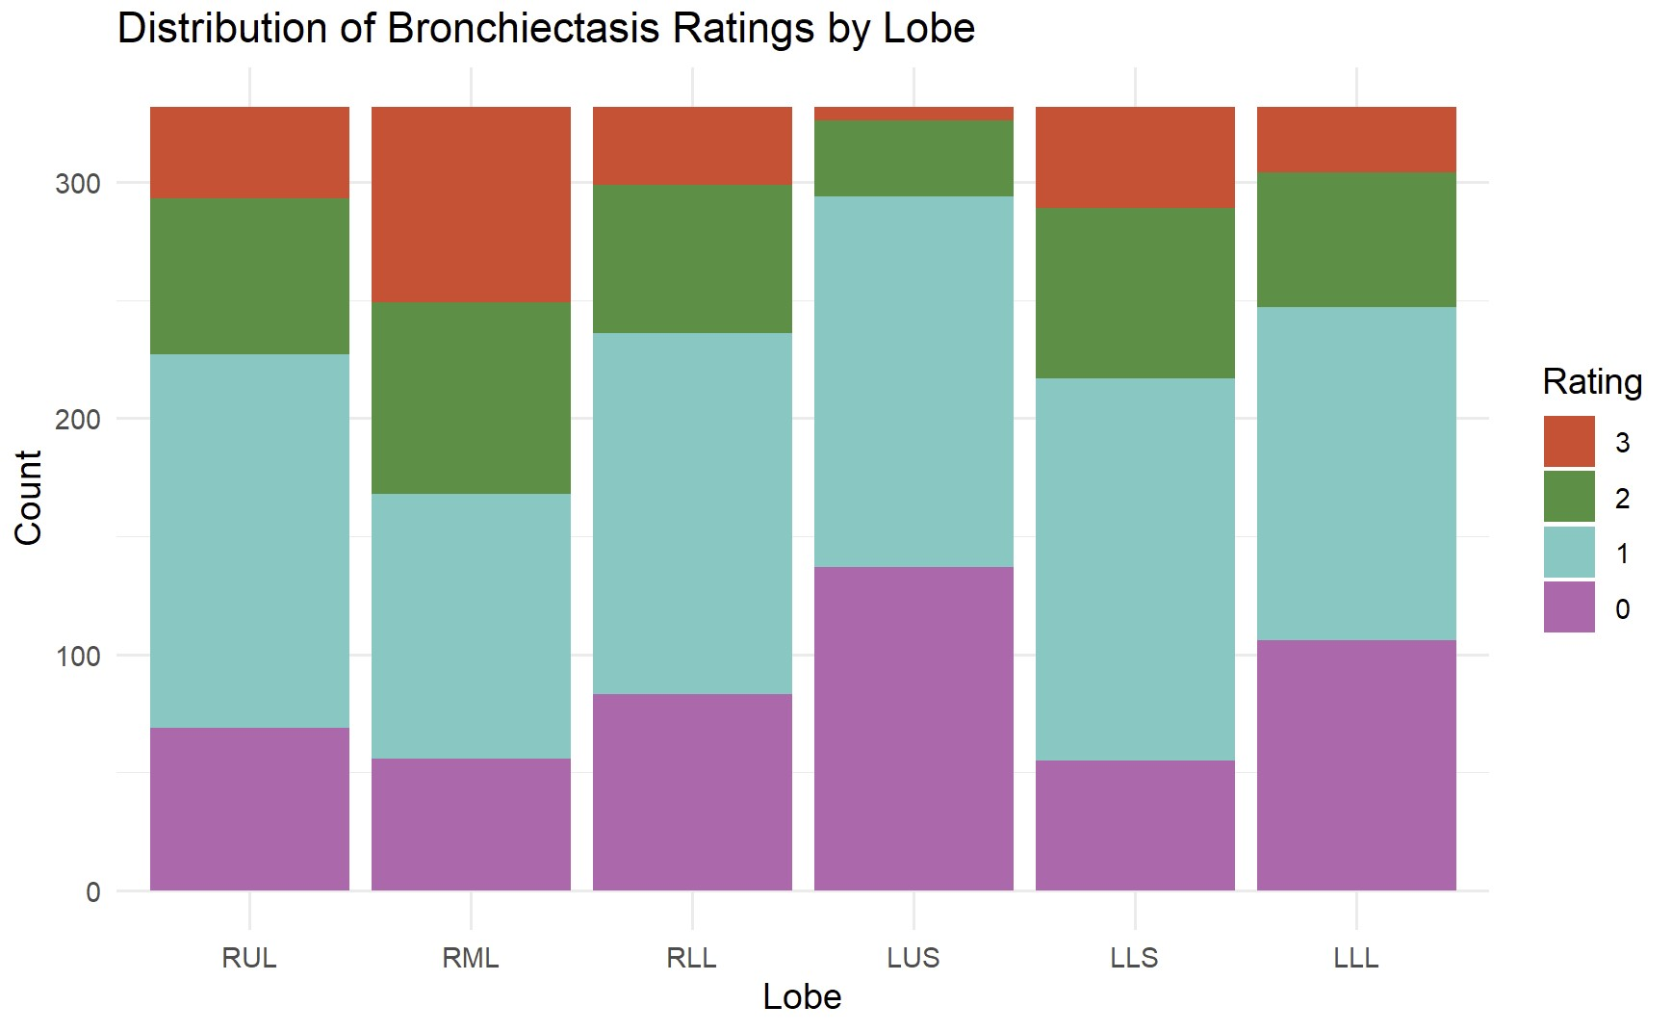
Raw Scores – Bronchiectasis

Slide 47
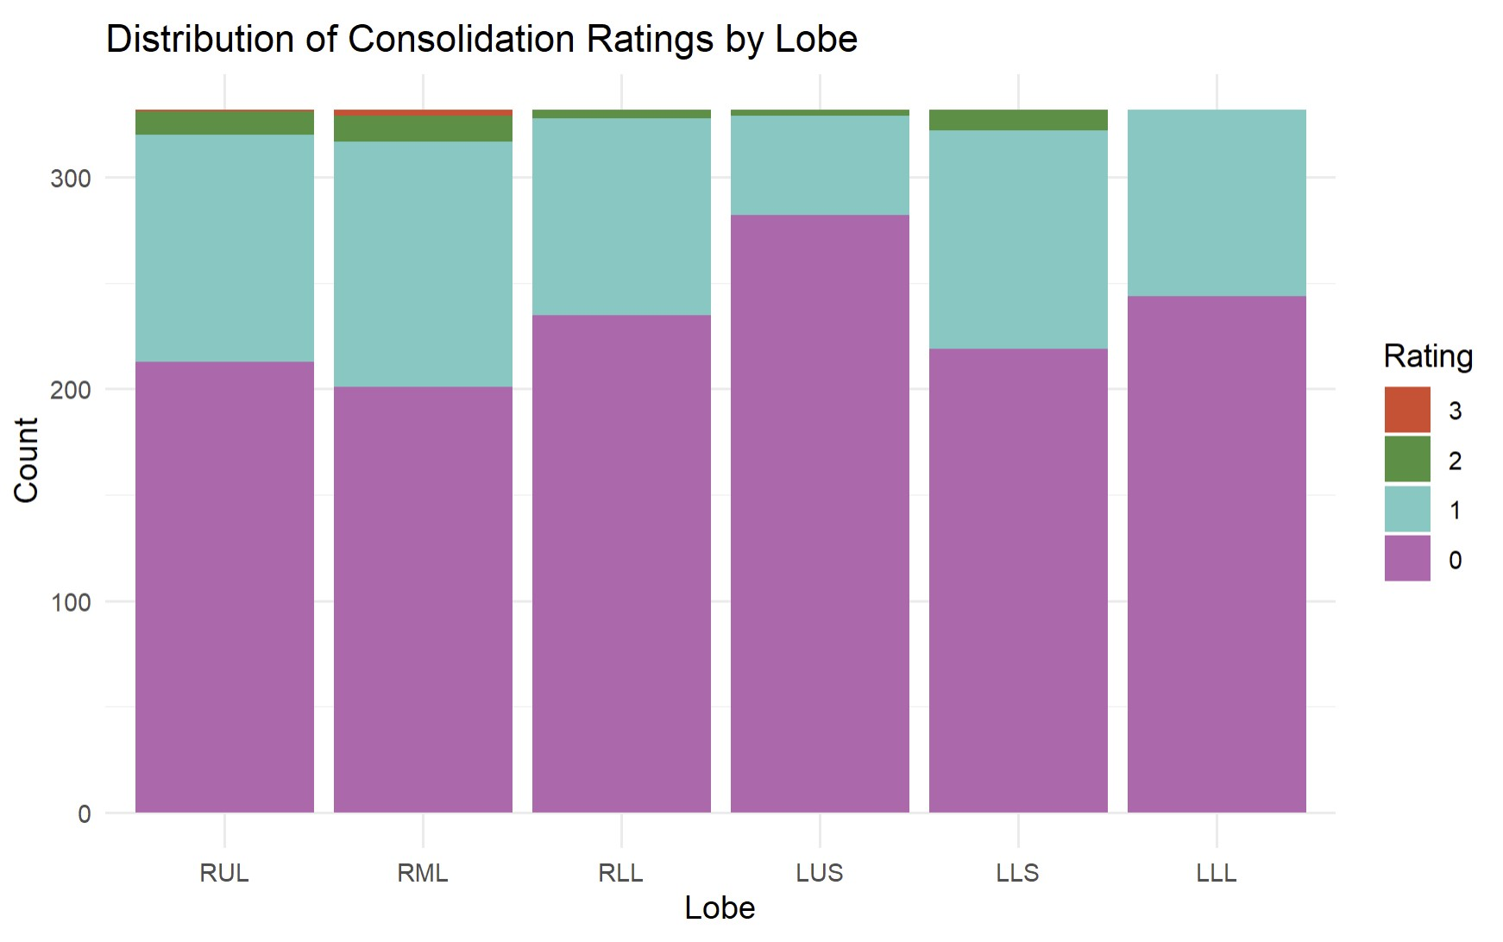
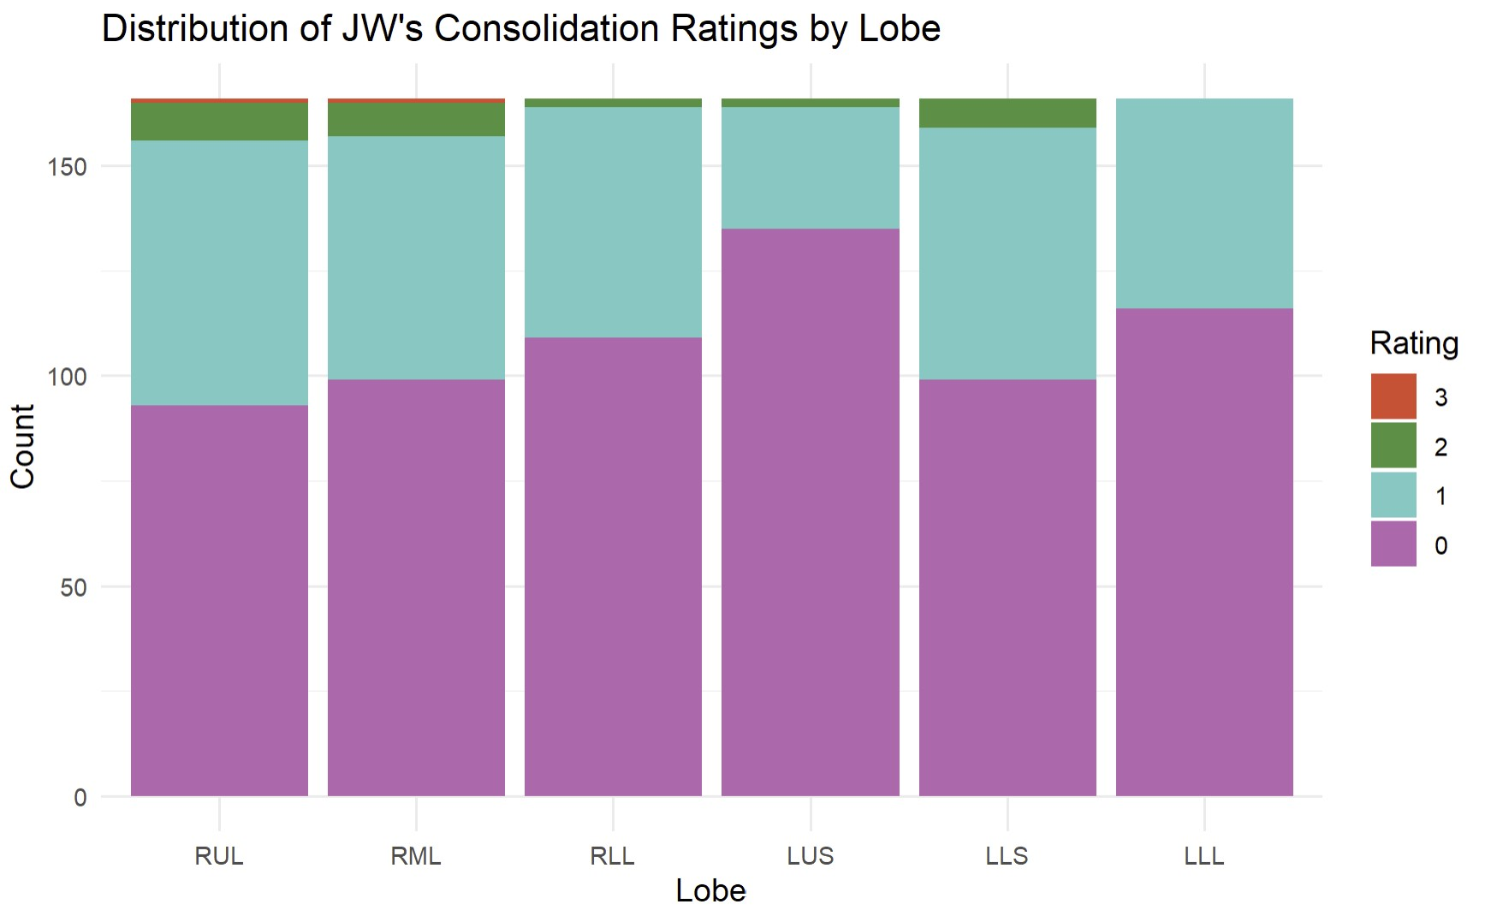
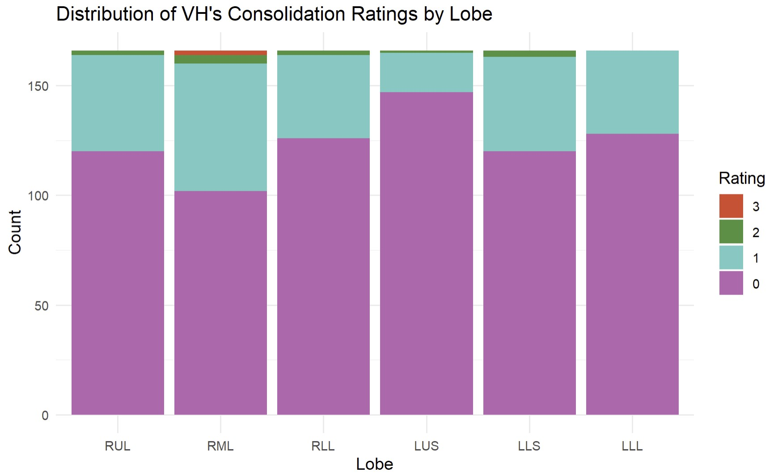
Raw Scores – Consolidation

Slide 48
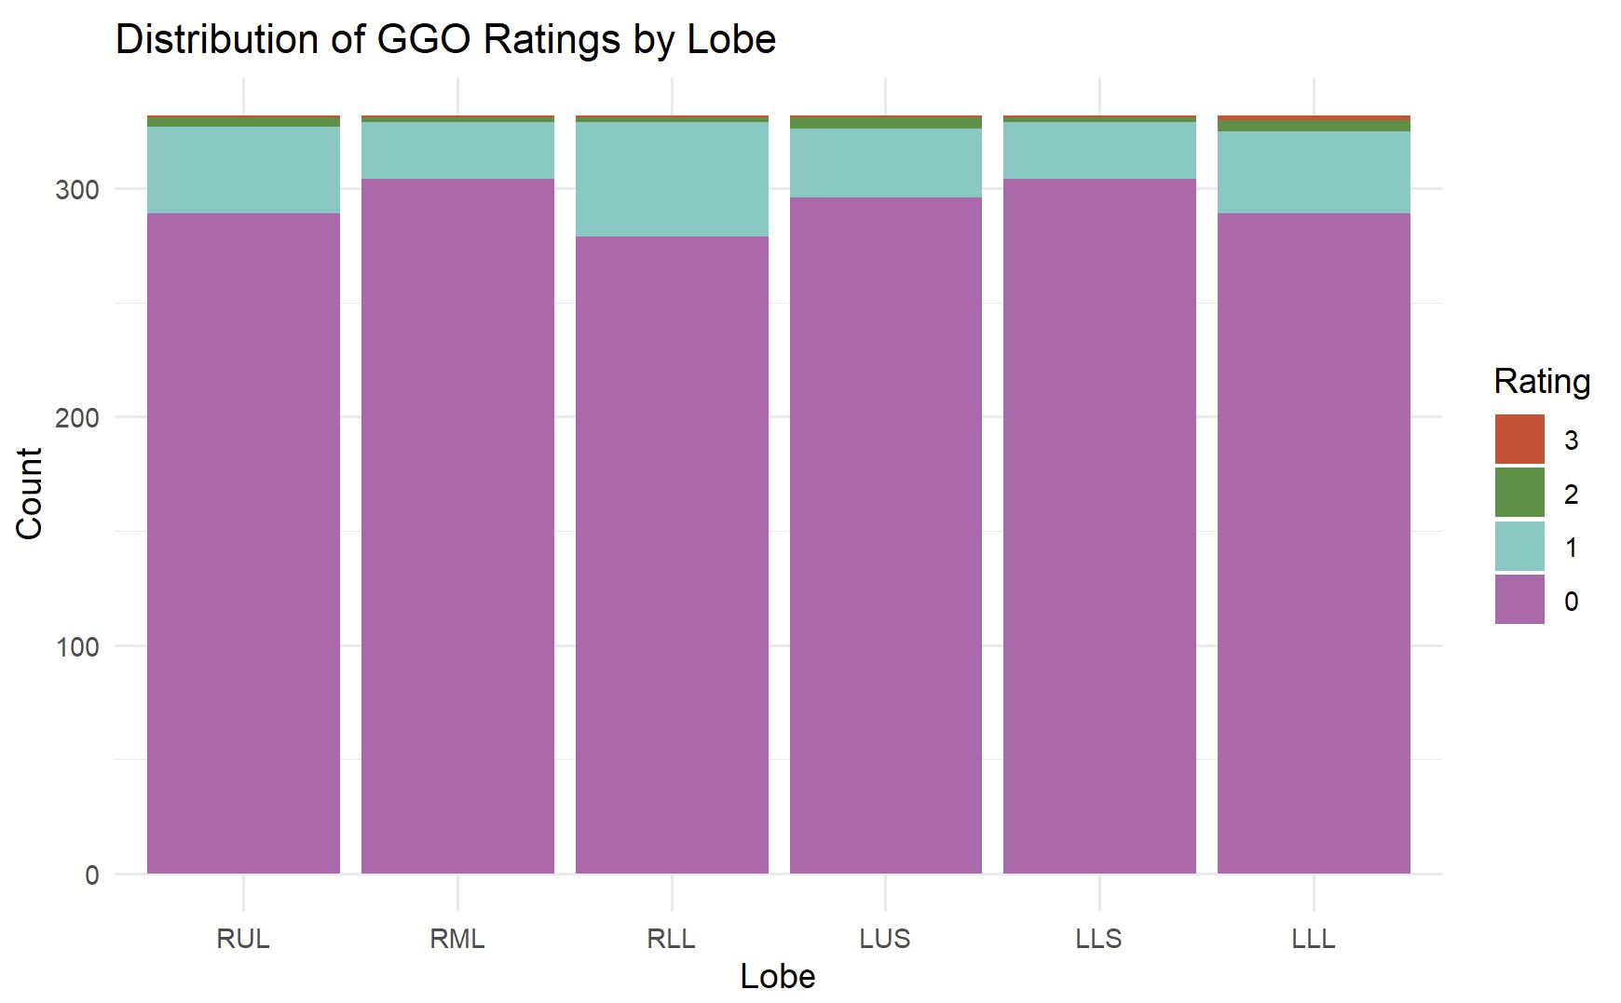
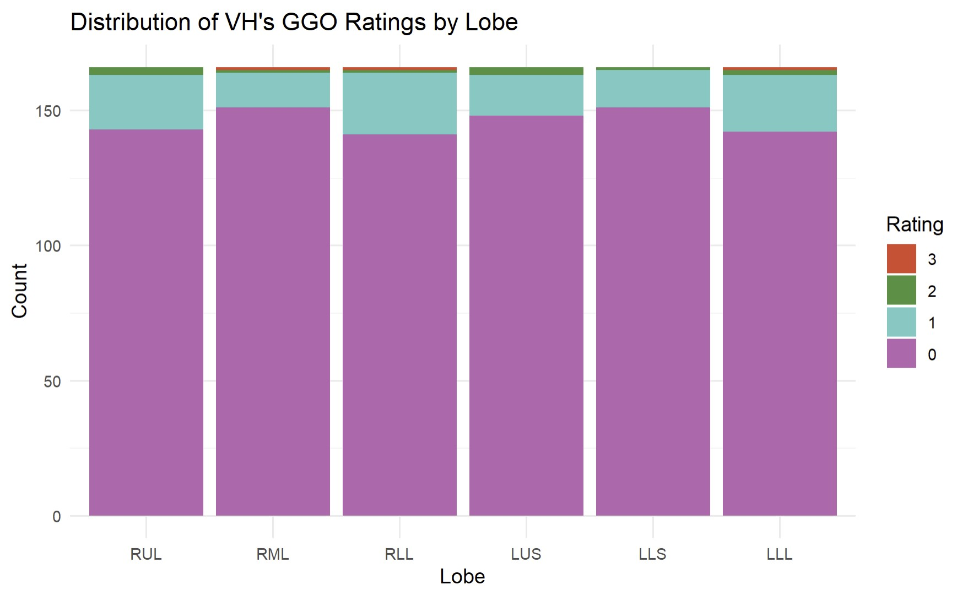
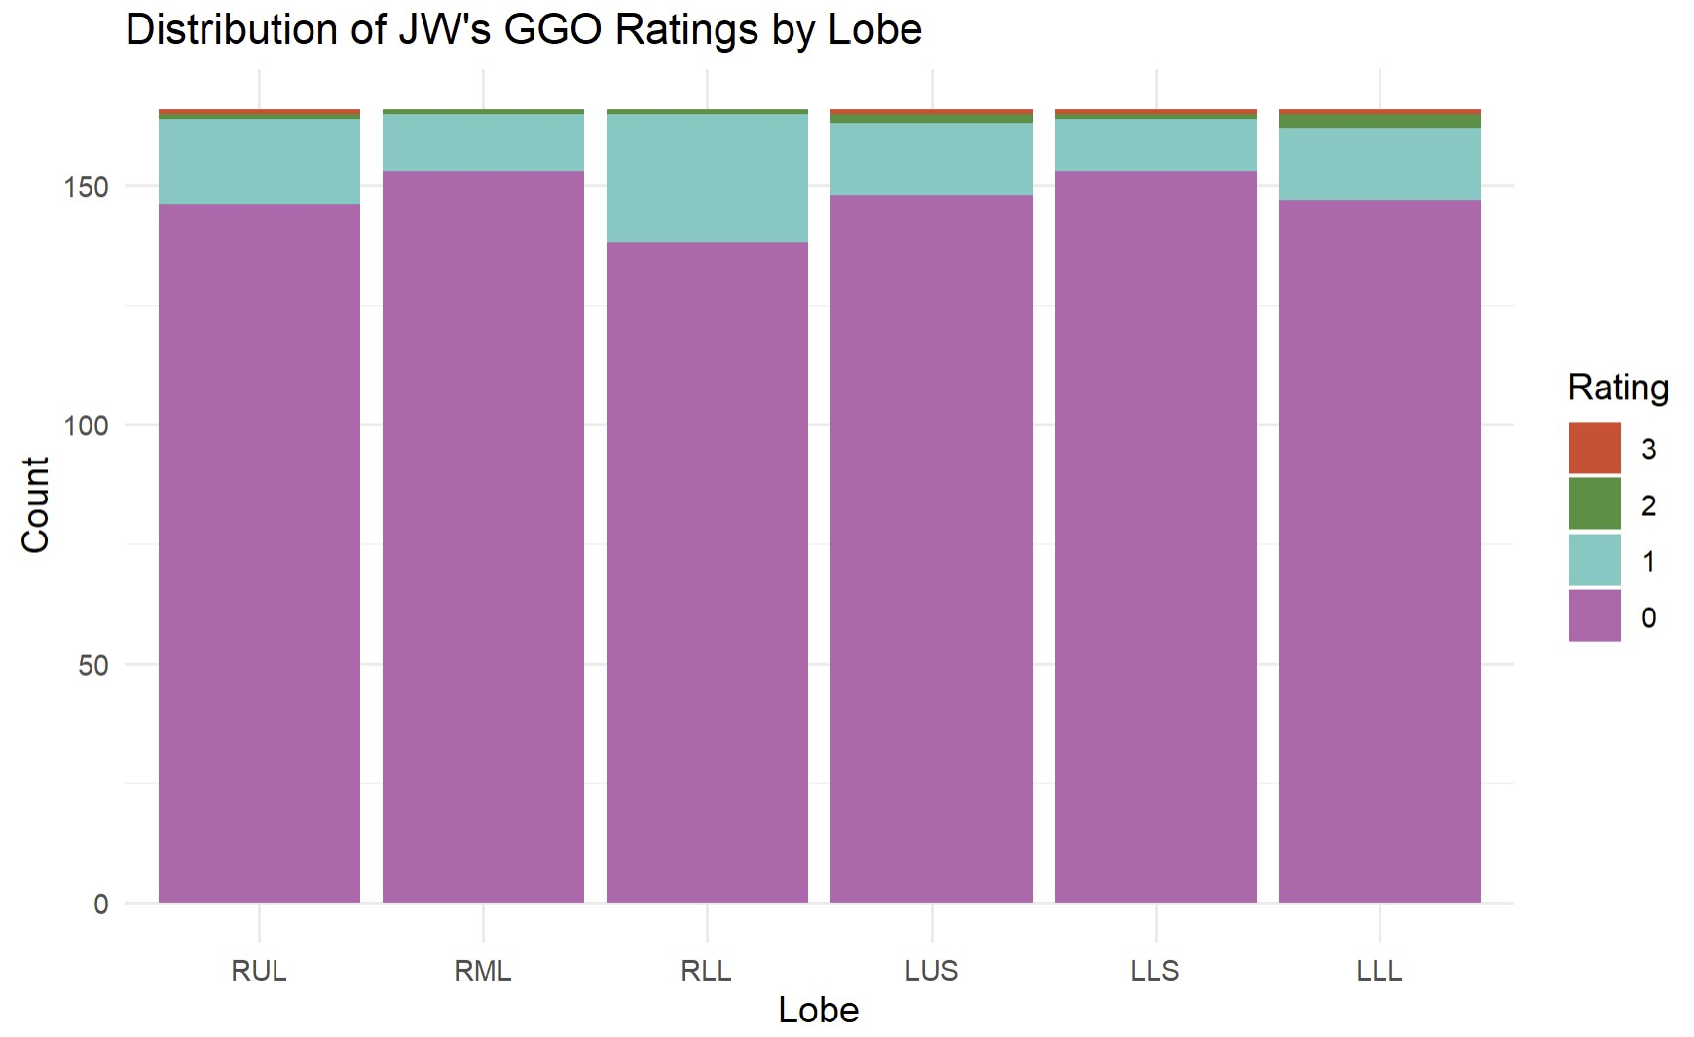
Raw Scores – Ground-Glass Opacities

Slide 49



Raw Scores – Large Nodules

Slide 50



Raw Scores – Thick Wall Cavities

Slide 51



Raw Scores – Thin Wall Cavities

Slide 52



Raw Scores – Tree-in-bud

Slide 53

Model Parameter Estimates – Atelectasis

Slide 54



Model Parameter Estimates – Bronchiectasis
NPO
Full
Reduced

Slide 55


Model Parameter Estimates – Consolidation
Full
Reduced

Slide 56


Model Parameter Estimates – Ground-Glass Opacities
Full
Reduced

Slide 57

Model Parameter Estimates – Large Nodules

Slide 58

Model Parameter Estimates – Thick Wall Cavity

Slide 59

Model Parameter Estimates – Thin Wall Cavity

Slide 60



Model Parameter Estimates – Tree-in-bud
Full
Reduced
NPO

Slide 61

Methods – Multiple Testing Correction
FDR method proposed by Benjamini and Hochberg
Suppose we test $H_{1},H_{2}, …, H_{m}$ based on corresponding p-values $P_{1},P_{2},…, P_{m}$, let $P_{(1)}, P_{(2)},…, P_{(m)}$ be the ordered p-values, and let $H_{(i)}$ be the null hypothesis corresponding to $P_{(i)}$. The following procedure controls the FDR at $q^{∗}$: let $k$ be the largest $i$ for which $P_{(i)}≤\frac{i}{m}q^{∗}$, then reject all $H_{(i)}, i=1, 2, …, k$,
$q^{∗}=α=0.05$, so our FDR-corrected p-values are thus $p_{(i)}^{FDR}=\frac{m}{i}P_{(i)}$, and hypotheses with $p_{(i)}^{FDR}<0.05$were determined to be significant.
Benjamini Y, Hochberg Y. Controlling the False Discovery Rate: A Practical and Powerful Approach to Multiple Testing. Journal of the Royal Statistical Society Series B: Statistical Methodology. 1995 Jan 1;57(1):289–300

Slide 62

Methods – Interrater Reliability
CIs determined through delta method described in Casella & Berger (2002)
Let $T_{1}, …, T_{k}$ be random variables with means $θ_{1}, …, θ_{k}$ and let $T=\left(T_{1}, …, T_{k}\right)$ and $θ=(θ_{1}, …, θ_{k})$. For a differentiable function $g(T)$, an approximate estimate of the variance is given by
$$Var_{θ}g\left(T\right)≈\sum_{i=1}^{k}{{\left[g_{i}^{′}\left(θ\right)\right]}^{2}Var_{θ}T_{i}}+2\sum_{i>j}{g_{i}^{′}\left(θ\right)g_{j}^{′}\left(θ\right)Cov_{θ}(T_{i},T_{j})}$$
We have $k=2$ parameters, where $T_{1}$ is our estimate for $σ_{subject}^{2}$, $T_{2}$ is our estimate for $σ_{rater}^{2}$, and $g\left(T\right)=\frac{T_{1}}{T_{1}+ T_{2}}$ is our estimate for ICC. We thus have that $g_{1}^{′}\left(θ\right)=\frac{∂g}{∂T_{1}}= \frac{T_{2}}{{\left(T_{1}+T_{2}\right)}^{2}}=A$ and $g_{2}^{′}\left(θ\right)=\frac{∂g}{∂T_{2}}= \frac{−T_{1}}{{\left(T_{1}+T_{2}\right)}^{2}}=B$,
$$Var_{θ}g\left(T\right)≈{\left(A\right)}^{2}Var_{θ}T_{1}+{\left(B\right)}^{2}Var_{θ}T_{2}+2 (A)(B)Cov(T_{1},T_{2})$$
Casella G, Berger RL. Statistical inference. 2nd ed. Australia ; Pacific Grove, CA: Thomson Learning; 2002. 660 p.

