Slide 1
Logistic and Ordinal Logistic Modeling of Computed Tomography Features Associated with Non-Tuberculous Mycobacteria Lung Disease
Edward Bosko
July 2, 2025
Notes:
Welcome

Slide 2
Introduction

Slide 3
Intro – Disease Overview
Non-tuberculous mycobacteria lung disease (NTM-LD)
Chronic infection of the lungs
Caused by inhalation of non-tuberculous mycobacteria (NTM)
Most NTM exposures do not lead to disease
Two main forms
Fibrocavitary
Nodular bronchiectasis
Associated with several radiographic features
Atelectasis, bronchiectasis, cavities, consolidation, ground-glass opacities, nodules, and tree-in-bud opacities

Slide 4
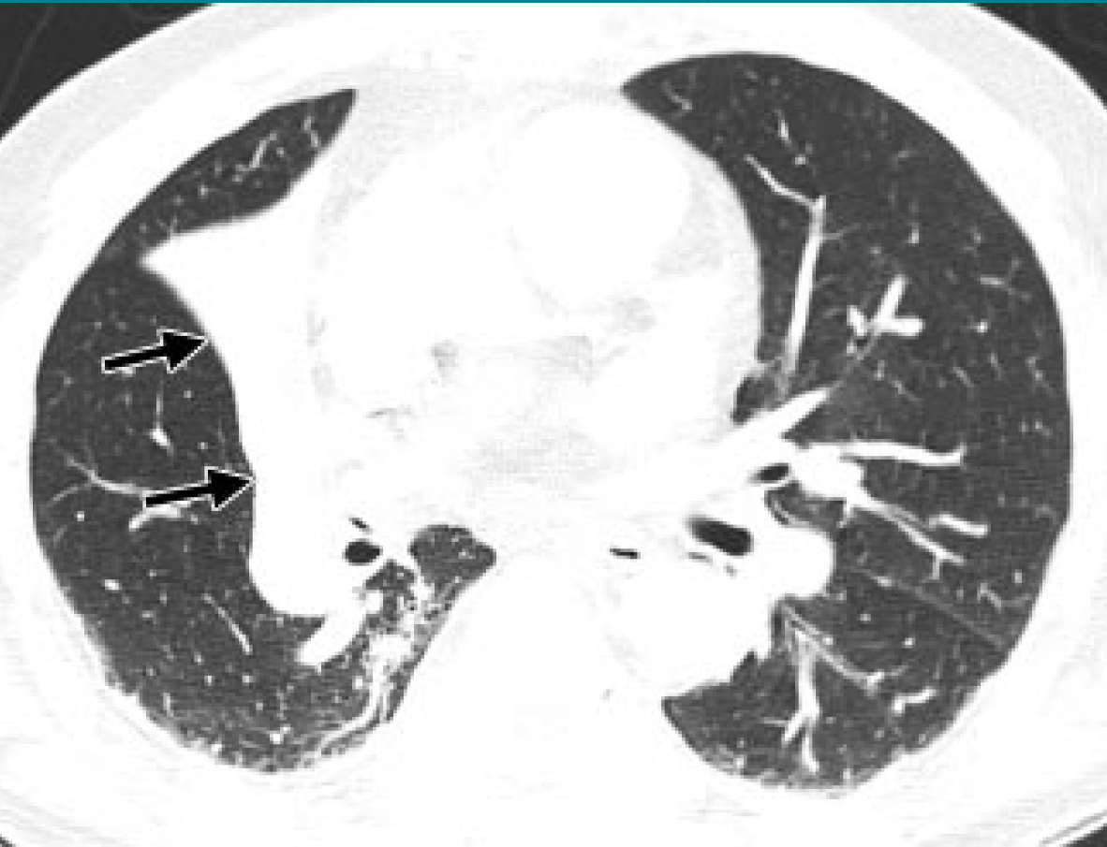
Intro – Disease Overview
Atelectasis
Collapse or reduction in inflation of lung
Identified by a reduction in volume and increase in opacity
CT scan on the right shows atelectasis of right middle lobe
Hansell DM, Bankier AA, MacMahon H, McLoud TC, Müller NL, Remy J. Fleischner Society: Glossary of Terms for Thoracic Imaging. Radiology. 2008 Mar;246(3):697–722

Slide 5
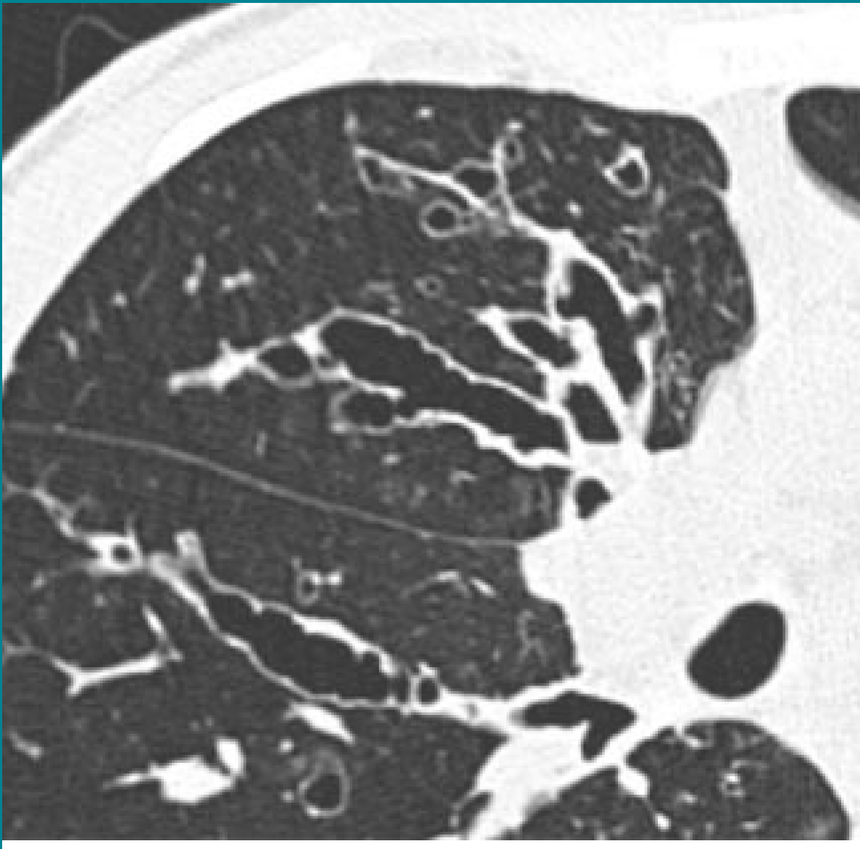
Intro – Disease Overview
Bronchiectasis
Permanent dilation of airways
Identified by widening and lack of tapering of airways
CT scan on the right shows varicose bronchiectasis
Hansell DM, Bankier AA, MacMahon H, McLoud TC, Müller NL, Remy J. Fleischner Society: Glossary of Terms for Thoracic Imaging. Radiology. 2008 Mar;246(3):697–722

Slide 6
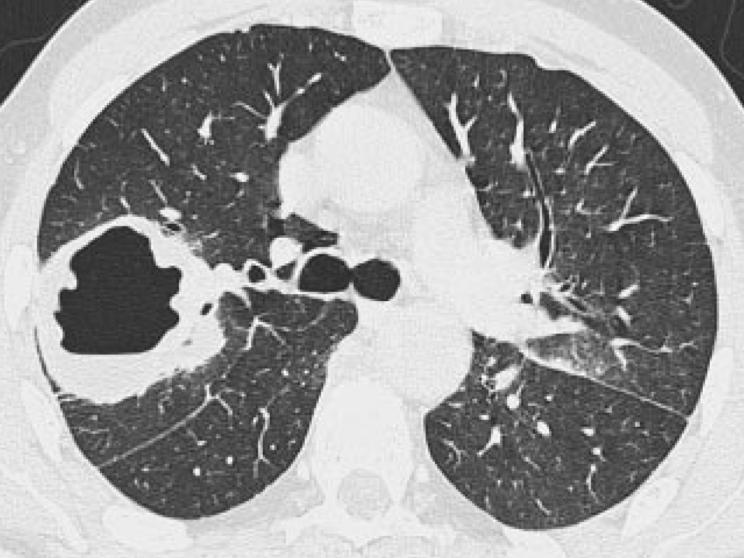
Intro – Disease Overview
Cavities
Gas-filled spaces within areas of consolidation, masses, or nodules
CT scan on right shows cavitating mass in right upper lobe
Hansell DM, Bankier AA, MacMahon H, McLoud TC, Müller NL, Remy J. Fleischner Society: Glossary of Terms for Thoracic Imaging. Radiology. 2008 Mar;246(3):697–722

Slide 7
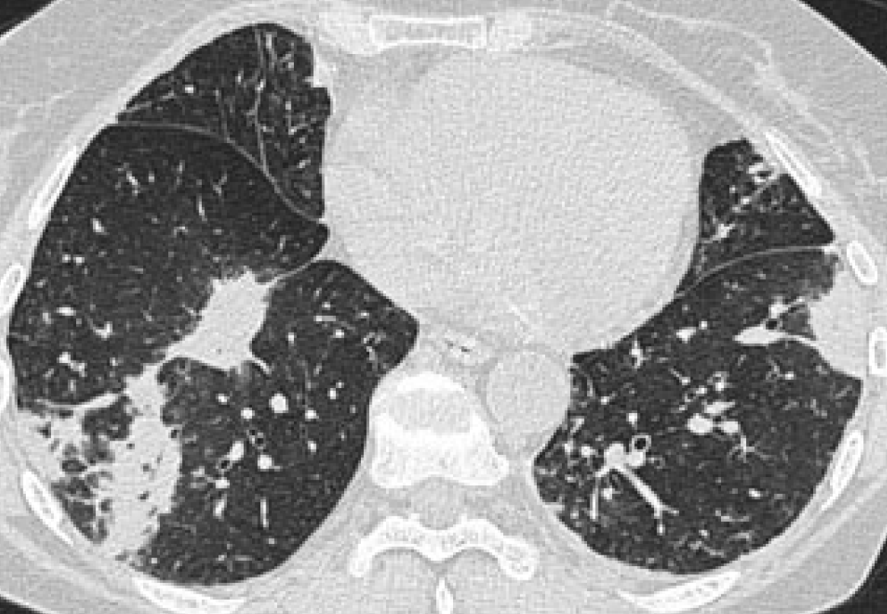
Intro – Disease Overview
Consolidation
Air in lung replaced by fluid or other disease byproduct
Renders lung “solid” looking
Appears as opaque areas in CT images
Hansell DM, Bankier AA, MacMahon H, McLoud TC, Müller NL, Remy J. Fleischner Society: Glossary of Terms for Thoracic Imaging. Radiology. 2008 Mar;246(3):697–722

Slide 8
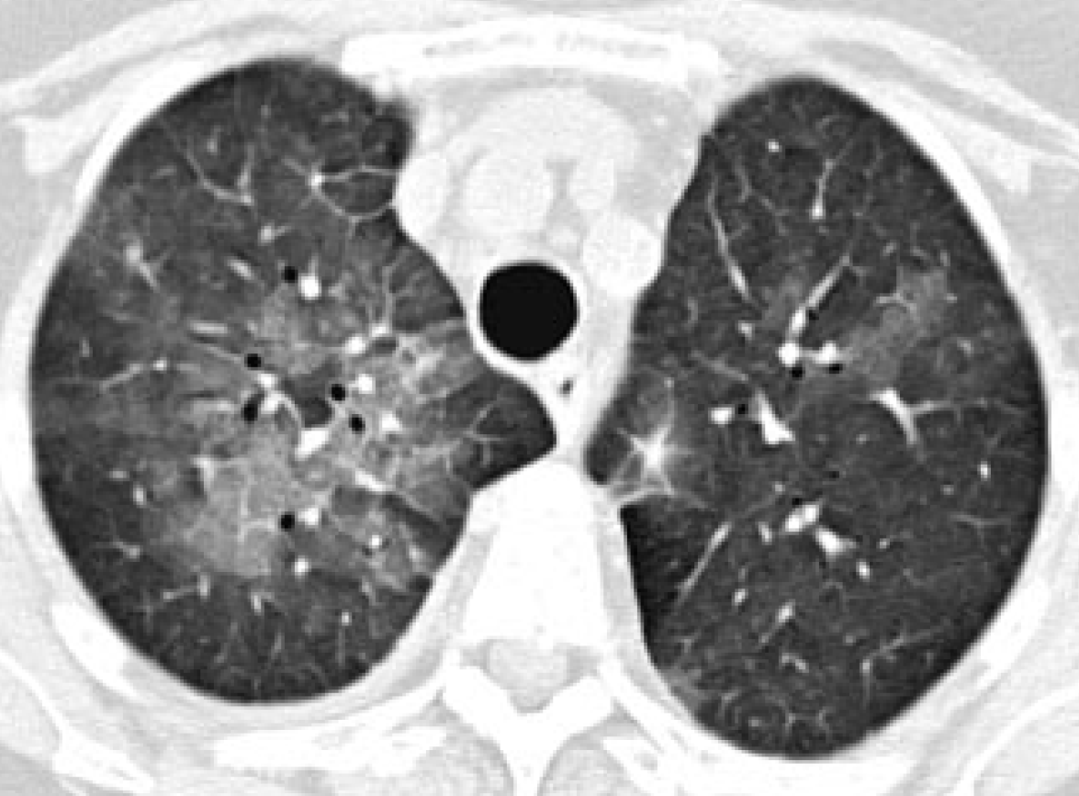
Intro – Disease Overview
Ground-glass opacities
Caused by fluid in airspaces or thickening of lung tissue
Appear as hazy opacities
Not as opaque as consolidation
Hansell DM, Bankier AA, MacMahon H, McLoud TC, Müller NL, Remy J. Fleischner Society: Glossary of Terms for Thoracic Imaging. Radiology. 2008 Mar;246(3):697–722

Slide 9
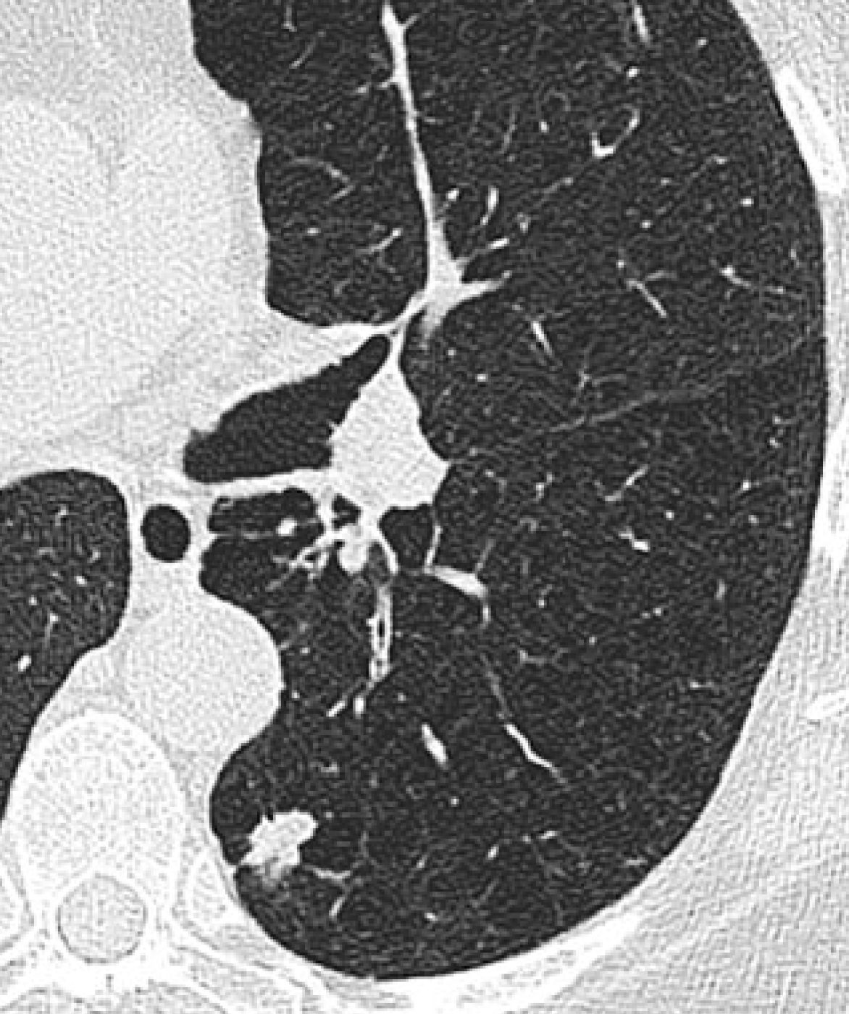
Intro – Disease Overview
Nodules
Round opacities measuring up to 3cm in diameter
CT scan on right shows irregular nodule in left lower lobe
Hansell DM, Bankier AA, MacMahon H, McLoud TC, Müller NL, Remy J. Fleischner Society: Glossary of Terms for Thoracic Imaging. Radiology. 2008 Mar;246(3):697–722

Slide 10
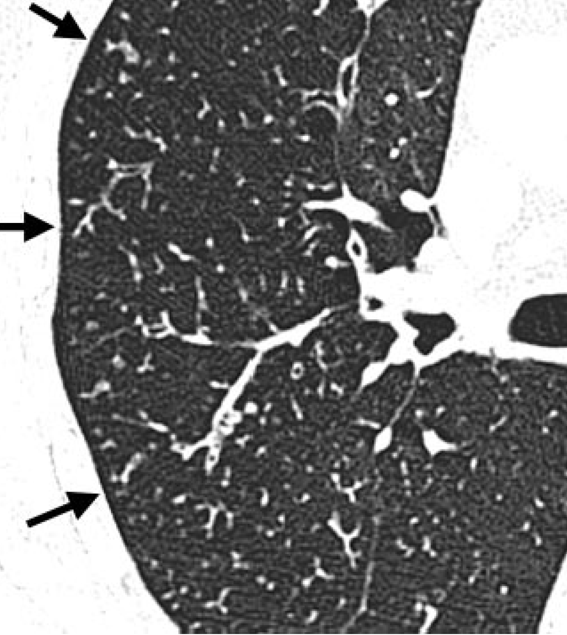
Intro – Disease Overview
Tree-in-bud Opacities
Small branching nodular opacities that resemble a budding tree
Caused by mucus impaction and inflammation
Hansell DM, Bankier AA, MacMahon H, McLoud TC, Müller NL, Remy J. Fleischner Society: Glossary of Terms for Thoracic Imaging. Radiology. 2008 Mar;246(3):697–722

Slide 11
Intro – Disease Overview
Indications in medical literature that certain areas of the lung are more severely affected than others
Reich & Johnson (1992): Studied 29 patients with NTM-LD, identified 6 elderly women with greater disease in right middle lobe and lingula
Moore et al. (1993): Studied 40 NTM-LD, found bronchiectasis was more severe in right middle lobe and lingula, ground-glass opacities and consolidation in lower lobes, and nodules evenly distributed
Hazelton et al. (2000): Studied 14 NTM-LD patients; bronchiectasis and nodules present in 13; 2 had greater severity of bronchiectasis in right middle lobe and lingula
Lee et al. (2013): Compared severity among 369 immunocompromised vs immunocompetent NTM-LD patients; no predominance in the lobar distribution of any of the features (bronchiectasis, cavities, nodules, opacities)

Slide 12
Research Question
Are there differences in the frequencies and severities for each of the specific CT features among the lung lobes in NTM-LD?

Slide 13
Methods

Slide 14
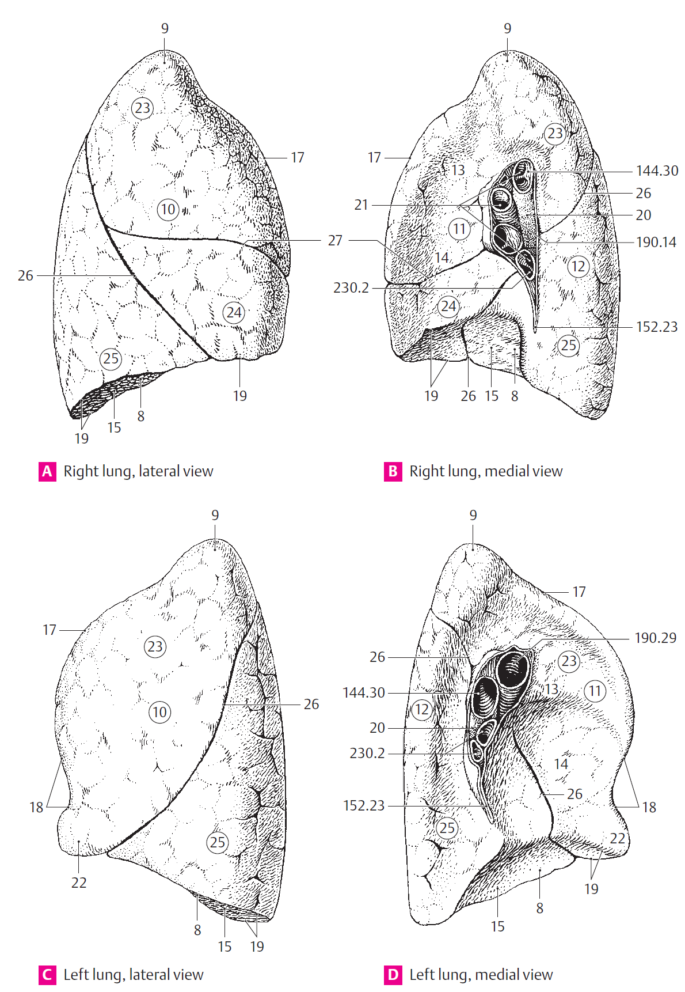
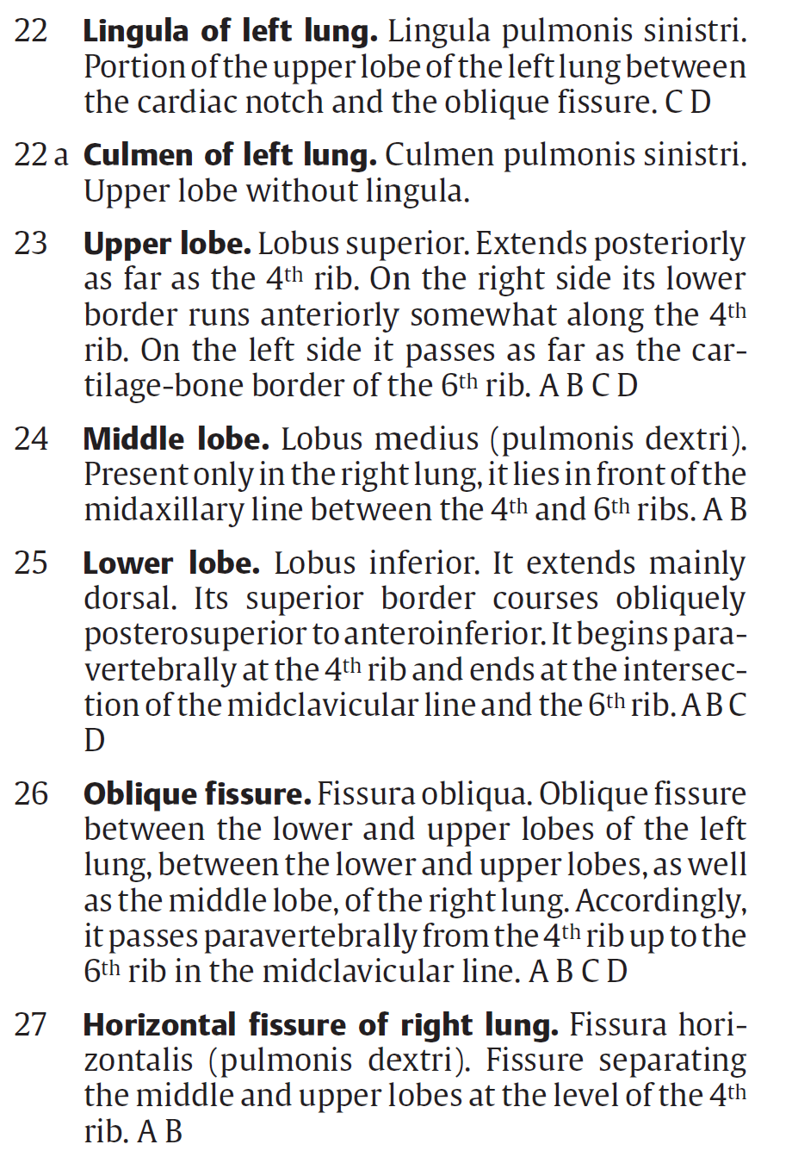
Feneis H, Dauber W, Feneis H. Pocket atlas of human anatomy: based on the international nomenclature. 4th ed., fully rev. Stuttgart New York: Thieme; 2000. 500 p. (Thieme flexibook).

Slide 15
Methods - Data
Data is comprised of scores for the radiographic features for subjects’ 6 lobes
Features with ordinal scores: atelectasis, bronchiectasis, consolidation, ground-glass opacities, tree-in-bud opacities
0: No involvement of lobe with given feature
1: <25% involvement
2: 25-50% involvement
3: >50% involvement
Features with binary scores: large nodules, thin wall cavities, thick wall cavities
0: Absence of feature from lobe
1: Presence of feature in lobe
166 subjects: 6 lobes scored with 2 raters scoring for each subject
Variables in analysis: subject ID, lobe, score of given lobe, rater
Data provided in an excel document
Data Cleaning
Minimal, mostly converting to long format

Slide 16
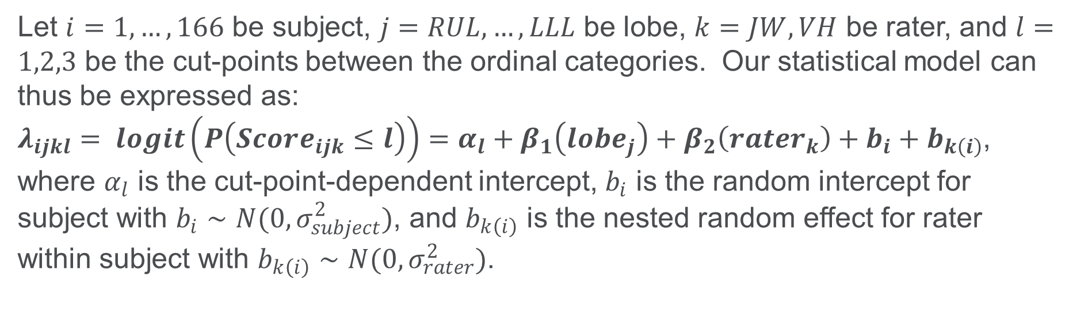
Methods - Modeling
Modeling Approach 1 – Proportional Odds Ordinal Logistic Regression (Full)
Let $i=1, …, 166$ be subject, $j=RUL, …, LLL$ be lobe, $k=JW, VH$ be rater, and $l=1,2,3$ be the cut-points between the ordinal categories. Our statistical model can thus be expressed as:
$λ_{ijkl}= logit\left(P\left(Score_{ijk}≤l\right)\right)=α_{l}+β_{1}\left(lobe_{j}\right)+β_{2}\left(rater_{k}\right)+b_{i}+b_{k\left(i\right)}$,
where $α_{l}$ is the cut-point-dependent intercept, $b_{i}$ is the random intercept for subject with $b_{i}∼N(0,σ_{subject}^{2})$, and $b_{k\left(i\right)}$ is the nested random effect for rater within subject with $b_{k\left(i\right)}∼N(0,σ_{rater}^{2})$.

Slide 17
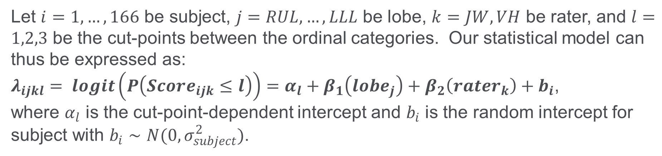
Methods - Modeling
Modeling Approach 2 – Proportional Odds Ordinal Logistic Regression (Reduced)
Let $i=1, …, 166$ be subject, $j=RUL, …, LLL$ be lobe, $k=JW, VH$ be rater, and $l=1,2,3$ be the cut-points between the ordinal categories. Our statistical model can thus be expressed as:
$λ_{ijkl}= logit\left(P\left(Score_{ijk}≤l\right)\right)=α_{l}+β_{1}\left(lobe_{j}\right)+β_{2}\left(rater_{k}\right)+b_{i}$,
where $α_{l}$ is the cut-point-dependent intercept and $b_{i}$ is the random intercept for subject with $b_{i}∼N(0,σ_{subject}^{2})$.

Slide 18
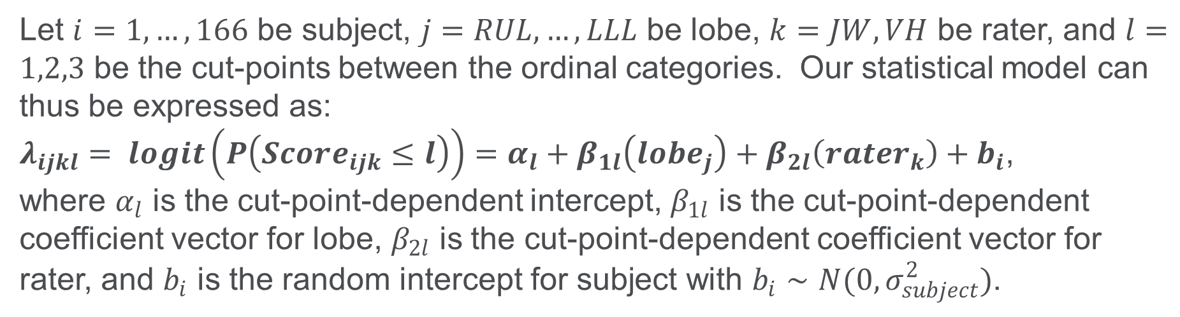
Methods - Modeling
Modeling Approach 3 – Non-Proportional Odds Ordinal Logistic Regression
Let $i=1, …, 166$ be subject, $j=RUL, …, LLL$ be lobe, $k=JW, VH$ be rater, and $l=1,2,3$ be the cut-points between the ordinal categories. Our statistical model can thus be expressed as:
$λ_{ijkl}= logit\left(P\left(Score_{ijk}≤l\right)\right)=α_{l}+β_{1l}\left(lobe_{j}\right)+β_{2l}\left(rater_{k}\right)+b_{i}$,
where $α_{l}$ is the cut-point-dependent intercept, $β_{1l}$ is the cut-point-dependent coefficient vector for lobe, $β_{2l}$ is the cut-point-dependent coefficient vector for rater, and $b_{i}$ is the random intercept for subject with $b_{i}∼N(0,σ_{subject}^{2})$.

Slide 19
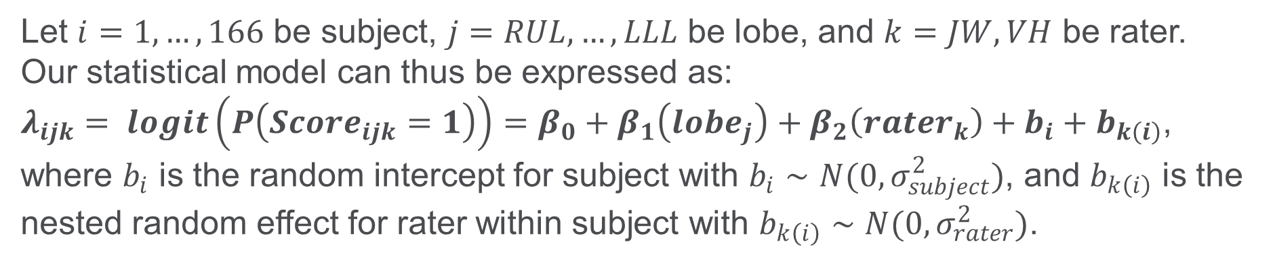
Methods - Modeling
Modeling Approach 4 – (Binary) Logistic Regression (Full)
Let $i=1, …, 166$ be subject, $j=RUL, …, LLL$ be lobe, and $k=JW, VH$ be rater. Our statistical model can thus be expressed as:
$λ_{ijk}= logit\left(P\left(Score_{ijk}=1\right)\right)=β_{0}+β_{1}\left(lobe_{j}\right)+β_{2}\left(rater_{k}\right)+b_{i}+b_{k\left(i\right)}$,
where $b_{i}$ is the random intercept for subject with $b_{i}∼N(0,σ_{subject}^{2})$, and $b_{k\left(i\right)}$ is the nested random effect for rater within subject with $b_{k\left(i\right)}∼N(0,σ_{rater}^{2})$.

Slide 20
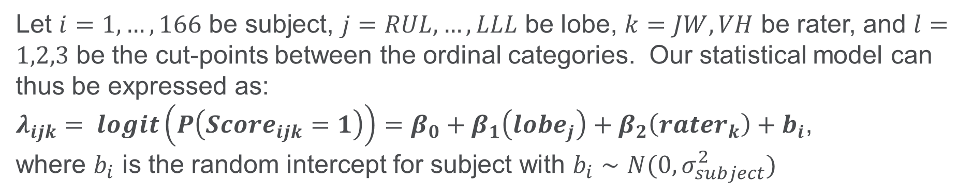
Methods - Modeling
Modeling Approach 5 – Logistic Regression (Reduced)
Let $i=1, …, 166$ be subject, $j=RUL, …, LLL$ be lobe, $k=JW, VH$ be rater, and $l=1,2,3$ be the cut-points between the ordinal categories. Our statistical model can thus be expressed as:
$λ_{ijk}= logit\left(P\left(Score_{ijk}=1\right)\right)=β_{0}+β_{1}\left(lobe_{j}\right)+β_{2}\left(rater_{k}\right)+b_{i}$,
where $b_{i}$ is the random intercept for subject with $b_{i}∼N(0,σ_{subject}^{2})$

Slide 21
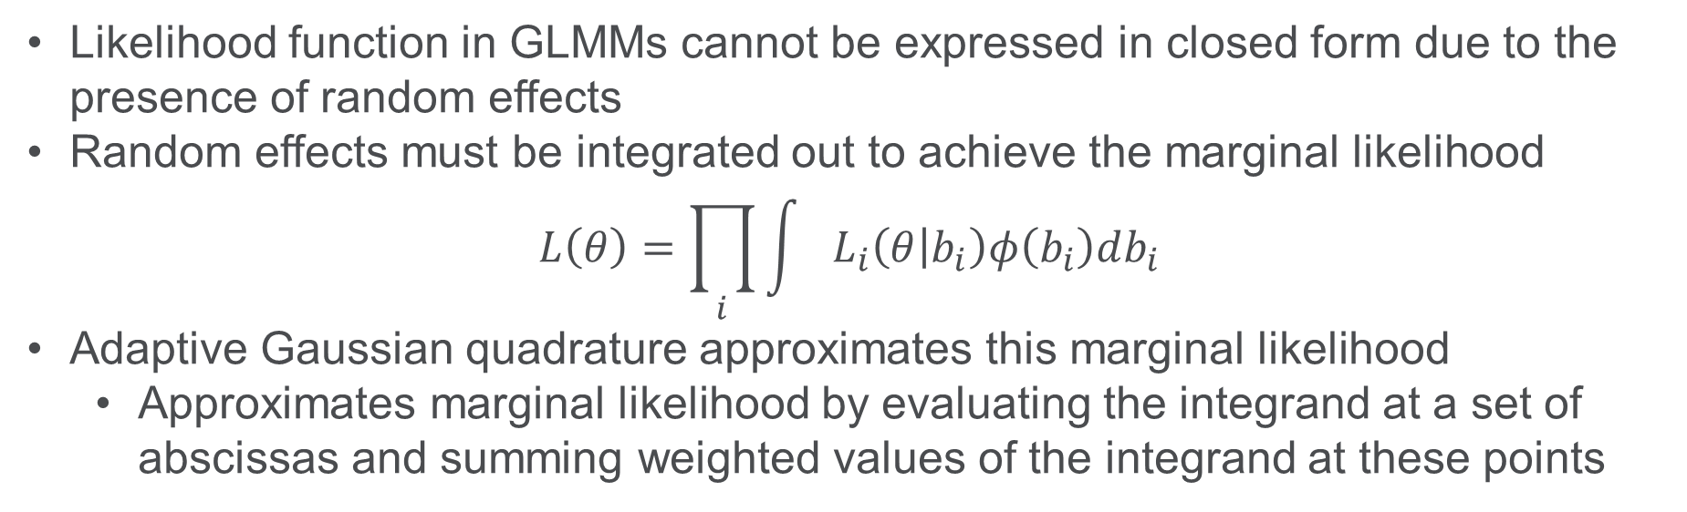
Methods – Estimation Method
Likelihood function in GLMMs cannot be expressed in closed form due to the presence of random effects
Random effects must be integrated out to achieve the marginal likelihood
$$L\left(θ\right)=\prod_{i}{\int{L_{i}\left(θ | b_{i}\right)φ\left(b_{i}\right)db_{i}}}$$
Adaptive Gaussian quadrature approximates this marginal likelihood
Approximates marginal likelihood by evaluating the integrand at a set of abscissas and summing weighted values of the integrand at these points

Slide 22
Methods – Lobe Comparisons
Constructed pairwise contrasts of fixed-effect estimates for lobe
First flipped sign for estimates in ordinal models
Exponentiated to get odds of higher disease severity
CIs determined by exponentiating 95% confidence limits from GLIMMIX
Contrasts formed within each cut-point for NPO models

Slide 23
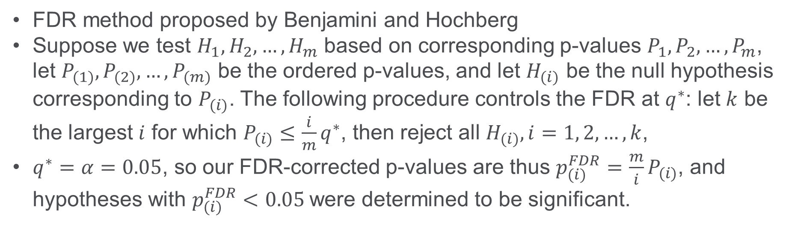
Methods – Multiple Testing Correction
FDR method proposed by Benjamini and Hochberg
Suppose we test $H_{1},H_{2}, …, H_{m}$ based on corresponding p-values $P_{1},P_{2},…, P_{m}$, let $P_{(1)}, P_{(2)},…, P_{(m)}$ be the ordered p-values, and let $H_{(i)}$ be the null hypothesis corresponding to $P_{(i)}$. The following procedure controls the FDR at $q^{∗}$: let $k$ be the largest $i$ for which $P_{(i)}≤\frac{i}{m}q^{∗}$, then reject all $H_{(i)}, i=1, 2, …, k$,
$q^{∗}=α=0.05$, so our FDR-corrected p-values are thus $p_{(i)}^{FDR}=\frac{m}{i}P_{(i)}$, and hypotheses with $p_{(i)}^{FDR}<0.05$were determined to be significant.
Benjamini Y, Hochberg Y. Controlling the False Discovery Rate: A Practical and Powerful Approach to Multiple Testing. Journal of the Royal Statistical Society Series B: Statistical Methodology. 1995 Jan 1;57(1):289–300

Slide 24
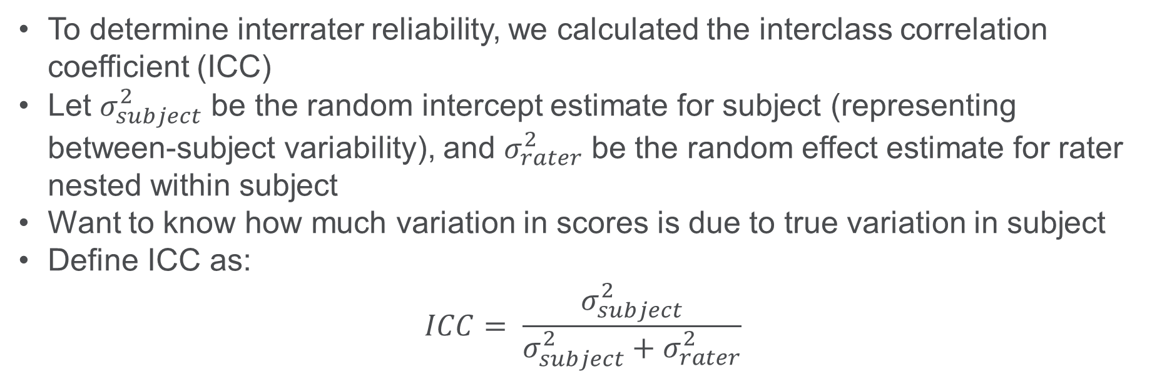
Methods – Interrater Reliability
To determine interrater reliability, we calculated the interclass correlation coefficient (ICC)
Let $σ_{subject}^{2}$ be the random intercept estimate for subject (representing between-subject variability), and $σ_{rater}^{2}$ be the random effect estimate for rater nested within subject
Want to know how much variation in scores is due to true variation in subject
Define ICC as:
$$ICC= \frac{σ_{subject}^{2}}{σ_{subject}^{2}+σ_{rater}^{2}}$$

Slide 25
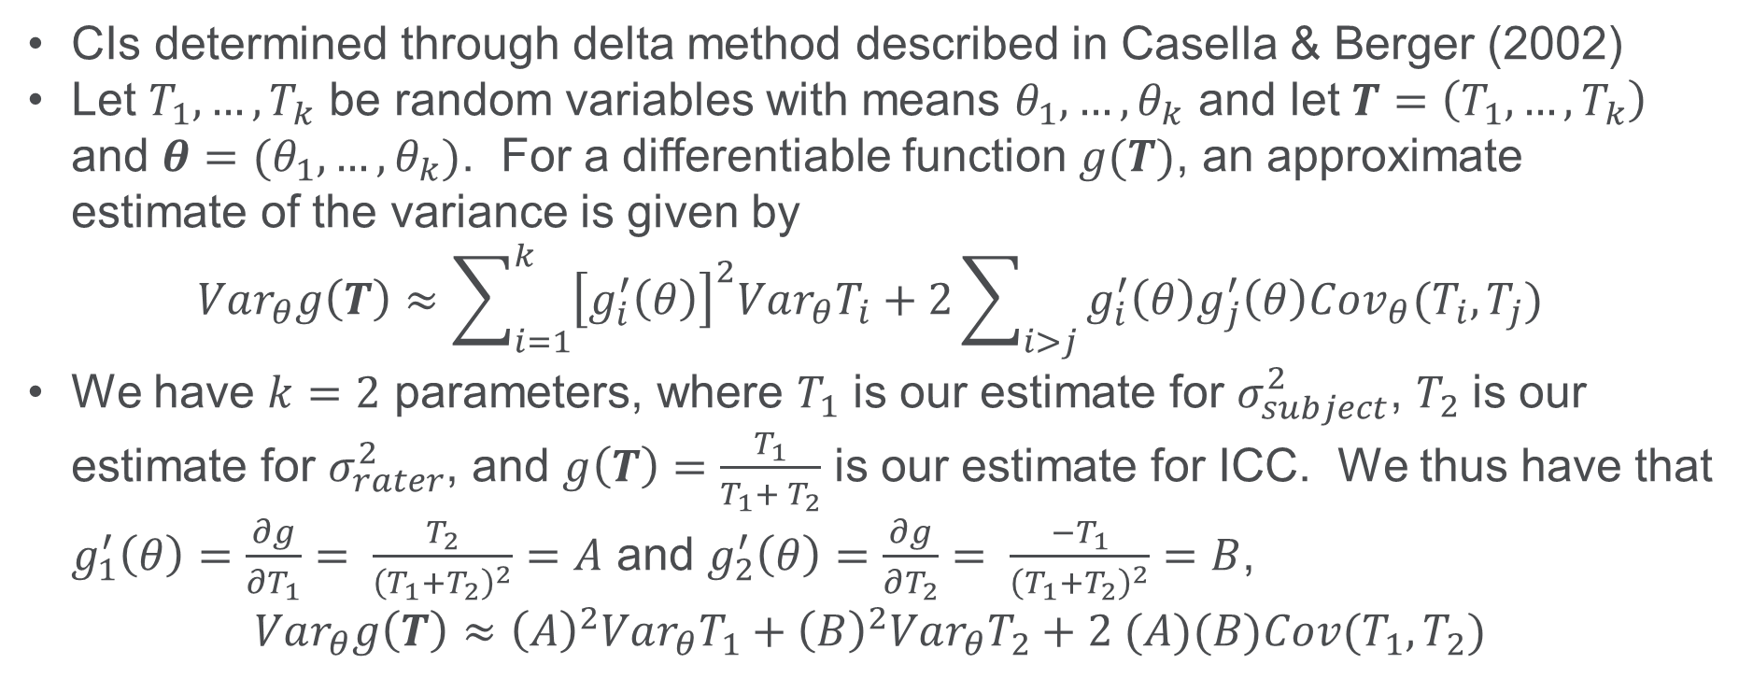
Methods – Interrater Reliability
CIs determined through delta method described in Casella & Berger (2002)
Let $T_{1}, …, T_{k}$ be random variables with means $θ_{1}, …, θ_{k}$ and let $T=\left(T_{1}, …, T_{k}\right)$ and $θ=(θ_{1}, …, θ_{k})$. For a differentiable function $g(T)$, an approximate estimate of the variance is given by
$$Var_{θ}g\left(T\right)≈\sum_{i=1}^{k}{{\left[g_{i}^{′}\left(θ\right)\right]}^{2}Var_{θ}T_{i}}+2\sum_{i>j}{g_{i}^{′}\left(θ\right)g_{j}^{′}\left(θ\right)Cov_{θ}(T_{i},T_{j})}$$
We have $k=2$ parameters, where $T_{1}$ is our estimate for $σ_{subject}^{2}$, $T_{2}$ is our estimate for $σ_{rater}^{2}$, and $g\left(T\right)=\frac{T_{1}}{T_{1}+ T_{2}}$ is our estimate for ICC. We thus have that $g_{1}^{′}\left(θ\right)=\frac{∂g}{∂T_{1}}= \frac{T_{2}}{{\left(T_{1}+T_{2}\right)}^{2}}=A$ and $g_{2}^{′}\left(θ\right)=\frac{∂g}{∂T_{2}}= \frac{−T_{1}}{{\left(T_{1}+T_{2}\right)}^{2}}=B$,
$$Var_{θ}g\left(T\right)≈{\left(A\right)}^{2}Var_{θ}T_{1}+{\left(B\right)}^{2}Var_{θ}T_{2}+2 (A)(B)Cov(T_{1},T_{2})$$
Casella G, Berger RL. Statistical inference. 2nd ed. Australia ; Pacific Grove, CA: Thomson Learning; 2002. 660 p.

Slide 26
Results

Slide 27
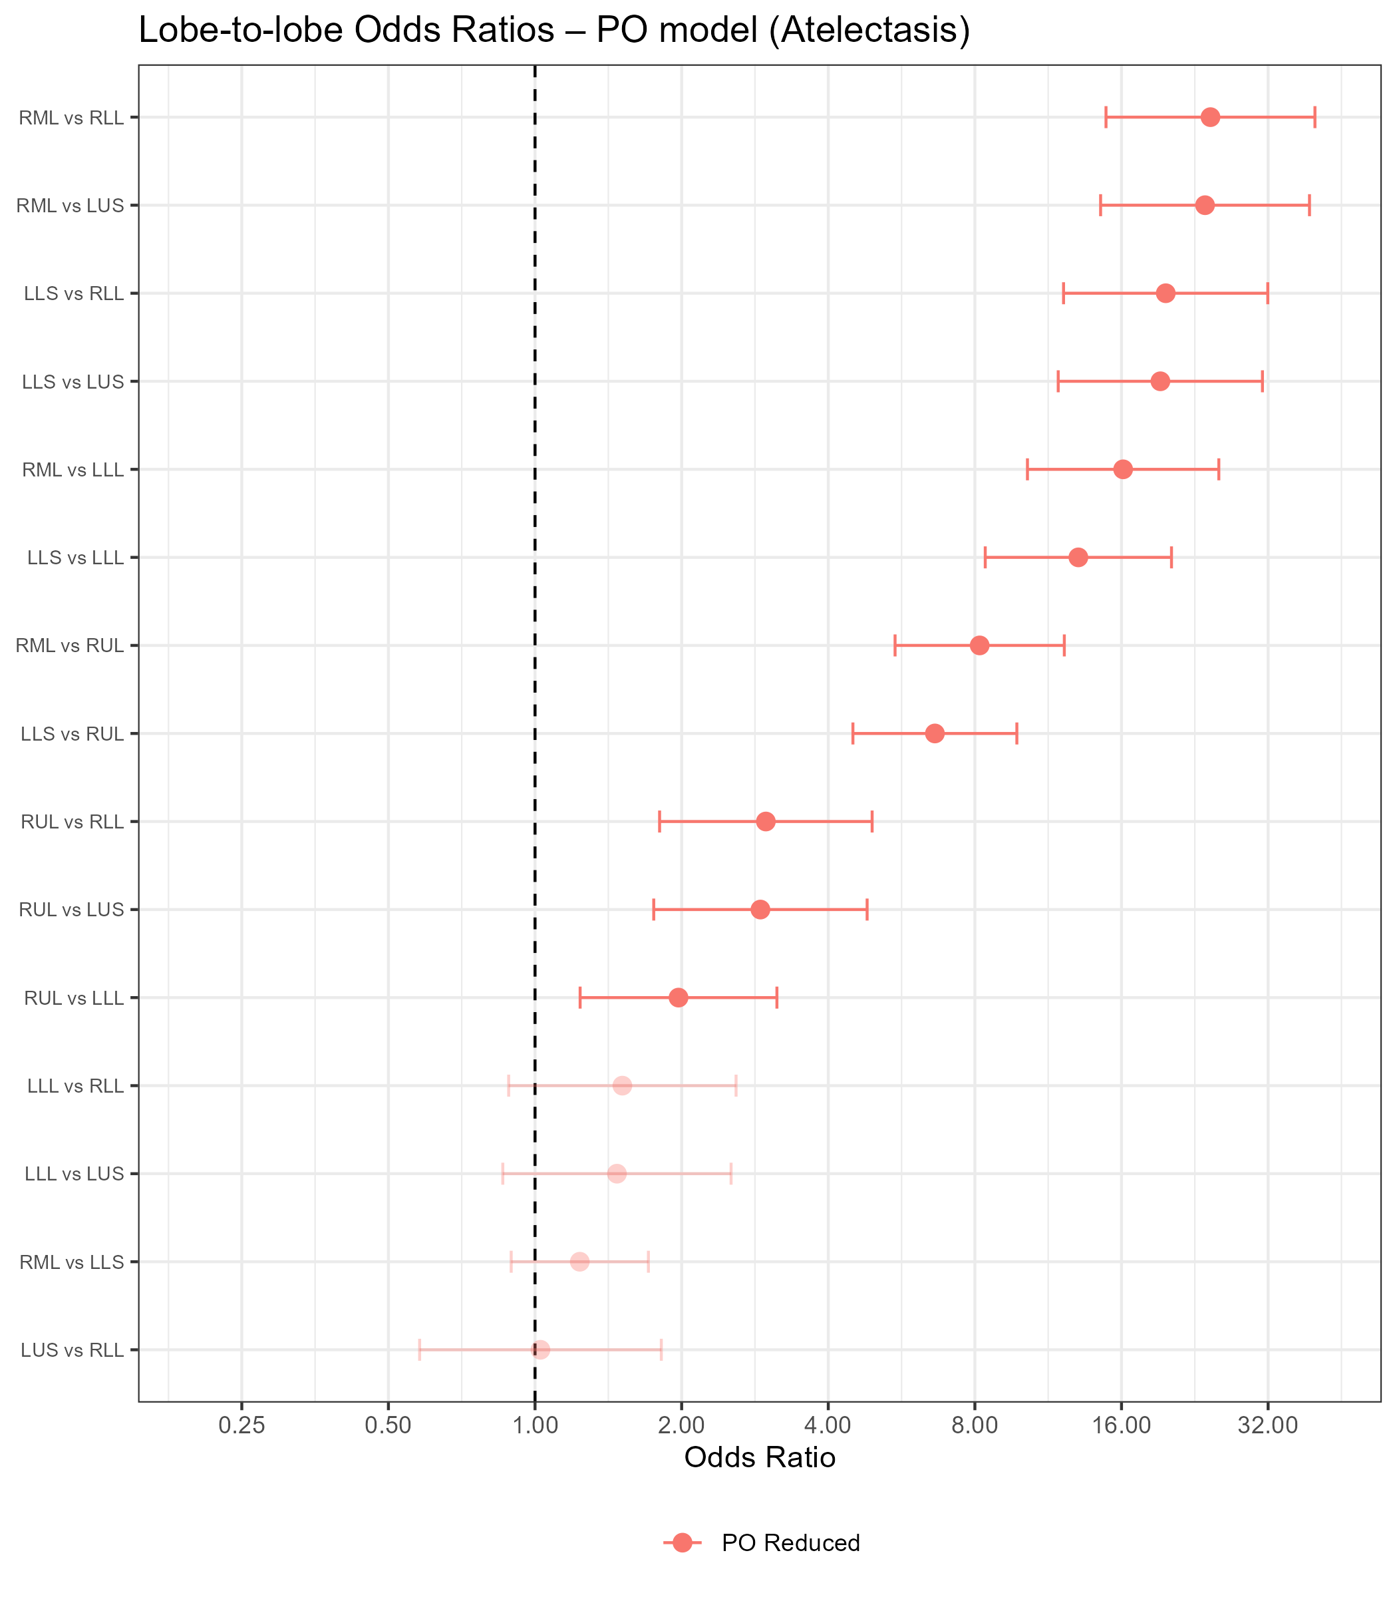
Results – Lobe Comparisons
Atelectasis
RML significantly greater severity than RLL, LUS, LLL, and RUL
ORs: 8.18-24.37
LLS significantly greater severity than RLL, LUS, LLL, and RUL
ORs: 6.62-19.72

Slide 28
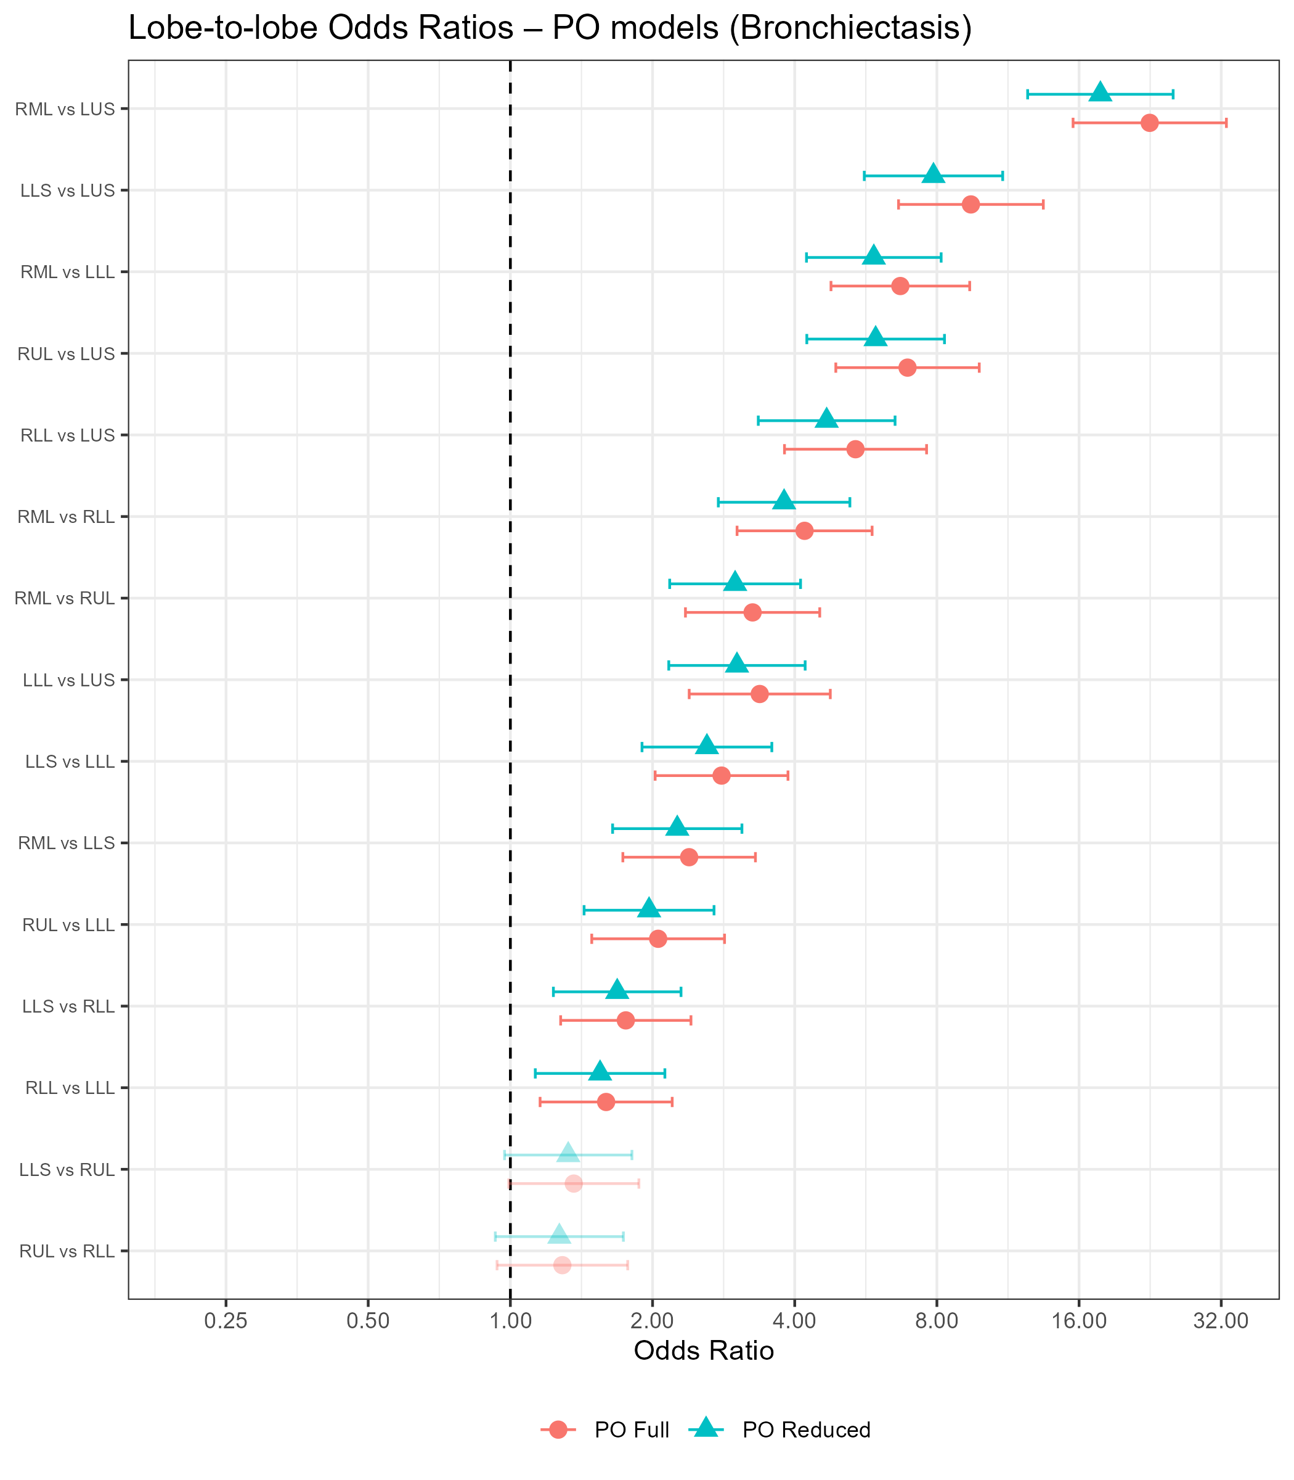
Results – Lobe Comparisons
Bronchiectasis
RML significantly greater severity than all other lobes
ORs: 2.39-22.58
LLS significantly greater severity than LUS, LLL, and RLL
ORs: 1.76-9.44
RML’s top reduced model’s contrast had a 21.4% lower estimate
LLS’s top reduced model’s contrast had a 16.7% lower estimate

Slide 29
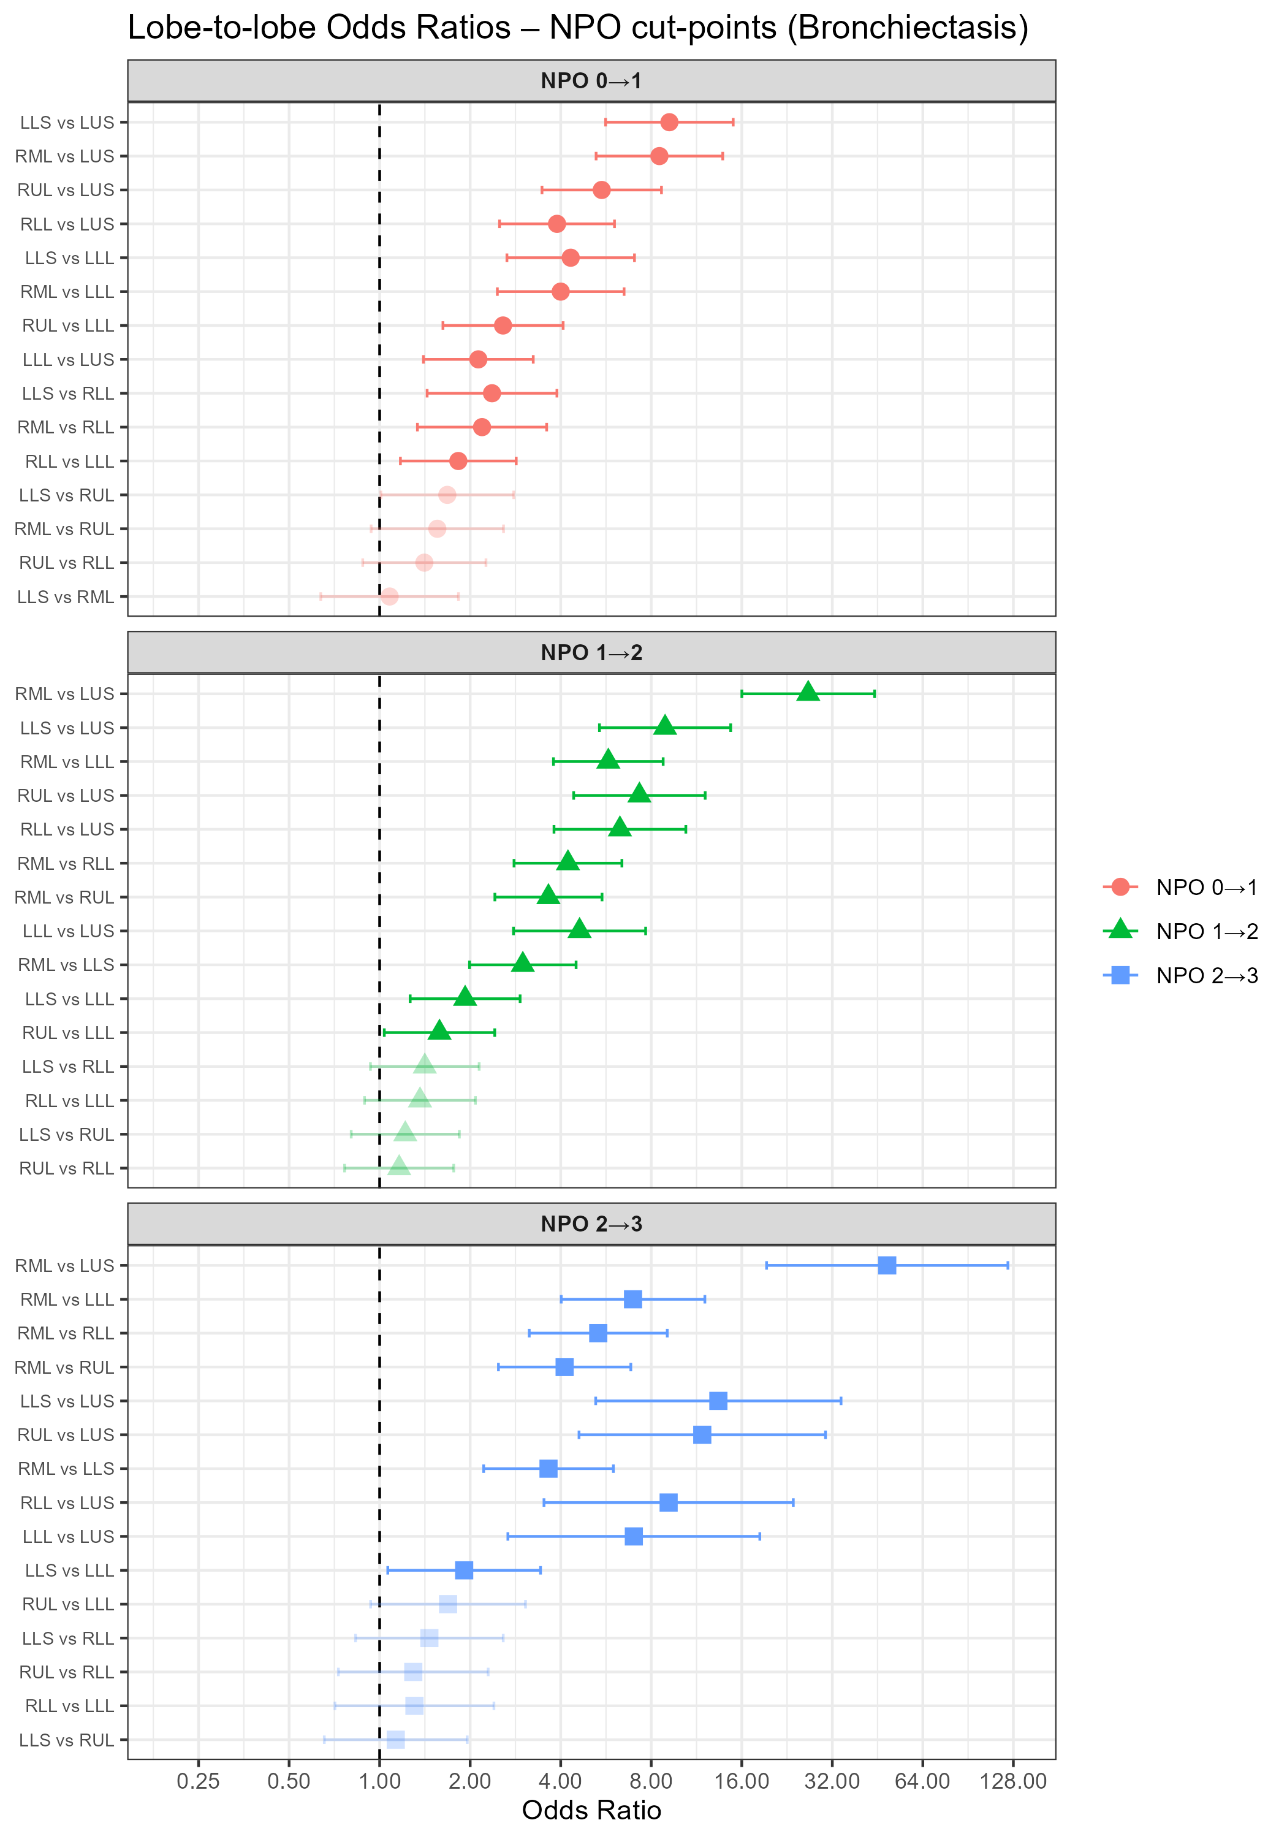
Results – Lobe Comparisons
Bronchiectasis
RML and LLS remain most significantly affected
OR CIs for 0|1 vs 1|2 and 0|1 vs 2|3 cut-points do not overlap for RML vs LUS
AIC for PO model lower than NPO model

Slide 30
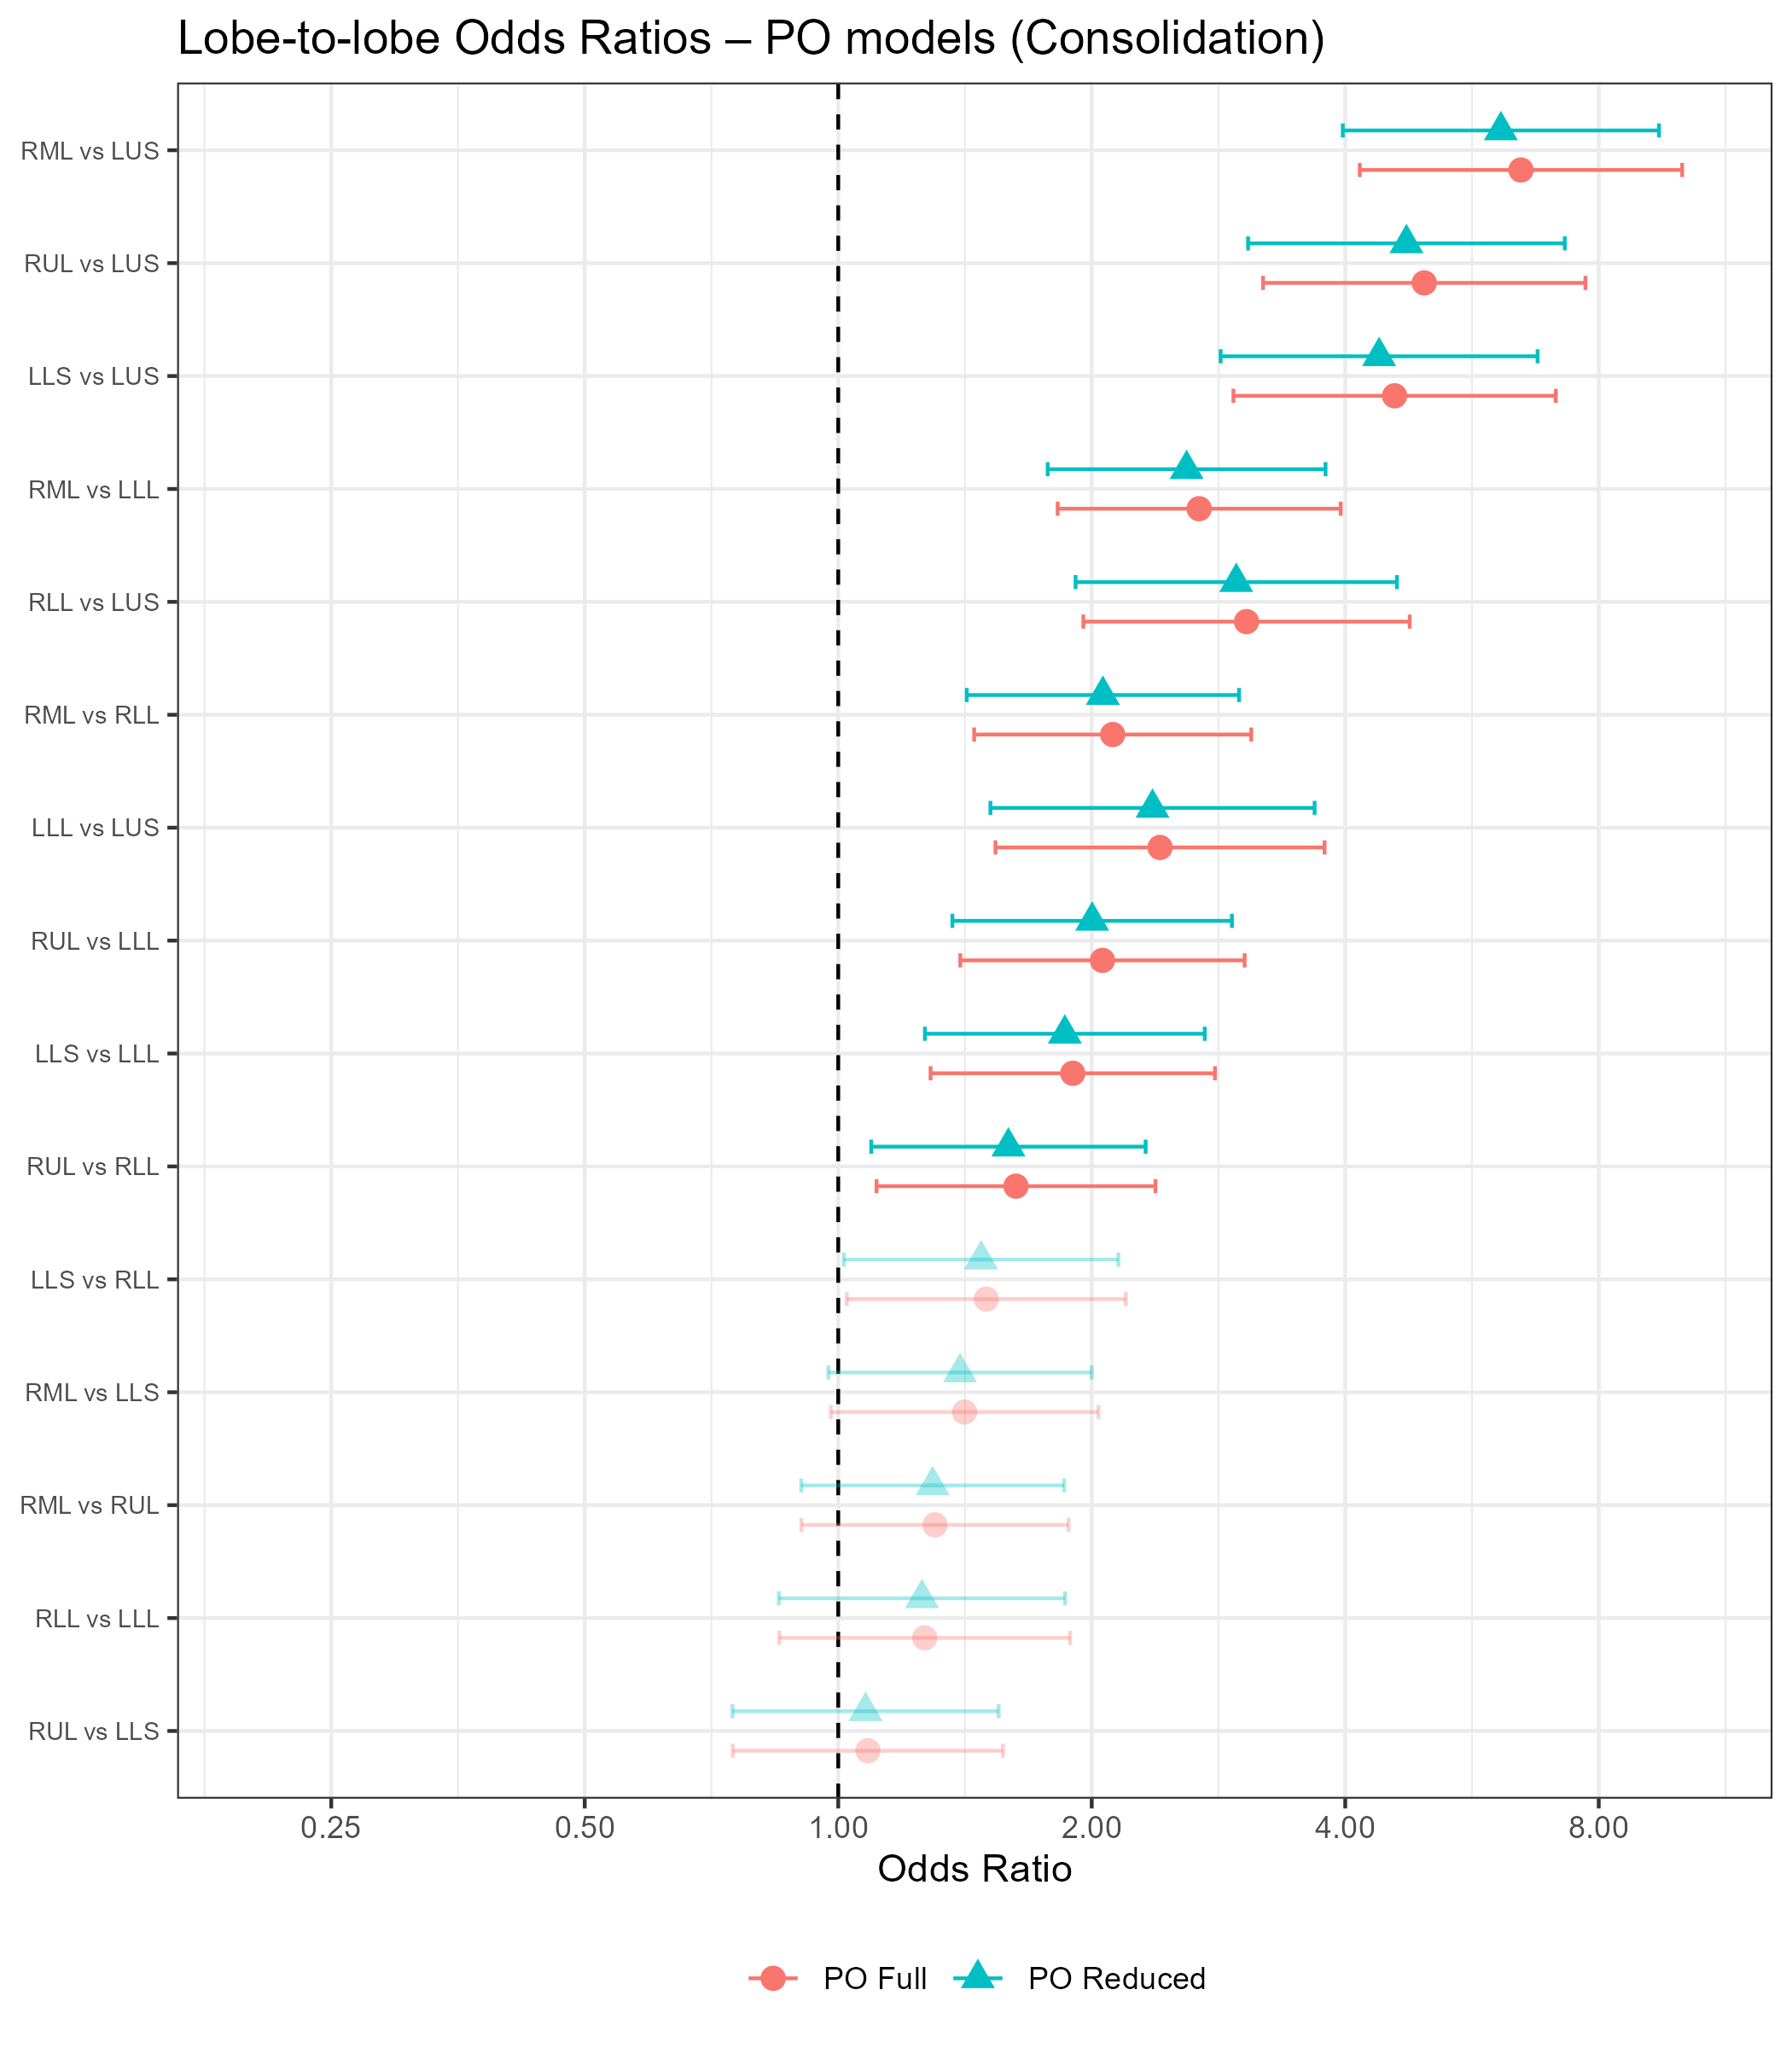
Results – Lobe Comparisons
Consolidation
RML significantly greater severity than LUS, LLL, and RLL
ORs: 2.12-6.47
RUL significantly greater severity than LUS, LLL, and RLL
ORs: 1.63-4.96
Similar estimates between full and reduced models

Slide 31
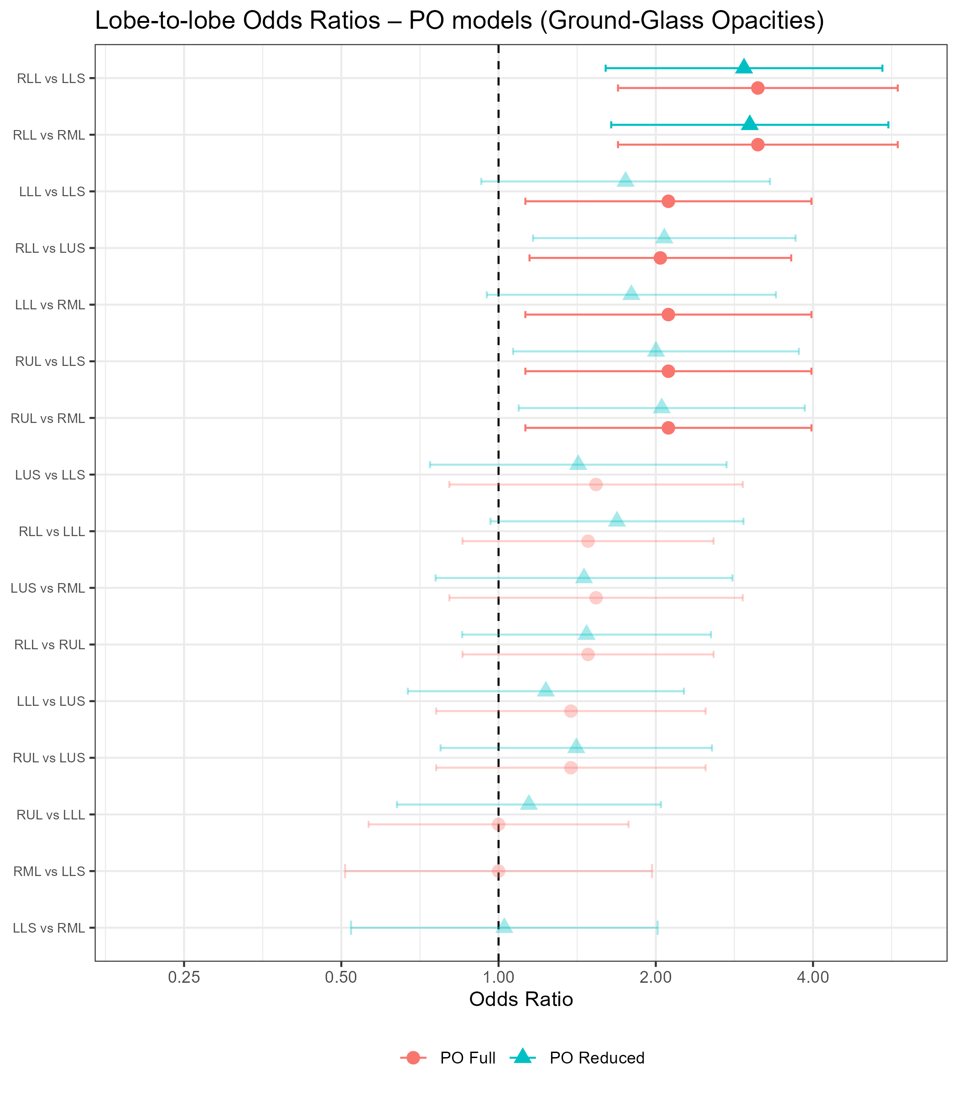
Results – Lobe Comparisons
Ground-glass opacities
Had to dichotomize outcome
RLL significantly greater severity than LLS, RML, and LUS
ORs: 2.08-3.03
RUL significantly greater severity than LLS and RML
ORs: 2.00-2.05
LLL significantly greater severity than LLS and RML
ORs: 1.75-1.80
Only RLL remains significant in reduced model

Slide 32
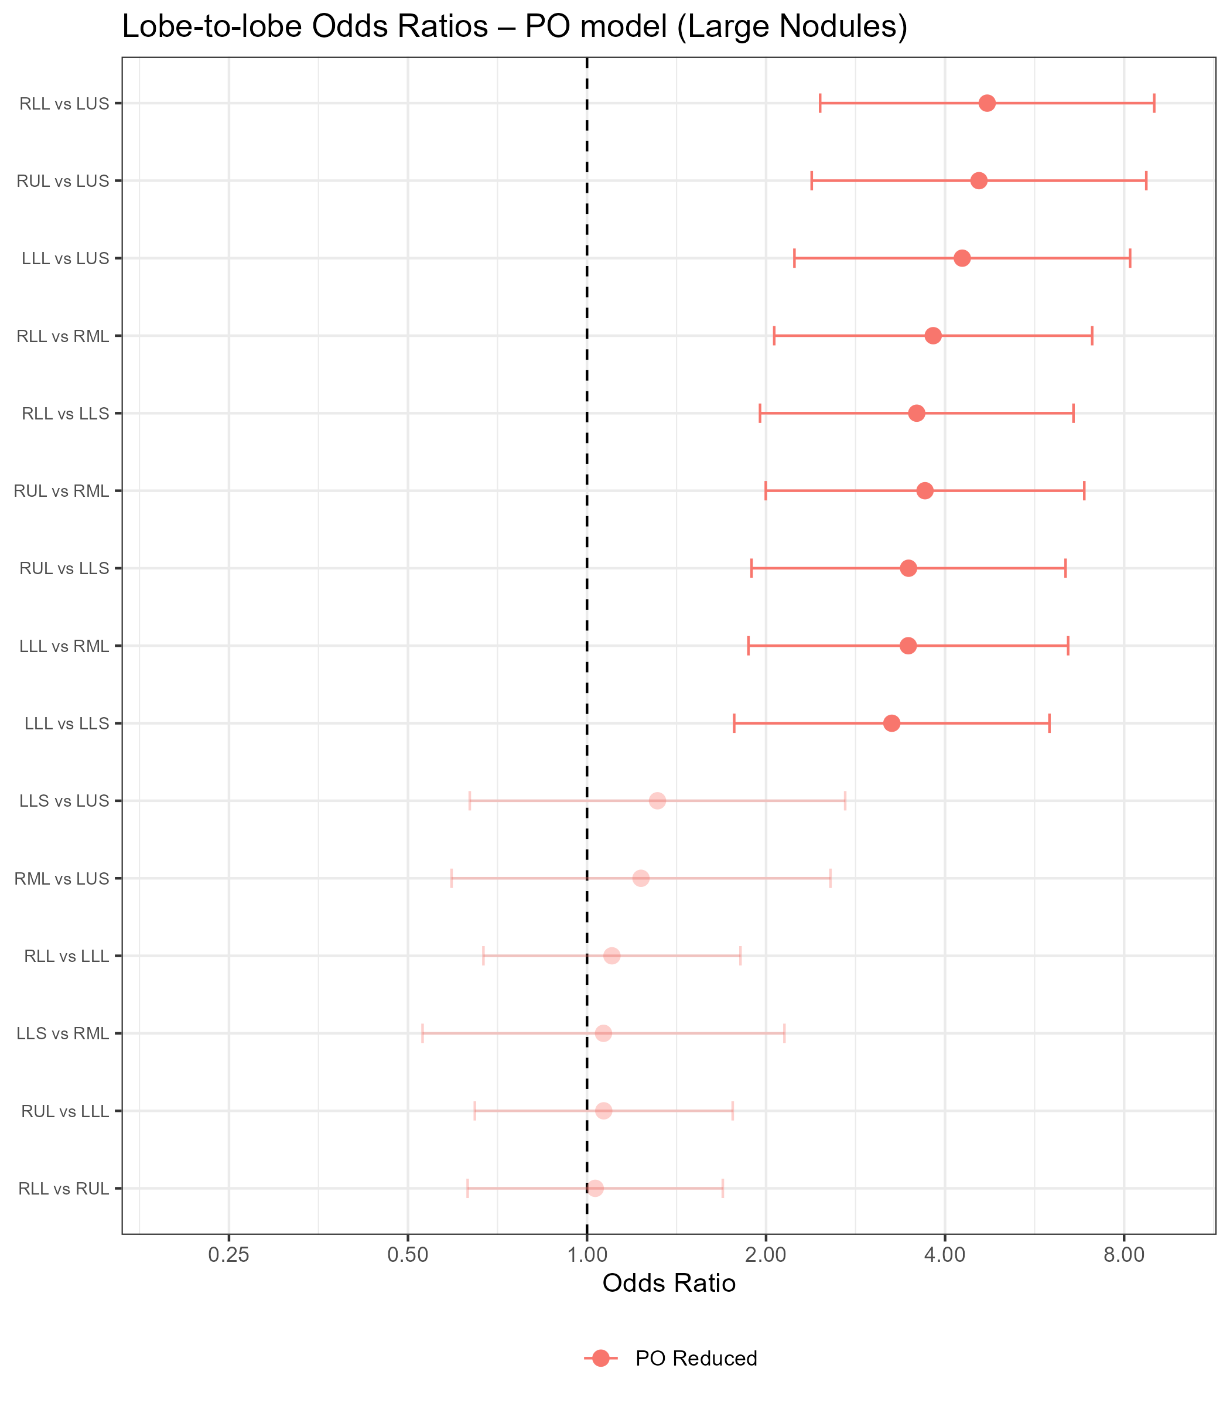
Results – Lobe Comparisons
Large Nodules
RLL significantly greater severity than LUS, RML, LLS
ORs: 3.58-4.71
RUL significantly greater severity than LUS, RML, LLS
ORs: 3.47-4.56
LLL significantly greater severity than LUS, RML, LLS
ORs: 3.25-4.28

Slide 33
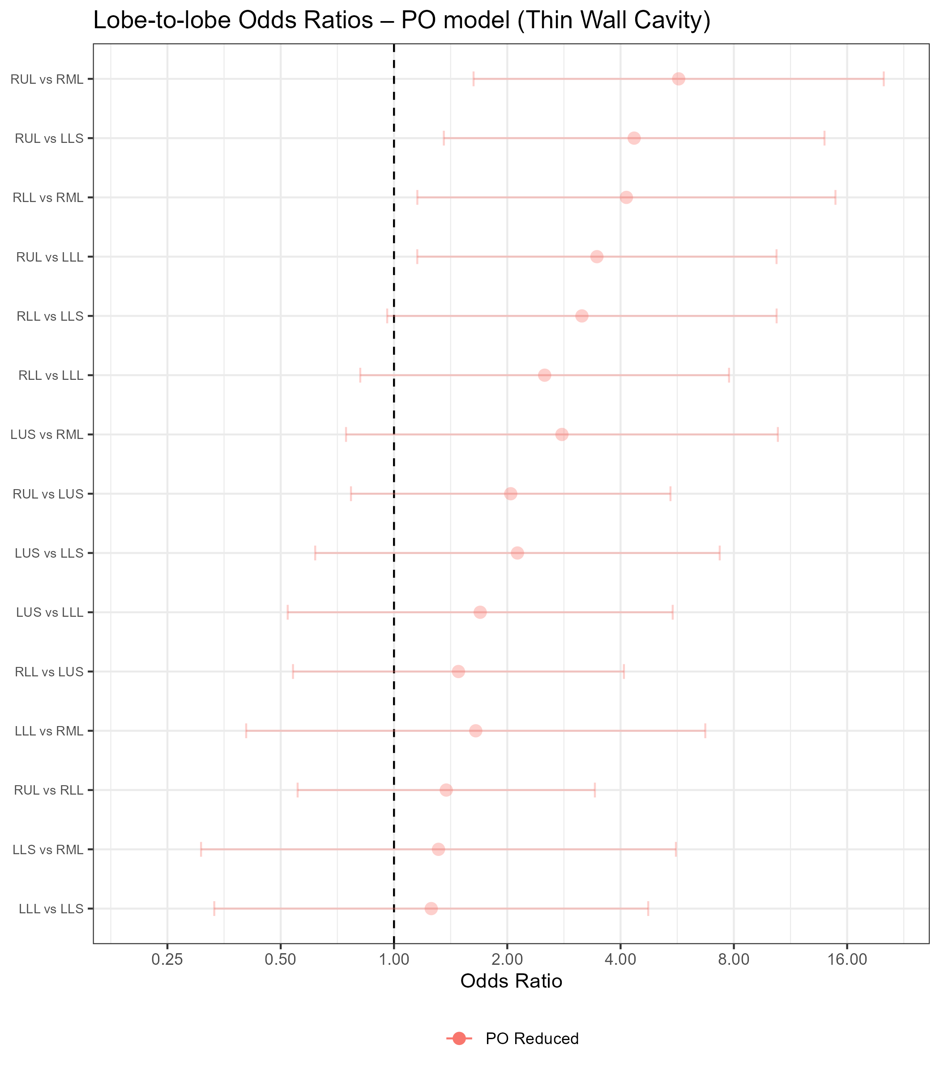
Results – Lobe Comparisons
Thin Wall Cavities
No significant differences in severity by lobe

Slide 34
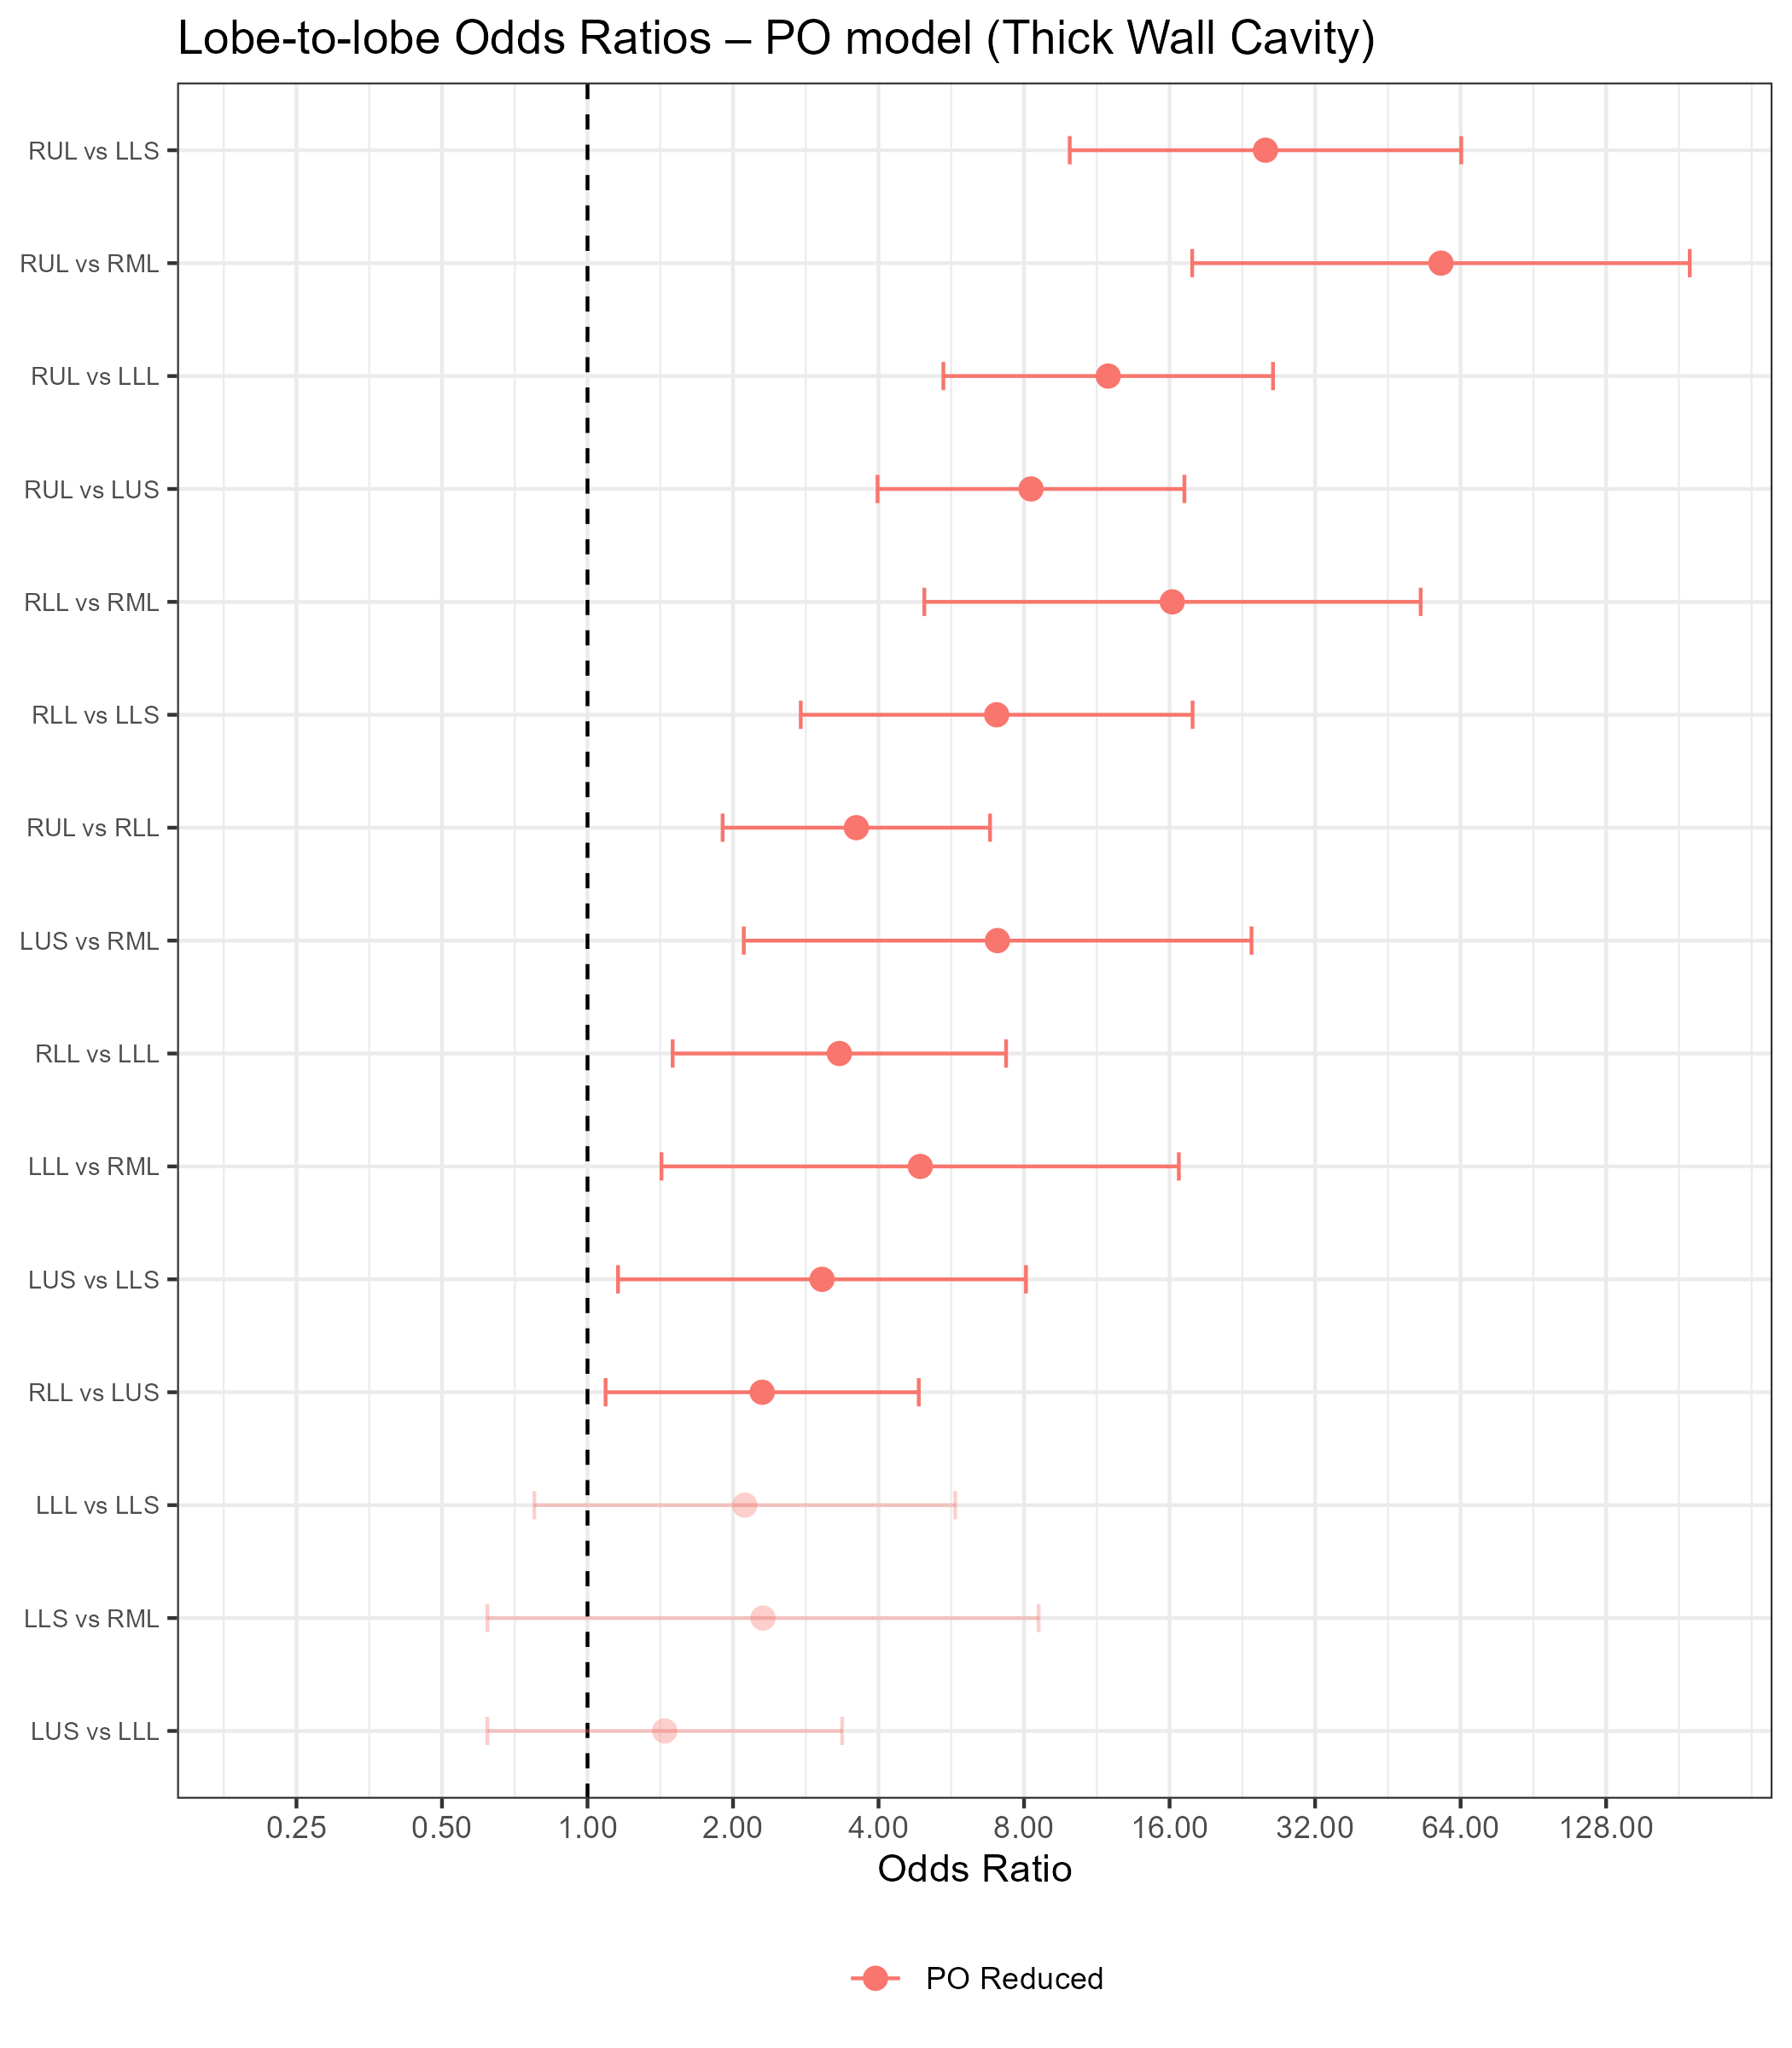
Results – Lobe Comparisons
Thick Wall Cavities
RUL significantly greater severity than all other lobes
ORs: 3.60-58.29
RLL significantly greater severity than RML, LLS, LLL, and LUS
ORs: 2.30-16.21

Slide 35
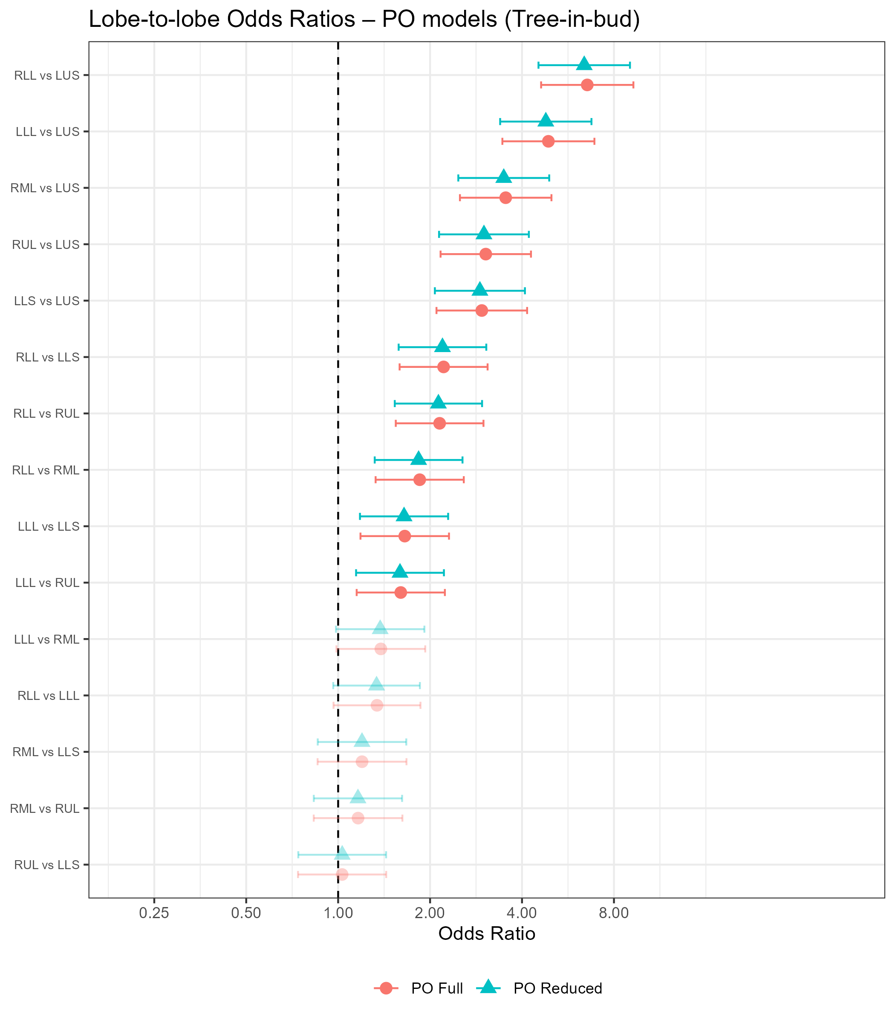
Results – Lobe Comparisons
Tree-in-bud Opacities
RLL significantly greater severity than LUS, LLS, RUL, and RML
ORs: 1.85-6.54
LLL significantly greater severity than LUS, LLS, and RUL
ORs: 1.60-4.88
Similar estimates between full and reduced models

Slide 36
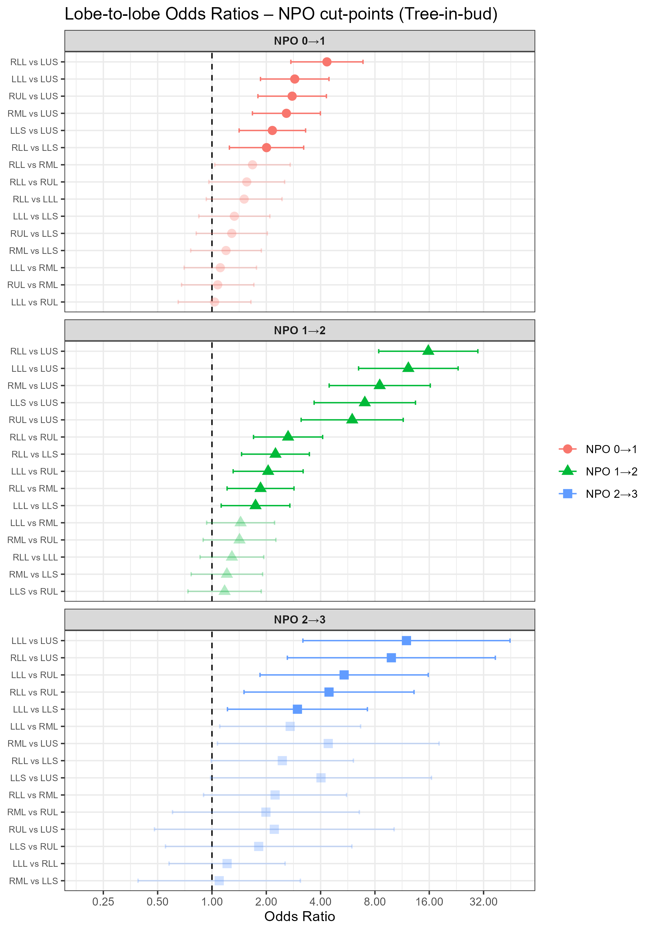
Results – Lobe Comparisons
Tree-in-bud Opacities
RLL and LLL remain most significantly affected
OR CIs for 0|1 vs 1|2 cut-points do not overlap for RLL vs LUS, LLL vs LUS, and RML vs LUS
AIC for NPO model lower than PO model

Slide 37
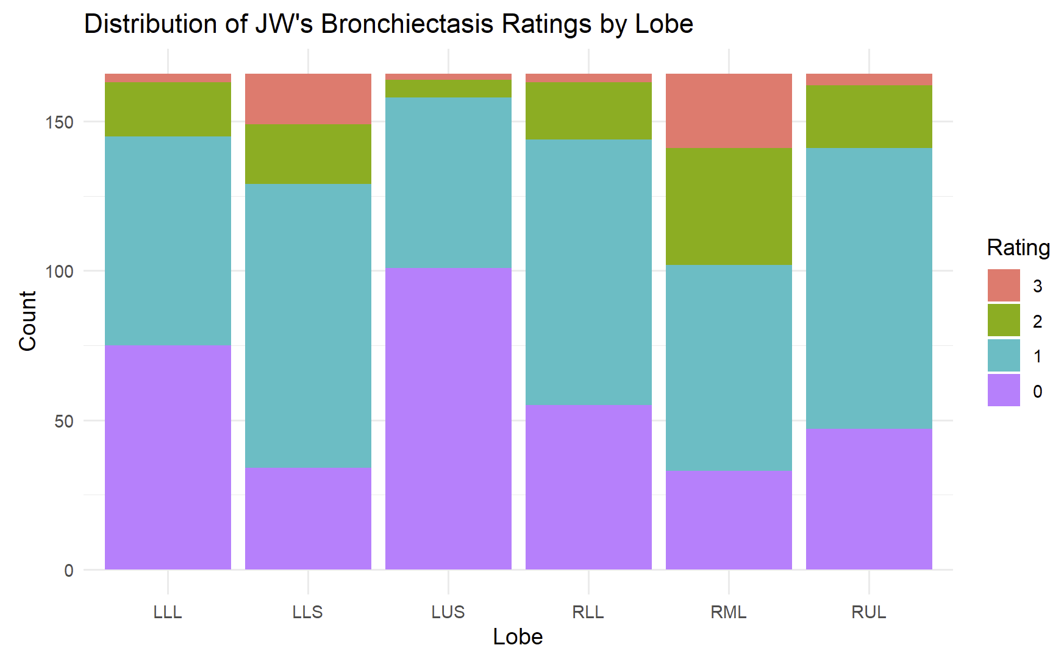
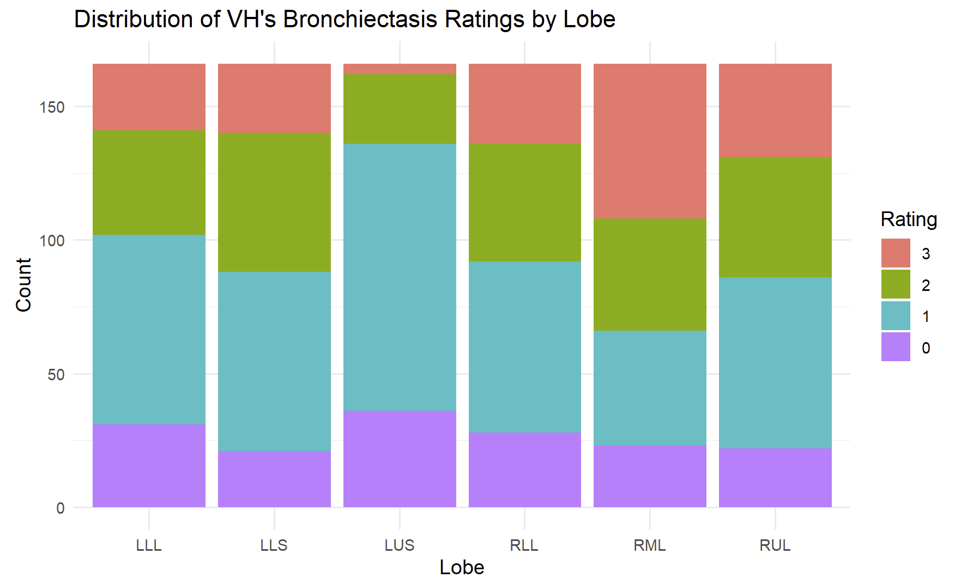
Results – Interrater Agreement
Feature | ICC (95% CI)
Bronchiectasis | 0.82 (0.74-0.90)
Consolidation | 0.85 (0.73-0.97)
Ground-Glass Opacities | 0.90 (0.80-1.00)
Tree-in-bud Opacities | 0.96 (0.90-1.00)

Slide 38
Discussion

Slide 39
Discussion – Health Implications
Our results indicate that the RUL has greater severity of thick wall cavities than all other lobes
Upper lobes have decreased blood perfusion
Decreased flow of immune cells/antibiotics
Greater stress on lung tissue of upper lobes during inspiration
Weight of lower lobes
May warrant lifestyle/treatment changes
Refraining from intense exercise
Lying down when resting and receiving antibiotics

Slide 40
Discussion – Limitations
Couldn’t fit full random effects structure for all models
Not fully accounting for all repeated measures per subject
Bayesian approach if more time
Separate models fit for each feature
May not account for correlated scores between features
Referral bias
Patients were referred to the study by their primary care physicians
Results may not be generalizable to broader NTM-LD population

Slide 41
Questions?
51

Slide 42
References

