Slide 1
Computed tomographic analysis of NTM lung disease reveals a surprising finding…but not for TB clinicians of years past Edward Bosko, Jiwon Lyu, Valerie A. Hale, Kum Ju Chae, Nathaniel M. Ivanick, Jared J. Eddy, David E. Griffith, Matthew J. Strand, Edward D. Chan Colorado School of Public Health, University of Colorado Anschutz Medical Campus, Aurora, Colorado; Soon Chun Hyang University Cheonan Hospital, Seoul, Korea National Jewish Health, Denver, Colorado; Rocky Mountain Regional Veterans Affairs Medical Center, Aurora, Colorado; State University of New York Jacobs School of Medicine and Biomedical Sciences, Buffalo, NY; Jeonbuk National University Hospital, Seoul, South Korea;
Notes:
CAT scan or CT scan is a common medical test

Slide 2
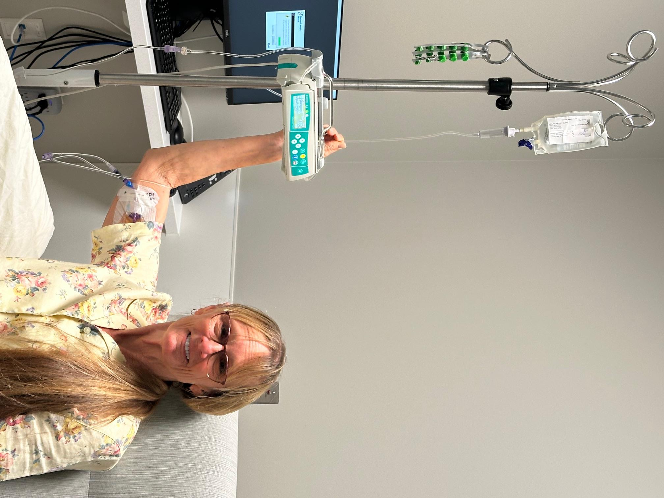
68-year-old woman with RUL cavitary lung disease due to Mycobacterium abscessus on omadacycline, clofazimine, IV imipenem BID, and IV amikacin TIW
NJH Infusion Clinic
Is the administration of the IV antibiotics optimal in this picture?
I’d say no!
Put her CT scan here
Permission obtained from patient & husband

Slide 3
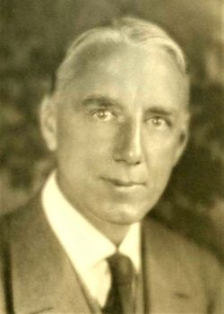
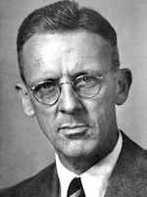
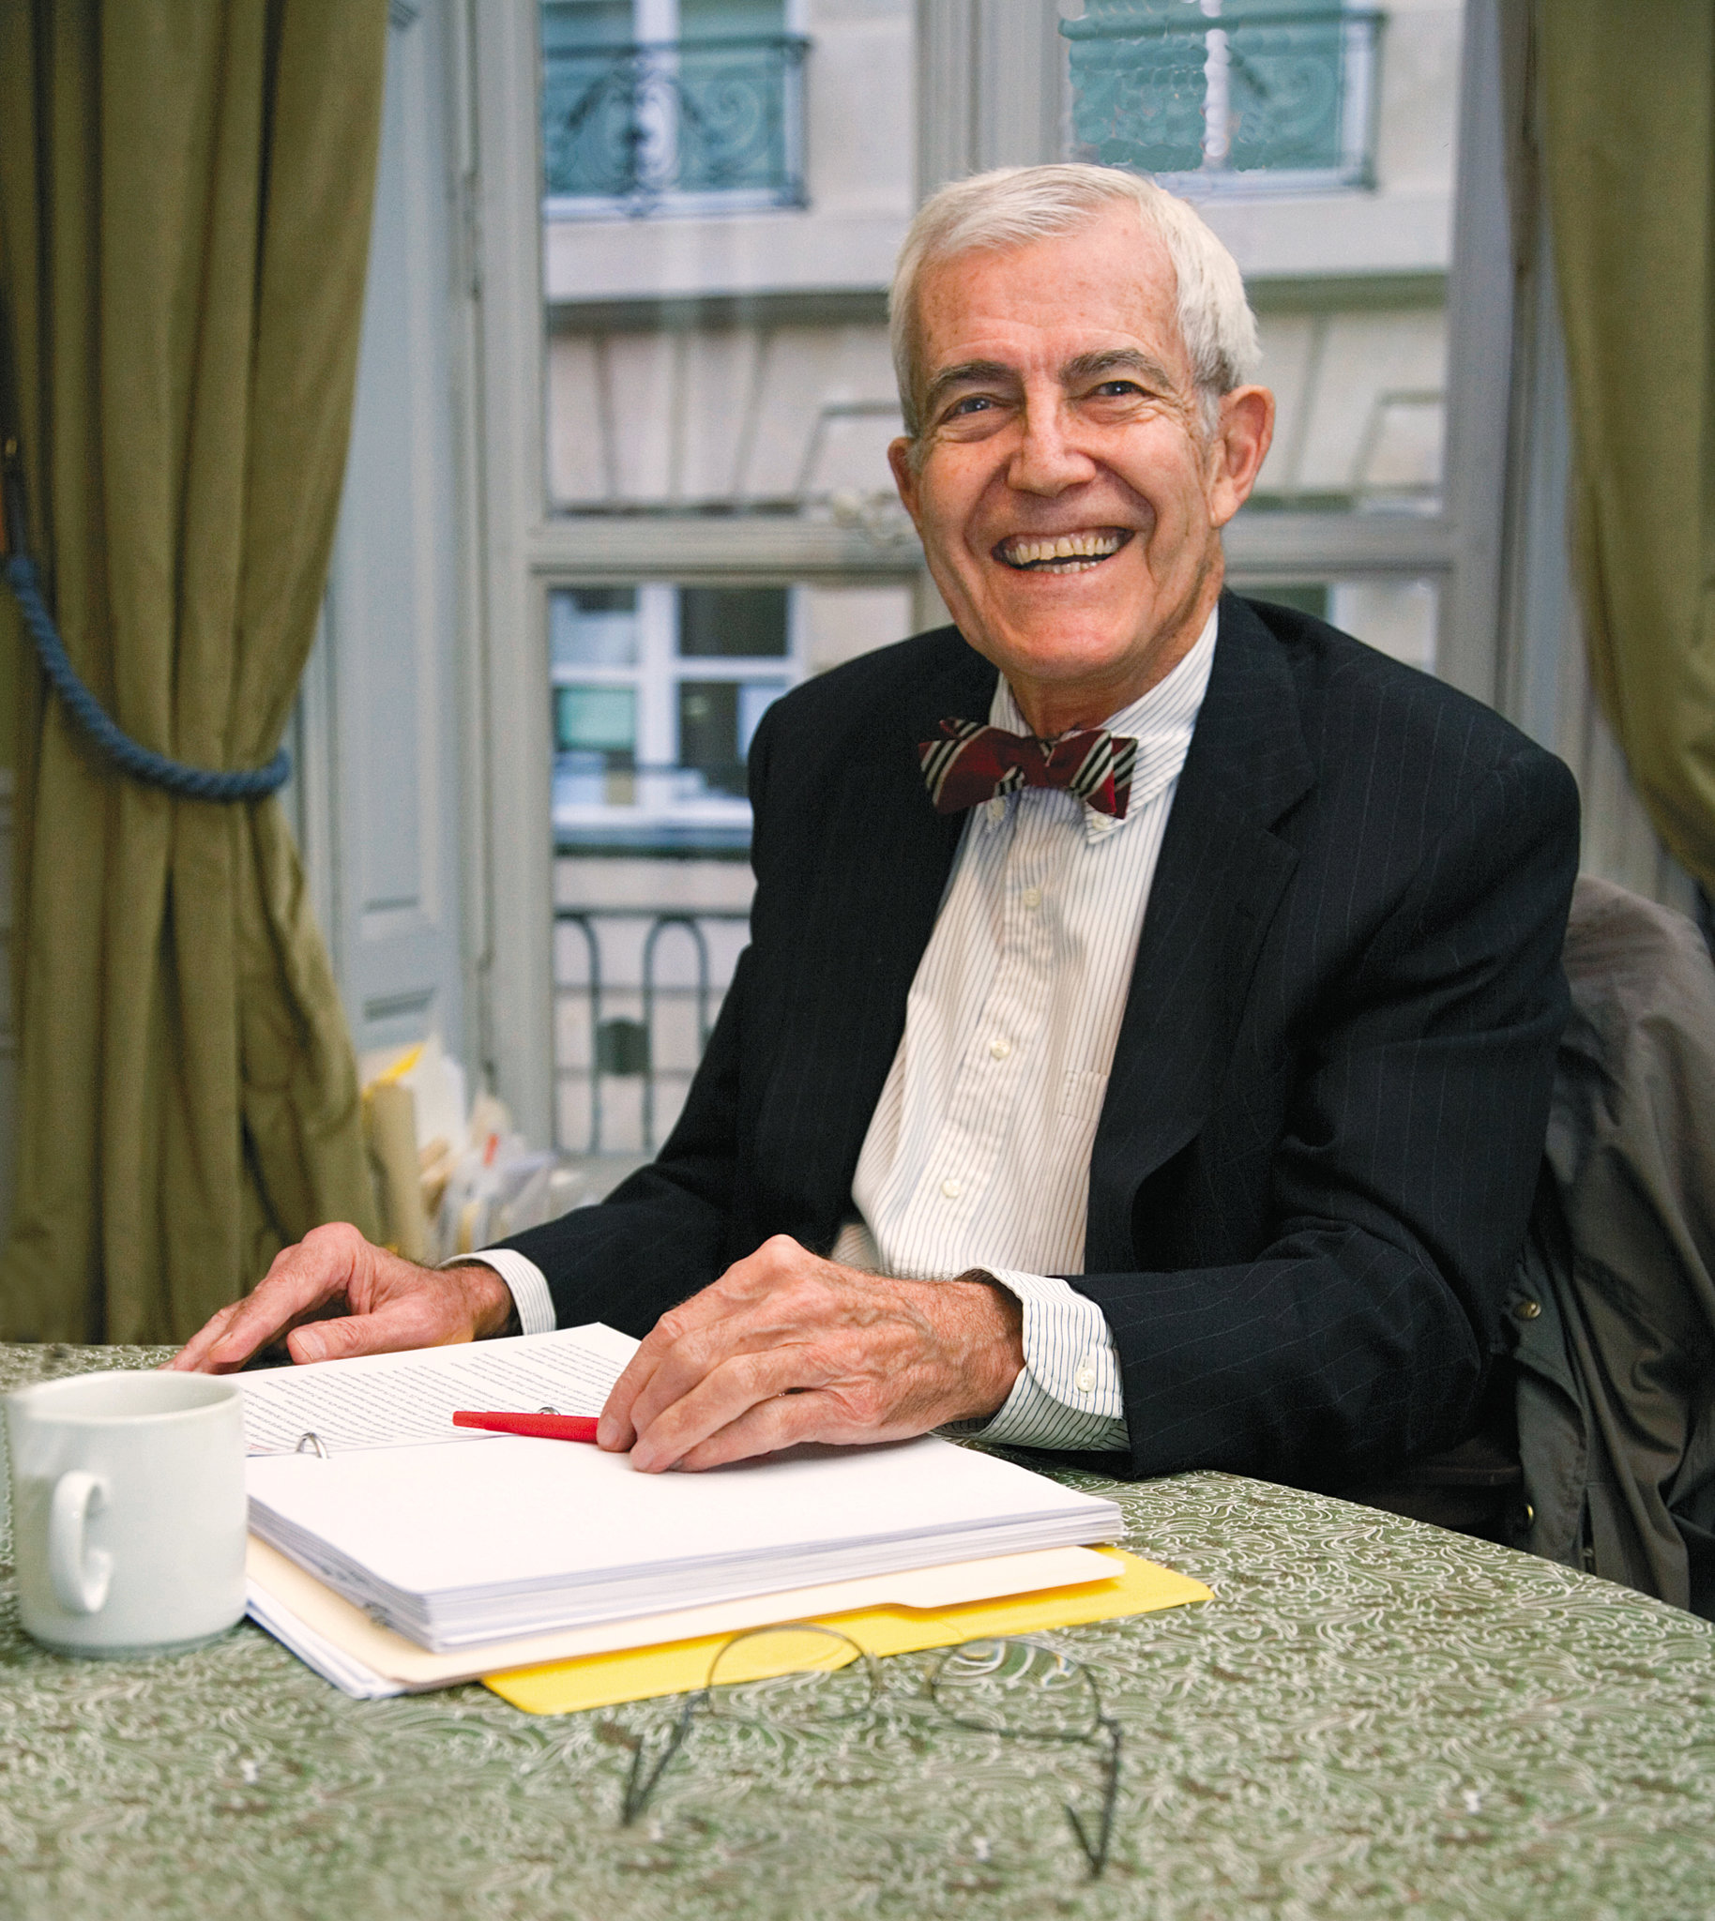
Physicians who would back up my answer
Gerald Bertram Webb, MD
(1871-1949)
TB clinician & researcher
William Dock, MD
(1898-1990)
cardiologist
John F. Murray, MD
(1927-2020)
Pulmonologist

Slide 4
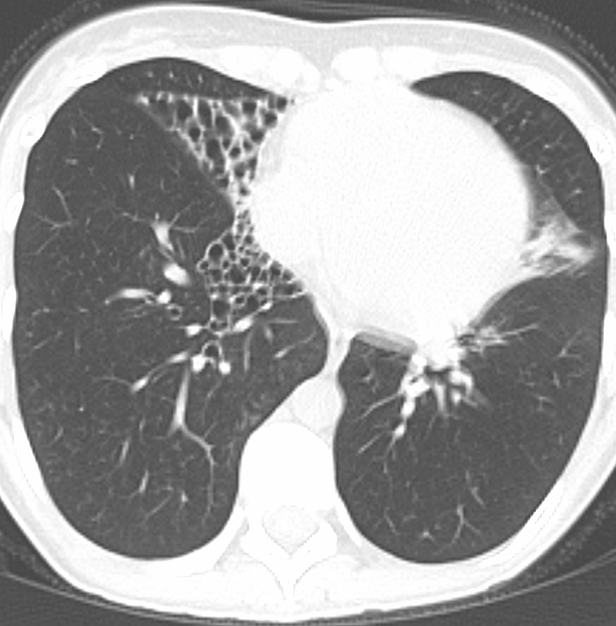
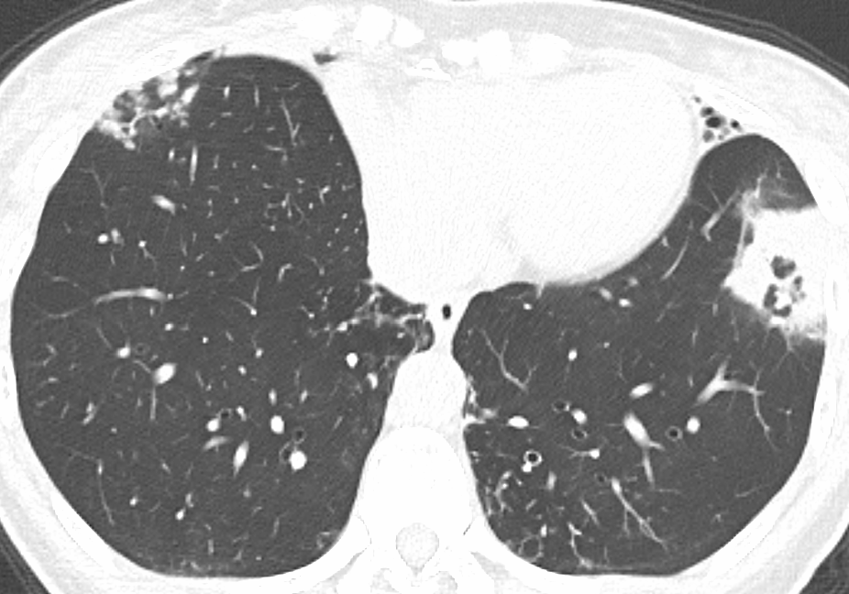
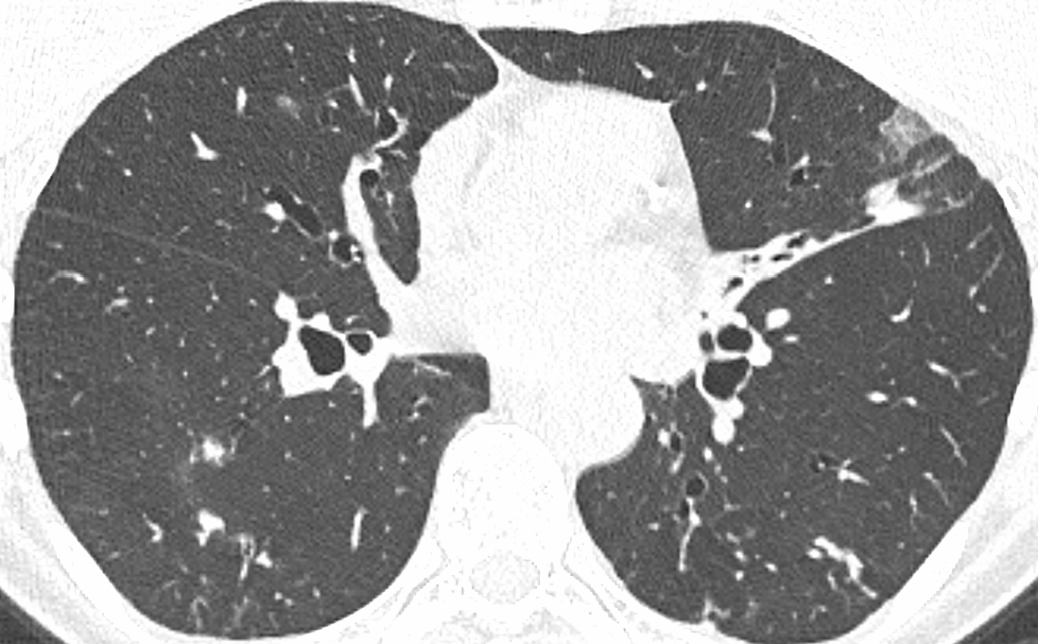
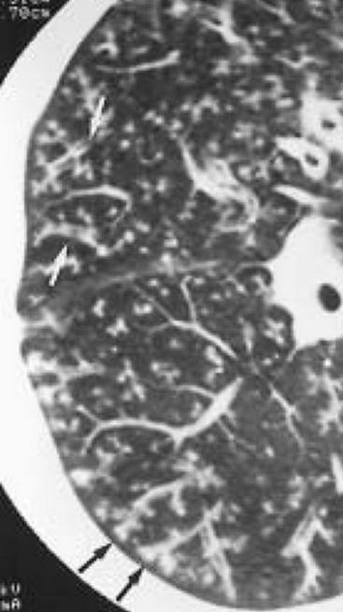
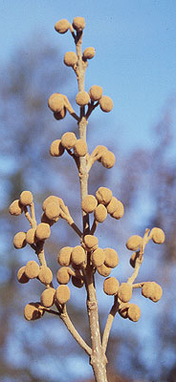
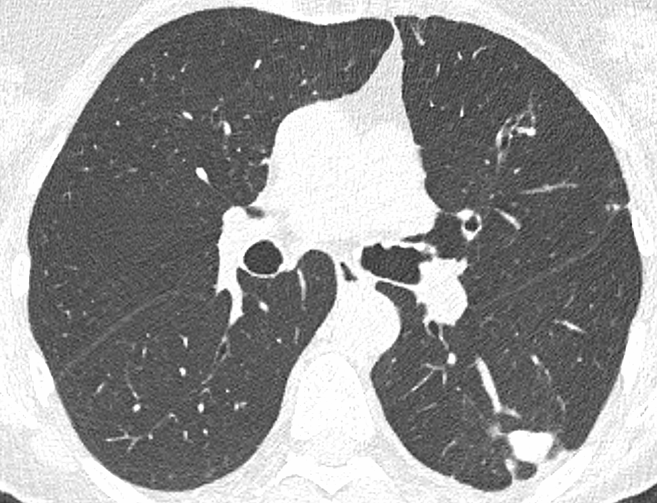
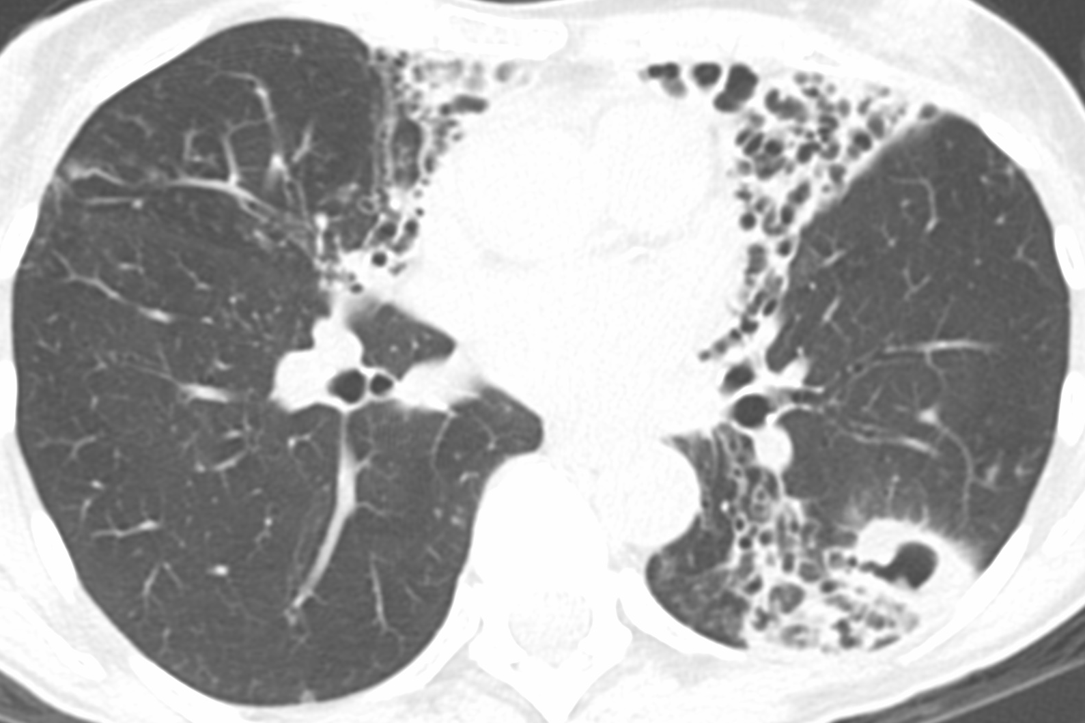
CT features of NTM lung disease
Atelectasis
Bronchiectasis
Consolidation
Ground glass opacities (GGO)
Tree-in-bud opacities
Large nodules (≥ 1 cm)
Cavities
Actual tree-in-bud
Notes:
CT features of NTM-LD include….these 5 features lend themselves to be semi-quantified with ordinal analysis. We also analyzed for large nodules and cavities.

Slide 5
Question
What is the frequency of each of the specific CT features in each of the lung lobes in NTM lung disease?
Notes:
So we were curious to find out…

Slide 6
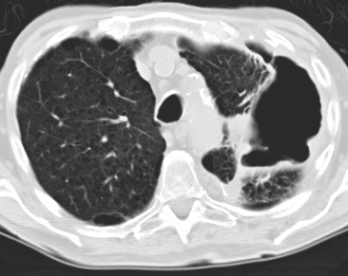
METHOD of CT scoring
Pre-surgical chest CTs of 166 NTM-LD patients were classified into four CT phenotypes: (i) nodular-bronchiectasis (NB), (ii) NB with cavitation (NBc), (iii) fibrocavitary disease, or (iv) unclassifiable.
NB
NBc
Fibrocavitary disease
The chest CTs were analyzed by a chest radiologist and a pulmonologist and the frequency of specific CT features in each of the (six) lobes was determined.
The severity of five CT features (atelectasis, bronchiectasis, consolidation, GGO, & tree-in-bud opacities) were graded for each lobe: Grade 0 (none), Grade 1 (<25% of the lobe involved), Grade 2 (25-50%), and Grade 3 (>50%) → ordinal outcomes.
The presence or absence of two CT features (large nodules ≥1 cm and cavities) were tabulated → binary outcomes.

Slide 7
METHODS (statistical analyses) Matt Strand, PhD (biostatistician), Edward Bosko, MS biostatistics candidate
Occurrences by lobe for features with ordinal outcomes (atelectasis, bronchiectasis, consolidation, GGO, & tree-in-bud opacities) were modeled using ordinal logistic regression, including a random intercept for subject to account for multiple measures per subjects and a random effect for rater nested within subject (a generalized linear mixed model). Features with binary outcomes (large nodules and cavities) were modeled similarly using logistic regression.
Lobes were compared using t-tests derived from these models.
Separate models were fit for each CT feature.
LUS
RUL
RML
Lingu
RLL
LLL

Slide 8
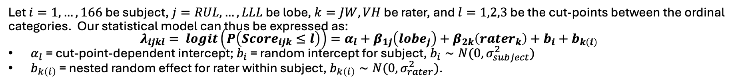
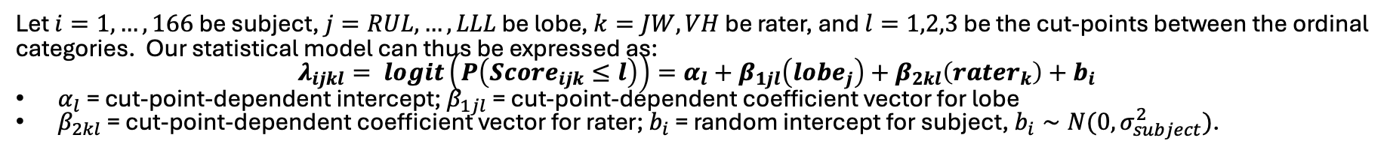
Methods (Statistical modeling approaches used)
Modeling Approach 1 – (Binary) Logistic Regression (Full)
Let $i=1, …, 166$ be subject, $j=RUL, …, LLL$ be lobe, and $k=JW, VH$ be rater. Our statistical model can thus be expressed as: $λ_{ijk}= logit\left(P\left(Score_{ijk}=1\right)\right)=β_{0}+β_{1j}\left(lobe_{j}\right)+β_{2k}\left(rater_{k}\right)+b_{i}+b_{k\left(i\right)}$
$b_{i}$ = random intercept for subject, $b_{i}∼N\left(0,σ_{subject}^{2}\right); b_{k\left(i\right)}$ = nested random effect for rater within subject, $b_{k\left(i\right)}∼N(0,σ_{rater}^{2})$
Interpretation/rationale:
modeling the odds of finding presence of a feature, using lobe and rater as predictors, with subject and rater (within subject) as random effects.
Modeling Approach 3 – Proportional Odds Ordinal Logistic Regression (Full)
Let $i=1, …, 166$ be subject, $j=RUL, …, LLL$ be lobe, $k=JW, VH$ be rater, and $l=1,2,3$ be the cut-points between the ordinal categories. Our statistical model can thus be expressed as:
$$λ_{ijkl}= logit\left(P\left(Score_{ijk}≤l\right)\right)=α_{l}+β_{1j}\left(lobe_{j}\right)+β_{2k}\left(rater_{k}\right)+b_{i}+b_{k\left(i\right)}$$
$α_{l}$ = cut-point-dependent intercept; $b_{i}$ = random intercept for subject, $b_{i}∼N(0,σ_{subject}^{2})$
$b_{k\left(i\right)}$ = nested random effect for rater within subject, $b_{k\left(i\right)}∼N(0,σ_{rater}^{2})$.
Interpretation/rationale:
modeling the odds of an increased rating of a feature, using lobe and rater as predictors, with subject and rater (within subject) as random effects. It’s an ordinal logistic regression model.
Modeling Approach 5 – Non-Proportional Odds Ordinal Logistic Regression
Let $i=1, …, 166$ be subject, $j=RUL, …, LLL$ be lobe, $k=JW, VH$ be rater, and $l=1,2,3$ be the cut-points between the ordinal categories. Our statistical model can thus be expressed as:
$$λ_{ijkl}= logit\left(P\left(Score_{ijk}≤l\right)\right)=α_{l}+β_{1jl}\left(lobe_{j}\right)+β_{2kl}\left(rater_{k}\right)+b_{i}$$
$α_{l}$ = cut-point-dependent intercept; $β_{1jl}$ = cut-point-dependent coefficient vector for lobe
$β_{2kl}$ = cut-point-dependent coefficient vector for rater; $b_{i}$ = random intercept for subject, $b_{i}∼N(0,σ_{subject}^{2})$.
Interpretation/rationale:
like approach 3, but using a model that does not require the proportional odds assumption (it’s a more flexible model).

Slide 9
RESULTS
Patient characteristic
 | NB (n=108) | NBc (n=36) | Fibrocavitary (n=13) | Unclassified (n=9) | p-value
Age (mean yrs ± SD) | 66.8 ± 10.0 | 65.6 ± 7.2 | 67.5 ± 7.3 | 58.4 ± 14.7 | 0.088
Female sex [n (%)] | 99 (91.7%) | 34 (94.4%) | 11 (84.6%) | 8 (88.9%) | 0.733
NB
NBc
Fibrocavitary disease

Slide 10
Mean % of each lobe affected by a particular CT feature
 | NB (n=108) |  |  |  |  |  | NBc (n=36)
 | RUL | RML | RLL | LUS | Lingu | LLL | RUL | RML | RLL | LUS | Lingu | LLL
Atelectasis | 13.9 | 50.5 | 6.5 | 4.2 | 52.8 | 13.0 | 33.3 | 61.1 | 18.1 | 13.9 | 61.1 | 8.3
BXSIS | 77.8 | 85.6 | 73.1 | 53.7 | 84.7 | 64.8 | 95.8 | 98.6 | 90.3 | 79.2 | 95.8 | 87.5
Consolidation | 29.6 | 43.1 | 25.9 | 12.5 | 38.0 | 27.8 | 48.6 | 44.4 | 37.5 | 16.7 | 33.3 | 25.0
GGO | 11.6 | 10.2 | 15.7 | 11.6 | 9.7 | 13.4 | 15.3 | 4.2 | 16.7 | 9.7 | 5.6 | 16.7
Large nodules | 13.0 | 6.5 | 16.7 | 2.8 | 6.0 | 16.7 | 20.8 | 5.6 | 15.3 | 5.6 | 6.9 | 6.9
Tree-in-bud | 82.4 | 86.6 | 86.6 | 66.2 | 80.1 | 80.6 | 94.4 | 79.2 | 94.4 | 80.6 | 84.7 | 91.7
 | Fibrocavitary disease (n=13) |  |  |  |  |  | Unclassified (n=9)
 | RUL | RML | RLL | LUS | Lingu | LLL | RUL | RML | RLL | LUS | Lingu | LLL
Atelectasis | 46.2 | 26.9 | 15.4 | 38.5 | 50.0 | 30.8 | 0 | 0 | 0 | 0 | 0 | 0
BXSIS | 84.6 | 65.4 | 69.2 | 69.2 | 73.1 | 73.1 | 22.2 | 16.7 | 44.4 | 22.2 | 33.3 | 22.2
Consolidation | 57.7 | 19.2 | 34.6 | 30.8 | 23.1 | 34.6 | 27.8 | 5.6 | 27.8 | 16.7 | 5.6 | 5.6
GGO | 7.7 | 11.5 | 19.2 | 15.4 | 11.5 | 7.7 | 27.8 | 0 | 11.1 | 0 | 0 | 0
Large nodules | 15.4 | 3.8 | 11.5 | 7.7 | 3.8 | 15.4 | 16.7 | 5.6 | 5.6 | 27.8 | 11.1 | 16.7
Tree-in-bud | 42.3 | 53.8 | 69.2 | 57.7 | 65.4 | 76.9 | 33.3 | 16.7 | 22.2 | 22.2 | 11.1 | 22.2
NB=nodular bronchiectasis CT phenotype; FC=fibrocavitary CT phenotype; BXSIS=bronchiectasis; GGO=gound glass opacities; RUL=right upper lobe; RML=right middle lobe; RLL=right lower lobe; LUS=left upper lobe segments; lingu=lingula; LLL=left lower lobe
Notes:
Based on two readers, we calculated the mean % of each lobe affected by a particular CT feature, stratified by the 4 CT phenotypes….the 6 lobes analyzed are the RUL…so for example, for the NB phenotype, atelectasis was found in 50% of the patients and BXSIS in 85% of the patients, etc
We have also colored the cells of the two lobes that were most commonly affected by each CT feature…so for 13 patients with FC disease, BXSIS was most common in the RUL, lingu, and LLL.
But this Table is hard to read and does not give indication of the extent of disease within each lobe.,

Slide 11
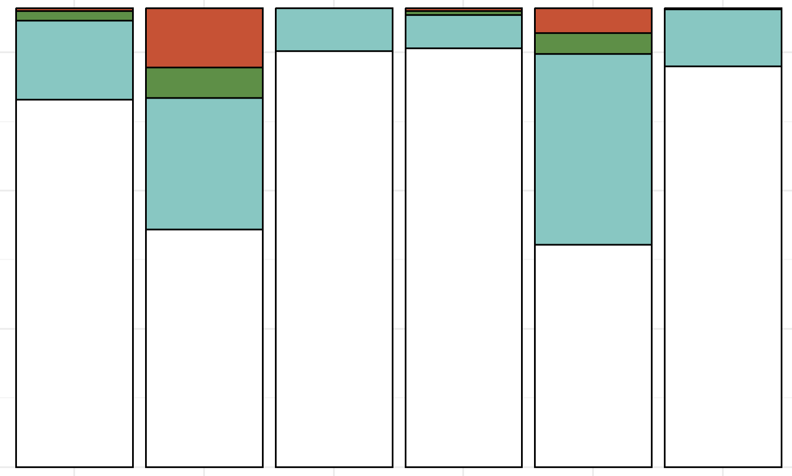
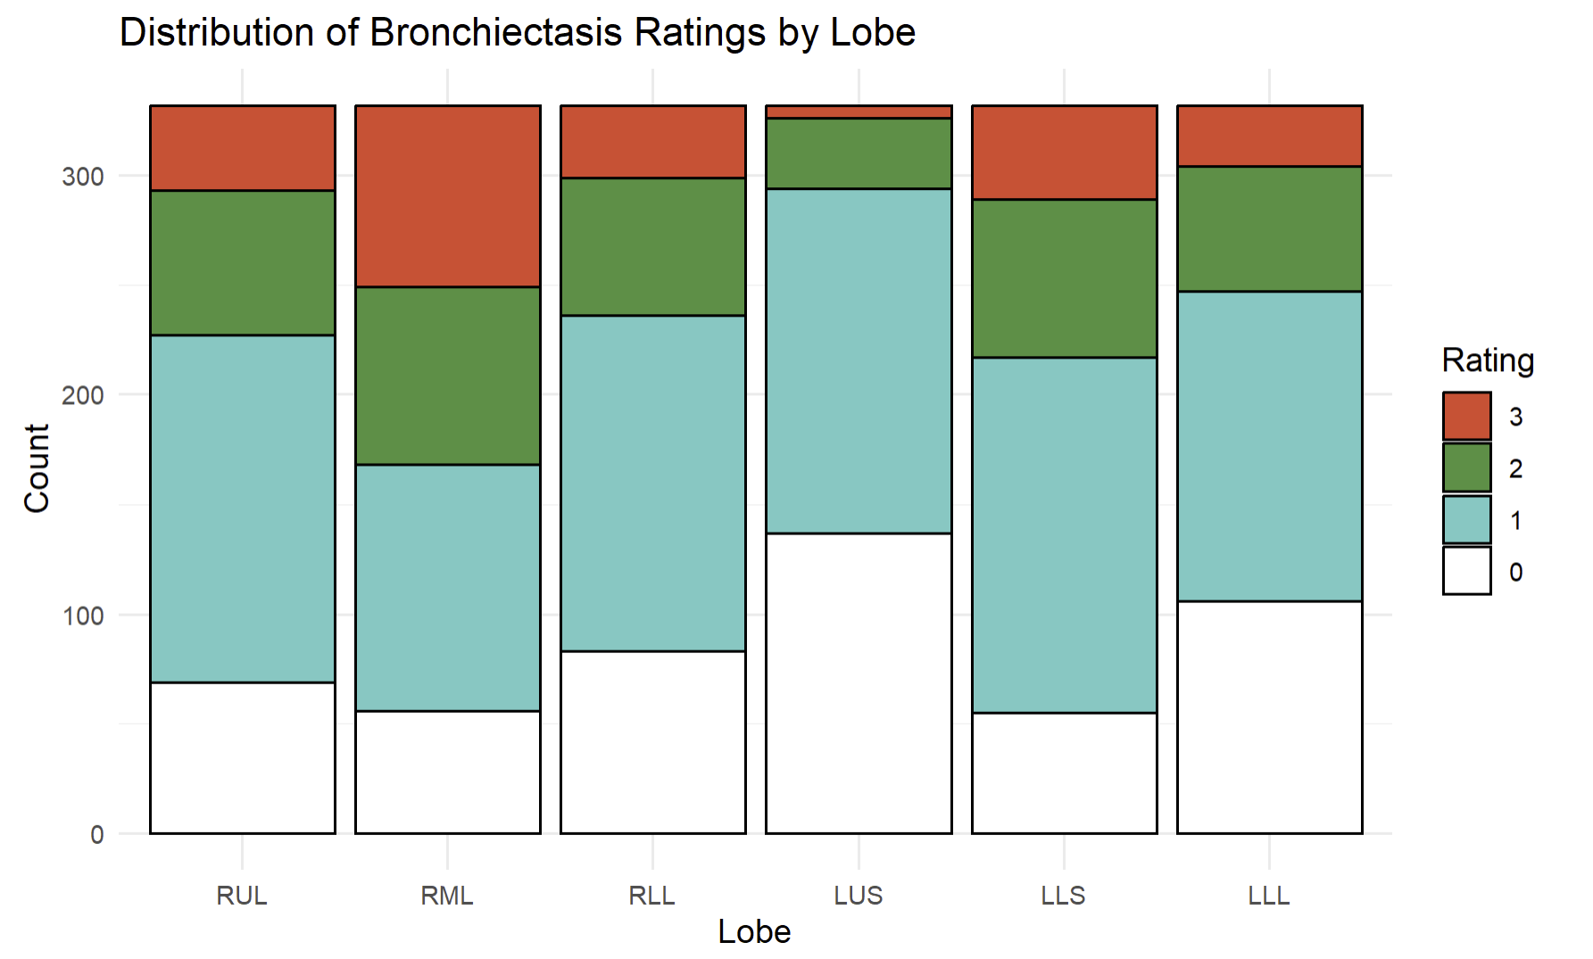

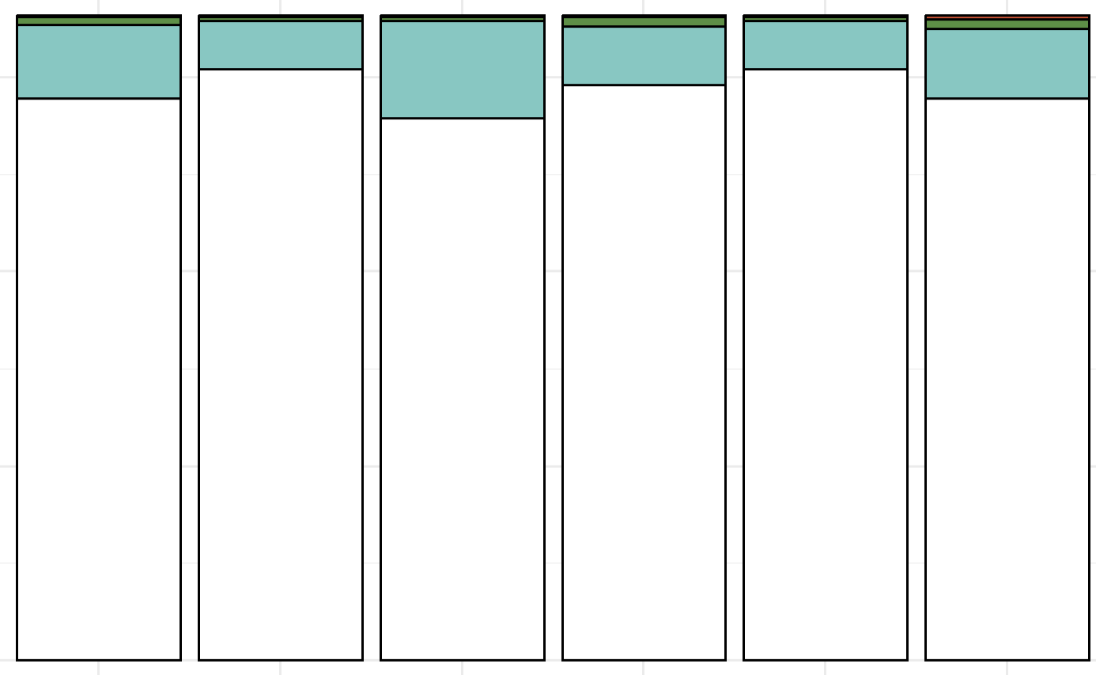
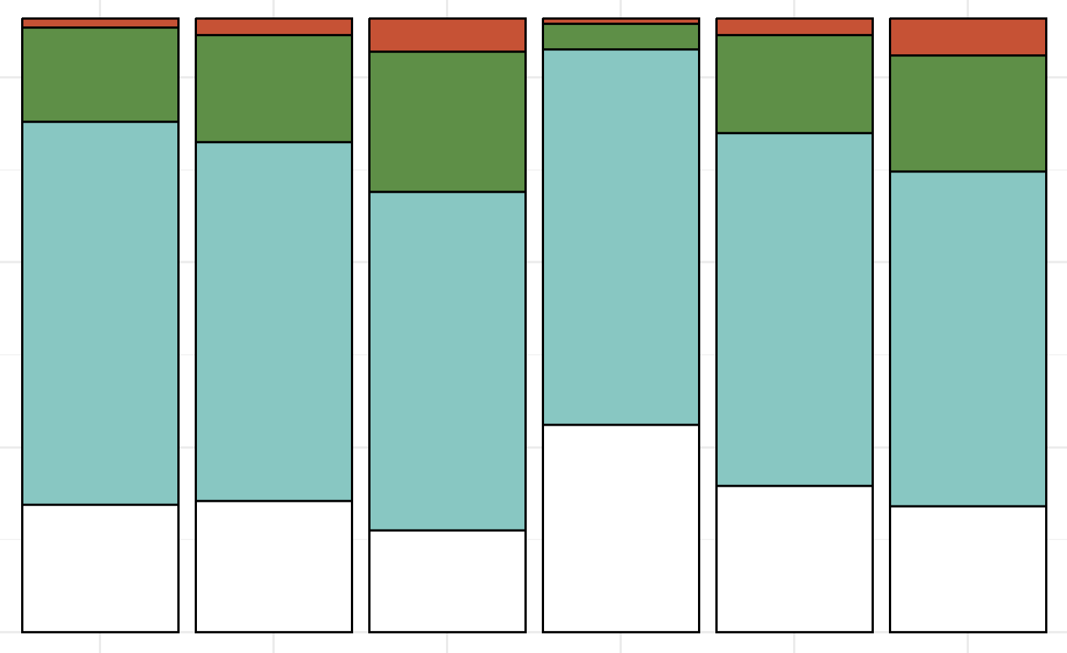
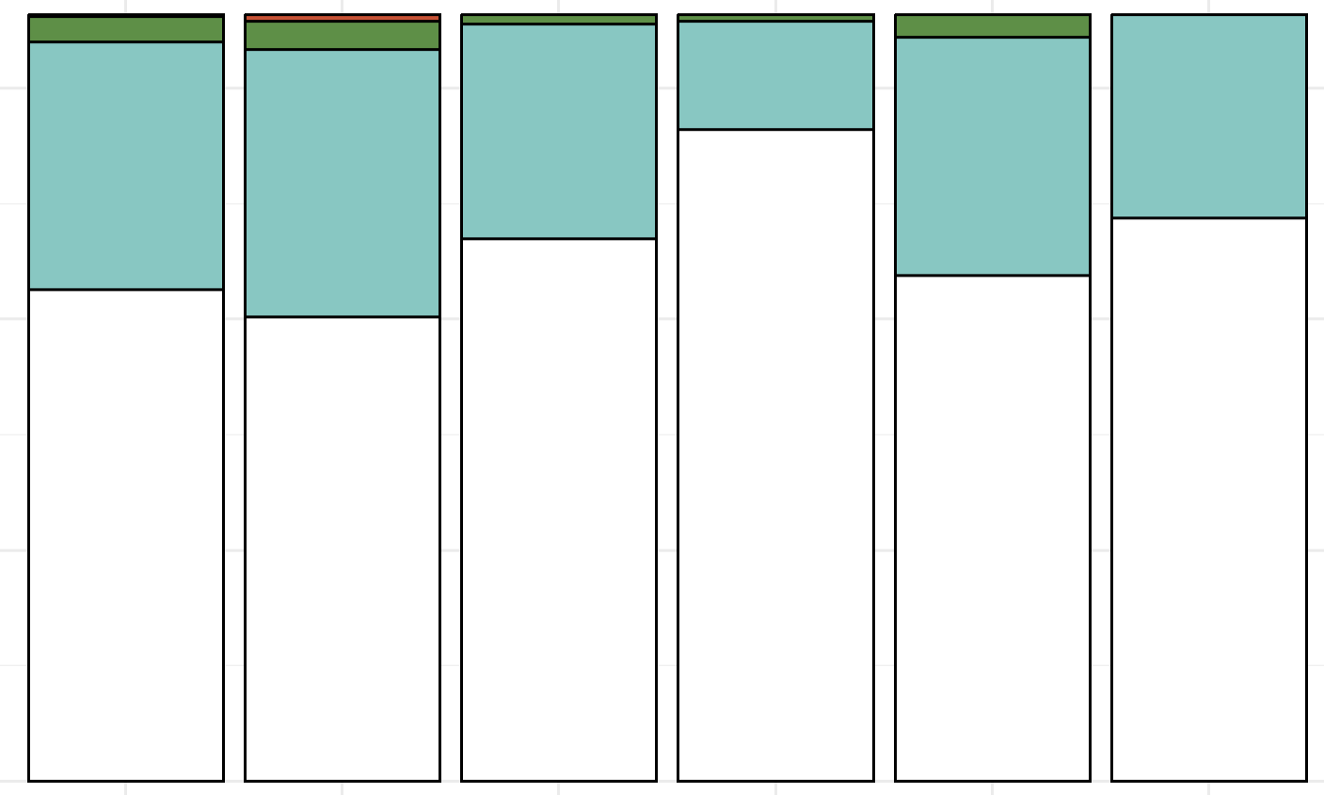
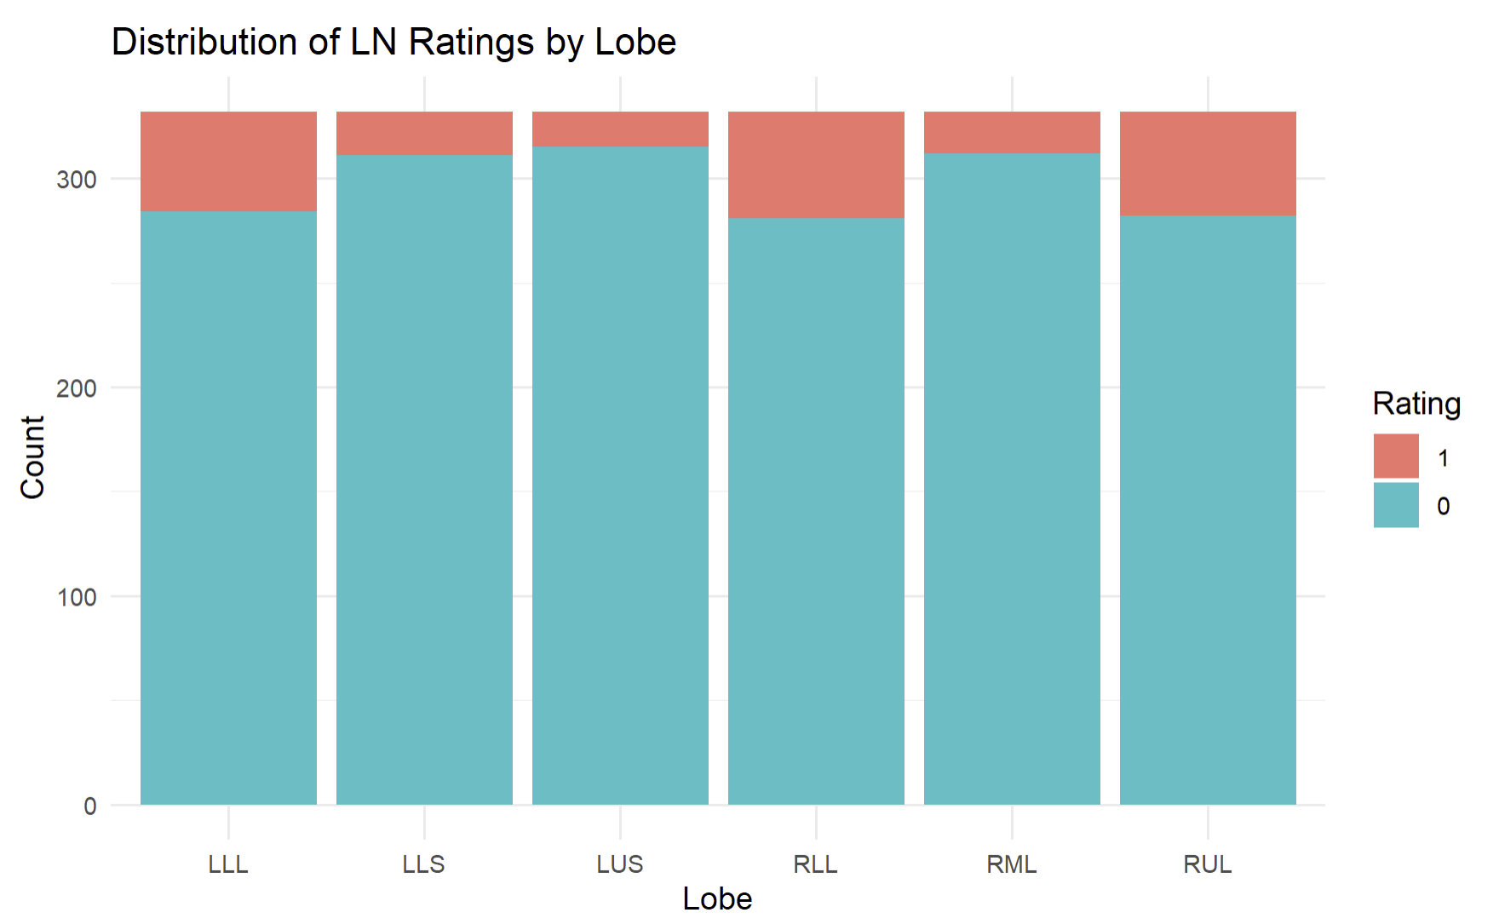
The lobes most commonly affected are also most severely affected
Atelectasis: Lingu, RML, RUL > others (OR 1.71-20.45)
GGO: RLL, LLL, RUL > others (OR 2.04-3.14)
Counts
RUL
RML
RLL
LUS
Ling
LLL
Counts
RUL
RML
RLL
LUS
Ling
LLL
Rating
300
300
3
200
2
200
100
1
100
0
Bronchiectasis: RML, Lingu > others (OR 1.76-22.58)
TIB: RLL, LLL > others (OR 1.60-6.54)
Rating
300
300
3
200
2
200
100
1
100
0
Consolidation: Lingu, RML, RUL > others (OR 1.63-6.47)
Lrg nodules: RLL, RUL, LLL > others (OR 3.25-4.71)
300
300
200
YES
200
NO
100
100

Slide 12
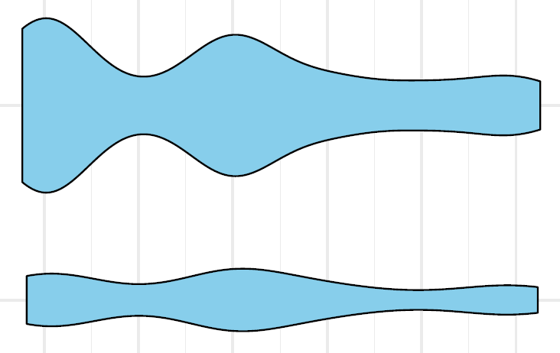
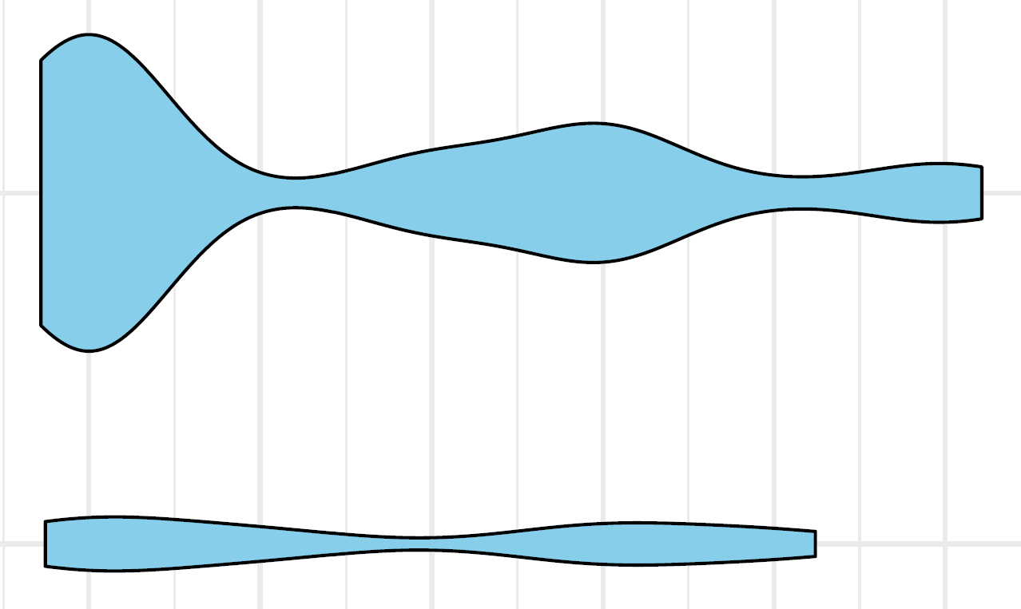
Cavities affects mainly the RUL, RLL, & LUS
Mean number of patients with cavities
 | Nodular BXSIS with cavity (n=36) |  |  |  |  |  | Fibrocavitary disease (n=13)
Cavity | RUL | RML | RLL | LUS | Lingu | LLL | RUL | RML | RLL | LUS | Lingu | LLL
Thick-wall | 16 44% | 2 5 6% | 13 35% | 4.5 13% | 3.5 10% | 5 14% | 11 85% | 0 0% | 2.5 19% | 4.5 35% | 0.5 3.9% | 2 15%
Thin-wall | 5.5 15% | 1 3% | 6 17% | 2.5 7% | 1 3% | 3 8% | 2 15% | 1 8% | 0 0% | 1.5 12% | 1 7.7% | 0 0%
All cavities: RUL, RLL, LUS > others (OR 2.340-58.29)
NBc
Fibrocavitary
Thick-wall
cavity
Thin-wall
cavity
RUL
RML
RLL
LUS
Lingu
LLL
RUL
RML
RLL
LUS
Lingu
LLL

Slide 13
Summary of key findings
Bronchiectasis & atelectasis are most common & severe in the RML and lingula (not surprising).
GGO & tree-in-bud opacities – plausibly a sign of endobronchial spread – occurr mainly in the RLL and LLL…role of aspiration?
NTM lung cavities
73% are mostly thick-walled
62% of all cavities occur in either the RUL or LUL.
40% of all cavities occur in the RUL (15-20% of the TLC).
With NBc, the RLL was the second most common site for cavities.

Slide 14
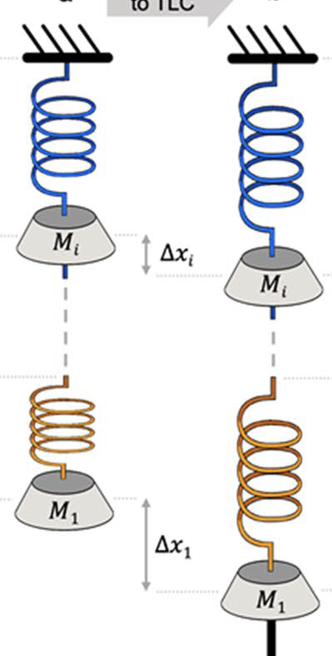
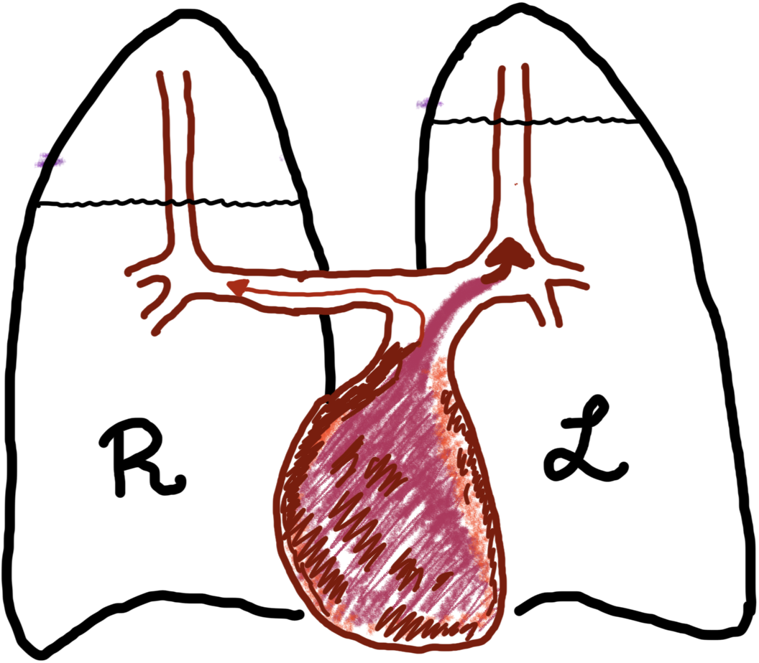
Why are NTM cavities more common in the RUL & LUL?
Anatomical-physiologic effects
Biological implications
Decreased influx of immune cells, soluble mediators, & antibiotics
Decreased blood perfusion
Decreased lymphatic formation
Decreased clearance of NTM & antigens
Increased O₂ / pH in alveolar spaces
Increased aerobic growth of NTM
Increased stiffness, alveolar spaces, & imposed weight on inspiration
Increased physical stress on lung tissue
*
Gravity & more tortuous route of the RUL blood supply → more vulnerable to TB & NTM.
Force (upper lobes) =
(Mi + M1) x g
*
Upright
lung
TLC
Force (lower lobes) =
M1 x g
Dock W. Am Rev Tuberc 1946; Dock W. Arch Intern Med 1954
West JB & Dollery CT. J Appl Physiol 1960

Slide 15
Potential health implications of our key finding…
Abd AG et al. Chest 1988
Should NTM-LD patients with cavities in the upper lobe(s) refrain from excessive exercise?
Should they be lying down more when resting?
Should they be lying down when getting IV (or inhaled) antibiotics?

Slide 16
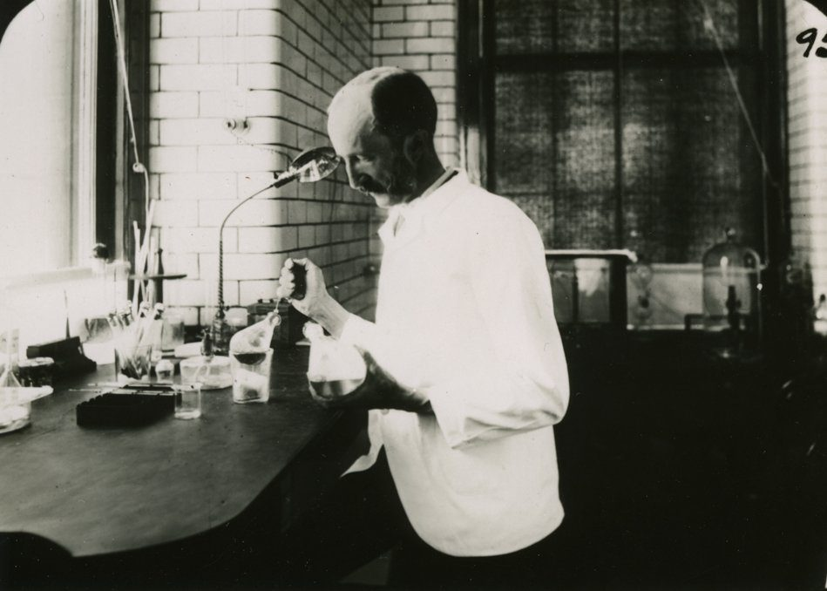
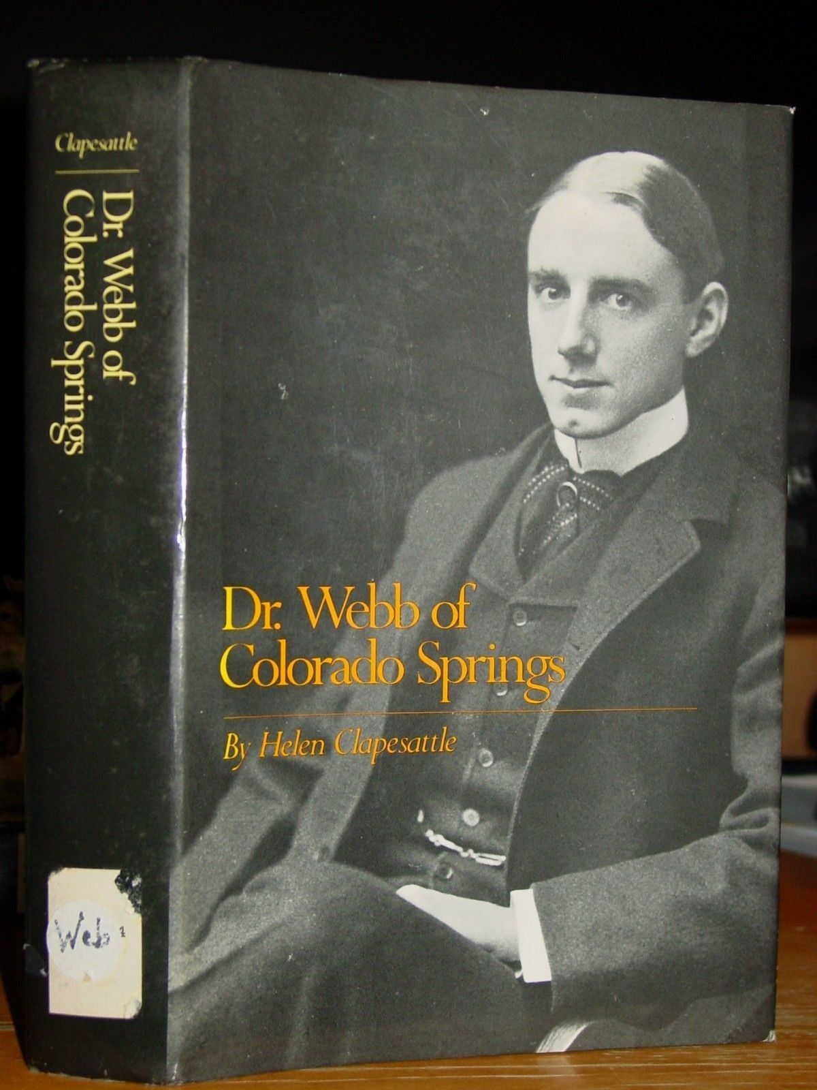
I know I have hurt nobody by rest, but I am quite sure I often have by allowing them to exercise (Edward Livingston Trudeau, MD, 1848-1915, New York).
A good rule is the following: Never stand when you can sit, never sit when you can lie down (Gerald Webb, MD, 1871-1949, Colorado) in Webb GB & Ryder CT. Overcoming TB: An Almanac of Recovery, 3rd edition, 1927).

Slide 17
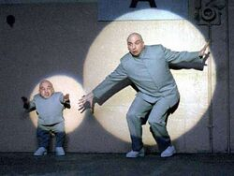
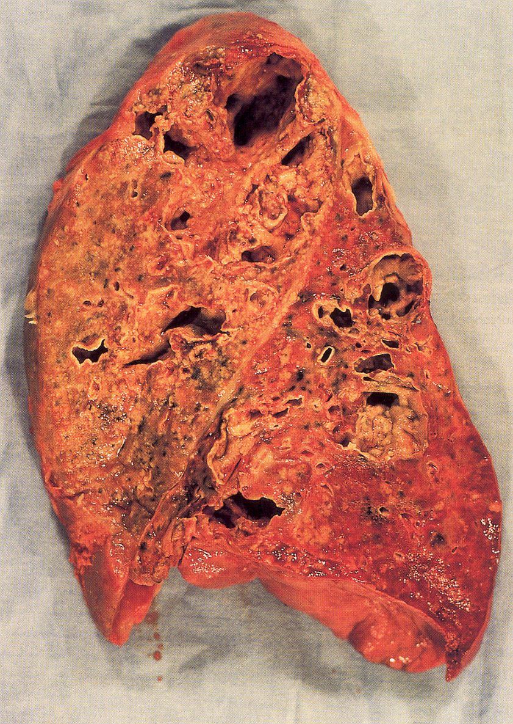
On-going work
Analyze the same data stratified by NTM species: MAC vs. M. abscessus vs. other NTM.
Determine whether the superior segment of the RLL is disproportionately affected in the RLL in those with NBc.
TB
Hypothesis: in the RLL, the superior segment would be more affected by cavities than the basilar segments because mechanically the RLL is like an independent “mini-lung.”
Total lung
RLL
Dr. Evil & Mini-Me

Slide 18
Physicians who would back up my answer
Gerald Bertram Webb, MD (1871-1949); Webb-Waring Lung Institute of University of Colorado.
Noted TB clinician & researcher in Colorado Springs, CO. From his home in CS, he researched on TB in small animals, primates, and humans. Founded the Cragmor Sanitorium.
Collaborated with Robert Koch, MD and Edward Livingston Trudeau, MD.
Voluteered for WWI, hunted with President Teddy Roosevelt, high-altitude immunology, coined the term “immunology,” and was the first president of the American Association of Immunologist.
William Dock, MD (1898-1990)
A leading cardiologist of his generation.
Known for an eponymously named diastolic murmur indicating severe stenosis of the LAD coronary artery.
‘Sutton’s Law‘ (Dock’s Law): “if ‘the money‘ resides in a specific diagnostic test, then that test should be conducted immediately….
John F. Murray, MD (1927-2020)
Noted pulmonologist at UCSF. Co-author of Murray & Nadel’s Textbook of Pulmonary Medicine.
Secretary General of the International Union Against Tuberculosis and Lung Disease.
Chief of Pulmonary at San Francisco General Hospital from 1966-1989
Wrote The Normal Lung: “You never finish a book; you just have to abandon it.”

Slide 19







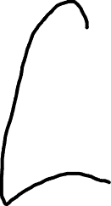
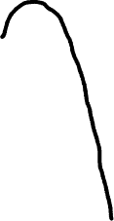














Hypothesized mechanisms by which the RML, lingula, and RUL are more severely affected by NTM lung disease
RUL
HYPOTHESIZED MECHANISMS
1) Less acute angle of right mainstem takeoff
2) Secretions down the medial wall of bronchus intermedius more likely to enter the RML
3) Narrower orifice of the RML
4) Secretions enter the ventral RML & lingula during prone position
5) Less acute angle of lingula bronchus
6) Effects of the beating heart on microatelectasis and macrophage phenotype
7) Electrical influence of the heart on cilia function
8) Decreased lymphatic flow of the upper lobes
9) Secretions enter RUL with supination and right lateral decubitus
8
9
1
2
5
3
RML
7
4
4
6
lingula

