Slide 1
Examining Differences in Lobar Severity of Disease by Causal Culture
Prepared by Edward Bosko

Slide 2
Descriptive Statistics

Slide 3
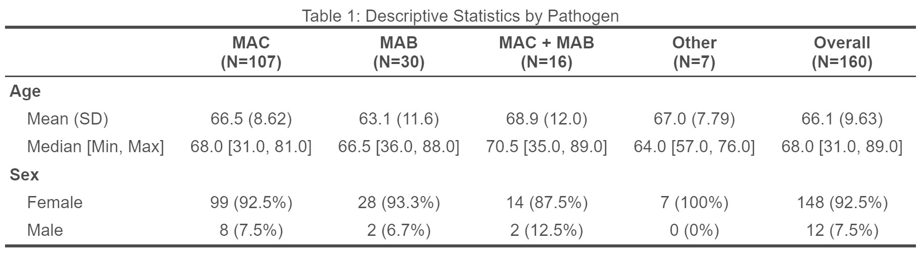

Slide 4
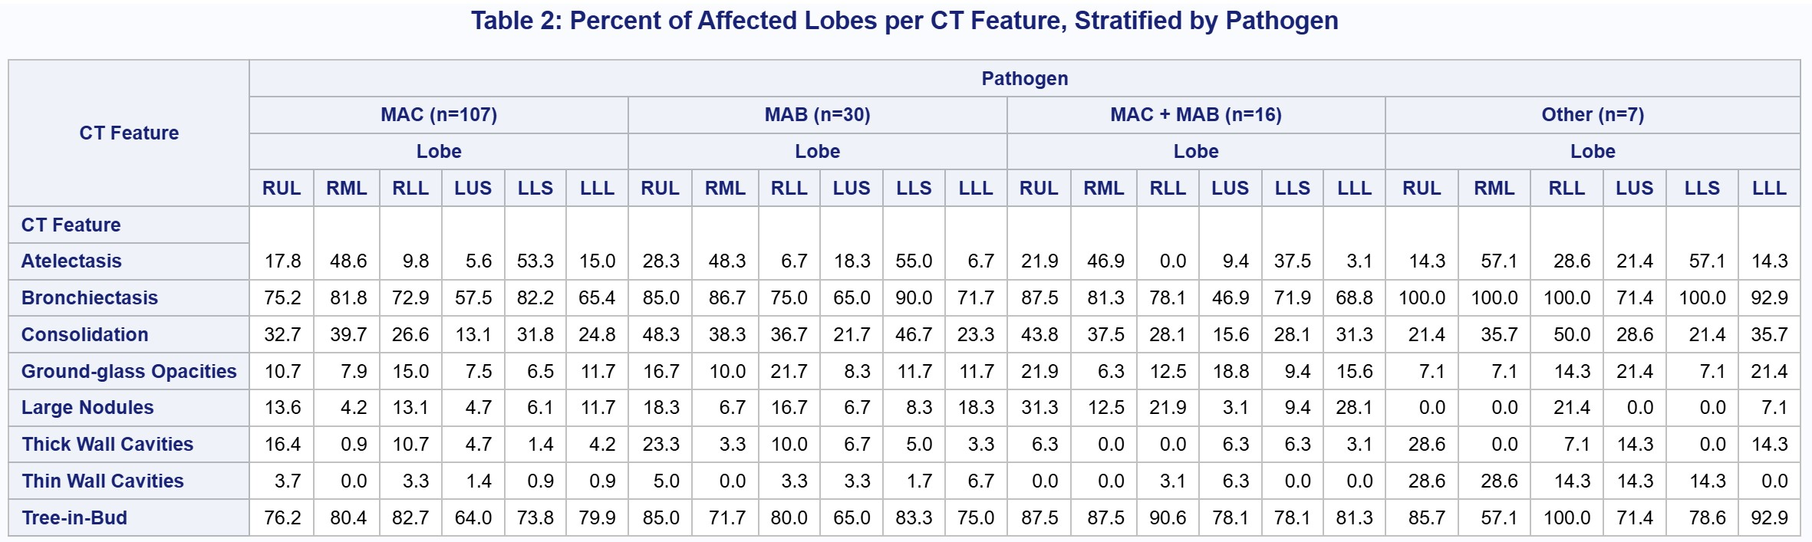

Slide 5
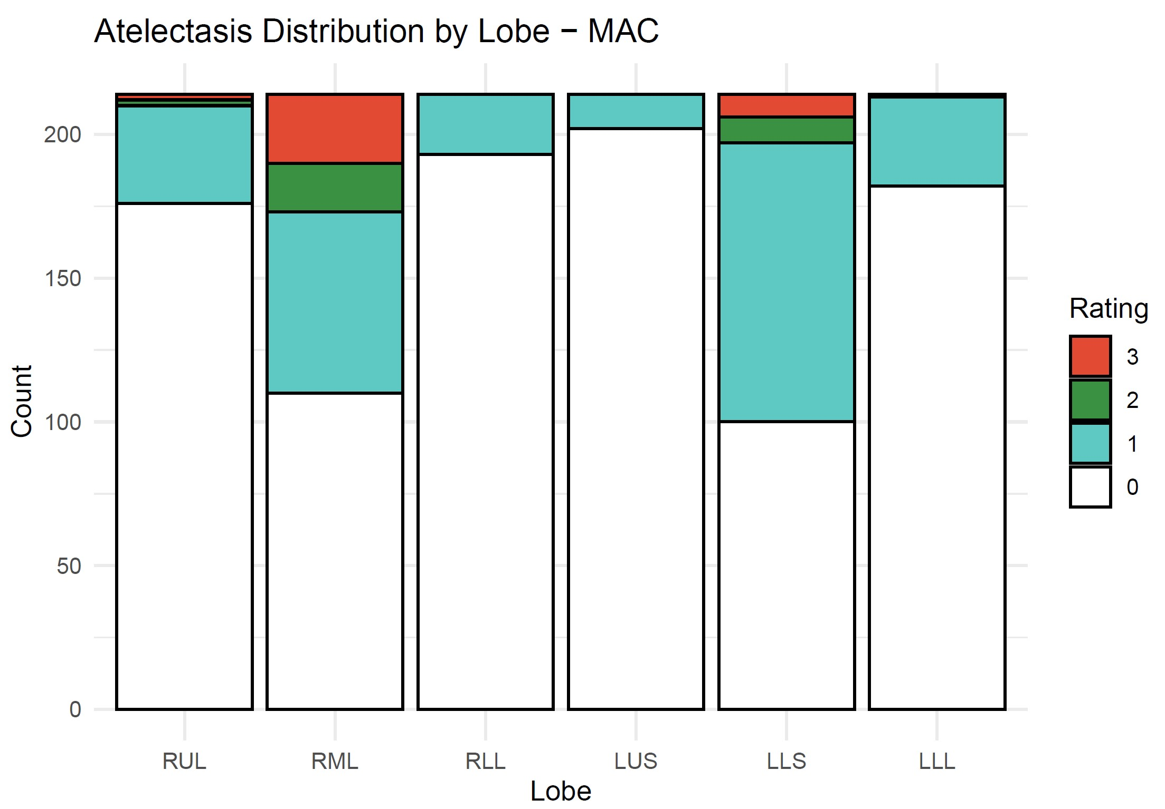
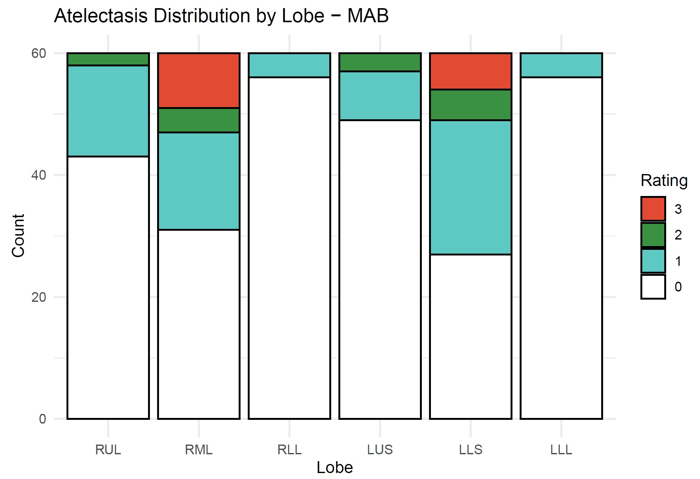
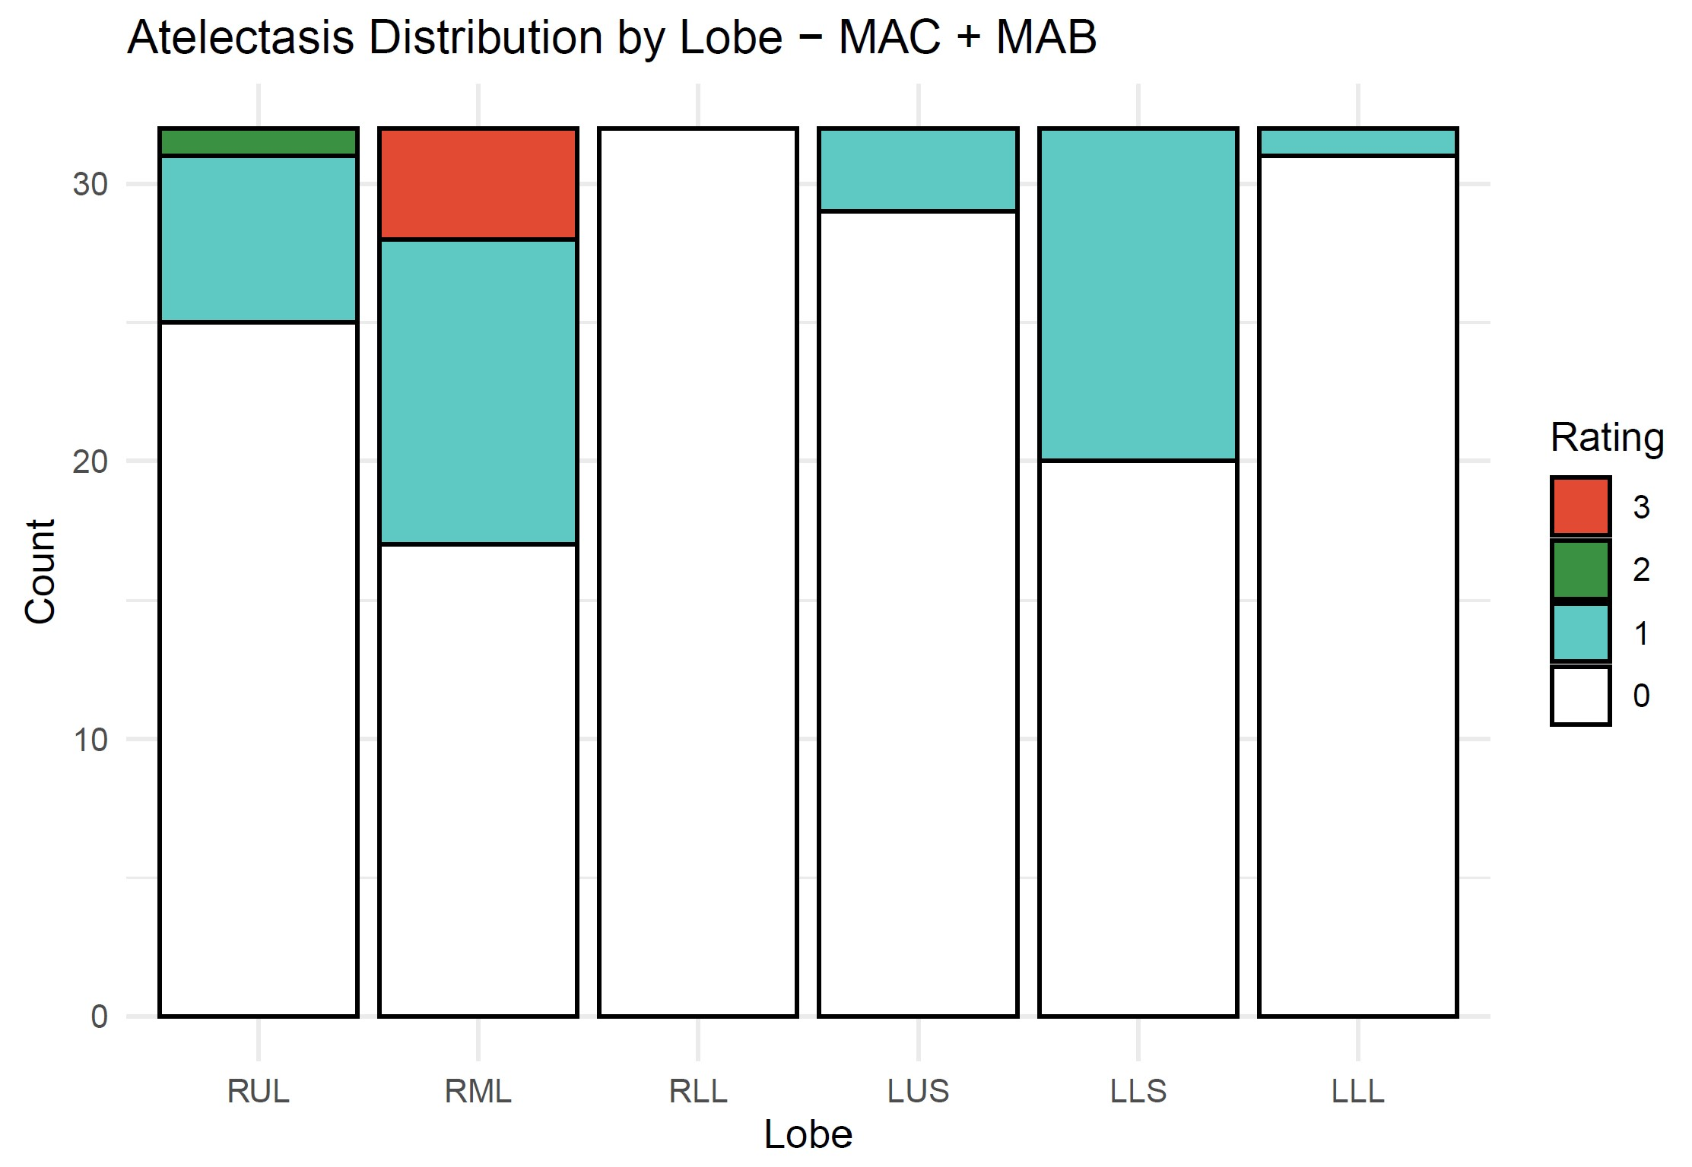
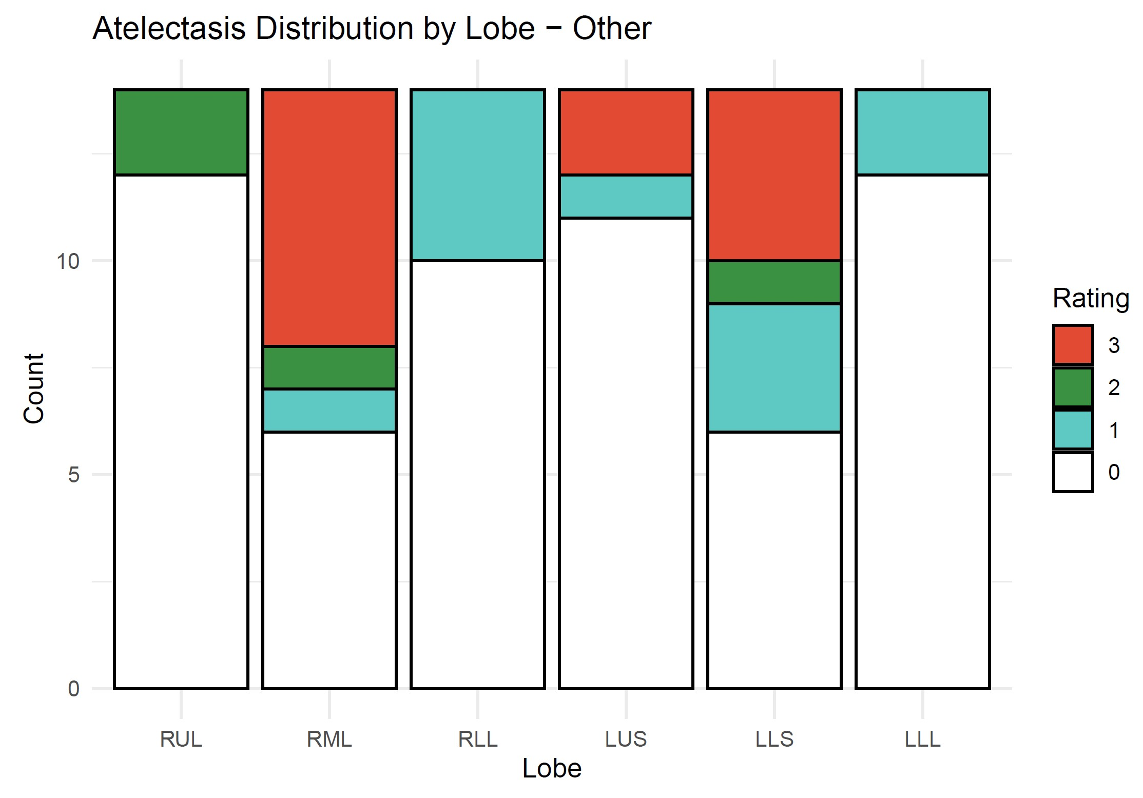

Slide 6
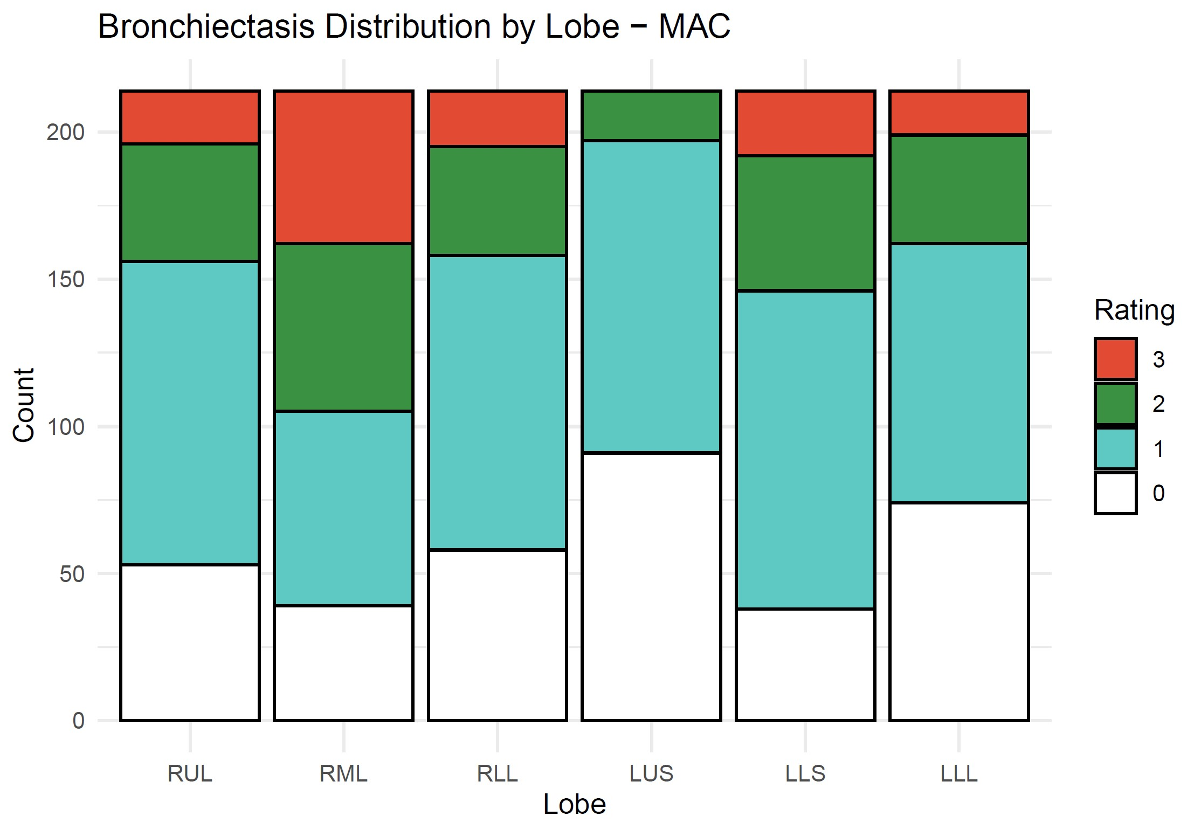
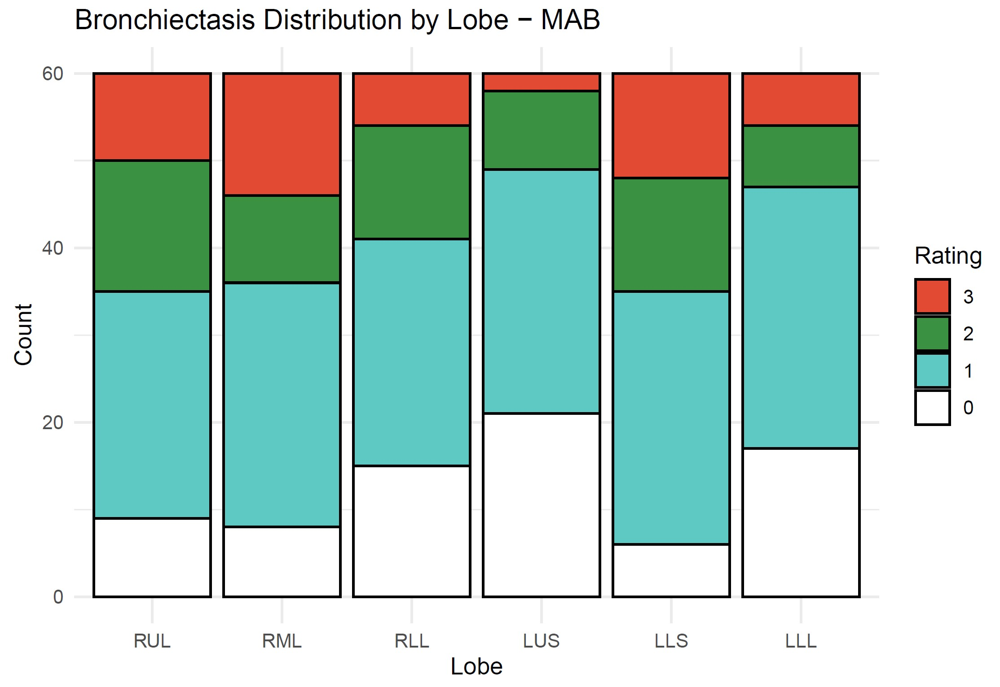
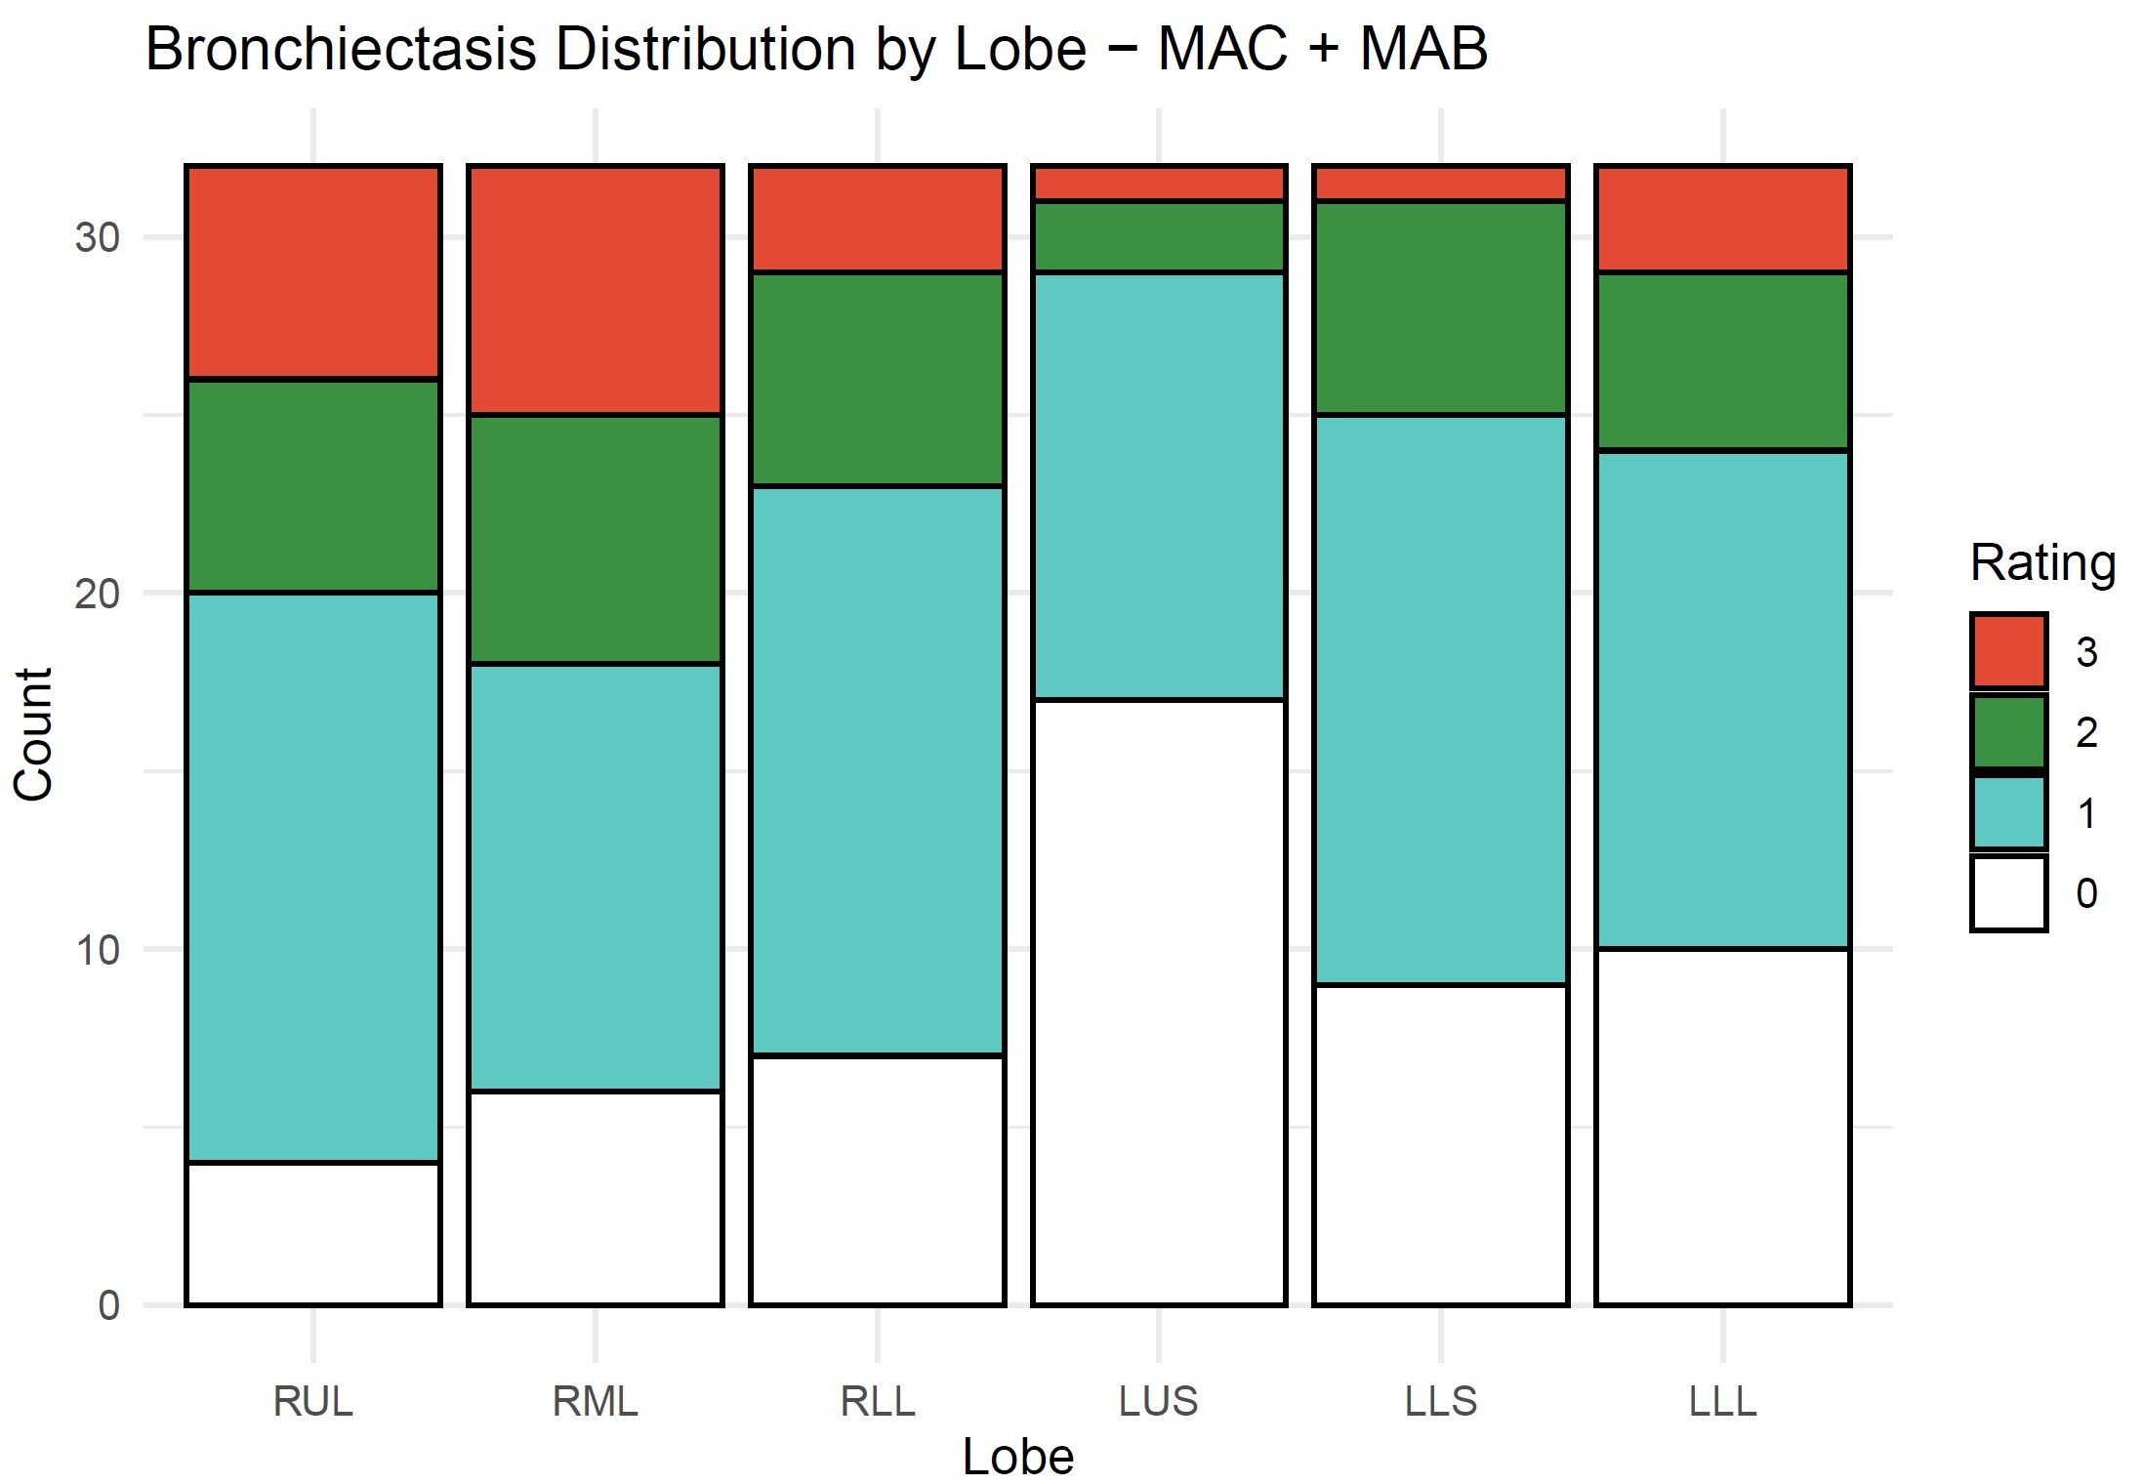
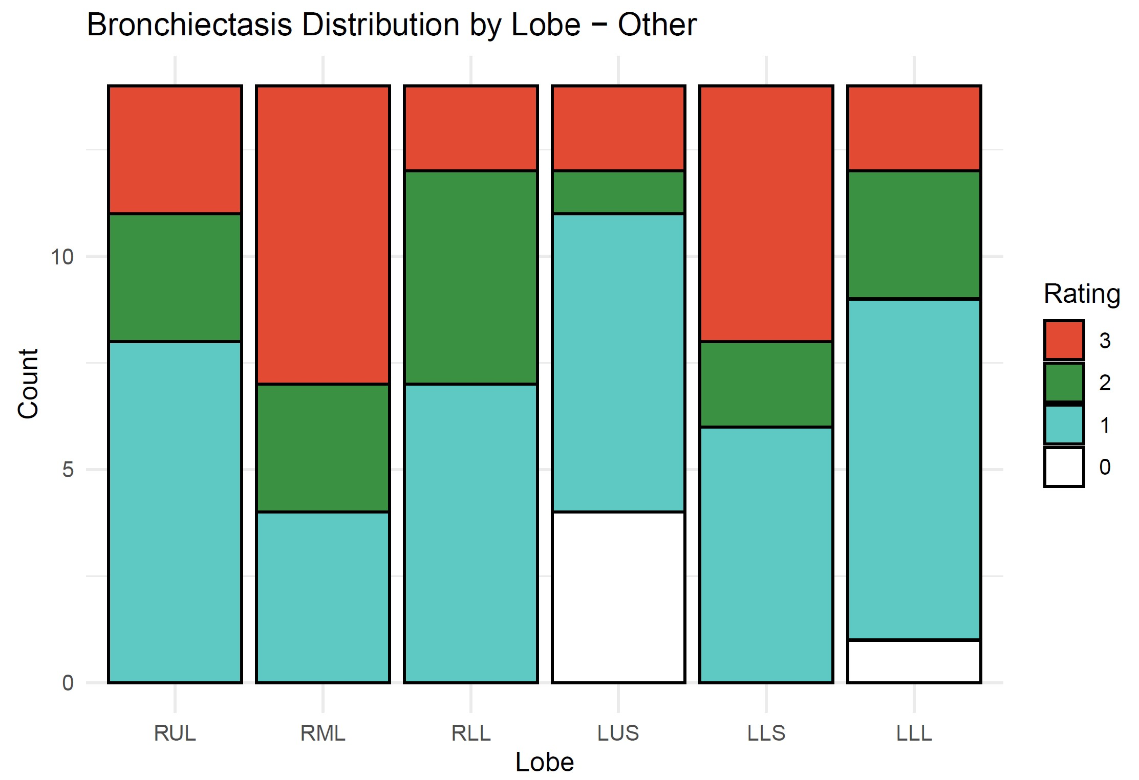

Slide 7
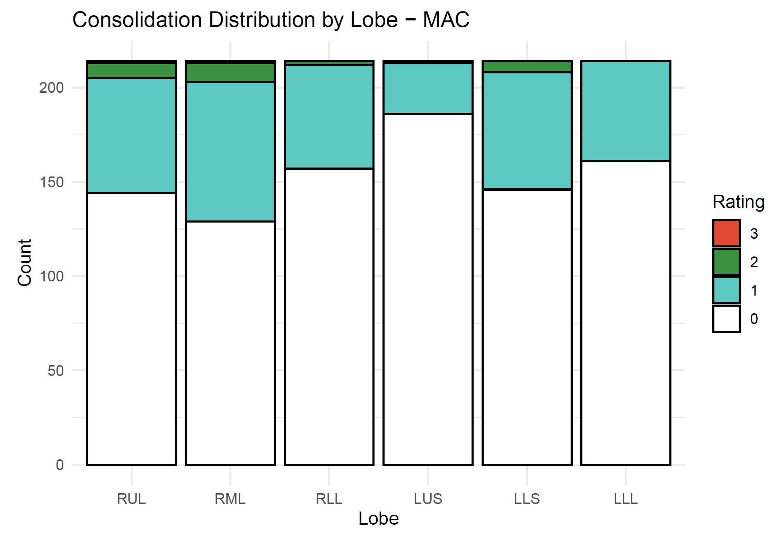
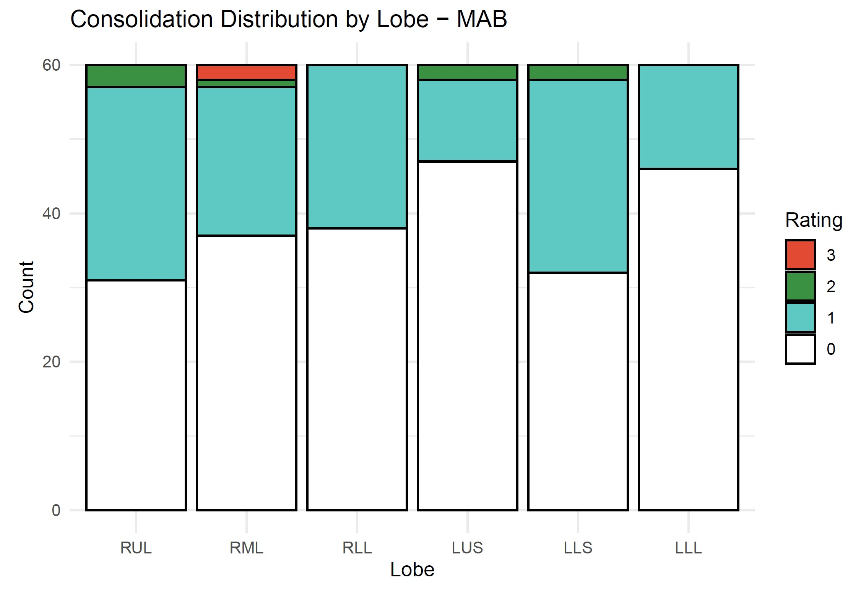
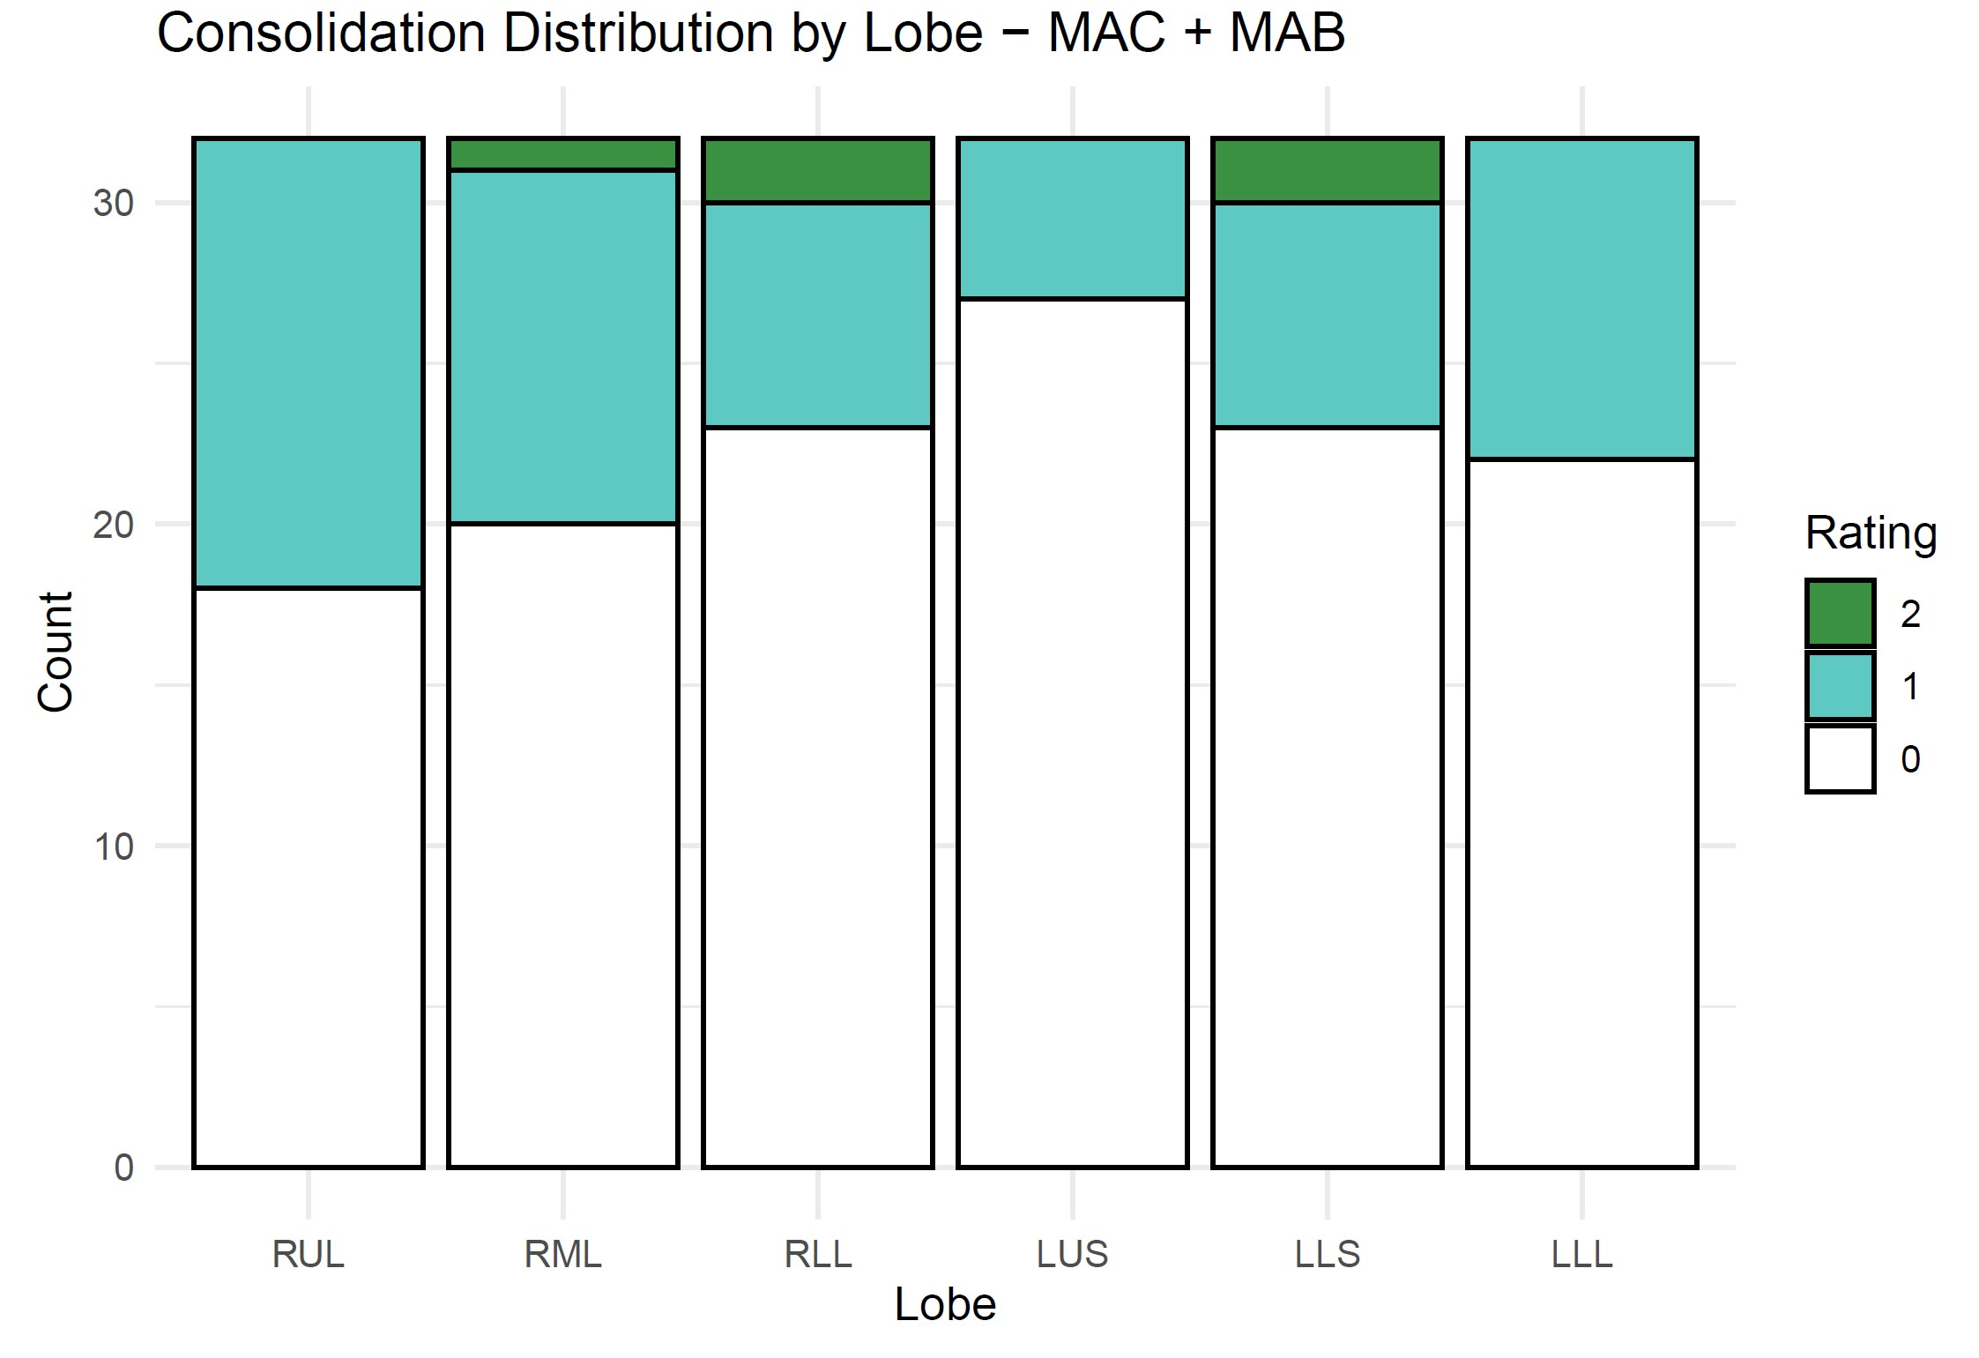
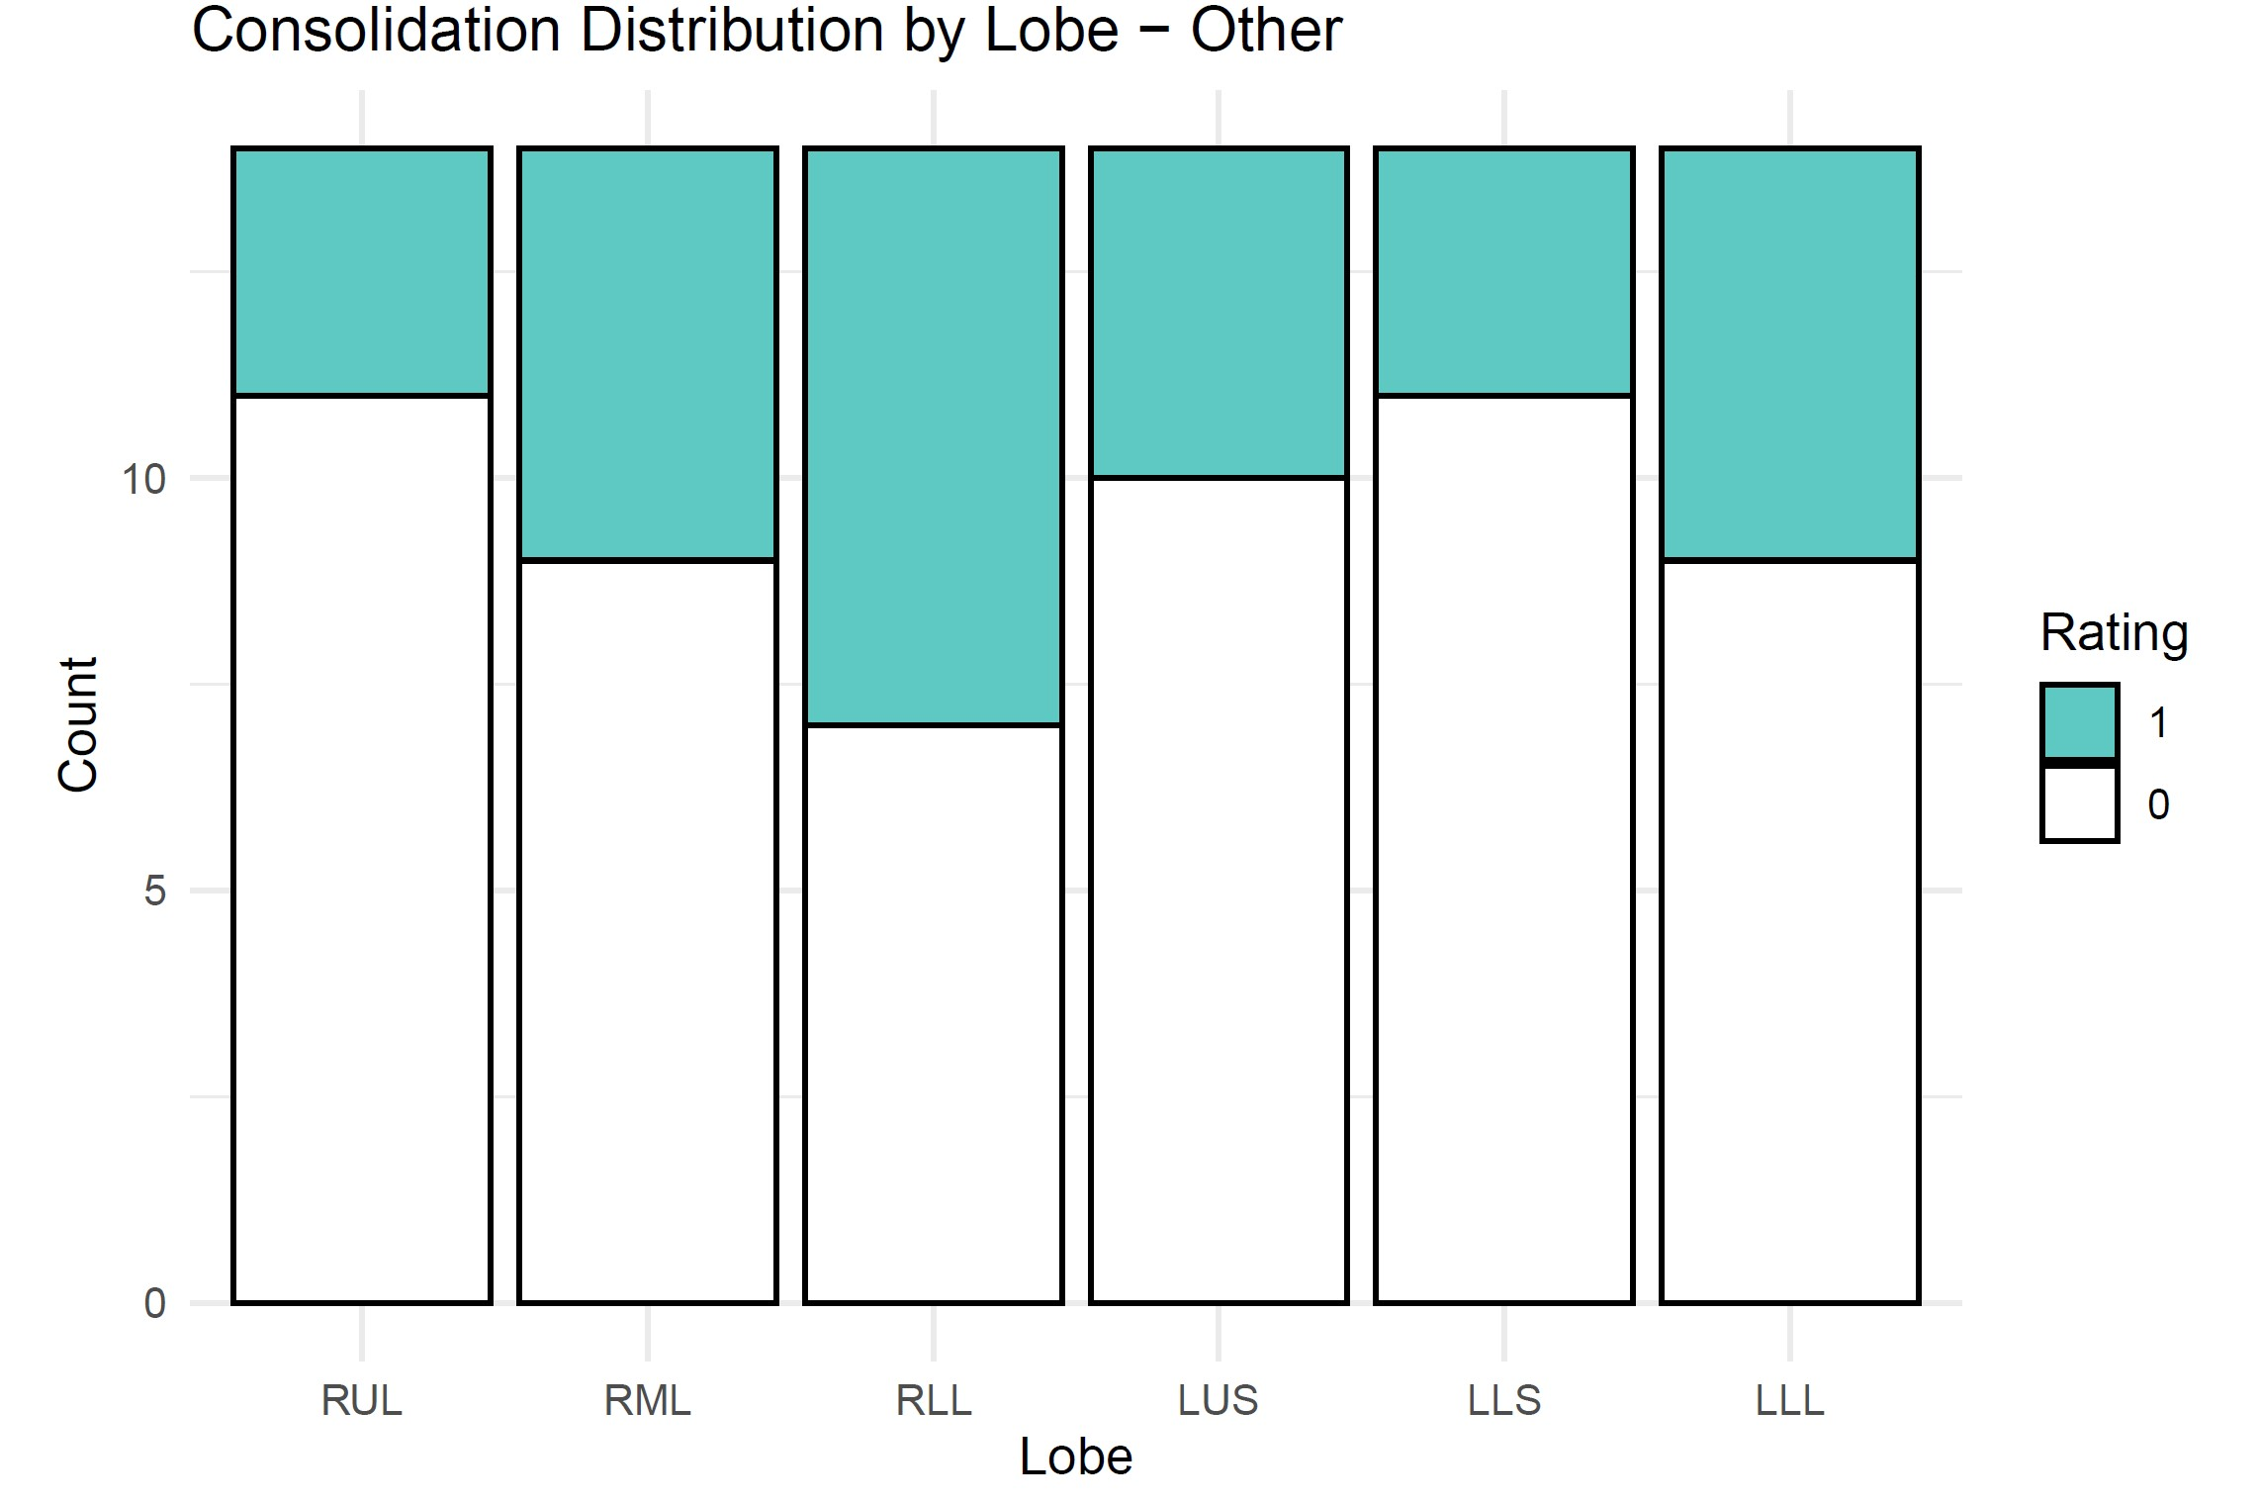

Slide 8
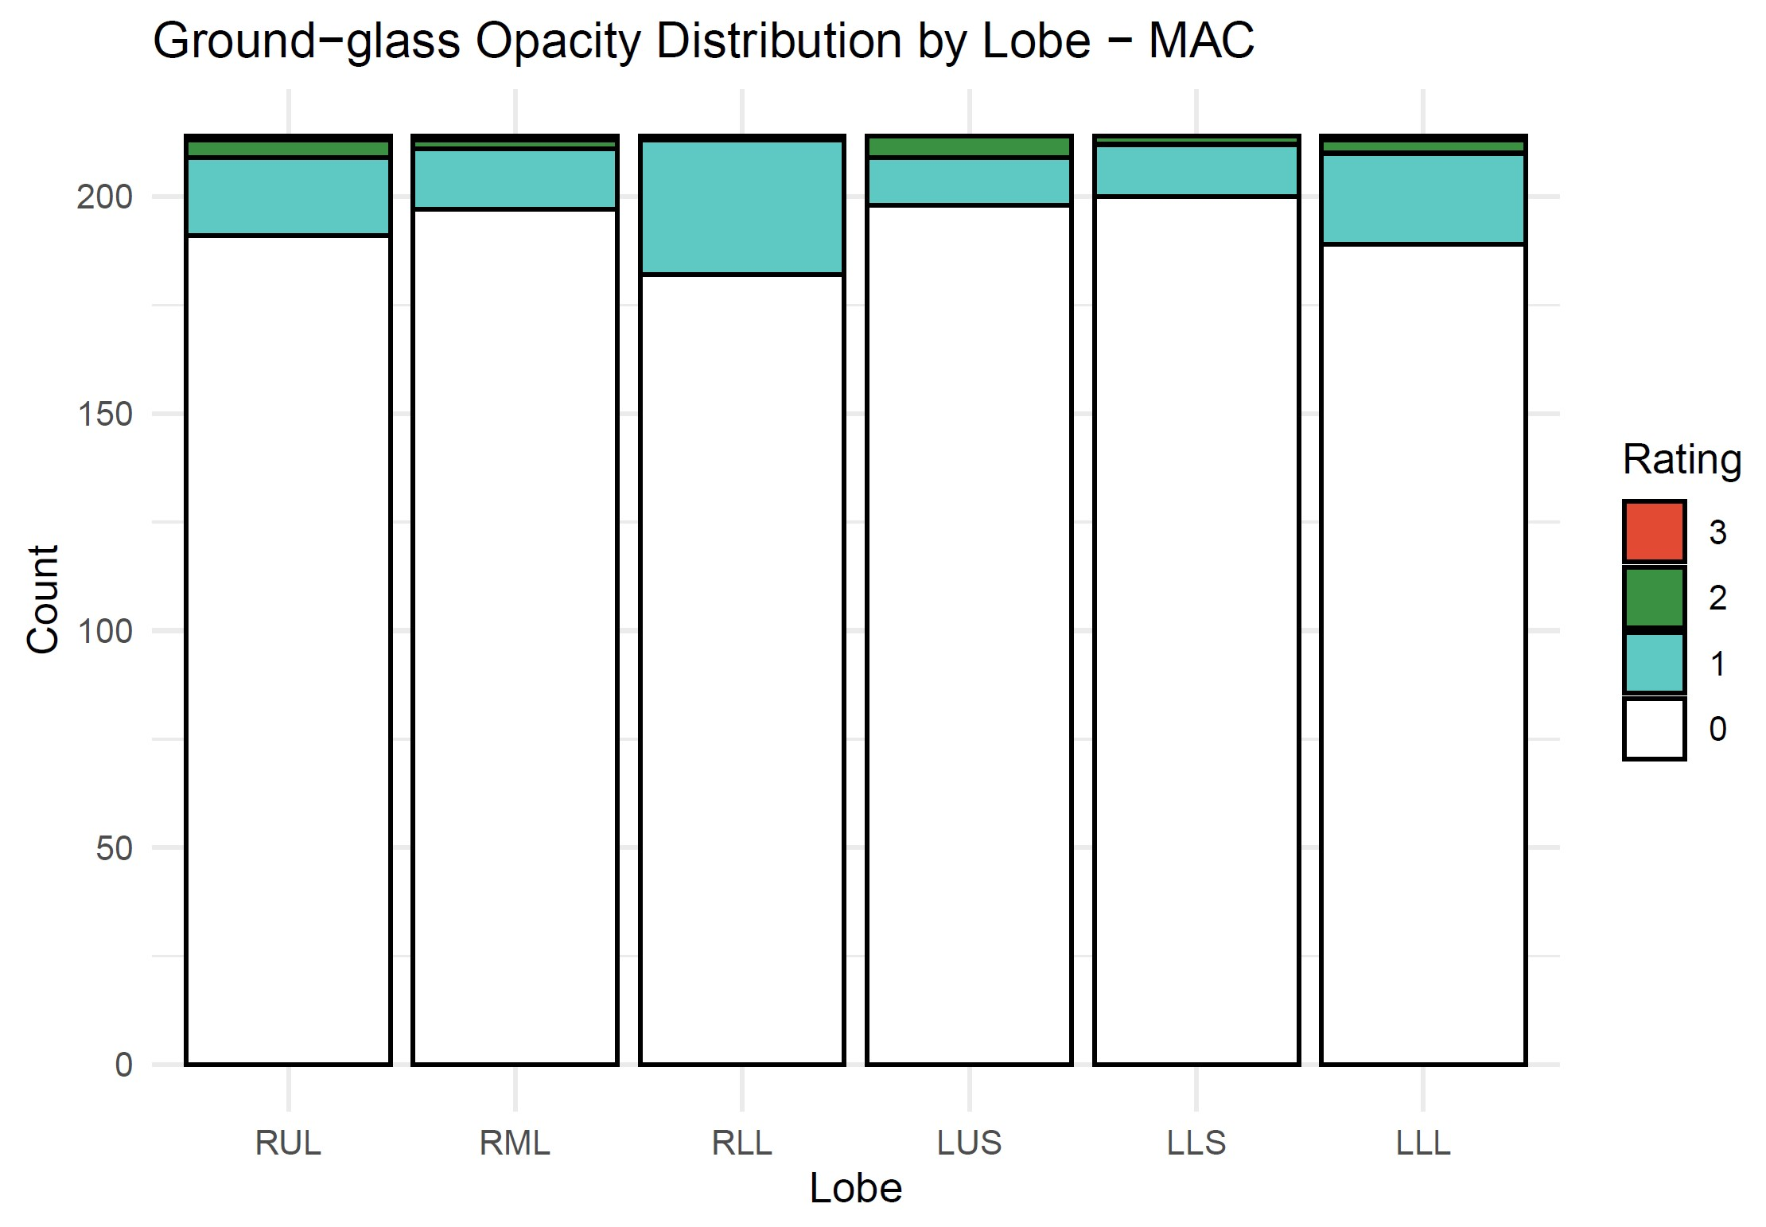
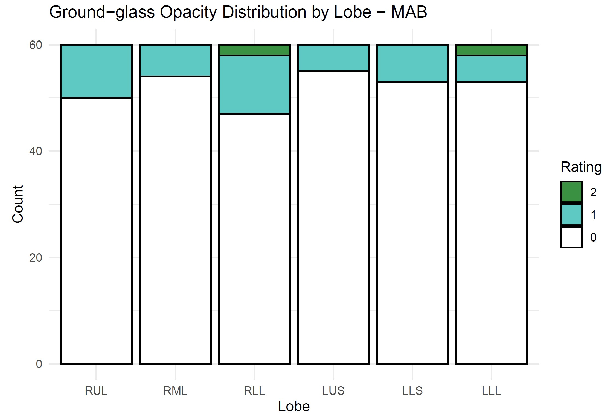
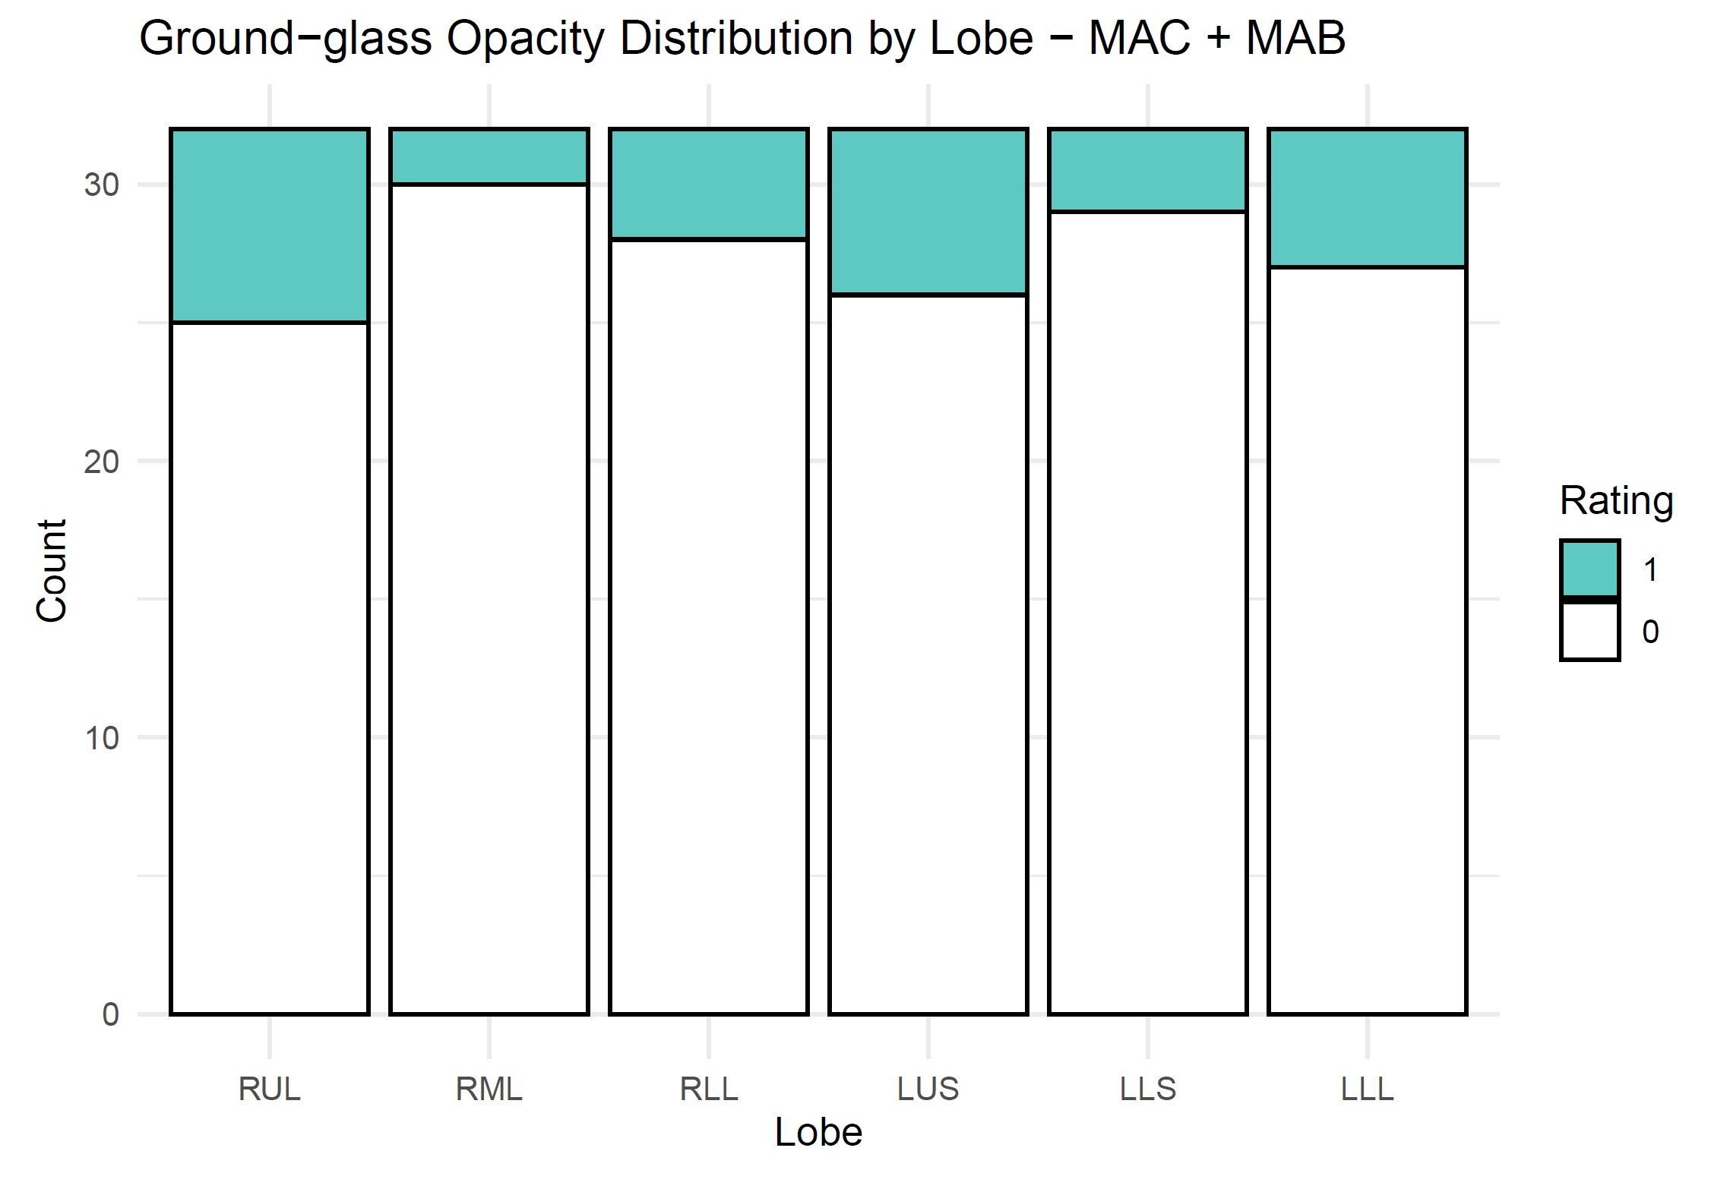
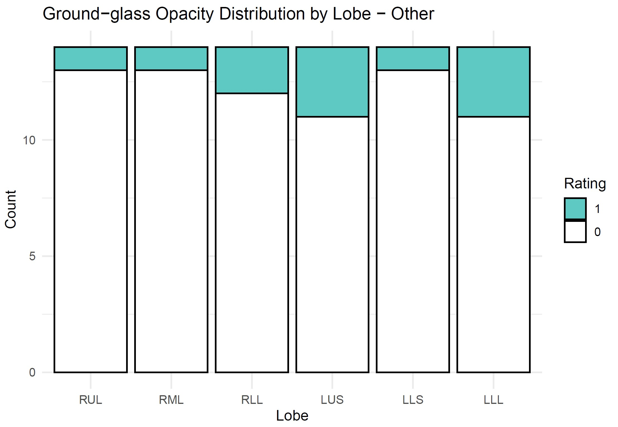

Slide 9
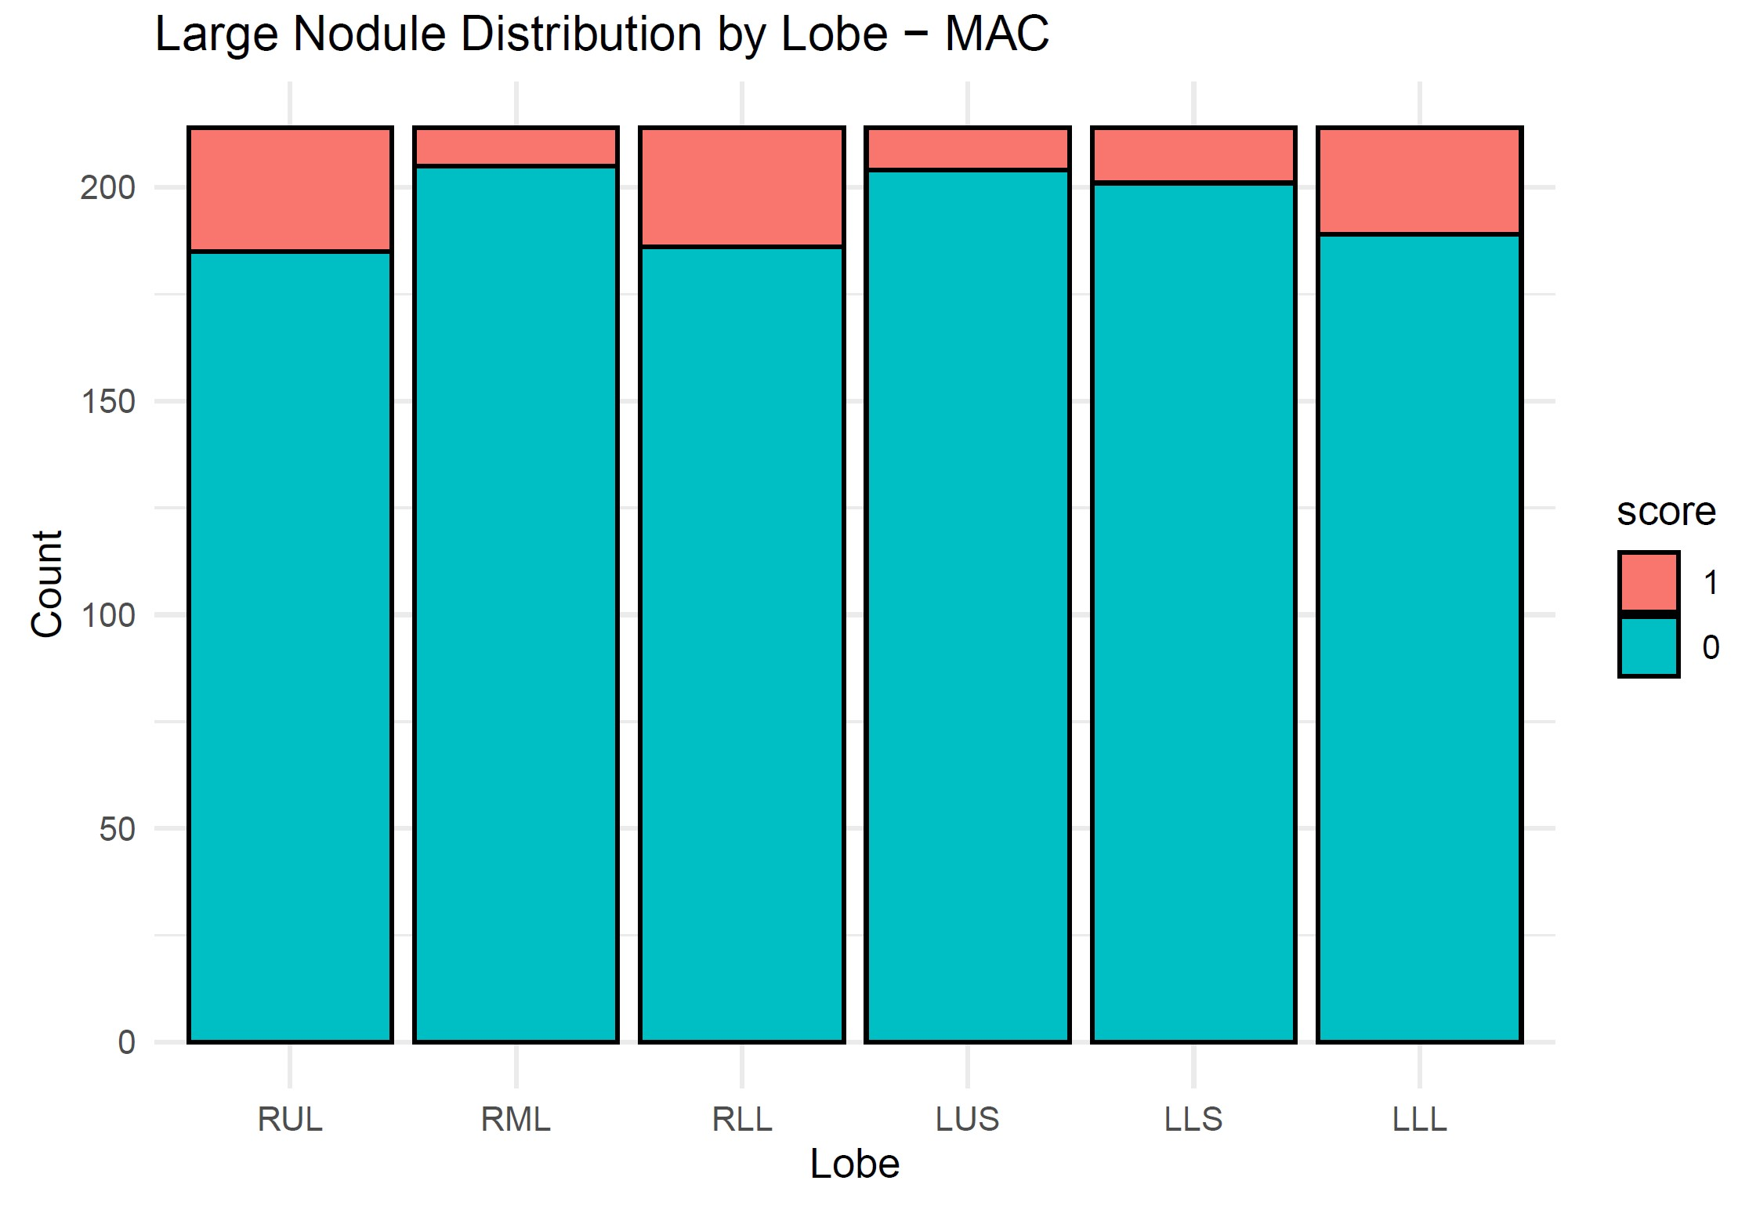
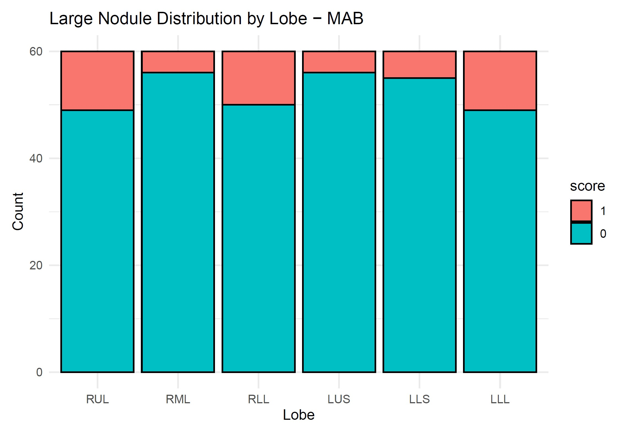
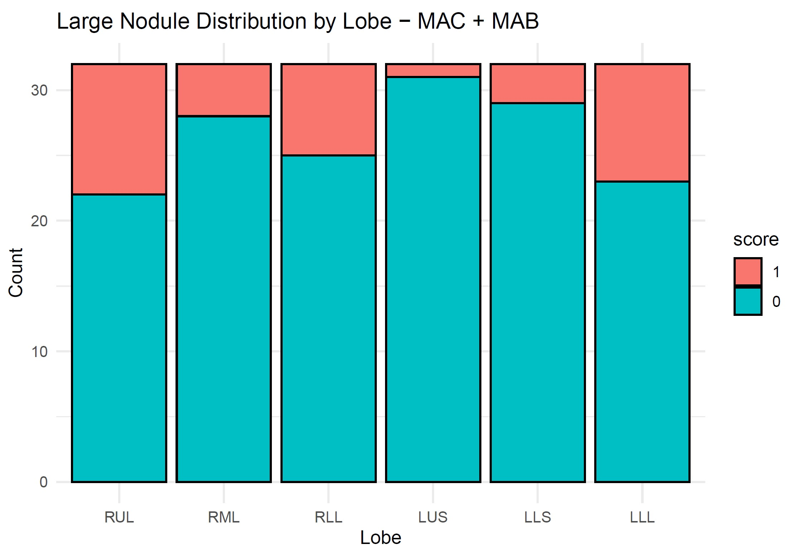
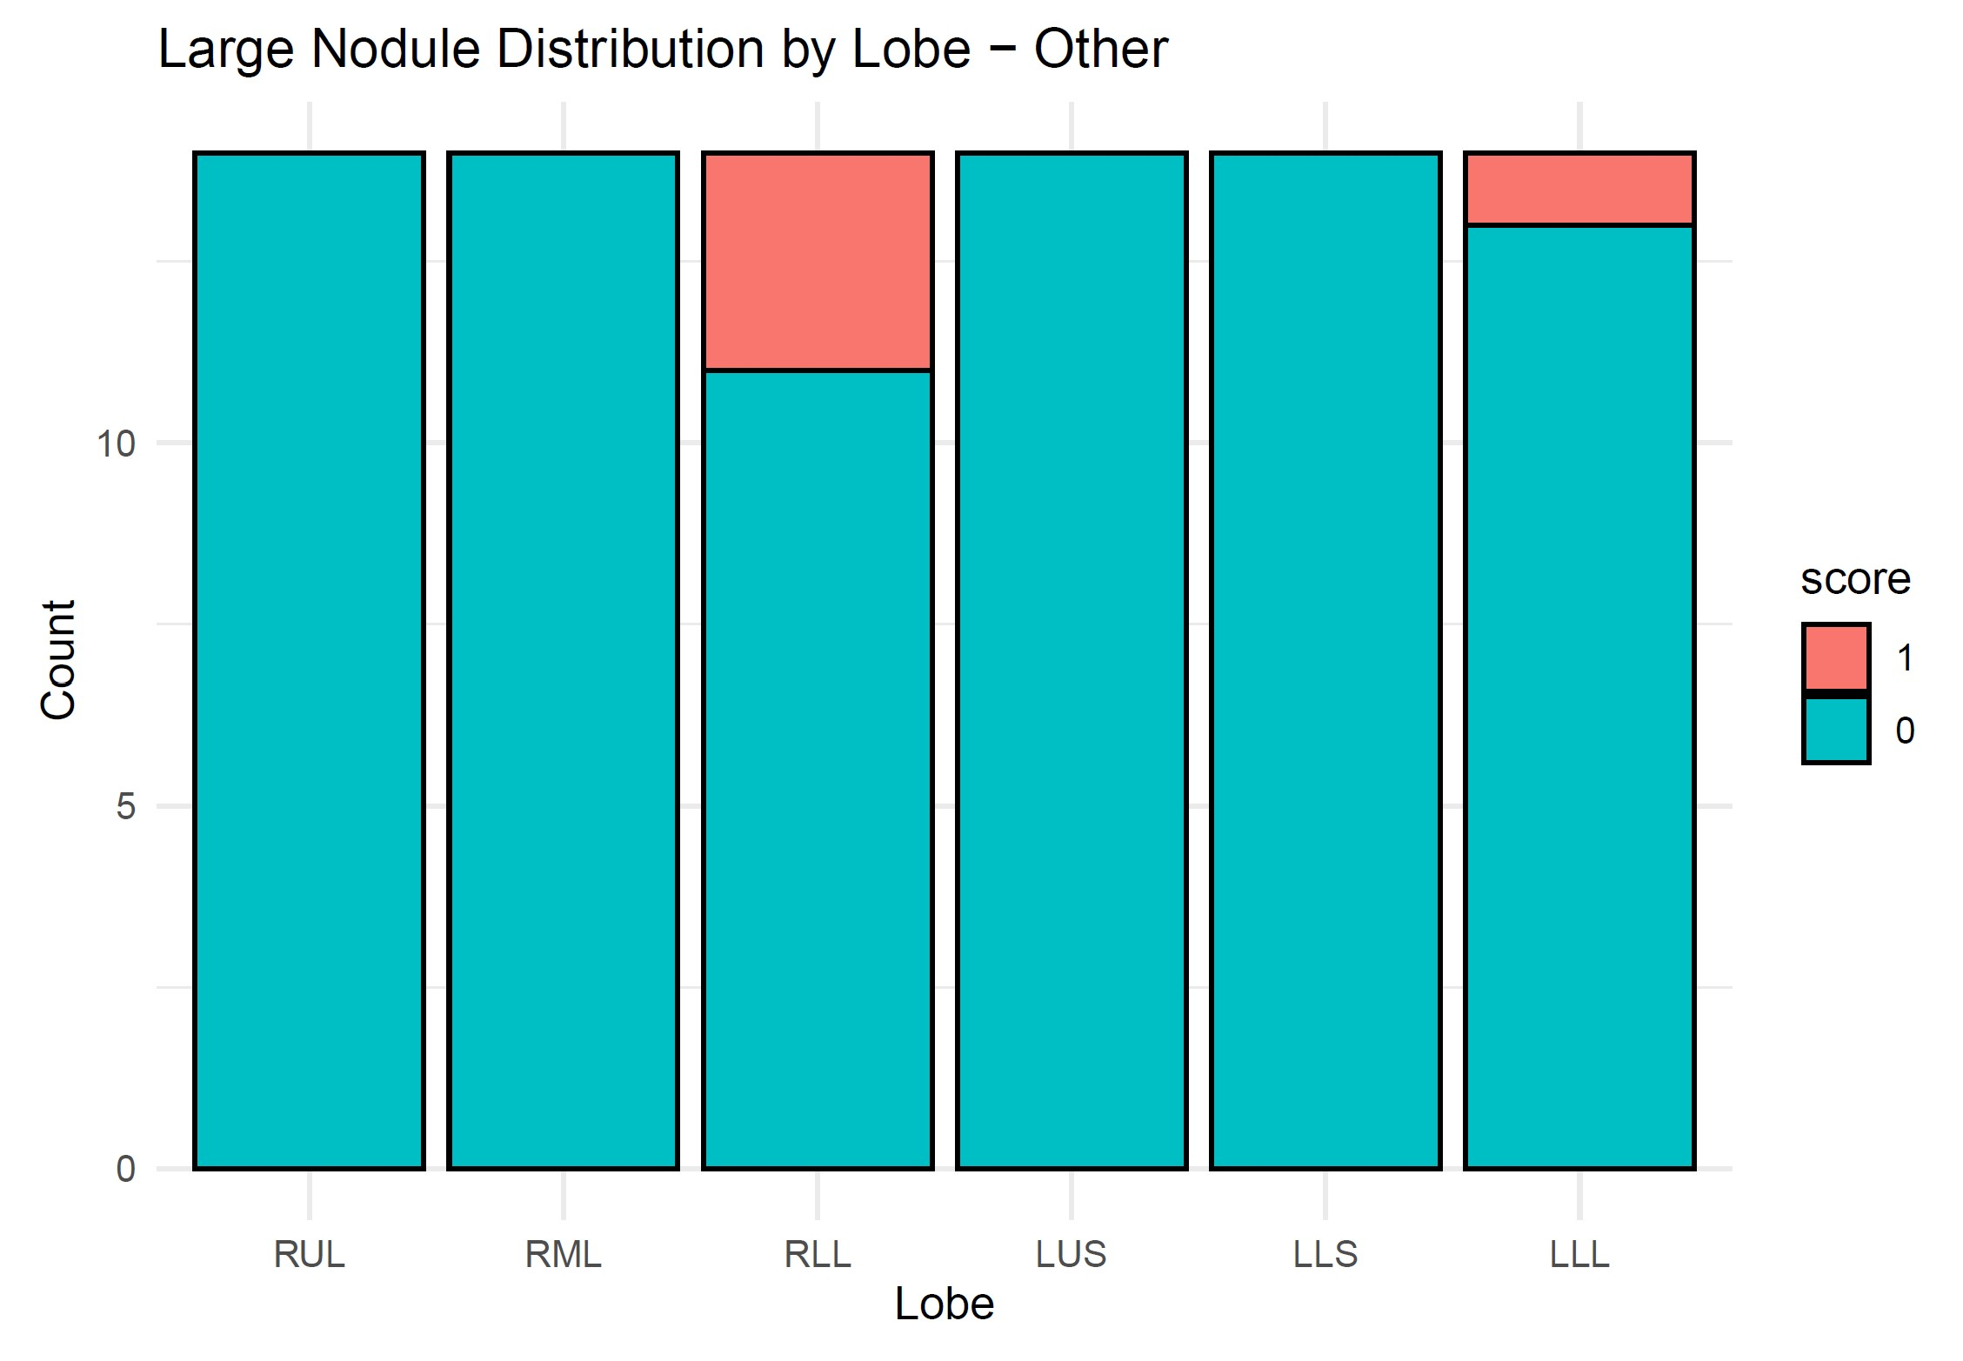

Slide 10
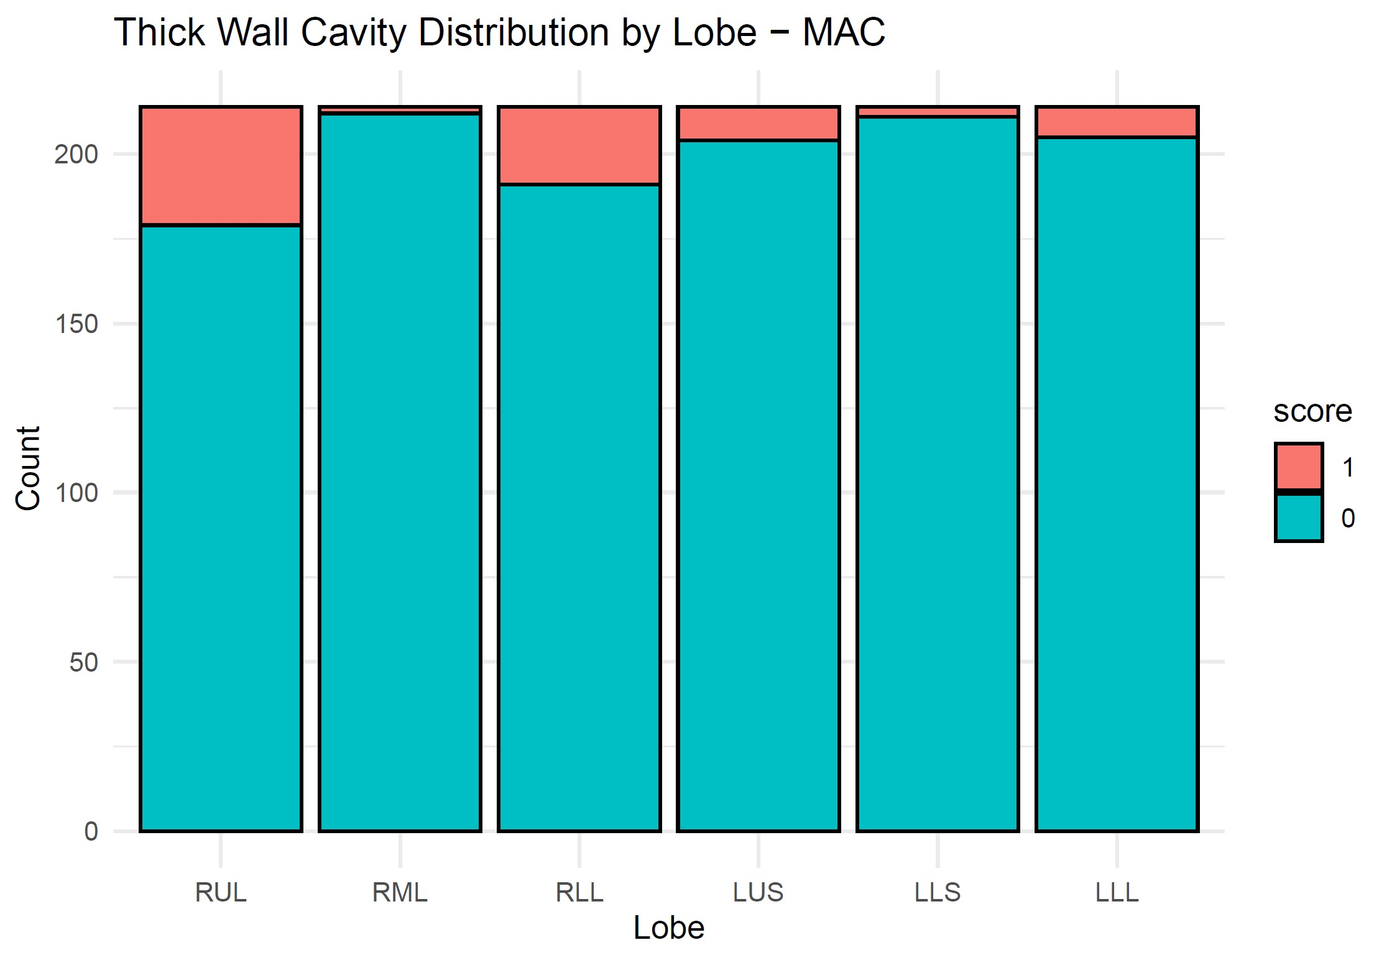
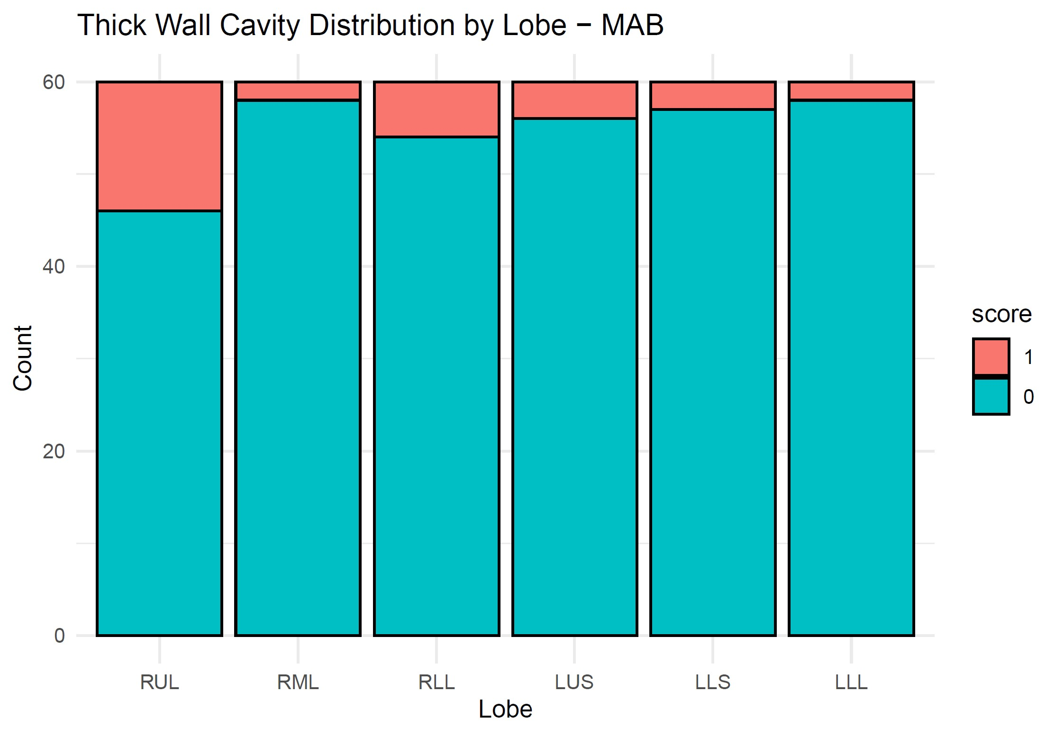
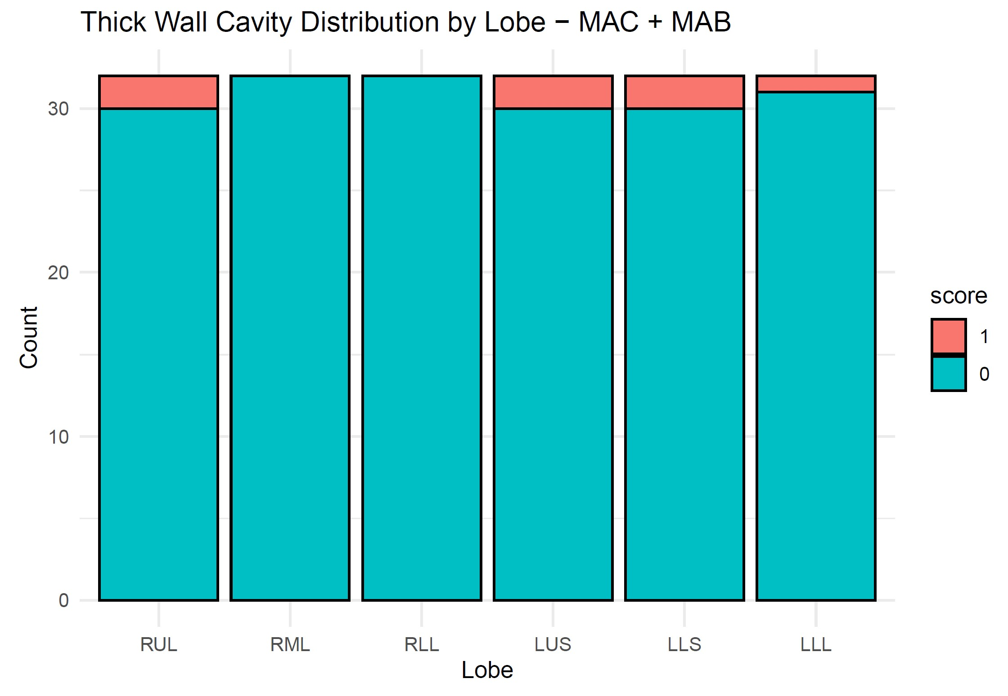
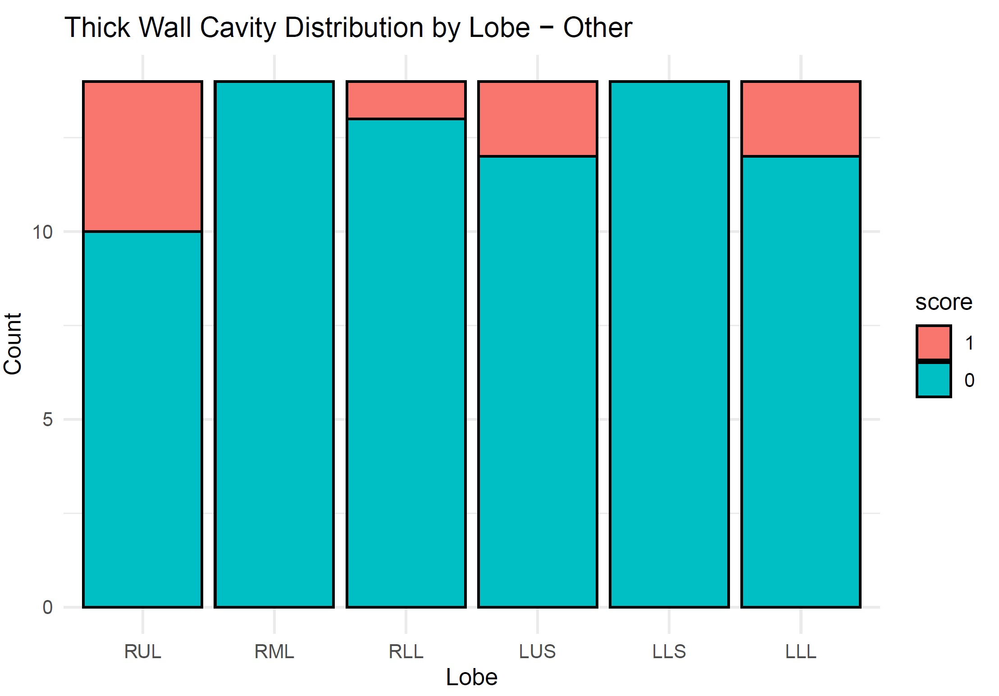

Slide 11
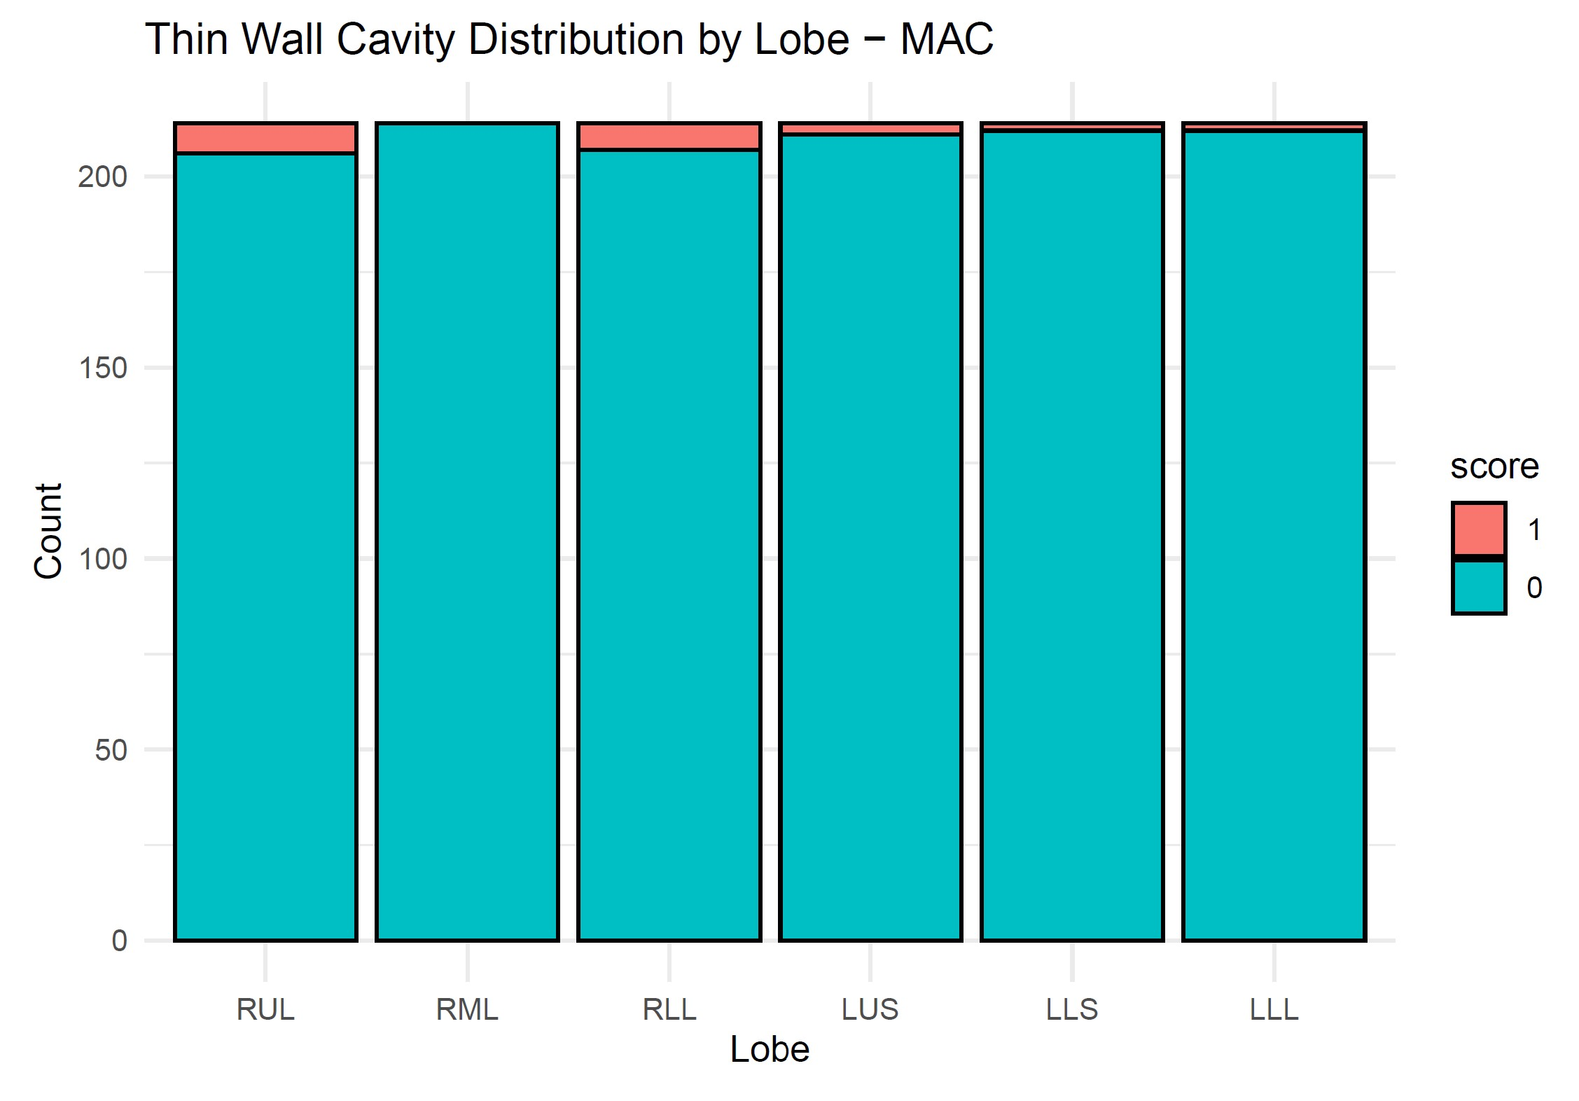
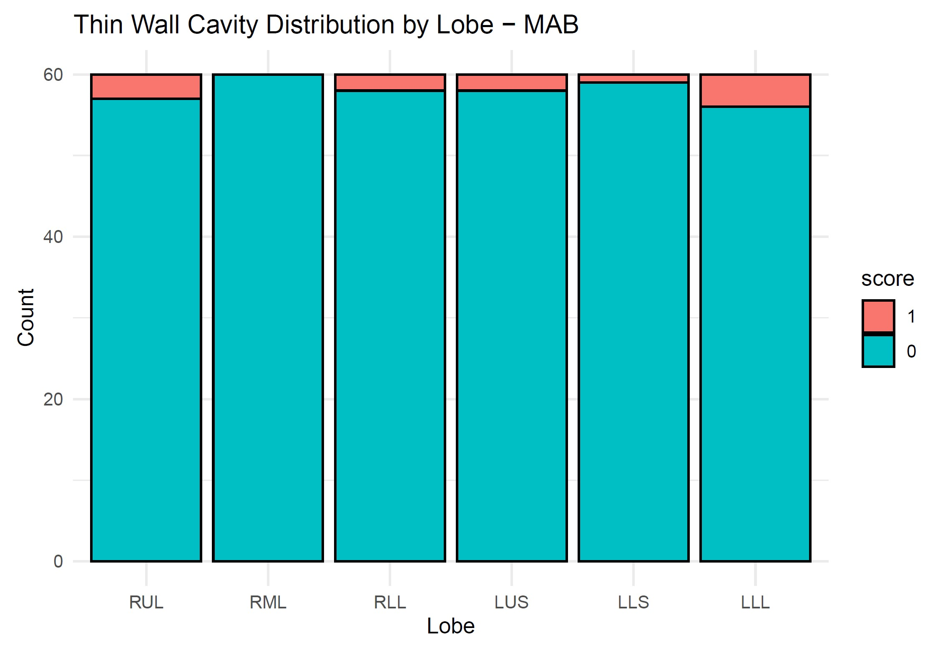
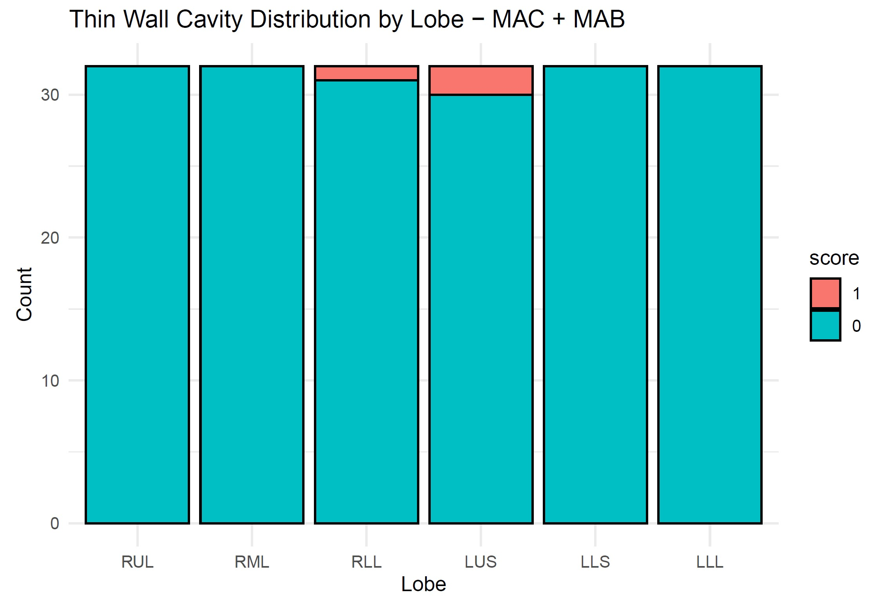
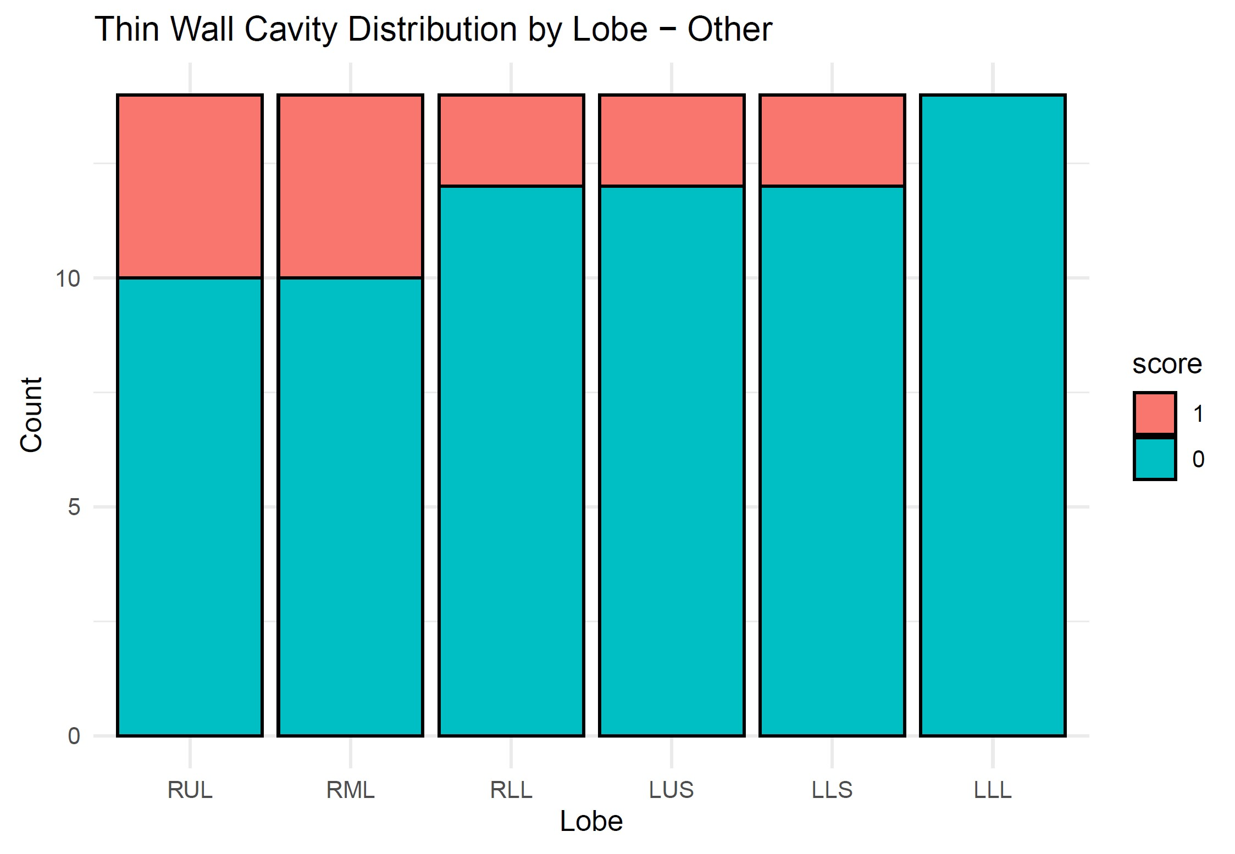

Slide 12
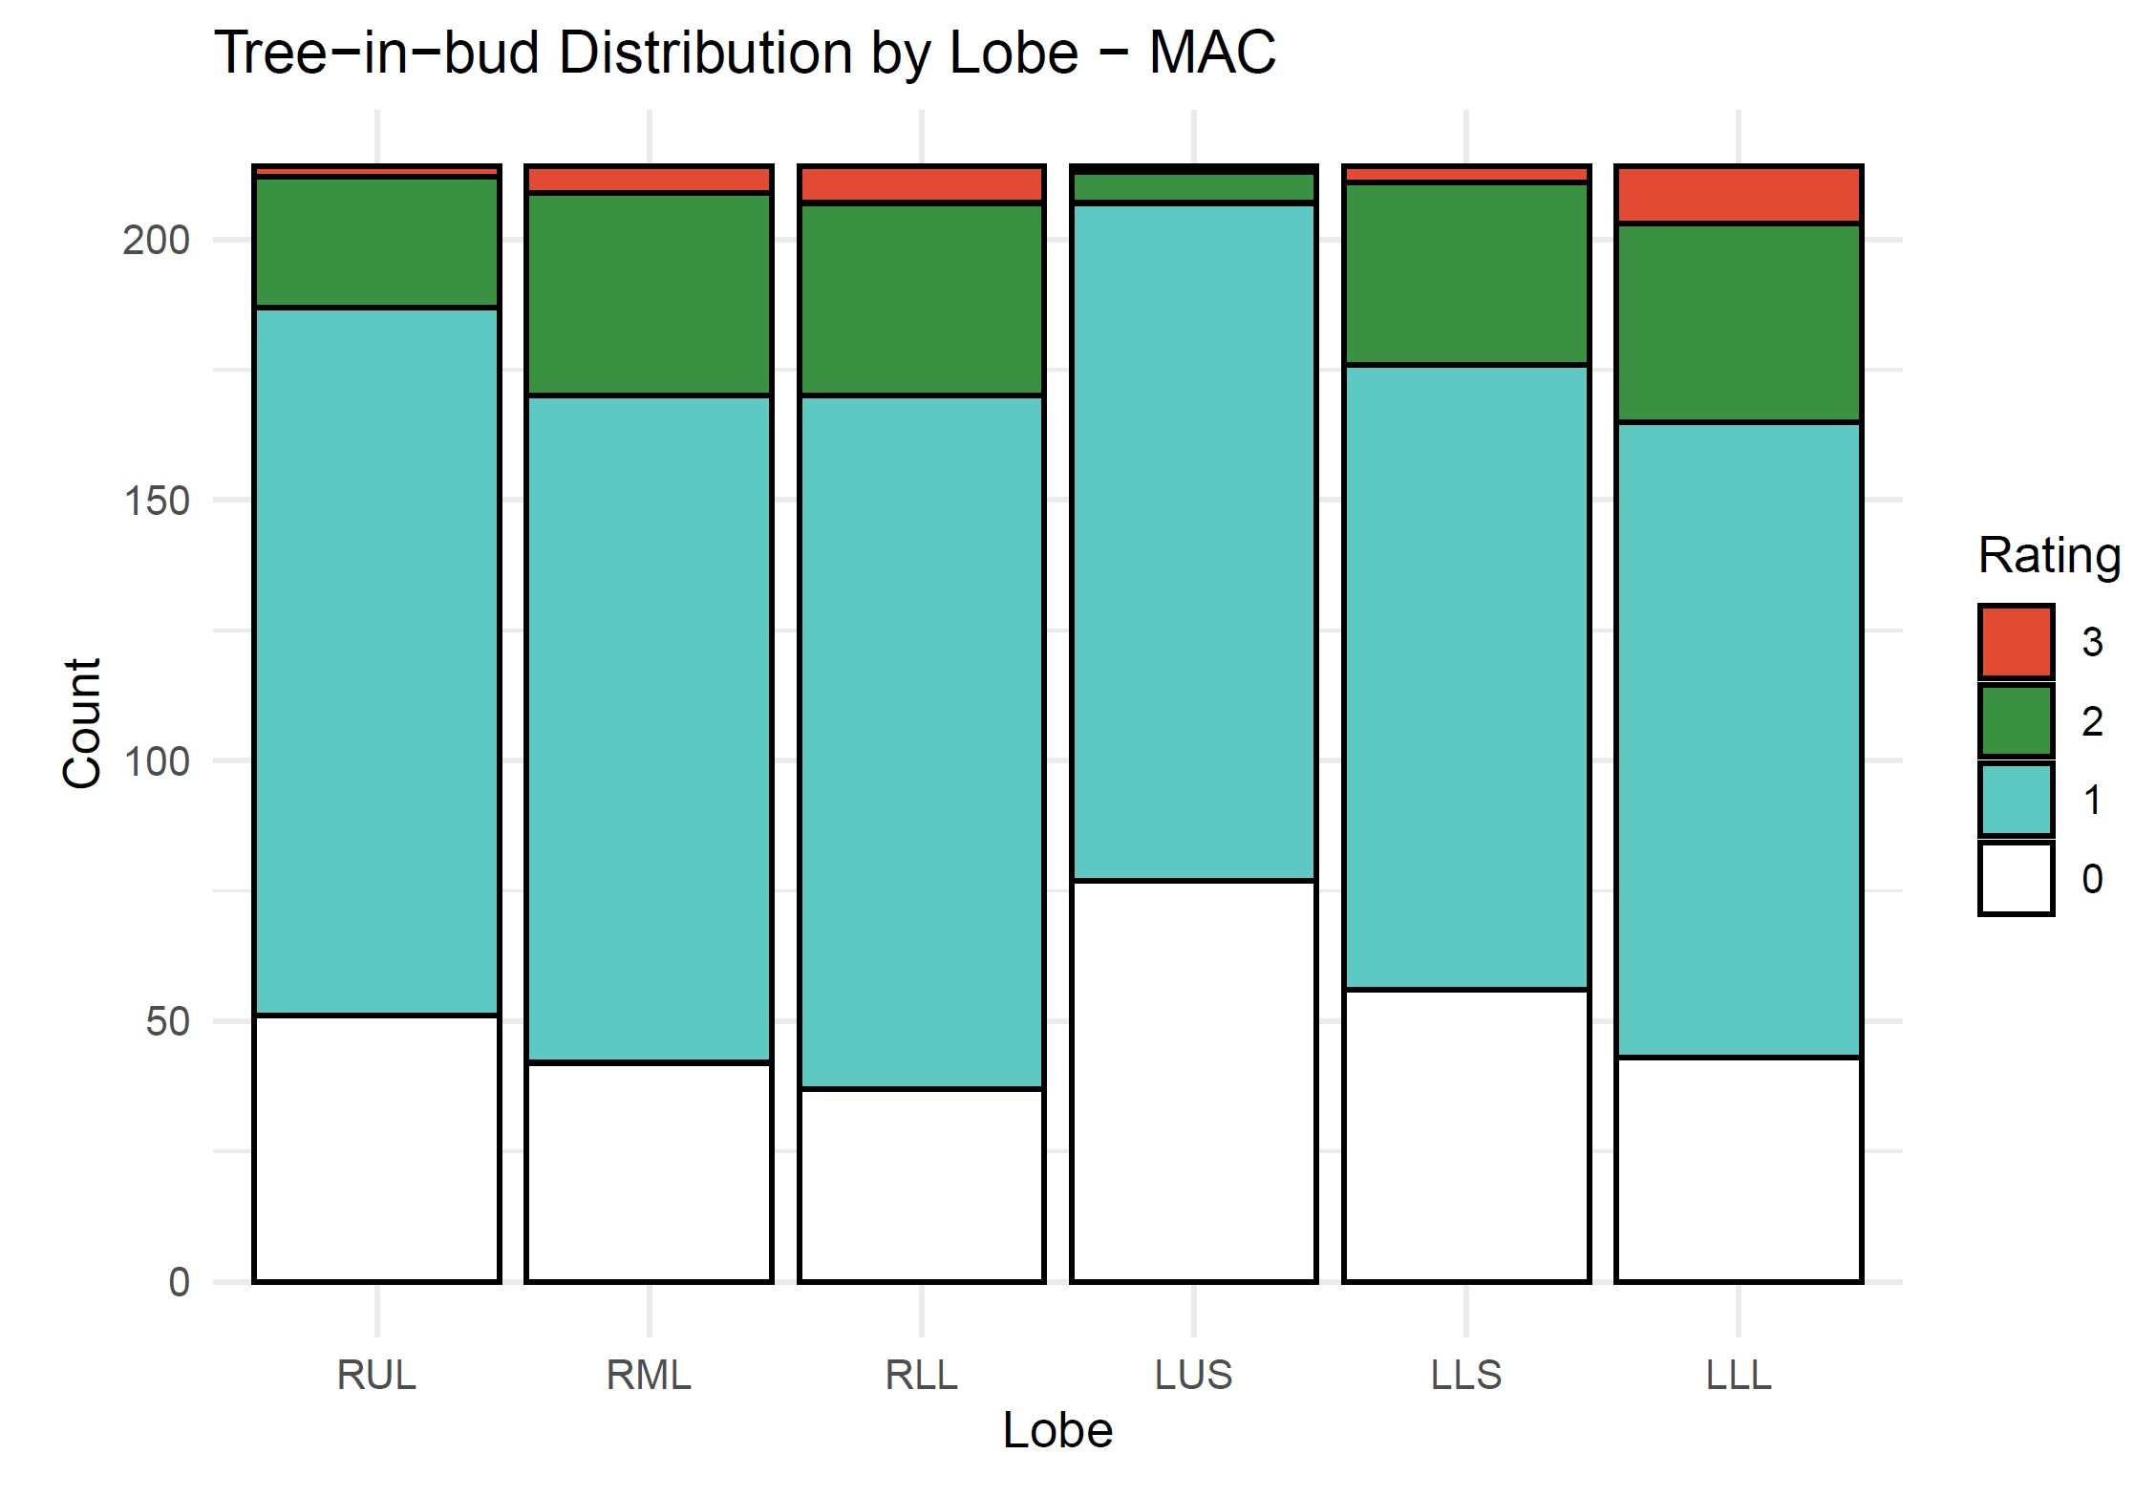
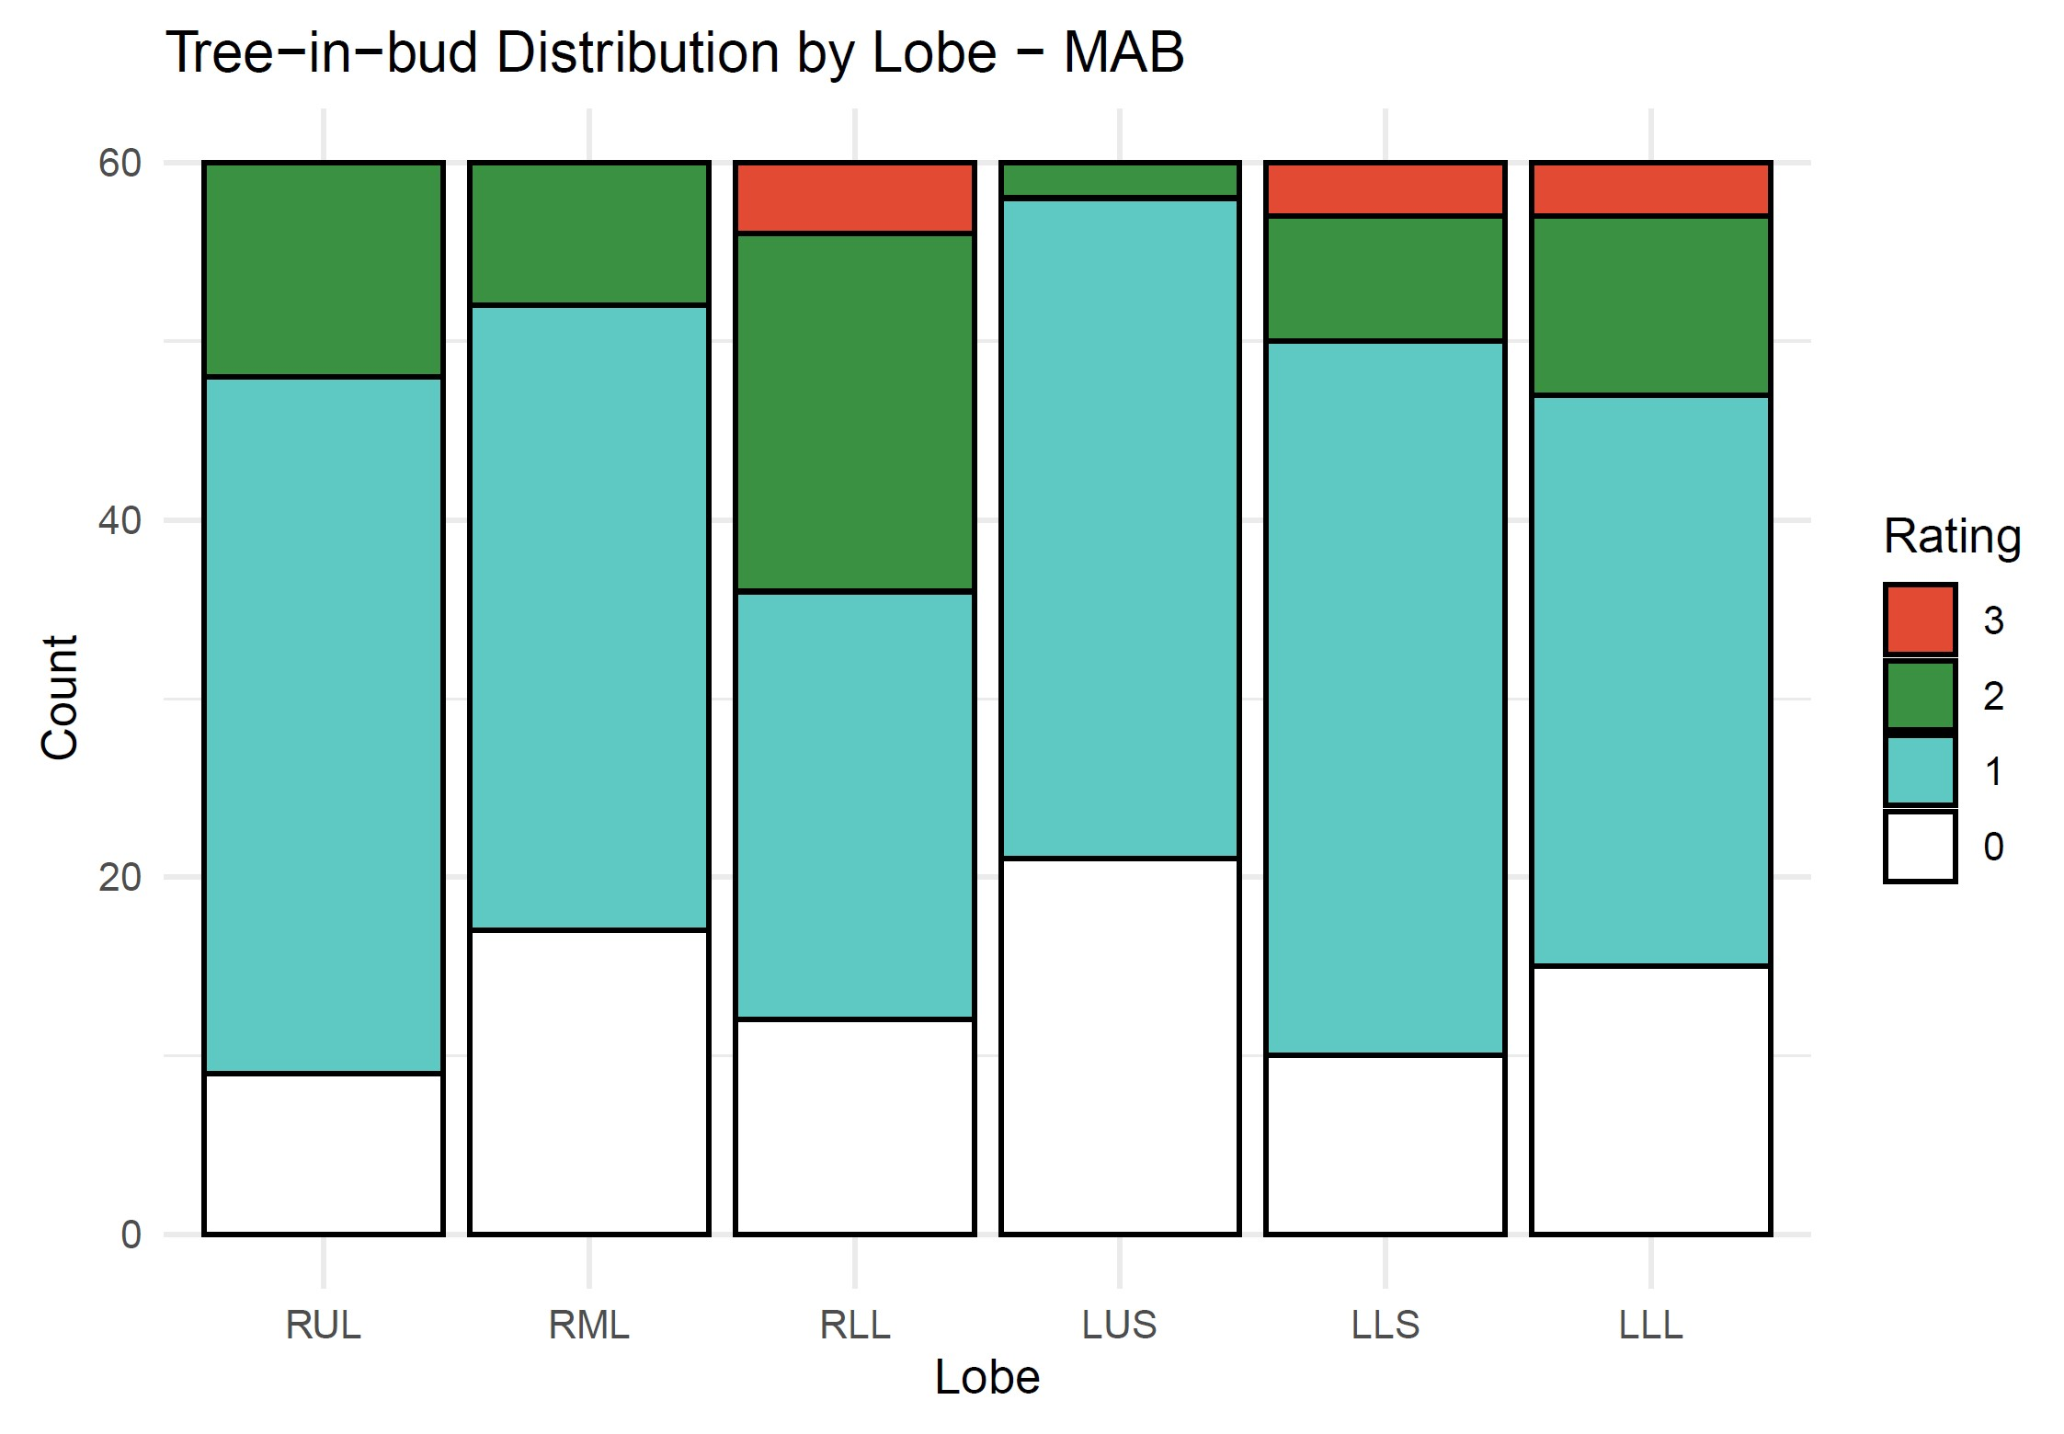
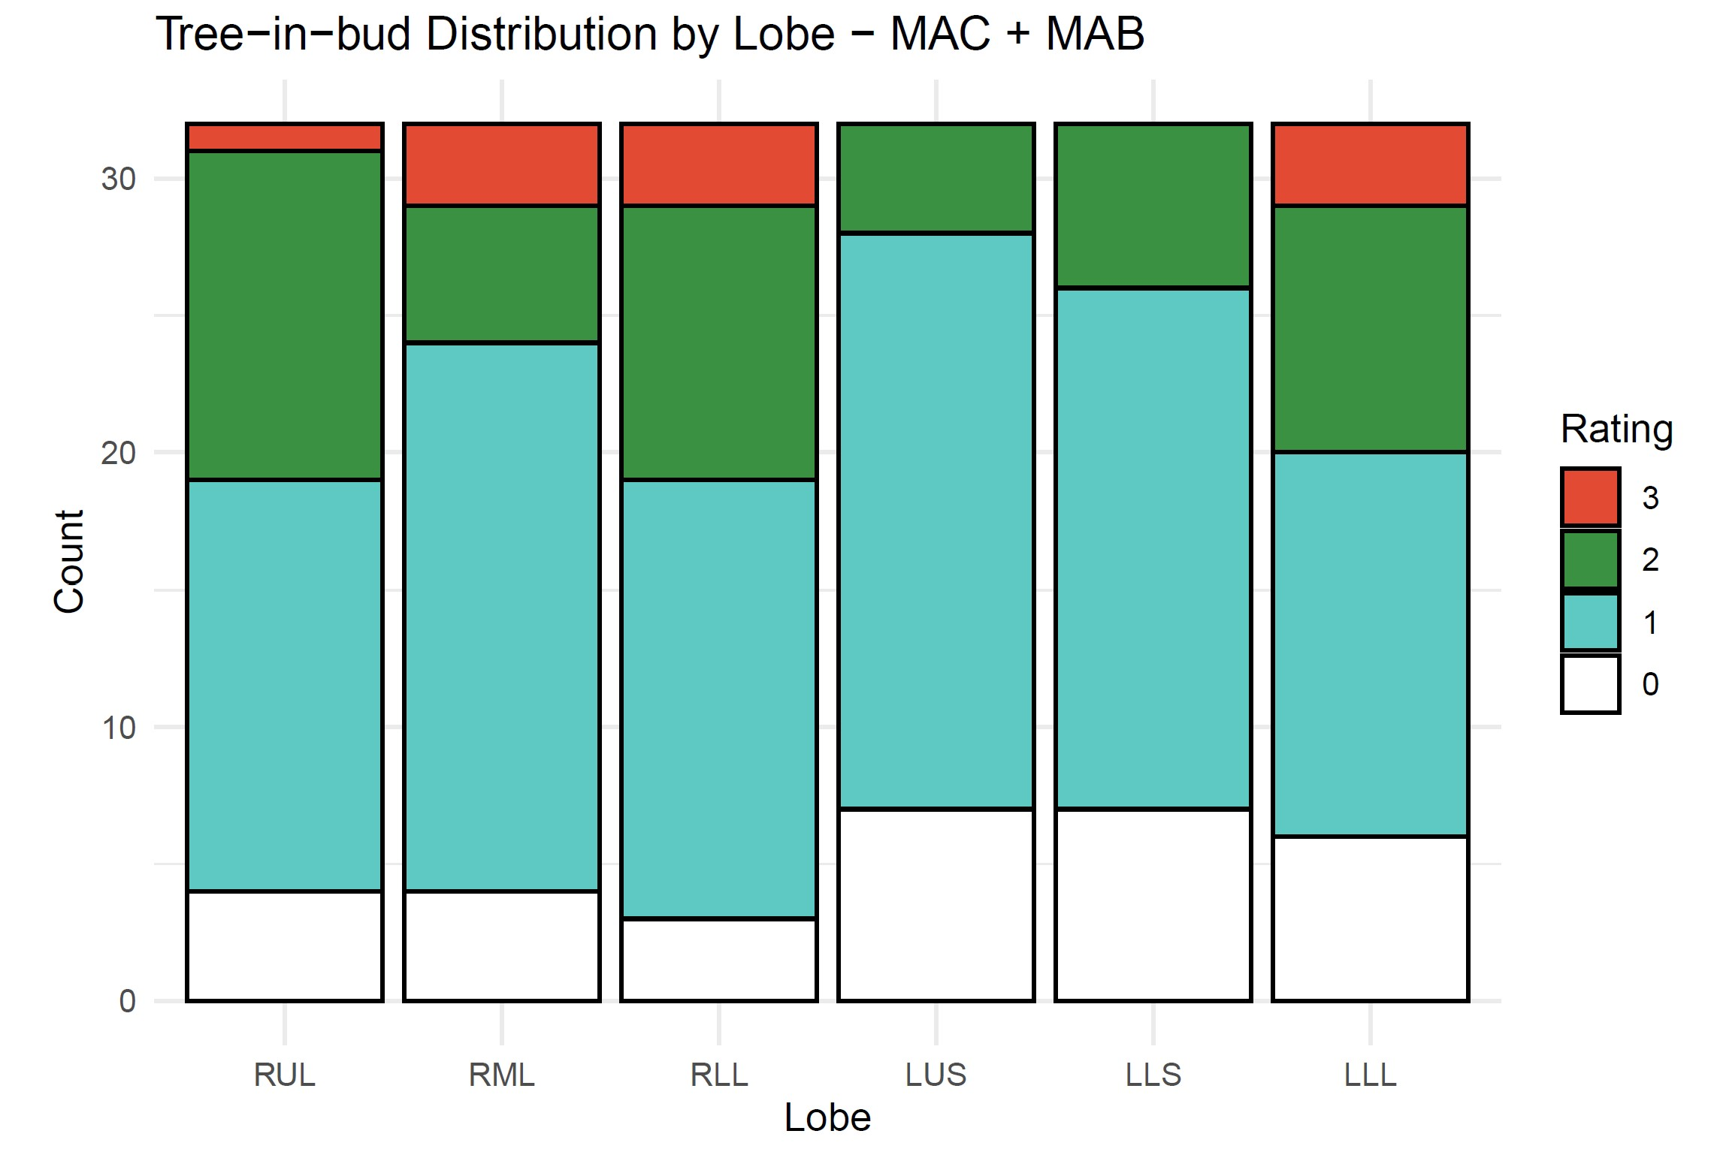
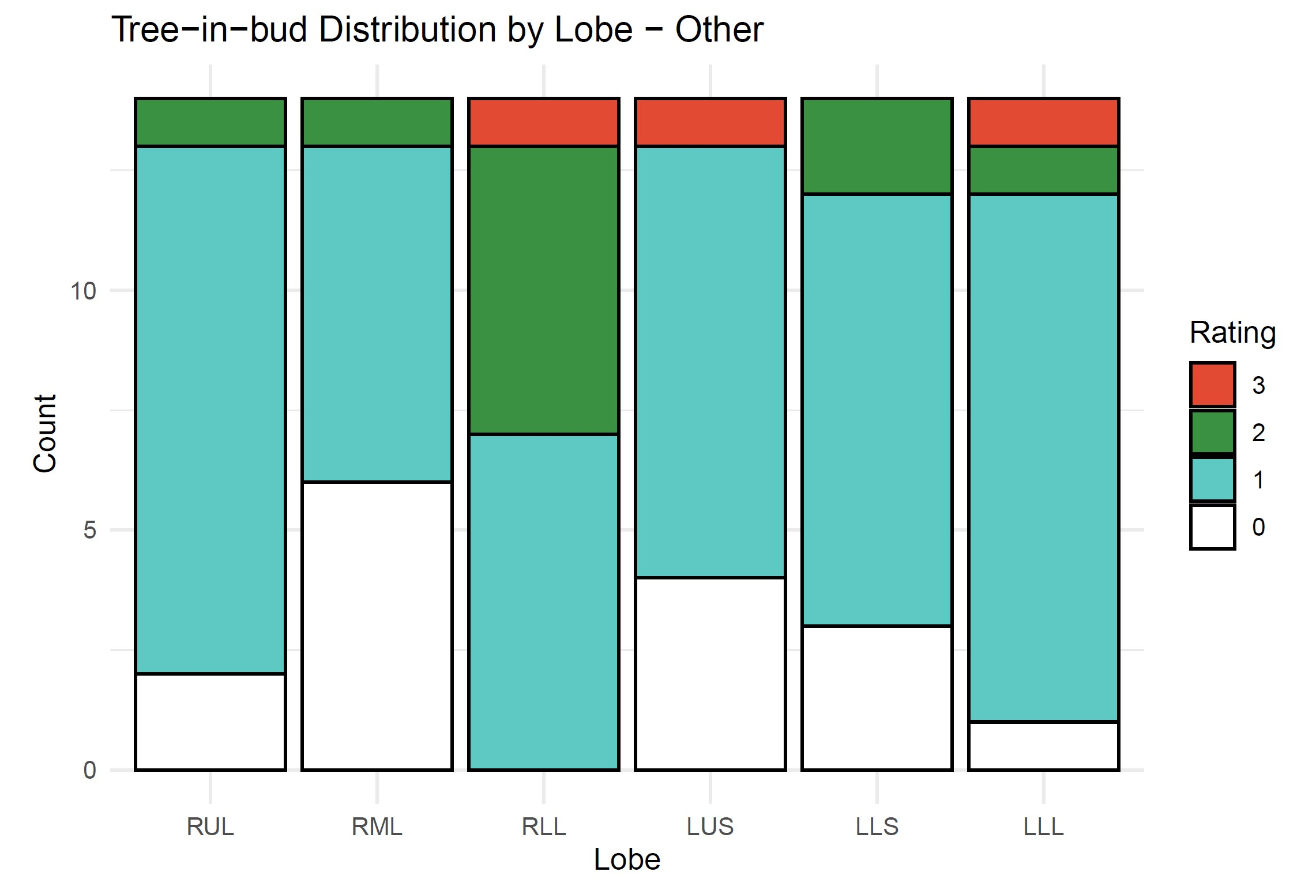

Slide 13
Model-Based Analysis

Slide 14
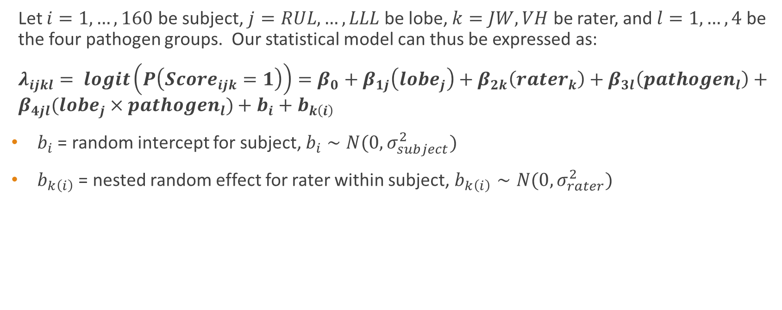
Modeling Approach 1 – (Binary) Logistic Regression
Let $i=1, …, 160$ be subject, $j=RUL, …, LLL$ be lobe, $k=JW, VH$ be rater, and $l=1,…,4$ be the four pathogen groups. Our statistical model can thus be expressed as:
$λ_{ijkl}= logit\left(P\left(Score_{ijk}=1\right)\right)=β_{0}+β_{1j}\left(lobe_{j}\right)+β_{2k}\left(rater_{k}\right)+β_{3l}\left(pathogen_{l}\right)+β_{4jl}(lobe_{j}×pathogen_{l})+b_{i}+b_{k\left(i\right)}$
$b_{i}$ = random intercept for subject, $b_{i}∼N(0,σ_{subject}^{2})$
$b_{k\left(i\right)}$ = nested random effect for rater within subject, $b_{k\left(i\right)}∼N(0,σ_{rater}^{2})$

Slide 15
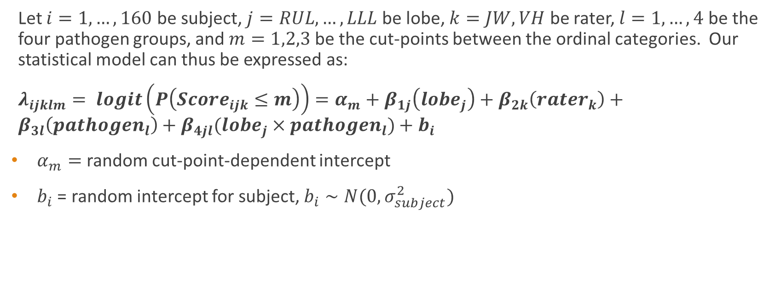
Modeling Approach 2 – Ordinal Logistic Regression (Reduced)
Let $i=1, …, 160$ be subject, $j=RUL, …, LLL$ be lobe, $k=JW, VH$ be rater, $l=1,…,4$ be the four pathogen groups, and $m=1,2,3$ be the cut-points between the ordinal categories. Our statistical model can thus be expressed as:
$λ_{ijklm}= logit\left(P\left(Score_{ijk}≤m\right)\right)=α_{m}+β_{1j}\left(lobe_{j}\right)+β_{2k}\left(rater_{k}\right)+β_{3l}\left(pathogen_{l}\right)+β_{4jl}(lobe_{j}×pathogen_{l})+b_{i}$
$α_{m}=$random cut-point-dependent intercept
$b_{i}$ = random intercept for subject, $b_{i}∼N(0,σ_{subject}^{2})$

Slide 16
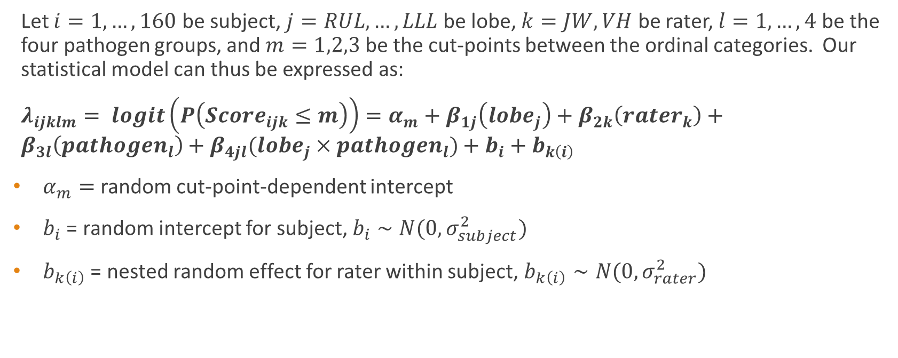
Modeling Approach 3 – Ordinal Logistic Regression (Full)
Let $i=1, …, 160$ be subject, $j=RUL, …, LLL$ be lobe, $k=JW, VH$ be rater, $l=1,…,4$ be the four pathogen groups, and $m=1,2,3$ be the cut-points between the ordinal categories. Our statistical model can thus be expressed as:
$λ_{ijklm}= logit\left(P\left(Score_{ijk}≤m\right)\right)=α_{m}+β_{1j}\left(lobe_{j}\right)+β_{2k}\left(rater_{k}\right)+β_{3l}\left(pathogen_{l}\right)+β_{4jl}(lobe_{j}×pathogen_{l})+b_{i}+b_{k\left(i\right)}$
$α_{m}=$random cut-point-dependent intercept
$b_{i}$ = random intercept for subject, $b_{i}∼N(0,σ_{subject}^{2})$
$b_{k\left(i\right)}$ = nested random effect for rater within subject, $b_{k\left(i\right)}∼N(0,σ_{rater}^{2})$

Slide 17
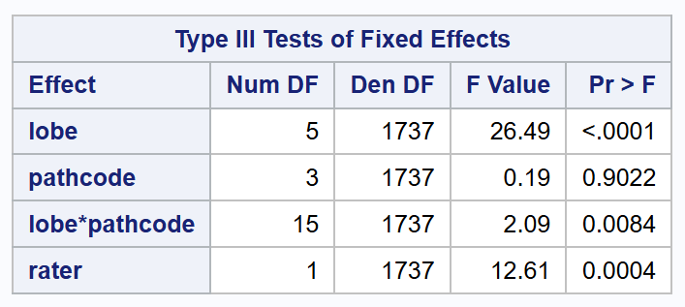
Atelectasis
Modeled using Approach 2
Type III Tests of the model’s fixed effects indicate a significant interaction between lobe and pathogen group (p=0.0084)
This means the effect of pathogen group is different depending on lung lobe, warranting post-hoc testing (see next slide)

Slide 18
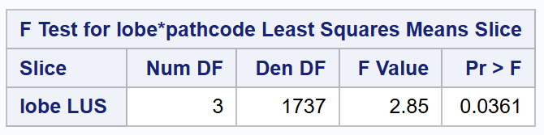
Atelectasis
Post-hoc testing revealed that the differences between pathogen groups were significant overall in the LUS (p=0.0361)
Additional testing performed to see which pathogen groups significantly differ within this lobes (see next slide)

Slide 19
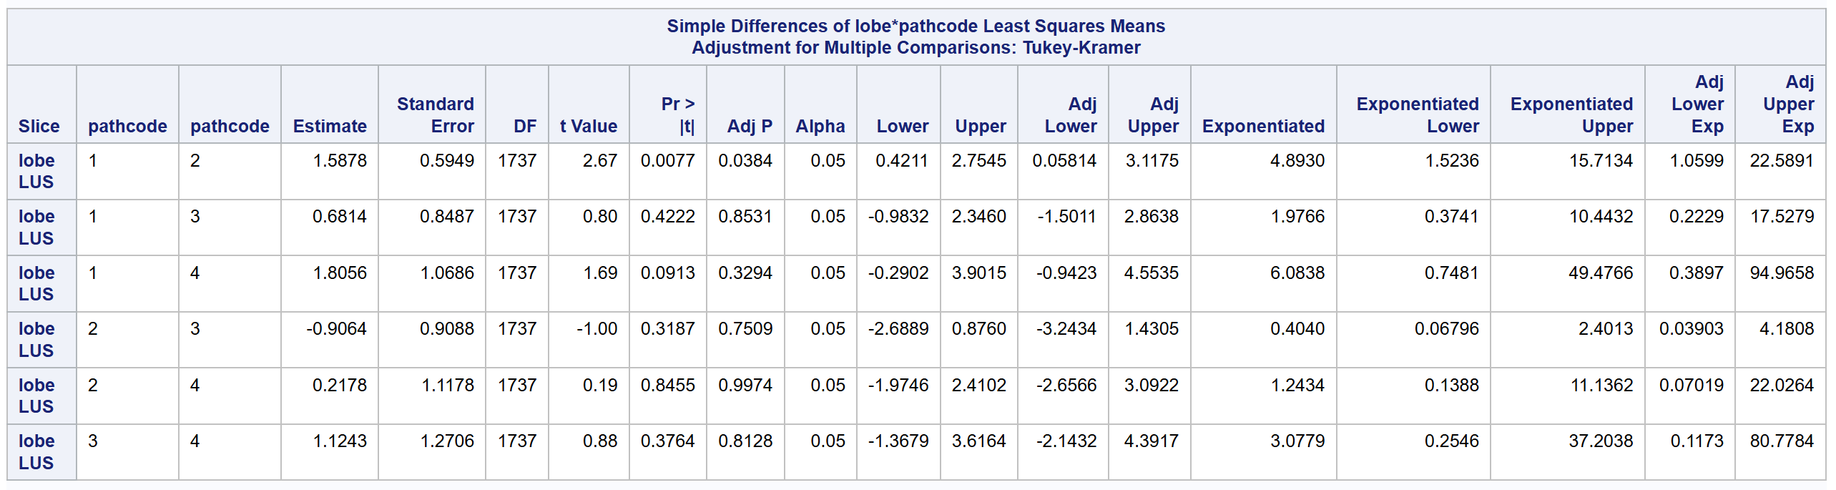
Atelectasis
In the LUS, the odds of having a higher disease score for pathogen group 2 (MAB) are 4.893 times the odds for pathogen group 1 (MAC) (95% CI: 1.06, 22.59) (p=0.0384)

Slide 20
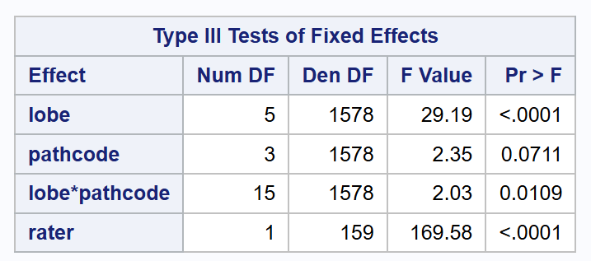
Bronchiectasis
Modeled using Approach 3
Type III Tests of the model’s fixed effects indicate a significant interaction between lobe and pathogen group (p=0.0109)
This means the effect of pathogen group is different depending on lung lobe, warranting post-hoc testing (see next slide)

Slide 21
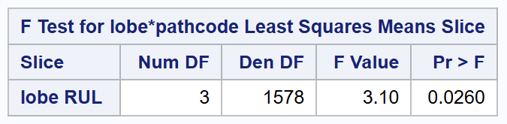
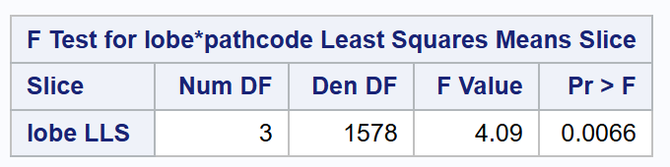
Bronchiectasis
Post-hoc testing revealed that the differences between pathogen groups were significant overall in the RUL and LLS (p=0.026 and p=0.0066, respectively)
Additional testing performed to see which pathogen groups significantly differ within these lobes (see next slides)

Slide 22
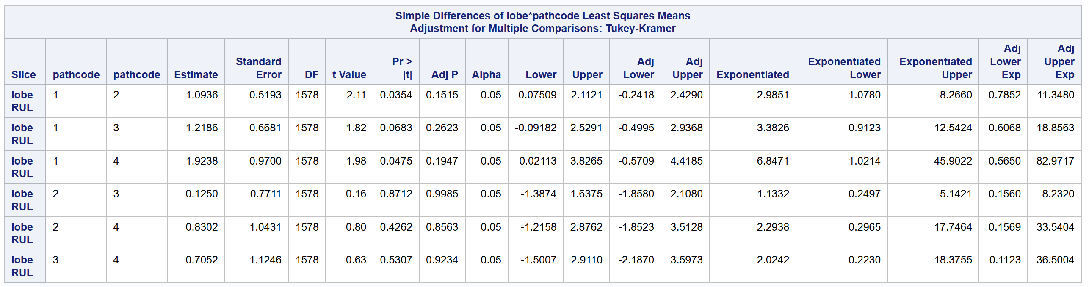
Bronchiectasis
In the RUL, no comparisons remain significant after adjusting for multiple comparisons

Slide 23
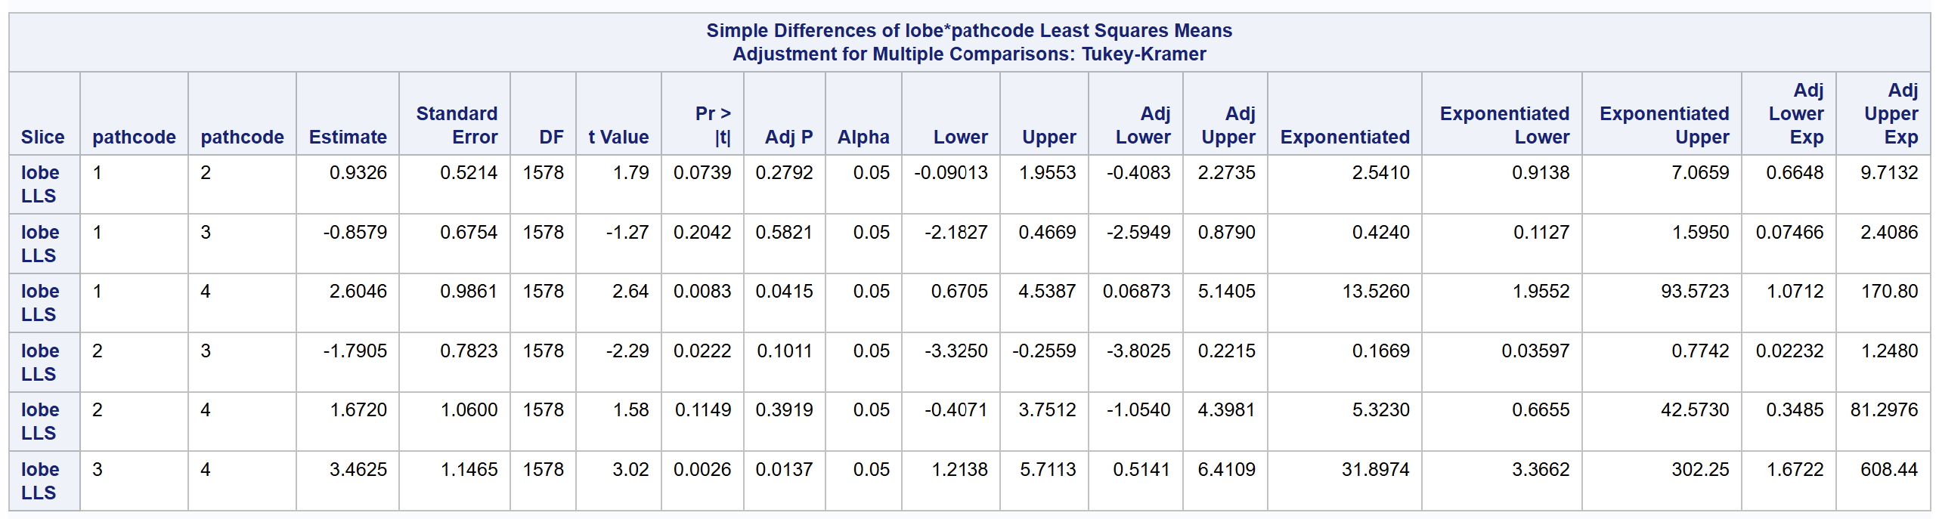
Bronchiectasis
In the LLS, the odds of having a higher disease score for pathogen group 4 (Other) are 13.53 times the odds for pathogen group 1 (MAC) (95% CI: 1.07, 170.8) (p=0.0415)
Similarly, the odds of having a higher disease score for pathogen group 4 (Other) are 31.9 times the odds for pathogen group 3 (MAC+MAB) (95% CI: 1.67, 608.4) (p=0.0137)

Slide 24
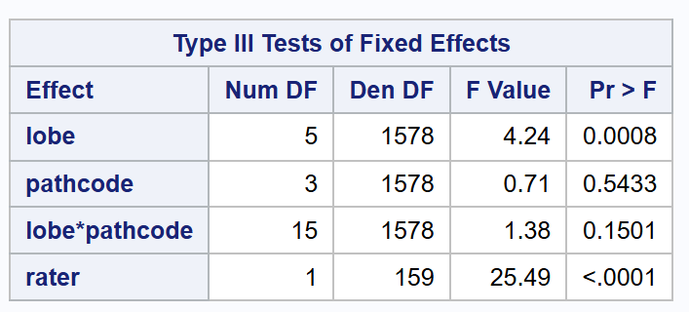
Consolidation
Modeled using Approach 3
Type III Tests of the model’s fixed effects indicate no significant interaction or main effect for pathogen group (p=0.1501, p=0.5433, respectively).
We conclude that there is no evidence to suggest that disease severity differs among the pathogen groups for this feature

Slide 25
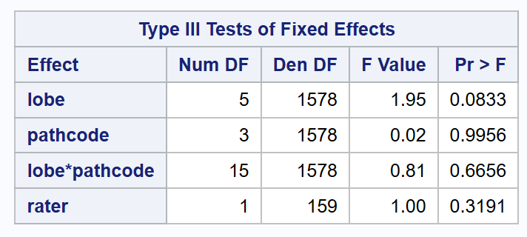
Ground-Glass Opacity
Modeled using Approach 3
Type III Tests of the model’s fixed effects indicate no significant interaction or main effect for pathogen group (p=0.6656, p=0.9956, respectively).
We conclude that there is no evidence to suggest that disease severity differs among the pathogen groups for this feature

Slide 26
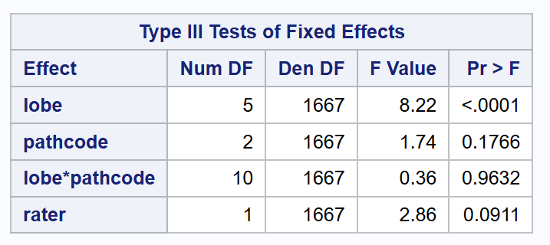
Large Nodules
Modeled using Approach 1
Excluded pathogen group 4 (Other) from analysis due to insufficient data (four of the six lobes had all 0 scores, see slide 9)
Type III Tests of the model’s fixed effects indicate no significant interaction or main effect for pathogen group (p=0.9632, p=0.1766, respectively).
We conclude that there is no evidence to suggest that disease severity differs among the pathogen groups for this feature

Slide 27
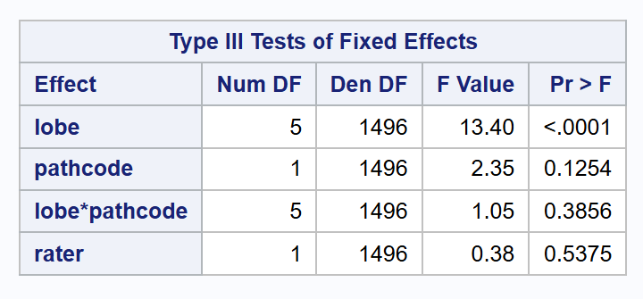
Thick Wall Cavity
Modeled using Approach 1
Excluded pathogen groups 3 (MAC + MAB) and 4 (Other) from analysis due to insufficient data (two of the six lobes had all 0 scores, see slide 10)
Type III Tests of the model’s fixed effects indicate no significant interaction or main effect for pathogen group (p=0.3856, p=0.1254, respectively).
We conclude that there is no evidence to suggest that disease severity differs among the pathogen groups for this feature

Slide 28
Thin Wall Cavity
Scores of “1” for this feature were too rare to fit a regression model with stable estimates (see slide 11). Instead, Fisher's Exact Test was used to test if the score's distribution was independent of the pathogen group within each lobe. This test calculates the exact probability of observing the data's pattern assuming no real association exists.
A statistically significant association was found in four lobes: the RUL (p=0.005), RML (p<0.0001), LUS (p=0.0216), and LLS (p=0.0326). These results indicate that the observed clustering of positive scores within certain pathogen groups is unlikely to be due to random chance. Although a statistical association is present, I suggest interpreting with caution due to the extreme data sparsity.

Slide 29
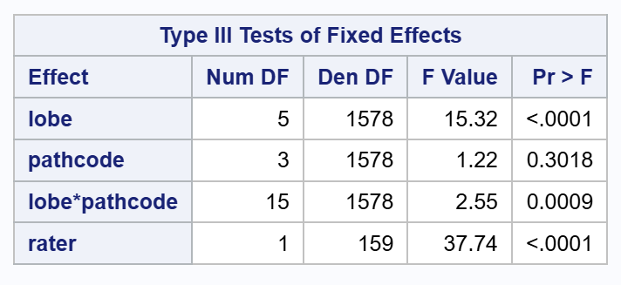
Tree-In-Bud
Modeled using Approach 3
Type III Tests of the model’s fixed effects indicate a significant interaction between lobe and pathogen group (p=0.0009)
This means the effect of pathogen group is different depending on lung lobe, warranting post-hoc testing (see next slide)

Slide 30


Tree-In-Bud
Post-hoc testing revealed that the differences between pathogen groups were significant overall in the RUL and RLL (p=0.0341 and p=0.0246, respectively)
Additional testing performed to see which pathogen groups significantly differ within these lobes (see next slides)

Slide 31

Tree-In-Bud
Further testing indicates that in the RUL, the odds of having a higher disease score for pathogen group 3 (MAC+MAB) are 5.27 times the odds for pathogen group 1 (MAC) (95% CI: 1.12, 24.72) (p=0.0292)

Slide 32

Tree-In-Bud
In the RLL, no comparisons remain significant after adjusting for multiple comparisons

