Slide 1
Stacked Bar Charts of Counts by Lobe with Updated Colors
Edward Bosko
December 19, 2025
Notes:
Welcome

Slide 2
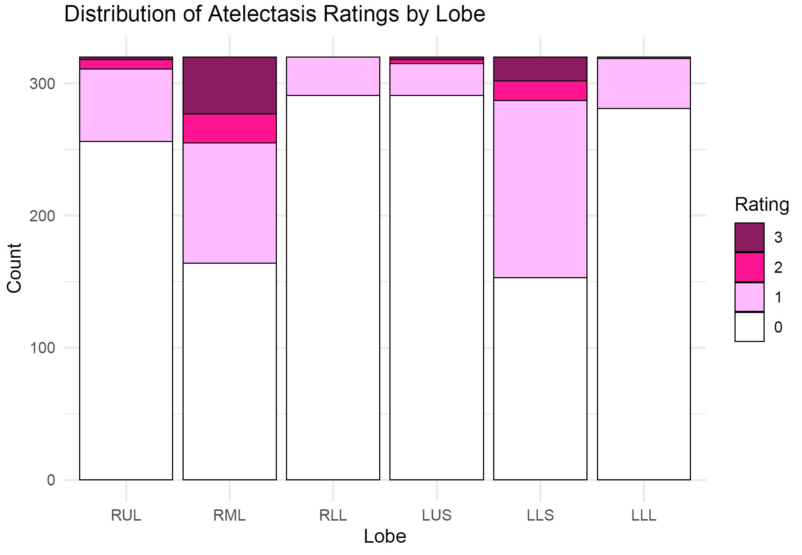

Slide 3
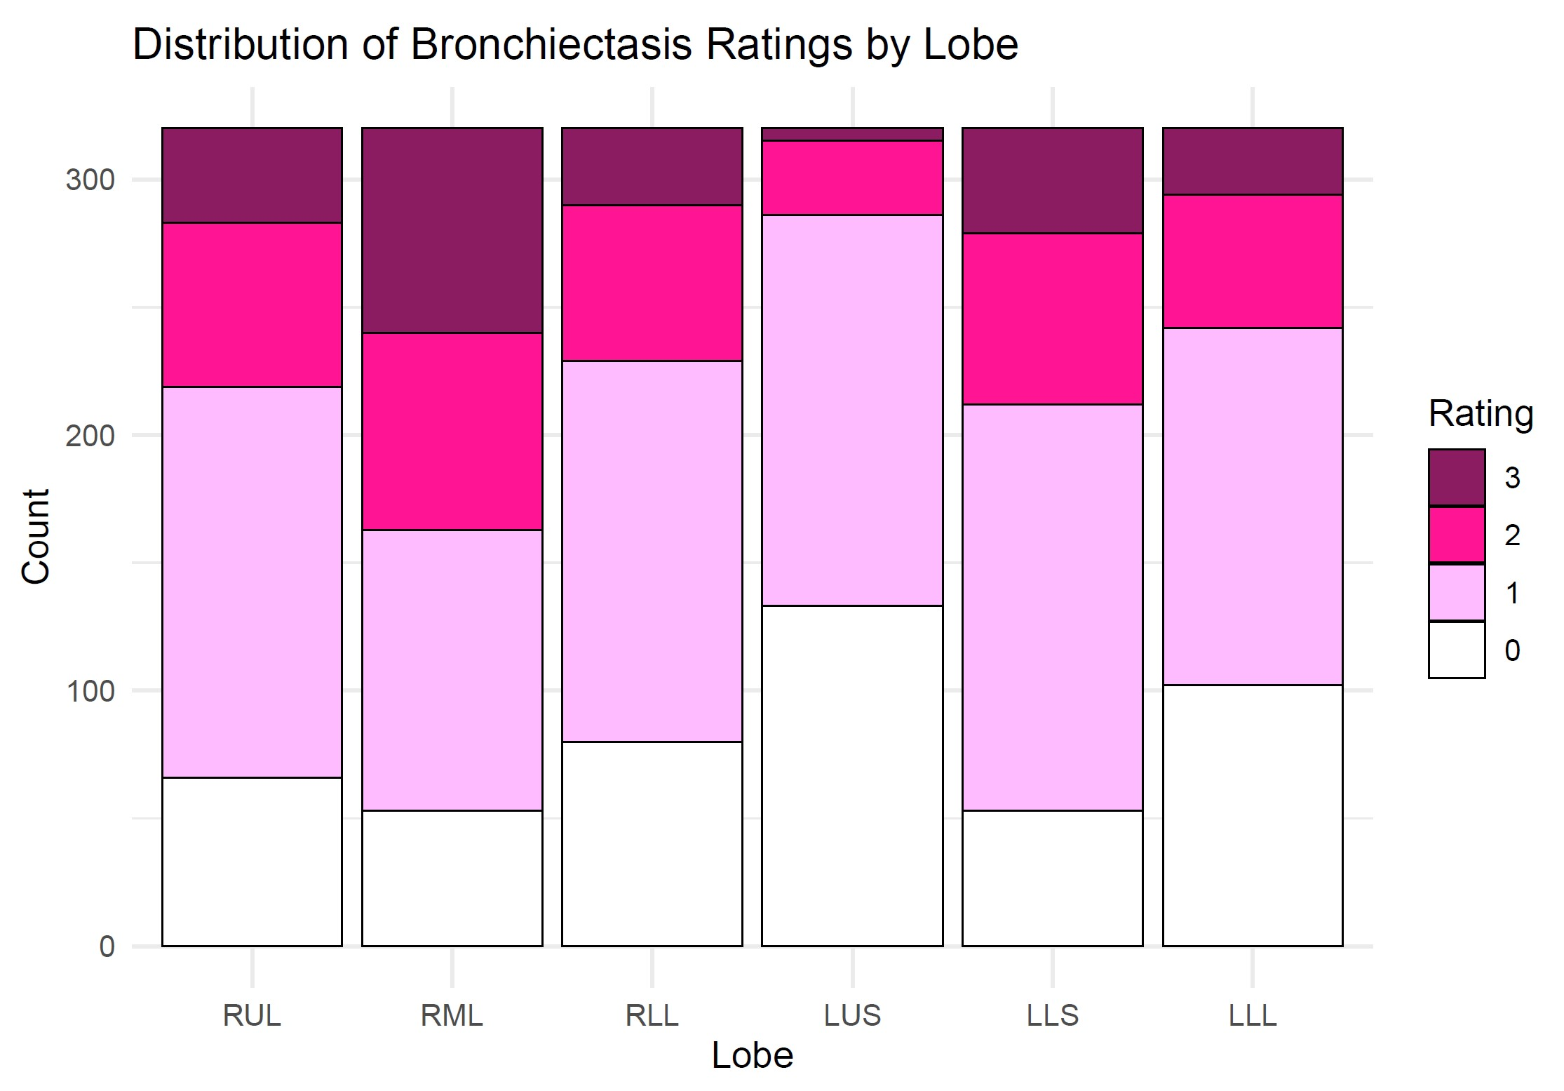

Slide 4
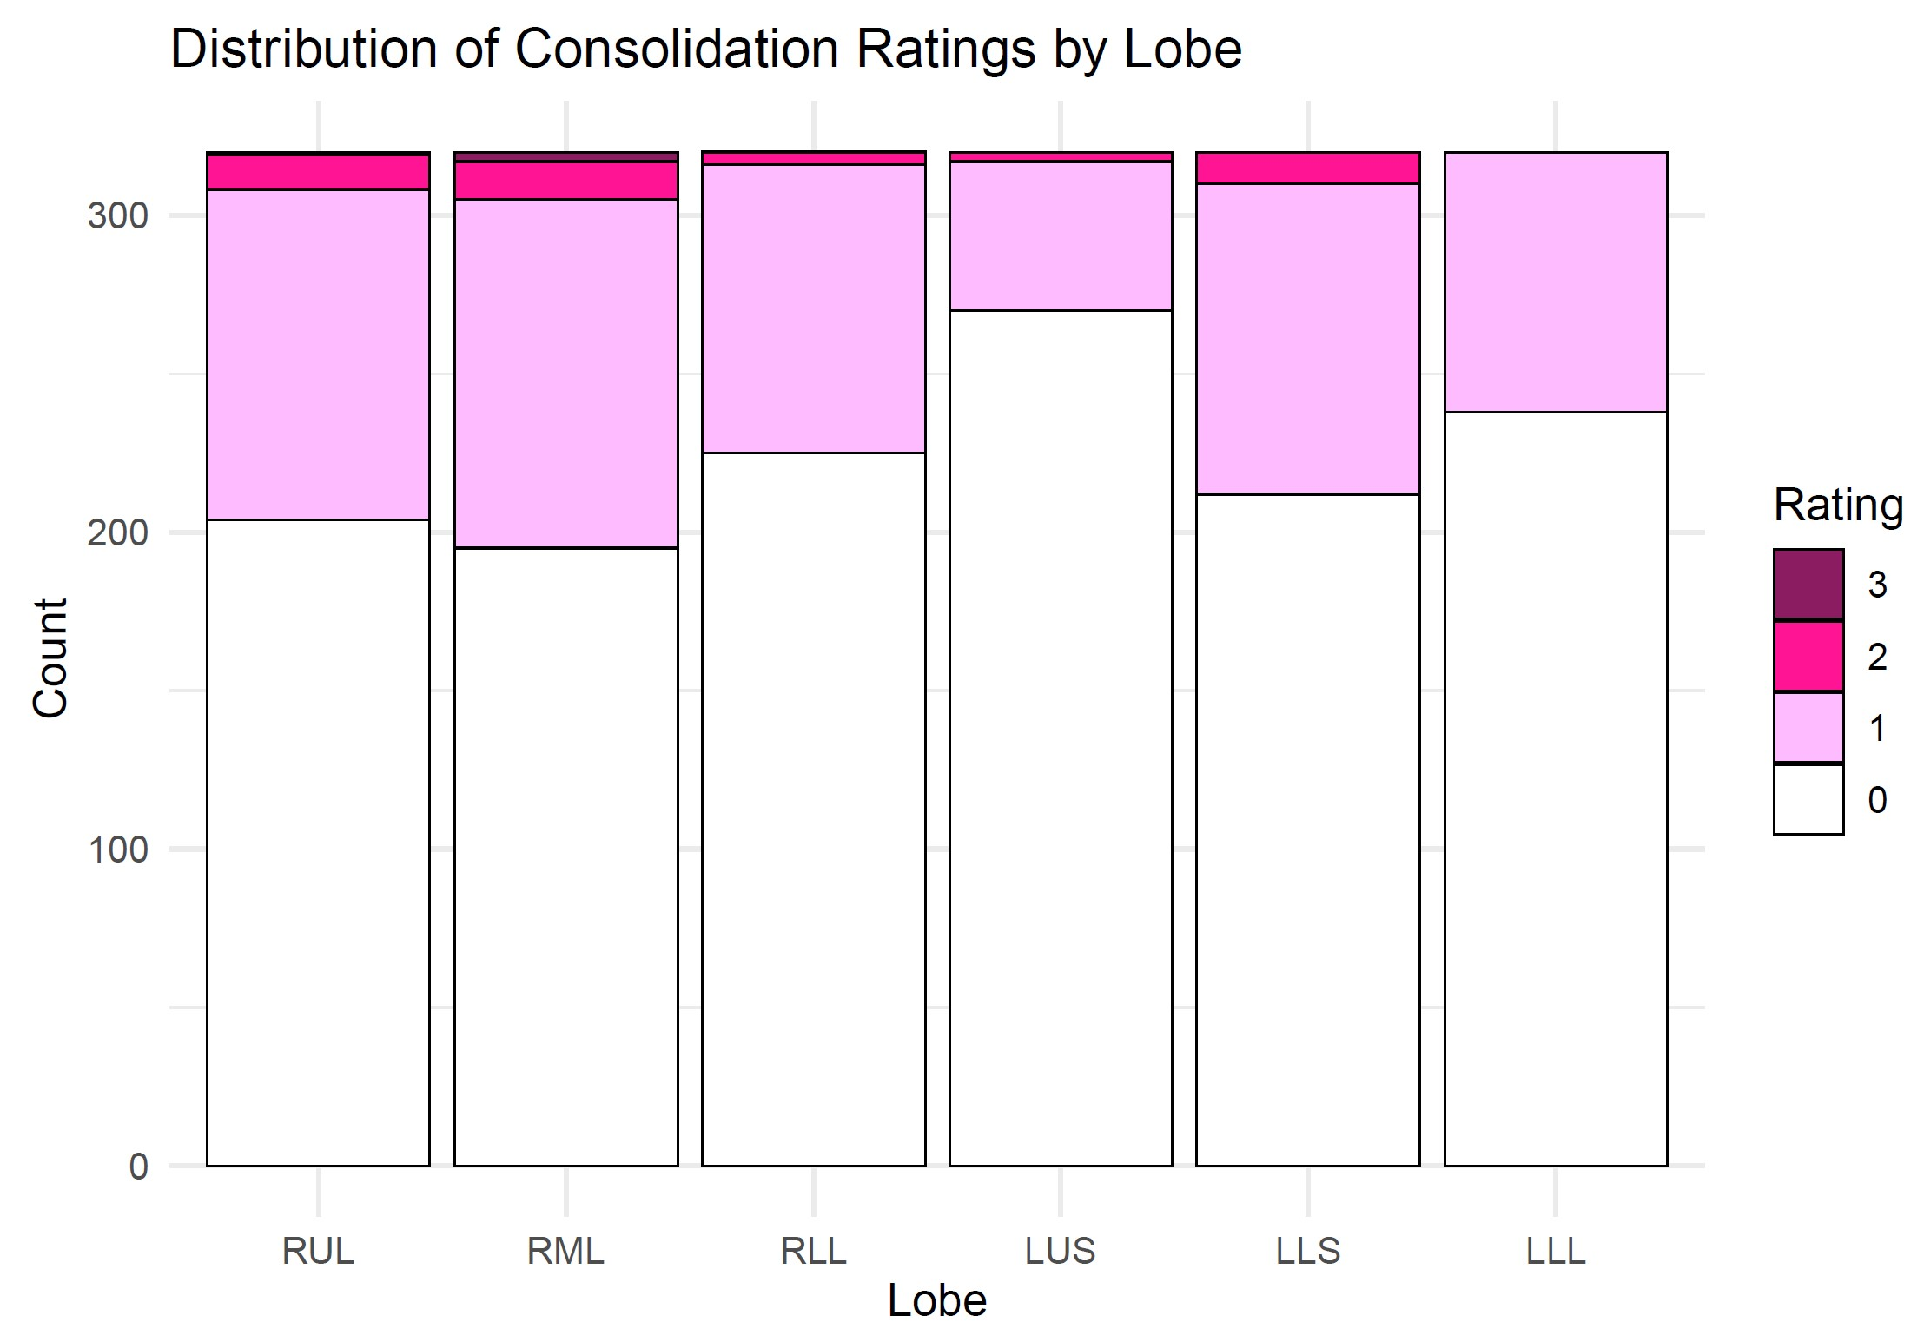

Slide 5
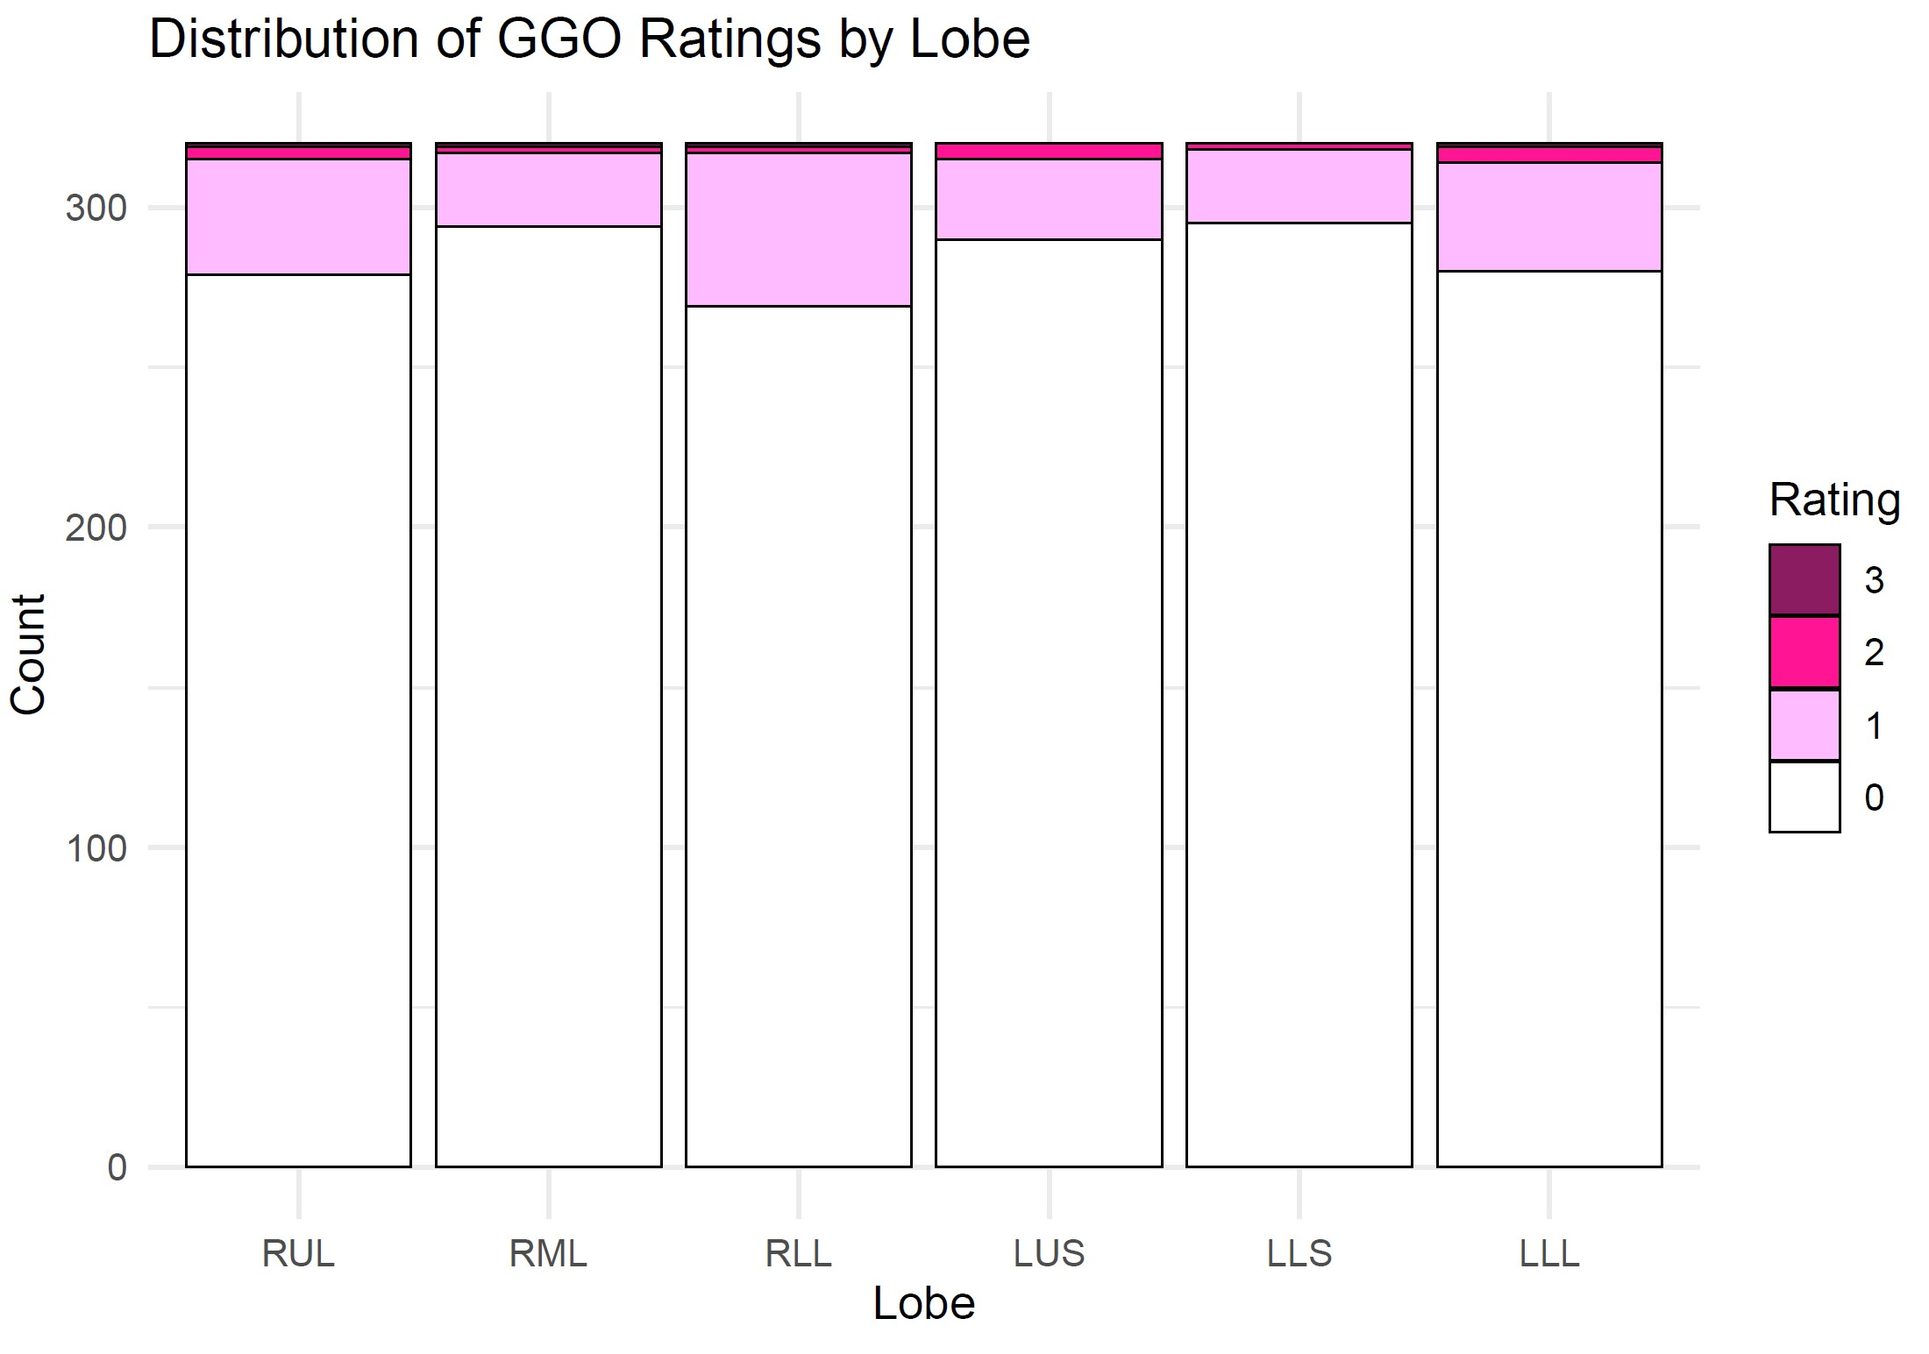

Slide 6
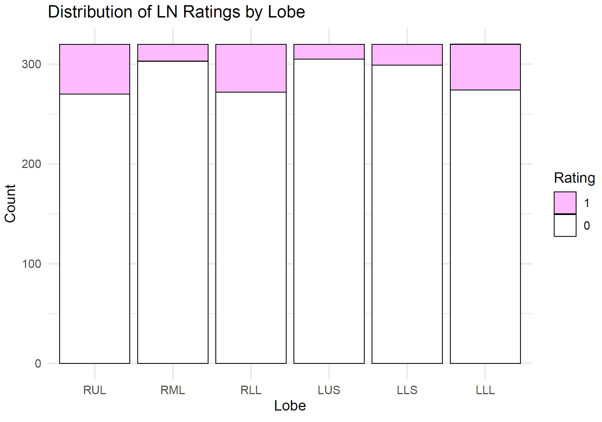

Slide 7
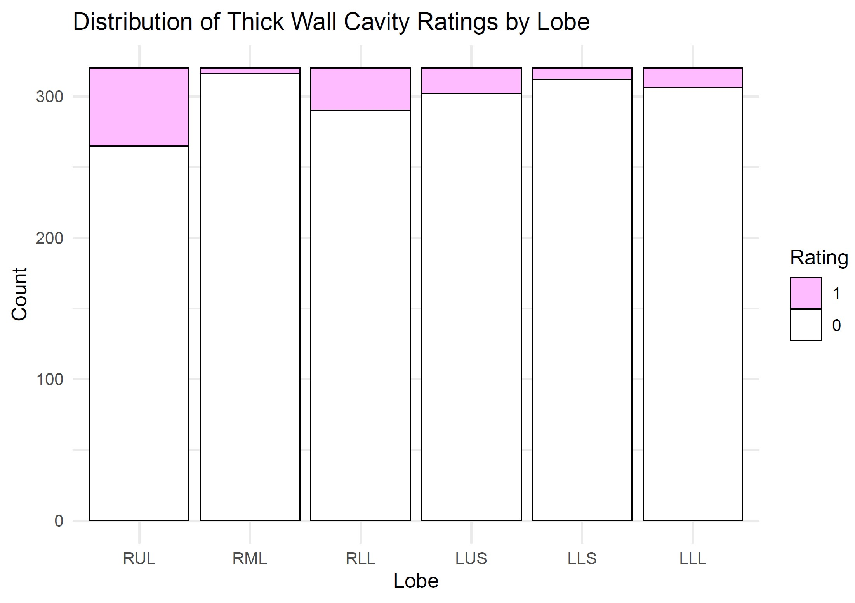

Slide 8
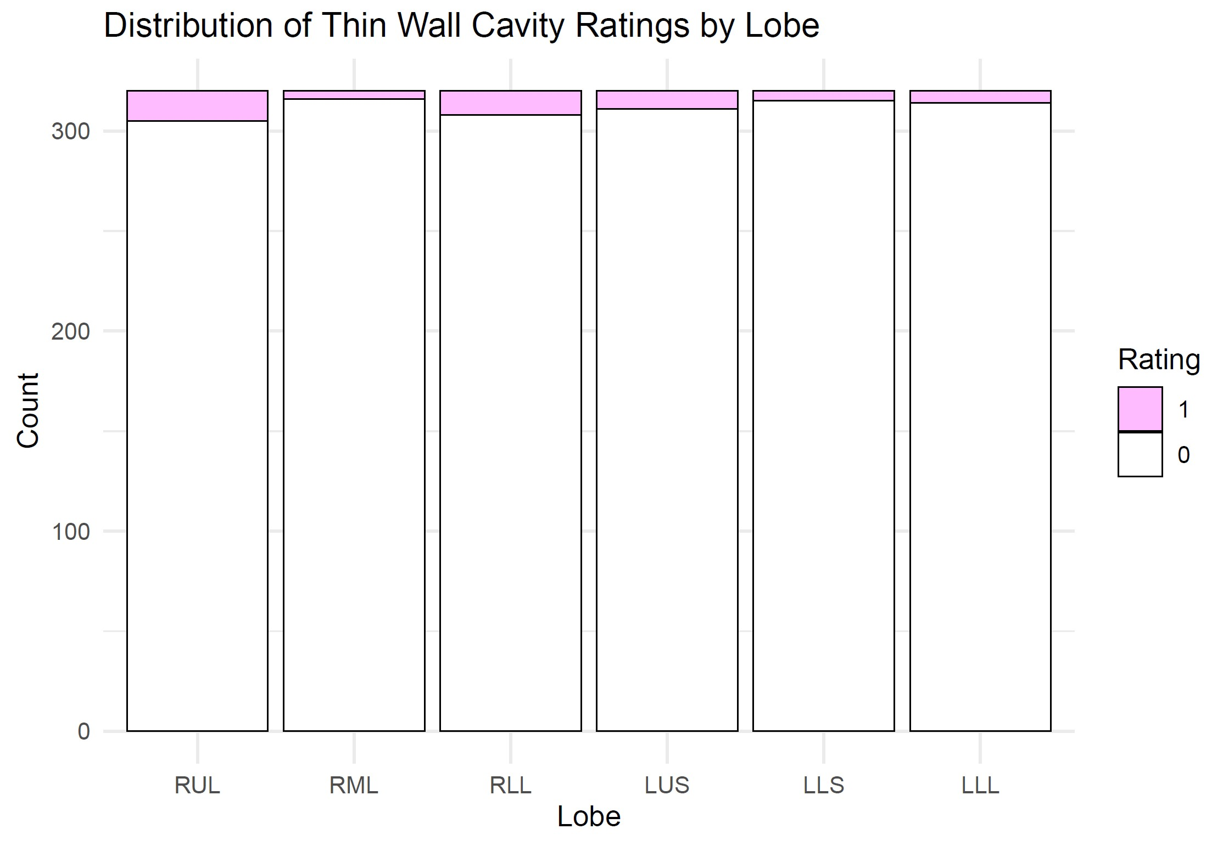

Slide 9
