Slide 1
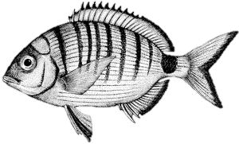
neutral

Slide 2
adaptive

Slide 3
adaptive
K = 2

Slide 4
adaptive
Iteration 2
K = 2
Subset individuals > 75% ancestry in Cluster 1

Slide 5
adaptive
K = 2

