Slide 1

Building a Car Price Prediction System
Using Machine Learning

Slide 2
Introduction
- Predicting used car prices with machine learning.
- Objective: Train a model to predict selling price based on car features.

Slide 3

Dataset Overview
- Features:
* Car brand and year
* Selling and present price
* Kilometers driven
* Fuel type (Petrol, Diesel, CNG)
* Seller type (Individual, Dealer)
* Transmission (Automatic, Manual)
* Ownership history

Slide 4
Workflow
1. Data Collection
- Sourced from Kaggle.
2. Data Preprocessing
- Checked and encoded categorical data.
3. Data Splitting
- Training (90%) and Testing (10%).
4. Model Training
- Linear and Lasso Regression.
5. Evaluation
- Metrics: R-squared error.
- Visualization: Scatter plots.

Slide 5
Model Performance
- Linear Regression:
* Training R-squared: ~0.879
* Testing R-squared: ~0.836
* Good alignment in scatter plots.
- Lasso Regression:
* Comparable R-squared.
* Predicted values closely match actual values.

Slide 6
Tools Used
- Libraries: Pandas, NumPy, Matplotlib, Seaborn, Scikit-learn.
- Environment: Jupyter.

Slide 7
Insights
- Linear Regression: Effective with positively correlated features.
- Lasso Regression: Reduces overfitting with multiple features.
- Predictions improve with larger datasets.

Slide 8
Future Enhancements
- Experiment with advanced models like XGBoost.
- Enhance feature engineering.
- Deploy as a web service for real-time predictions.

Slide 9
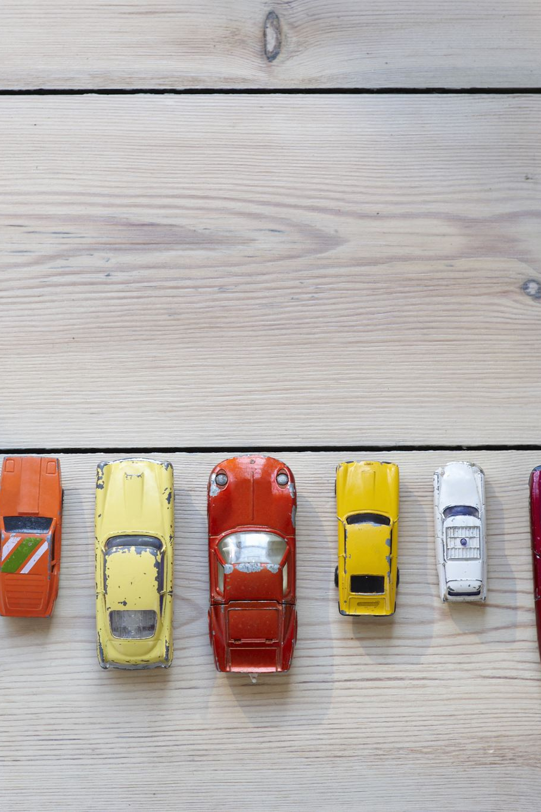
Conclusion
- Successfully predicted car prices.
- Models evaluated using accuracy and visualizations.
- Demonstrated regression techniques in machine learning.

