Slide 1

Grade 5 Science | Topic 3: Earth's Systems
Lesson 2: Hydrosphere and Atmosphere
The Complete Lesson • Monday
Week 9 • October 25 - 29, 2026
Mr. Ibrahim Ahmad • EDUGATES International School

Slide 2

GRADE 5 | EARTH'S SYSTEMS T3 L2 | FULL LESSON - MONDAY
Lesson Goals
1
Describe where Earth's water is found and how it moves through the water cycle.
2
Describe the atmosphere - what it is made of and why it matters for living things.
3
Explain how the hydrosphere and the atmosphere work together in weather.
Tell a partner: which goal sounds hardest? Why?

Slide 3
GRADE 5 | EARTH'S SYSTEMS T3 L2 | FULL LESSON - MONDAY
Warm-Up
You step in a puddle in the morning. By afternoon, the puddle is GONE. Where did the water go?
Connection: Last week we modeled the GEOSPHERE (land) and the BIOSPHERE (living things). Today we add two more spheres: the HYDROSPHERE and the ATMOSPHERE.
Think - Pair - Share: write one sentence with your best idea, then compare with your partner.
Warm-up: 3 min

Slide 4
GRADE 5 | EARTH'S SYSTEMS T3 L2 | FULL LESSON - MONDAY
Key Vocabulary
hydrosphere
atmosphere
evaporation
All the water on Earth - oceans, ice, rivers, lakes and groundwater.
The blanket of gases that surrounds Earth.
Liquid water warms up and changes into water vapor (a gas).
condensation
precipitation
water vapor
Water vapor cools and changes back into tiny liquid drops - clouds form.
Water falls from clouds as rain, snow, sleet or hail.
Water in its gas form, invisible in the air.

Slide 5
GRADE 5 | EARTH'S SYSTEMS T3 L2 | FULL LESSON - MONDAY
The Hydrosphere: Where Is Earth's Water?
Not shared evenly
Oceans (salty water): about 97%
Ice caps and glaciers (frozen fresh water): about 2%
Liquid fresh water - lakes, rivers, groundwater: about 1%
Wow fact
Almost all liquid fresh water is hidden underground.
The water in rivers and lakes is only a tiny slice we can see.
Every drop on Earth is part of the hydrosphere.

Slide 6
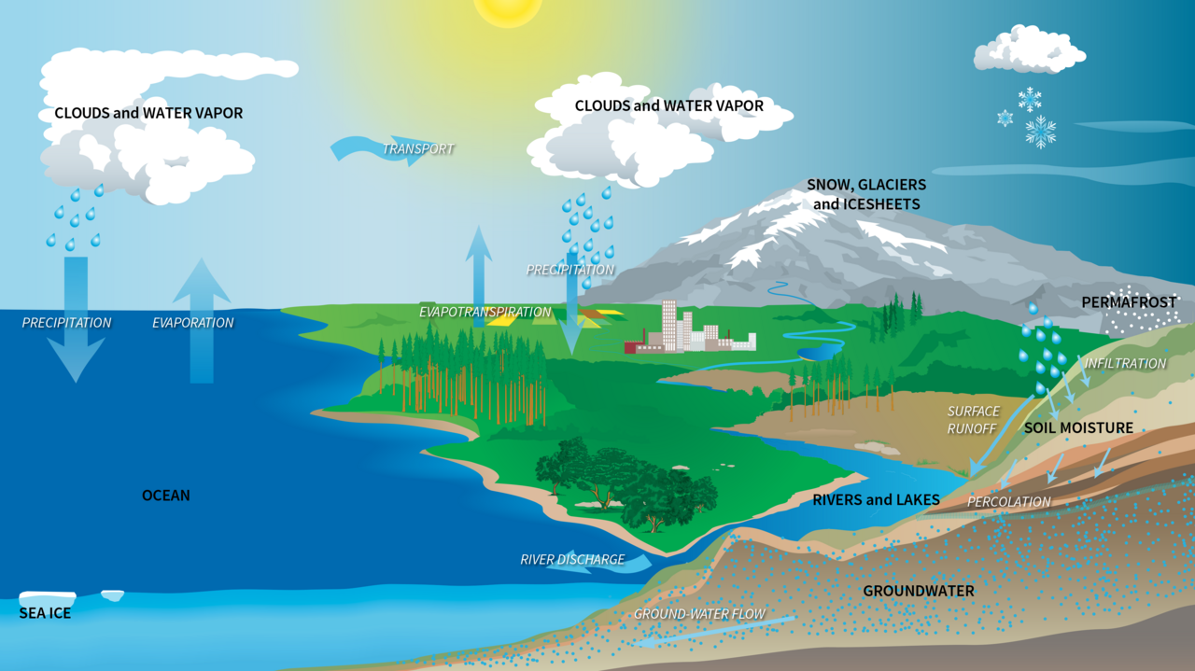

GRADE 5 | EARTH'S SYSTEMS T3 L2 | FULL LESSON - MONDAY
The Water Cycle
The same water is used again and again.
The Sun heats the ocean. Water rises as vapor, cools into clouds, falls as rain and flows back to the sea.
The Sun's energy drives the WHOLE cycle.
Find it on the diagram: where do evaporation, condensation, precipitation and collection happen?
Image: NASA (public domain)

Slide 7
GRADE 5 | EARTH'S SYSTEMS T3 L2 | FULL LESSON - MONDAY
Four Key Processes
The Sun's energy moves water through the same four steps, again and again.
1. EVAPORATION
2. CONDENSATION
3. PRECIPITATION
4. COLLECTION
The Sun heats water in oceans, lakes and rivers. It changes into water vapor and rises.
High up, the air is cold. Vapor cools into tiny drops - a cloud is born.
Drops grow heavy and fall: rain, snow, sleet or hail.
Water gathers in rivers, lakes and oceans - and soaks into the ground.
Remember: the SUN provides the energy - GRAVITY pulls water down - WIND (the atmosphere) carries the clouds.
The cycle has no beginning and no end - the water you drink today was once rain over a dinosaur forest!

Slide 8
GRADE 5 | EARTH'S SYSTEMS T3 L2 | FULL LESSON - MONDAY
The Atmosphere: Earth's Blanket of Gases
What is it made of?
Nitrogen: about 78%
Oxygen: about 21%
Other gases: about 1% - including carbon dioxide and water vapor
Why it matters
Gives us the air we breathe.
Keeps Earth warm enough for life.
Blocks harmful rays from the Sun.
It is where ALL weather happens.

Slide 9
GRADE 5 | EARTH'S SYSTEMS T3 L2 | FULL LESSON - MONDAY
Guided Practice: Follow a Drop of Water
With your partner, trace ONE drop of water from the Red Sea to a cloud - and back again.
1
Start: your drop floats in the warm sea. What happens first - and what provides the energy?
2
Your drop is now vapor, high in the atmosphere. What happens next - and what carries it?
3
How does your drop get back to the sea? Name each process on the way.
Use the vocabulary words: evaporation, condensation, precipitation, collection.
Guided practice: 8 min

Slide 10
GRADE 5 | EARTH'S SYSTEMS T3 L2 | FULL LESSON - MONDAY
Group Activity: Draw the Water Cycle
1
In pairs, draw a big water cycle poster: the Sun, the sea, clouds, rain and a river.
GROUP WORK
10
minutes
2
Label the four processes with arrows: evaporation, condensation, precipitation, collection.
3
Add ONE sphere label at each step: hydrosphere, atmosphere, geosphere, biosphere.
Pairs. Worksheets on Classera when you finish.
4
Gallery walk: explain your poster to another pair using your vocabulary words.
Success criteria:
all 4 processes labeled with arrows, 4 sphere labels, one clear explanation.
Activity: 10 min

Slide 11
GRADE 5 | EARTH'S SYSTEMS T3 L2 | FULL LESSON - MONDAY
Check for Understanding
Quick check - answer on your mini whiteboard:
EXIT TICKET
1
Which process turns liquid water into water vapor?
In one or two sentences: explain how the hydrosphere and the atmosphere work together in the water cycle. Use at least two vocabulary words.
2
Where is most of Earth's water found?
3
Name one gas in the atmosphere - and one way the atmosphere helps us.
Homework on Classera
Check: 5 min

