Slide 1

Grade 6 Science | Reproduction of Organisms
Lesson 1: Inheritance
Part 1: Traits and How They Pass Down
Week 9 • October 25 - 29, 2026
Mr. Ibrahim Ahmad • EDUGATES International School

Slide 2

GRADE 6 | REPRODUCTION OF ORGANISMS L1 PART 1
Lesson Goals
1
Define inheritance and tell the difference between inherited and acquired traits.
2
Explain how traits pass from parents to offspring through genes.
3
Use a simple Punnett square to predict offspring traits.
Tell a partner: which goal sounds hardest? Why?

Slide 3
GRADE 6 | REPRODUCTION OF ORGANISMS L1 PART 1
Warm-Up
Look at the family photo cards on your table. Which features do children share with their parents - and which are different?
Connection: You already know living things reproduce. But why do offspring look LIKE their parents - yet never exactly the same?
Think - Pair - Share: sort the trait cards into 'born with it' and 'got it during life', then defend your sorting.
Warm-up: 3 min

Slide 4
GRADE 6 | REPRODUCTION OF ORGANISMS L1 PART 1
Key Vocabulary
inheritance
trait
inherited trait
The passing of traits from parents to offspring.
A characteristic of an organism, like eye color or height.
A trait you are born with, passed from your parents.
acquired trait
gene
variation
A trait you gain during life, like a scar or a skill.
A segment of DNA that carries the instructions for a trait.
Differences in traits among members of the same species.

Slide 5
GRADE 6 | REPRODUCTION OF ORGANISMS L1 PART 1
Why Do We Look Like Our Parents?
The instruction manual
Your body is built from instructions stored in your genes.
Half of your genes came from your mother and half from your father.
That is why you may have your mother's eyes and your father's smile.
Inherited or acquired?
Inherited: eye color, dimples, blood type, natural hair color.
Acquired: reading, riding a bike, a scar, dyed hair.
Rule of thumb: if a skill or an event caused it, it is acquired.

Slide 6
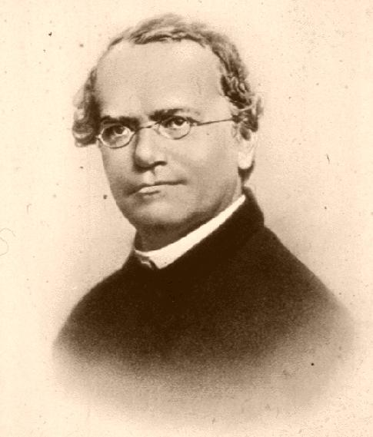

GRADE 6 | REPRODUCTION OF ORGANISMS L1 PART 1
The Father of Genetics
Gregor Mendel
an Austrian friar and scientist (1822-1884).
He grew thousands of pea plants and counted their traits: tall or short stems, purple or white flowers.
His careful numbers showed that traits pass down in predictable patterns - before anyone knew DNA existed!
He is remembered as the father of genetics.
Image: Gregor Mendel portrait, public domain (Wikimedia Commons)

Slide 7
GRADE 6 | REPRODUCTION OF ORGANISMS L1 PART 1
Predicting Traits: The Punnett Square
A Punnett square shows every way the parents' gene versions (alleles) can combine.
Cross: Tt x Tt (T = tall, dominant t = short, recessive)
T
t
TT
Tt
Each parent gives ONE allele for each gene.
The square lists all combinations - it counts every chance.
Question: can two tall parents have a short child?
T
tall
tall
t
Tt
tt
tall
short
Result: TT, Tt, Tt are TALL - 3 of 4 boxes.
tt is SHORT - 1 of 4 boxes. Ratio 3 tall : 1 short (75% / 25%)

Slide 8
GRADE 6 | REPRODUCTION OF ORGANISMS L1 PART 1
Dominant and Recessive
Alleles and dominance
Alleles are the different versions of a gene.
A dominant allele shows its trait whenever it is present (T).
A recessive allele shows its trait only when no dominant allele is there (tt).
What this means for families:
Two tall parents (Tt x Tt) can have a short child (tt) - about a 25% chance each time.
That is why a child can show a trait that neither parent shows.
Grandparents' traits can skip a generation!

Slide 9
GRADE 6 | REPRODUCTION OF ORGANISMS L1 PART 1
Guided Practice: Read the Square
With your partner, use the Tt x Tt Punnett square, then answer:
1
How many of the 4 boxes give a TALL plant? What fraction is that?
2
Which box gives a short plant - and why that box only?
3
Both parents are tall. How can the baby plant be short? Explain using alleles.
Keep question 3 in mind - it explains why traits can skip a generation.
Guided practice: 8 min

Slide 10
GRADE 6 | REPRODUCTION OF ORGANISMS L1 PART 1
Group Activity: Trait Detectives
1
In pairs, list 5 traits you can see in our class (dimples, curly hair, attached earlobes...).
GROUP WORK
10
minutes
2
Label each one: inherited or acquired? Be ready to prove it.
3
Pick one inherited trait and survey the class: how many students have it?
Pairs. Worksheets on Classera when you finish.
4
Present: is your trait common or rare? Guess if it is dominant.
Success criteria:
5 traits listed and labeled, one class survey, one dominant-or-recessive guess.
Activity: 10 min

Slide 11
GRADE 6 | REPRODUCTION OF ORGANISMS L1 PART 1
Check for Understanding
Quick check - answer on your mini whiteboard:
EXIT TICKET
1
What is inheritance?
In your own words: explain how two tall parents can have a short child. Use the words allele, dominant and recessive.
2
Give one inherited trait and one acquired trait.
3
In a Tt x Tt cross, what fraction of the offspring are short?
Homework on Classera
Check: 5 min

