Slide 1
Grade 5 - Hydrosphere and Atmosphere
Student Book Work - Week 9 - Elevate Science, Lesson 2 (pages 110-116)
Answers are written in red at each question. Page numbers are shown on every page.

Slide 2
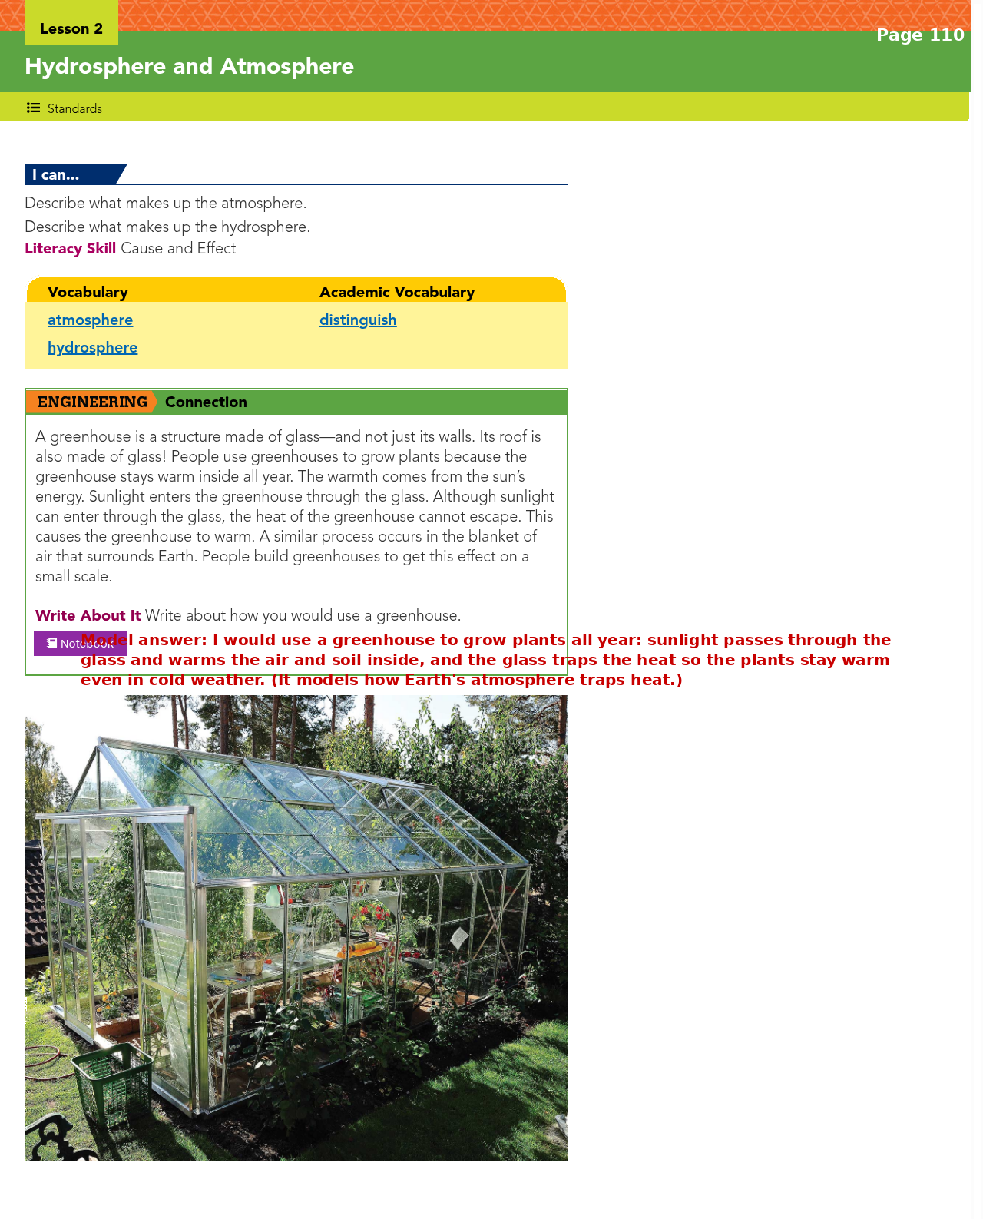

Slide 3
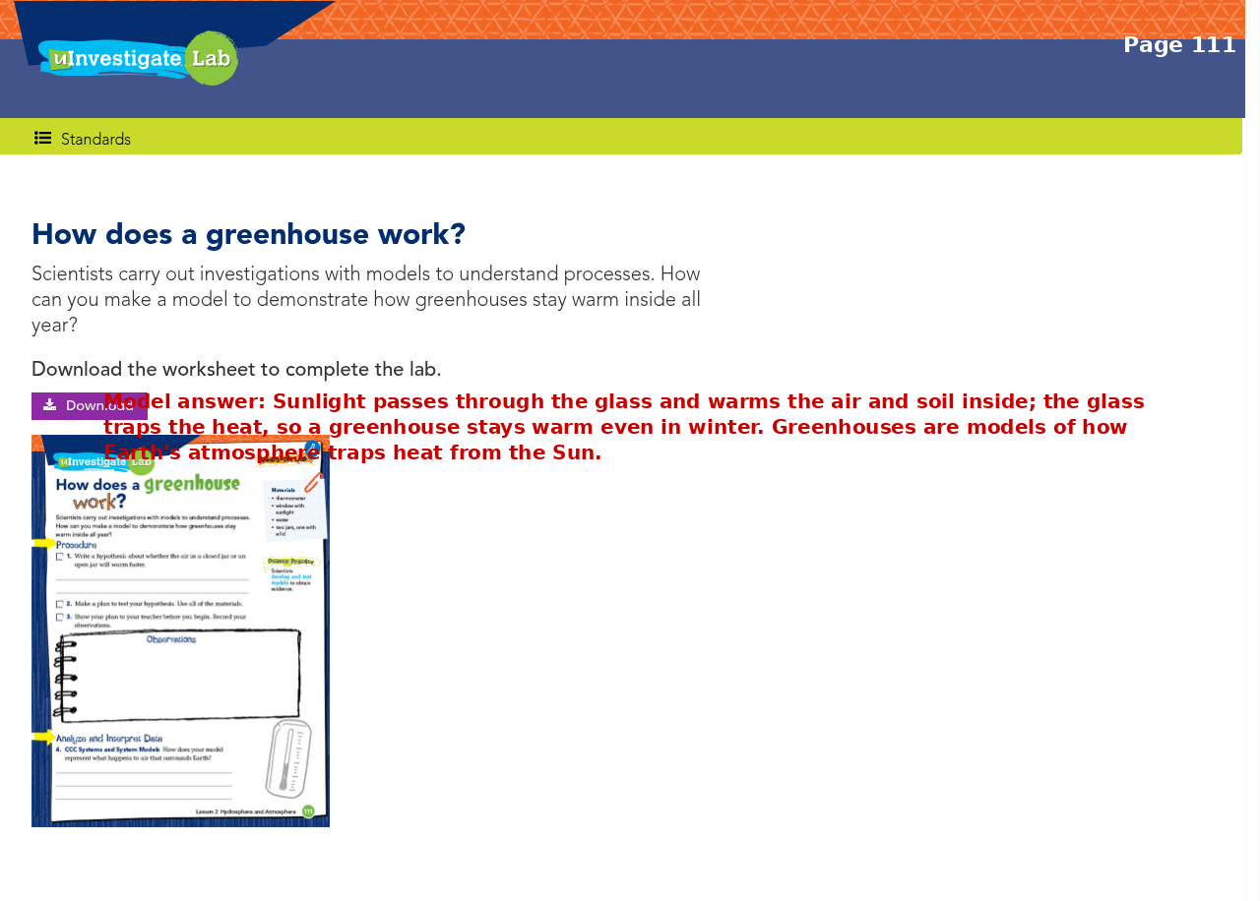

Slide 4
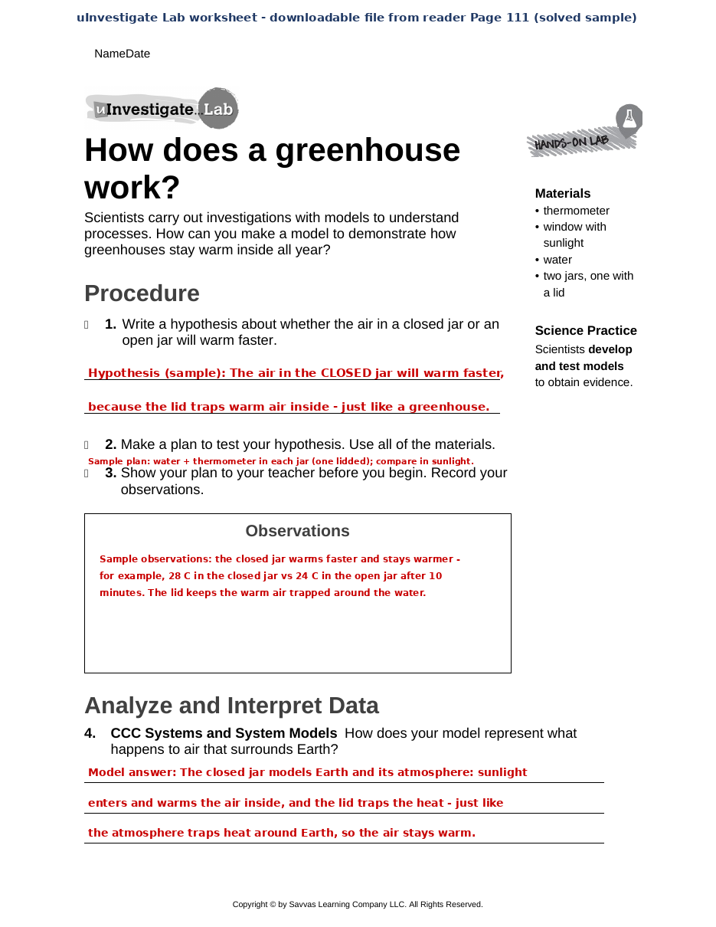

Slide 5
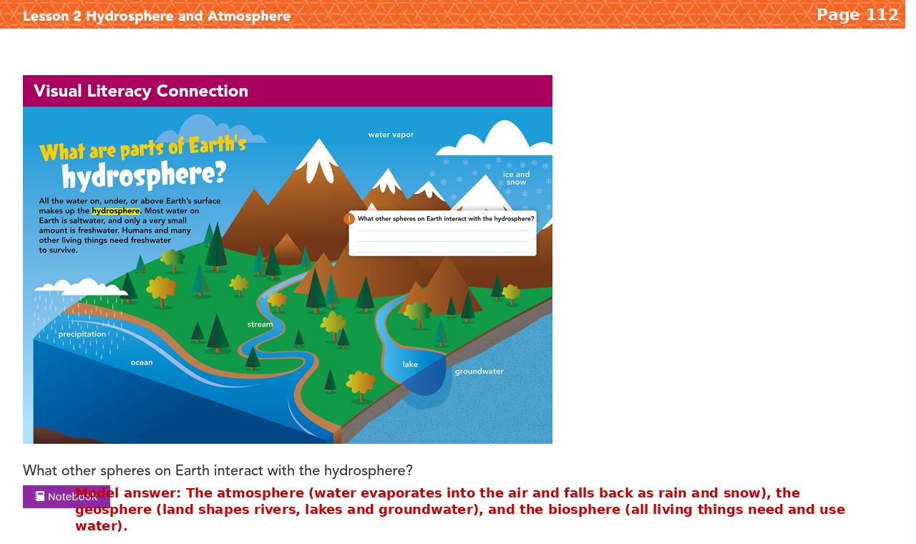

Slide 6
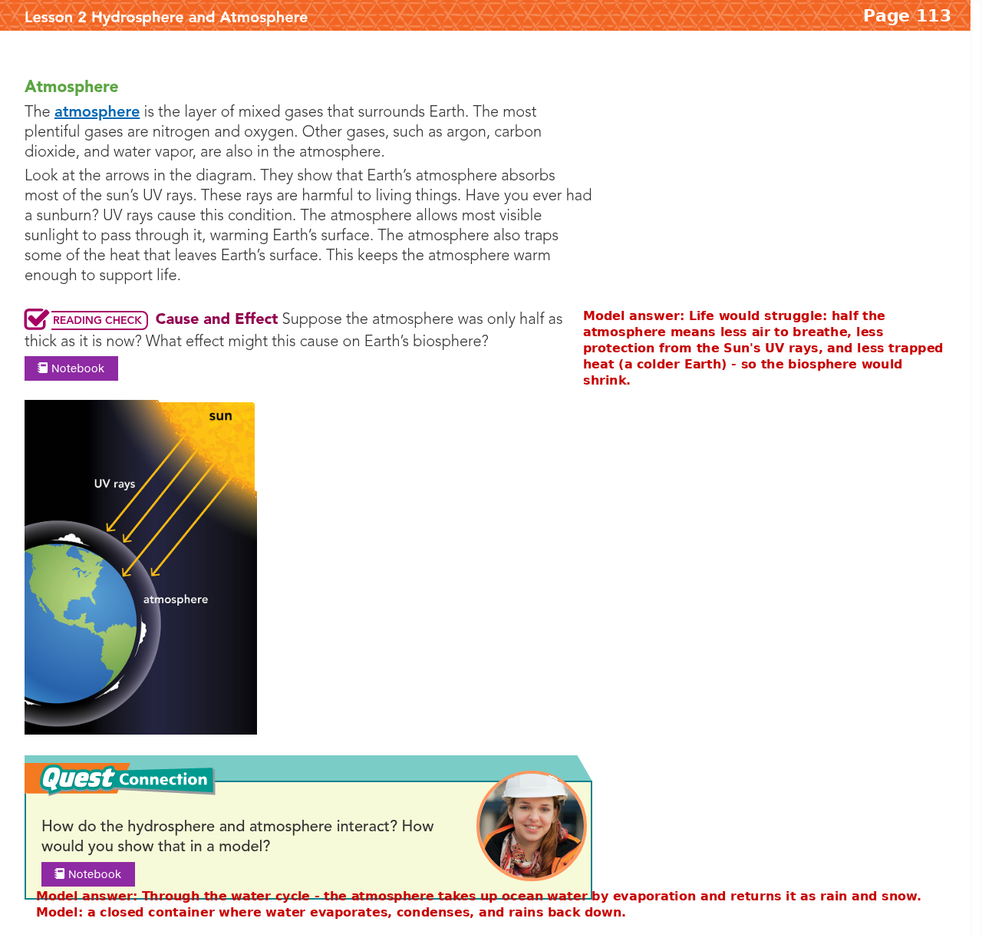

Slide 7
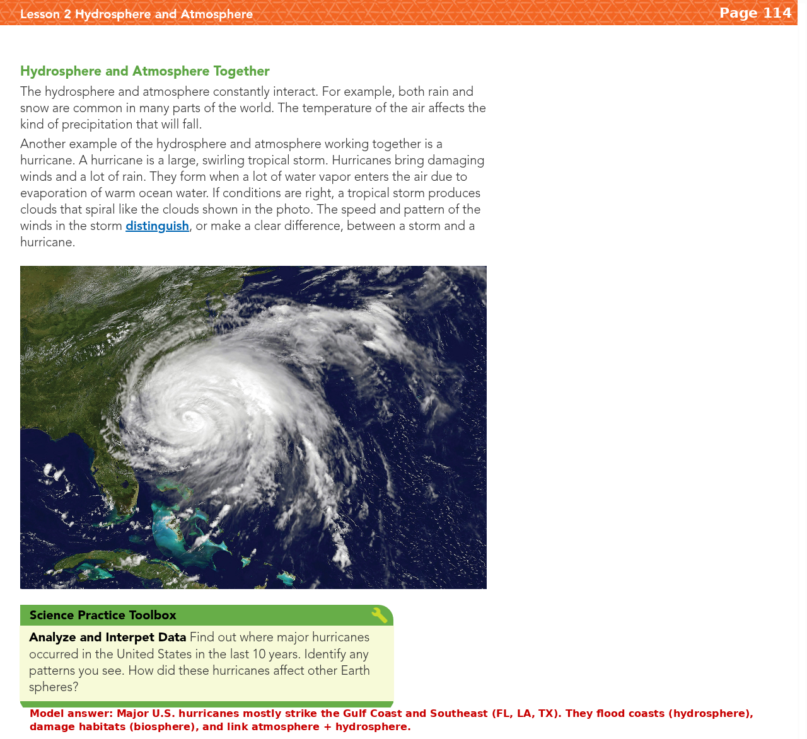

Slide 8
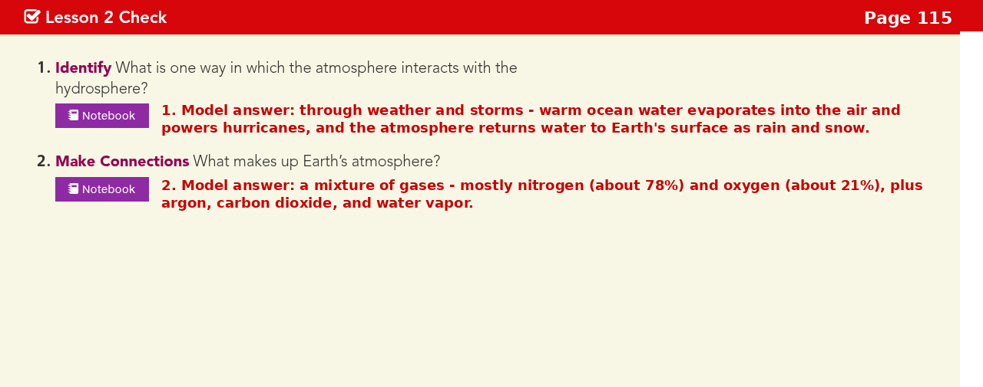

Slide 9
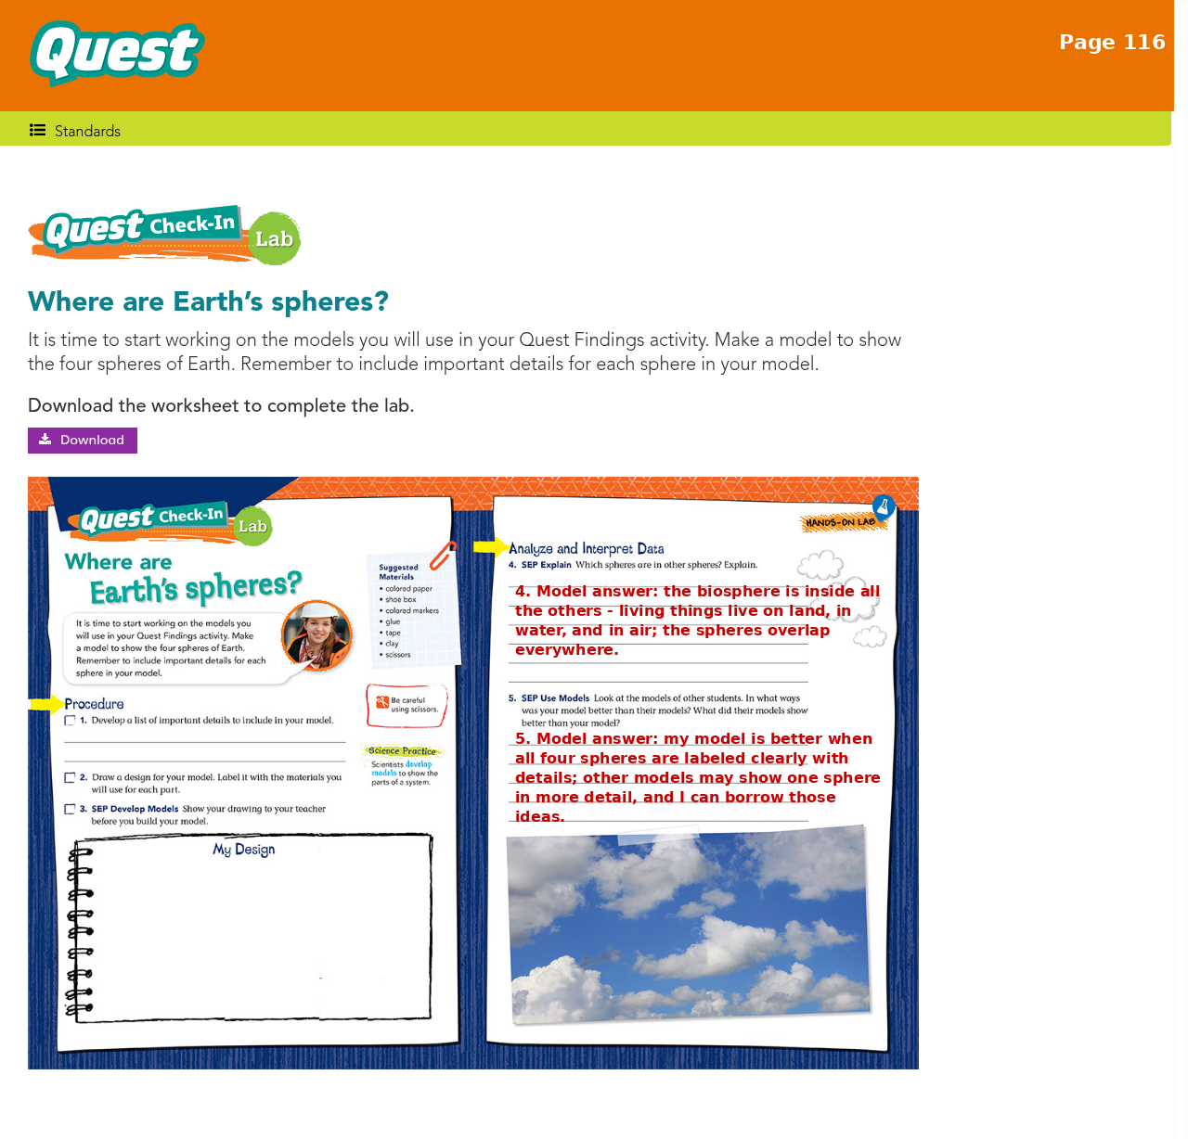

Slide 10
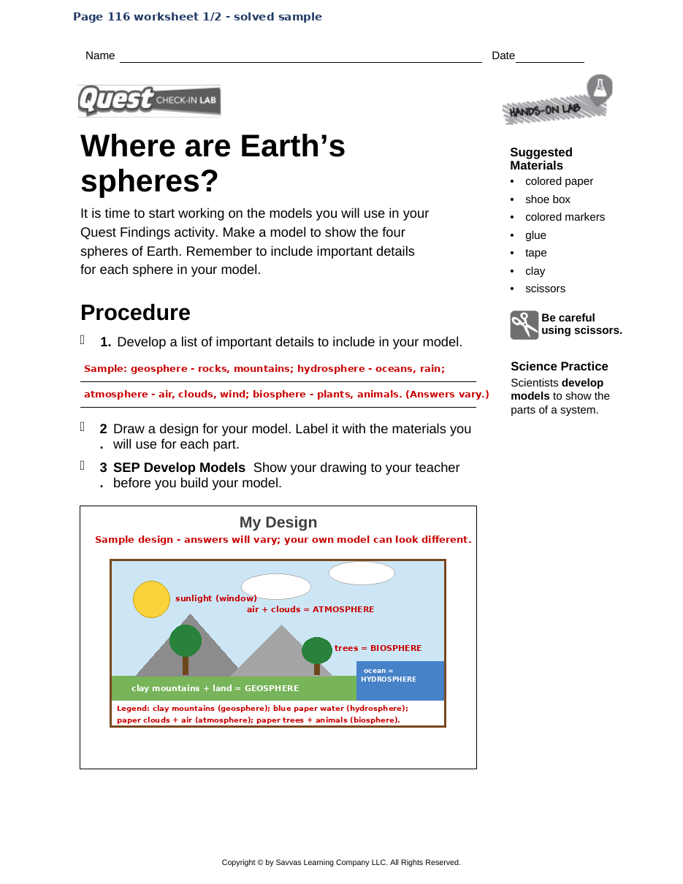

Slide 11
