Slide 1

Grade 9 Biology | Module 4: Ecology
Lesson 2: Human Population
Review and Simple Questions • Wednesday
Week 9 • October 25 - 29, 2026
Mr. Ibrahim Ahmad • EDUGATES International School

Slide 2

GRADE 9 | ECOLOGY M4 L2 | REVIEW - WEDNESDAY
Lesson Goals
1
Review human population growth and the growth curve.
2
Review the four factors that change a population.
3
Answer simple questions about the whole lesson with confidence.
Tell a partner: which goal sounds hardest? Why?

Slide 3
GRADE 9 | ECOLOGY M4 L2 | REVIEW - WEDNESDAY
Warm-Up: 60-Second Brain Dump
In 60 seconds, write EVERYTHING you remember from yesterday about the human population. Go!
Connection: Yesterday we studied how fast our population is growing and what changes it. Today we review and practice with simple questions.
Compare your list with your partner. Who remembered more?
Warm-up: 3 min

Slide 4
GRADE 9 | ECOLOGY M4 L2 | REVIEW - WEDNESDAY
Key Vocabulary
population
population density
birthrate
All the members of one species living in the same area.
The number of individuals living in a given area.
The number of births in a population in a given time.
death rate
migration
carrying capacity
The number of deaths in a population in a given time.
Movement of individuals into or out of a population.
The largest population an environment can support over time.

Slide 5
GRADE 9 | ECOLOGY M4 L2 | REVIEW - WEDNESDAY
Quick Review: How Fast Are We Growing?
Remember the story
Slow growth for most of human history.
1 billion around 1800 - about 8 billion today.
Medicine, sanitation and farming cut the death rate.
Quick questions
What SHAPE is the human growth curve?
Why did growth speed up after 1800?
Does every country grow at the same rate?

Slide 6
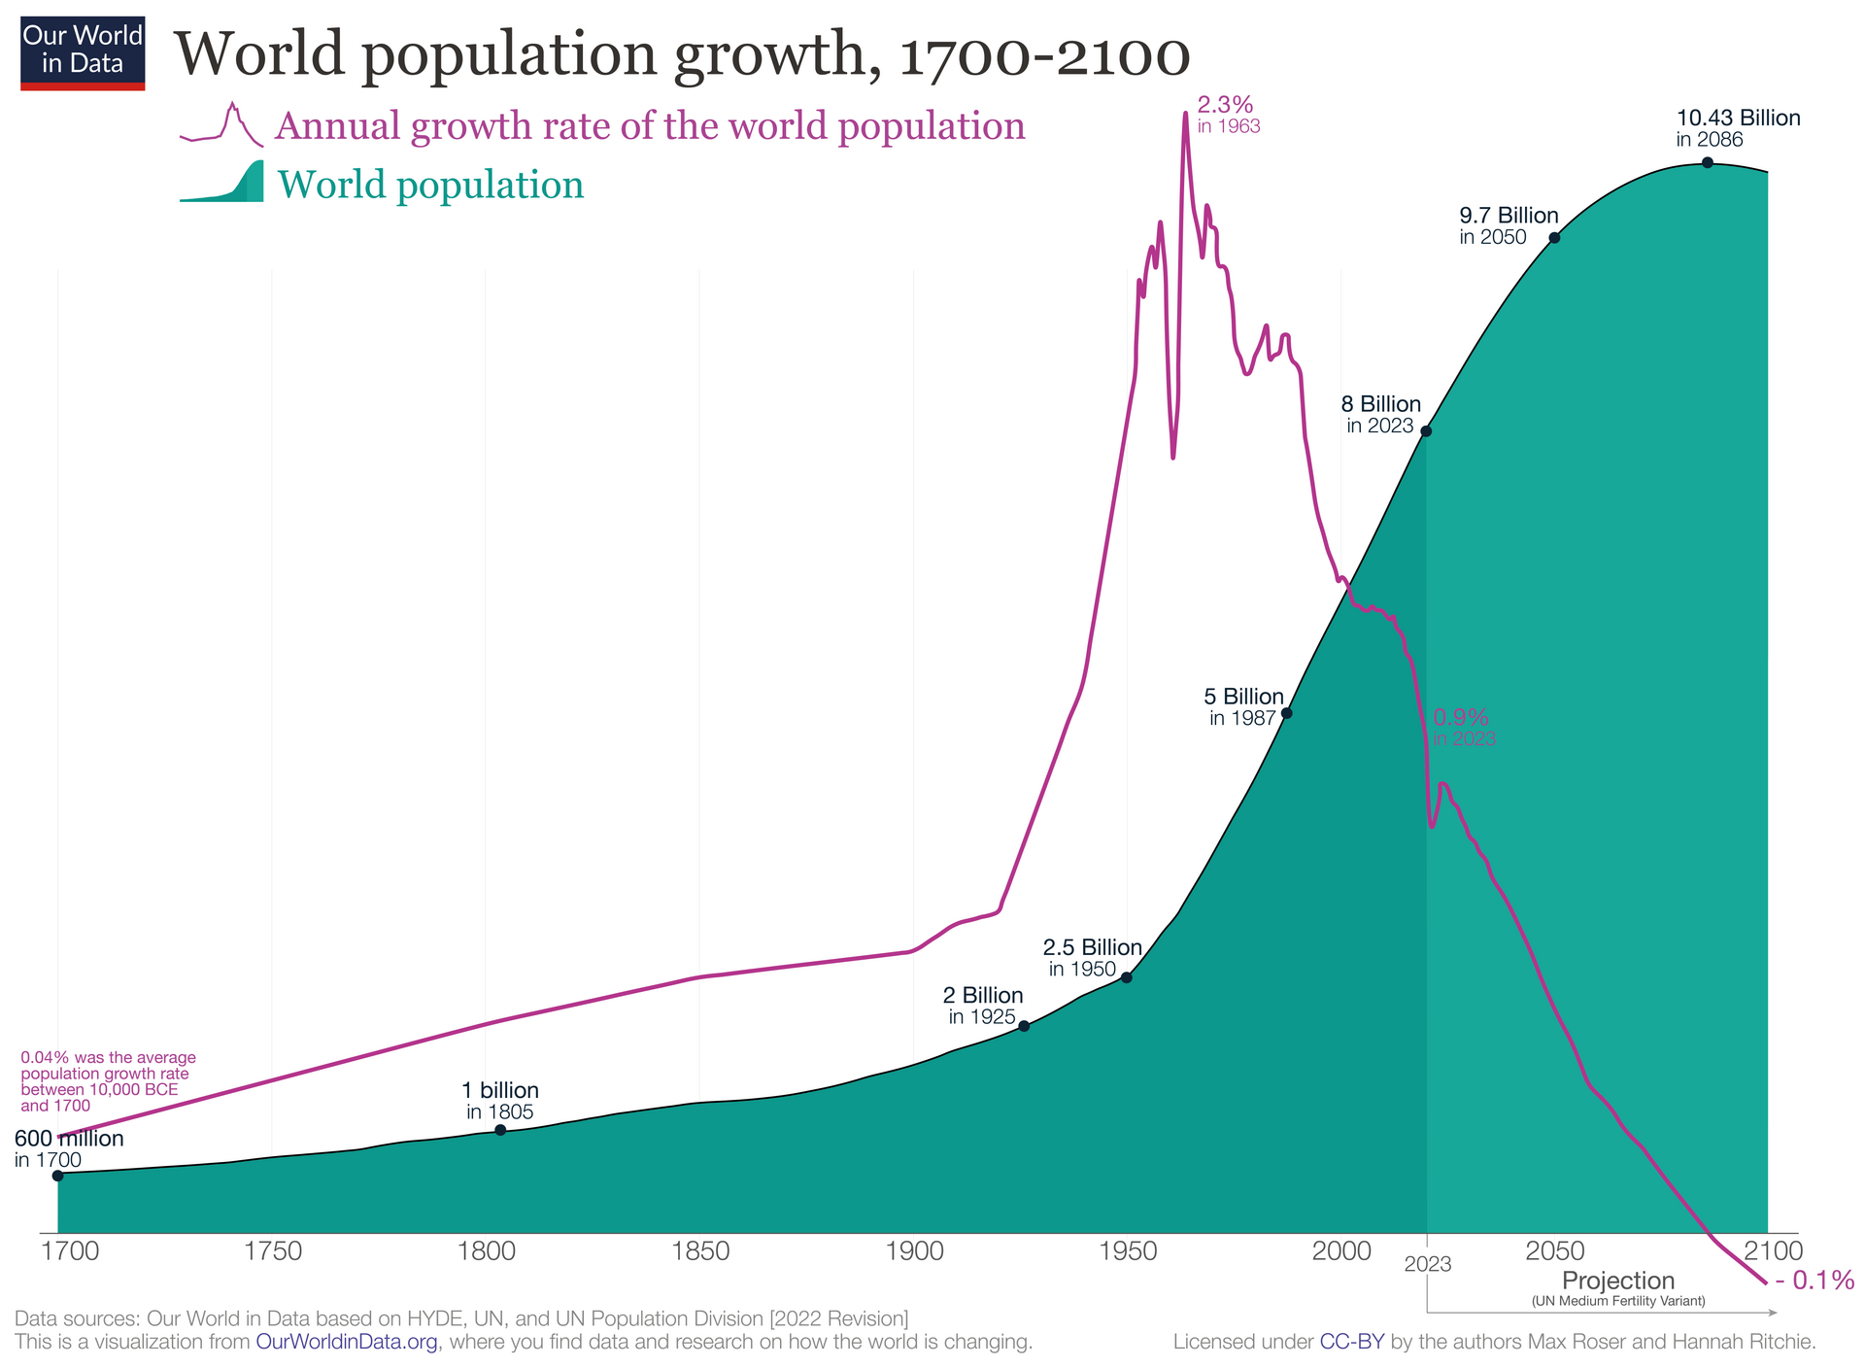

GRADE 9 | ECOLOGY M4 L2 | REVIEW - WEDNESDAY
Quick Review: Reading the Curve
Trace the curve with your finger and describe it to your partner.
Quick questions:
Where is the curve flat? Where is it steep?
What is this kind of growth called?
What does the curve predict if nothing changes?
Image: Our World in Data, CC BY 4.0

Slide 7
GRADE 9 | ECOLOGY M4 L2 | REVIEW - WEDNESDAY
Quick Review: Four Factors
Say the four factors - then test yourself with the questions below.
BIRTHRATE
DEATH RATE
IMMIGRATION
EMIGRATION
Q: If birthrate rises, what happens to the population? (it grows)
Q: What lowers a death rate? (medicine, clean water, food)
Q: People moving IN - does the population grow or shrink? (grow)
Q: People moving OUT - grow or shrink? (shrink)
Memory formula: population change = (births + immigration) - (deaths + emigration). Say it once more, out loud.

Slide 8
GRADE 9 | ECOLOGY M4 L2 | REVIEW - WEDNESDAY
Quick Review: People and the Planet
Remember the links
More people = more food, water, energy and space needed.
Cities grow, habitats shrink.
Every environment has a carrying capacity.
Quick questions
Name TWO resources a growing population needs more of.
What is carrying capacity in your own words?
Name ONE warning sign that a population is stressing its environment.

Slide 9
GRADE 9 | ECOLOGY M4 L2 | REVIEW - WEDNESDAY
Practice: Simple Questions
Answer on your mini whiteboard - first pair to finish wins:
1
What is a population?
2
Birthrate is 20, death rate is 12, and nobody moves. Is the population growing or shrinking?
3
True or false: migration means only moving INTO a place.
Bonus: why can no population grow forever?
Guided practice: 8 min

Slide 10
GRADE 9 | ECOLOGY M4 L2 | REVIEW - WEDNESDAY
Group Activity: Team Quiz Game
1
Form teams of 3-4. Each team writes TWO simple questions about the lesson.
GROUP WORK
10
minutes
2
Teams swap questions and answer them - no books!
3
Score: 1 point per correct answer, 1 bonus point for using a vocabulary word.
Pairs. Worksheets on Classera when you finish.
4
Winning team explains the four factors to the class in 30 seconds.
Success criteria:
two fair questions written, answers given from memory, vocabulary used.
Activity: 10 min

Slide 11
GRADE 9 | ECOLOGY M4 L2 | REVIEW - WEDNESDAY
Check for Understanding
Quick check - answer on your mini whiteboard:
EXIT TICKET
1
Name the four factors that change a population's size.
In one or two sentences: explain why the human population grew so quickly in the last 200 years. Use at least two vocabulary words.
2
About how many people live on Earth today?
3
What is the difference between immigration and emigration?
Homework on Classera
Check: 5 min

