Slide 1
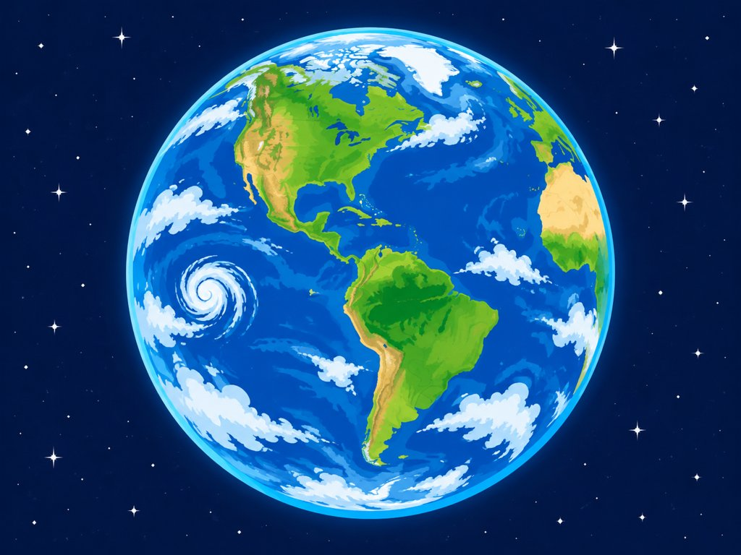
GRADE 5 SCIENCE | TOPIC 3: EARTH'S SYSTEMS
The Biosphere
and the Geosphere
Lesson 1, Session 3: Living things and the land they depend on
Elevate Science Grade 5 | Mr. Ibrahim
Notes:
Welcome. Today: the biosphere, how living things depend on land and soil, and how the biosphere and geosphere interact.

Slide 2
Today I Can...
I can...
Key Words
Define the biosphere as Earth's living things.
Explain how organisms depend on land and soil.
Describe an interaction between the biosphere and the geosphere.
biosphere: all living things on Earth
geosphere: rocks, soil and sediments
lithosphere: Earth's rigid outer layer
system: parts that work together
Skill: Cause and Effect
Find what happens (effect) and why it happens (cause).
Example: Plowing (cause) helps plants grow better (effect).
Grade 5 Science | Earth's Systems | Lesson 1: Geosphere and Biosphere
Notes:
Source: Elevate Science Grade 5, Topic 3 Lesson 1 (I can statements and vocabulary).

Slide 3
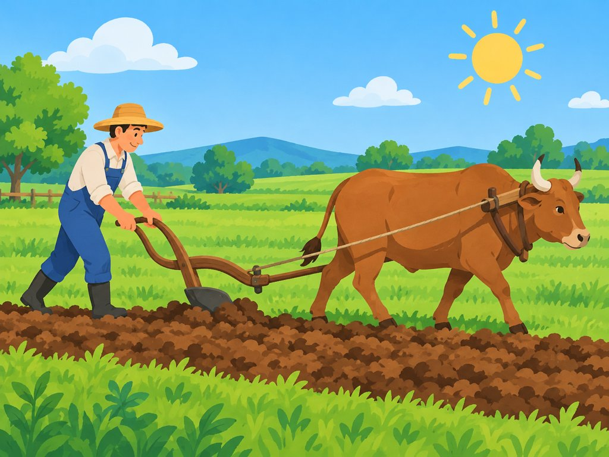
Warm-Up: The Plow
• A plow turns over the soil.
• Before plows, farmers used digging sticks.
• Plowed soil lets plants get water and nutrients more easily.
• Better growing plants make more food.
Think: How does plowing help plants grow better?
Grade 5 Science | Earth's Systems | Lesson 1: Geosphere and Biosphere
Notes:
Book Connection: plows turn over soil so plants get water and nutrients more easily. Summarize answer: plowing breaks up soil, so plants reach water and nutrients and grow better.

Slide 4
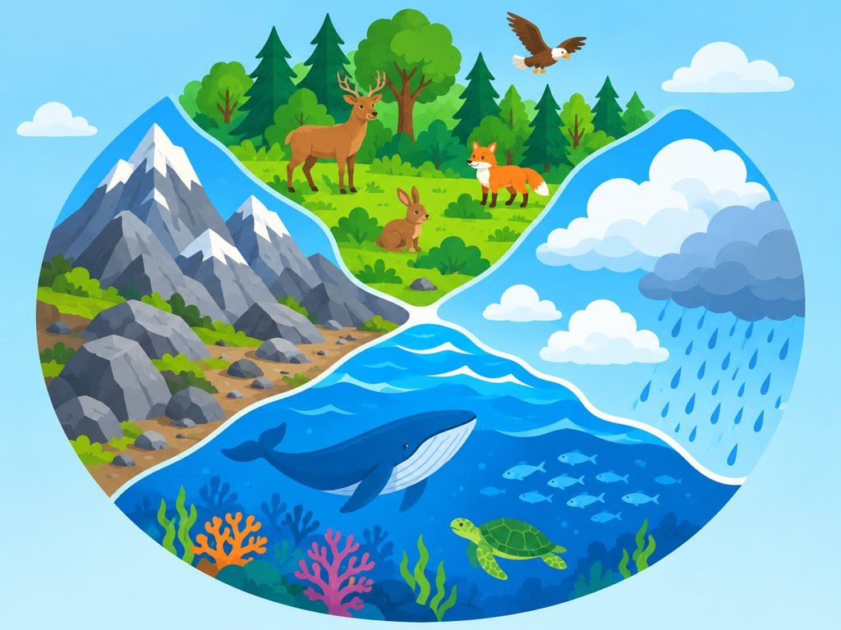
Earth Has Four Major Systems
Geosphere
Biosphere
rocks, soil, sediments
all living things
Hydrosphere
Atmosphere
water
layer of gases
Earth is the only planet in our solar system with all four systems. Only Earth has a biosphere!
Grade 5 Science | Earth's Systems | Lesson 1: Geosphere and Biosphere
Notes:
Only Earth has all four systems. Seven of the planets have an atmosphere, but only Earth has a biosphere.

Slide 5
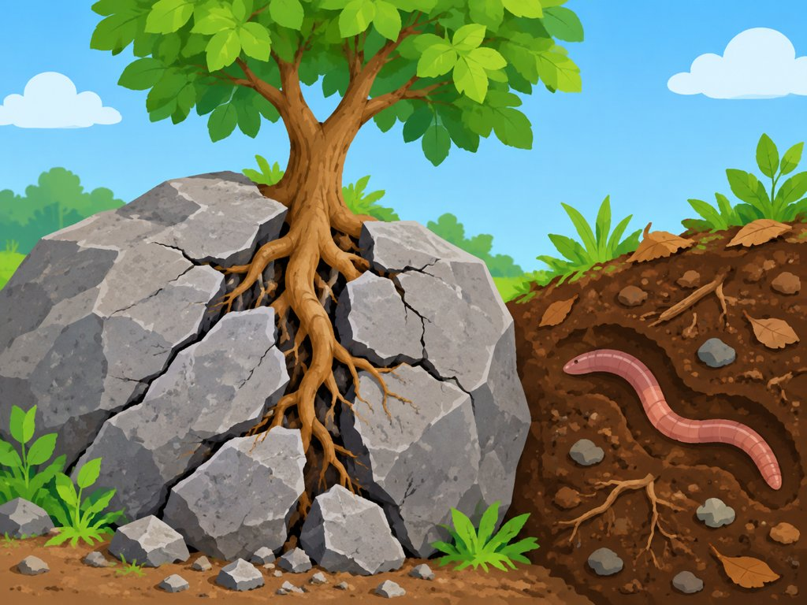
What Is a System?
A system is...
A collection of parts that work together.
Different processes move Earth's materials within and between systems.
If a part is damaged...
The system may not work as well, or not at all.
Other systems may be affected too.
Example: a tree's roots can break rock. Living and nonliving parts affect each other.
Grade 5 Science | Earth's Systems | Lesson 1: Geosphere and Biosphere
Notes:
If a part of a system is damaged or missing, the system works less well and other systems may be affected.

Slide 6
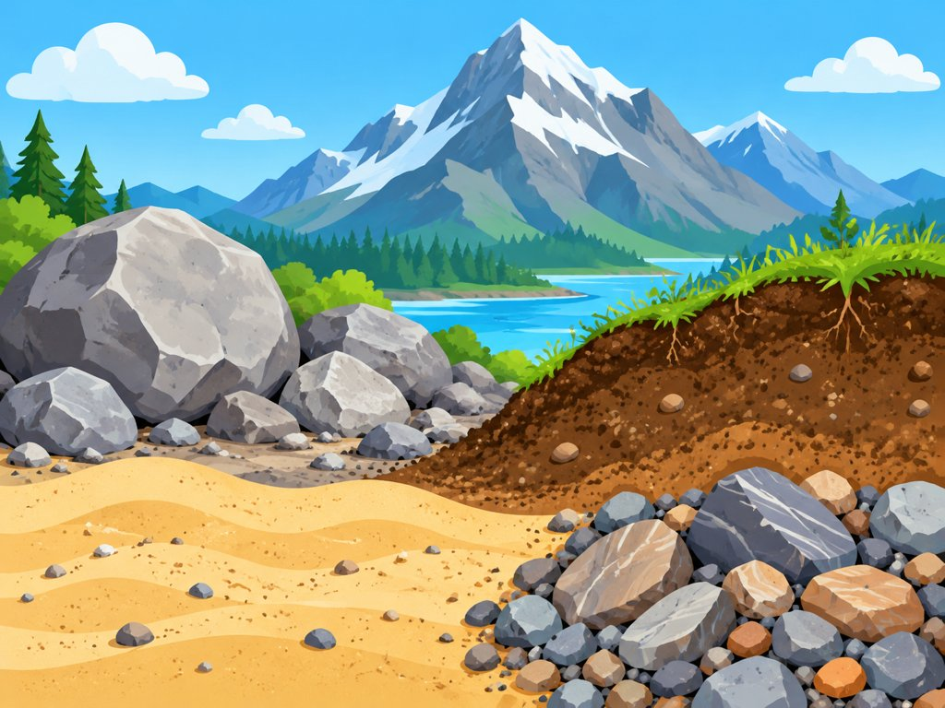
Geosphere: Earth's Rocky System
• The geosphere is the Earth system with rocks, soil, and sediments.
• Rocks on the surface are easy to see.
• Rocks are also below the surface. Some are molten, or melted.
• Rocks are in all parts of Earth, from the surface to the very center.
Grade 5 Science | Earth's Systems | Lesson 1: Geosphere and Biosphere
Notes:
Geosphere = rocks, soil and sediments, from the surface to the center. Some rock below the surface is molten (melted).

Slide 7
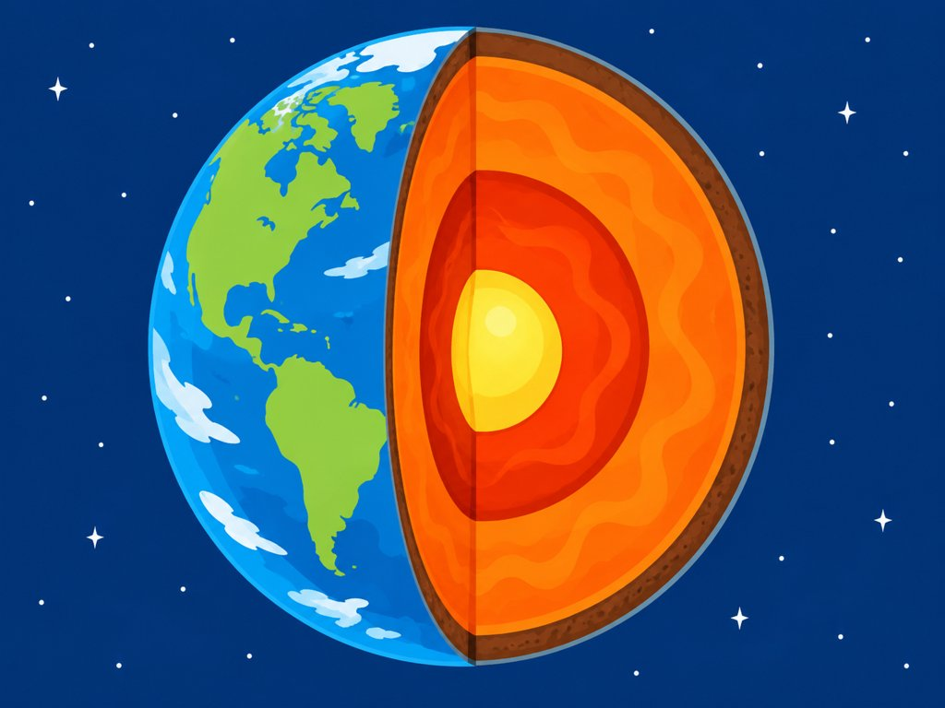
Layers of the Geosphere
The mantle is much thicker than the crust. The crust is only about 25 km thick on average.
Grade 5 Science | Earth's Systems | Lesson 1: Geosphere and Biosphere
Notes:
Book data (Math Toolbox): inner core 1,220 km; outer core 2,260 km; mantle 2,866 km; continental crust about 25 km average. Mantle is about 115 times thicker than the crust on average, so mantle is much thicker.

Slide 8
The Lithosphere
• The lithosphere is an important part of the geosphere.
• It is Earth's outer, rocky part: the crust and the rigid top of the mantle.
• It forms the land AND the ocean floor.
• It can be over 200 km (124 miles) thick under continents.
• Below it, mantle rock can move and flow.
Grade 5 Science | Earth's Systems | Lesson 1: Geosphere and Biosphere
Notes:
Lithosphere: crust plus the outer, rigid part of the mantle; can extend over 200 km (124 miles) below continents; also forms the ocean floor.

Slide 9
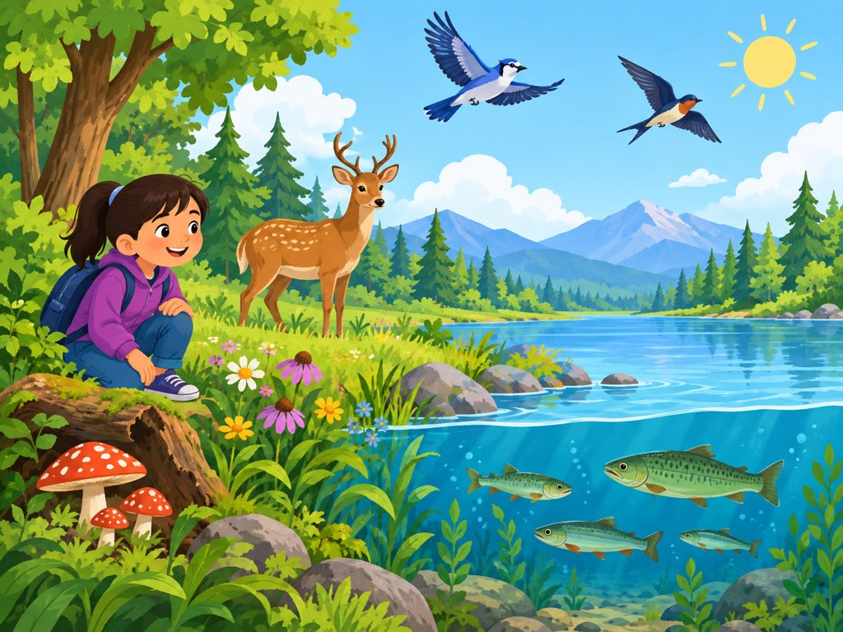
The Biosphere: Earth's Living Things
• The biosphere is the Earth system that includes ALL living things.
• It includes living things in the air, in water, and on land.
• Humans are part of the biosphere too.
In the air
In water
On land
Humans too
Grade 5 Science | Earth's Systems | Lesson 1: Geosphere and Biosphere
Notes:
The biosphere includes ALL living things: living things in the air, in the water, and on land, including humans (Savvas eText pp104-105). Air, water and the sun are nonliving - they are places where living things live, not parts of the biosphere (p106).

Slide 10
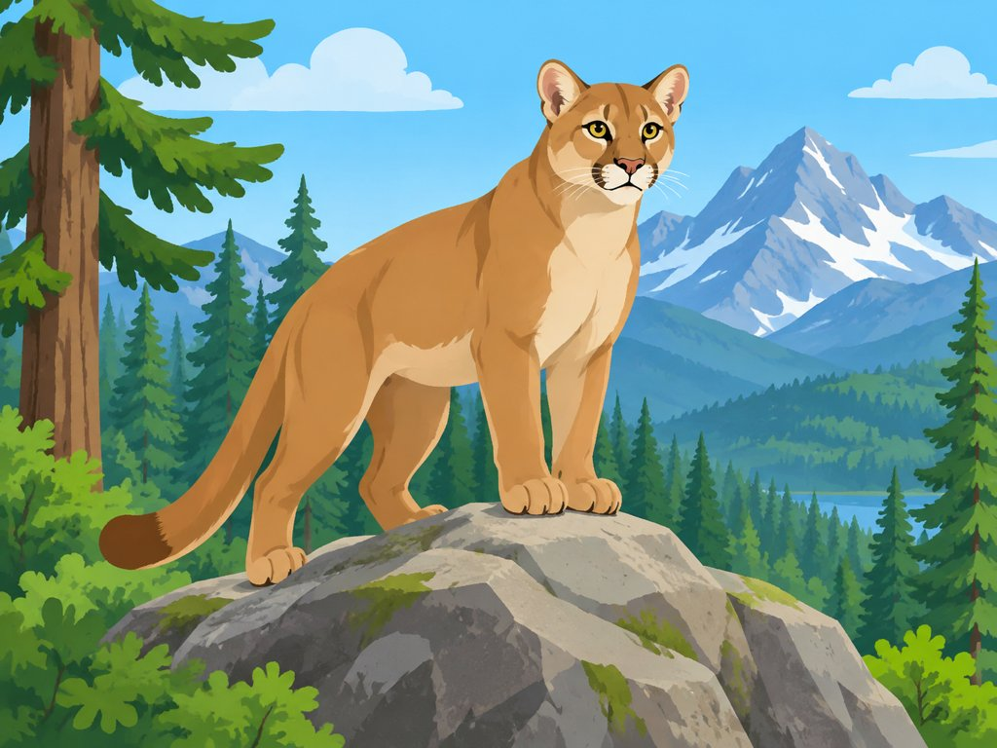
Why So Many Kinds of Life?
Cause and Effect
CAUSE: The biosphere interacts with the other spheres.
▼
EFFECT: It supports millions of kinds of living things.
The mountain lion (biosphere) stands on a rock (geosphere).
Grade 5 Science | Earth's Systems | Lesson 1: Geosphere and Biosphere
Notes:
Cause: the biosphere interacts with the other spheres (geosphere, hydrosphere, atmosphere). Effect: it can support millions of kinds of living things. Mountain lion on a rock shows living thing + geosphere.

Slide 11
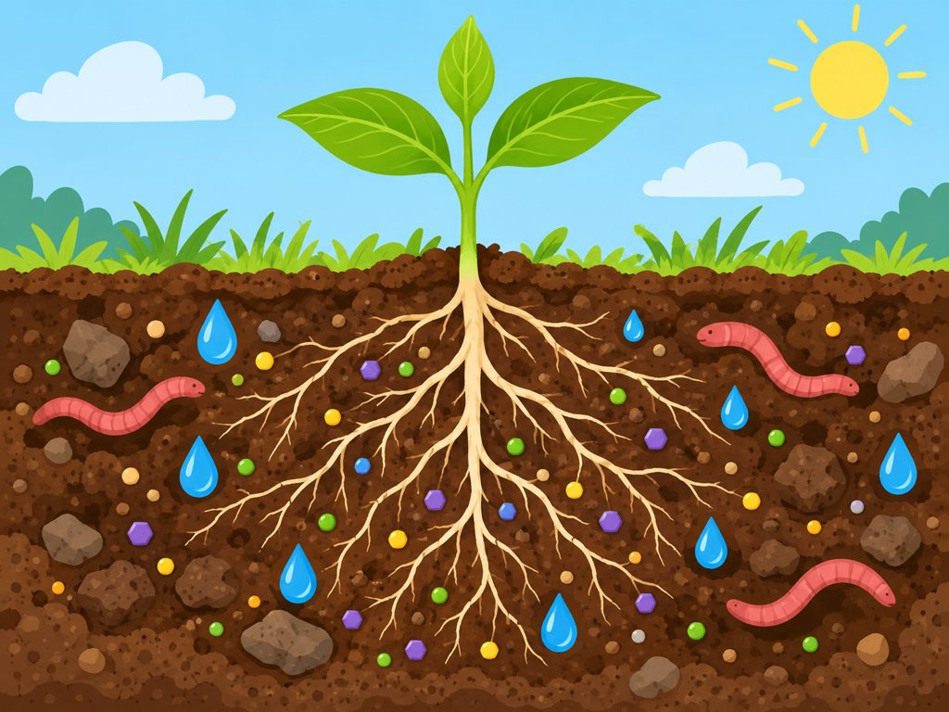
Living Things Depend on Land and Soil
Plants
Roots hold plants and take in water and nutrients from soil.
Animals
Live on land and eat plants that grow in soil.
People
Grow food in soil; plowing helps.
Grade 5 Science | Earth's Systems | Lesson 1: Geosphere and Biosphere
Notes:
Soil is part of the geosphere. Plants get water and nutrients from soil; animals eat plants. Plowing (from the warm-up) makes soil easier for roots.

Slide 12
Biosphere + Geosphere = Interaction!
Biosphere affects geosphere
Tree roots grow into rock cracks and can split the rock.
Geosphere supports biosphere
Soil gives plants water, nutrients and a place to grow.
People change the land
Plowing turns over soil so crops grow better.
Grade 5 Science | Earth's Systems | Lesson 1: Geosphere and Biosphere
Notes:
Interaction: living things and rocks/soil affect each other. Examples: roots breaking rock (biosphere affects geosphere); plowing/farming changes soil; soil gives nutrients to plants (geosphere supports biosphere).

Slide 13
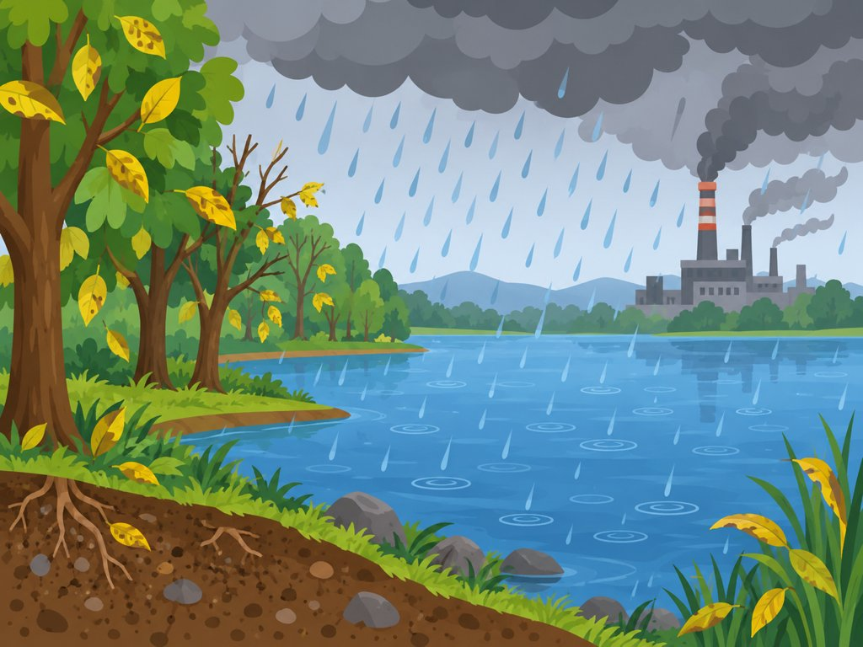
Quest Check-In: Raining Acid
• Rain can pick up pollutants from the air.
• Very polluted rain is called acid rain.
• It can enter lakes and streams.
• It can strip minerals from soil.
• It can harm land and water organisms, and change gases in the atmosphere.
How might acid rain's effect on soil affect crops and plants?
Grade 5 Science | Earth's Systems | Lesson 1: Geosphere and Biosphere
Notes:
Acid rain: rainwater picks up pollutants and becomes harmful. It enters lakes and streams, strips minerals like aluminum from soil, harms organisms that need soil or drink polluted water, and changes gases in the atmosphere. Question: how might acid rain's effect on soil affect crops and plants? Answer: stripped minerals mean less healthy soil, so crops and plants may grow poorly.

Slide 14
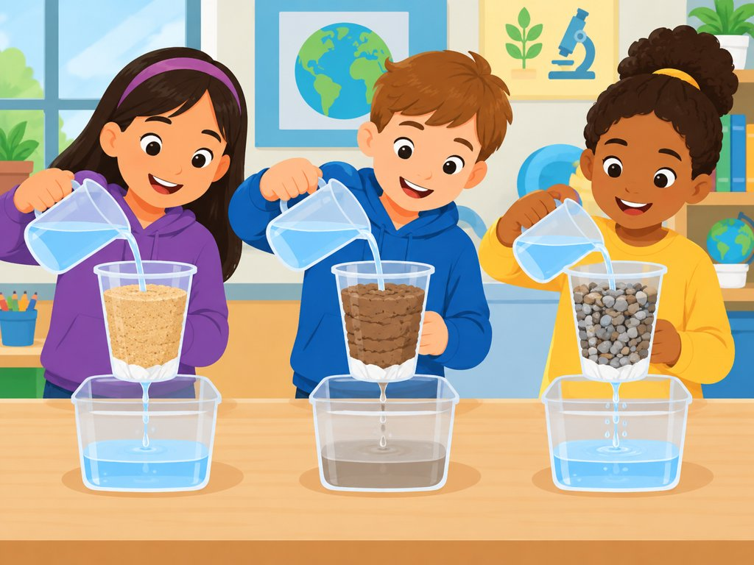
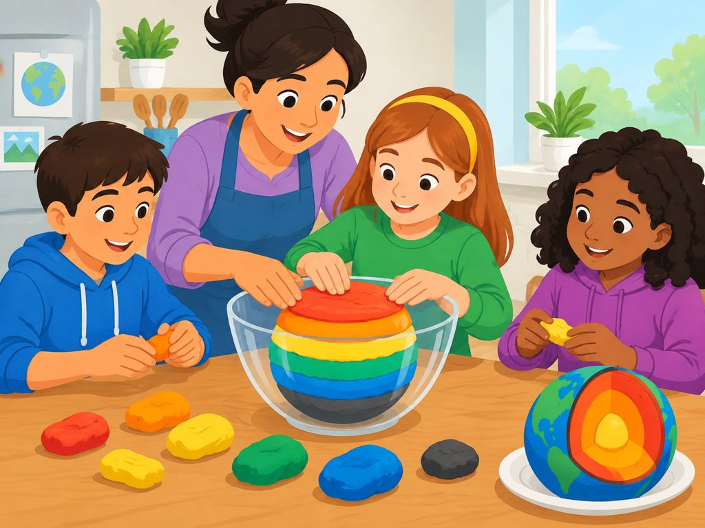
Model It!
Lab: How does water move through soil?
Model Earth's layers in a mixing bowl
Grade 5 Science | Earth's Systems | Lesson 1: Geosphere and Biosphere
Notes:
Book activities: (1) uInvestigate Lab: How does water move through soil? (worksheet on the book site). (2) Earth layers cross-section model with an adult using a mixing bowl.

Slide 15
Check Your Understanding
1. What makes up the biosphere?
2. Describe the lithosphere. How is it related to the geosphere?
3. How do living things depend on soil?
4. Give one way the biosphere and geosphere interact.
5. Cause and effect: what can acid rain do to soil?
Grade 5 Science | Earth's Systems | Lesson 1: Geosphere and Biosphere
Notes:
Answers: 1) The biosphere is made of all living things - living things in the air, in the water, and on land, including humans. 2) The lithosphere is the outer rocky part of Earth: crust plus the rigid top of the mantle. It is part of the geosphere. 3) Plants take water and nutrients from soil; animals eat plants. 4) Roots splitting rock, or plowing changing soil. 5) Cause: polluted rain; effect: soil loses minerals, harming plants.

Slide 16
Exit Ticket and Recap
Remember
The biosphere = all living things.
The geosphere = rocks, soil, sediments.
Living things depend on land and soil.
Exit Ticket
Write one fact about the biosphere and one way it interacts with the geosphere.
Earth's systems work together!
Grade 5 Science | Earth's Systems | Lesson 1: Geosphere and Biosphere
Notes:
Exit ticket via SmartStudio or sticky note: write one fact about the biosphere and one way it interacts with the geosphere.

