Slide 1

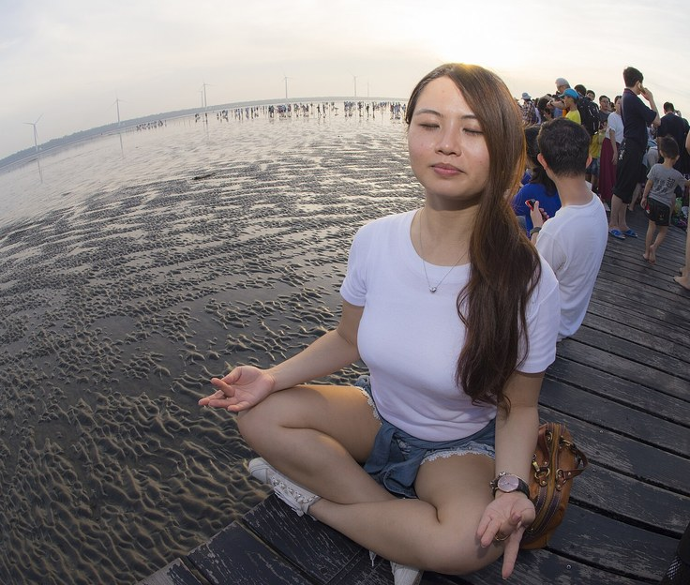
GRADE 10 | HEALTH - CHAPTER 3: MANAGING STRESS | ONLINE CLASS
Quick Review: Your Stress Plan
Last week: you built a personal stress plan - signs, triggers, techniques, support.
Hands up in the chat: who actually USED one technique? What happened?
Plans fail when skills are not trained - a plan on paper is not a reflex.
Today: from knowing to doing - practice, apply, and know when to get help.
Two quiet minutes a day builds the calm reflex before you need it. Photo: Wikimedia Commons.
Week 10 • Tuesday, November 3, 2026 • Mr. Ibrahim Ahmad • EDUGATES International School
1

Slide 2
GRADE 10 | HEALTH - CHAPTER 3: MANAGING STRESS | ONLINE CLASS
Practice Makes Calm
Coping skills work like sports skills: they fail under pressure if you never train them.
DEEP BREATHING - try it now
In through the nose 4 counts, hold 2, out through the mouth 6 - repeat 5 times.
PROGRESSIVE MUSCLE RELAXATION
Tense each muscle group 5 seconds, release 10 - from your feet up to your face.
Week 10 • Tuesday, November 3, 2026 • Mr. Ibrahim Ahmad • EDUGATES International School
2

Slide 3
GRADE 10 | HEALTH - CHAPTER 3: MANAGING STRESS | ONLINE CLASS
Think About It - Question 1
Q1 List the steps of the deep-breathing reset.
Q2 Why must coping skills be practiced before stress peaks?
Answer in your notebook first - then check the next slide.
Week 10 • Tuesday, November 3, 2026 • Mr. Ibrahim Ahmad • EDUGATES International School
3

Slide 4
GRADE 10 | HEALTH - CHAPTER 3: MANAGING STRESS | ONLINE CLASS
Question 1 - Answers
Q1 - List the steps of the deep-breathing reset.
Answer: In through the nose 4 counts, hold 2, out through the mouth 6 - repeat 5 times.
Q2 - Why must coping skills be practiced before stress peaks?
Answer: Coping skills work like sports skills - untrained skills fail under pressure. Two minutes a day builds the reflex before you need it.
Week 10 • Tuesday, November 3, 2026 • Mr. Ibrahim Ahmad • EDUGATES International School
4

Slide 5
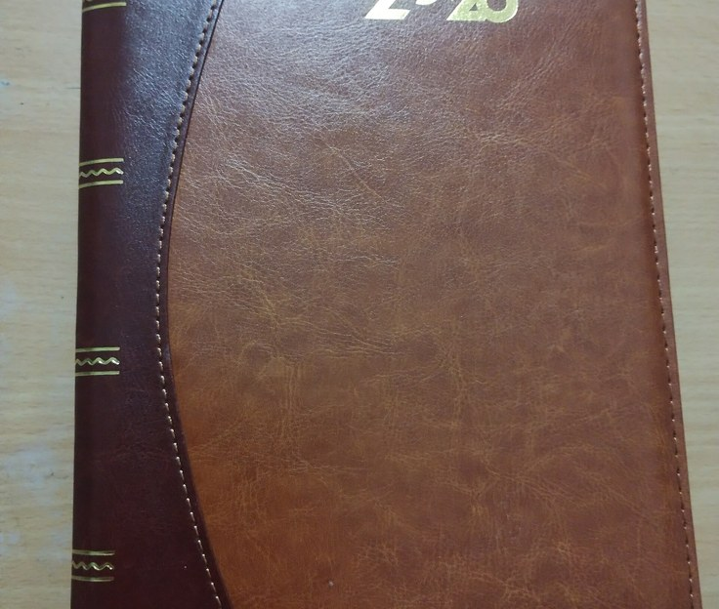
GRADE 10 | HEALTH - CHAPTER 3: MANAGING STRESS | ONLINE CLASS
Time Management Under Pressure
List everything due this week; mark what is urgent and what is important.
Break big tasks into 25-minute blocks with 5-minute breaks.
Sleep and meals are appointments too - schedule them first, not last.
A written plan removes the mental load of remembering - that alone lowers stress.
A written plan removes the mental load of remembering. Photo: Wikimedia Commons.
Week 10 • Tuesday, November 3, 2026 • Mr. Ibrahim Ahmad • EDUGATES International School
5

Slide 6
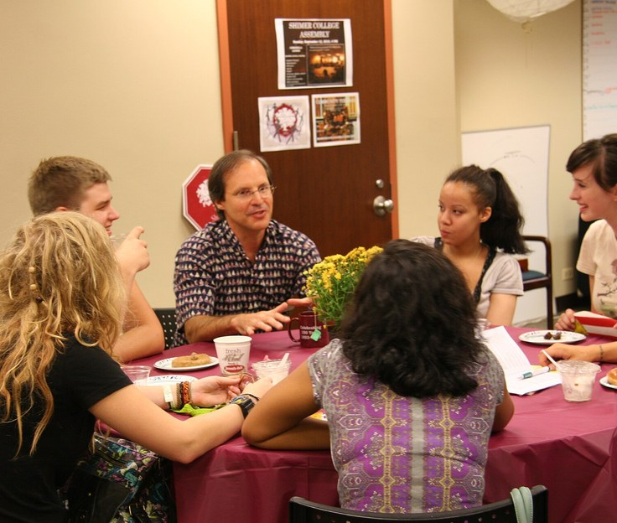
GRADE 10 | HEALTH - CHAPTER 3: MANAGING STRESS | ONLINE CLASS
When to Get Help
Normal stress fades after the cause passes; ongoing distress does not.
Warning signs: weeks of poor sleep, appetite change, hopelessness, withdrawing from friends.
Talking to a trusted adult or counselor is a strength, not a failure.
If a friend shares dark thoughts with you, never keep it secret - walk with them to an adult.
Talking to someone you trust is a strength, not a failure. Photo: Wikimedia Commons.
Week 10 • Tuesday, November 3, 2026 • Mr. Ibrahim Ahmad • EDUGATES International School
6

Slide 7
GRADE 10 | HEALTH - CHAPTER 3: MANAGING STRESS | ONLINE CLASS
Guided Practice: Match the Fix
Scenario 1 Layla has three exams in two days and has not started. Which skills first?
Scenario 2 Omar's heart races before every presentation. Which technique, and when?
Scenario 3 Sara has felt sad and sleepless for three weeks. What is the right move?
Decide alone, then type your answers in the chat - we check together on the next slide.
Week 10 • Tuesday, November 3, 2026 • Mr. Ibrahim Ahmad • EDUGATES International School
7

Slide 8
GRADE 10 | HEALTH - CHAPTER 3: MANAGING STRESS | ONLINE CLASS
Guided Practice: Answers
Scenario 1 - Layla has three exams in two days and has not started. Which skills first?
Answer: Time management: a written two-day plan with study blocks and breaks - plus short breathing resets between blocks.
Scenario 2 - Omar's heart races before every presentation. Which technique, and when?
Answer: Deep breathing or progressive muscle relaxation - practiced daily, then used in the minutes before presenting.
Scenario 3 - Sara has felt sad and sleepless for three weeks. What is the right move?
Answer: Beyond self-help: she should talk to a trusted adult or counselor - ongoing distress needs support.
Week 10 • Tuesday, November 3, 2026 • Mr. Ibrahim Ahmad • EDUGATES International School
8

Slide 9
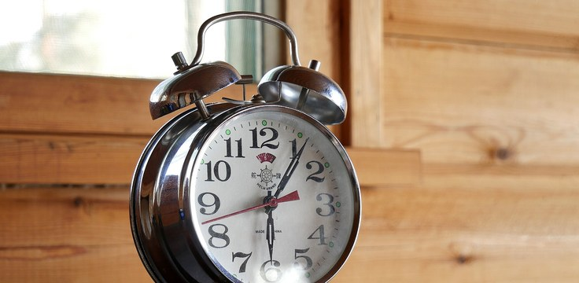
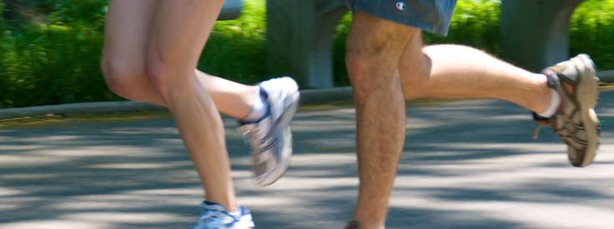
GRADE 10 | HEALTH - CHAPTER 3: MANAGING STRESS | ONLINE CLASS
Protect the Basics: Sleep, Food, Movement
SLEEP
Schedule it first: a tired brain reads every problem as bigger than it is.
MEALS
Real appointments: regular meals keep energy and mood steady through the day.
Sleep is an appointment too - schedule it first, not last. Photo: Wikimedia Commons.
MOVEMENT
Daily reset: walking, stretching or sport burns off the stress response.
Daily movement lowers the body's stress response. Photo: Wikimedia Commons.
Week 10 • Tuesday, November 3, 2026 • Mr. Ibrahim Ahmad • EDUGATES International School
9

Slide 10
GRADE 10 | HEALTH - CHAPTER 3: MANAGING STRESS | ONLINE CLASS
Think About It - Question 2
Q1 Name two time-management moves that lower stress.
Q2 List two warning signs that mean it is time to seek help.
Answer in your notebook first - then check the next slide.
Week 10 • Tuesday, November 3, 2026 • Mr. Ibrahim Ahmad • EDUGATES International School
10

Slide 11
GRADE 10 | HEALTH - CHAPTER 3: MANAGING STRESS | ONLINE CLASS
Question 2 - Answers
Q1 - Name two time-management moves that lower stress.
Answer: Any two: list tasks and mark urgent vs important; break big tasks into 25-minute blocks with breaks; schedule sleep and meals first; write the plan down.
Q2 - List two warning signs that mean it is time to seek help.
Answer: Any two: weeks of poor sleep, appetite change, hopelessness, withdrawing from friends.
Week 10 • Tuesday, November 3, 2026 • Mr. Ibrahim Ahmad • EDUGATES International School
11

Slide 12
GRADE 10 | HEALTH - CHAPTER 3: MANAGING STRESS | ONLINE CLASS
What We Learned Today
Coping skills work only if you train them - practice a little every day.
Deep breathing and progressive muscle relaxation calm the body's alarm in minutes.
A written plan, real breaks, sleep and movement keep pressure from piling up.
Ongoing distress needs support - telling a trusted adult is a strength.
EXIT TICKET (in the chat): In one sentence: what will YOU practice for two minutes every day this week?
Week 10 • Tuesday, November 3, 2026 • Mr. Ibrahim Ahmad • EDUGATES International School
12

Slide 13
GRADE 10 | HEALTH - CHAPTER 3: MANAGING STRESS | ONLINE CLASS
Exit Ticket - Answer
In one sentence: what will YOU practice for two minutes every day this week?
Answer: Any personal choice counts - for example: deep breathing, in 4 counts, hold 2, out 6, five times a day.
Week 10 • Tuesday, November 3, 2026 • Mr. Ibrahim Ahmad • EDUGATES International School
13

