Slide 1

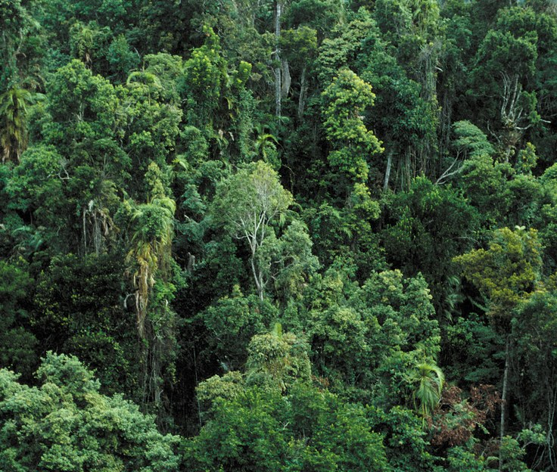
GRADE 9 | BIOLOGY - MODULE 5: BIODIVERSITY AND CONSERVATION | ONLINE CLASS
What Is Biodiversity?
Biodiversity = the variety of life, at every scale - genes, species and ecosystems.
It includes every plant, animal, fungus and microorganism - and the differences within them.
Earth holds millions of species, and most are still undescribed by science.
Biodiversity is not spread evenly: tropical regions hold far more than polar ones.
A tropical rainforest - the richest biodiversity on land. Photo: Wikimedia Commons.
Week 10 • Tuesday, November 3, 2026 • Mr. Ibrahim Ahmad • EDUGATES International School
1

Slide 2
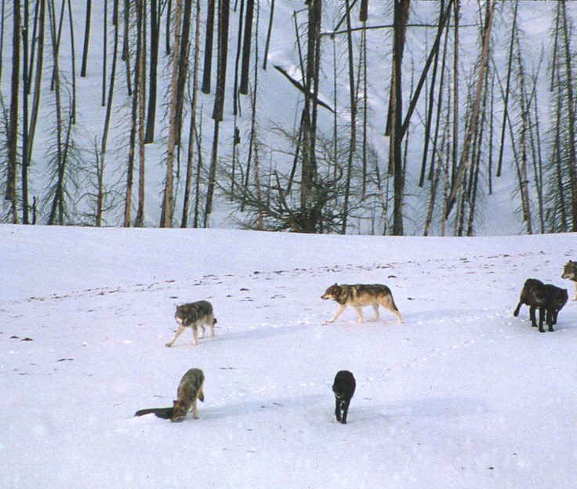
GRADE 9 | BIOLOGY - MODULE 5: BIODIVERSITY AND CONSERVATION | ONLINE CLASS
Three Levels of Diversity
GENETIC DIVERSITY
Different alleles within one species - it lets populations adapt to change.
SPECIES DIVERSITY
The count and balance of species in a community (richness and evenness).
ECOSYSTEM DIVERSITY
The variety of ecosystems in a region - deserts, reefs, forests, wetlands.
Two wolf packs can carry different coat-color alleles - genetic diversity. Photo: Wikimedia Commons.
Conservation must protect all three levels, not just species counts.
Week 10 • Tuesday, November 3, 2026 • Mr. Ibrahim Ahmad • EDUGATES International School
2

Slide 3
GRADE 9 | BIOLOGY - MODULE 5: BIODIVERSITY AND CONSERVATION | ONLINE CLASS
Think About It - Question 1
Case A Two wolf packs carry different coat-color alleles. Which level of diversity?
Case B A reef holds 200 fish species; another holds 12. Which level are you comparing?
Case C A country protects its deserts, forests and wetlands as one plan. Which level?
Classify each case alone, then type in the chat - we check together on the next slide.
Week 10 • Tuesday, November 3, 2026 • Mr. Ibrahim Ahmad • EDUGATES International School
3

Slide 4
GRADE 9 | BIOLOGY - MODULE 5: BIODIVERSITY AND CONSERVATION | ONLINE CLASS
Question 1 - Answers
Case A - Two wolf packs carry different coat-color alleles. Which level of diversity?
Answer: Genetic diversity - variety of genes within one species.
Case B - A reef holds 200 fish species; another holds 12. Which level are you comparing?
Answer: Species diversity - the number and balance of species in a community.
Case C - A country protects its deserts, forests and wetlands as one plan. Which level?
Answer: Ecosystem diversity - the variety of ecosystems in a region.
Week 10 • Tuesday, November 3, 2026 • Mr. Ibrahim Ahmad • EDUGATES International School
4

Slide 5
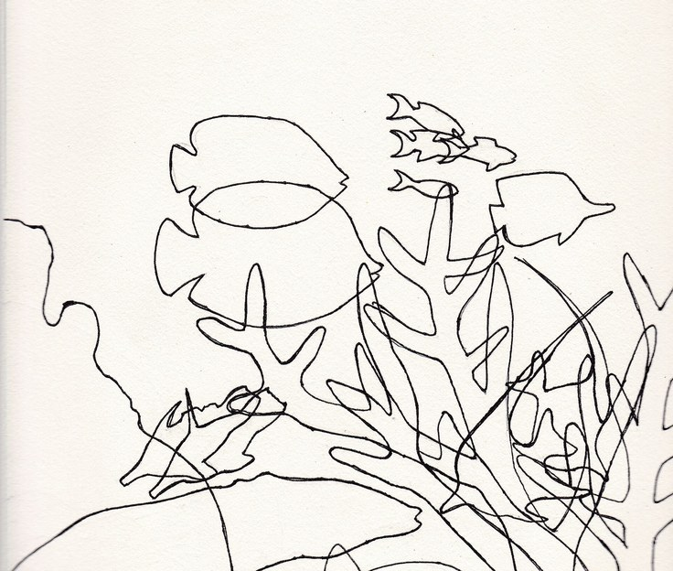
GRADE 9 | BIOLOGY - MODULE 5: BIODIVERSITY AND CONSERVATION | ONLINE CLASS
Measuring Biodiversity
Scientists sample plots, nets or transects and count species and individuals.
Species richness = how many species; evenness = how balanced their numbers are.
Two forests can have equal richness but very different evenness - and different health.
Long-term monitoring shows whether diversity is rising or falling.
A reef with 200 fish species has higher species diversity than one with 12. Photo: Wikimedia Commons.
Week 10 • Tuesday, November 3, 2026 • Mr. Ibrahim Ahmad • EDUGATES International School
5

Slide 6
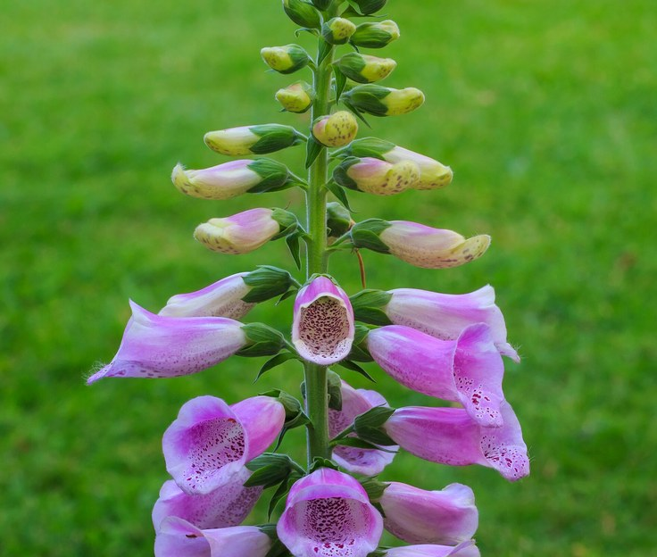
GRADE 9 | BIOLOGY - MODULE 5: BIODIVERSITY AND CONSERVATION | ONLINE CLASS
Why Biodiversity Matters
Stability: diverse ecosystems cope better - if one species drops, others fill its role.
Ecosystem services: pollination, water purification, soil formation, climate regulation.
Medicine: a large share of our drugs started as natural compounds in wild species.
Food security: crop wild relatives carry genes for drought and disease resistance.
Many medicines began as natural compounds in wild plants. Photo: Wikimedia Commons.
Week 10 • Tuesday, November 3, 2026 • Mr. Ibrahim Ahmad • EDUGATES International School
6

Slide 7
GRADE 9 | BIOLOGY - MODULE 5: BIODIVERSITY AND CONSERVATION | ONLINE CLASS
Think About It - Question 2
Q1 What is the difference between species richness and evenness?
Q2 Give TWO ecosystem services and explain one.
Answer in your notebook first - then check the next slide.
Week 10 • Tuesday, November 3, 2026 • Mr. Ibrahim Ahmad • EDUGATES International School
7

Slide 8
GRADE 9 | BIOLOGY - MODULE 5: BIODIVERSITY AND CONSERVATION | ONLINE CLASS
Question 2 - Answers
Q1 - What is the difference between species richness and evenness?
Answer: Richness is how many species live in a community; evenness is how balanced their numbers are. Two forests can have the same richness but very different evenness - and different health.
Q2 - Give TWO ecosystem services and explain one.
Answer: Examples: pollination and water purification. Pollination: insects carry pollen between flowers, so crops and wild plants can make seeds and fruit - a service we get free from nature.
Week 10 • Tuesday, November 3, 2026 • Mr. Ibrahim Ahmad • EDUGATES International School
8

Slide 9
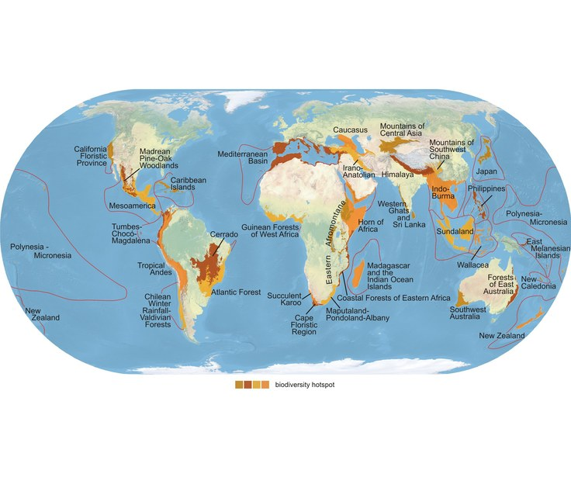
GRADE 9 | BIOLOGY - MODULE 5: BIODIVERSITY AND CONSERVATION | ONLINE CLASS
Biodiversity Hotspots
Hotspots are regions with many species found nowhere else - and under heavy threat.
They cover a small fraction of land but hold a huge share of Earth's species.
Protecting hotspots protects the most irreplaceable life per hectare.
Conservation targets hotspots first - the smartest use of limited resources.
The world's biodiversity hotspots (Conservation International) - species-rich regions under threat. Map: Wikimedia Commons.
Week 10 • Tuesday, November 3, 2026 • Mr. Ibrahim Ahmad • EDUGATES International School
9

Slide 10
GRADE 9 | BIOLOGY - MODULE 5: BIODIVERSITY AND CONSERVATION | ONLINE CLASS
Think About It - Question 3
Q1 Why do conservation groups protect biodiversity hotspots first?
Q2 Name ONE biodiversity hotspot shown on this map.
Answer in your notebook first - then check the next slide.
Biodiversity hotspots worldwide (Conservation International). Map: Wikimedia Commons.
Week 10 • Tuesday, November 3, 2026 • Mr. Ibrahim Ahmad • EDUGATES International School
10

Slide 11
GRADE 9 | BIOLOGY - MODULE 5: BIODIVERSITY AND CONSERVATION | ONLINE CLASS
Question 3 - Answers
Q1 - Why do conservation groups protect biodiversity hotspots first?
Answer: Hotspots hold many species found nowhere else and are under heavy threat - protecting them saves the most irreplaceable life per hectare.
Q2 - Name ONE biodiversity hotspot shown on this map.
Answer: Any one from the map - for example: Madagascar and the Indian Ocean Islands, the Tropical Andes, the Mediterranean Basin, or the Horn of Africa.
Week 10 • Tuesday, November 3, 2026 • Mr. Ibrahim Ahmad • EDUGATES International School
11

Slide 12
GRADE 9 | BIOLOGY - MODULE 5: BIODIVERSITY AND CONSERVATION | ONLINE CLASS
What We Learned Today
Biodiversity is the variety of life at three levels: genetic, species and ecosystem.
Scientists measure it with richness (how many species) and evenness (how balanced).
Diverse ecosystems are more stable and give us services: pollination, clean water, medicine, food.
Hotspots hold the most irreplaceable life - protecting them protects people too.
EXIT TICKET (in the chat): In one sentence: why does protecting biodiversity protect us too?
Week 10 • Tuesday, November 3, 2026 • Mr. Ibrahim Ahmad • EDUGATES International School
12

Slide 13
GRADE 9 | BIOLOGY - MODULE 5: BIODIVERSITY AND CONSERVATION | ONLINE CLASS
Exit Ticket - Answer
In one sentence: why does protecting biodiversity protect us too?
Answer: Healthy, diverse ecosystems support pollination, clean water, medicine and food that people depend on.
Week 10 • Tuesday, November 3, 2026 • Mr. Ibrahim Ahmad • EDUGATES International School
13

