Slide 1

Grade 5 Science | Topic 3: Earth's Systems
Lesson 2: Hydrosphere and Atmosphere
Part 1: Earth's Water and the Water Cycle
Week 9 • Sunday, October 25, 2026 • Period 4
Mr. Ibrahim Ahmad • EDUGATES International School

Slide 2

GRADE 5 | T3 L2 PART 1
Lesson Goals
1
Identify where Earth's water is found - oceans, ice, rivers, lakes and groundwater.
2
Describe the main processes of the water cycle: evaporation, condensation, precipitation and collection.
3
Explain why water moves between Earth's spheres - and what provides the energy.
Tell a partner: which goal sounds hardest? Why?

Slide 3
GRADE 5 | T3 L2 PART 1
Warm-Up
You step in a puddle in the morning. By afternoon, the puddle is GONE. Where did the water go?
Connection: Yesterday we modeled the GEOSPHERE (land) and BIOSPHERE (living things). Today we add two more spheres: the HYDROSPHERE and the ATMOSPHERE.
Think - Pair - Share: write one sentence with your best idea, then compare with your partner.
Warm-up: 3 min

Slide 4
GRADE 5 | T3 L2 PART 1
Key Vocabulary
hydrosphere
atmosphere
evaporation
All the water on Earth - oceans, ice, rivers, lakes and groundwater.
The blanket of gases that surrounds Earth.
Liquid water warms up and changes into water vapor (a gas).
condensation
precipitation
water cycle
Water vapor cools and changes back into tiny liquid drops - clouds form.
Water falls from clouds: rain, snow, sleet or hail.
The journey water takes, over and over, between Earth and the sky.

Slide 5
GRADE 5 | T3 L2 PART 1
The Hydrosphere: Where Is Earth's Water?
The hydrosphere is ALL of Earth's water. But it is not shared evenly:
Oceans (salty water)
~97%
Ice caps and glaciers (frozen fresh water)
~2%
Liquid fresh water - lakes, rivers, groundwater
~1%
Wow fact:
almost all liquid fresh water is hidden underground. The water in rivers and lakes is a tiny slice of Earth's water!
Discussion:
Why do people worry about saving water, even though Earth is covered in water?

Slide 6
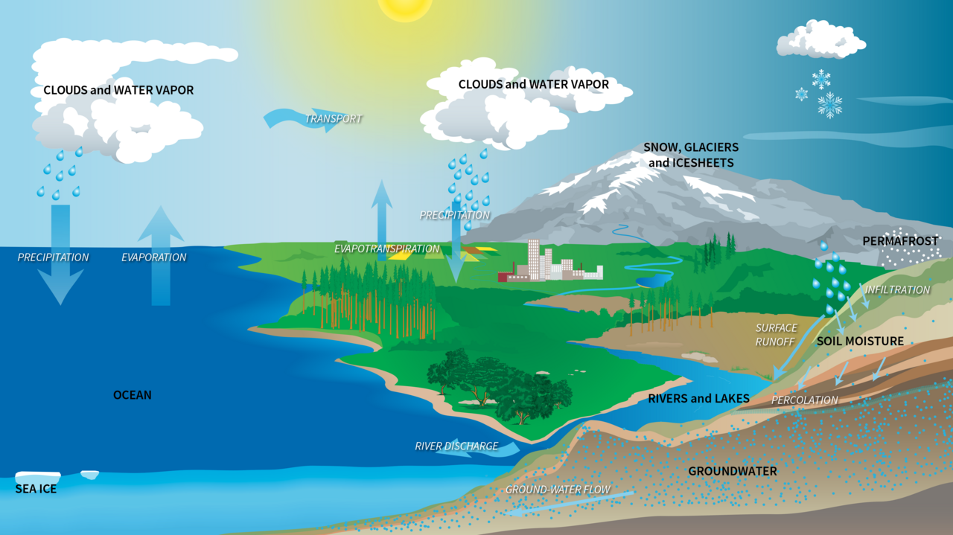
GRADE 5 | T3 L2 PART 1
The Water Cycle
The same water is used again and again.
The Sun heats the ocean. Water rises as vapor, cools into clouds, falls as rain, and flows back to the sea.
The Sun's energy drives the WHOLE cycle.
Image: NASA (public domain)

Slide 7
GRADE 5 | T3 L2 PART 1
Four Key Processes
1. EVAPORATION
The Sun heats water in oceans, lakes and rivers. It changes into water vapor and rises.
2. CONDENSATION
High up, the air is cold. Vapor cools into tiny drops - a cloud is born.
3. PRECIPITATION
Drops grow heavy and fall: rain, snow, sleet or hail.
4. COLLECTION
Water gathers in rivers, lakes and oceans - and soaks into the ground. The cycle starts again!
Bonus:
plants also release water vapor from their leaves: transpiration.

Slide 8
GRADE 5 | T3 L2 PART 1
Why Does Water Move Between the Spheres?
THE SUN
GRAVITY
WIND (atmosphere)
Heats the hydrosphere and gives energy for evaporation.
Pulls precipitation down and makes rivers flow downhill.
Carries clouds and water vapor across the planet.
Water connects all four spheres:
hydrosphere (ocean) → atmosphere (vapor and clouds) → geosphere (rain on land, rivers) → biosphere (plants and animals drink and use it).
Think:
What would happen to the water cycle if the Sun suddenly stopped shining?

Slide 9
GRADE 5 | T3 L2 PART 1
Guided Practice: Trace a Water Droplet
Imagine you are ONE drop of water in the Red Sea. Tell your journey using our vocabulary words.
1
Start: the drop floats in the warm Red Sea
2
The Sun heats it → EVAPORATION into the atmosphere
3
It cools high up → CONDENSATION into a cloud
4
The drop falls → PRECIPITATION as rain on land
5
It flows in a river → COLLECTION back to the sea
Challenge: can your journey visit a GLACIER or UNDERGROUND water on the way?
Guided practice: 8 min

Slide 10
GRADE 5 | T3 L2 PART 1
Group Activity: Draw the Water Cycle
1
In pairs, draw a big water cycle poster: the Sun, the sea, clouds, rain and a river.
GROUP WORK
10
minutes
2
Label the four processes with arrows: evaporation, condensation, precipitation, collection.
3
Add ONE sphere label at each step: hydrosphere, atmosphere, geosphere or biosphere.
Pairs. Worksheets on Classera when you finish.
4
Be ready to explain your poster in 30 seconds.
Success criteria:
all four processes labeled with correct arrows + at least two spheres named.
Activity: 10 min

Slide 11
GRADE 5 | T3 L2 PART 1
Check for Understanding
Quick check - answer on your mini whiteboard:
EXIT TICKET
1
Which process turns liquid water into water vapor?
In one or two sentences: explain how the Sun drives the water cycle, using at least two vocabulary words.
2
Where is most of Earth's water found?
3
What provides the energy that drives the water cycle?
Homework on Classera
Check: 5 min

