Slide 1

Grade 10 Health | Chapter 3: Mental and Emotional Health
Lesson 4: Coping with Stress
The Complete Lesson • Tuesday
Week 9 • October 25 - 29, 2026
Mr. Ibrahim Ahmad • EDUGATES International School

Slide 2

GRADE 10 | HEALTH CH3 L4 | FULL LESSON - TUESDAY
Lesson Goals
1
Explain what stress is and how the body responds to it.
2
Identify common stressors in a student's life and tell helpful stress from harmful stress.
3
Choose healthy strategies for coping with stress - and know when to ask for help.
Tell a partner: which goal sounds hardest? Why?

Slide 3
GRADE 10 | HEALTH CH3 L4 | FULL LESSON - TUESDAY
Warm-Up
Your heart races before a big exam - and also before a big football final. Same body response. Is stress always a BAD thing?
Connection: This chapter is about mental and emotional health. Stress touches every one of us - today we learn to manage it, not fear it.
Think - Pair - Share: write your one-sentence answer, then compare with your partner.
Warm-up: 3 min

Slide 4
GRADE 10 | HEALTH CH3 L4 | FULL LESSON - TUESDAY
Key Vocabulary
stress
stressor
stress response
The body's reaction to a demand, challenge or threat.
Anything that causes stress - an exam, a conflict, a big change.
The body's automatic alarm: heart speeds up, muscles tense, senses sharpen.
adrenaline
coping strategy
eustress
The hormone released during the stress response - it prepares the body to act.
A way of managing stress - some are healthy, some are not.
POSITIVE stress that motivates you - like preparing for a match or a performance.

Slide 5
GRADE 10 | HEALTH CH3 L4 | FULL LESSON - TUESDAY
What Is Stress?
Not always the enemy
A little stress (eustress) sharpens focus and pushes you to prepare.
Too much stress for too long harms sleep, mood and health.
Common teen stressors
Exams and grades. Friend conflicts and social media.
Family changes. Big decisions about the future.
Different people feel different stressors - that is normal.

Slide 6
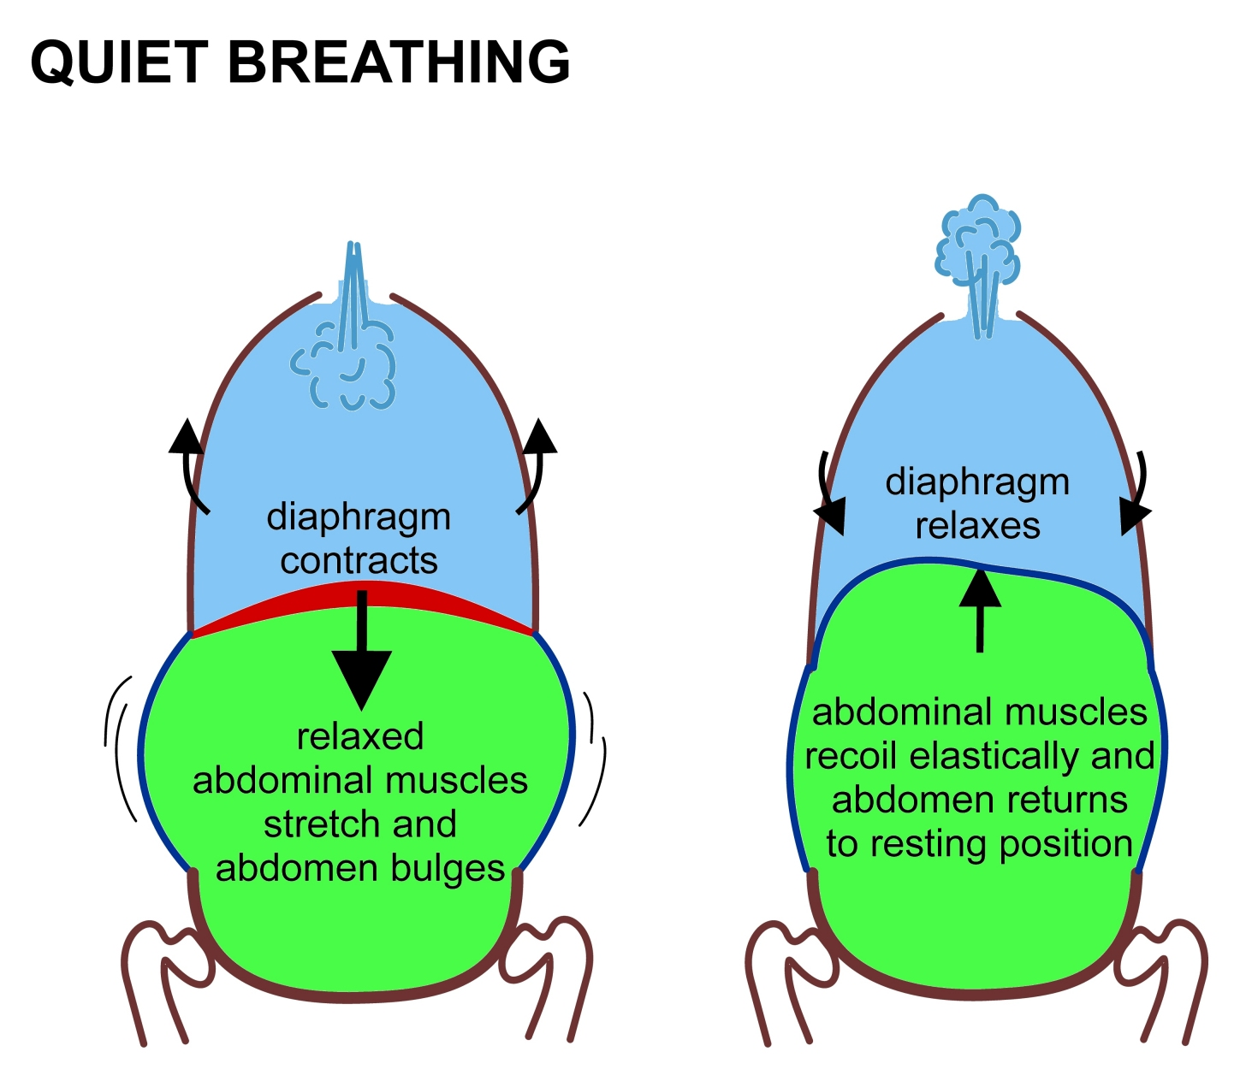

GRADE 10 | HEALTH CH3 L4 | FULL LESSON - TUESDAY
The Body's Alarm System
The stress response is FIGHT or FLIGHT: adrenaline makes your heart pound, breathing quicken and muscles ready.
Great for real danger - but unhelpful when the "danger" is a math test.
Slow, deep breathing is the fastest way to switch the alarm OFF.
Try it now: in for 4 counts, hold for 4, out for 4 - three times.
Image: Wikimedia Commons, CC BY-SA 4.0

Slide 7
GRADE 10 | HEALTH CH3 L4 | FULL LESSON - TUESDAY
Healthy Ways to Cope
You cannot delete stress - but you can choose your response to it.
MOVE
TALK
PLAN
RECHARGE
Exercise burns off stress hormones and lifts your mood.
Share it with a friend, parent or counselor - saying it out loud shrinks it.
Break big tasks into small steps. A plan beats panic.
Sleep well, eat well, breathe slowly, take screen breaks.
UNHEALTHY coping looks like: avoiding the problem, overeating or not eating, angry outbursts, endless scrolling, risky behavior.
Warning sign: if stress feels too heavy for too long - TALK to a trusted adult. Asking for help is a strength.

Slide 8
GRADE 10 | HEALTH CH3 L4 | FULL LESSON - TUESDAY
Stress and Your Health
Short-term signs
Racing heart, sweaty hands, upset stomach, trouble focusing.
These fade when the stressor passes.
Long-term risks
Ongoing stress can weaken immunity, disturb sleep and feed anxiety.
That is why daily coping habits matter - not just emergency fixes.

Slide 9
GRADE 10 | HEALTH CH3 L4 | FULL LESSON - TUESDAY
Guided Practice: Sort the Strategies
With your partner, label each response HEALTHY or UNHEALTHY - and say why:
1
Sara has three exams this week, so she makes a study timetable and starts tonight.
2
Omar is stressed about a fight with his friend, so he plays games until 3 AM and skips school.
3
Lina feels panic before a presentation, so she does ten slow breaths and practices out loud.
Challenge: replace each unhealthy response with a better one.
Guided practice: 8 min

Slide 10
GRADE 10 | HEALTH CH3 L4 | FULL LESSON - TUESDAY
Group Activity: My Stress Plan
1
In pairs, list your TOP TWO personal stressors (keep them as private as you like).
GROUP WORK
10
minutes
2
For each stressor, choose TWO healthy coping strategies from today's lesson.
3
Add one DAILY habit that keeps stress low: sleep, movement, breathing or planning.
Pairs. Worksheets on Classera when you finish.
4
Share one strategy (not the stressor) with the class.
Success criteria:
two stressors matched with healthy strategies, one daily habit chosen.
Activity: 10 min

Slide 11
GRADE 10 | HEALTH CH3 L4 | FULL LESSON - TUESDAY
Check for Understanding
Quick check - answer on your mini whiteboard:
EXIT TICKET
1
What is the difference between a stressor and the stress response?
In one or two sentences: explain why learning to cope with stress is part of staying healthy. Use at least two vocabulary words.
2
Name one healthy and one unhealthy way to cope with stress.
3
What is eustress - and give one example.
Homework on Classera
Check: 5 min

