Slide 1

Grade 5 Science | Topic 3: Earth's Systems
Lesson 2: Hydrosphere and Atmosphere
Review and Simple Questions • Tuesday
Week 9 • October 25 - 29, 2026
Mr. Ibrahim Ahmad • EDUGATES International School

Slide 2

GRADE 5 | EARTH'S SYSTEMS T3 L2 | REVIEW - TUESDAY
Lesson Goals
1
Review the water cycle and the four processes.
2
Review the atmosphere - its gases and why we need it.
3
Answer simple questions about the whole lesson with confidence.
Tell a partner: which goal sounds hardest? Why?

Slide 3
GRADE 5 | EARTH'S SYSTEMS T3 L2 | REVIEW - TUESDAY
Warm-Up: 60-Second Brain Dump
In 60 seconds, write EVERYTHING you remember from yesterday about water in our world. Go!
Connection: Yesterday we learned the full lesson - the hydrosphere, the water cycle and the atmosphere. Today we review it and practice with simple questions.
Compare your list with your partner. Who remembered more?
Warm-up: 3 min

Slide 4
GRADE 5 | EARTH'S SYSTEMS T3 L2 | REVIEW - TUESDAY
Key Vocabulary
hydrosphere
atmosphere
evaporation
All the water on Earth - oceans, ice, rivers, lakes and groundwater.
The blanket of gases that surrounds Earth.
Liquid water warms up and changes into water vapor.
condensation
precipitation
water vapor
Water vapor cools into tiny drops - clouds form.
Water falls from clouds: rain, snow, sleet or hail.
Water in its gas form, invisible in the air.

Slide 5
GRADE 5 | EARTH'S SYSTEMS T3 L2 | REVIEW - TUESDAY
Quick Review: Where Is the Water?
Remember the numbers
Oceans: about 97%
Ice caps and glaciers: about 2%
Liquid fresh water: about 1%
Quick questions
Where is MOST of Earth's water?
Is most fresh water easy to see, or hidden underground?
Why must we protect the tiny fresh-water slice?

Slide 6
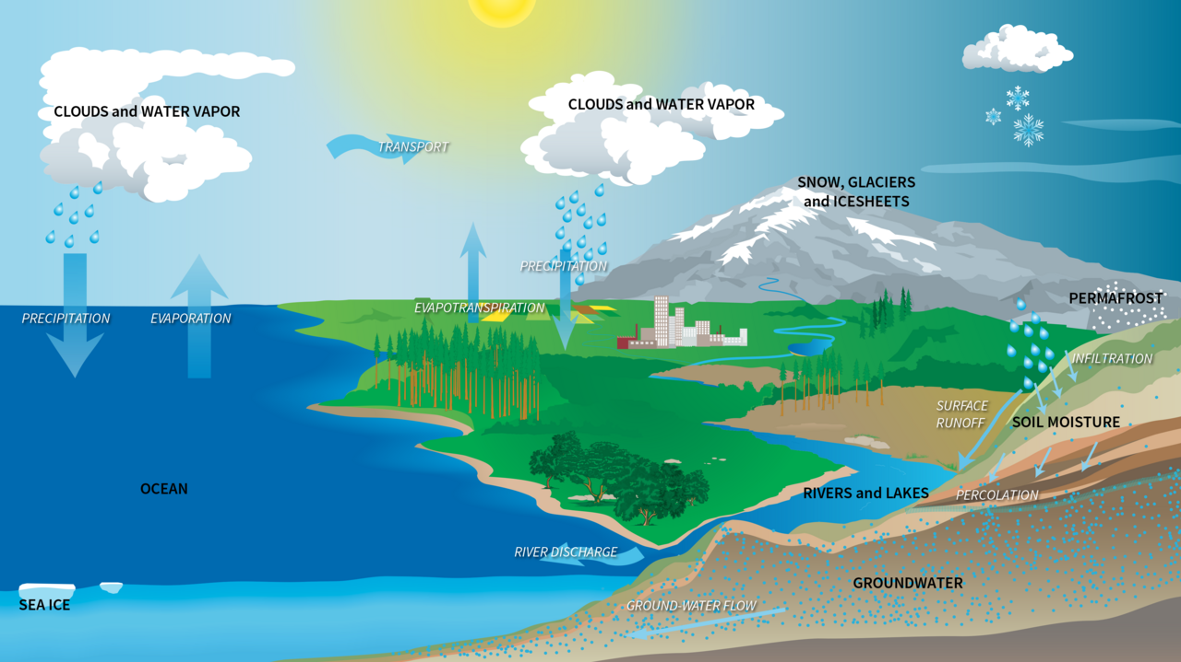

GRADE 5 | EARTH'S SYSTEMS T3 L2 | REVIEW - TUESDAY
Quick Review: The Water Cycle
Point at the diagram and say each process out loud.
Quick questions:
Which process makes clouds?
Which process needs the Sun's heat?
What drives the WHOLE cycle?
Image: NASA (public domain)

Slide 7
GRADE 5 | EARTH'S SYSTEMS T3 L2 | REVIEW - TUESDAY
Quick Review: Four Key Processes
Say the four steps in order - then test yourself with the questions below.
1. EVAPORATION
2. CONDENSATION
3. PRECIPITATION
4. COLLECTION
Q: What changes liquid water into vapor? (the Sun's heat)
Q: What forms when vapor cools high in the sky? (a cloud)
Q: Name two kinds of precipitation. (rain, snow...)
Q: Where does water gather after it falls? (rivers, lakes, oceans, ground)
Memory trick: the SUN lifts the water, the COLD makes the clouds, GRAVITY brings the rain, and the LAND collects it.

Slide 8
GRADE 5 | EARTH'S SYSTEMS T3 L2 | REVIEW - TUESDAY
Quick Review: The Atmosphere
Remember the gases
Nitrogen: about 78%
Oxygen: about 21%
Other gases: about 1%
Quick questions
Which gas do we breathe to live?
Where does ALL weather happen?
Name two ways the atmosphere protects us.

Slide 9
GRADE 5 | EARTH'S SYSTEMS T3 L2 | REVIEW - TUESDAY
Practice: Simple Questions
Answer on your mini whiteboard - first pair to finish wins:
1
What is the hydrosphere?
2
Put these in order: rain falls, the Sun heats the sea, a cloud forms.
3
True or false: the atmosphere is mostly oxygen.
Bonus: why is the water cycle called a CYCLE?
Guided practice: 8 min

Slide 10
GRADE 5 | EARTH'S SYSTEMS T3 L2 | REVIEW - TUESDAY
Group Activity: Team Quiz Game
1
Form teams of 3-4. Each team writes TWO simple questions about the lesson.
GROUP WORK
10
minutes
2
Teams swap questions and answer them - no books!
3
Score: 1 point per correct answer, 1 bonus point for using a vocabulary word.
Pairs. Worksheets on Classera when you finish.
4
Winning team explains the water cycle to the class in 30 seconds.
Success criteria:
two fair questions written, answers given from memory, vocabulary used.
Activity: 10 min

Slide 11
GRADE 5 | EARTH'S SYSTEMS T3 L2 | REVIEW - TUESDAY
Check for Understanding
Quick check - answer on your mini whiteboard:
EXIT TICKET
1
Which process turns water vapor back into liquid drops?
In one or two sentences: describe the journey of one raindrop from the sea and back again. Use at least two vocabulary words.
2
About how much of Earth's water is in the oceans?
3
Name the gas that makes up most of the atmosphere.
Homework on Classera
Check: 5 min

