Slide 1

Grade 6 Science | Reproduction of Organisms
Lesson 1: Inheritance
Part 2: Genes, Alleles and Family Patterns • Tuesday
Week 9 • October 25 - 29, 2026
Mr. Ibrahim Ahmad • EDUGATES International School

Slide 2

GRADE 6 | REPRODUCTION OF ORGANISMS L1 | PART 2 - TUESDAY
Lesson Goals
1
Explain the difference between genotype and phenotype.
2
Use dominant and recessive alleles to explain trait patterns in families.
3
Explain why variation makes every brother and sister unique.
Tell a partner: which goal sounds hardest? Why?

Slide 3
GRADE 6 | REPRODUCTION OF ORGANISMS L1 | PART 2 - TUESDAY
Warm-Up
Two parents both have brown eyes. Their baby has BLUE eyes. How is that possible?!
Connection: Yesterday we crossed Tt x Tt and saw a short plant appear from two tall parents. Today we use the same tool on YOUR traits.
Think - Pair - Share: write your best explanation in one sentence, then compare with your partner.
Warm-up: 3 min

Slide 4
GRADE 6 | REPRODUCTION OF ORGANISMS L1 | PART 2 - TUESDAY
Key Vocabulary
genotype
phenotype
dominant allele
The gene combination behind a trait - the letters, like Tt.
The trait you actually see - like tall or short.
The allele that shows its trait whenever it is present (capital letter).
recessive allele
homozygous
heterozygous
The allele that shows only when NO dominant allele is present (small letter).
Two of the SAME allele: TT or tt.
Two DIFFERENT alleles: Tt - one dominant, one recessive.

Slide 5
GRADE 6 | REPRODUCTION OF ORGANISMS L1 | PART 2 - TUESDAY
Genotype and Phenotype
Genotype = the letters
The gene combination inside your cells: TT, Tt or tt.
You cannot see a genotype - it is written in DNA.
Phenotype = what you SEE
Tall or short. Brown eyes or blue eyes.
Watch out: TT and Tt plants have DIFFERENT genotypes but the SAME tall phenotype.

Slide 6
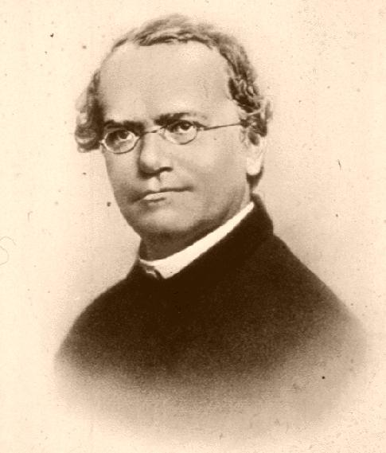

GRADE 6 | REPRODUCTION OF ORGANISMS L1 | PART 2 - TUESDAY
Mendel's Numbers
Mendel crossed two hybrid (Tt) tall plants
and counted the offspring:
787 tall plants and 277 short plants.
Almost exactly 3 tall : 1 short - the 3:1 ratio.
Real numbers proved the hidden alleles were there!
Image: Gregor Mendel portrait, public domain (Wikimedia Commons)

Slide 7
GRADE 6 | REPRODUCTION OF ORGANISMS L1 | PART 2 - TUESDAY
Practice Cross: Brown Eyes Bb x Bb
B = brown (dominant) b = blue (recessive). Every parent gives ONE allele.
Cross: Bb x Bb (B = brown, dominant b = blue, recessive)
B
b
BB
Bb
Same phenotype can hide different genotypes - that is the family-mystery key.
Question: which BOX is the blue-eyed child?
B
brown
brown
b
Bb
bb
brown
BLUE
Result: BB, Bb, Bb are BROWN - 3 of 4 boxes.
Only bb is BLUE - 1 of 4 boxes (25%). THAT is how two brown-eyed parents can have a blue-eyed child!

Slide 8
GRADE 6 | REPRODUCTION OF ORGANISMS L1 | PART 2 - TUESDAY
Why Siblings Are Different
Variation
Every child gets a different mix of alleles from the same parents.
Like shuffling cards: same deck, different hand every time.
Nature AND nurture
Height needs genes AND good nutrition.
Skills like reading or swimming are acquired - not in your genes.
Your traits = inheritance + your life.

Slide 9
GRADE 6 | REPRODUCTION OF ORGANISMS L1 | PART 2 - TUESDAY
Guided Practice: Eye-Color Mystery
With your partner, draw a Punnett square for each question:
1
Blue eyes are recessive (b). What genotype MUST a blue-eyed child have?
2
Both parents are Bb. What is the chance of a blue-eyed child?
3
One parent is BB and the other is Bb. Can they have a blue-eyed child? Explain.
Say your answers using the words genotype and phenotype.
Guided practice: 8 min

Slide 10
GRADE 6 | REPRODUCTION OF ORGANISMS L1 | PART 2 - TUESDAY
Group Activity: Family Tree Detectives
1
In pairs, choose one trait: attached earlobes, dimples or a widow's peak.
GROUP WORK
10
minutes
2
Draw a 3-generation family tree and mark who SHOWS the trait (phenotype).
3
Propose a genotype for each person: BB, Bb or bb (use your own letter).
Pairs. Worksheets on Classera when you finish.
4
Present: does your trait look dominant or recessive? Defend it with the tree.
Success criteria:
3 generations drawn, phenotypes marked, genotypes proposed and defended.
Activity: 10 min

Slide 11
GRADE 6 | REPRODUCTION OF ORGANISMS L1 | PART 2 - TUESDAY
Check for Understanding
Quick check - answer on your mini whiteboard:
EXIT TICKET
1
What is the difference between genotype and phenotype?
In your own words: explain how two brown-eyed parents can have a blue-eyed child. Use the words genotype, phenotype and recessive.
2
Which allele shows its trait with only ONE copy: dominant or recessive?
3
In a Bb x Bb cross, what fraction of the offspring show the recessive trait?
Homework on Classera
Check: 5 min

