Slide 1

Grade 9 Biology | Module 4: Ecology
Lesson 2: Human Population
The Complete Lesson • Tuesday
Week 9 • October 25 - 29, 2026
Mr. Ibrahim Ahmad • EDUGATES International School

Slide 2

GRADE 9 | ECOLOGY M4 L2 | FULL LESSON - TUESDAY
Lesson Goals
1
Describe how the human population has grown - and why it grew so fast recently.
2
Explain the four factors that change a population: birthrate, death rate, immigration and emigration.
3
Discuss how human population growth affects natural resources and the environment.
Tell a partner: which goal sounds hardest? Why?

Slide 3
GRADE 9 | ECOLOGY M4 L2 | FULL LESSON - TUESDAY
Warm-Up
It took ALL of human history to reach 1 billion people. The last billion took only about 12 years. Why the sudden speed?
Connection: Last lesson we studied how populations of plants and animals grow and are limited. Today we turn the same lens on OUR species.
Think - Pair - Share: write one sentence with your best explanation, then compare with your partner.
Warm-up: 3 min

Slide 4
GRADE 9 | ECOLOGY M4 L2 | FULL LESSON - TUESDAY
Key Vocabulary
population
population density
birthrate
All the members of one species living in the same area.
The number of individuals living in a given area - how crowded a place is.
The number of births in a population in a given time.
death rate
migration
carrying capacity
The number of deaths in a population in a given time.
Movement of individuals into (immigration) or out of (emigration) a population.
The largest population an environment can support over time.

Slide 5
GRADE 9 | ECOLOGY M4 L2 | FULL LESSON - TUESDAY
Human Population Growth
Slow for most of history
For thousands of years, growth was slow - disease, famine and war kept numbers low.
Around 1800 the population reached 1 billion.
Then it exploded
Better medicine, sanitation and farming cut the death rate.
About 8 billion people today - and still growing.
Growth is fastest where birthrates stay high.

Slide 6
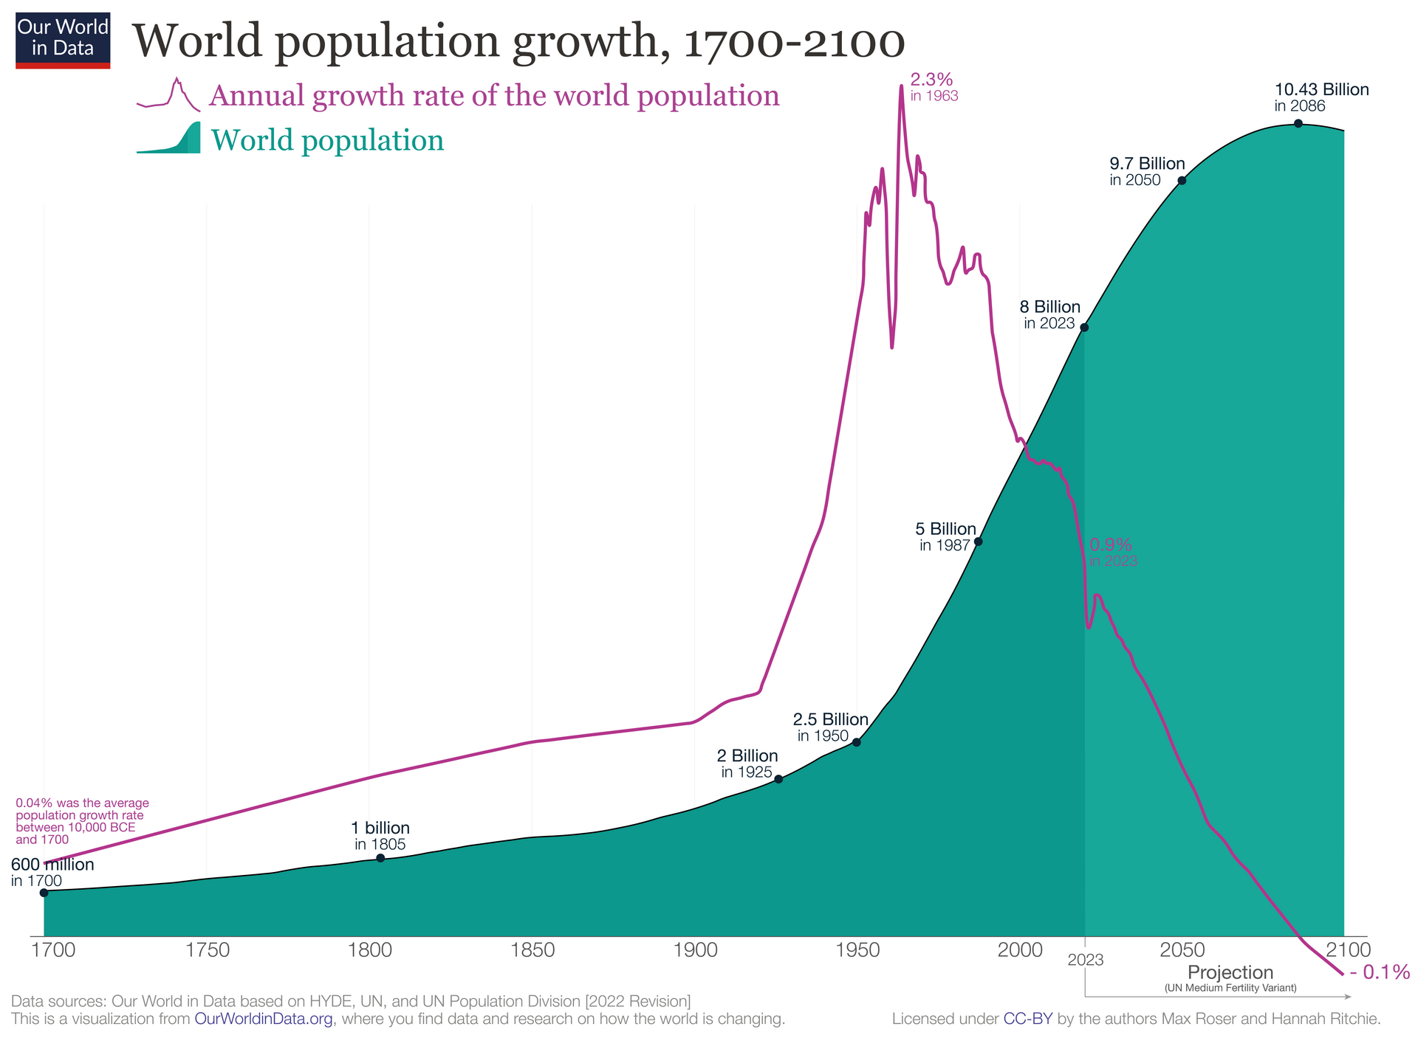

GRADE 9 | ECOLOGY M4 L2 | FULL LESSON - TUESDAY
Reading the Growth Curve
The curve stays almost flat for centuries, then bends sharply upward.
This shape is EXPONENTIAL growth - the bigger the population, the faster it adds new people.
Find it on the graph: where does the curve start to bend? What changed around that time?
Image: Our World in Data, CC BY 4.0

Slide 7
GRADE 9 | ECOLOGY M4 L2 | FULL LESSON - TUESDAY
Four Factors Change a Population
A population grows when more people arrive than leave - and shrinks when more leave or die.
BIRTHRATE
DEATH RATE
IMMIGRATION
EMIGRATION
Births ADD people. High birthrate = faster growth.
Deaths REMOVE people. Medicine and clean water lower it.
People moving IN add to the population.
People moving OUT take away from the population.
Population change = (births + immigration) - (deaths + emigration)
When births beat deaths and more people arrive than leave, the population GROWS.

Slide 8
GRADE 9 | ECOLOGY M4 L2 | FULL LESSON - TUESDAY
Growth and the Environment
More people, more needs
Every person needs food, water, energy and space.
Growing cities replace forests and farmland.
Resource use rises even faster than population.
No unlimited growth
Every environment has a carrying capacity.
Waste, pollution and habitat loss are the warning signs.
Science helps us plan: clean energy, smart farming, family planning.

Slide 9
GRADE 9 | ECOLOGY M4 L2 | FULL LESSON - TUESDAY
Guided Practice: What Happens to the Population?
With your partner, decide: does each event make the population GROW, SHRINK, or STAY THE SAME?
1
A new hospital lowers the death rate in a country.
2
Thousands of workers move OUT of a city to find jobs abroad.
3
Birthrate and death rate become exactly equal.
Challenge: explain your answers using the population change formula.
Guided practice: 8 min

Slide 10
GRADE 9 | ECOLOGY M4 L2 | FULL LESSON - TUESDAY
Group Activity: Population Scientists
1
In groups, choose a country and estimate: is its population growing fast, slowly, or shrinking?
GROUP WORK
10
minutes
2
List two reasons for your answer - use birthrate, death rate and migration.
3
Predict one resource problem your country could face if its population doubles.
Pairs. Worksheets on Classera when you finish.
4
Present your reasoning to the class in 60 seconds.
Success criteria:
a clear prediction, two correct factors used, one resource problem explained.
Activity: 10 min

Slide 11
GRADE 9 | ECOLOGY M4 L2 | FULL LESSON - TUESDAY
Check for Understanding
Quick check - answer on your mini whiteboard:
EXIT TICKET
1
Name the four factors that change the size of a population.
In one or two sentences: explain how human population growth can affect the environment. Use at least two vocabulary words.
2
Why did the human population grow so quickly in the last 200 years?
3
What is carrying capacity?
Homework on Classera
Check: 5 min

