Slide 1
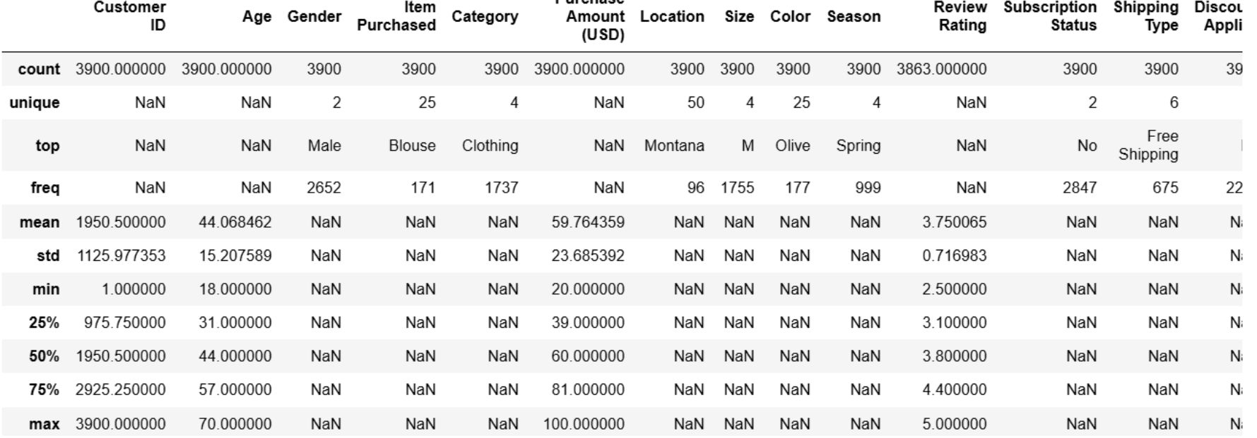
CUSTOMER SHOPPING BEHAVIOR / ANALYSIS
CUSTOMER SHOPPING BEHAVIOR ANALYSIS
Transactional evidence from 3,900 purchases across product categories, customer segments, product preferences, and subscription behavior.
18 columns · 37 missing Review Rating values · Python + MySQL

Slide 2
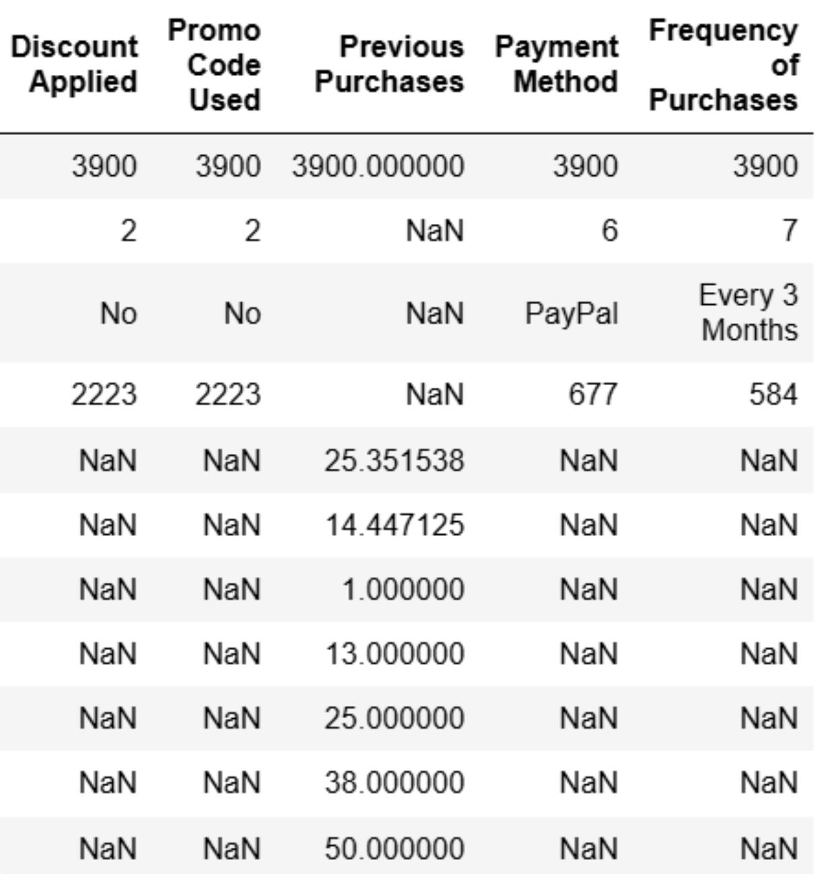

01 — DATA PREPARATION
ANALYSIS BEGAN WITH A CLEAN, TRACEABLE DATASET
Preparation moved from raw transactions to a structured database ready for business questions.
Missing Review Rating values were imputed with the median rating of each product category.
01
02
03
Load
Explore
Standardize
Imported the dataset using pandas.
Checked structure with df.info() and summary statistics with .describe().
Renamed columns to snake case for readability.
SHOPPING BEHAVIOR
2

Slide 3
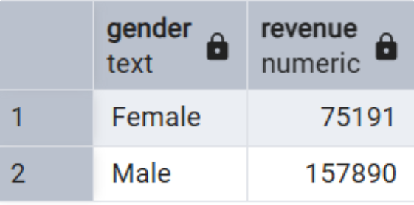
02 — CUSTOMER AND PRODUCT SIGNALS
Discount users still spend above average
TOP 5 PRODUCTS BY RATING
Item purchased | Average product rating
Gloves | 3.86
Sandals | 3.84
Boots | 3.82
Hat | 3.80
Skirt | 3.78
CUSTOMER SIGNAL
High-spending discount users
Identified customers who used discounts but still spent above the average purchase amount.
SHOPPING BEHAVIOR
3

Slide 4
03 — SHIPPING AND SUBSCRIPTION BEHAVIOR
Shipping and subscription status: spend patterns
SHIPPING TYPE COMPARISON
AVERAGE PRODUCT RATING
Shipping type | Average purchase amount
Standard | 58.46
Express | 60.48
Item purchased | Average Product Rating
Gloves | 3.86
Sandals | 3.84
Boots | 3.82
Hat | 3.80
Skirt | 3.78
SUBSCRIBERS
NON-SUBSCRIBERS
1,053 customers
2,847 customers
Average spend: 59.49
Total revenue: 62,645.00
Average spend: 59.87
Total revenue: 170,436.00
SHOPPING BEHAVIOR
4

Slide 5
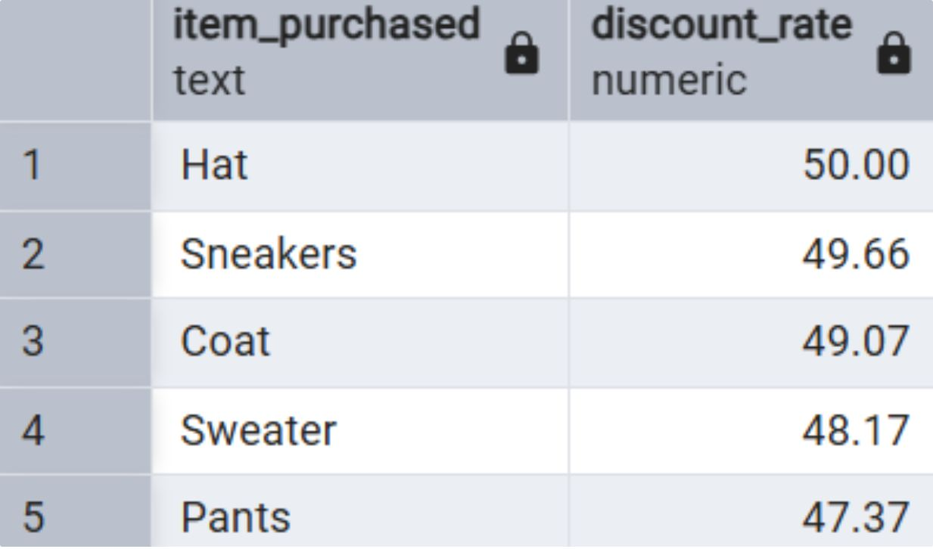
04 — DISCOUNT DEPENDENCY
DISCOUNT RELIANCE IS CONCENTRATED IN A SMALL PRODUCT SET
Five products carry the highest percentage of discounted purchases.
Item purchased | Discounted purchases
Hat | 50.00%
Sneakers | 49.66%
Coat | 49.07%
Sweater | 48.17%
Pants | 47.37%
SHOPPING BEHAVIOR
5

Slide 6
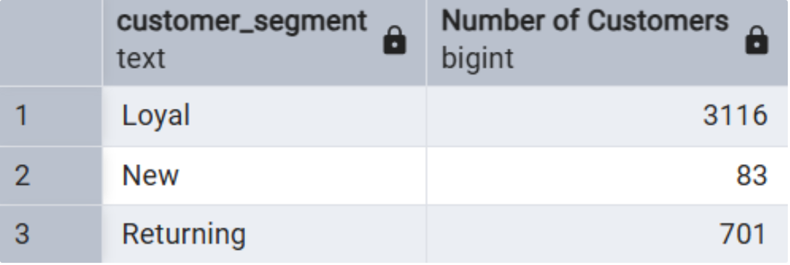
05 — CUSTOMER SEGMENTS AND CATEGORY DEMAND
LOYAL CUSTOMERS DOMINATE THE CUSTOMER BASE
TOP 3 PRODUCTS PER CATEGORY
CUSTOMER SEGMENTATION
Rank | Category | Item purchased | Total orders
1 | Accessories | Jewelry | 171
2 | Accessories | Sunglasses | 161
3 | Accessories | Belt | 161
1 | Clothing | Blouse | 171
2 | Clothing | Pants | 171
3 | Clothing | Shirt | 169
1 | Footwear | Sandals | 160
2 | Footwear | Shoes | 150
3 | Footwear | Sneakers | 145
Segment | Number of customers
Loyal | 3,116
Returning | 701
New | 83
Revenue contribution by age group was also calculated for comparison.
SHOPPING BEHAVIOR
6

Slide 7
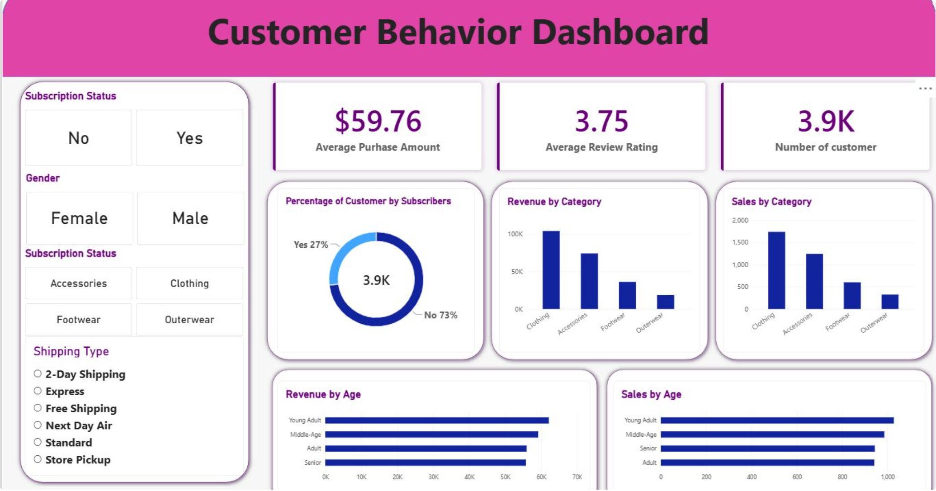
06 — DECISION VIEW
THE ANALYSIS BECOMES A WORKING CUSTOMER VIEW
Filters connect subscription status, gender, category, shipping type, and customer behavior to the metrics that matter.

Slide 8
07 — BUSINESS IMPLICATIONS
TURN SHOPPING SIGNALS INTO TARGETED ACTION
Four practical moves follow directly from the customer, product, shipping, and subscription analysis.
01
02
Customer Loyalty Programs
Review Discount Policy
Reward repeat buyers to move them into the “Loyal” segment.
Balance sales boosts with margin control.
03
04
Product Positioning
Targeted Marketing
Highlight top-rated and best-selling products in campaigns.
Focus efforts on high-revenue age groups and express-shipping users.
SHOPPING BEHAVIOR
8

