Slide 1
















Node.js
Mohamed Omran
Senior Software Engineer @The Fabulous

Slide 2
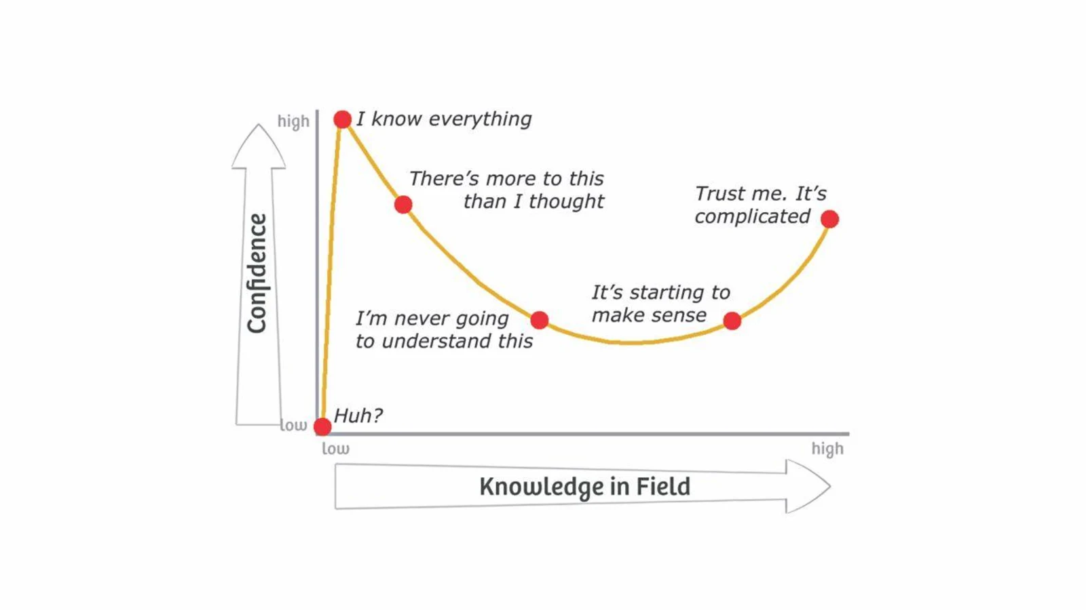

Slide 3



Slide 4

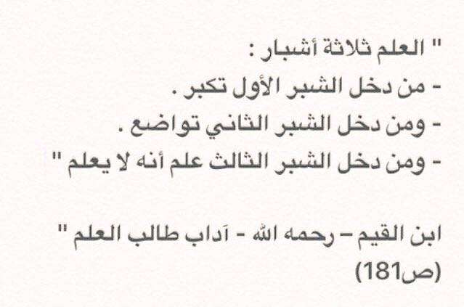

Slide 5
Content (Day 4)
Model, controller, route
CORS
Mongoose
Hashing VS Encryption
bcrypt.js
Error handling

Slide 6
Model, controller, route

Slide 7
CORS;

Slide 8
Mongoose
ODM
Schema, Model => Collection
Schema Types
Validations (update validators)
Custom Validations
Queries (promises?, exec, where, limit, sort, select)
Populate (Relations)
Static vs Instance Methods
Middlewares (ex: saving passwords, cascade delete, built-in validate)
Transactions
toJSON {transformer}

Slide 9
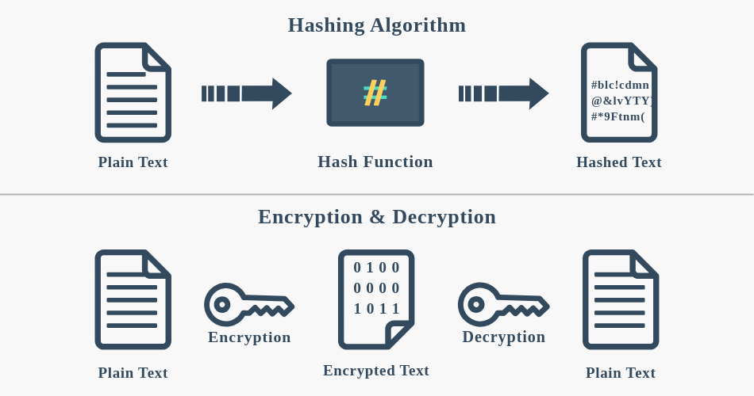
Hashing VS Encryption

Slide 10
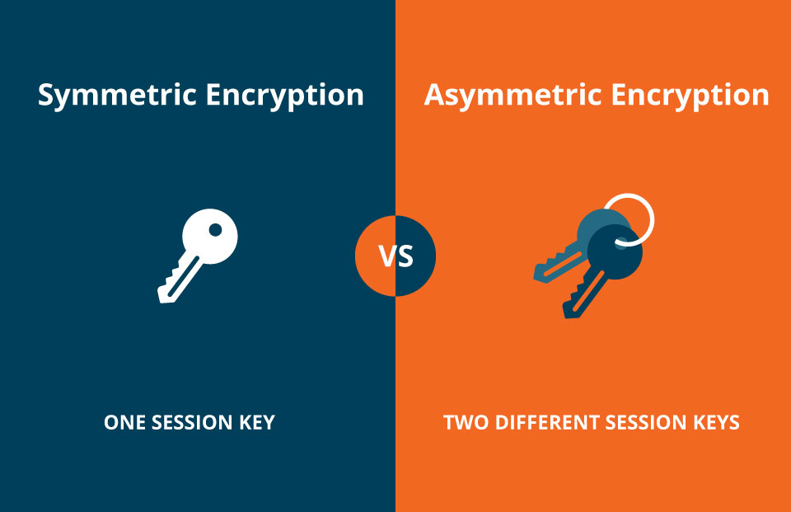
Hashing VS Encryption

Slide 11
bcrypt.js;

Slide 12
Error Handling;

