Slide 1
University Management System
By: Ali Al Ibrahim

Slide 2

ASP.NET Core Web App (MVC)
Has added functionalities and pages such as departments and instructors.
Ability to create, edit, view ,and delete.
Has a complex database

Slide 3
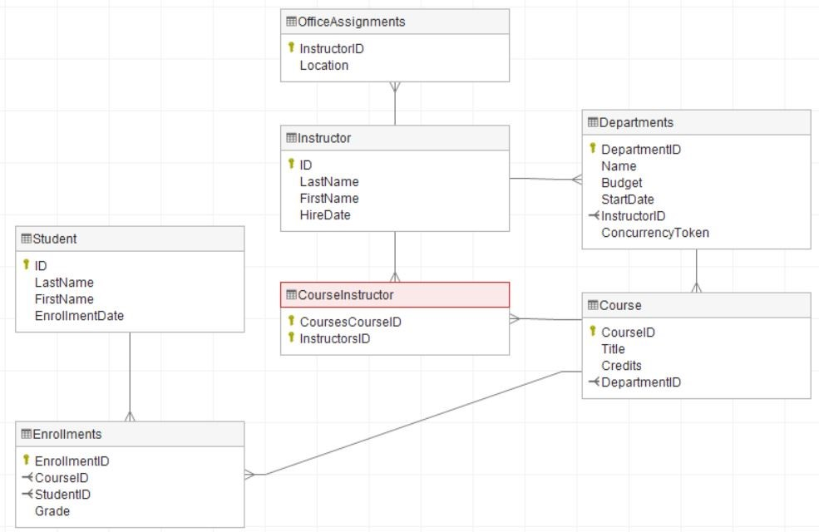
Many to many relations in the database.
Such as Instructors to Courses.
Departments to Instructors.
Student to courses.
Courses to Departments.

Slide 4
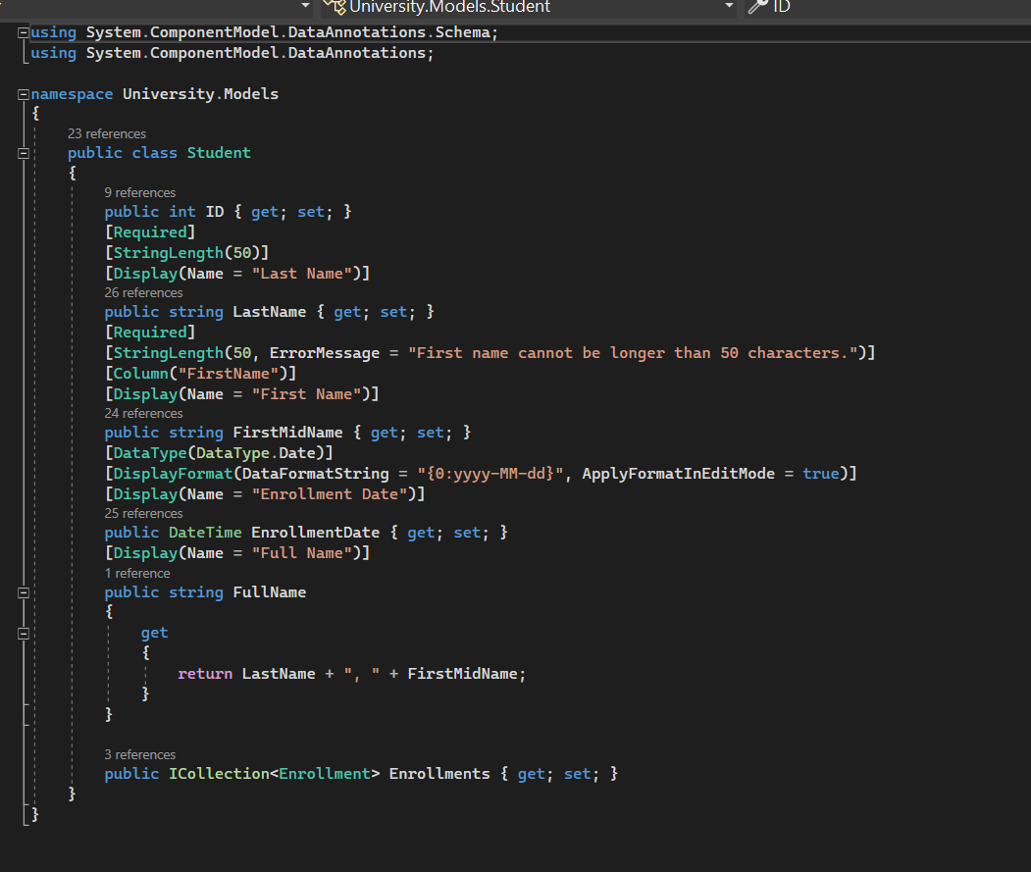
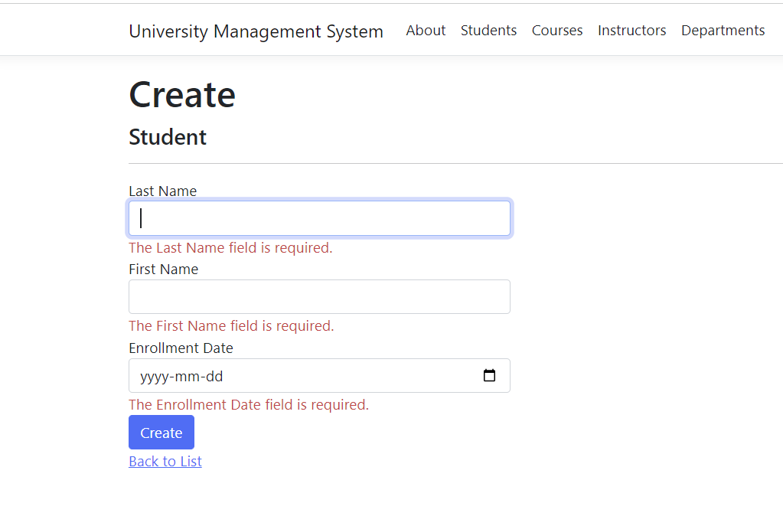
The Required and display attributes
Accepts min and max length
specifies that the caption for the text boxes

Slide 5
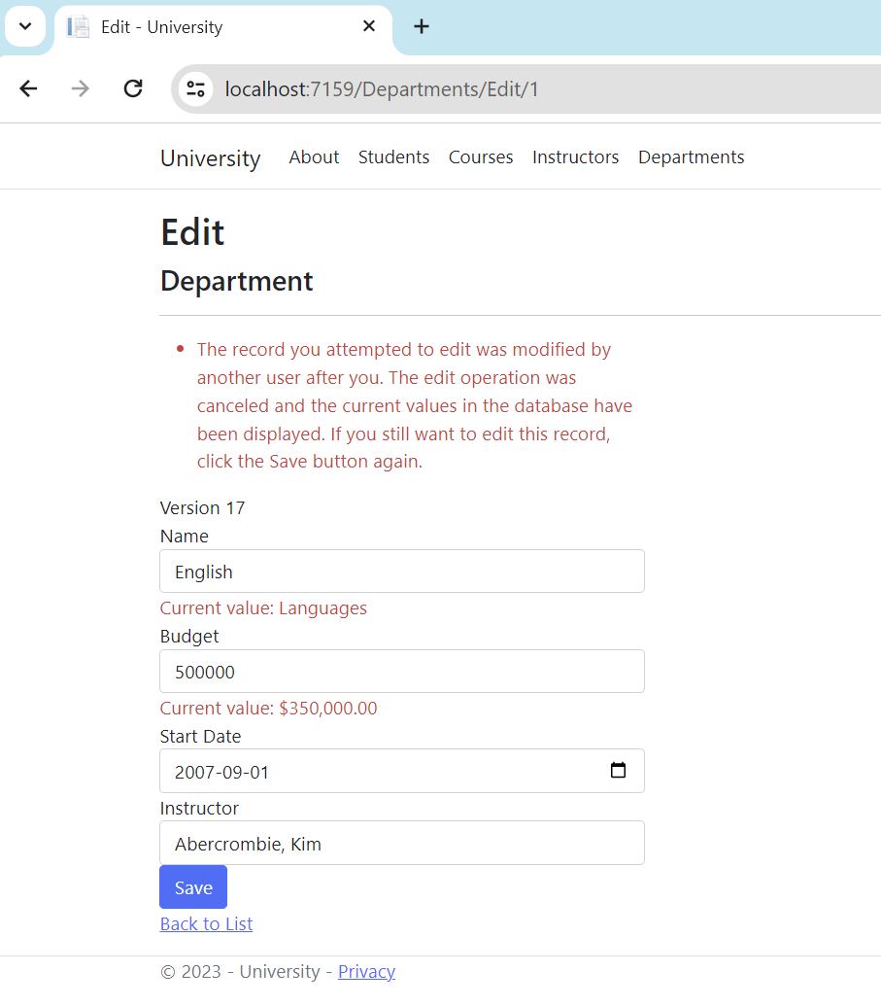
Concurrency management
A concurrency conflict occurs when:
A user navigates to the edit page for an entity.
Another user updates the same entity before the first user's change is written to the database.
By adding timestamp and concurrencytoken

Slide 6
Thank You!
References: https://learn.microsoft.com/en-us/aspnet/core/data/ef-rp/intro?view=aspnetcore-7.0&tabs=visual-studio

