Slide 1
Statistics:
1-The arguments of Python’s print
Published on: Dec 26, 2025
View: 1,823
Likes: 89.5 %
2-Stop using For-Loops for Lists
Pulished on: Dec 27, 2025
Views: 1,444
Likes: 82.4 %

Slide 2
py_001_print
Video 1
Print arguments

Slide 3
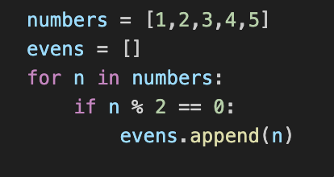
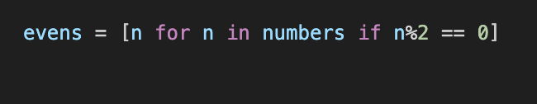
DIRTY CODE
py_002_list_comprehensions
CLEAN CODE
Notes:
This Slide was second one and has been made on 26.12.2025, the related file is : list-comprehensions.py
Info:
Video Number: 2
Published Date: 26.12.2025
File Name: list-comprehensions.py

Slide 4
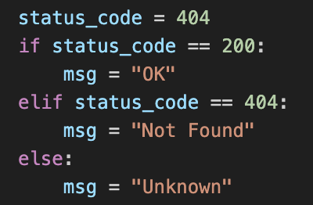
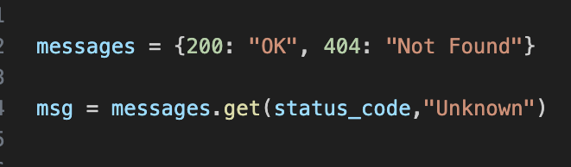
@CodeWithEbrahim
If-Else Overload!
py_003_dictionary_get
Cleaner and Faster
@CodeWithEbrahim
Notes:
Video 3 published on 29.12.2025

Slide 5

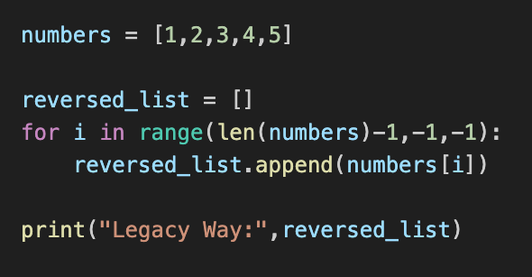

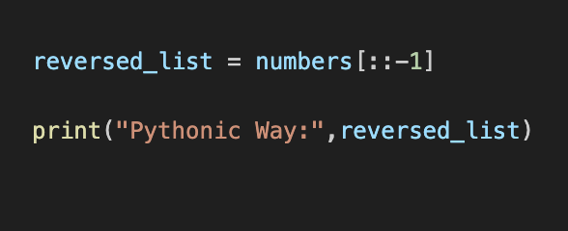
py_004_sequence_slicing
Legacy Way
Pythonic Way
Notes:
Video 4 Published on 31.12.2025
Related files:

Slide 6

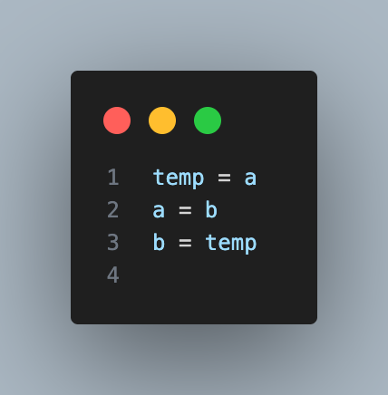
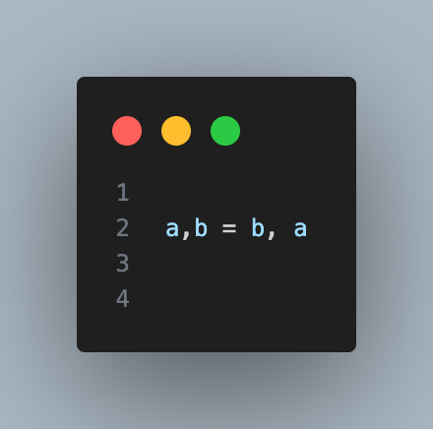
py_005_swap_variables
Normal Way
Pythonic Way
Notes:
Video 5
Title: Swap Variables

Slide 7
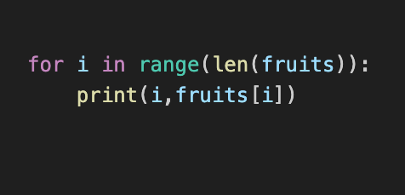
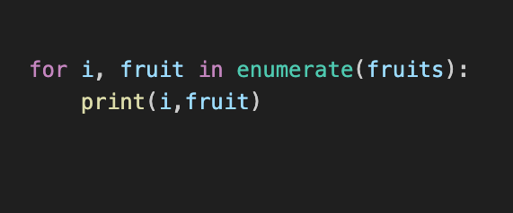
py_006_enumerate
List Index based
More readable and prevents “IndexError” bugs
Notes:
Video 6
Title: enumerate

Slide 8
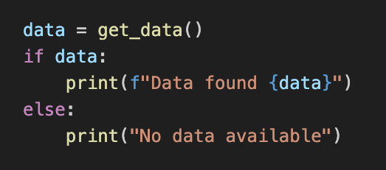
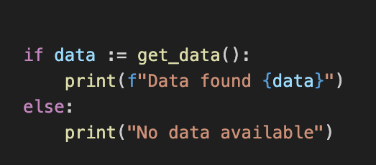
py_007_walrus_operator
Use Walrus Operator(:=) in your codes
Concise & Readable

Slide 9
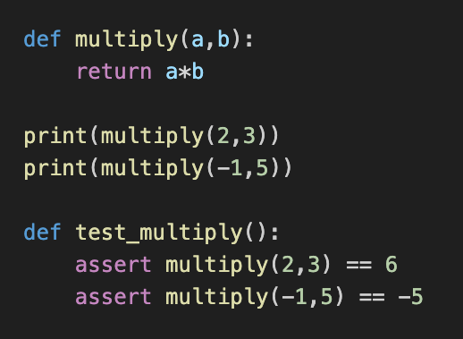
py_008_pytest_assert
Stop using print() to test your code!
Pre Requisite: pip install pytest
Run: pytest

Slide 10
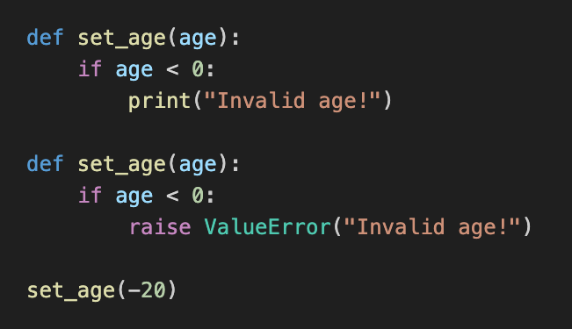
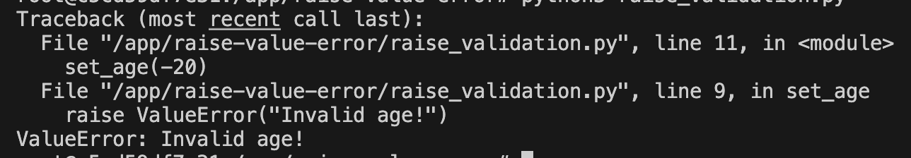
py_009_raise_value_error
Print is for YOU, Raise is for your CODE!
Output

Slide 11


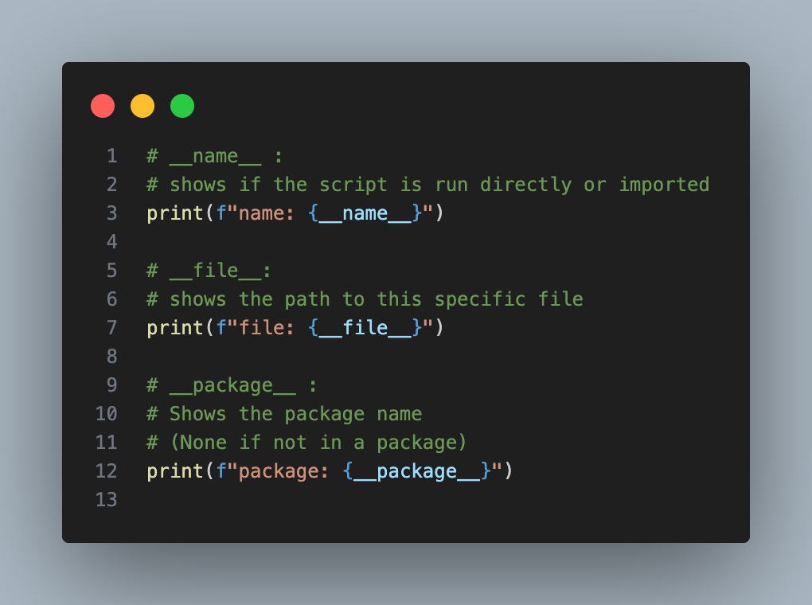
@CodeWithEbrahim
py_010_special_variable_names
Python Special Variables
File name: magic_vars.py
__name__
__main__ or magic_vars
__file__
/app/magic_vars.py
__package__
None or name of package

Slide 12

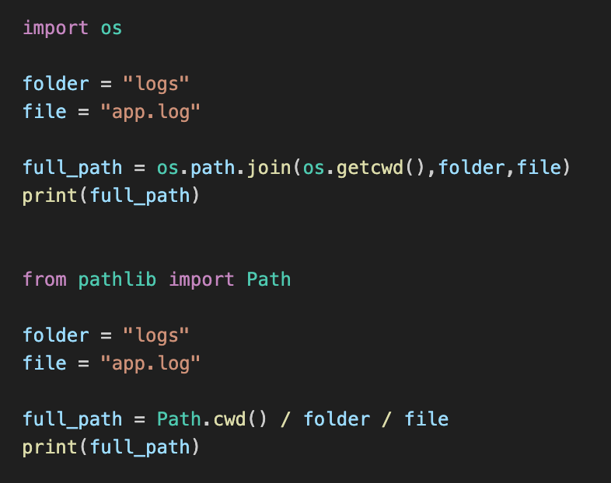
py_011_pathlib
pathlib
Readable:
Use the / operator to join paths easily.
Smart:
Auto-handles Windows vs. Linux
Powerful:
Everything is an object, not just a string.
Notes:
Video 011 Folder: py_011_pathlib

Slide 13

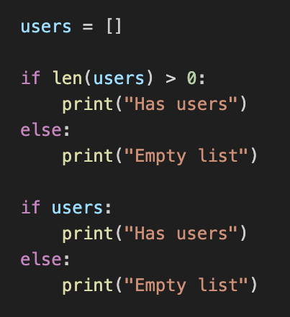
py_012_python_truthiness
Truthiness

Slide 14
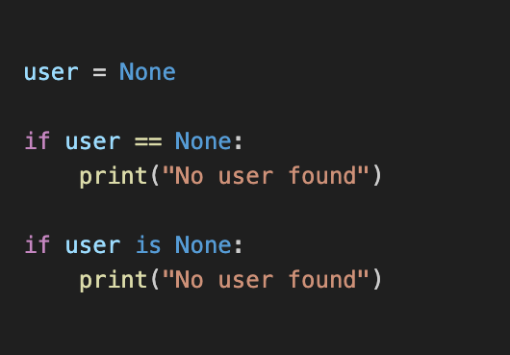
py_013_is_none_comparision
is None vs == None
Faster:
Uses memory address comparison
Safer:
Avoids custom --eq-- method bugs
Pythonic:
Follows the official PEP 8 standard

Slide 15
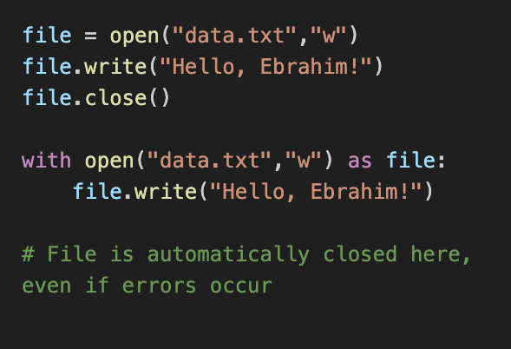
py_014_with_statement
Use 'with' Statement
Automatic:
No more manual close() calls
Safe:
Prevents leaks during errors
Clean:
Less code, better readability

Slide 16
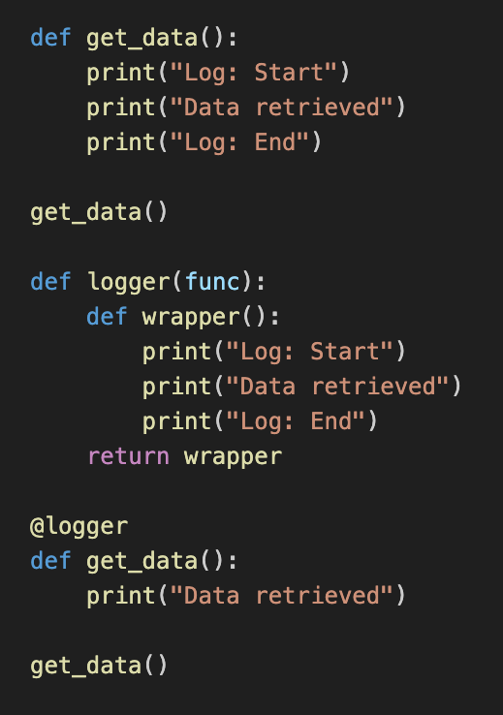
py_015_decorators
Decorators
Powerful & Reusable
Extend behavior without changing the core logic
Notes:
Video 011 Folder: py_011_pathlib

Slide 17
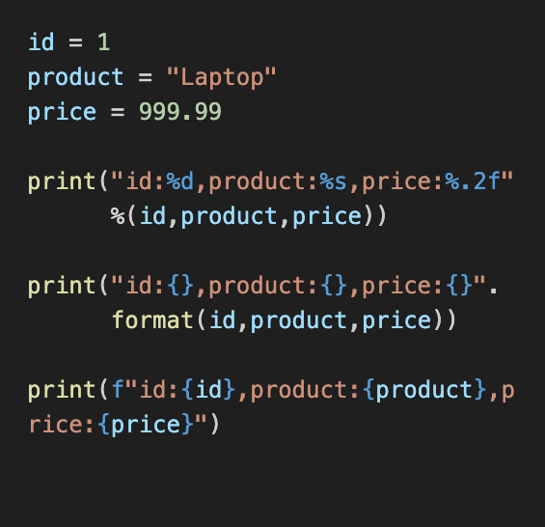
py_016_f_strings_vs_format
F-Strings vs Format
Readable:
Direct variable injection into strings
Faster:
F-Strings are optimized by the compiler
Modern:
The standard since Python 3.6+

Slide 18
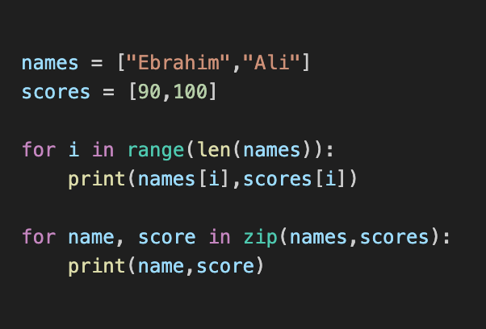
py_017_zip_function
Zip function
Efficient:
Loops through multiple iterables at once
Pythonic:
Eliminates the need for manual indexing
Simple:
Makes your loops cleaner and shorter

Slide 19
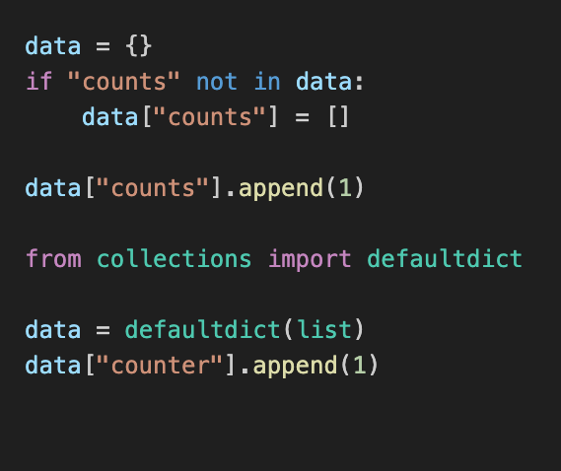
py_018_default_dictionary
defaultdict vs standard Dict
Elegant Logic:
Automatically handle missing keys without manual checks

Slide 20
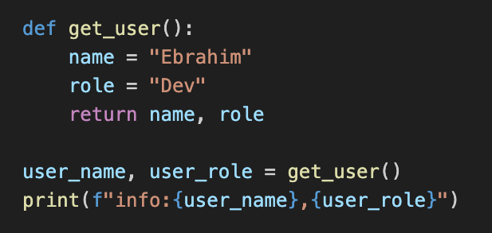
py_019_multiple_return_value
Multiple Return Value
Simple & Powerful:
Return and unpack multiple results in one line

Slide 21
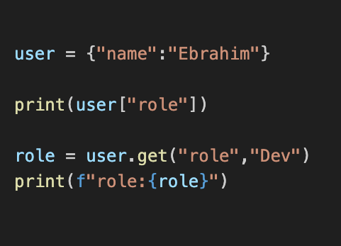
py_020_avoid_key_error_with_get
Avoid KeyError with .get
Safe Access:
Provide a default value if the key doesn’t exist

Slide 22
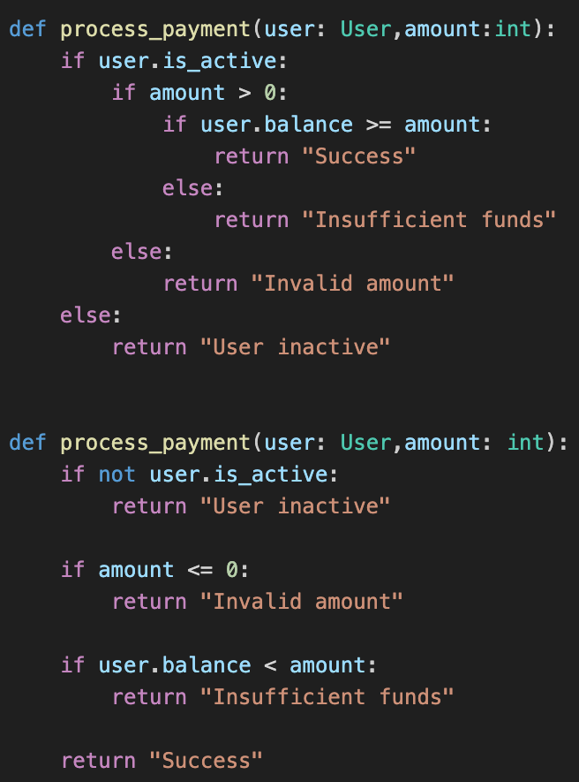
py_021_guard_clauses
Stop Nested If-Else
Flatten your code by returning early

Slide 23
py_022_clean_if_statement
Stop Nested If-Else
Flatten your code by returning early

Slide 24
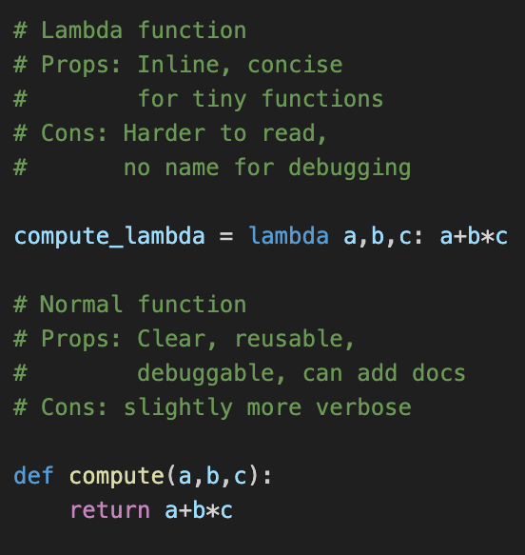
py_023_lambda
lambda function
A lambda function is a small anonymous function.

Slide 25

py_024_sql_injection
Stop SQL Injection!
Always use parameters, never f-strings for queries!

Slide 26
py_025_authomatic_db_client
Automatic DB Cleanup
Use the with block to handle the heavy lifting of closing sessions automatically.

Slide 27
py_026_zero_error_data_models
Zero-Error Data Models
Define a Pydantic model for autocomplete and type safety.

Slide 28

py_027_type_safe_sql
Type-Safe SQL
Stop writing SQL strings—use SQLAlchemy 2.0.

Slide 29
py_028_db_insert_10x_faster
10x Faster DB Inserts
One by one is slow—bulk is better.

Slide 30
py_029_db_insert_10x_faster
New idea
New idea

Slide 31

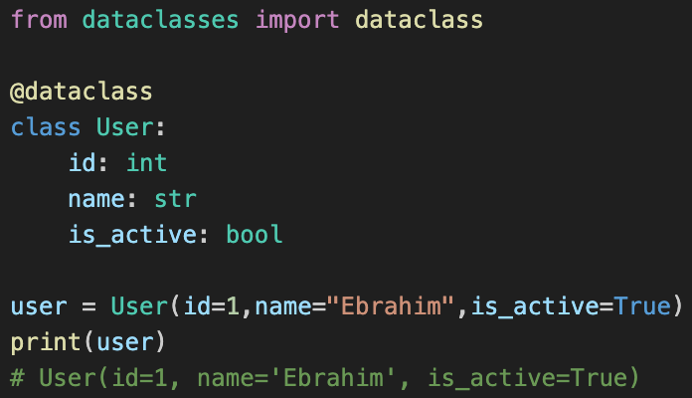
Image:py_001_dataclass
dataclass
Using dataclass to manage structured data

Slide 32
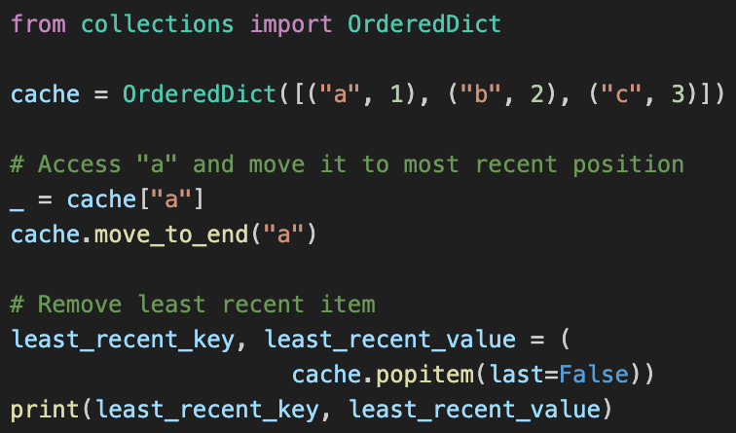
Shorts/py_022_use_OrderedDict
Use OrderedDict
Python Tip:
Order Is Logic, Not Style

Slide 33
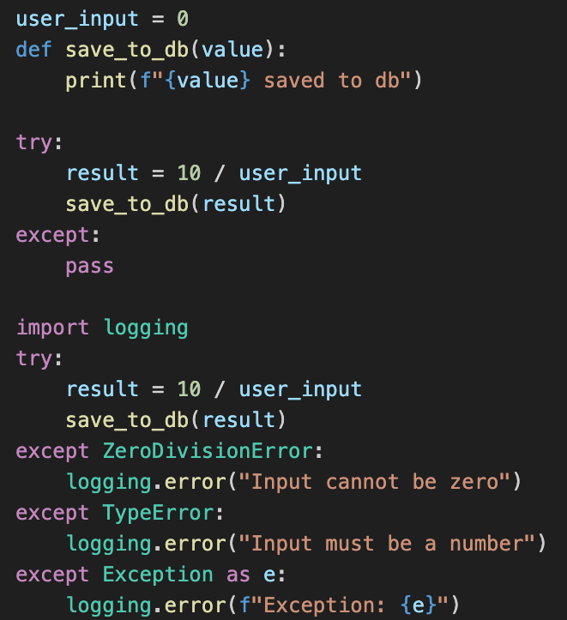
Shorts/py_025_avoid_bare_except
Avoid Bare Exception

Slide 34
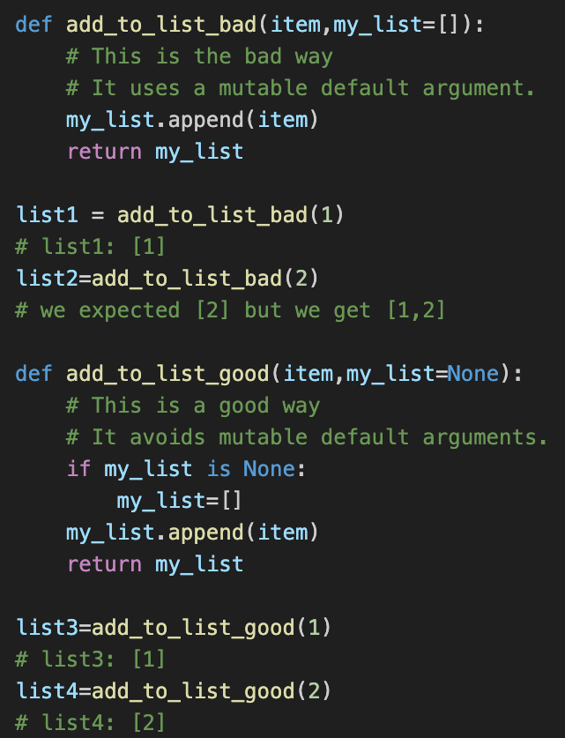
Shorts/py_024_mutable_default_arguments
Mutable Default Arguments

Slide 35
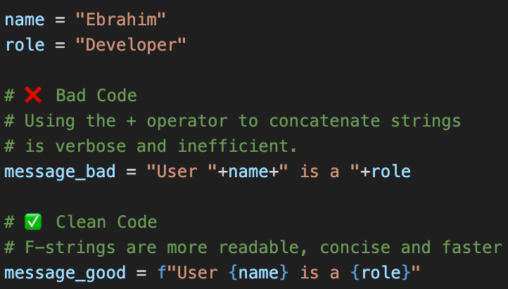
py_026_f_string_vs_concatenation
String vs Concatenation
Stop building strings with + in Python! Use F-strings instead.

Slide 36

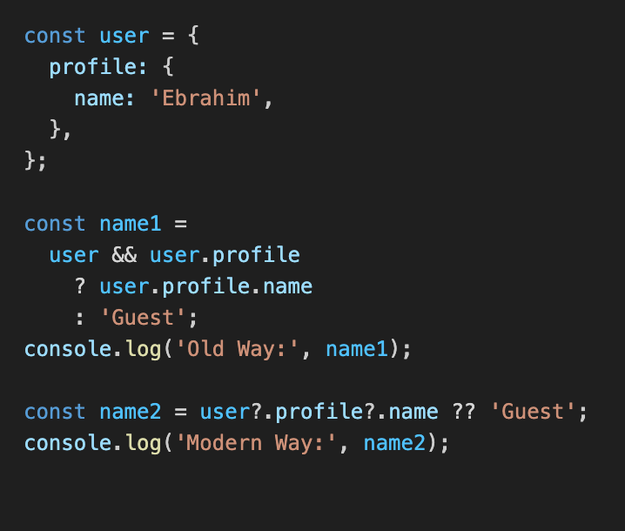
ts_001_optional_chaining
Simplify Nested Access
Safe Navigation:
Access nested values line-by-line

Slide 37
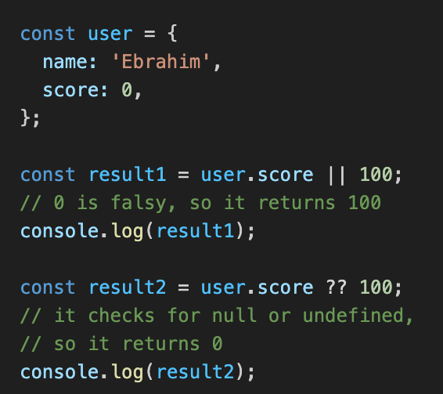
ts_002_nullish_coalescing
Proper Default Values
Precision Defaults:
Use ?? To handle null and undefined

Slide 38
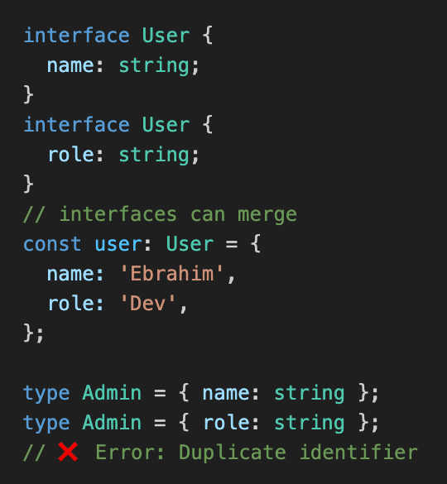
ts_003_interface_merging
Interface: Open vs Type: Closed
Interfaces are open to expansion, Types are closed.

Slide 39
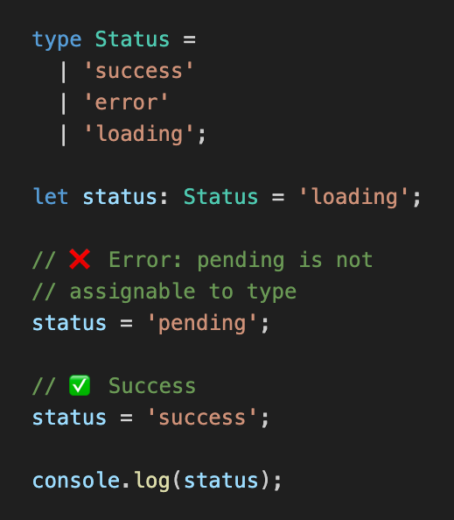
ts_004_union_types
Union Types
Restrict a variable to only specific allowed values

Slide 40
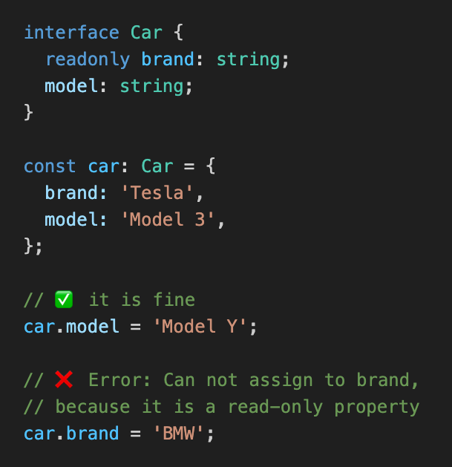
ts_005_readonly_properties
Lock your Data With readonly
Prevent accidental changes to critical object properties

Slide 41

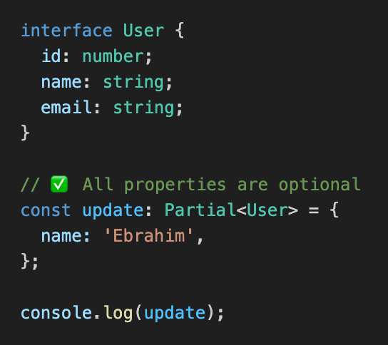
ts_006_partial_type
The Power of Partial<T>
Make all properties in an interface optional

Slide 42

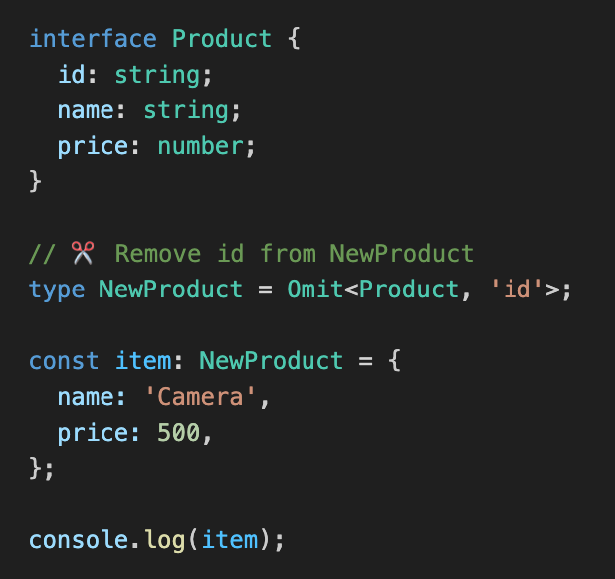
ts_007_omit_type
Remove Fields with Omit
Create new models by excluding specific properties

Slide 43
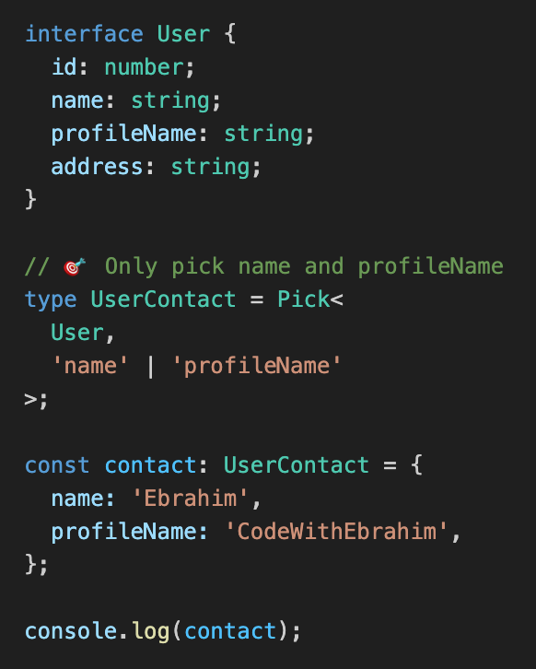
ts_008_pick_type
Pick what you need
Create a new Type by selecting specific fields from an interface

Slide 44
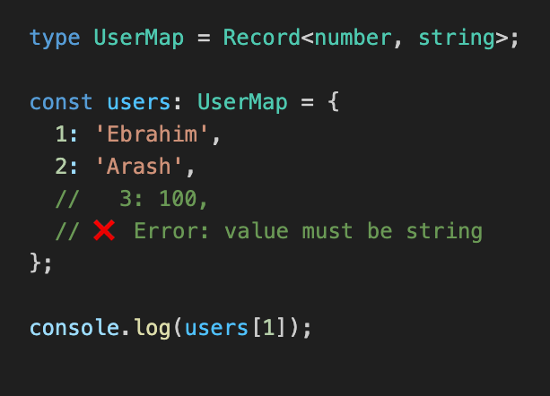
ts_009_record_type
Quick Maps with Record
Define Key-Value pairs with specific types

Slide 45
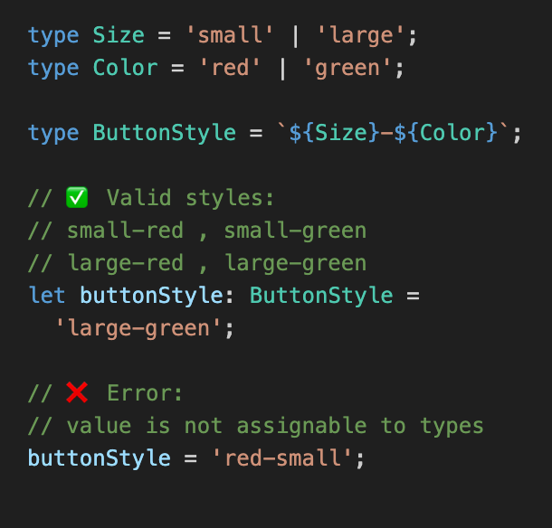
ts_010_template_literals
Dynamic String Types
Combine multiple types into new string formats

Slide 46

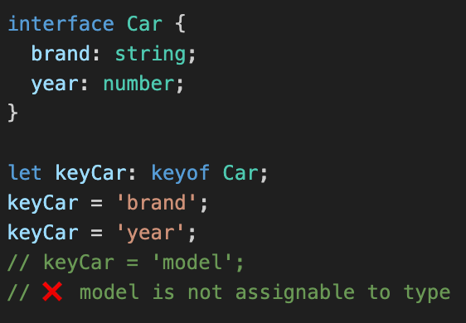
ts_011_dynamic_key_access
Dynamic Key Access
Ensure you only access properties that actually exist

Slide 47
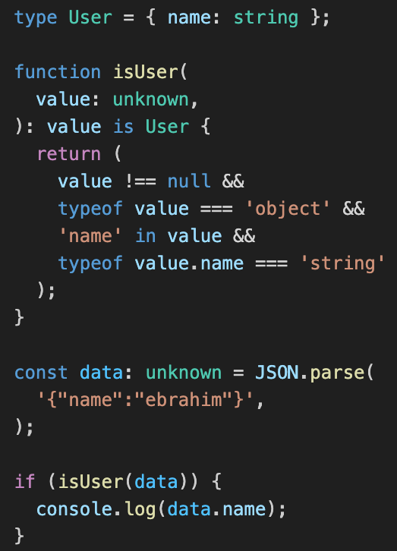
ts_012_use_unknown_instead_of_any
Use unknown instead of any

Slide 48
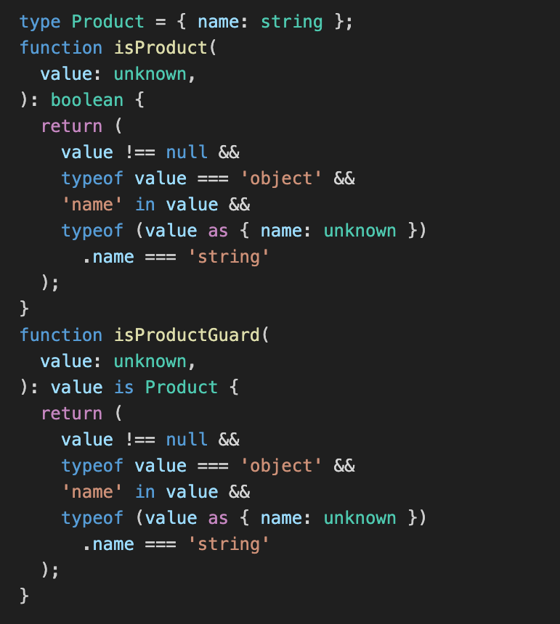
ts_013_type_guard_vs_Boolean_check
Type Guard vs Boolean Check
Type Guard

Slide 49
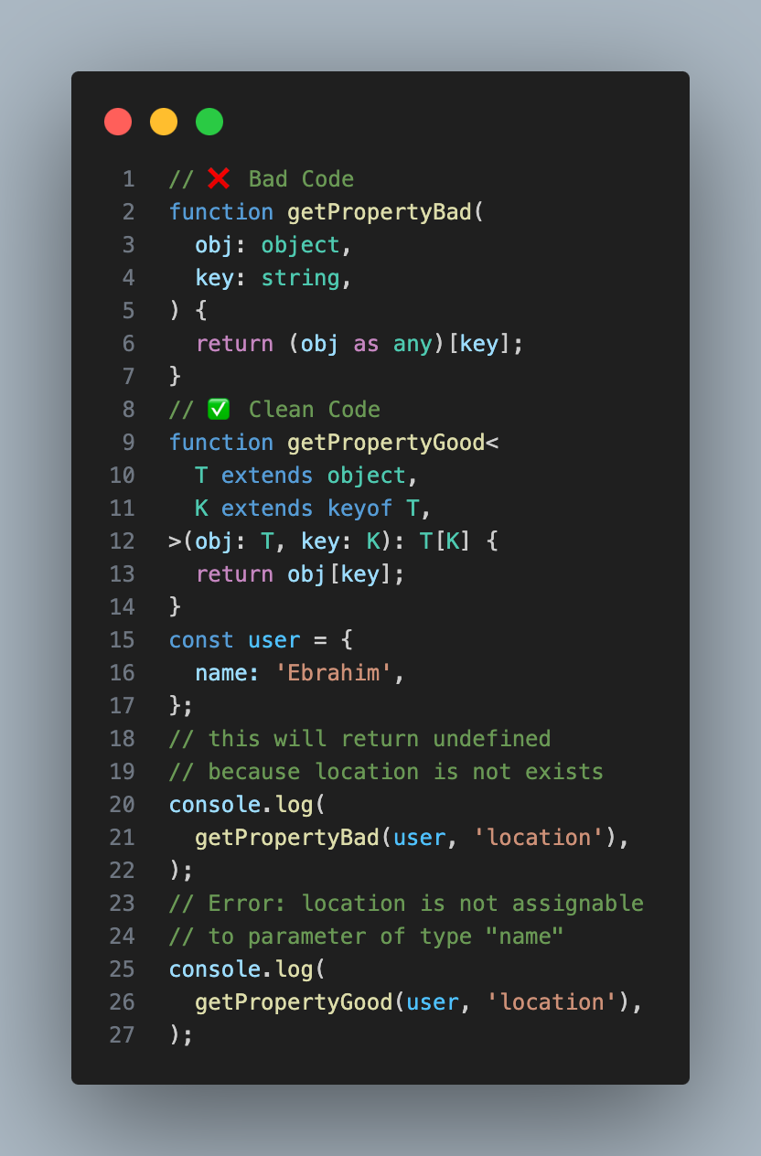
ts_014_keyof_operator
Dynamic Key Access

Slide 50

rt_001_te
…….

Slide 51

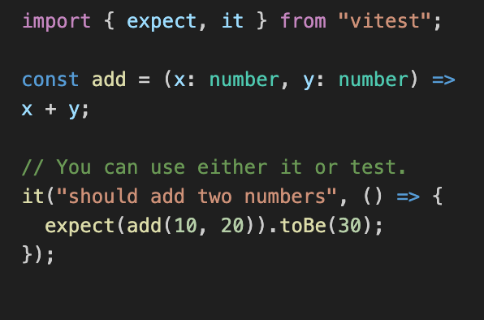
Image: vitest_001_test_your_code
Test Your Code with Vitest
Unit Testing Your TypeScript with Vitest

