Slide 1

py_011_pathlib
Stop Manual Validation!
If you need validation, use zod in Typescript and pydantic in Python
Typescript:
npm install zod
Python:
pip install pydantic
pip install email-validator
Notes:
Video 011 Folder: py_011_pathlib

Slide 2

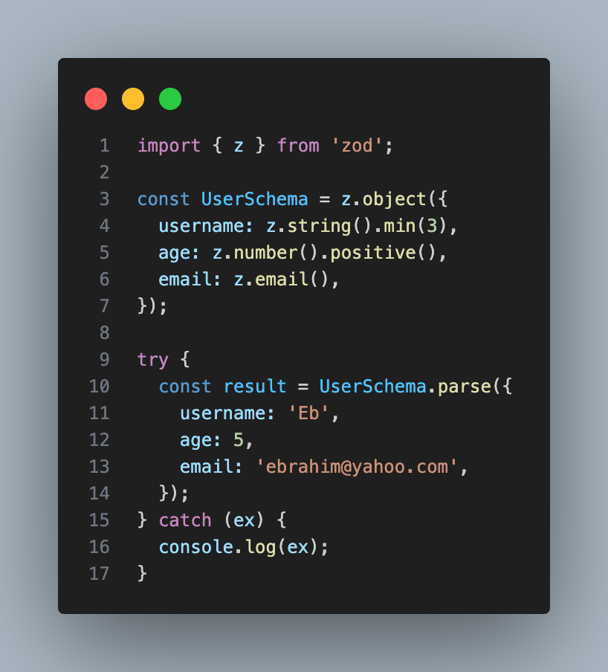
py_011_pathlib
Zod
Notes:
Video 011 Folder: py_011_pathlib

Slide 3

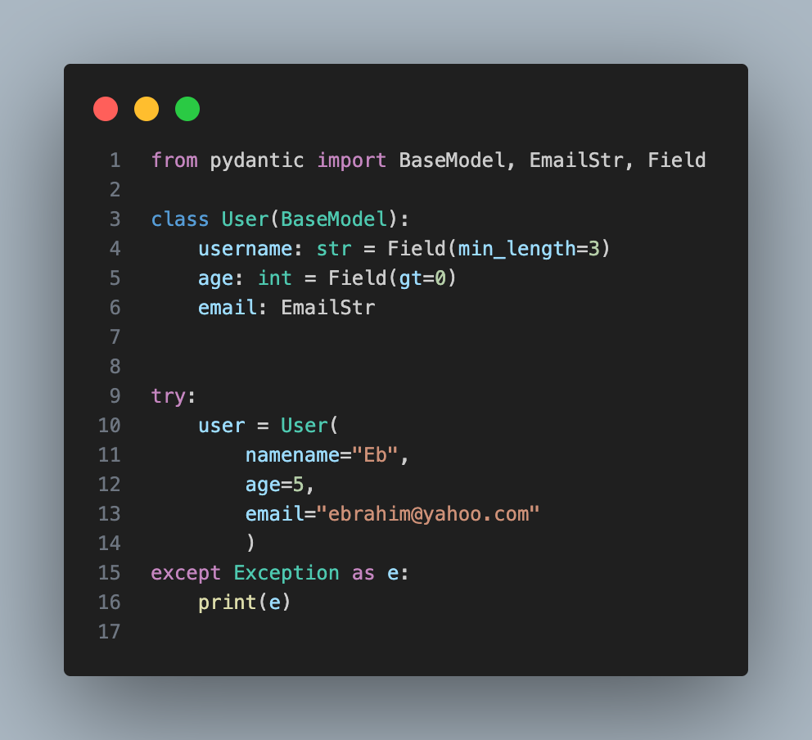
py_011_pathlib
Pydantic
Notes:
Video 011 Folder: py_011_pathlib

Slide 4
py_011_pathlib
Why we need Validation
Zero Runtime Crashes: Avoid throwing errors in the app.
Self-Documenting: Like a contract, it describes the data it requires.
Automatic Casting: Data is cast automatically.
Clean API: Prevents dirty data from entering the core of your system.
Notes:
Video 011 Folder: py_011_pathlib

Slide 5
py_011_pathlib
Questions?
Which one do you prefer?
Tell me in the comments please
Notes:
Video 011 Folder: py_011_pathlib

Slide 6
py_013_is_none_comparision
RegExp: Stop Struggling!
Goal: Extract Email Addresses
[a-zA-Z0-9._%+-]+@[a-zA-Z0-9.-]+\.[a-zA-Z]{2,}
User Name
Domain Name
Top Level Domain
ebrahim
gmail, yahoo
com, org

Slide 7

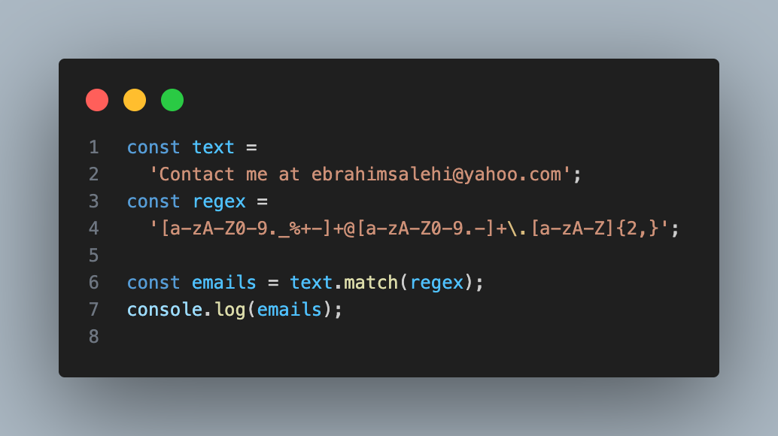
py_013_is_none_comparision
RegExp: Stop Struggling!
Javascript Code

Slide 8
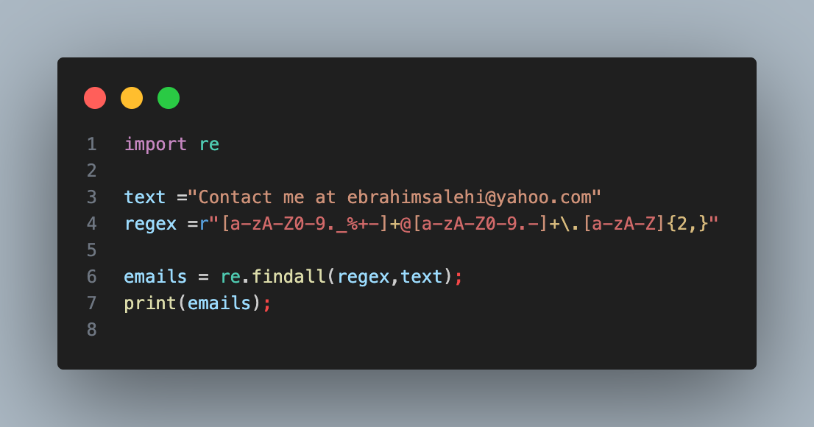
py_013_is_none_comparision
RegExp: Stop Struggling!
Python Code

Slide 9
py_013_is_none_comparision
RegExp: Stop Struggling!
Which syntax is easier? JS or Python?
Save this Regex for your next project!

Slide 10

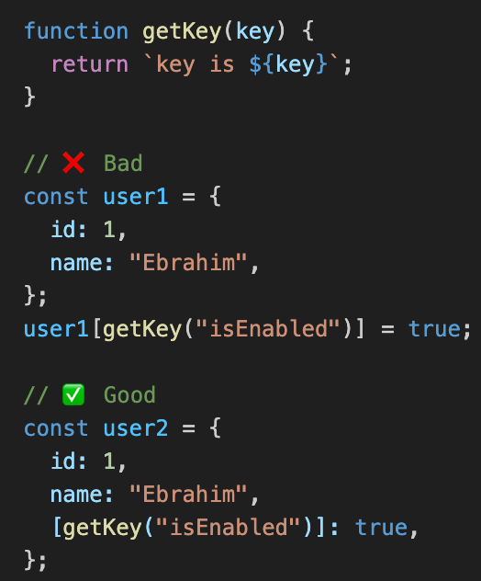
js_002_computed_property
Computed Property Names

Slide 11
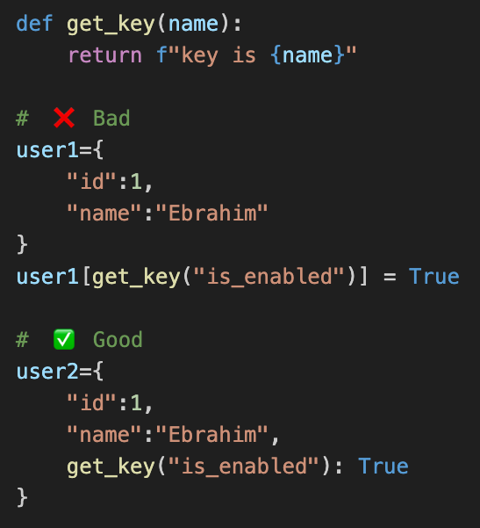
py_004_computed_property
Computed Property Names

Slide 12
Computed Property Names
Sometimes you need dynamic properties in your object s or dictionaries. Instead of adding them later, it’s better to use computed values during the declaration step.

Slide 13
Computed Property Names
Do you agree?
Please write in the comments !!!

Slide 14
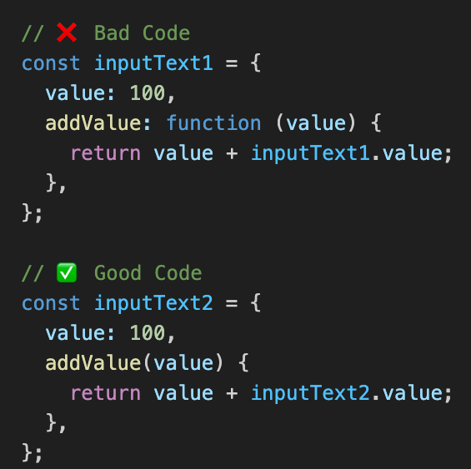
py_014_with_statement
Shorthand Method Definition

Slide 15
py_014_with_statement
Shorthand Method Definition
Using {key: function()} is old-school and adds unnecessary noise to your object structure.
Use Method Shorthand.
{function(){}}
It’s cleaner, more concise, and the standard way to define functions inside objects in modern JS.

Slide 16
py_014_with_statement
Shorthand Method Definition
Which method are you using?
Please write in the comments !!!

Slide 17

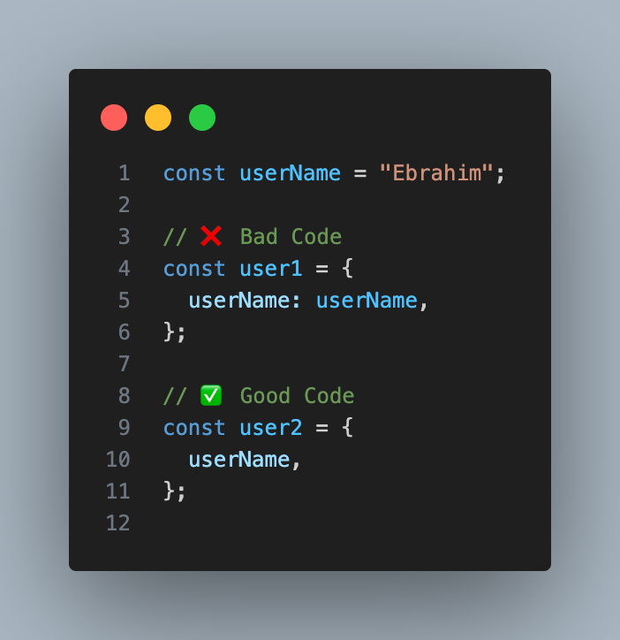
js_004_property_value_shorthand
Shorthand Property Value

Slide 18
py_014_with_statement
Shorthand Property Value
What’s your opinion on this?
Please write in the comments !!!

Slide 19
py_015_decorators
Pytorch
Pytorch is a powerful machine learning framework designed for Deep Learning.
How to install:
pip install torch
Notes:
Video 011 Folder: py_011_pathlib

Slide 20
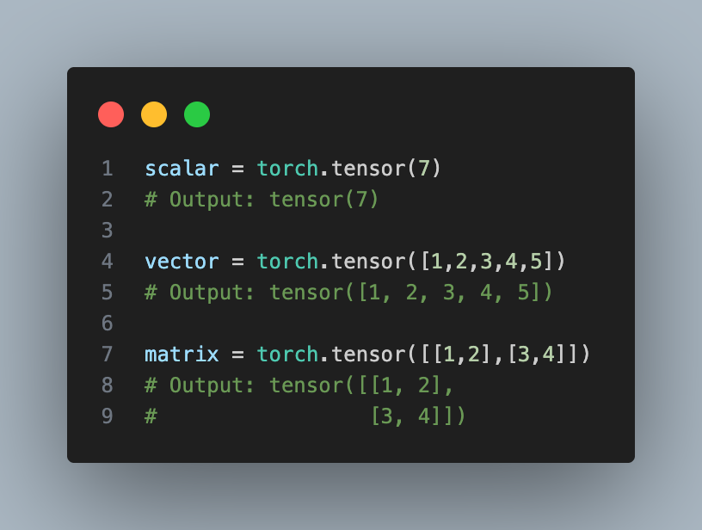
py_015_decorators
Pytorch
Tensor is a fundamental building block of PyTorch, Think of multi dimensional array (like NumPy’s array).
Notes:
Video 011 Folder: py_011_pathlib

Slide 21
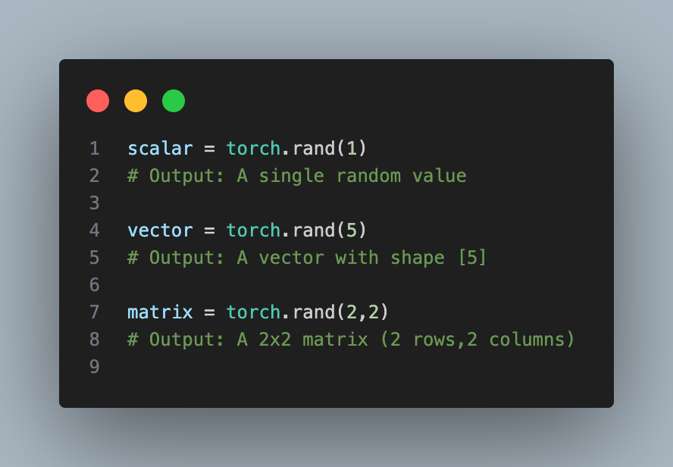
py_015_decorators
Pytorch
Notes:
Video 011 Folder: py_011_pathlib

Slide 22
py_015_decorators
Pytorch
What’s your opinion on this?
Please write in the comments !!!
Notes:
Video 011 Folder: py_011_pathlib

Slide 23
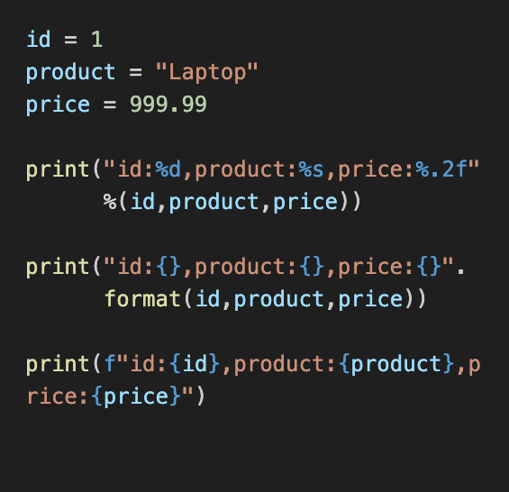
py_016_f_strings_vs_format
F-Strings vs Format
Readable:
Direct variable injection into strings
Faster:
F-Strings are optimized by the compiler
Modern:
The standard since Python 3.6+

Slide 24
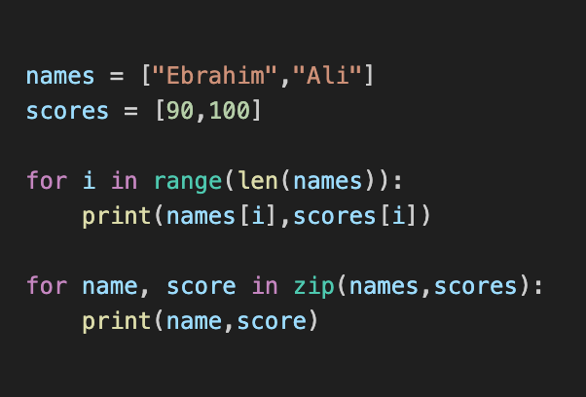
py_017_zip_function
Zip function
Efficient:
Loops through multiple iterables at once
Pythonic:
Eliminates the need for manual indexing
Simple:
Makes your loops cleaner and shorter

Slide 25
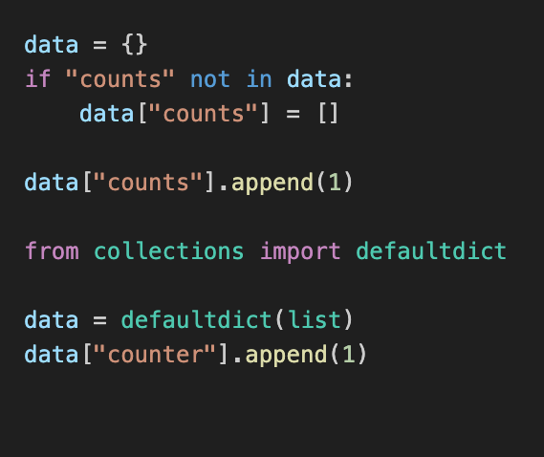
py_018_default_dictionary
defaultdict vs standard Dict
Elegant Logic:
Automatically handle missing keys without manual checks

Slide 26
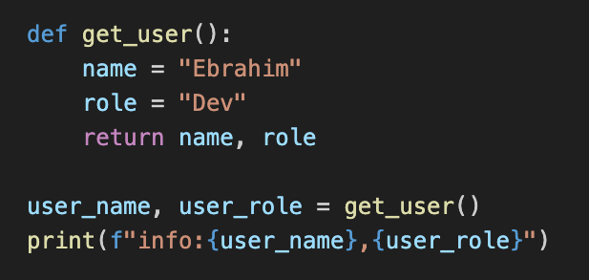
py_019_multiple_return_value
Multiple Return Value
Simple & Powerful:
Return and unpack multiple results in one line

Slide 27
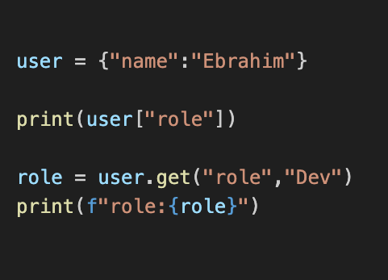
py_020_avoid_key_error_with_get
Avoid KeyError with .get
Safe Access:
Provide a default value if the key doesn’t exist

Slide 28
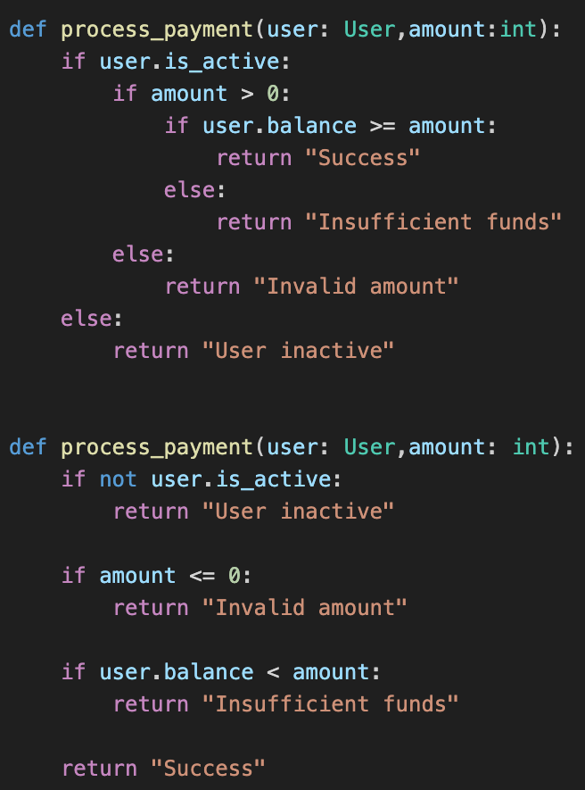
py_021_guard_clauses
Stop Nested If-Else
Flatten your code by returning early

Slide 29
py_022_clean_if_statement
Stop Nested If-Else
Flatten your code by returning early

Slide 30

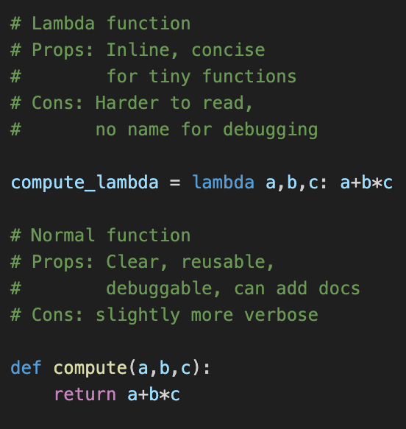
py_023_lambda
lambda function
A lambda function is a small anonymous function.

Slide 31

py_024_sql_injection
Stop SQL Injection!
Always use parameters, never f-strings for queries!

Slide 32
py_025_authomatic_db_client
Automatic DB Cleanup
Use the with block to handle the heavy lifting of closing sessions automatically.

Slide 33
py_026_zero_error_data_models
Zero-Error Data Models
Define a Pydantic model for autocomplete and type safety.

Slide 34
py_027_type_safe_sql
Type-Safe SQL
Stop writing SQL strings—use SQLAlchemy 2.0.

Slide 35
py_028_db_insert_10x_faster
10x Faster DB Inserts
One by one is slow—bulk is better.

Slide 36
py_029_db_insert_10x_faster
New idea
New idea

Slide 37

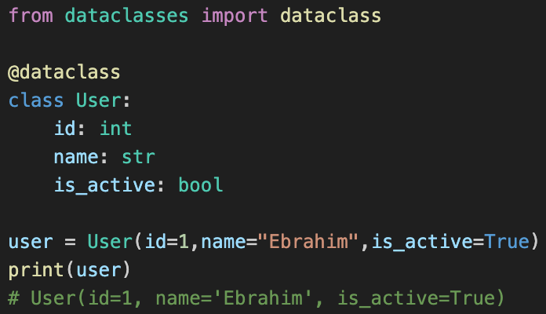
Image:py_001_dataclass
dataclass
Using dataclass to manage structured data

Slide 38
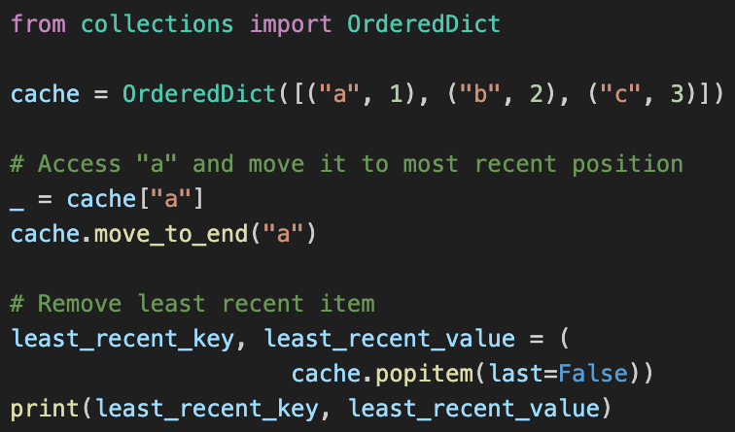
Shorts/py_022_use_OrderedDict
Use OrderedDict
Python Tip:
Order Is Logic, Not Style

Slide 39
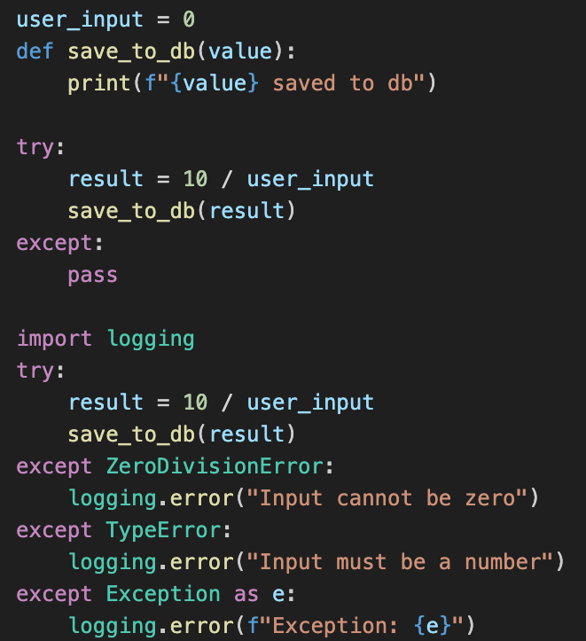
Shorts/py_025_avoid_bare_except
Avoid Bare Exception

Slide 40
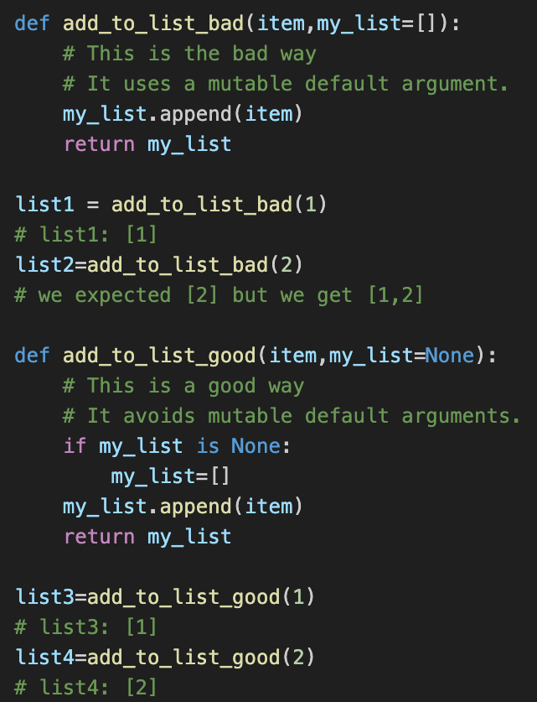
Shorts/py_024_mutable_default_arguments
Mutable Default Arguments

Slide 41
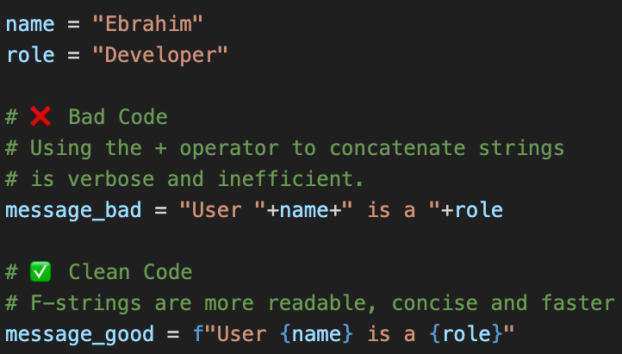
py_026_f_string_vs_concatenation
String vs Concatenation
Stop building strings with + in Python! Use F-strings instead.

Slide 42
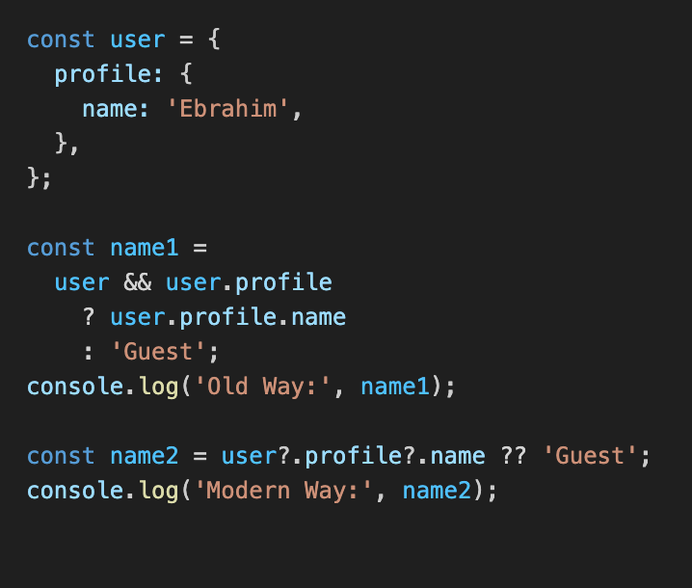
ts_001_optional_chaining
Simplify Nested Access
Safe Navigation:
Access nested values line-by-line

Slide 43
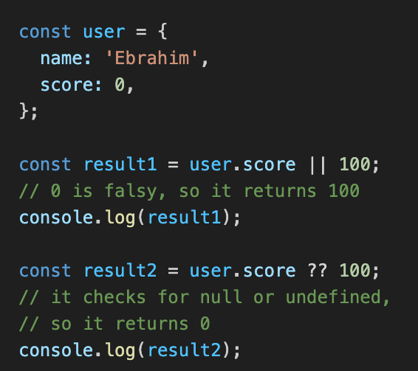
ts_002_nullish_coalescing
Proper Default Values
Precision Defaults:
Use ?? To handle null and undefined

Slide 44
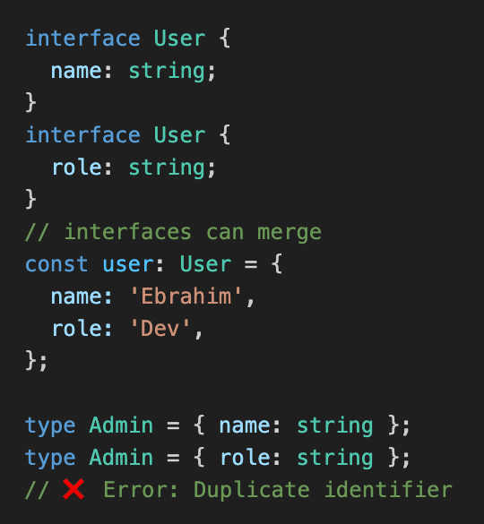
ts_003_interface_merging
Interface: Open vs Type: Closed
Interfaces are open to expansion, Types are closed.

Slide 45
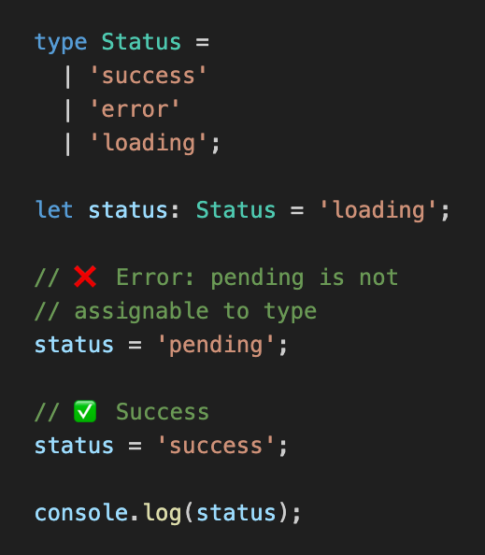
ts_004_union_types
Union Types
Restrict a variable to only specific allowed values

Slide 46
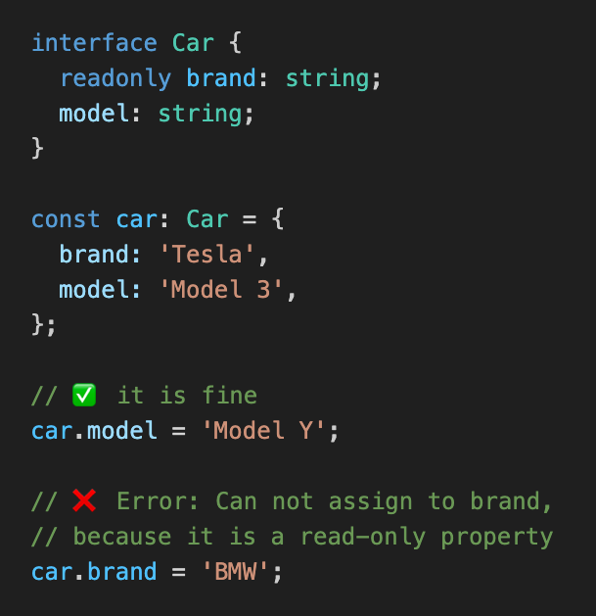
ts_005_readonly_properties
Lock your Data With readonly
Prevent accidental changes to critical object properties

Slide 47

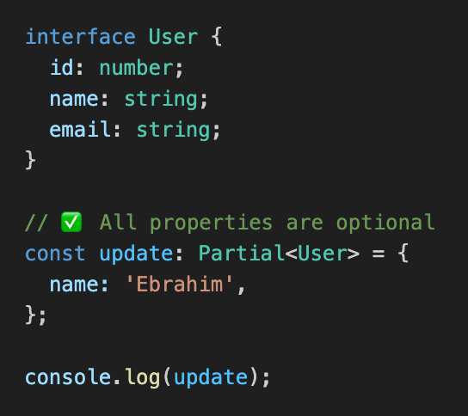
ts_006_partial_type
The Power of Partial<T>
Make all properties in an interface optional

Slide 48

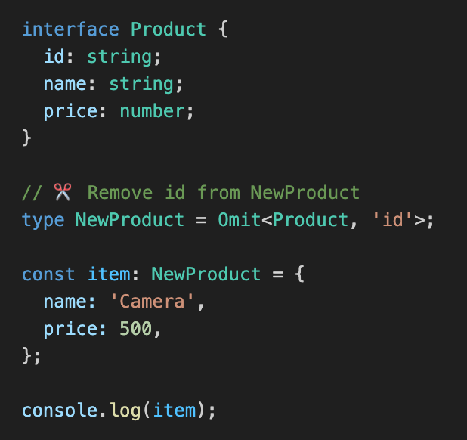
ts_007_omit_type
Remove Fields with Omit
Create new models by excluding specific properties

Slide 49
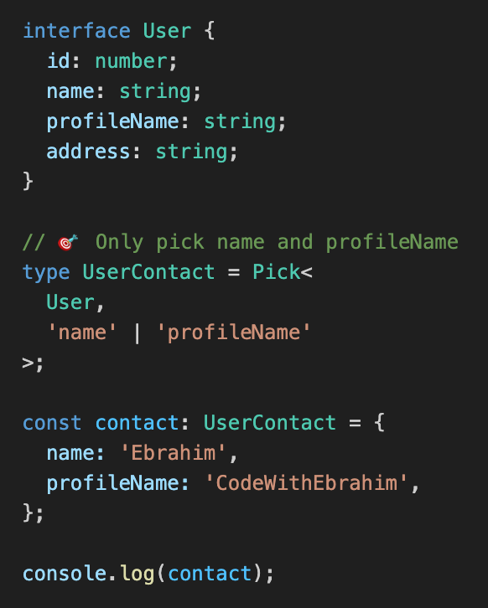
ts_008_pick_type
Pick what you need
Create a new Type by selecting specific fields from an interface

Slide 50
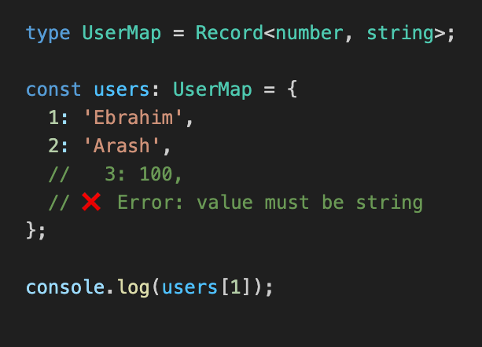
ts_009_record_type
Quick Maps with Record
Define Key-Value pairs with specific types

Slide 51
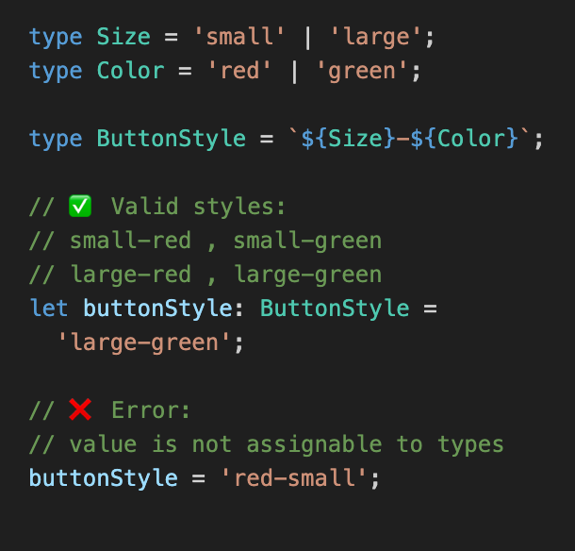
ts_010_template_literals
Dynamic String Types
Combine multiple types into new string formats

Slide 52

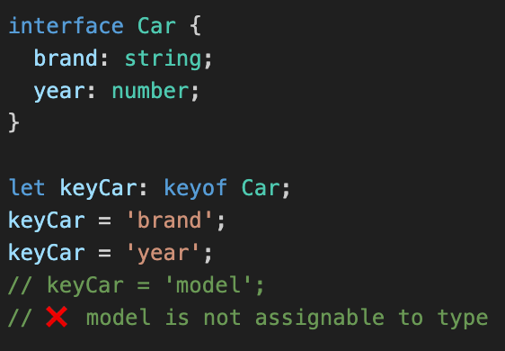
ts_011_dynamic_key_access
Dynamic Key Access
Ensure you only access properties that actually exist

Slide 53
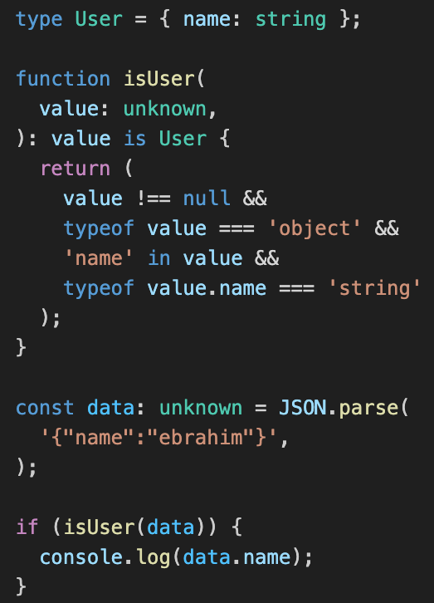
ts_012_use_unknown_instead_of_any
Use unknown instead of any

Slide 54
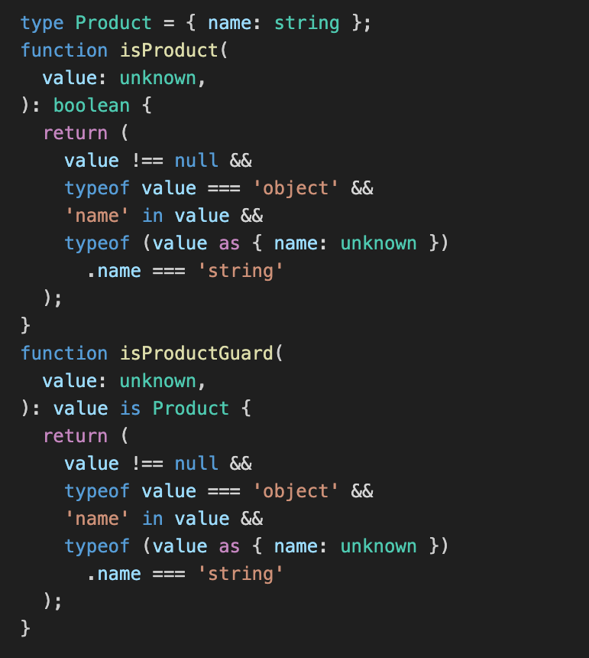
ts_013_type_guard_vs_Boolean_check
Type Guard vs Boolean Check
Type Guard

Slide 55
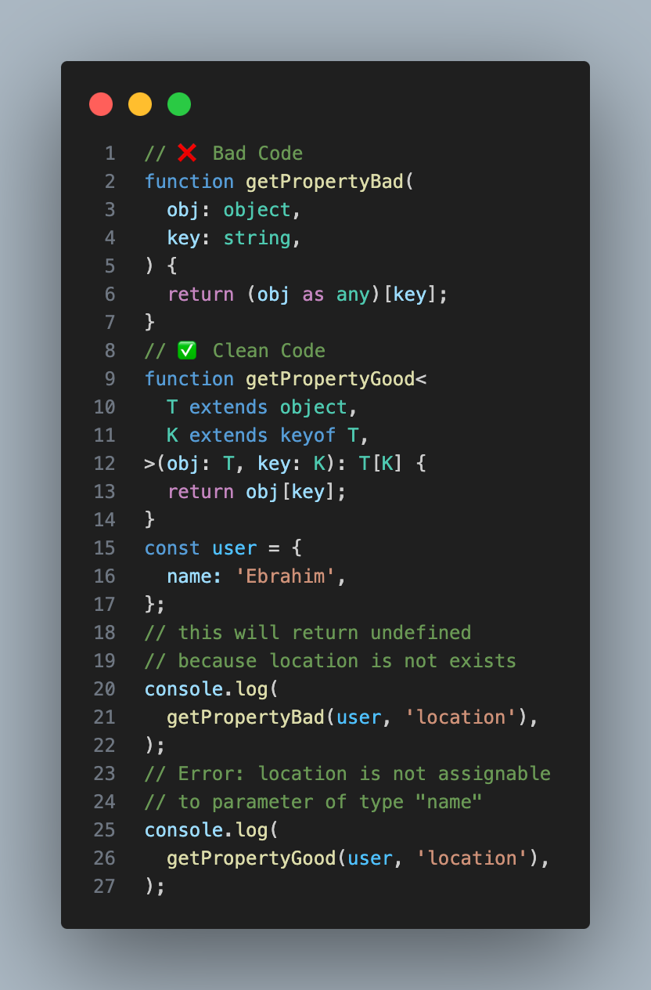
ts_014_keyof_operator
Dynamic Key Access

Slide 56

rt_001_te
…….

Slide 57

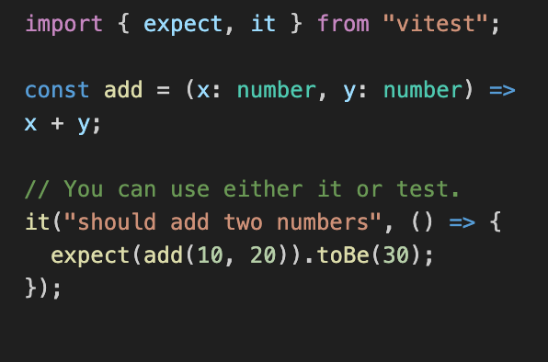
Image: vitest_001_test_your_code
Test Your Code with Vitest
Unit Testing Your TypeScript with Vitest

