Slide 1

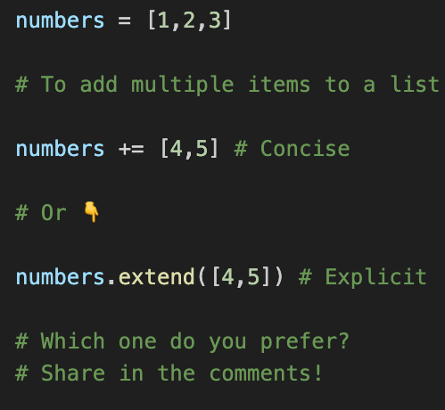
py_010_special_variable_names
+= vs extend()

Slide 2

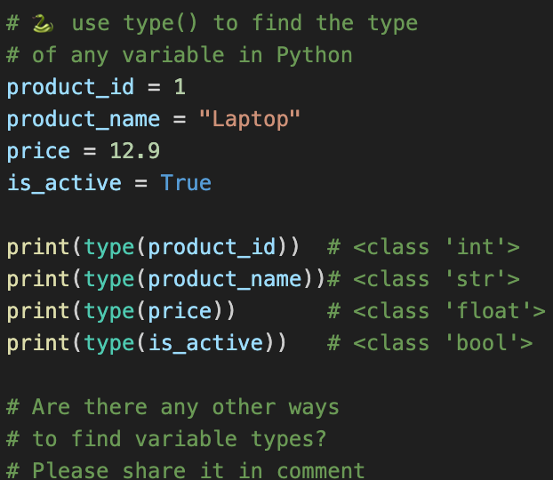
type()
Notes:
Video 011 Folder: py_011_pathlib

Slide 3
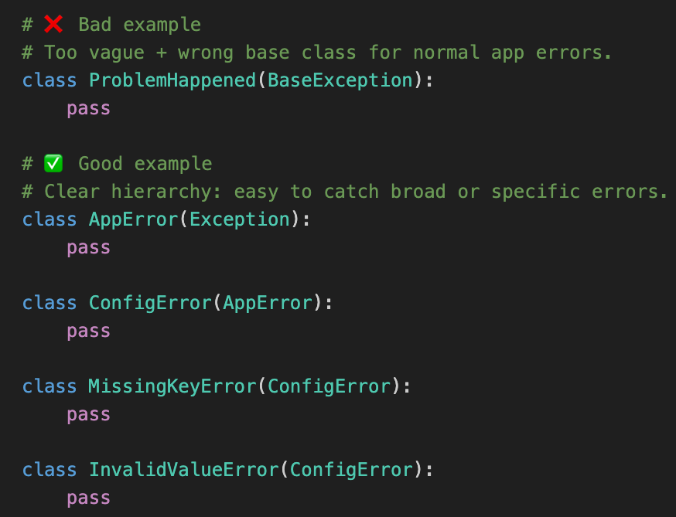
py_013_ custom_exceptions
Custom Exceptions
Stop Raising Generic Errors: Build Clean Custom Exceptions in Python

Slide 4

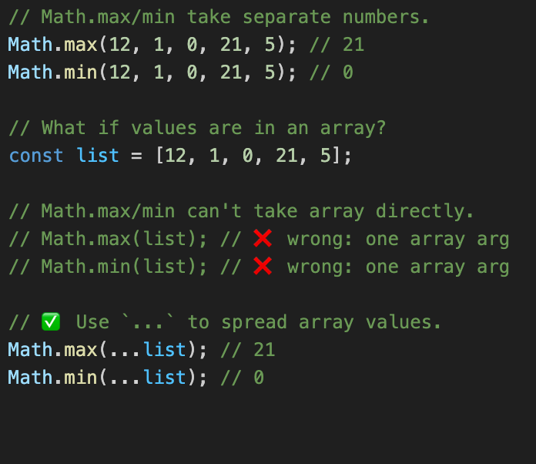
spread
Spread vs Rest in TypeScript: Same ..., Different Job
Next
Notes:
Video 011 Folder: py_011_pathlib

Slide 5
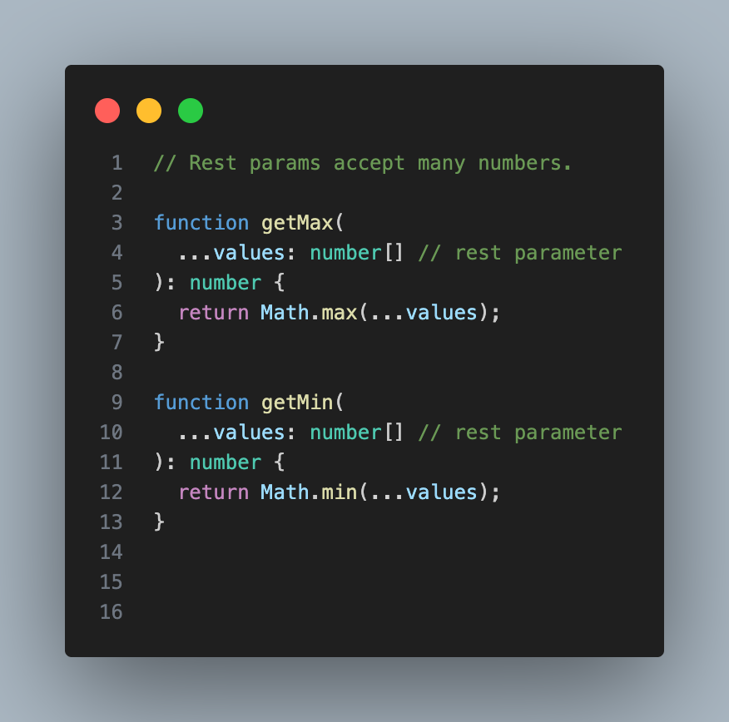
rest
Spread vs Rest in TypeScript: Same ..., Different Job
Notes:
Video 011 Folder: py_011_pathlib

Slide 6

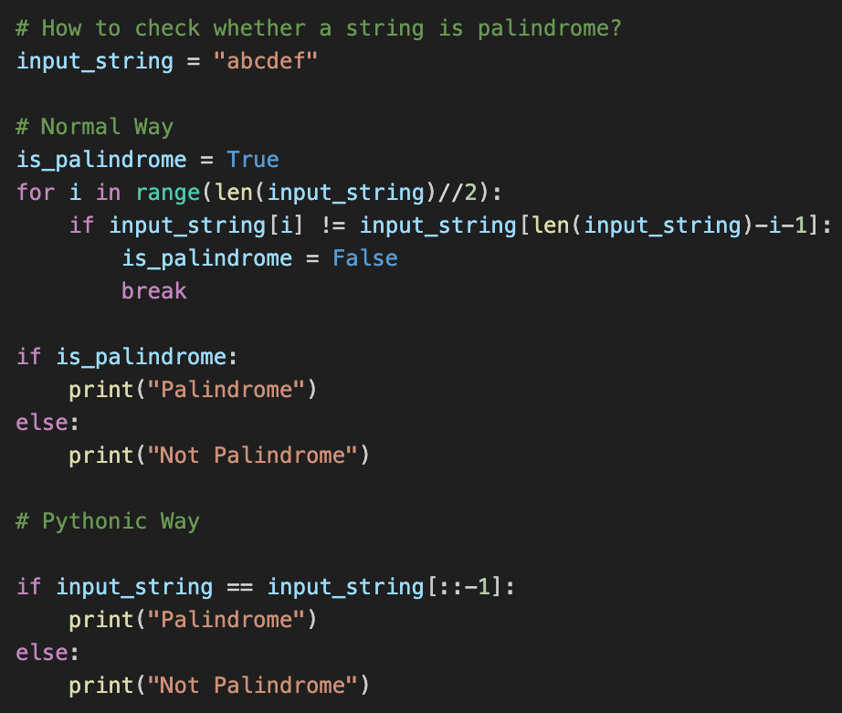
Palindrome Hack

Slide 7
py_005_string_slicing
String Slicing Basics
s
0 | 1 | 2 | 3
a | b | c | d
character from index 1 to 3
s[1:4]
0 | 1 | 2 | 3
a | b | c | d
from start to index 2
s[:3]
0 | 1 | 2 | 3
a | b | c | d
from index 3 to end
s[3:]
0 | 1 | 2 | 3
a | b | c | d
reverse string
s[::-1]
0 | 1 | 2 | 3
d | c | b | a

Slide 8
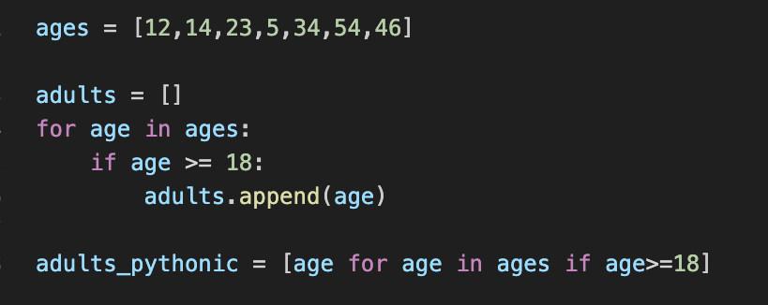
py_006_list_comprehensions
List Comprehensions
Prefer List Comprehensions Over Loops

Slide 9
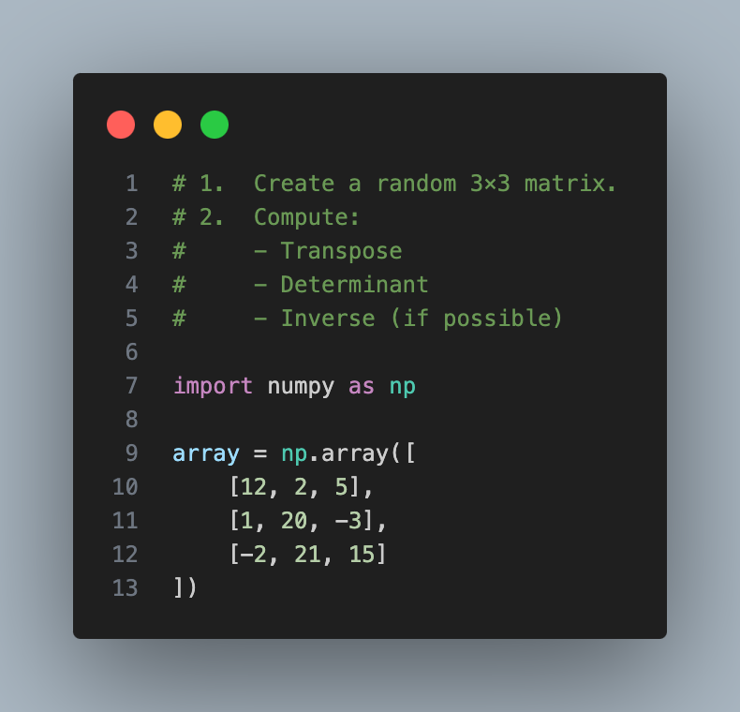
py_020_matrix_transpose_determinant_inverse
Transpose, Determinant, Inverse

Slide 10
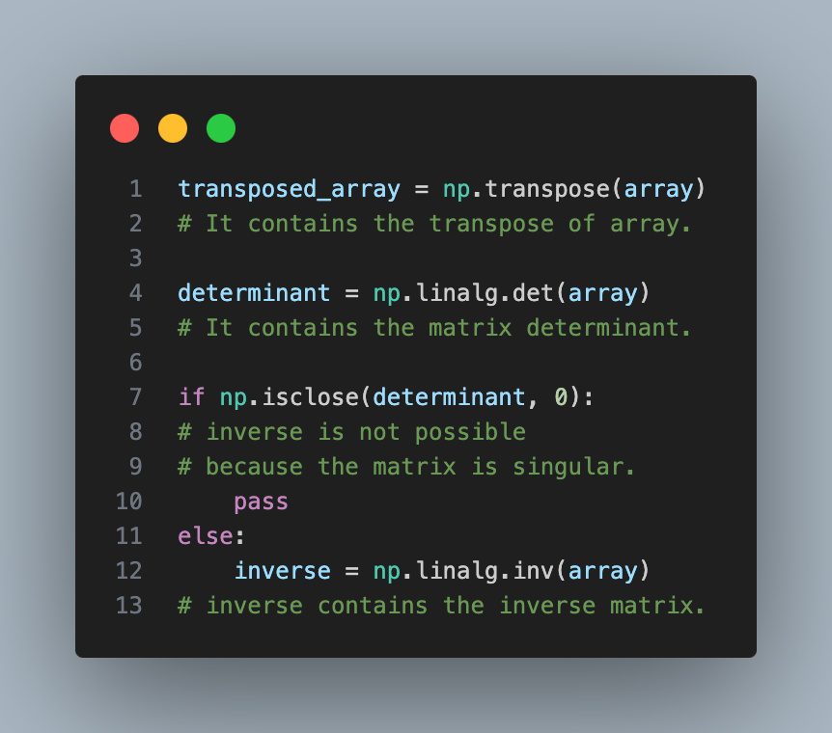
py_020_matrix_transpose_determinant_inverse
Transpose, Determinant, Inverse

Slide 11
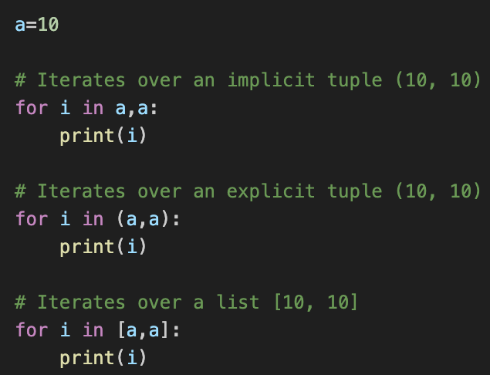
Understanding Tuples & Lists
Tuple vs List in Python - Spot the Difference!

Slide 12
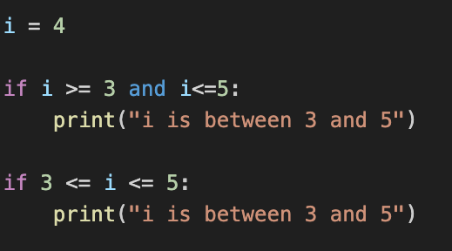
Range Checking
Stop Using AND! Python's Secret Trick
Notes:
Video 011 Folder: py_011_pathlib

Slide 13
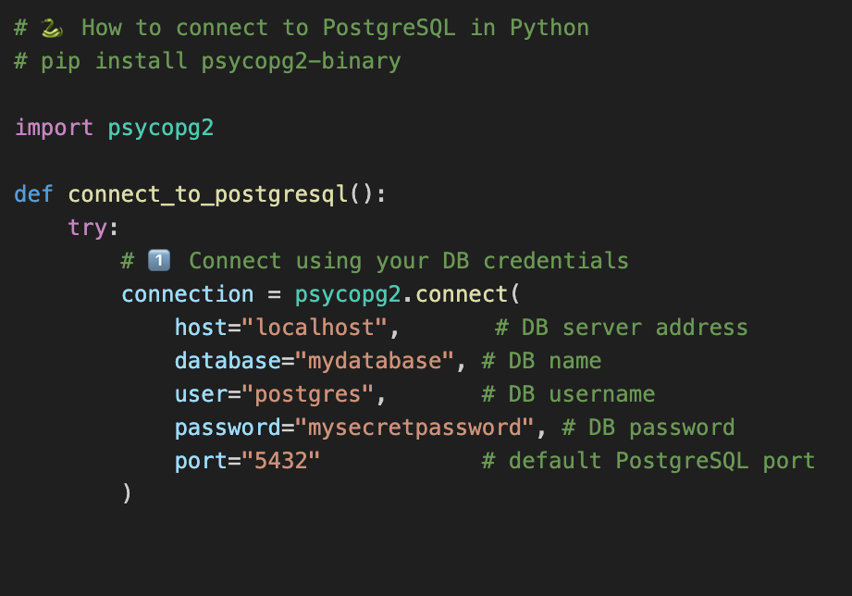
Connect to PostgreSQL
psycopg2.connect() with credentials
Next

Slide 14
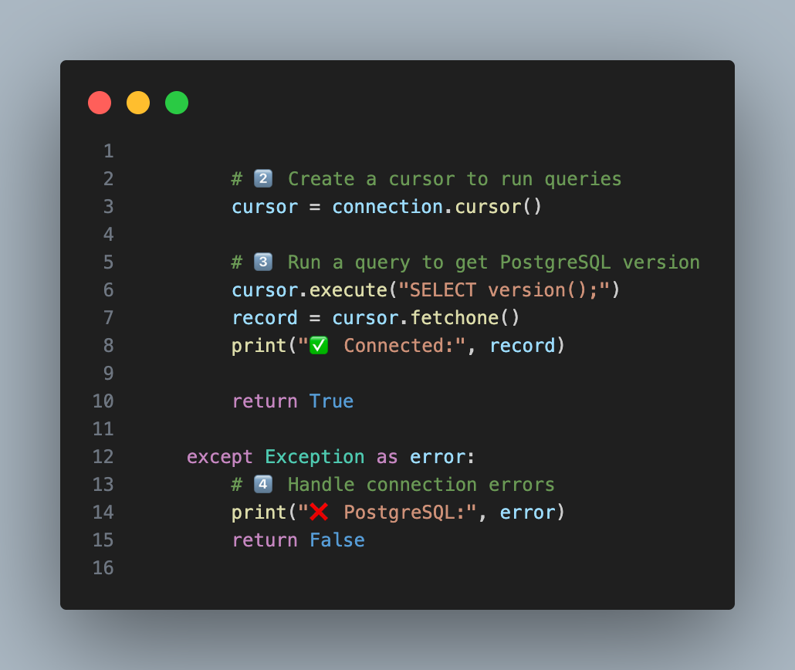
Connect to PostgreSQL
cursor, query execution & error handling

Slide 15

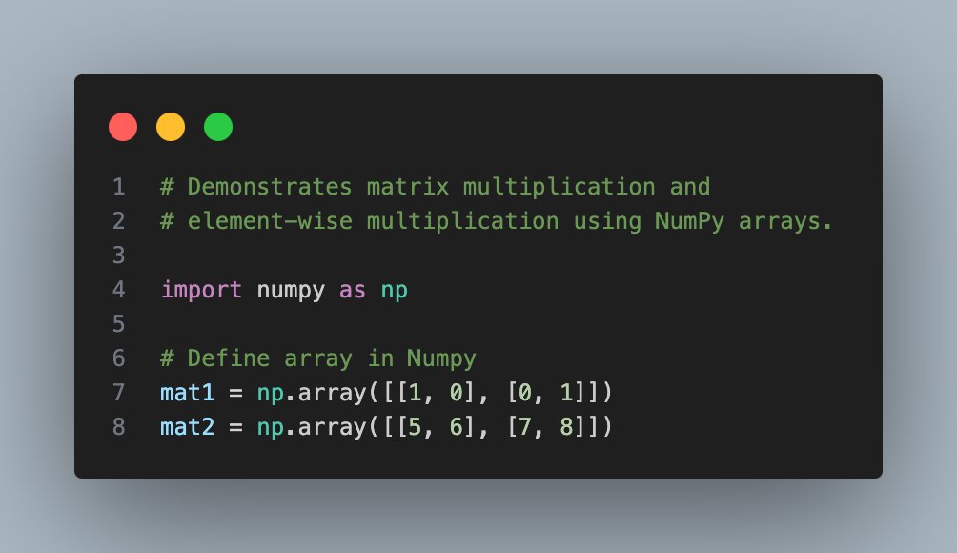
NumPy Matrix Multiplication
mat1
1 0
0 1
mat2
5 6
7 8

Slide 16
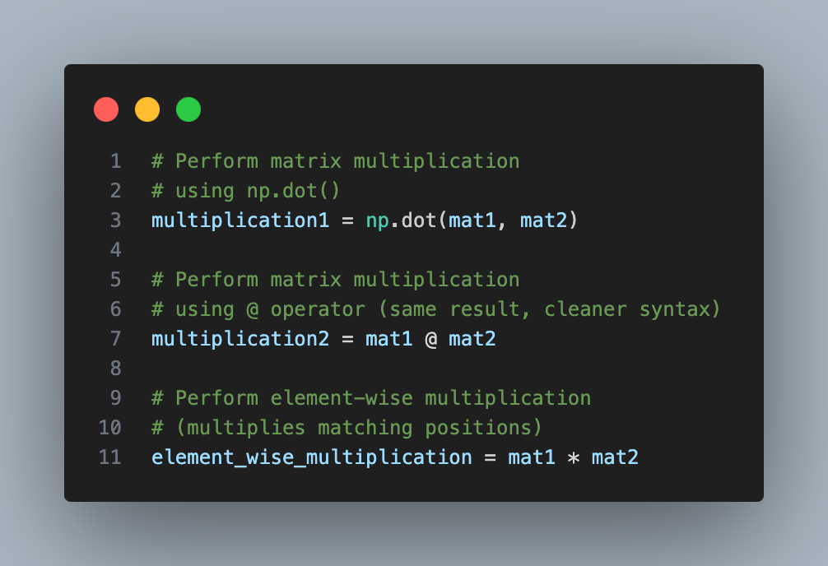
NumPy Matrix Multiplication
multiplication1
multiplication2
5 6
7 8
element_wise_multiplication
5 0
0 8

Slide 17
Neural Network Neuron
Input_1 (1)
*
W=0.2
+
Input_2 (2)
*
W=0.8
+
[ neuron ] + bias(0.7) --> output
1*0.2+2*0.8+3*-0.5+0.7 --> 1.0
Input_3 (3)
*
W=-0.5
+
Simulating a Neural Network Neuron

Slide 18
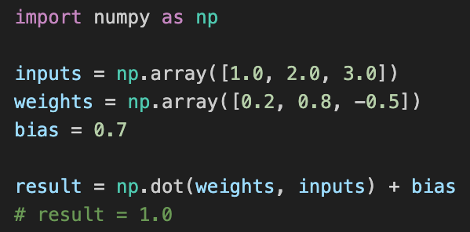
Neural Network Neuron

Slide 19
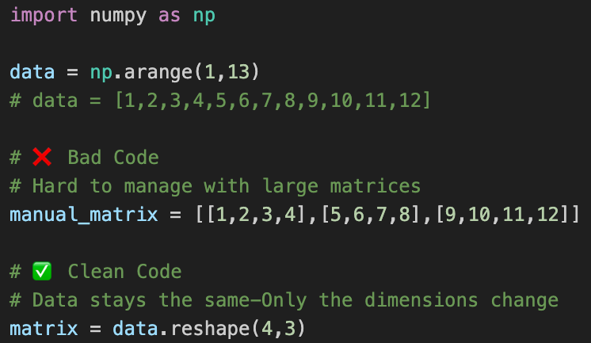
NumPy: Reshape Your Data
1 2 3 4
matrix
5 6 7 8
9 10 11 12

Slide 20

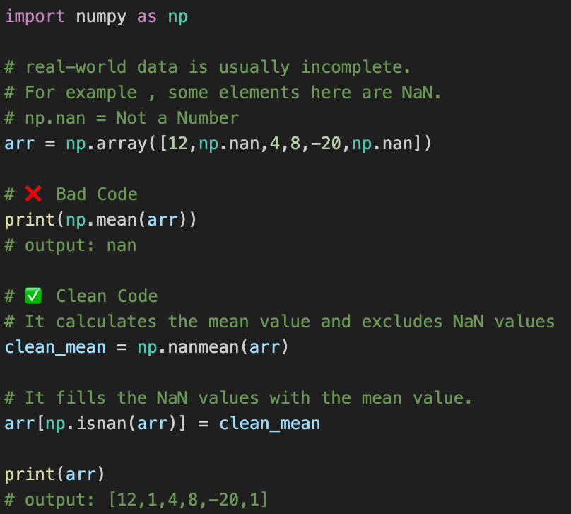
Don't Let NaNs Ruin Your Data!

Slide 21
NumPy: Reshape Your Data
1 2 3 4
matrix
5 6 7 8
9 10 11 12

Slide 22
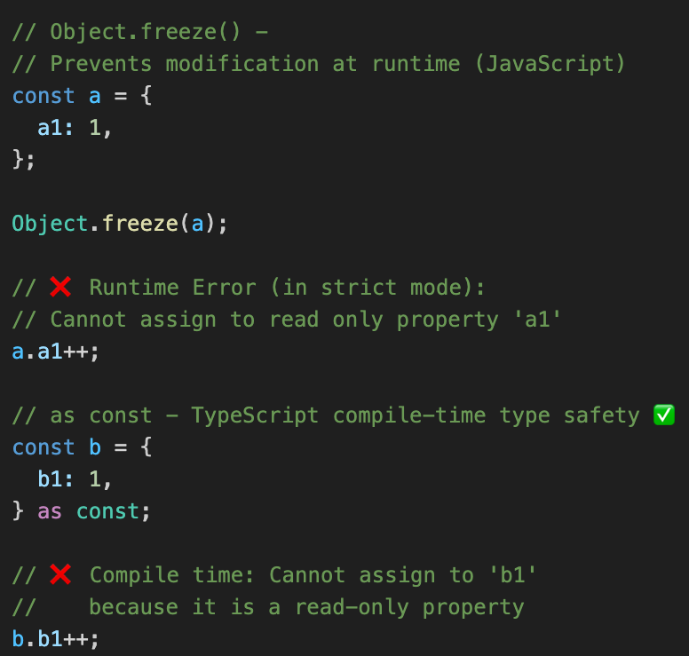
ts_001_object_freeze_vs_as_const
Object.freeze() vs as const
Object.freeze() → Runtime protection
as const → Compile-time type safety

Slide 23
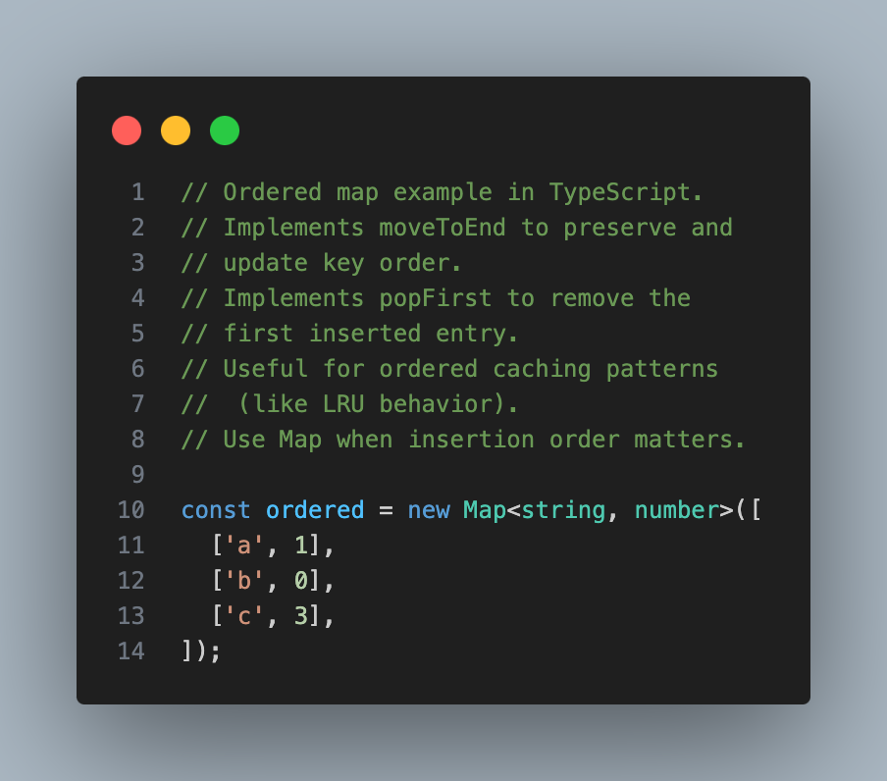
ts_017_ordered_map
Use Map for ordered key-values

Slide 24
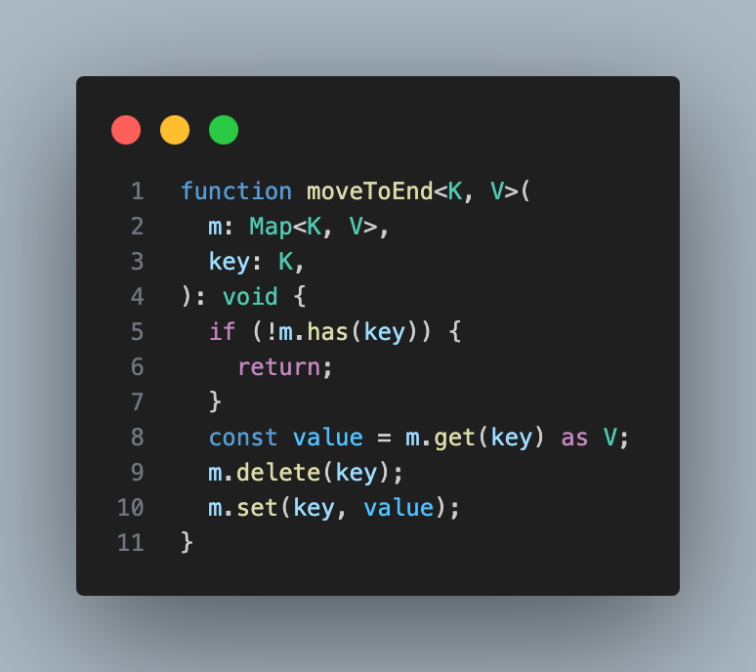
Use Map for ordered key-values
ts_017_ordered_map

Slide 25
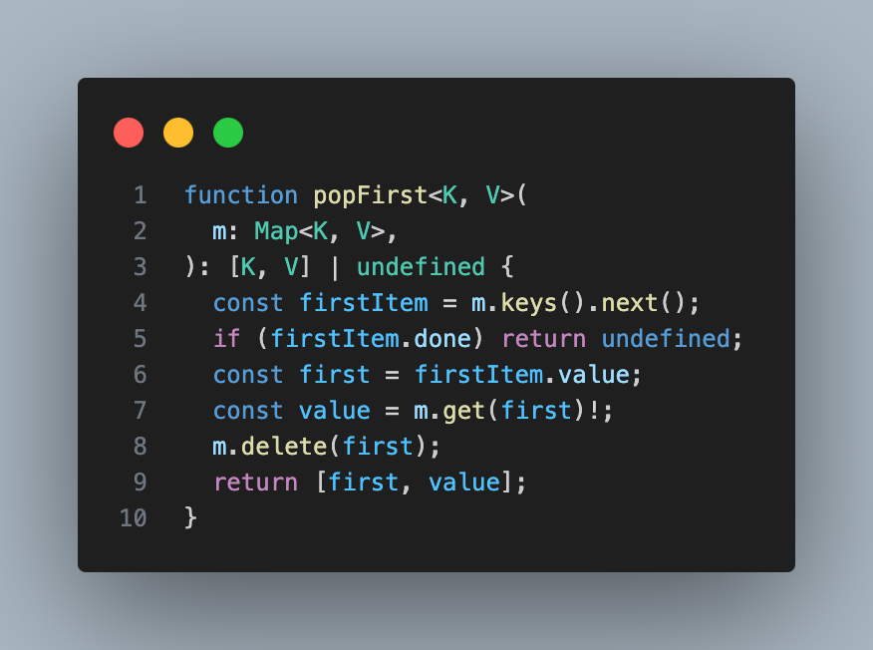
Use Map for ordered key-values
ts_017_ordered_map

Slide 26

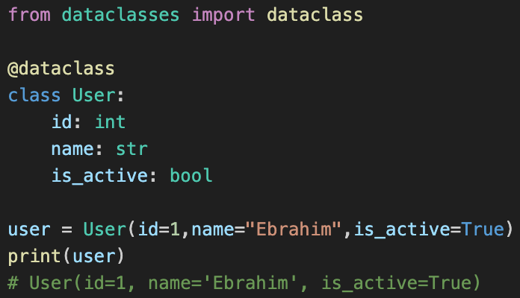
py_001_dataclass
dataclass
Using dataclass to manage structured data

Slide 27
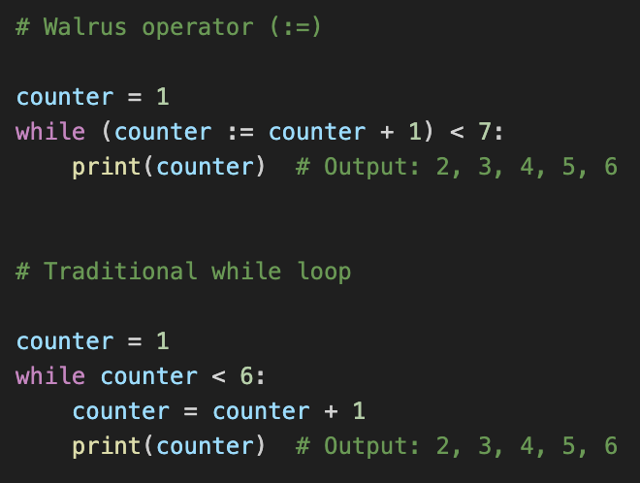
Walrus Operator vs While
The Secret := Operator in Python

Slide 28

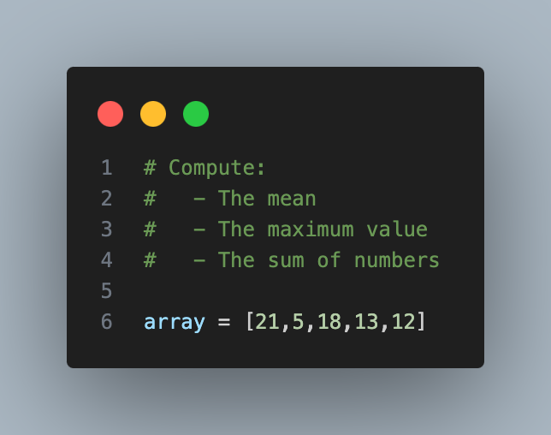
py_001_dataclass
plain Python vs NumPy
Same array, same result

Slide 29
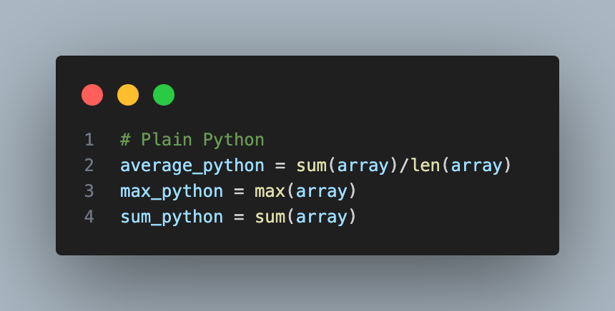
py_001_dataclass
plain Python vs NumPy
Clean and simple with built-in functions like sum(), len(), and max()

Slide 30
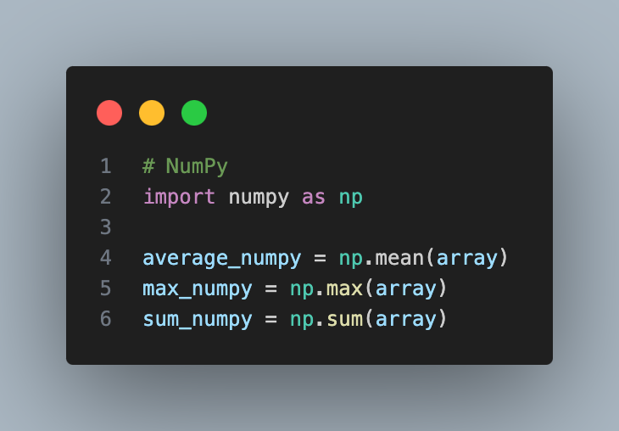
py_001_dataclass
plain Python vs NumPy
Short and powerful with np.mean(), np.max(), and np.sum()

Slide 31
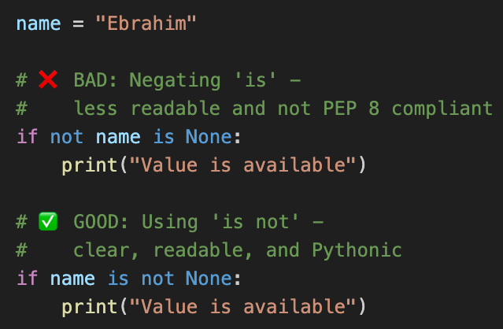
is not None
Stop using 'not is None' ❌ Python wants 'is not None' ✅ #pythontips

Slide 32
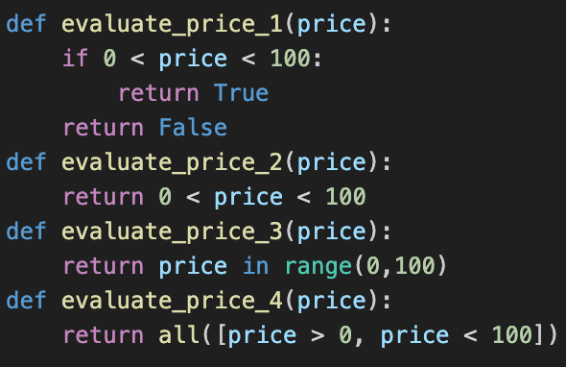
If Statements
Which one would be better? Why?

Slide 33
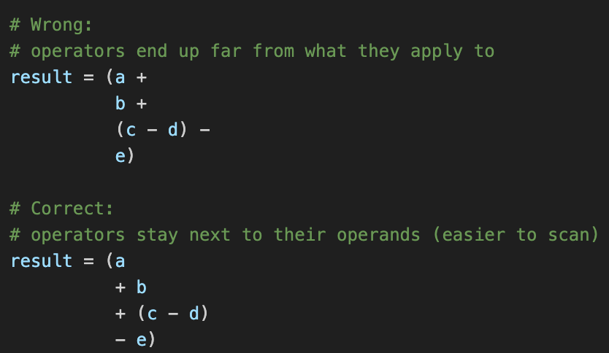
PEP 8: Better line breaks
Stop breaking lines like this in Python

Slide 34
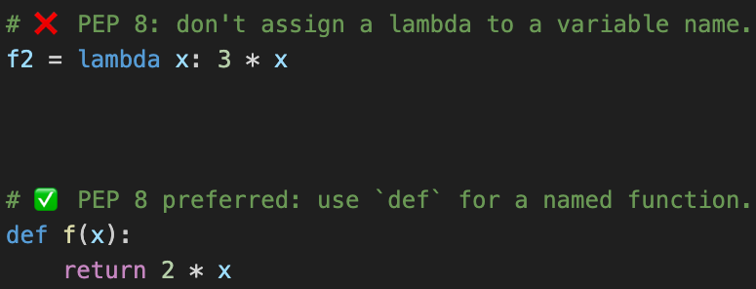
use def, not f = lambda
Use def instead of an assignment that binds a lambda expression.

Slide 35
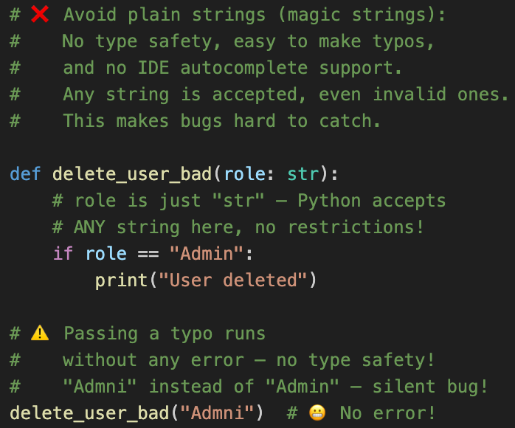
Don’t Use Plain Strings

Slide 36
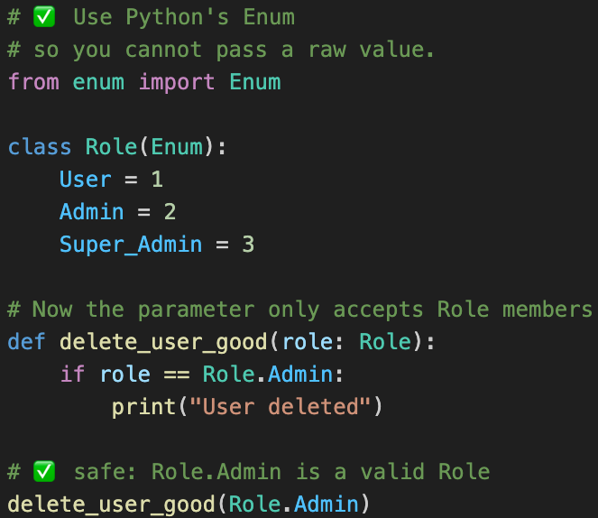
Use Enum Instead

Slide 37
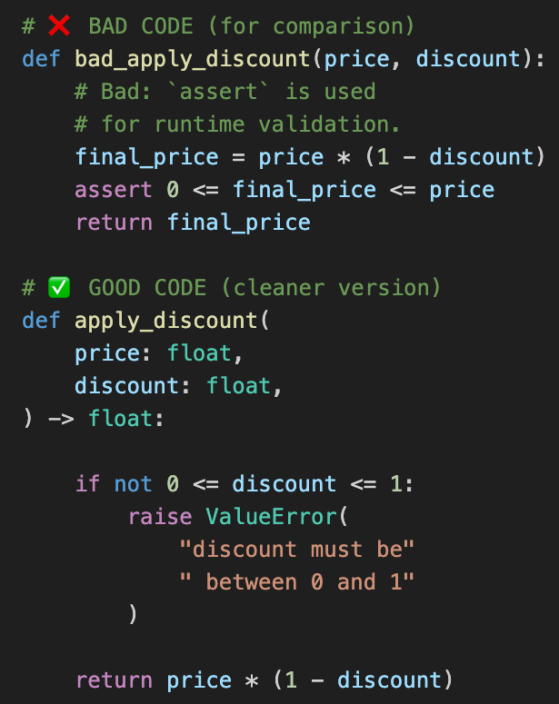
Assert vs Exception

Slide 38
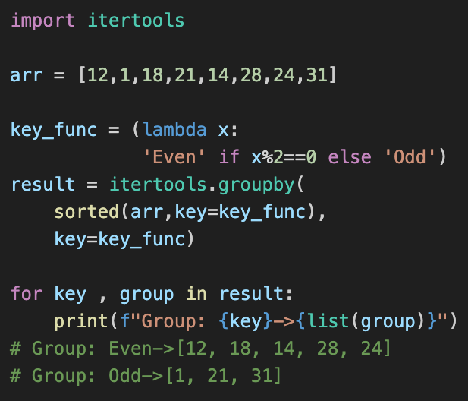
Use itertools.groupby
Use groupby to group your array

Slide 39
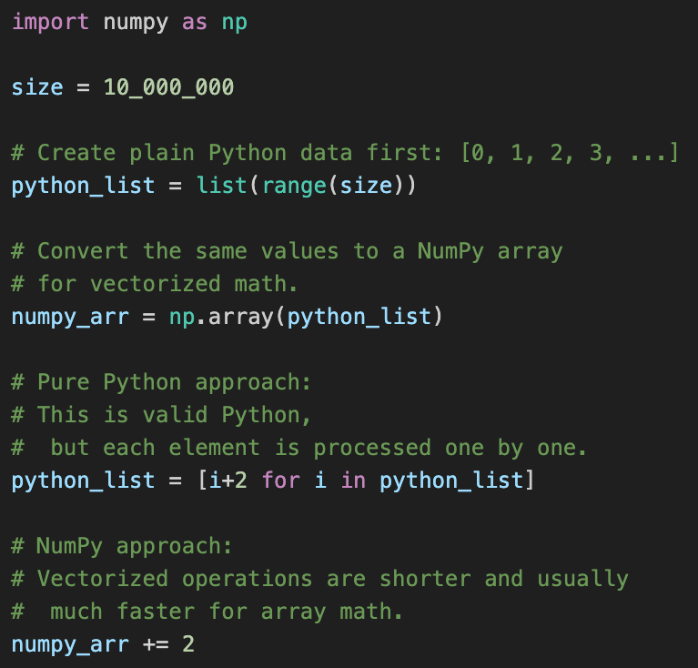
Python List vs NumPy Speed!

Slide 40
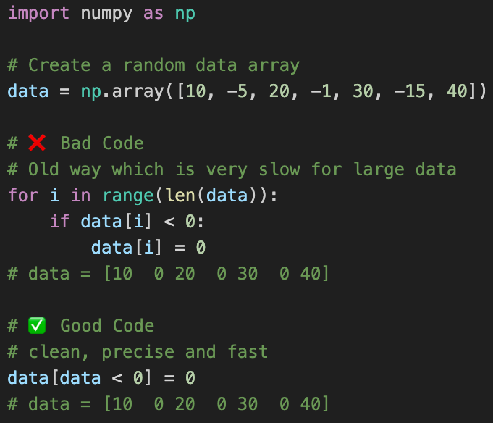
Python List vs NumPy Speed!
Use Boolean Masks for instant data manipulation

Slide 41
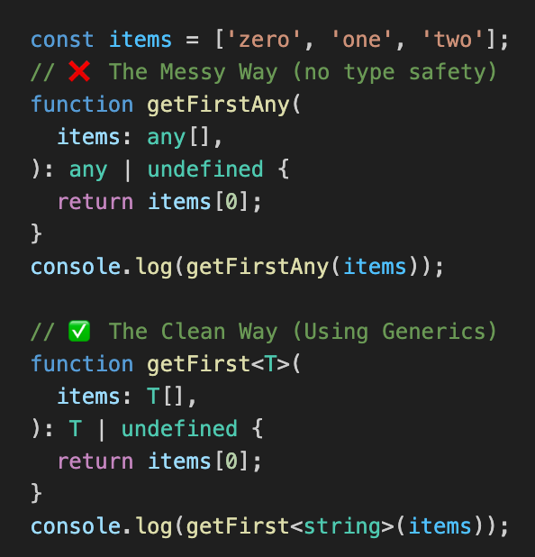
Write Reusable Code with Generics
Write type-safe generic functions.

Slide 42
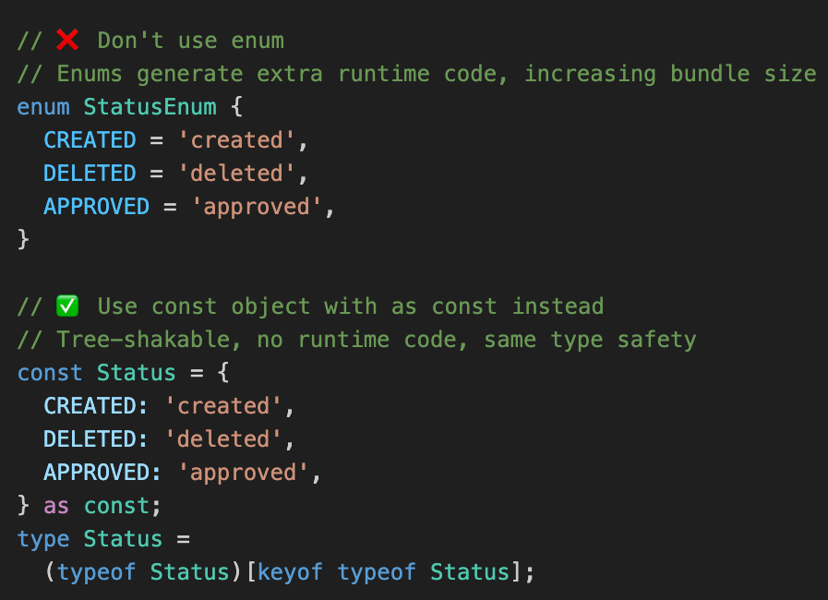
enum vs const object
Stop using TypeScript enums

Slide 43

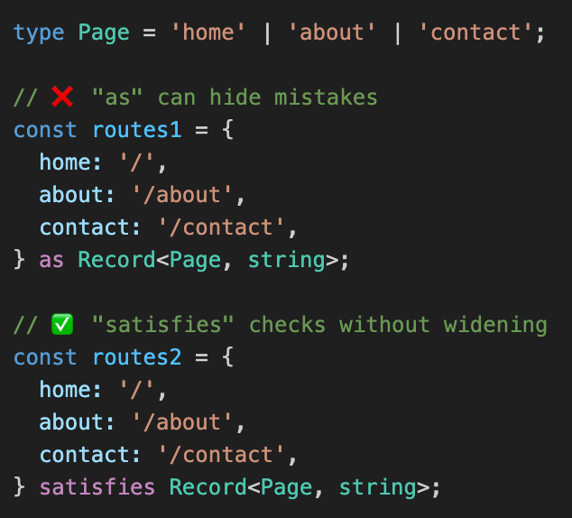
as vs satisfies
Stop lying to TypeScript with as

Slide 44
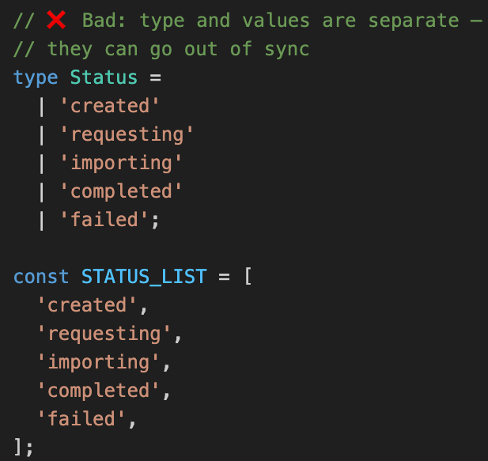
Stop Defining Your Union Types Twice

Slide 45
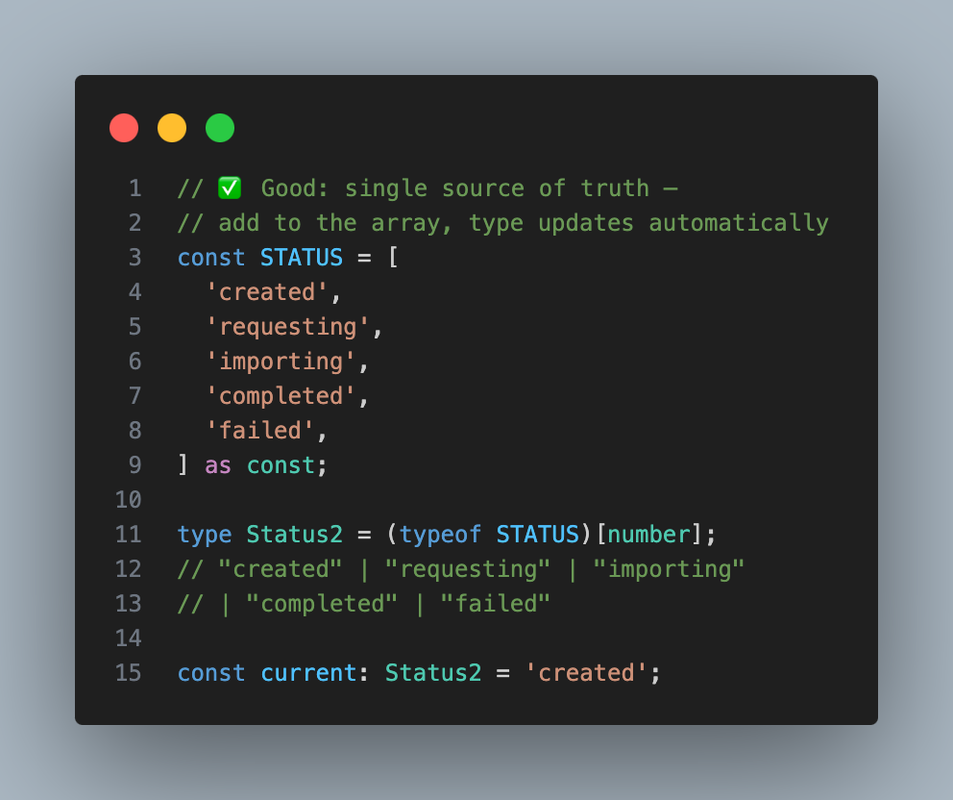
Stop Defining Your Union Types Twice

Slide 46
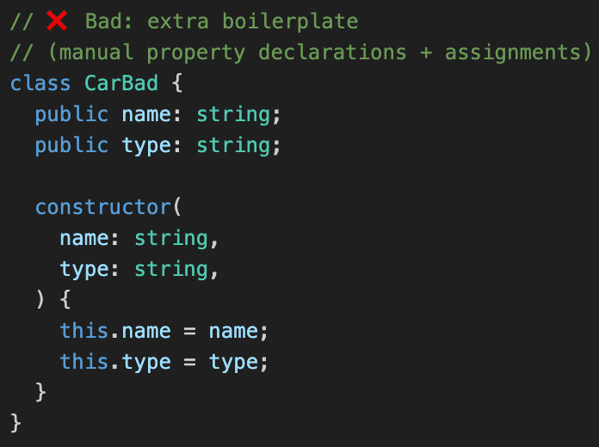
Boilerplate Constructors

Slide 47
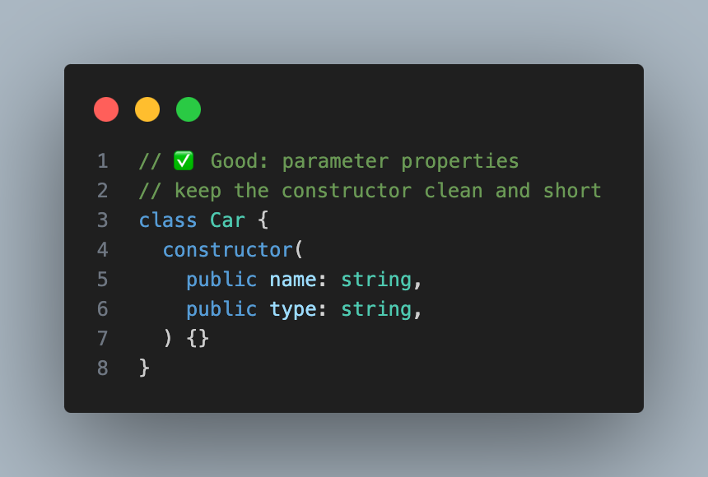
Parameter Properties

Slide 48
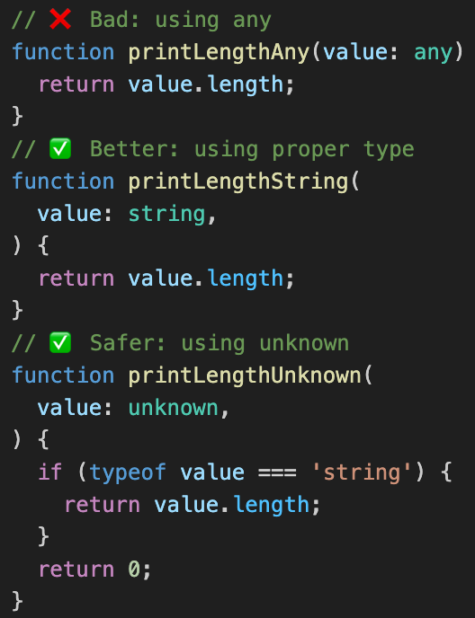
Stop using any

Slide 49
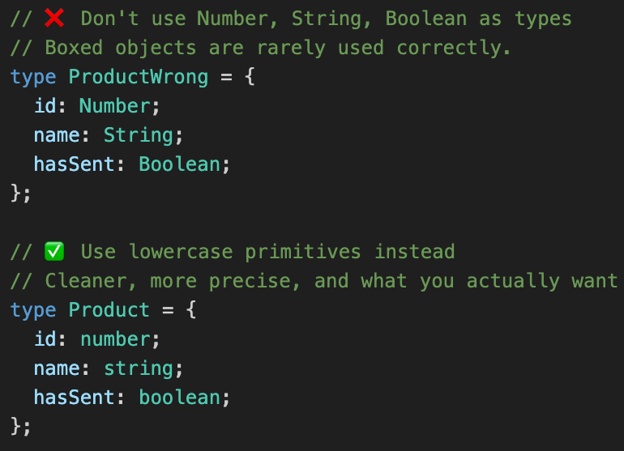
Don't Use Capitalized Types
Stop Using Number, String, Boolean in TypeScript

Slide 50

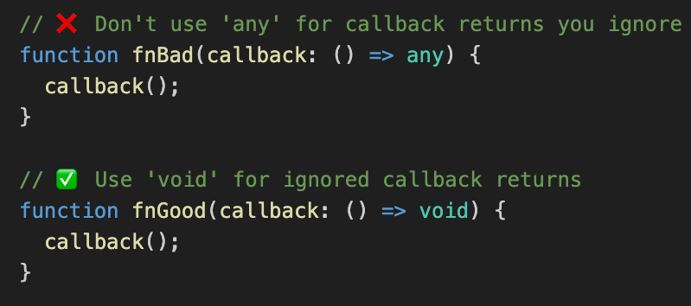
Callback Types: any vs void
Stop Using 'any' in TypeScript Callbacks

Slide 51
Use Type Guards
Type guards are a powerful feature in
TypeScript that allow you to narrow down
the type of an object within a conditional block.
This is particularly useful when dealing with
values of type unknown or any, ensuring type safety
before accessing properties of the object.
type Response = {
status: number;
message?: string;
};

Slide 52
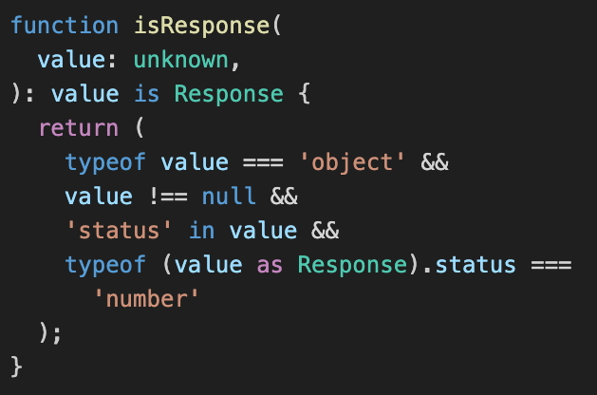
Use Type Guards
This is a custom Type Guard. It checks
if an unknown value is a Response object.

Slide 53
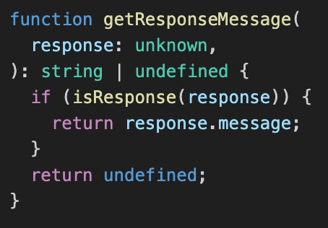
Use Type Guards
Here is shown how to write the Type Guard
Function that handles the response.

Slide 54

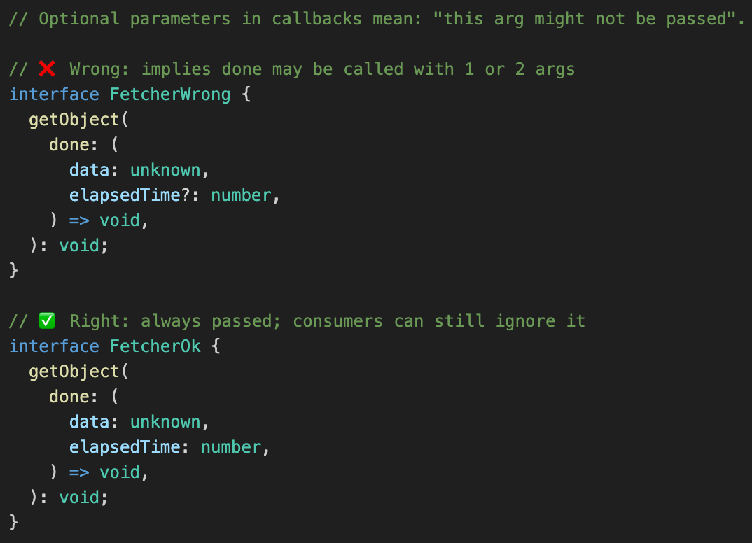
Callbacks: avoid ?:
Stop making callback params optional in TypeScript

Slide 55

Verbose vs Short Class
Create a new Type by selecting specific fields from an interface
Which approach do you prefer?

Slide 56

Don’t Use enum

Slide 57

Use String Unions

Slide 58


Inline type import
npm run build
generated js file
Emitted JS: `User` is erased, only the module is imported (side-effect).

Slide 59

Stop Using as any for JSON.parse
How to use unknown and ReturnType in TypeScript when handling fetched data.
Next

Slide 60

Stop Using as any for JSON.parse

Slide 61


statement level type import
npm run build
generated js file
Emitted JS: `User` type is completely erased (no import statement remains).

Slide 62
Dynamic String Types
Combine multiple types into new string formats

Slide 63

Use Exclude
Declare a type
Exclude

Slide 64

Use Exclude
Have you ever used Exclude?

Slide 65

Long if/else vs Object Map
Cleaner, shorter, easier to scale

Slide 66

rt_001_te
…….

Slide 67


Image: vitest_002_test_react_component
How to Test a React Component
Use screen.getByRole to find an element by its ARIA role

Slide 68

Image: vitest_001_test_your_code
Test Your Code with Vitest
Unit Testing Your TypeScript with Vitest

Slide 69

js_001_const_vs_var_vs_let
const, let or var
Are you still using var?
const : Use this by default for variables and objects that shouldn’t be reassigned.
let : Use this only when a value needs to change during the code lifecycle.
var : Avoid this! It’s outdated, prone to bugs, and has confusing scoping rules.

Slide 70

js_001_const_vs_var
var vs const

Slide 71

js_001_const_vs_var
var vs let

Slide 72
js_001_const_vs_var
const, let or var
What are your preferences?
Write in the comments !!!

Slide 73

003_literal_vs_constructor
Literal vs Constructor
Using a constructor means creating a new object from a class and manually setting its properties. This is often unnecessary for simple objects.
For example:
const item = new Object();
OR
item = dict()

Slide 74

003_literal_vs_constructor
Literal vs Constructor

Slide 75

003_literal_vs_constructor
Literal vs Constructor

Slide 76
003_literal_vs_constructor
Literal vs Constructor
Do you agree?
What‘s your take on this?
Drop a comment below!

Slide 77

js_005_no_array_constructor
No Array Constructor

Slide 78
003_literal_vs_constructor
No Array Constructor
Do you agree?
What‘s your take on this?
Drop a comment below!

Slide 79

Do Not Copy Arrays

Slide 80
Do Not Copy Arrays
Do you agree?
What‘s your take on this?
Drop a comment below!

Slide 81
Genarators
Generators are special functions that can be paused during execution.They are highly memory-efficient that ideal for iterating over large datasets step-by-step.
These powerful concept a core feature in JavaScript, TypeScript and Python.

Slide 82

Generators

Slide 83

Generators
Type-Safe generators
Generator<YieldType, ReturnType, NextType>

Slide 84

Generators

Slide 85
Genarators
What‘s your opinion on this?
Drop a comment below!

Slide 86


yield vs return
Do you know, what is difference between return and yield in python?

Slide 87

yield vs return
Or let’s see another example

Slide 88
yield vs return
return (Eager Evaluation) the function processes everything at once and allocates memory for the entire result. This can lead to memory overflows when handling large datasets.

Slide 89
yield vs return
yield (Lazy Evaluation) the function produces values only on demand. It pauses execution after each yield and resumes only when next() is called, making it extremely memory-efficient for high-performance applications.

Slide 90
yield vs return
Would you like me to create a concrete example to compare the memory allocation between these two methods?
Drop a comment below!

Slide 91

Optional Params vs Overloads
Suppose we want to write a function like the one below in Typescript
f(a,b,c) = $a^{2}+b^{2}+c^{2}$
I change it to the function below
selfPowerSum(a,b,c) = a**a + b**b + c**c

Slide 92

Use Optional Params

Slide 93
Any Points ?
What‘s your opinion on this?
Drop a comment below!

Slide 94

py_005_infinite_numbers
Generator
What does this output?

Slide 95

py_010_special_variable_names
Generator
What does this output?

Slide 96

py_010_special_variable_names
Generator
What does this output?

Slide 97

to_001_new_to_typeorm
TypeORM
TypeORM is an ORM (Object relational mapping) for the typescript, javascript world. It allows you to avoid complex SQL queries by acting as a bdridge between relational databases and Object-Oriented Programming(OOP).

Slide 98
to_001_new_to_typeorm
TypeORM
TypeORM supports a wide range of databases, including PostgreSQL, MySQL, MariaDB, Oracle, MS SQL Server, SQLite, and MongoDB. This flexibility allows you to switch between different database engines with minimal code changes.

Slide 99

to_001_new_to_typeorm
TypeORM

Slide 100

to_001_new_to_typeorm
TypeORM
Each entity must be registered in your Data Source option.

Slide 101

to_001_new_to_typeorm
TypeORM
To manage your data, use the save method from AppDataSource.manager to persist new records, and the find method to retrieve your previously saved data efficiently .

Slide 102
to_001_new_to_typeorm
TypeORM
What‘s your opinion on this?
Drop a comment below!

Slide 103
to_001_new_to_typeorm
findBy in TypeORM
Suppose we have a user table like the one in the table below
User
id
firstName
role

Slide 104

to_001_new_to_typeorm
findBy in TypeORM

Slide 105

to_001_new_to_typeorm
findBy in TypeORM
Two ways to find specific columns

Slide 106

to_001_new_to_typeorm
findBy in TypeORM
How do the SQL queries look like?

Slide 107
to_001_new_to_typeorm
findBy in TypeORM
What‘s your opinion on this?
Drop a comment below!

Slide 108

to_001_new_to_typeorm
Relations in TypeORM
Suppose we have tables like those below

Slide 109

to_001_new_to_typeorm
Relations in TypeORM

Slide 110

to_001_new_to_typeorm
Relations in TypeORM

Slide 111

to_001_new_to_typeorm
Relations in TypeORM

Slide 112
to_001_new_to_typeorm
Relations in TypeORM
What‘s your opinion on this?
Drop a comment below!

Slide 113
to_004_primary_key_generate_id
PrimaryKey in TypeORM
@PrimaryColumn()
Use this decorator to declare the column as a primary key. In this case,
you must handle IDs yourself.

Slide 114

to_004_primary_key_generate_id
PrimaryKey in TypeORM
Return:
User
{ username: 'ebrahim', id: 100 }

Slide 115
to_004_primary_key_generate_id
PrimaryKey in TypeORM
@PrimaryGeneratedColumn()
Use this decorator to let the TypeORM handle the IDs automatically.
Generated IDs will be 1,2,3,…

Slide 116

to_004_primary_key_generate_id
PrimaryKey in TypeORM
Return:
User
{ username: 'ebrahim', id: 1 }

Slide 117
to_004_primary_key_generate_id
PrimaryKey in TypeORM
@PrimaryGeneratedColumn(‘uuid’)
Use this decorator to let the TypeORM handle UUIDs automatically.

Slide 118

to_004_primary_key_generate_id
PrimaryKey in TypeORM
Return:
User {
username: 'ebrahim',
id: '33e47825-8a2a-4c45-8199-984adb199f12'
}

Slide 119
to_004_primary_key_generate_id
PrimaryKey in TypeORM
What‘s your opinion on this?
Drop a comment below!

Slide 120
to_004_primary_key_generate_id
PrimaryKey in TypeORM
Use @PrimaryGeneratedColumn('uuid') if you want to keep your data secure and scalable.

Slide 121

ts_022_function_promise
Promise.resolve

Slide 122
ts_022_function_promise
Promise.resolve
Do you know why?
Drop a comment below!

Slide 123

to_001_new_to_typeorm
Use Self-Closing Tags

Slide 124
to_001_new_to_typeorm
Use Self-Closing Tags
What‘s your opinion on this?
Drop a comment below!

Slide 125
to_001_new_to_typeorm
installation
React Testing Library
npm install --save-dev @testing-library/react @testing-library/dom
With TypeScript
npm install --save-dev @testing-library/react @testing-library/dom @types/react @types/react-dom

Slide 126

to_001_new_to_typeorm
test
render:
Render the component.
screen.getByText:
Get the element by text.
expect:
Assert that the Text exists in the DOM.

Slide 127
to_001_new_to_typeorm
comments
What‘s your opinion on this?
Drop a comment below!

Slide 128

ts_023_constants
as const

Slide 129

ts_023_constants
as const

Slide 130

ts_023_constants
as const

Slide 131

ts_023_constants
as const

Slide 132

ts_023_constants
as const

Slide 133
ts_023_constants
as const
What‘s your opinion on this?
Drop a comment below!

Slide 134


ts_023_constants
CSS flex
How can we create a shape like the one below in HTML & CSS?

Slide 135

ts_023_constants
CSS flex

Slide 136

ts_023_constants
CSS flex

Slide 137

ts_023_constants
CSS flex

Slide 138
ts_023_constants
CSS flex
What‘s your opinion on this?
Drop a comment below!

Slide 139


css_002_use_display_grid
CSS grid
How can we create a shape like the one below in HTML & CSS?

Slide 140

css_002_use_display_grid
CSS grid

Slide 141

css_002_use_display_grid
CSS grid

Slide 142
css_002_use_display_grid
CSS grid
What‘s your opinion on this?
Drop a comment below!

