Slide 1
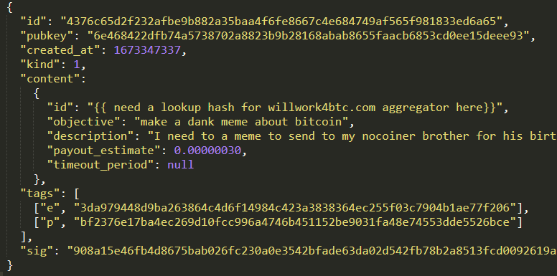
NOSTR
Paying in BTC
Working 4 BTC
willwork4btc.com
NOSTR EVENTS w/ Job/Task/Bounty/Request payable in Sats
Template
NOSTR LITE RELAY AGGREGATOR (COLLATOR)
PostgreSQL
Paid Relays
Paid Relays
Paid Relays

Slide 2
Website Material
“We are the circular economy”
“Find or do anything for bitcoin”

