Slide 1
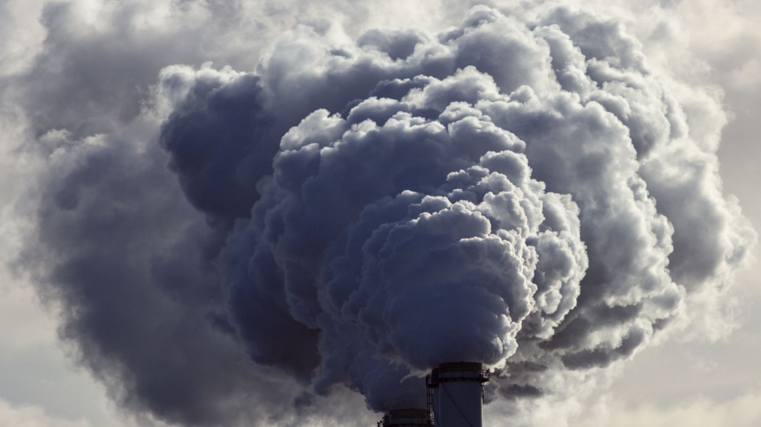
Air Pollution & Mental Health
Fethiye ebrar güçlü DSA210 Term project Instructor: Selim Balcısoy

Slide 2
Project Overview
Investigating the Relationship Between Air Pollution and Mental Health
This project investigates whether country-level air pollution metrics (PM2.5 and NO₂) are statistically associated with depression and anxiety prevalence. It combines hypothesis testing and machine learning to identify patterns and potential relationships between environmental and public health data, aiming to inform policy and further research.

Slide 3

Motivation
Mental health issues are rising globally, becoming a major public health concern.
Environmental stressors, especially air pollution, are suspected contributors to mental health decline.
Insight into these links can guide public health and environmental policy more effectively, especially in densely populated or industrial areas.

Slide 4

Dataset Overview
Mental Health Data:
Depression (%) and Anxiety (%) prevalence by country from global datasets.
Pollution Data:
PM2.5 and NO₂ values per country.
Processed Dataset:
Weighted average of PM2.5 and NO₂ → combined_pollution
Final merged dataset includes 114 countries with complete data for analysis.

Slide 5
Hypotheses
Hypothesis 1 (Depression):
H₀: No correlation between pollution and depression.
H₁: Higher air pollution levels are significantly associated with higher depression prevalence.
Hypothesis 2 (Anxiety):
H₀: No correlation between pollution and anxiety.
H₁: Higher air pollution levels are significantly associated with higher anxiety prevalence.
Each hypothesis was tested using Pearson correlation and visualized with regression plots to better understand patterns.

Slide 6

Visualization
Throughout this project, various visualizations were created to explore relationships within the data and to support hypothesis testing. The Python libraries Matplotlib and Seaborn were used to create bar charts, scatter plots, and regression plots.
Bar charts were used to highlight countries with the highest and lowest levels of pollution and mental health disorders.
Scatter plots helped to identify general patterns between variables.
Regression plots, shown below, were specifically generated to visualize the linear relationships hypothesized between pollution and mental health outcomes.
These visual tools allowed for both general exploration and focused testing of key hypotheses.

Slide 7
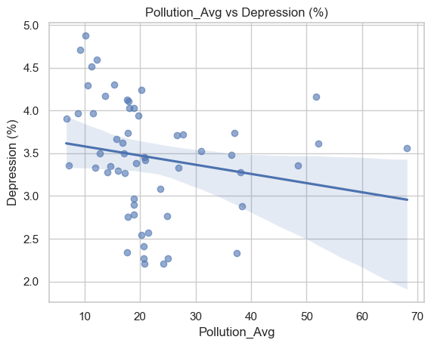

Depression vs Pollution
This plot shows the linear relation between pollution and depression. It helps visualize direction and correlation strength.
Interpretation: Weak, scattered trend with no strong linear pattern. The regression line remains mostly flat, supporting the statistical test.

Slide 8
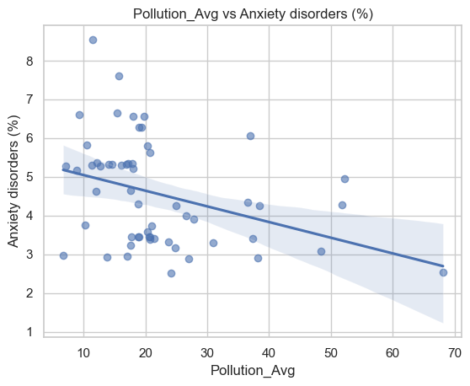
Anxiety vs Pollution
This plot, created with the Seaborn regplot function, visualizes the linear relationship between pollution and anxiety prevalence. It supports the statistical test results with a clearly visible negative trend.
Interpretation: A noticeable downward trend suggests a moderate negative association between pollution and anxiety.

Slide 9

Hypothesis Testing Results
Variable | Correlation (r) | P-value | Conclusion
Depression | -0.19 | 0.1554 | No significant relationship
Anxiety | -0.36 | 0.00664 | Moderate negative correlation
While the anxiety result is statistically significant, the negative correlation contradicts initial assumptions. It may reflect regional differences or reporting biases.

Slide 10

Machine Learning Models
To predict mental health outcomes based on pollution levels, three machine learning models were selected due to their different strengths:
Linear Regression was used to establish a simple baseline model assuming a direct linear relationship.
Decision Tree Regressor was applied for its ability to handle non-linear patterns and interpret decision splits.
Random Forest Regressor was chosen to reduce overfitting and improve accuracy by combining multiple decision trees.

Slide 11
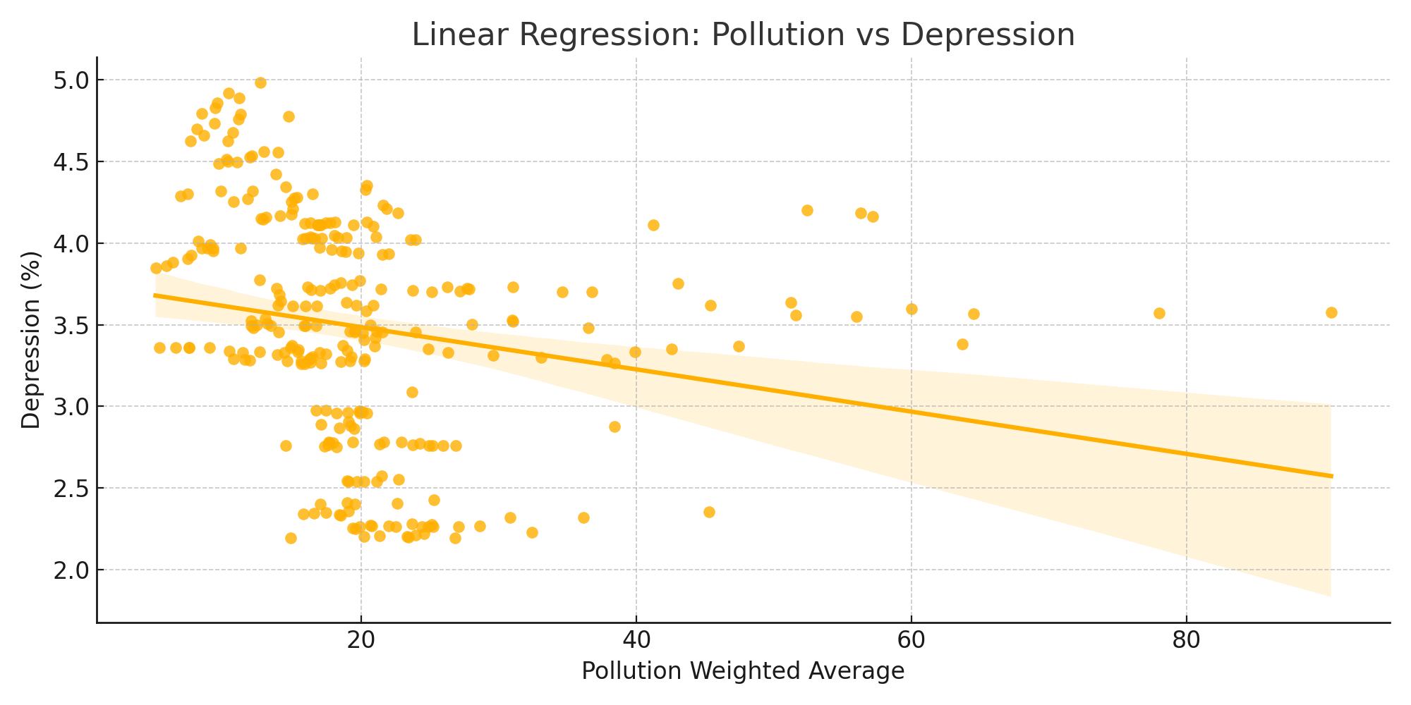
Linear Regression
Pollution vs Depression – Linear Regression
This plot shows a flat trendline, indicating very weak correlation. With an R² of 0.05, pollution explains only a small part of depression rates.

Slide 12
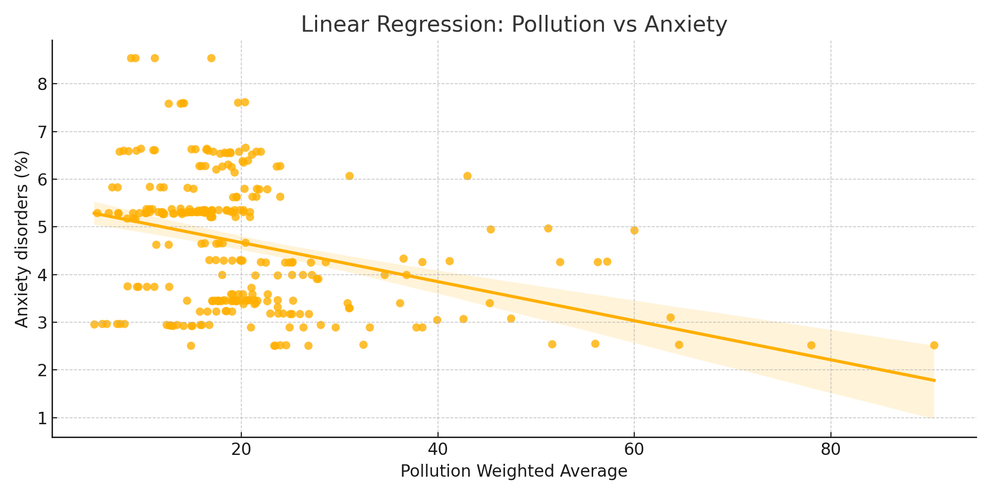
Pollution vs Anxiety – Linear Regression
The regression line fails to capture the pattern in anxiety rates. The negative R² (-0.10) shows the model performs worse than a simple average.

Slide 13

Summary of Findings
No clear correlation between pollution and depression.
Anxiety shows a statistically significant negative correlation.
Machine learning models confirm better prediction performance for anxiety.

Slide 14
Limitations
Country-level data may obscure individual-level effects.
Mental health prevalence is modeled and subject to reporting bias.
Other variables such as economic indicators or cultural factors are not included.

Slide 15
Next Steps
Collect individual- or city-level data for more granular analysis.
Expand feature set to include urban density, healthcare access, and income levels.
Test additional ML models like XGBoost and regularized regressions for robustness.

Slide 16
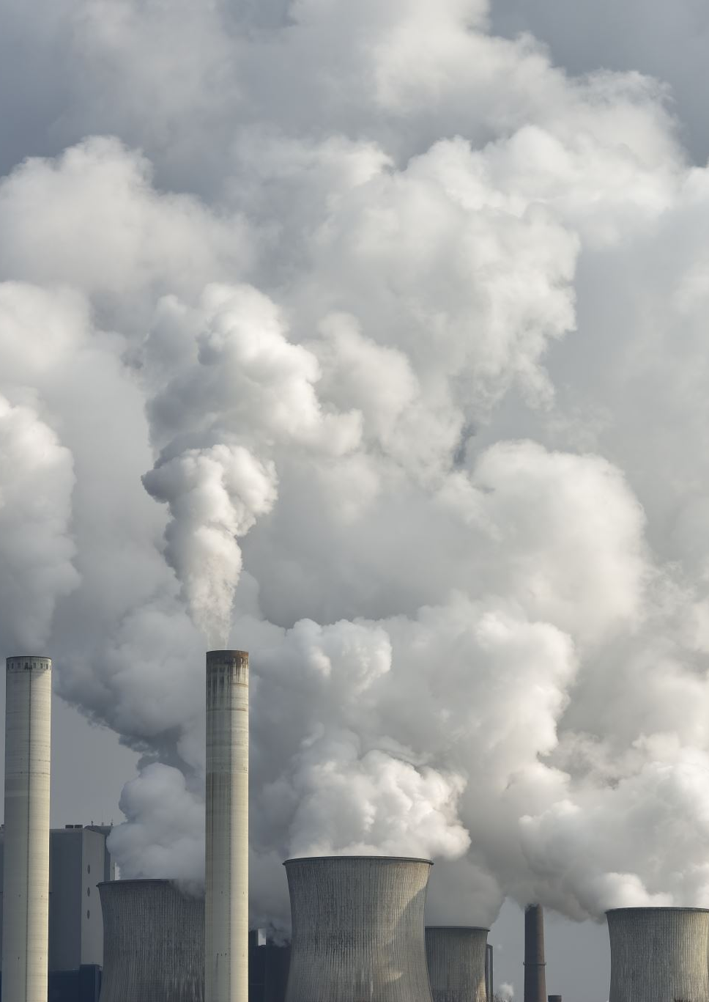
Conclusion
Pollution is not a reliable predictor of depression.
A statistically significant yet unexpected negative correlation exists with anxiety.
Suggests need for cautious interpretation and deeper multivariate investigation.

