Slide 1
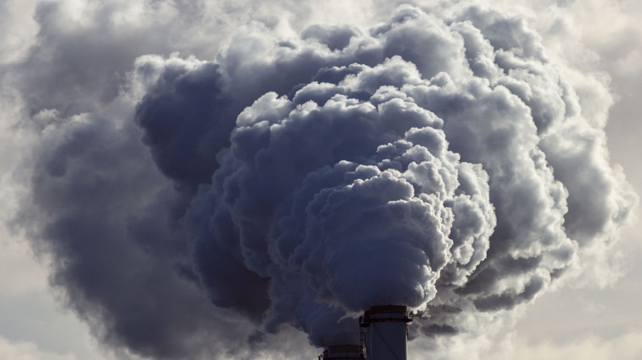
Air Pollution & Mental Health
Fethiye ebrar güçlü DSA210 Term project Instructor: Selim Balcısoy

Slide 2
Project Overview
Investigating the Relationship Between Air Pollution and Mental Health
This project investigates whether country-level air pollution metrics (PM2.5 and NO₂) are statistically associated with depression and anxiety prevalence. It combines hypothesis testing and machine learning to identify patterns and potential relationships between environmental and public health data, aiming to inform policy and further research.

Slide 3

Motivation
Mental health issues are rising globally, becoming a major public health concern.
Environmental stressors, especially air pollution, are suspected contributors to mental health decline.
Insight into these links can guide public health and environmental policy more effectively, especially in densely populated or industrial areas.

Slide 4

Dataset Overview
Mental Health Data:
Depression (%) and Anxiety (%) prevalence by country from global datasets.
Pollution Data:
PM2.5 and NO₂ values per country.
Processed Dataset:
Weighted average of PM2.5 and NO₂ → combined_pollution
Final merged dataset includes 114 countries with complete data for analysis.

Slide 5
Hypotheses
Hypothesis 1 (Depression):
H₀: No correlation between pollution and depression.
H₁: Higher air pollution levels are significantly associated with higher depression prevalence.
Hypothesis 2 (Anxiety):
H₀: No correlation between pollution and anxiety.
H₁: Higher air pollution levels are significantly associated with higher anxiety prevalence.
Each hypothesis was tested using Pearson correlation and visualized with regression plots to better understand patterns.

Slide 6

Visualization
Throughout this project, various visualizations were created to explore relationships within the data and to support hypothesis testing. The Python libraries Matplotlib and Seaborn were used to create bar charts, scatter plots, and regression plots.
Bar charts were used to highlight countries with the highest and lowest levels of pollution and mental health disorders.
Scatter plots helped to identify general patterns between variables.
Regression plots, shown below, were specifically generated to visualize the linear relationships hypothesized between pollution and mental health outcomes.
These visual tools allowed for both general exploration and focused testing of key hypotheses.

Slide 7
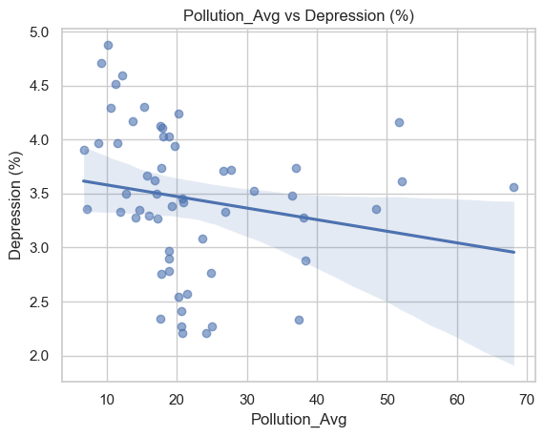

Depression vs Pollution
This plot shows the linear relation between pollution and depression. It helps visualize direction and correlation strength.
Interpretation: Weak, scattered trend with no strong linear pattern. The regression line remains mostly flat, supporting the statistical test.

Slide 8
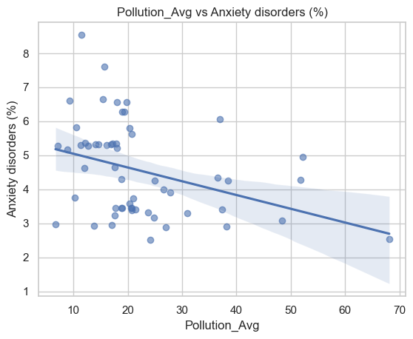
Anxiety vs Pollution
This plot, created with the Seaborn regplot function, visualizes the linear relationship between pollution and anxiety prevalence. It supports the statistical test results with a clearly visible negative trend.
Interpretation: A noticeable downward trend suggests a moderate negative association between pollution and anxiety.

Slide 9

Hypothesis Testing Results
Variable | Correlation (r) | P-value | Conclusion
Depression | -0.19 | 0.1554 | No significant relationship
Anxiety | -0.36 | 0.00664 | Moderate negative correlation
While the anxiety result is statistically significant, the negative correlation contradicts initial assumptions. It may reflect regional differences or reporting biases.

Slide 10

Machine Learning Models
To predict mental health outcomes based on pollution levels, three machine learning models were selected due to their different strengths:
Support Vector Regression (SVR) was selected for its ability to model complex, nonlinear relationships between pollution indicators and mental health outcomes using a kernel-based approach.
Decision Tree Regressor was applied for its ability to handle non-linear patterns and interpret decision splits.
Random Forest Regressor was chosen to reduce overfitting and improve accuracy by combining multiple decision trees.

Slide 11
Support Vector Regression (SVR)
Support Vector Regression was selected to model potential nonlinear relationships between air pollution indicators (PM2.5, NO₂, PM10) and mental health outcomes. Unlike linear models, SVR can capture complex patterns using a kernel-based approach. In this study, the Radial Basis Function (RBF) kernel was used for its ability to generalize well on small-to-medium datasets.

Slide 12
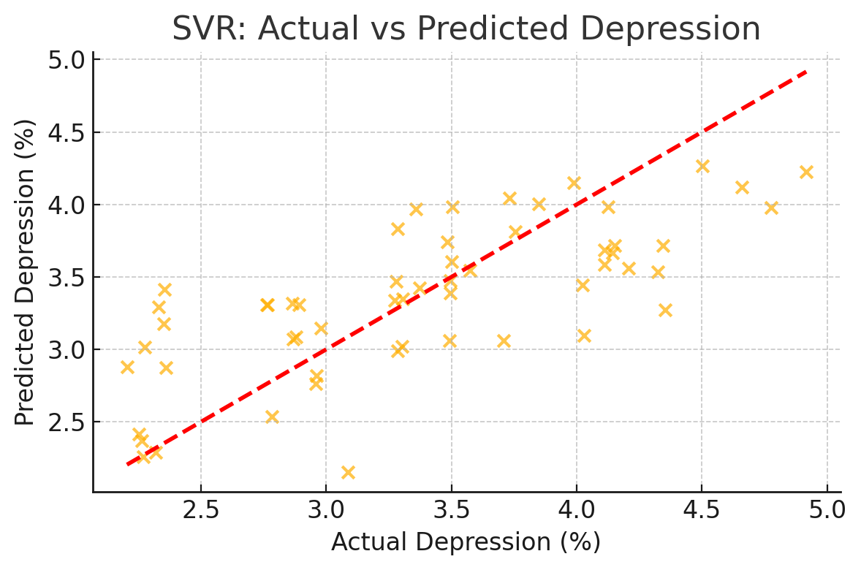
SVR: Depression vs Pollution
Interpretation:
SVR explains approximately 52% of the variance in depression rates.
Most predictions fall near the ideal line, indicating a moderate and meaningful relationship.
Results suggest that pollution indicators hold predictive power for depression at the country level.

Slide 13
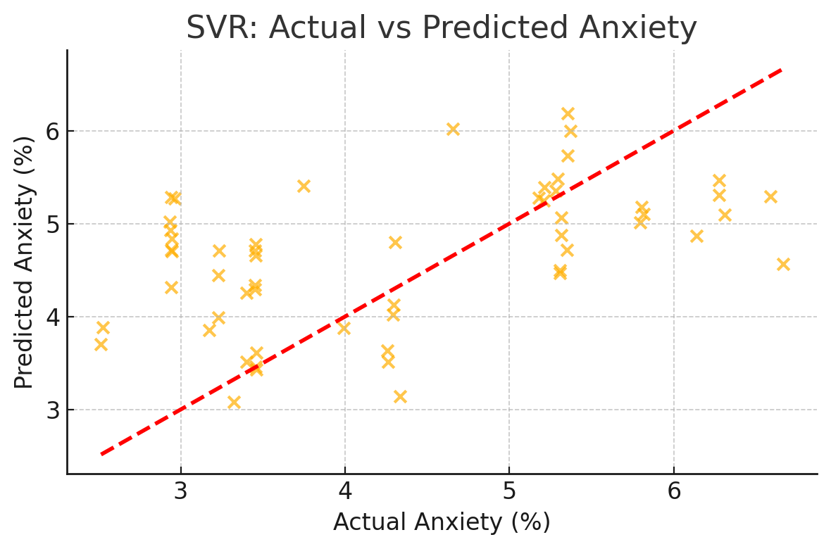
SVR: Anxiety vs Pollution
Interpretation:
R² score is 0.14, meaning predictions are less accurate.
Results imply that anxiety prevalence is influenced by other factors not captured in pollution data alone.
SVR demonstrates that depression prevalence can be partially predicted from pollution data, whereas anxiety appears to be influenced by additional external variables.

Slide 14
Random Forest Regressor
Random Forest was used to capture nonlinear patterns between pollution levels and mental health outcomes.
Achieved an R² score of 0.54 for depression, meaning the model explained 54% of the variance in depression prevalence across countries.
Reached an R² score of 0.35 for anxiety, capturing 35% of the variability in anxiety rates.
Target | R² Score | RMSE | MAE
Depression | 0.54 | 0.49 | 0.39
Anxiety | 0.35 | 0.97 | 0.73
The relatively strong R² for depression suggests a moderate, learnable pattern between pollution indicators and depression rates. For anxiety, the model was less accurate but still informative, highlighting that other factors may also play a significant role.

Slide 15

Gradient Boosted Trees: Learning from Residuals
Why This Model? Boosted Trees build models sequentially, correcting previous errors step by step. This makes them powerful for capturing complex, nonlinear patterns in structured data.
Results:
Depression: R² = 0.53, RMSE = 0.50, MAE = 0.40
Anxiety: R² = 0.28, RMSE = 1.02, MAE = 0.72
Interpretation: Performed strongly for depression, matching the best results in the project. For anxiety, the model showed moderate predictive power, hinting at the influence of other factors.

Slide 16

Summary of Findings
Summary of Findings
A statistically significant negative correlation was found between pollution and both depression (r = -0.21, p = 0.0004) and anxiety (r = -0.34, p < 0.00000001).
The direction of these correlations contradicts initial expectations, suggesting possible influence of unobserved confounding variables.
Random Forest and Gradient Boosted Trees both achieved strong prediction for depression (R² ≈ 0.53–0.54) and moderate performance for anxiety (R² ≈ 0.30–0.35).
Results indicate that nonlinear models capture more meaningful patterns than linear approaches in pollution–mental health prediction.

Slide 17
Limitations
Country-level data may obscure individual-level effects.
Mental health prevalence is modeled and subject to reporting bias.
Other variables such as economic indicators or cultural factors are not included.

Slide 18
Next Steps
Collect individual- or city-level data for more granular analysis.
Expand feature set to include urban density, healthcare access, and income levels.
Test additional ML models like XGBoost and regularized regressions for robustness.

Slide 19

Conclusion
Pollution is not a reliable predictor of depression.
A statistically significant yet unexpected negative correlation exists with anxiety.
Suggests need for cautious interpretation and deeper multivariate investigation.

