Slide 1
Café Time
Sales Analysis: Questions, Answers & Charts
Mar 2024 – Mar 2025 | 3,547 sales | 8 drinks

Slide 2
OVERVIEW
Data Overview
What does the data look like, and is it clean?
112,246
3,547
31.65
0
Total revenue
Number of sales
Average bill
Missing or duplicate rows
The data is clean: no duplicate rows, no missing values, and Date is a proper datetime column.
Months include both March 2024 and March 2025, so compare months with care.

Slide 3
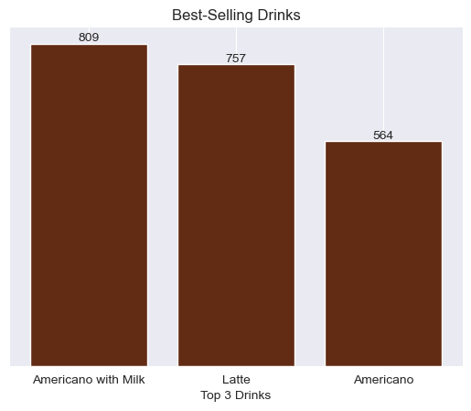
PRODUCTS
Top 3 Best-Selling Drinks
Which 3 drinks are ordered the most?
Americano with Milk (809), Latte (757) and Americano (564).
Together they make up 60% of all orders.

Slide 4
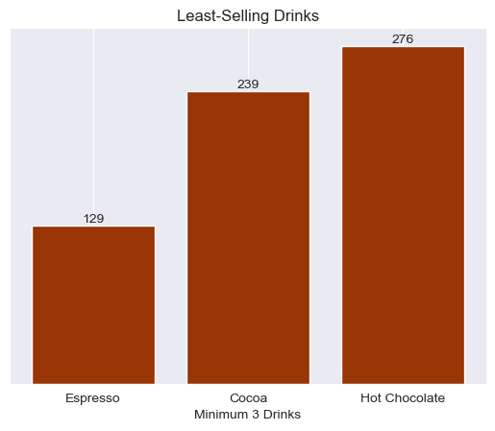
PRODUCTS
Least-Selling Drinks
Which drinks are ordered the least?
Espresso (129), Cocoa (239) and Hot Chocolate (276).
Cocoa and Hot Chocolate are low in volume but high in price — a growth opportunity.

Slide 5
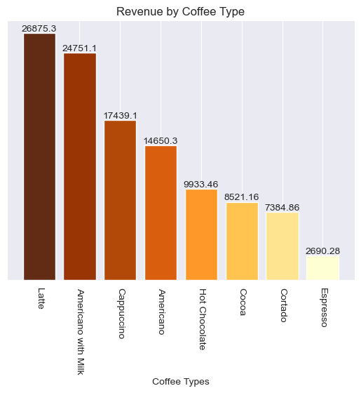
PRODUCTS
Revenue by Drink
Which drink earns the most? Is best-selling the same as most profitable?
Latte leads with 26,875 (24%), then Americano with Milk (24,751) and Cappuccino (17,439).
Top 3 = 61.5% of revenue.
Not the same: Cappuccino is 4th in orders but 3rd in revenue; Americano is the reverse.

Slide 6
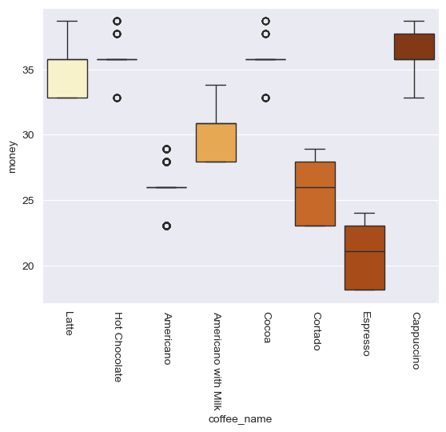
PRODUCTS
Price Distribution by Drink
What is the average, lowest and highest price of each drink?
Average price: Espresso 20.85, Cortado 25.73, Americano 25.98, Americano with Milk 30.59.
Latte, Cappuccino, Cocoa and Hot Chocolate sit at ~35.5–36.
Prices vary within the same drink (e.g. Latte 32.82–38.70): worth checking for price changes or discounts.

Slide 7
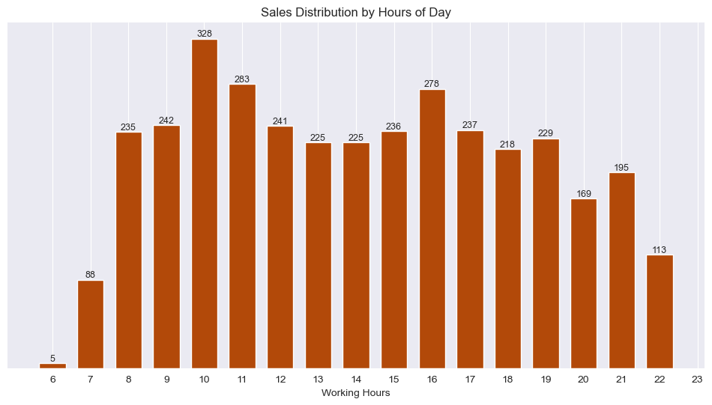
TIMING
Busiest Hours
Which hours of the day are the busiest?
Peak: 10 am (328), 11 am (283), 4 pm (278).
Quiet: before 8 am and after 8 pm.

Slide 8
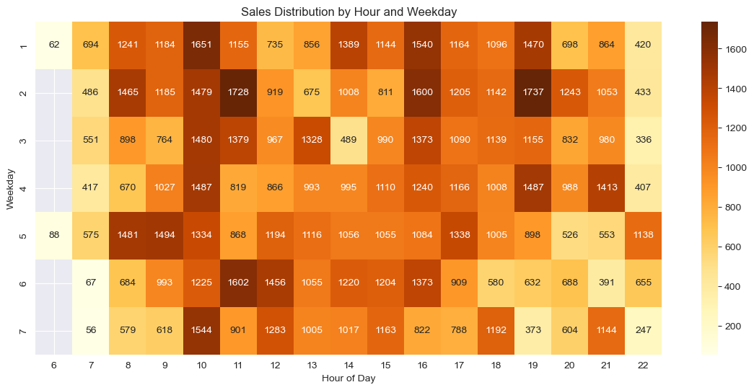
TIMING
Sales by Hour and Weekday
How do sales spread across hours and days? (Revenue heatmap)
Hottest cells: Tue 7 pm (1,737), Tue 11 am (1,728), Mon 10 am (1,651).
Coldest: 6–7 am, 10 pm and weekend evenings (e.g. Sun 7 pm: 373).

Slide 9
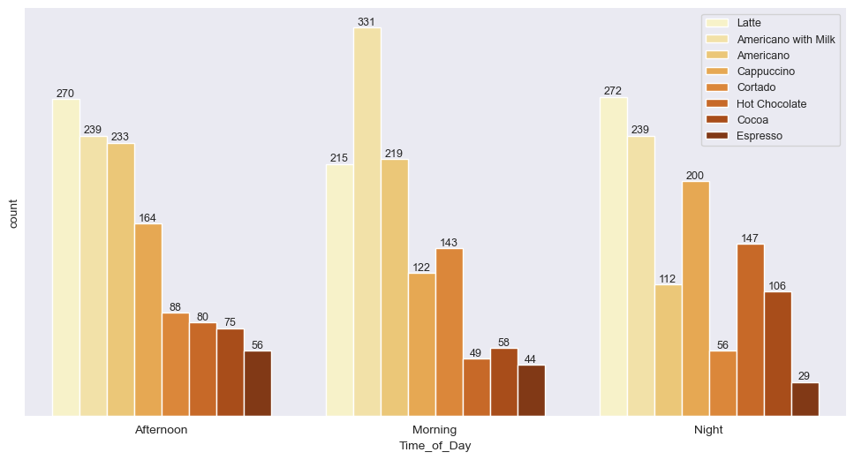
TIMING
Morning, Afternoon & Night
Do sales and drink choice change across the day?
Volume is similar: Morning 1,181 | Afternoon 1,205 | Night 1,161.
Morning: Americano with Milk leads (331). Afternoon and Night: Latte leads.
Night: Hot Chocolate + Cocoa = 253 orders vs. 107 in the morning.

Slide 10
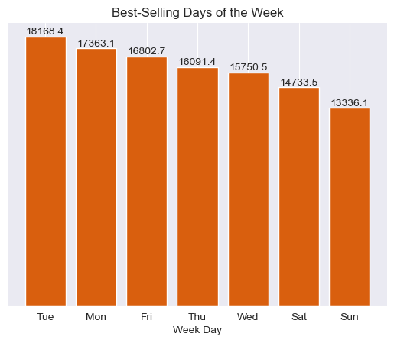
TIMING
Best-Selling Weekdays
Which days of the week sell the most?
Tuesday leads (18,168; 572 orders), then Monday (17,363).
Sunday is the lowest (13,336; 419 orders).
Weekdays see ~20% more sales than the weekend.

Slide 11
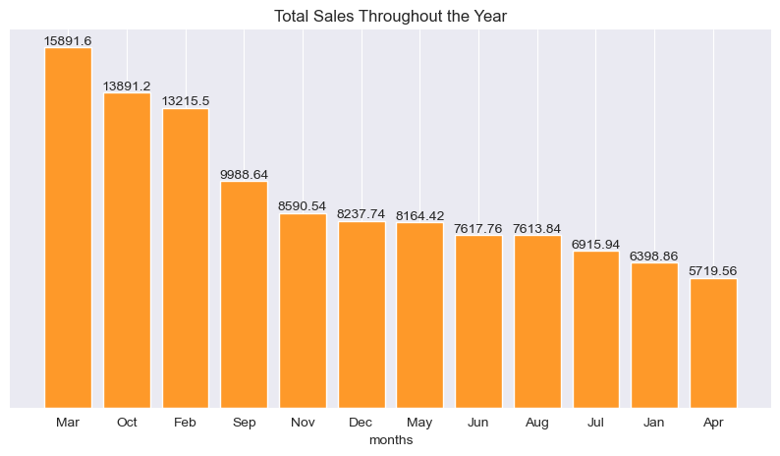
TIMING
Monthly Sales Ranking
Which months sell the most? Is there a seasonal or weather link?
Top: March (15,892), October (13,891), February (13,215).
Lowest: April (5,720) and January (6,399).
March mixes two years and Jan–Feb are 2025 only, so check Year-Month before concluding a weather effect.

Slide 12
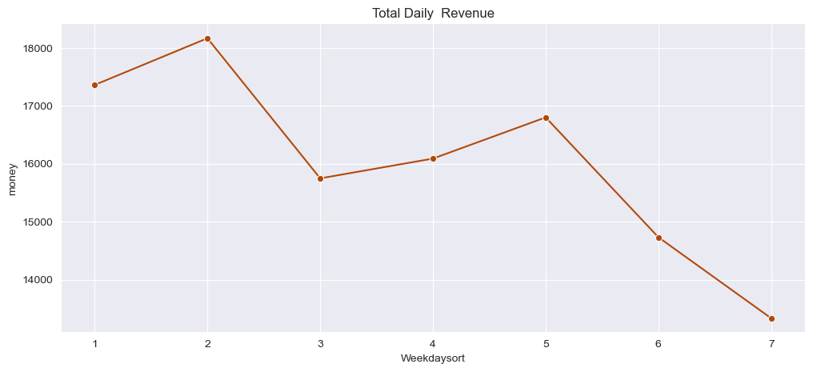
REVENUE
Revenue Across Weekdays
Is there a pattern in revenue during the week?
Revenue rises early in the week (Mon–Tue peak), stays steady midweek, and falls on the weekend.

Slide 13
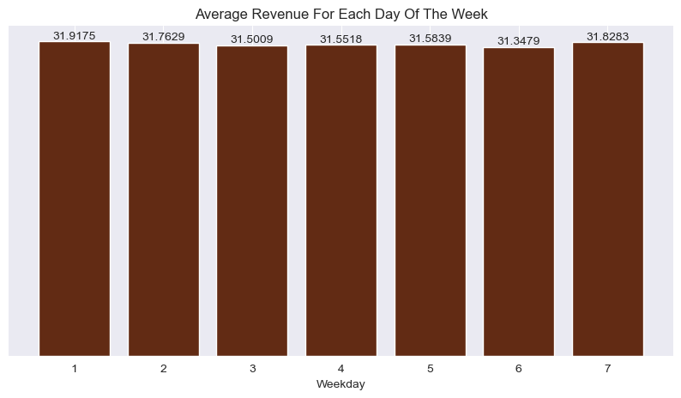
REVENUE
Average Bill by Weekday
Does the average bill change by day?
No. The average bill stays flat at ~31.3–31.9.
So the weekday gap comes from the number of customers, not spending per customer.

Slide 14
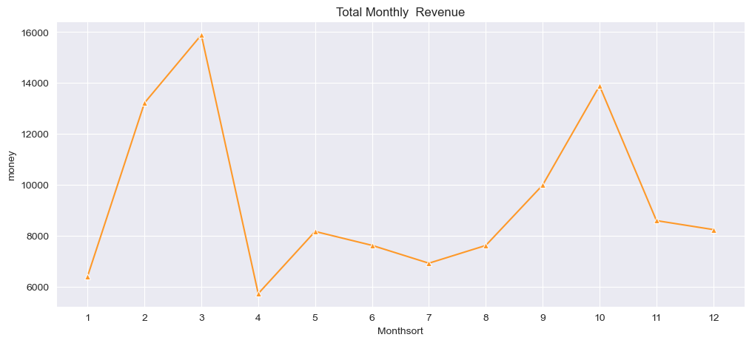
REVENUE
Monthly Revenue Trend
Is revenue increasing or decreasing over time?
No clear up or down trend; revenue swings seasonally, with peaks in Feb–Mar and Oct.

Slide 15
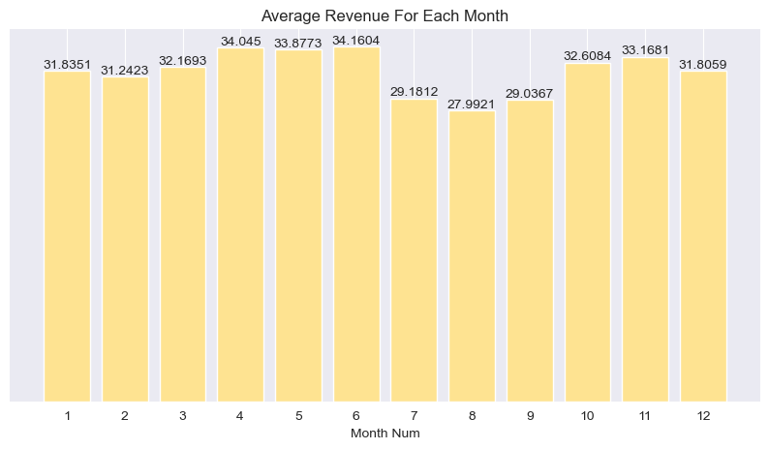
REVENUE
Average Bill by Month
Does the average bill change through the year?
Highest in Apr–Jun (~34), lowest in Jul–Sep (28–29).
Summer months show a lower bill; worth checking whether cheaper drinks dominate then.

Slide 16
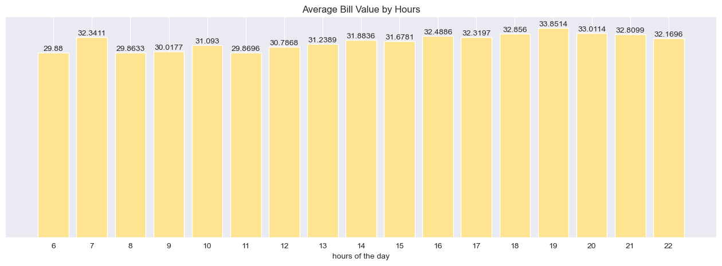
REVENUE
Average Bill by Hour
Do some hours bring a higher bill?
The bill grows through the day: ~29.9 at 6 am up to a peak of 33.85 at 7 pm.

Slide 17
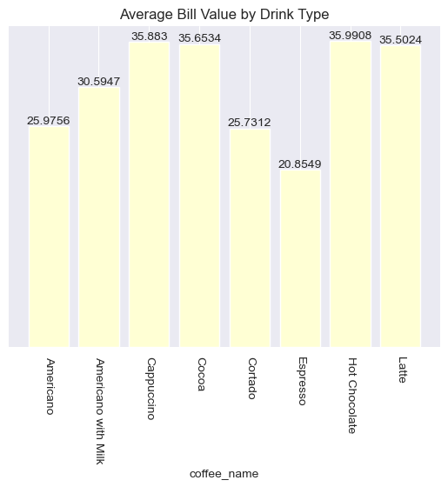
REVENUE
Average Bill by Drink
What is the average bill per drink?
Espresso is the lowest (20.85) and Hot Chocolate the highest (35.99).
Overall average bill: 31.65.

Slide 18
PAYMENT
Payment Method
How do customers pay?
Card is the only payment method in the data.
Confirm whether cash sales are recorded in the system; if not, revenue may be under-reported.
100%
Card (3,547 sales)

Slide 19
Recommendations
1. Focus on the stars
2. Raise the bill value
Latte and Americano with Milk = 46% of revenue; keep them in stock and fast to prepare.
Offer an upgrade from Americano to Americano with Milk (+4.6) and promote Cappuccino.
3. Offers for quiet times
4. Staff scheduling
Sat & Sun, after 8 pm and before 8 am — e.g. a Happy Hour.
Add staff at 10–11 am and 4–5 pm, and on Mondays and Tuesdays.
5. Night drinks
6. Payment & data
Promote Hot Chocolate and Cocoa in the evening; bundle Espresso in a combo (only 2.4% of revenue).
Confirm cash sales are recorded (currently 100% card) and log the year with the month for cleaner comparisons.

