Slide 1
Final Project Presentation
Group 15
Evan Brittain
Roselyn Duong
Nick Myers

Slide 2
Problem Statement
Identify various functional and non-functional issues of the Task Manager app using unit, module, and system tests; as well as analyzing test coverage
Front End
Apply white box testing to buttons and form fields
State diagrams to show transition between activities and alert dialog boxes
Back End
Apply white box testing for all database transactions
Use control flow graphs to test implementation as designed

Slide 3
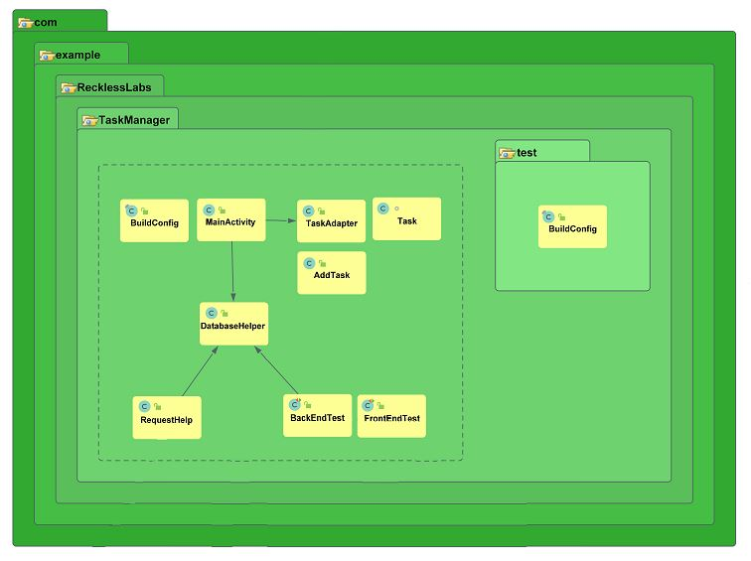
Our Software
The software we tested is a Task Manager - an Android app where users can log and track the completion of personal tasks.
The Task Manager:
Uses a SQLite database to store tasks
Has multiple interfaces (screens) for user interaction
Prompts for input and displays fields, lists, reports, etc.
Stores and plots historical task activity

Slide 4
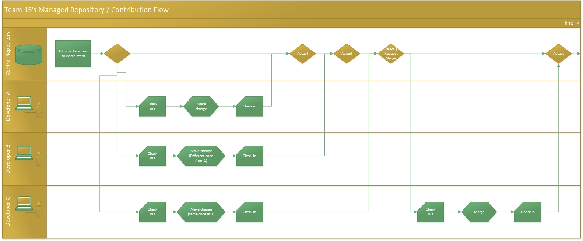
Git Workflow

Slide 5
High Level Test Specification
Top functional requirements
Adding and removing a task
Starting and stopping the timer for a task
Viewing and editing task information
Viewing historical task runtimes graphically
Accurate write/read operations on database

Slide 6
User Interface Testing
Key Testing Areas
Add/Delete
Start/Stop
View/Edit
View Stats
State diagrams
Illustrate transitions users will experience
Model tests by finding set of all possible paths
Eliminate redundant tests to find minimum test set for maximum coverage
Espresso API to automate all user interface tests

Slide 7
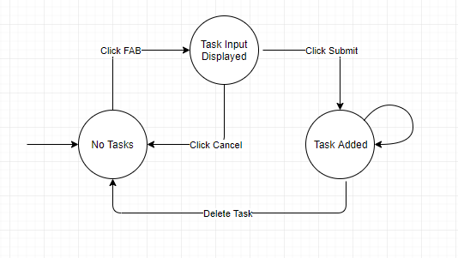
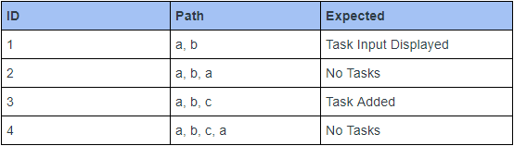
Add/Delete Task

Slide 8
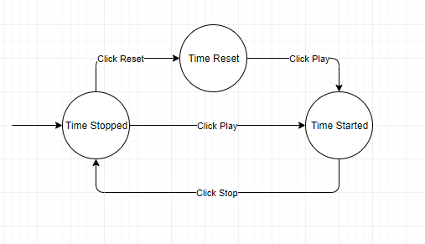
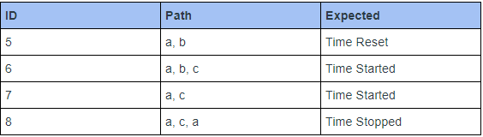
Start/Stop Task

Slide 9
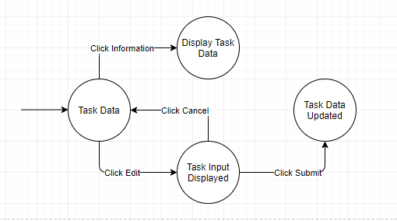
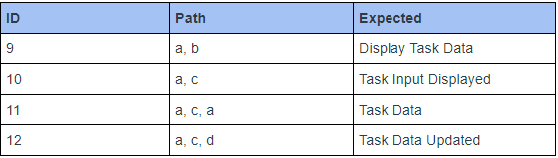
View/Edit

Slide 10
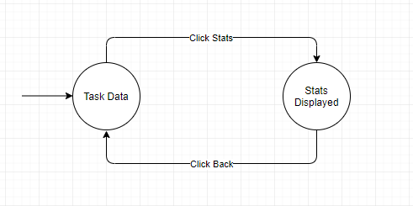

View Stats

Slide 11
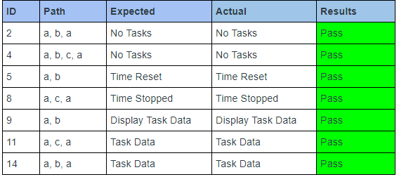
Results

Slide 12
Back End Testing
Control Flow Graphs
Analyze code and determine possible nodes
Model tests by finding set of all possible paths
Create diagrams to illustrate flow
Roboelectric API to automate test running
Key Testing Areas - Database interactions
Get Data
Insert Data
Update Data
Delete Data

Slide 13
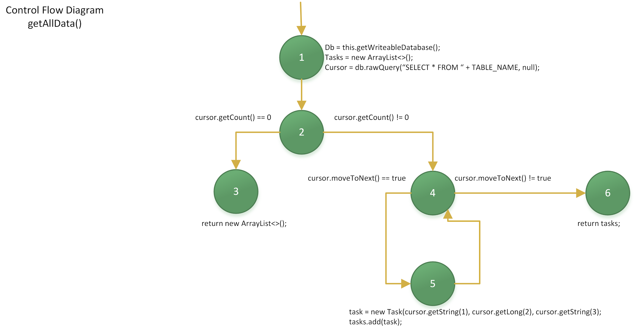
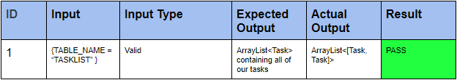
Get All Data

Slide 14
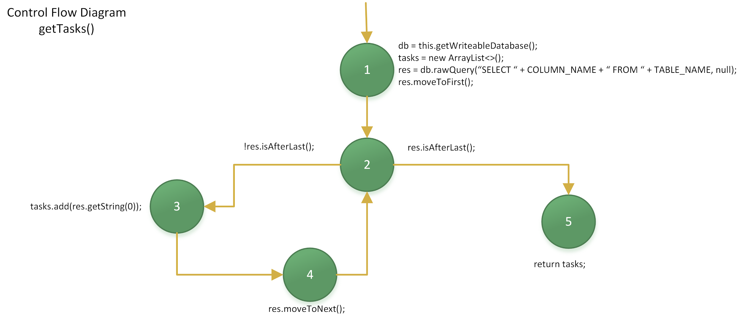
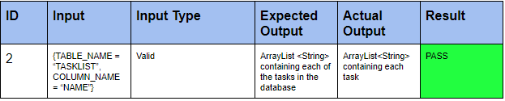
Get Tasks

Slide 15
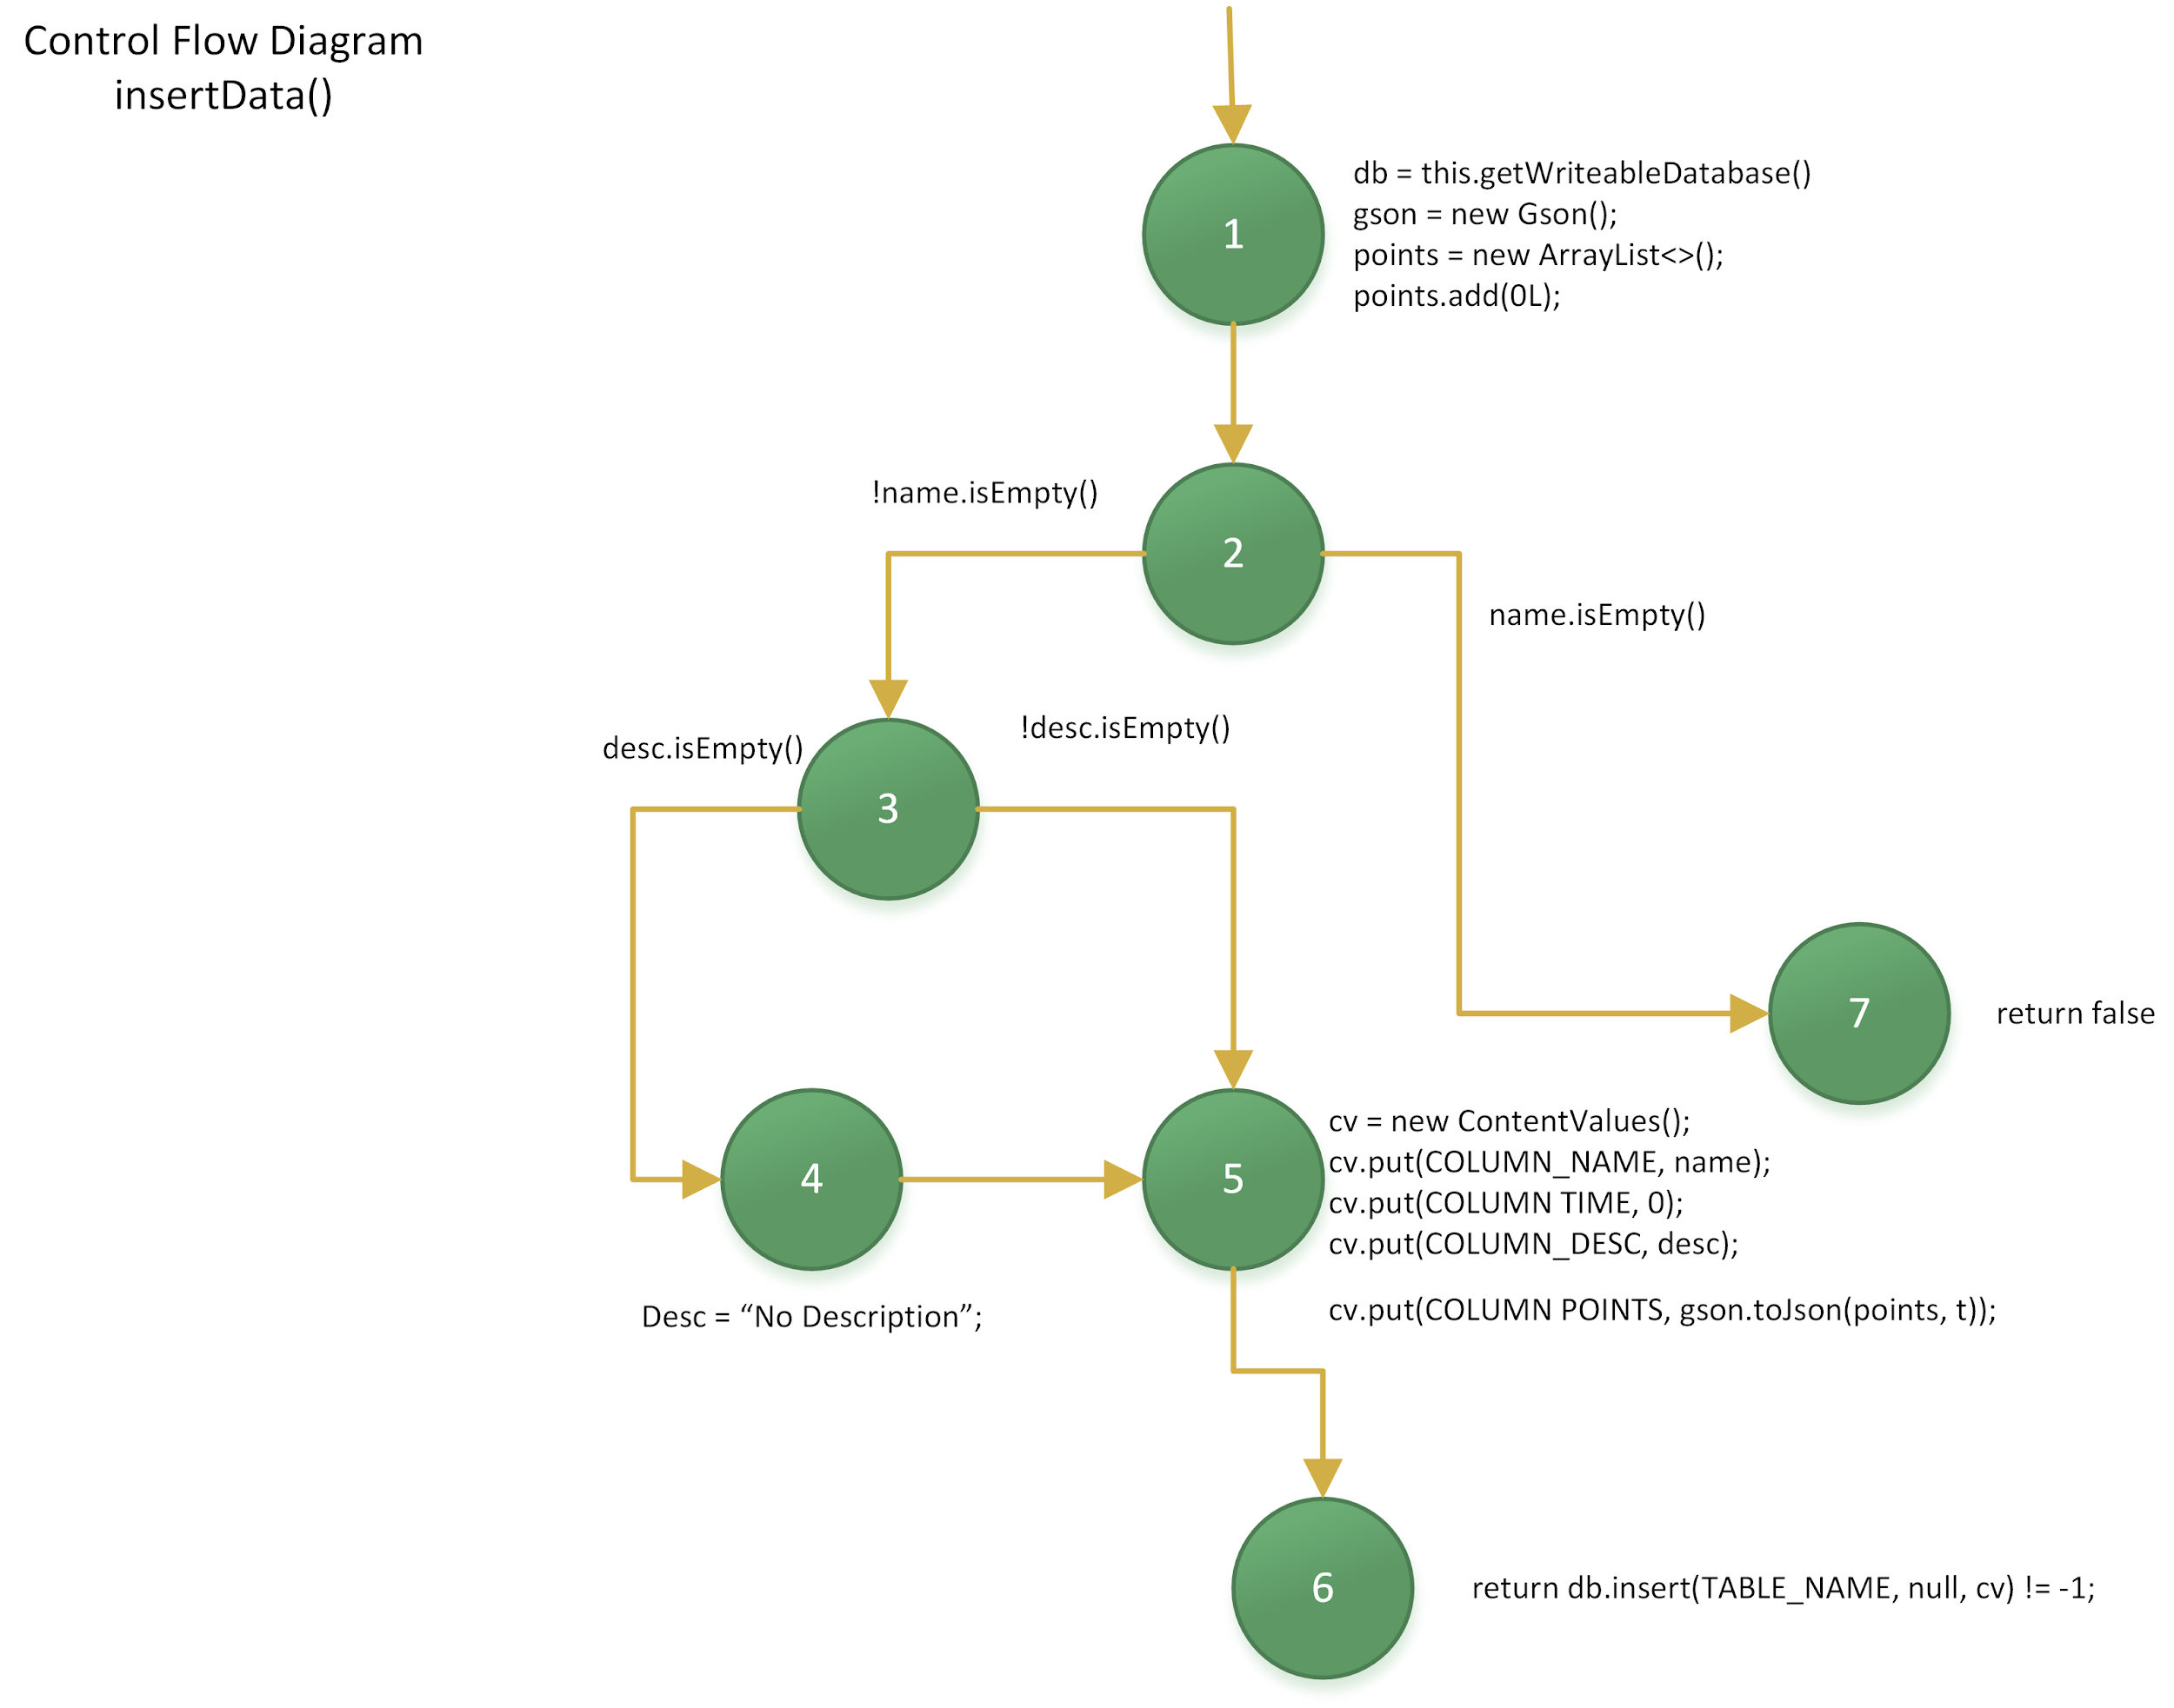
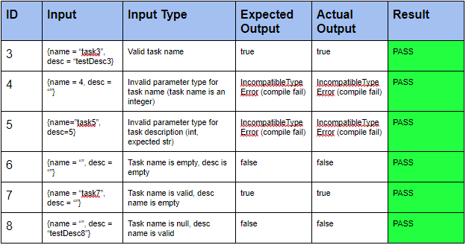
Insert Data

Slide 16
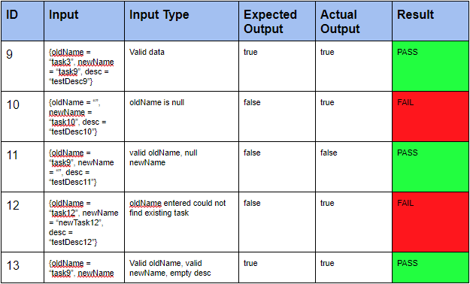
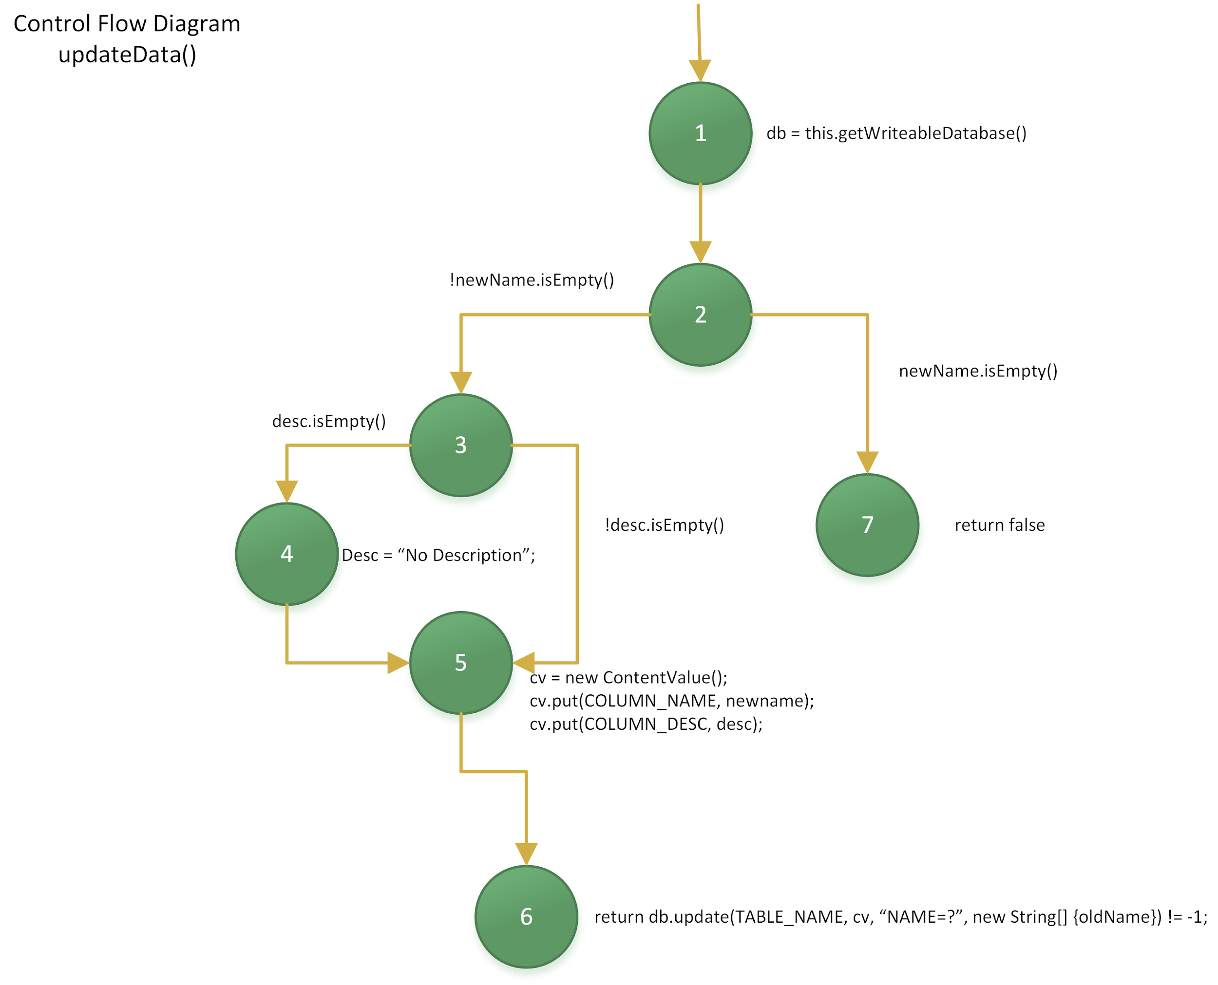
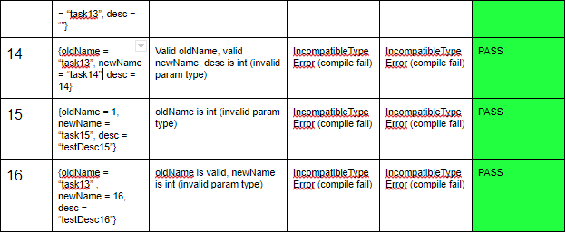
Update Data

Slide 17
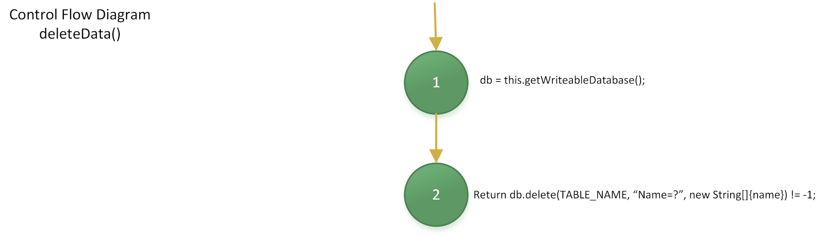
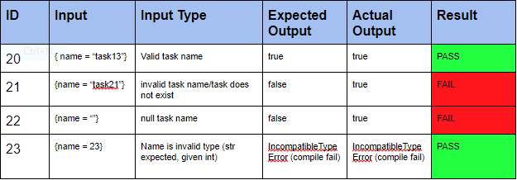
Delete Data

Slide 18
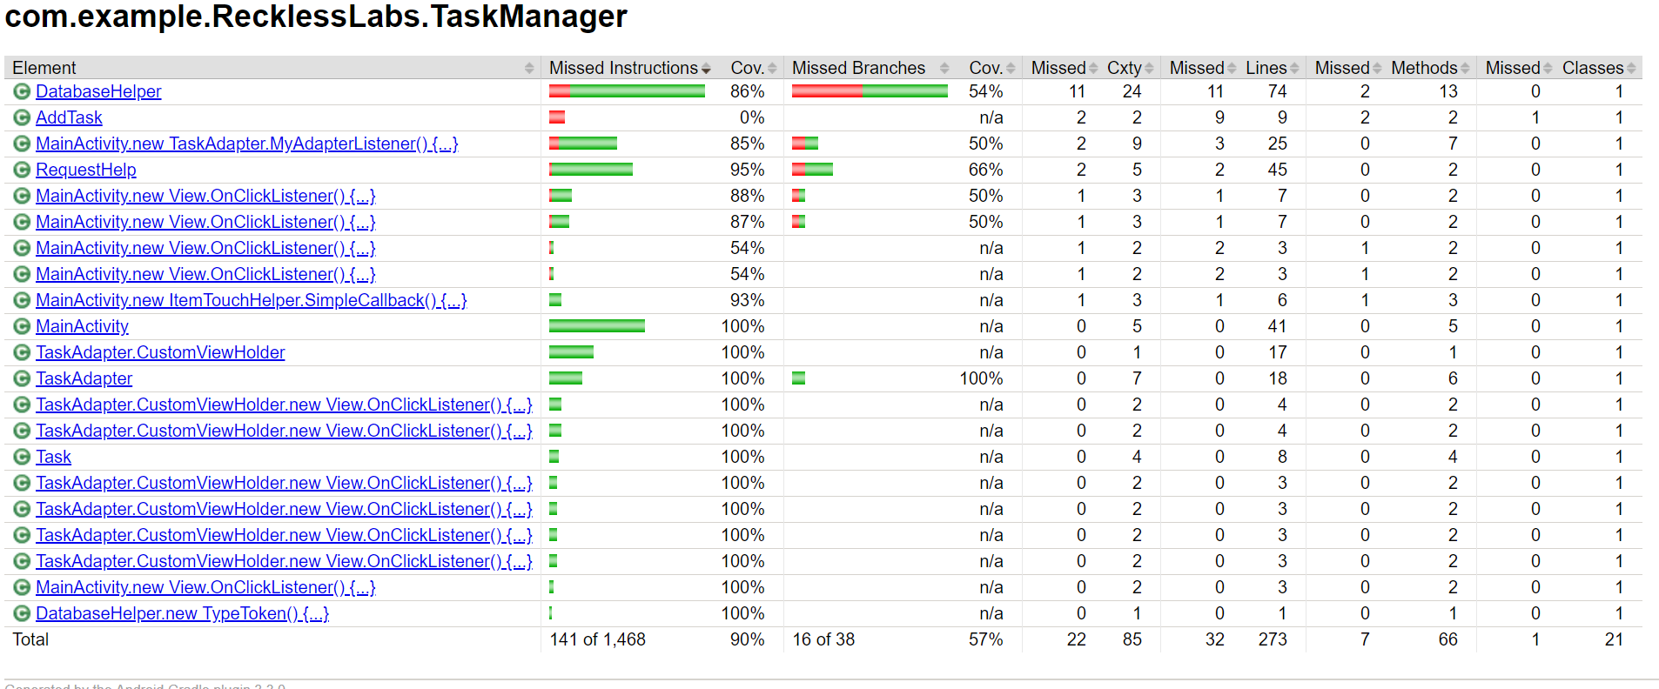

Slide 19


Slide 20
Conclusion
As a result, our total coverage is 90%
We were able to apply the knowledge we gained of quality assurance and testing
Practiced white-box testing techniques
We learned about the different types of models and graphs and we were able to implement our own control flow graphs and state diagrams
SW testing can be difficult to determine correct scope
Testing requires you to think differently
Learned the importance of quality assurance

