Slide 1

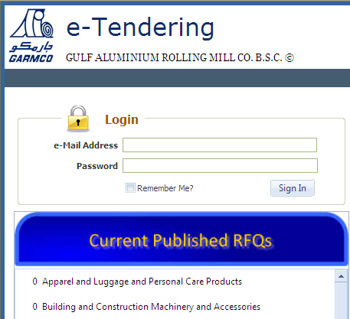

Slide 2

Why E-Tendering?
Major Functions / Process Flow
Benefits
Implementation Plan
Demo

Slide 3

It’s a Business Requirement
  Competiveness
  Transparency
  Manual Workflow
  Manual Follow Up
  Delays

Slide 4


Be Proactive
In Par With Current Trends
Technically Feasible

Slide 5

Supplier Self Service
Automatic Workflow
Online Tender Session
Buyers Workbench
Integrated With JDE
UNSP Code Integration

Slide 6

Supplier Invoice Workflow
Purchase Order Workflow
Non Stock Master Integration
Outlook Calendar Integration

Slide 7
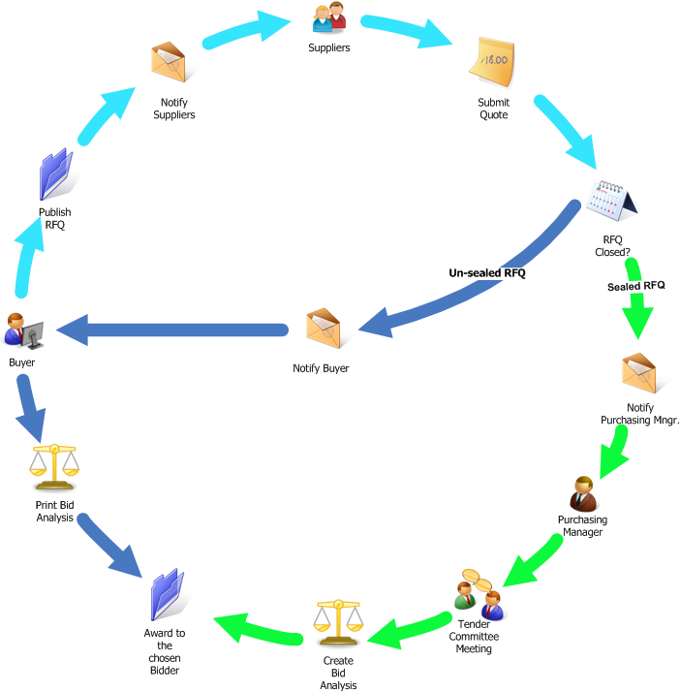


Slide 8

Wider Competition
  More Supplier Participation
  Option for Alternatives
Improved Lead Time
Better Transparency & Controls
Able to Handle Larger Volume

Slide 9


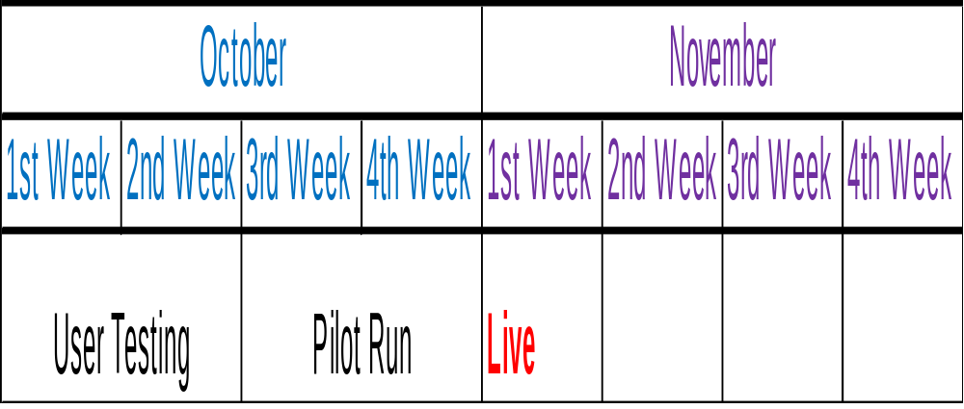

Slide 10

Supplier Emails – Prior to go live
UNSPC Update – On going process

Slide 11

Supplier Self-Service
  Registration
  Quote Response
Tender Session
Buyer’s Workbench

Slide 12
Thank you
https://etendering.garmco.com
http://grmdevtst1:8191

