Slide 1
PowerShell OSS Story

Slide 2
Distro Coverage
1176 issues were opened, 566 closed
712 pull requests were opened, 685 closed, and 577 merged
Packages available [http://packages.microsoft.com/]
Ubuntu 14.04
Ubuntu 16.04
CentOS 7
OpenSUSE 42.1
Arch Linux
RHEL 7.2/7.3
Debian 8
Also
MacOS 10
AppImage
Docker images

Slide 3
Code Coverage
5861 test cases run on Windows [ 40% code coverage ]
4585 test cases on Linux and Mac [not yet]

Slide 4
Beta1?
Beta1 use .NET Core App 2.0.0 (preview1)
=> compatible with .NET Standard 2.0.
=>compatible with Windows PowerShell (down to .NET 4.5.1) and PowerShell Core 6

Slide 5
When?
https://github.com/PowerShell/PowerShell/projects [11]
Cross-platform JEA
Developer Experience/SDK
Linux Distro/Mac Coverage
Linux/Mac Usability
Remoting over SSH
PowerShell-RFC
Remoting over WSMan
Semantic Version
Telemetry
Test/Release Automation
Testability
Windows PowerShell compatibility (.NET Standard 2.0)

Slide 6
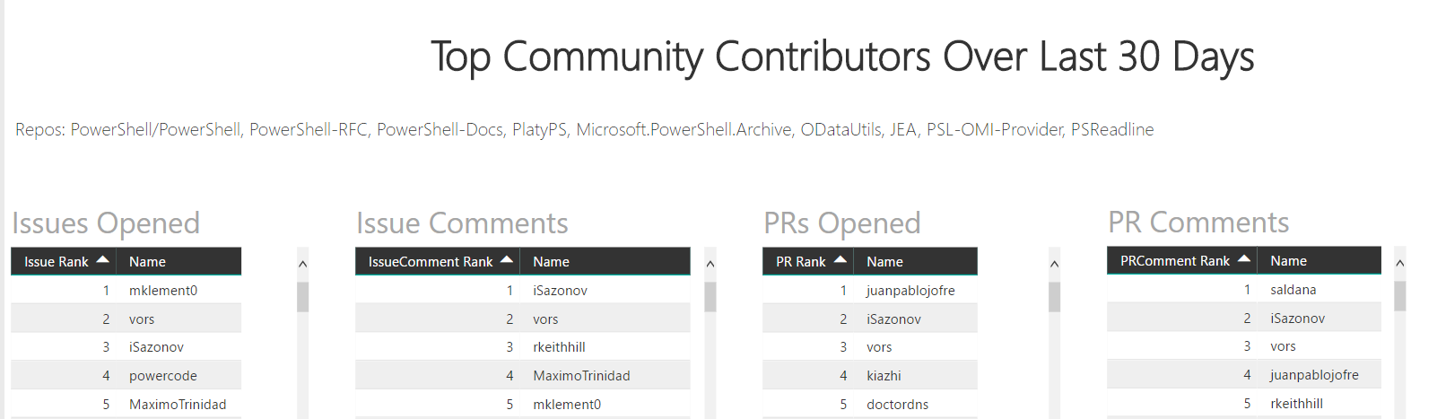
Top Contributors
https://msit.powerbi.com/view?r=eyJrIjoiYTYyN2U3ODgtMjBlMi00MGM1LWI0ZjctMmQ3MzE2ZDNkMzIyIiwidCI6IjcyZjk4OGJmLTg2ZjEtNDFhZi05MWFiLTJkN2NkMDExZGI0NyIsImMiOjV9&pageName=ReportSection3

Slide 7
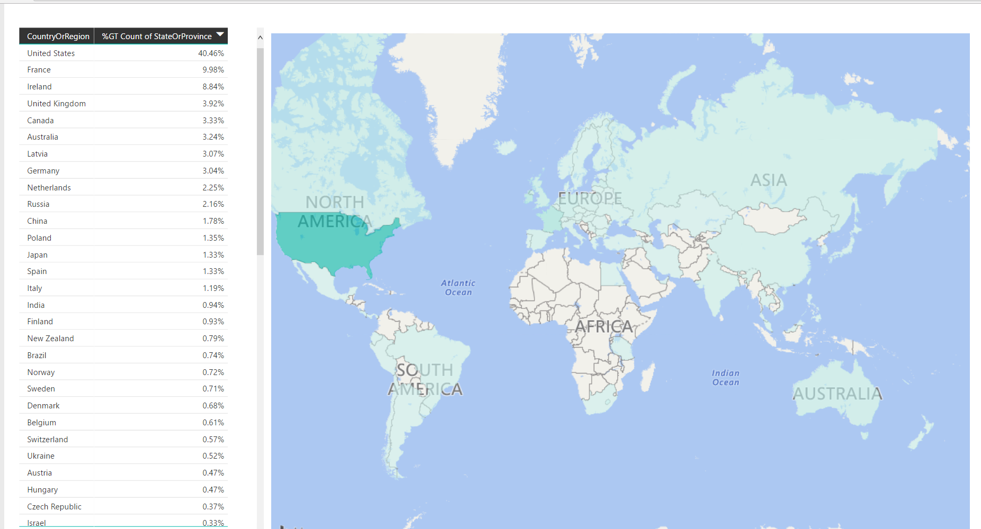
Telemetry
https://msit.powerbi.com/view?r=eyJrIjoiYTYyN2U3ODgtMjBlMi00MGM1LWI0ZjctMmQ3MzE2ZDNkMzIyIiwidCI6IjcyZjk4OGJmLTg2ZjEtNDFhZi05MWFiLTJkN2NkMDExZGI0NyIsImMiOjV9&pageName=ReportSection5

Slide 8
