Slide 1

PSCONFEU RECAP
London 25/05/2017

Slide 2
AGENDA
PowershellCore

Slide 3
1. cross-platform powershell
Sessions
Start-NewEra -Repo PowerShell
Ben Gelens (English)
Knock, knock, knock – Linux at your door
Bartosz Bielawski (English)
Hell freezing over: PowerShell on Linux and GitHub
Bartosz Bielawski (English)

Slide 4
history
August 18, 2016 -Jsnover’s Talk
Current Version: v6.0.0-beta.1 release of PowerShellCore

Slide 5
plan
PSRP over OpenSSH
PowerShell-based DSC resources on Linux

Slide 6
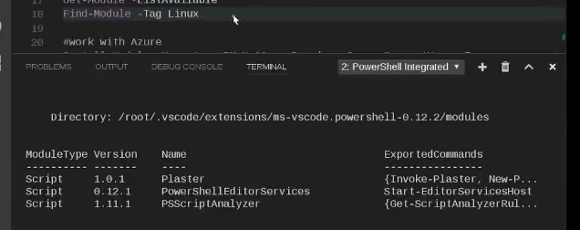
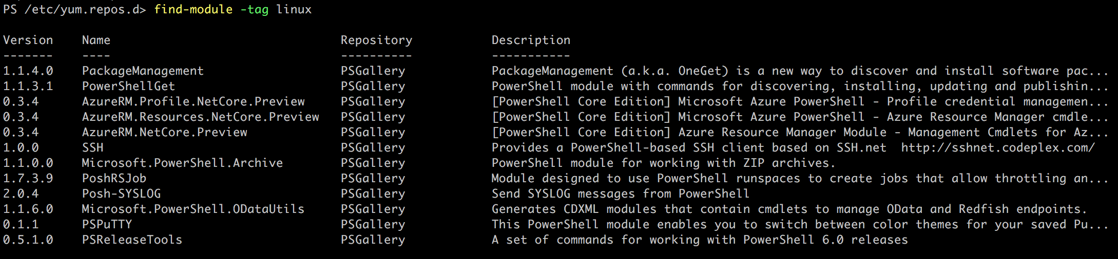
plan

Slide 7
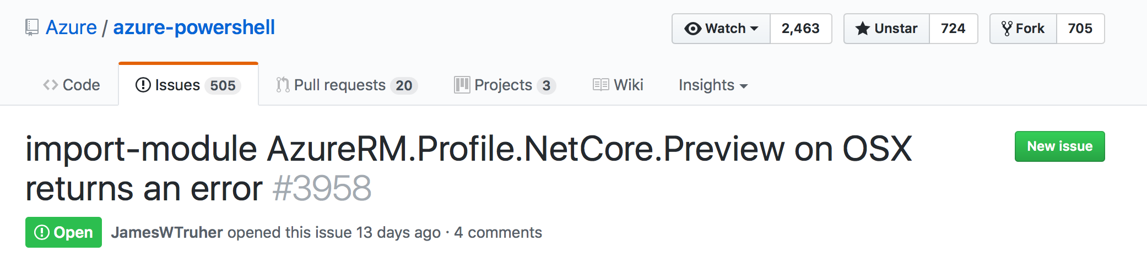
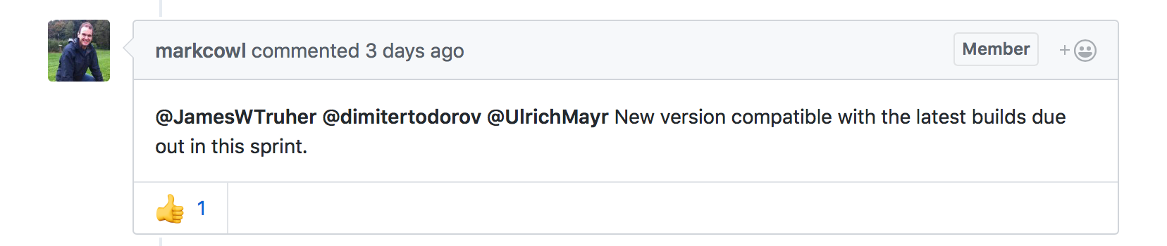
plan

Slide 8
references
https://blogs.msdn.microsoft.com/wsl/2016/04/22/windows-subsystem-for-linux-overview/
https://blogs.technet.microsoft.com/heyscriptingguy/2016/09/28/part-1-install-bash-on-windows-10-omi-cim-server-and-dsc-for-linux/
Snover’s blog:
https://azure.microsoft.com/en-us/blog/powershell-is-open-sourced-and-is-available-on-linux/
https://blogs.msdn.microsoft.com/powershell/2016/08/18/powershell-on-linux-and-open-source-2/
Packages MS:
https://docs.microsoft.com/en-us/windows-server/administration/linux-package-repository-for-microsoft-software
AzureRM.Profile.NetCore.Preview
https://github.com/Azure/azure-powershell/issues/3958
Releases
https://github.com/PowerShell/PowerShell/releases

Slide 9
thank you!
Questions?

Slide 10
Thank you!
Questions?

