Slide 1
Using Angular and HTTP
Eren Brumley – eren.Brumley@daugherty.com

Slide 2
Angular 1? Angular 2?
Angular is the name for the Angular of today and tomorrow (from version 2 and up). AngularJS is the name for all v1.x versions of Angular.
Angular is not an upgrade of AngujarJS. It was completely rewritten. You do not need to know AngularJS to learn Angular.
For details on transitioning from AngularJS to Angular check out: https://angular.io/docs/ts/latest/cookbook/ajs-quick-reference.html
There are primarily four things that you'll need to be familiar with:
ES6 (JavaScript),
TypeScript (a typed superset of JavaScript that compiles to plain JavaScript),
RxJS (a library for transforming, composing, and querying streams of data),
and build tools (node.js and npm)

Slide 3
Angular QuickStart
Install node v4.x.x or higher. Node powers client development and build tools. You can check by running node -v
Install npm 3.x.x or higher. The npm package manager, itself a node application, installs JavaScript libraries. You can check by running npm -v
Clone or download the project located at : https://github.com/angular/quickstart
Open the folder with package.json in your IDE
Run npm install and npm start
You will see “Hello Angular” from http://localhost:3000/
This code is maintained by angular.io, great start for any project, always up to date
Notes:
In my case, it is: C:\Users\eeb1114\Documents\Learning\AngularPresentation\quickstart-master

Slide 4
Basic Hello World
Angular applications are made up of components. A component is the combination of an HTML template and a component class that controls a portion of the screen. app.component.ts is an example of a component that displays a simple string.
The selector property tells Angular to display the component inside a custom <my-app> tag in the index.html.
At runtime, Angular replaces {{name}} with the value of the component's name property via interpolation binding (one of multiple types of bindings)
Change the component class's name property from 'Angular' to 'World' in app.component.ts and see what happens.

Slide 5
Creating a class for the app data
Create a new file under src/app named person.ts
It is kind of a POJO
Create people.service.ts
Create a new file under src/app named people.service.ts
It calls the API that gives us the data
It converts it from the response to our person class
Notes:
export interface Person {
id: number;
name: string;
weight: number;
height: number;
gender: string;
}
==============
import { Injectable } from '@angular/core';
import { Http, Response, Headers} from '@angular/http';
import { Observable } from 'rxjs/Rx';
import { Person } from './person';
@Injectable()
export class PeopleService {
private baseUrl: string = 'http://swapi.co/api';
constructor(private http: Http) {
}
getAll(): Observable<Person[]> {
let people$ = this.http
.get(`${this.baseUrl}/people`, {headers: this.getHeaders()})
.map(mapPersons)
.catch(handleError);
return people$;
}
get(id: number): Observable<Person> {
let person$ = this.http
.get(`${this.baseUrl}/people/${id}`, {headers: this.getHeaders()})
.map(mapPerson);
return person$;
}
private getHeaders() {
let headers = new Headers();
headers.append('Accept', 'application/json');
return headers;
}
}
function mapPersons(response: Response): Person[] {
// uncomment to simulate error:
// throw new Error('ups! Force choke!');
// The response of the API has a results
// property with the actual results
return response.json().results.map(toPerson);
}
function toPerson(r: any): Person {
let person = <Person>({
id: extractId(r),
url: r.url,
name: r.name,
weight: r.mass,
height: r.height,
gender: r.gender,
});
console.log('Parsed person:', person);
return person;
}
// to avoid breaking the rest of our app
// I extract the id from the person url
function extractId(personData: any) {
let extractedId = personData.url.replace('http://swapi.co/api/people/', '').replace('/', '');
return parseInt(extractedId);
}
function mapPerson(response: Response): Person {
// toPerson looks just like in the previous example
return toPerson(response.json());
}
// this could also be a private method of the component class
function handleError (error: any) {
// log error
// could be something more sofisticated
let errorMsg = error.message || `Yikes! There was was a problem with our hyperdrive device and we couldn't retrieve your data!`;
console.error(errorMsg);
// throw an application level error
return Observable.throw(errorMsg);
}

Slide 6
Enhance app.component.ts
We added the import for the PeopleService
We changed the template
We have an error in the console because router-outlet does not exist.
Enhance app.module.ts
We added the import for the HttpModule and routing
Notes:
import { Component } from '@angular/core';
import { PeopleService } from './people.service';
@Component({
selector: 'my-app',
template: `
<h1> {{title}} </h1>
<router-outlet></router-outlet>
`,
// This registers the PeopleService
providers: [PeopleService]
})
export class AppComponent {
title: string = 'SWAPI - Star Wars People!';
}
==============================
import { NgModule } from '@angular/core';
import { BrowserModule } from '@angular/platform-browser';
import { HttpModule } from '@angular/http';
import { routing } from './app.routes';
import { AppComponent } from './app.component';
// import { PeopleListComponent } from './people-list.component';
// import { PersonDetailsComponent } from './person-details.component';
@NgModule({
imports: [ BrowserModule, routing, HttpModule],
// declarations: [ AppComponent, PeopleListComponent, PersonDetailsComponent],
declarations: [ AppComponent],
bootstrap: [ AppComponent ]
})
export class AppModule { }

Slide 7
Create app.routes.ts
Create a new file under src/app named app.routes.ts
It handles what happens when you hit a url in the app
Now we have a GET in the console but it fails because our listing component hasn’t been created.
Create a template to display a list
Create a new file under src/app named people-list.component.html
It has a holder label for loading and error messages
And an li with a loop that shows all the results, using *ngFor.
*ngFor is a directive that iterates over a collection of data. It instantiates a template once per item from an iterable
Notes:
import { Routes, RouterModule } from '@angular/router';
import { PeopleListComponent } from './people-list.component';
// import { PersonDetailsComponent } from './person-details.component';
// Route config lets you map routes to components
const routes: Routes = [
// map '/persons' to the people list component
{
path: 'persons',
component: PeopleListComponent,
},
// map '/persons/:id' to person details component
// {
// path: 'persons/:id',
// component: PersonDetailsComponent
// },
// map '/' to '/persons' as our default route
{
path: '',
redirectTo: '/persons',
pathMatch: 'full'
},
];
export const routing = RouterModule.forRoot(routes);
======================================
<section>
<section *ngIf="isLoading && !errorMessage">
Loading our hyperdrives!!! Retrieving data...
</section>
<ul>
<li *ngFor="let person of people">
<!-- <a href="#" [routerLink]="['/persons', person.id]">
{{person.name}}
</a> -->
{{person.name}}
</li>
</ul>
<section *ngIf="errorMessage">
{{errorMessage}}
</section>
</section>

Slide 8
Create the component for the list
Create a new file under src/app named people-list.component.ts
It references the PeopleService, the Person class, and the template.
Uncomment the place holders from app.module.ts
List of characters appears.
Let’s add their details
Notes:
import { Component, OnInit } from '@angular/core';
import { Person } from './person';
import { PeopleService } from './people.service';
@Component({
selector: 'people-list',
templateUrl: 'app/people-list.component.html'
})
export class PeopleListComponent implements OnInit {
people: Person[] = [];
errorMessage: string = '';
isLoading: boolean = true;
constructor(private peopleService: PeopleService) { }
ngOnInit() {
this.peopleService
.getAll()
.subscribe(
/* happy path */ p => this.people = p,
/* error path */ e => this.errorMessage = e,
/* onComplete */ () => this.isLoading = false);
}
}

Slide 9
Create a template to display details
Create a new file under src/app named person-details.component.html
The *ngIf directive conditionally adds or removes content from the DOM based on whether or not an expression is true or false. The section will never render whilst “person” is undefined.
Create the component for the details
Create a new file under src/app named person-details.component.ts
Has the reference to the template url, uses Person class and PeopleService
Update people-list.component.html and app.routes.ts, and app.module.ts
The details appear when you click on an individual link
Notes:
<section *ngIf="person">
<section>
<h2>You selected: {{person.name}}</h2>
<h3>Description: </h3>
<p>
{{person.name}} weights {{person.weight}} and is {{person.height}} tall. <br/>
Their gender is {{person.gender}}.
</p>
</section>
<!-- this is the back button -->
<button (click)="gotoPeoplesList()">Back to People list</button>
</section>
======================================
import { Component, OnInit, OnDestroy } from '@angular/core';
import { ActivatedRoute, Router } from '@angular/router';
import { Person } from './person';
import { PeopleService } from './people.service';
@Component({
selector: 'person-details',
templateUrl: 'app/person-details.component.html'
})
export class PersonDetailsComponent implements OnInit, OnDestroy {
person: Person;
sub: any;
constructor(private peopleService: PeopleService,
private route: ActivatedRoute,
private router: Router) {
}
ngOnInit() {
this.sub = this.route.params.subscribe(params => {
// here is how to get the parameter id number from the url
let id = Number.parseInt(params['id']);
console.log('getting person with id: ', id);
this.peopleService
.get(id)
.subscribe(p => this.person = p);
});
}
ngOnDestroy() {
// to avoid memory leaks
this.sub.unsubscribe();
}
gotoPeoplesList() {
let link = ['/persons'];
this.router.navigate(link);
// you can also use the window.history API instead of the two previous lines:
// window.history.back();
}
}

Slide 10
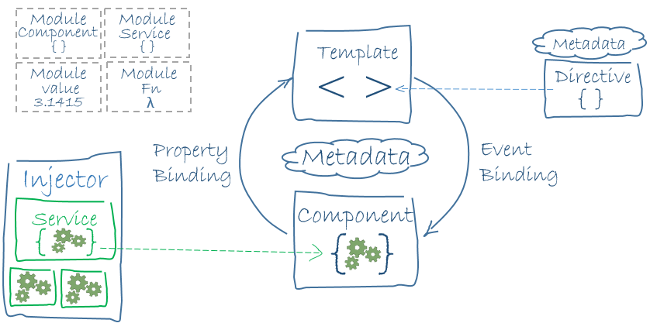
Architecture Overview
https://angular.io/docs/ts/latest/guide/architecture.html
Notes:
Every Angular app has at least one Angular module class, the root module, conventionally named AppModule. Most apps have many more feature modules, each a cohesive block of code dedicated to an application domain, a workflow, or a closely related set of capabilities. An Angular module, whether a root or feature, is a class with an @NgModule decorator. Ours is app.module.ts.
Angular ships as a collection of JavaScript modules. You can think of them as library modules. Each Angular library name begins with the @angular prefix. You install them with the npm package manager and import parts of them with JavaScript import statements, for example @angular/http
A component controls a patch of screen called a view. You define a component's view with its companion template. A template is a form of HTML that tells Angular how to render the component. A template looks like regular HTML, except for a few differences. Metadata tells Angular how to process a class.
Angular supports data binding, a mechanism for coordinating parts of a template with parts of a component. Add binding markup to the template HTML to tell Angular how to connect both sides.
Angular templates are dynamic. When Angular renders them, it transforms the DOM according to the instructions given by directives. A directive is a class with a @Directive decorator. A component is a directive-with-a-template; a @Component decorator is actually a @Directive decorator extended with template-oriented features. (This example doesn’t have directives)
Service is a broad category encompassing any value, function, or feature that your application needs, examples include: logging service, data service, message bus, tax calculator, application configuration. Ours was people.service.ts.
When Angular creates a component, it first asks an injector for the services that the component requires. An injector maintains a container of service instances that it has previously created. If a requested service instance is not in the container, the injector makes one and adds it to the container before returning the service to Angular.

Slide 11
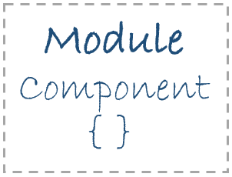
Modules
Every Angular app has at least one Angular module class, the root module, conventionally named AppModule. Most apps have many more feature modules, each a cohesive block of code dedicated to an application domain, a workflow, or a closely related set of capabilities. An Angular module, whether a root or feature, is a class with an @NgModule decorator. Ours is app.module.ts.

Slide 12
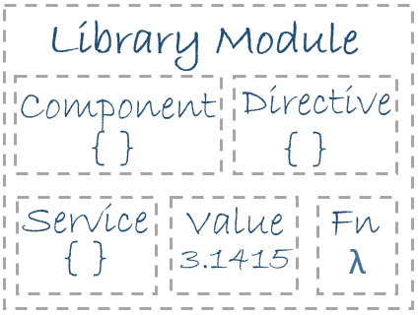
Angular Libraries
Angular ships as a collection of JavaScript modules. You can think of them as library modules. Each Angular library name begins with the @angular prefix. You install them with the npm package manager and import parts of them with JavaScript import statements, for example @angular/http

Slide 13
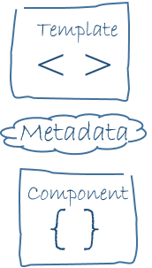
Components-Templates-Metadata
A component controls a patch of screen called a view. You define a component's view with its companion template. A template is a form of HTML that tells Angular how to render the component. A template looks like regular HTML, except for a few differences. Metadata tells Angular how to process a class.

Slide 14
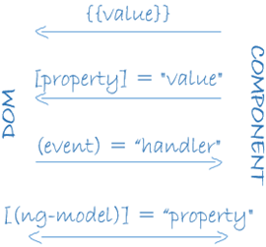
Data binding
Angular supports data binding, a mechanism for coordinating parts of a template with parts of a component. Add binding markup to the template HTML to tell Angular how to connect both sides.

Slide 15

Directives
Angular templates are dynamic. When Angular renders them, it transforms the DOM according to the instructions given by directives. A directive is a class with a @Directive decorator. A component is a directive-with-a-template; a @Component decorator is actually a @Directive decorator extended with template-oriented features. (This example doesn’t have directives)

Slide 16

Services
Service is a broad category encompassing any value, function, or feature that your application needs, examples include:
logging service,
data service,
message bus,
tax calculator,
application configuration.
Ours was people.service.ts.

Slide 17
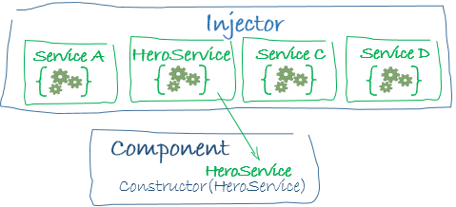
Dependency Injection
When Angular creates a component, it first asks an injector for the services that the component requires. An injector maintains a container of service instances that it has previously created. If a requested service instance is not in the container, the injector makes one and adds it to the container before returning the service to Angular.

Slide 18
More to learn
The Angular Tour of Heroes is a great resource to try some of the other features of Angular.
https://angular.io/docs/ts/latest/tutorial/
This presentation was based on a workshop by Jaime González García at:
https://www.barbarianmeetscoding.com/blog/2016/03/25/getting-started-with-angular-2-step-by-step-1-your-first-component/
Slides and code at:
https://github.com/ebrumley-dbs/angular-pres

