Slide 1

Introduction to Angular
Eren Brumley
Eren.Brumley@Daugherty.com

Slide 2
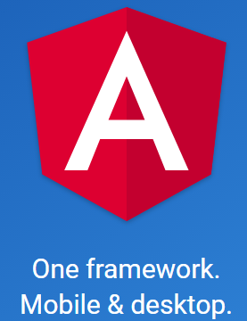

Angular 1, Angular 2, Angular JS?
Angular 1.* has been renamed “AngularJS” and its documentation is at https://angularjs.org/
Angular 2 was a ground-up rewrite of Angular 1. It is not backwards compatible with Angular 1.
Angular 2 was renamed “Angular” and its documentation is at https://angular.io/
The current version is Angular v4 and is the one we will use in this workshop.

Slide 3
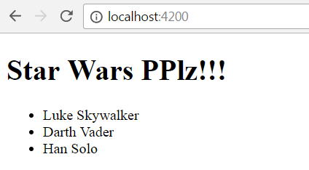
Setup
You MUST HAVE node v4.x.x and npm 3.x.x
Running node -v and npm –v will give you the version you have
Clone into your local https://github.com/ebrumley-dbs/angular-pres.git
In IntelliJ or Webstorm, open the before folder you cloned (like C:\Users\eeb1114\Downloads\before).
In the IDE terminal make sure you are in the before folder and type: npm install
Have patience, it takes a bit of time.
When done, type: npm start
Open in browser: http://localhost:4200

Slide 4

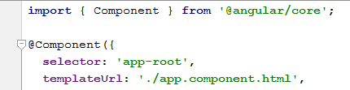
Entry point and bootstrapping
index.html is the entry point to the application. It is very sparse. In our case, it only contains the custom tag app-root.
app.component.ts has the custom tag definition of app-root.
Angular uses bootstrapping logic to set the starting point of the application. In this example, it is set in the src/main.ts module
AppModule is the main module for this application, it is declared in app.module.ts

Slide 5
More to Learn
The code for this presentation was developed by Jaime González García https://www.barbarianmeetscoding.com/blog/2016/03/25/getting-started-with-angular-2-step-by-step-1-your-first-component/
Other tutorial resources:
Tour of Heroes tutorial from Angular.io https://angular.io/docs/ts/latest/tutorial/
Angular 2 First Look by John Papa https://app.pluralsight.com/library/courses/angular-2-first-look/table-of-contents

