Slide 1

Unlocking Data: Understanding APIs and How to Access the Information You Need
Eli Brunette

Slide 2
Why APIs Matter
Data Is Everywhere
Examples:
Salesforce
GitHub
Microsoft 365
Weather services
Banking applications
Social media
Blizzard

Slide 3
What Is an API?
API = Application Programming Interface
Simple definition:
An API is a way for applications to communicate and exchange information.
Use a restaurant analogy:
Customer = You
Waiter = API
Kitchen = Server
Meal = Data
User
↓
API
↓
Application/Database
↓
Response

Slide 4
Everyday APIs
Examples everyone recognizes:
Weather apps
Google Maps
Amazon product searches
Spotify playlists
Online banking
Question:
How many APIs do you think you used today?

Slide 5
Anatomy of an API Request
Request
Contains:
Endpoint
Method
Headers
Parameters
Example
GET /users/123
POST /user
{
“name”: “Eli”,
“profession”: “data engineer”
“years”: 6
}

Slide 6
Common HTTP Methods
Method | Purpose
GET | Read Data
POST | Create Data
PUT | Update Data
DELETE | Delete Data

Slide 7
Understanding Responses
{
"bookstore": {
"book": [
{
"id": "bk101",
"category": "fiction",
"title": {
"lang": "en",
"content": "The Great Gatsby"
},
"author": "F. Scott Fitzgerald",
"year": 1925,
"price": 14.99
},
…
]
}
}
<bookstore>
<book id="bk101" category="fiction">
<title lang="en">The Great Gatsby</title>
<author>F. Scott Fitzgerald</author>
<year>1925</year>
<price>14.99</price>
</book>
<book id="bk102" category="programming">
<title lang="en">Learning XML</title>
<author>Erik T. Ray</author>
<year>2003</year>
<price>39.95</price>
</book>
</bookstore>

Slide 8

APIs and Authentication
Free website for APIs
https://free-apis.github.io/#/browse
Header:
API Keys
Bearer Tokens
Combination
OAuth

Slide 9

Example API Flow
Python
↓
Request
↓
API
↓
JSON Response
↓
Transform
↓
Database
↓
Dashboard

Slide 10
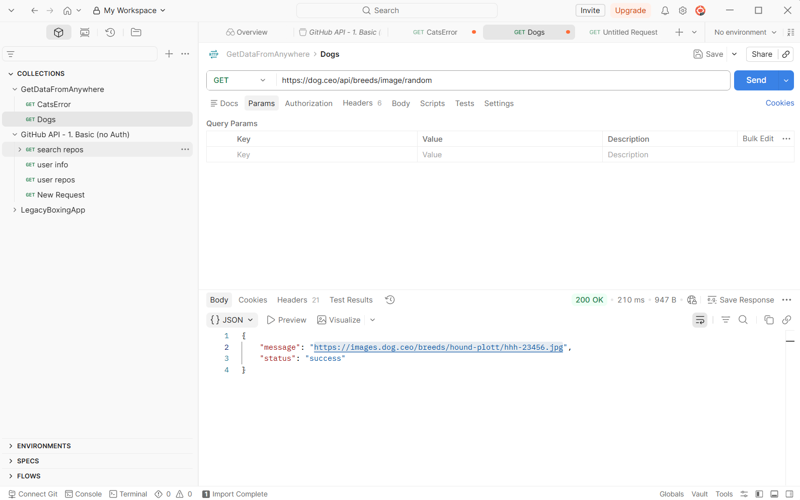
Tools for Exploring APIs
Tools:
Browser
Postman
Curl
Python requests
Power BI
Excel

Slide 11
Reading API Documentation
Show typical documentation sections:
Endpoint
Parameters
Authentication
Example request
Example response
WoW API Example
https://community.developer.battle.net/documentation
https://community.developer.battle.net/documentation/world-of-warcraft/game-data-apis

Slide 12
Live Example via Postman
Notes:
https://www.postman.com/postman/postman-api-101-with-auth/documentation/vglcfpa/github-api-2-advanced-with-auth?sideView=agentMode
Dogs Example:
https://dog.ceo/dog-api/

Slide 13
Common Challenges
Topics:
Authentication errors
Pagination
Rate limits
Missing fields
Timeouts
Version changes

Slide 14
APIs in Data Engineering
CRM
ERP
HR
Billing
IoT
↓
APIs
↓
ETL / ELT
↓
Snowflake
↓
dbt
↓
Power BI / Sigma

Slide 15
Real-World Use Cases
Sales Analytics
Salesforce API → Warehouse → Dashboard
Financial Reporting
NetSuite API → Snowflake
Monitoring
Azure API → Cost reporting
IoT
Sensor APIs → Analytics

Slide 16
Best Practices
Read the docs.
01
Start with Postman.
02
Handle errors gracefully.
03
Respect rate limits.
04
Never hardcode secrets.
05
Log requests and responses.
06
Build reusable code.
07

Slide 17
Key Takeaways
APIs Enable Modern Data Access
✔ APIs allow systems to communicate.
✔ Requests and responses are the foundation.
✔ Authentication keeps data secure.
✔ JSON is the most common data format.
✔ APIs power analytics and automation.

Slide 18
Questions!

