Slide 1

Creating Things That Think
-
Project 2
Eric Martin
September 29, 2021
IDEA 310L

Slide 2
Description of Design Process
Design requirements :
Two digital or analog inputs with at most one button/switch
Using at least two digital outputs, using at most one LED
Design Process :
Wanted to utilize the rotary encoder
  Made me think of using a Masterlock
Decided to design a ‘cracking the lock game’
  Use the LCD screen to display information
Needed some auditory feedback to simulate using a Masterlock
  Utilized the piezoelectric transducer to simulate the ‘click’ of a turn
  A different click is played when the target number is passed
Use of Serial Input and Output for user interaction
  User can set their own password or generate a random password to crack
Alarm and light system for incorrect final guess
Nice presentation

Slide 3
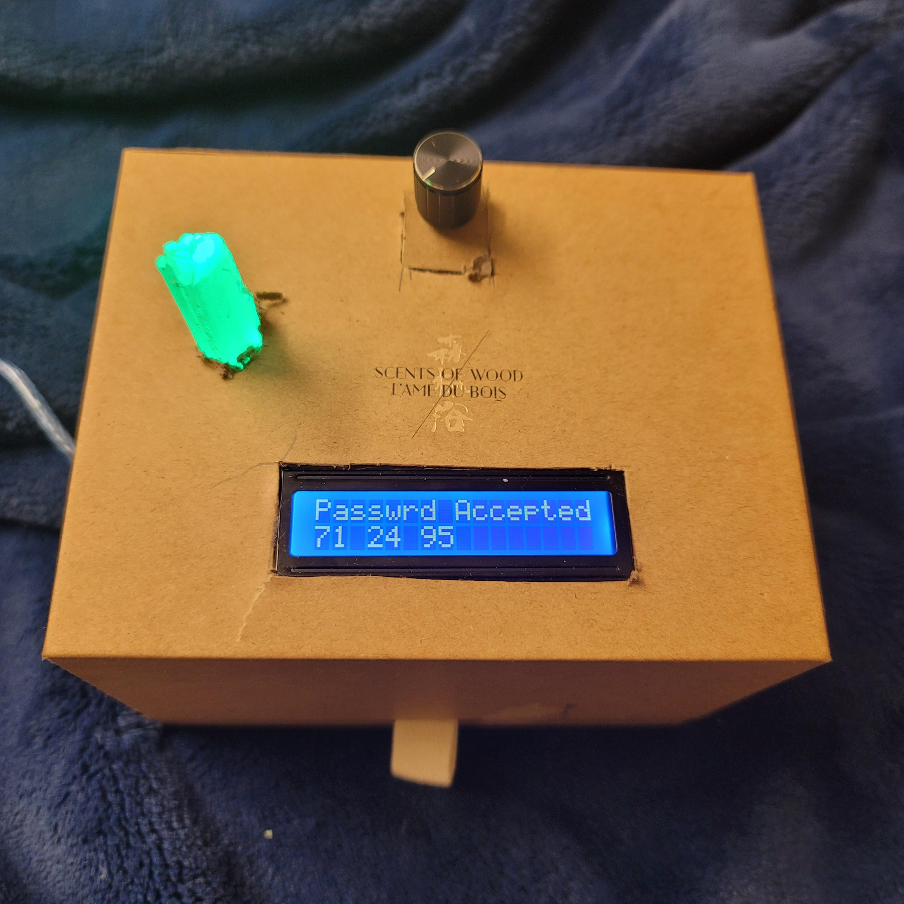
Design
Using a heavy-duty cardboard box with magnetic closure an LCD screen, Rotary Encoder, and Selenite crystal were embedded to create a fun presentation

Slide 4
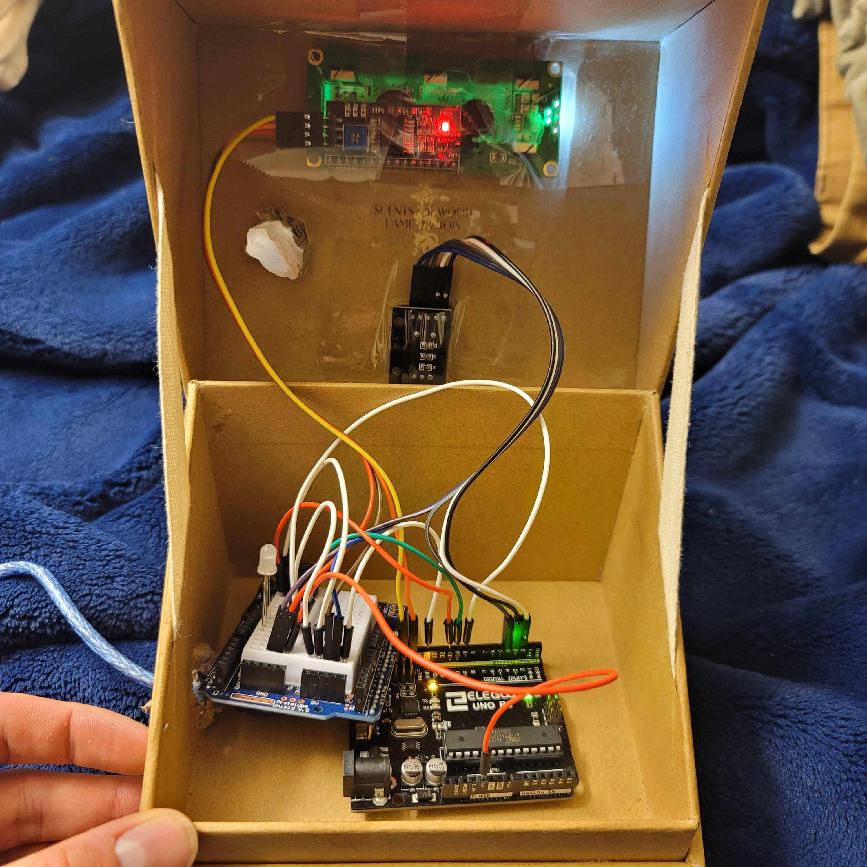
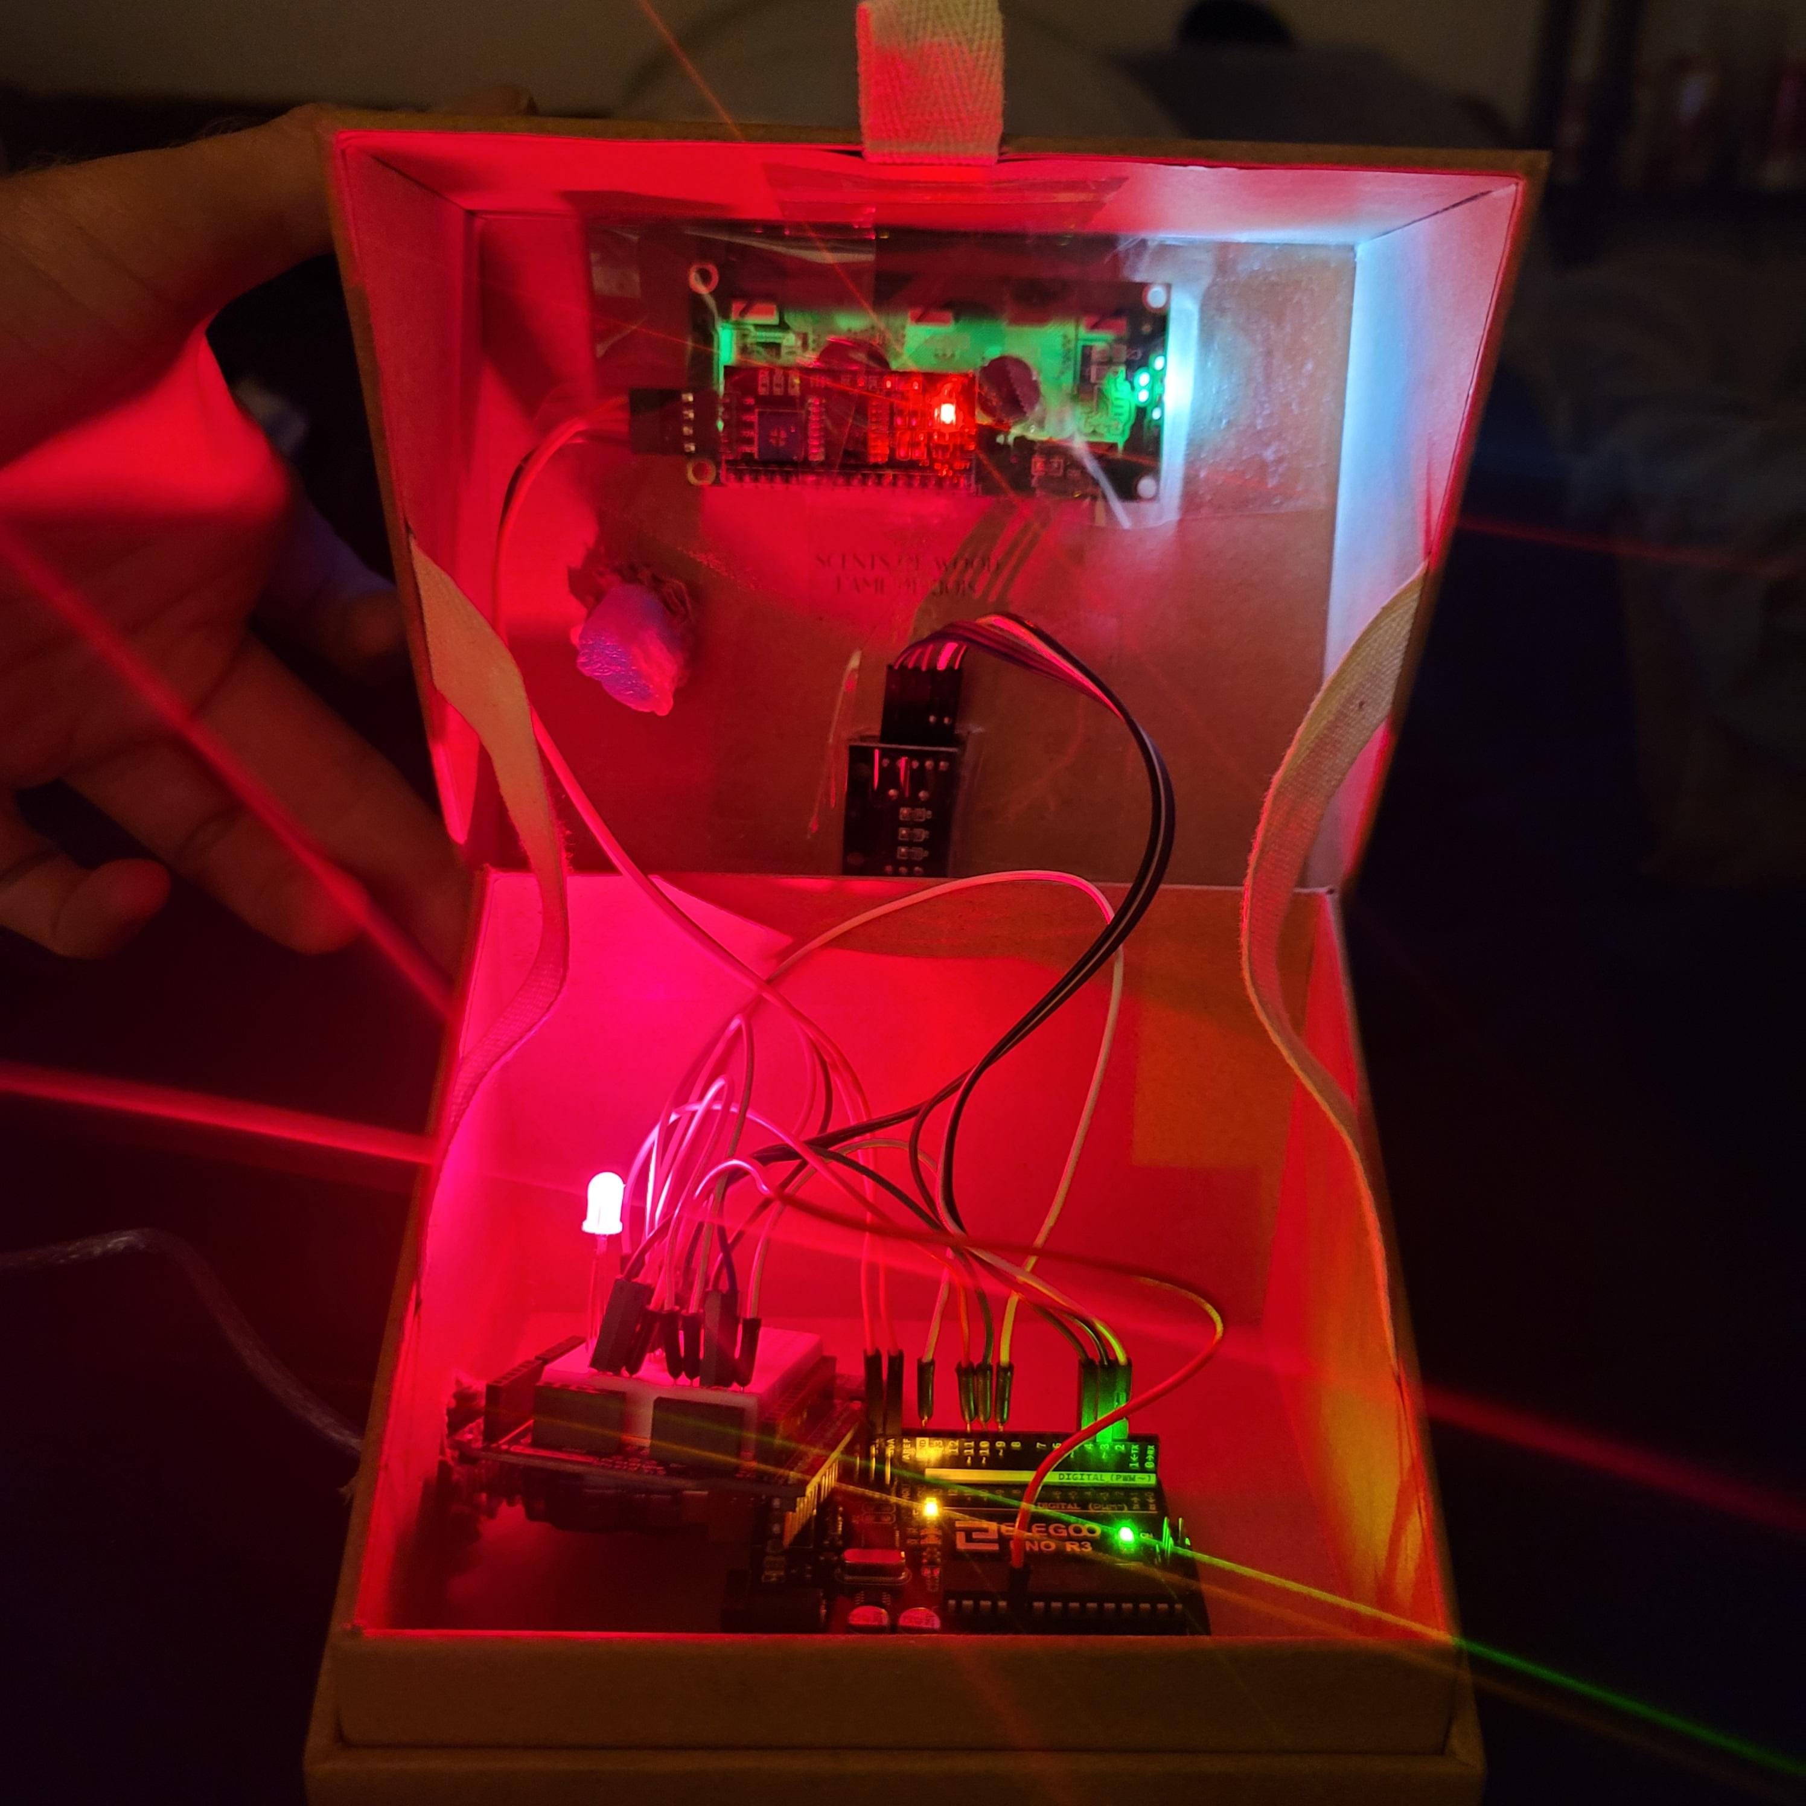
When closed, the crystal sits above the LED and funnels the light outside of the box

Slide 5
Description of Game
Crack the code game!
You are attempting to crack into a device that contains sensitive cryptocurrency data.
Have someone set a 3-digit password via the Serial Port or use the random function to generate one for you.
  Input error checking is programmed in to ensure proper input format.
Follow the on-screen instructions containing information on how to play.
  Use the rotary encoder and listen for a variation in the sound of the clicks to identify the target number and press the switch to select the chosen number.
Once the player has chosen all three numbers, the device will either accept or decline the password
  On success, a green light will shine through the crystal and sensitive information will be displayed. WINNER!
  On failure, a red light will shine through the crystal, an alarm will sound. FAILURE!

Slide 6

Schematic

Slide 7
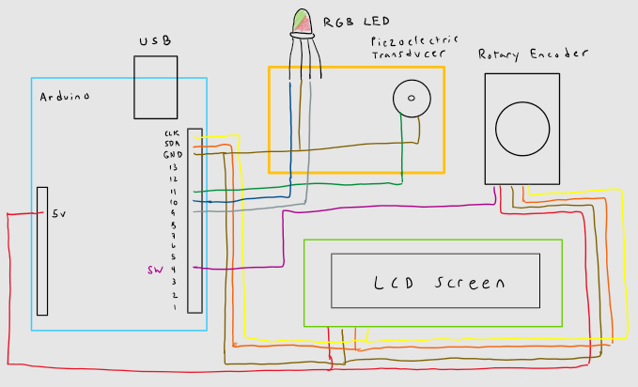
“Schematic”

Slide 8
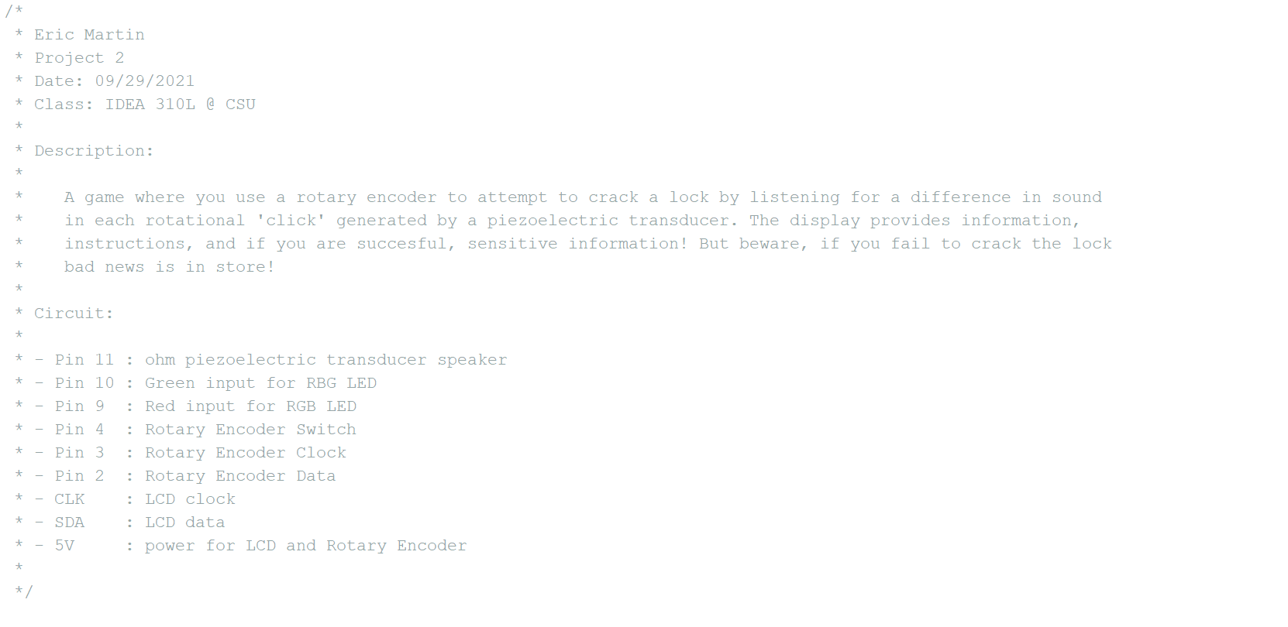
Schematic – Pin Layout

Slide 9

Demonstration

Slide 10

Code

Slide 11
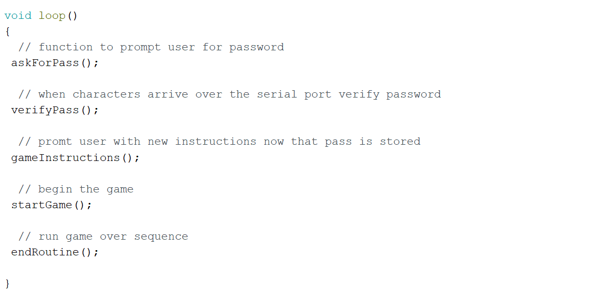
Code

Slide 12
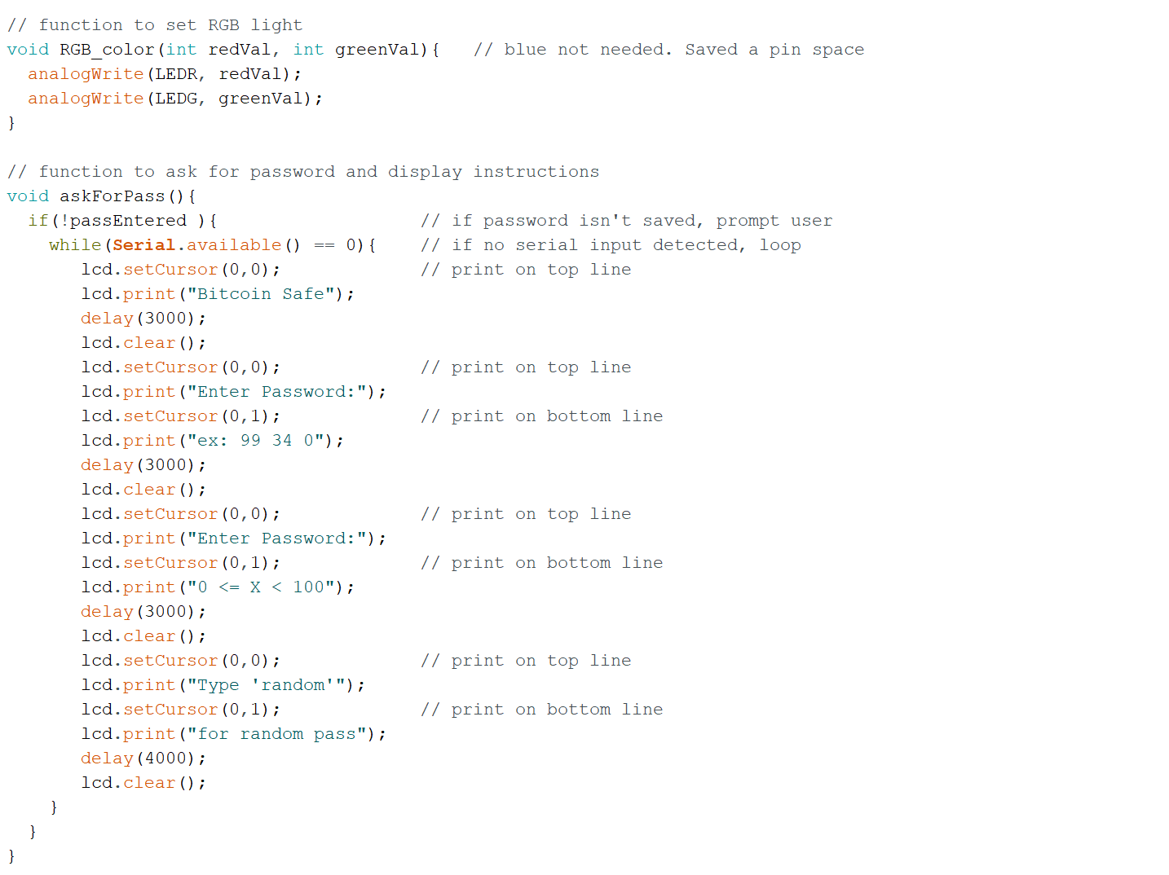
Code

Slide 13
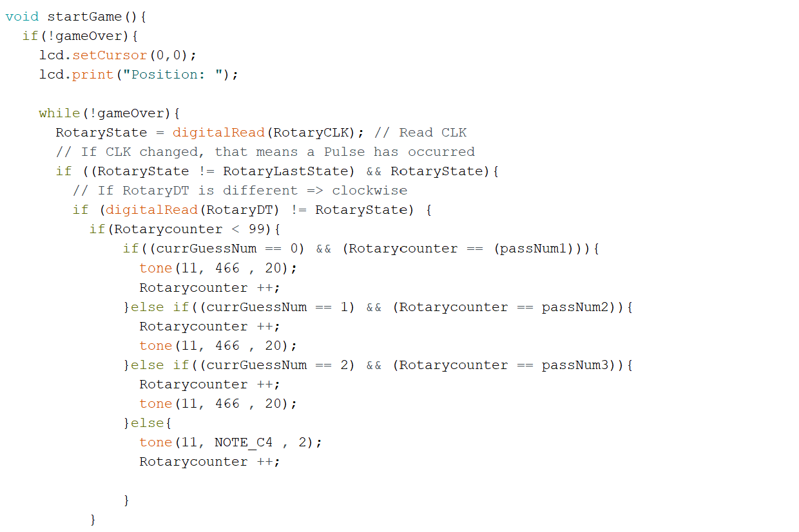
Code

Slide 14

Challenges / Issues
Parsing the user input string into 3 integers was proving difficult
  The game only works on random mode as of now
Screen text must fully cycle through loop before user input is read
  This makes for some wait time after user input
I could not get the target number to cause a unique ‘click’ when you turn to the number
  The unique ‘click’ sound will only occur once you pass the number in either direction.
Rotary Encoder could be better secured into box

