Slide 1

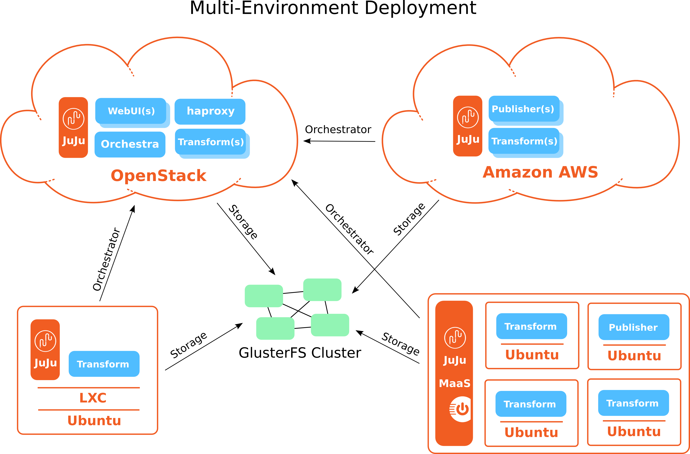
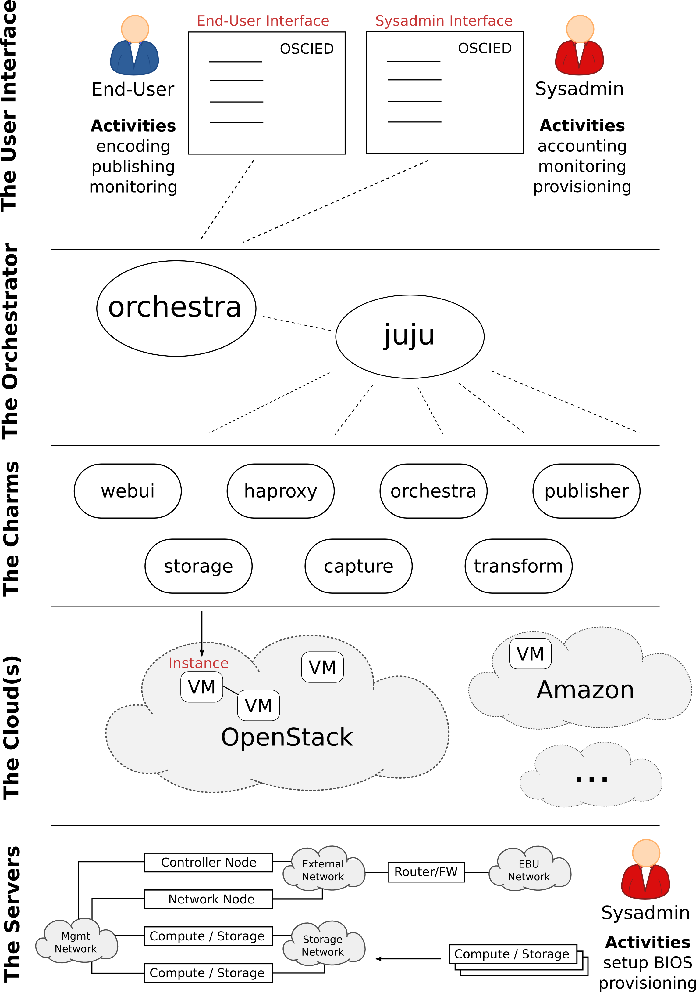
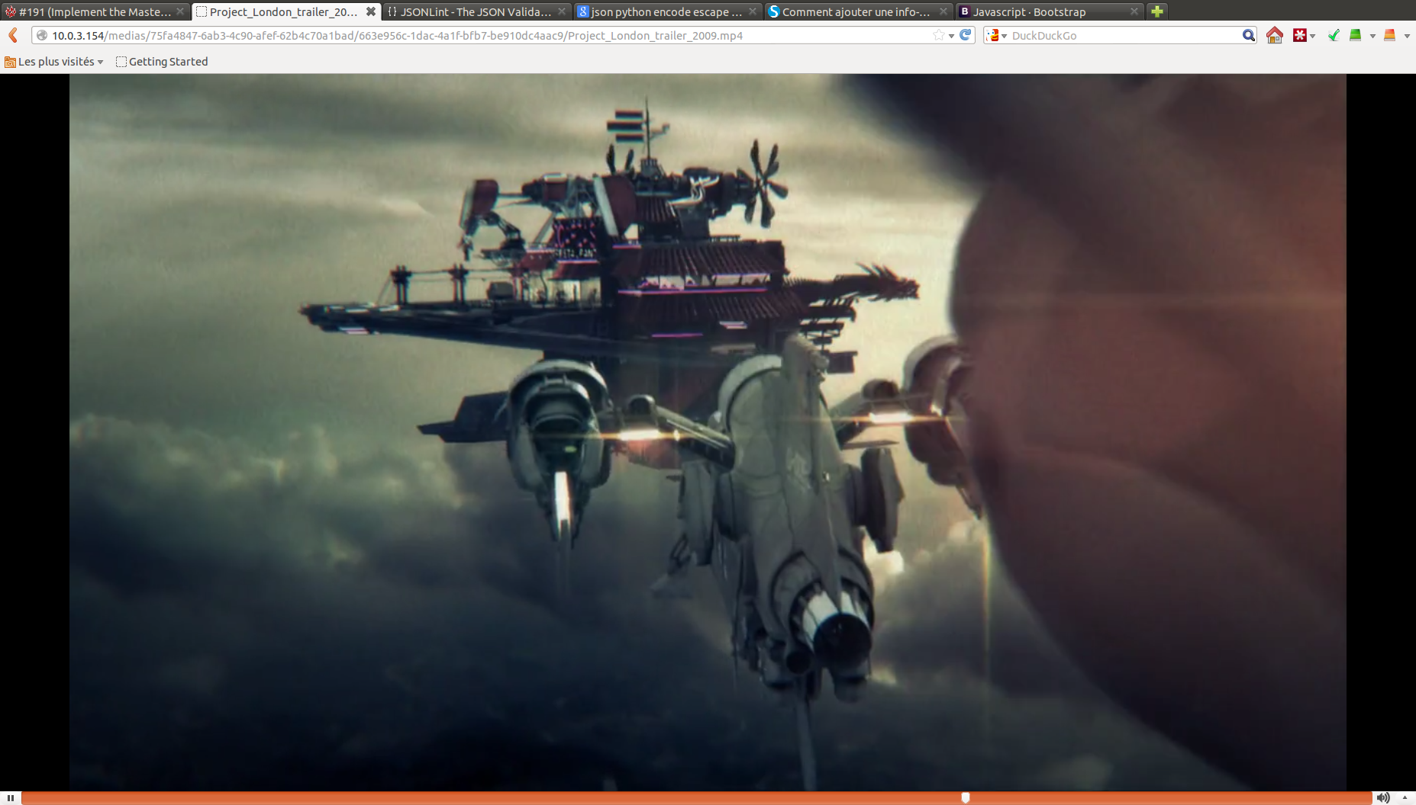
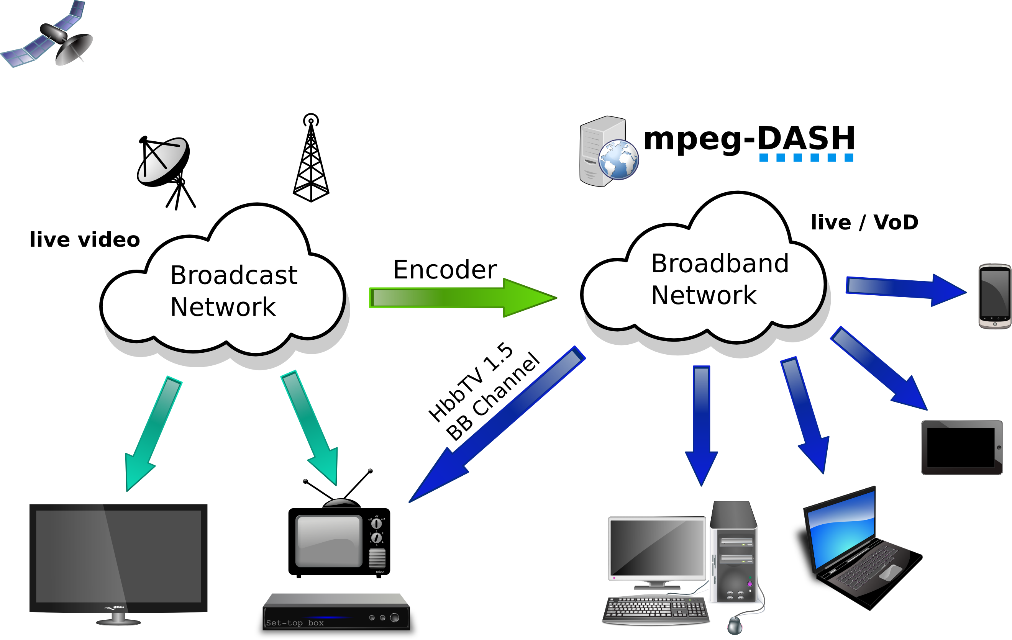
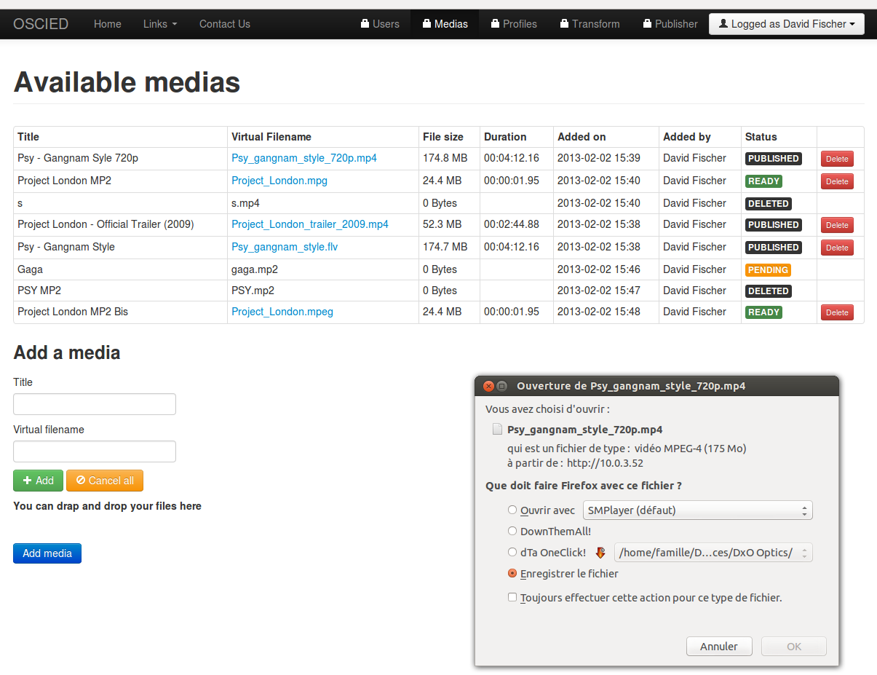
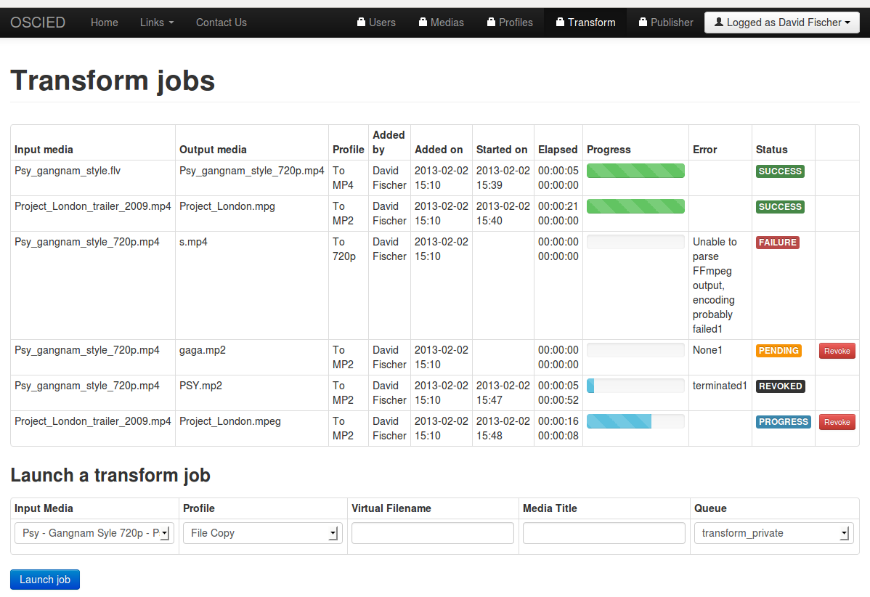

Travail de Master of Science HES-SO en Engineering
Plateforme de distribution MPEG-DASH
Project « Open-Source Cloud Infrastructure for Encoding and Distribution »
David Fischer
Professeur responsable : Andrés Revuelta, Hepia
En collaboration avec European Broadcasting Union (EBU/UER)
DESCRIPTION
RESULTATS
The Internet is growing in importance for broadcasters, as it allows to deliver content directly to end-users and interact with them via interfaces. A downside to this story is the fact that distributing content over the Internet is very expensive.
One of the challenges they face is the transcoding of their on demand content libraries to new file formats that are optimized for multi-screen consumption (e.g. MPEG-DASH). Normally they need to encode to at least 8 file representations of the same video. This process is a constant factor when the daily production of content is contributed but also knows peaks in cases when libraries need to be transcoded. Another challenge is the scaling of distribution servers. This process is dominated by changing demands because traffic peaks during the day, is at a minimum at night and sometimes when a video becomes a hit it will peak also.
Both these challenges are met by an encoding (or transcoding) and distribution environment that can up- or down-scale capacity easily. Ideally a distribution environment is downscaled at night and only upscaled at peak events. A transcoding environment needs to be upscaled when more transcoding jobs are waiting.
I build a cloud-aware platform that can up-or down-scale transcoding or distribution nodes in a private (local servers) or in a public cloud (like Amazon Web Services). Made possible because platform’s functionalities are split into components and therefore can be deployed on multiple clouds in parallel and even more !
This environment will allow all kinds of other interesting functionalities for content providers as broadcasters. The encoding/transcoding can easily make new codecs available, you can optimize costs by up scaling in the night when the cloud computing resources are cheaper, encoding of live-content can be added etc. etc. From the distribution side the media gateways of different cloud providers can be used to cache content closer to the end user and with that optimize the data flows, or add different types of streaming, or define edges in different CDN‘s and use OSCIED as a CDN overlay. The system as a whole can grow into a full fledged publication platform with professional management layers (which I started with already) that can publish, revoke but perhaps in the future also use cloud computing resources to deliver personalized transformations of the content deep into the network close to the end user.
OBJECTIFS
This project is aimed by the goal of providing a scalable Open-Source media platform to members of the European Broadcasting Union (EBU/UER).
This platform, based on cloud-era Open-Source technologies, would be dedicated and designed based on broadcasters specific needs such as transcoding of a wide collection of medias or online publication of popular medias, two use cases of this preliminary demonstrator.
This Open-Source platform would be freely available for broadcasters to promote interchange of knowledge and drive the project’s developments by a wider community of experts.
The private-cloud environment runs on the Open-Source cloud software OpenStack. The project involves 4 servers consisting of a Controller, a Network gateway and Nodes (Computer/Storage) machines that will be configured and installed during the thesis.
The context and the project separated in logical layers, from the physical servers
to the end-user
Medias encoding jobs, publication jobs and web-based playout of published medias, few screeshots of OSCIED web user interface
CONCLUSION
With OSCIED I proved that building a platform based on cloud-era Open-Source technologies can fix the scalability issue by providing a rather simple but yet powerful way to consume already existing enterprise’s IT ressources mixed with necessary amount of public cloud resources. The hybrid-cloud model is the perfect approach to combine the highly available, low-cost, in-house IT infrastructure with scalable, on-demand public cloud infrastructures : You decide, OSCIED do !
The platform I developed made available on-demand scalable transcoding and distribution services that can be used through an uncluttered, user-friendly web interface that actually maps the call of orchestrator’s RESTful API. This API is a key feature allowing broadcasters to automate usage of the platform and make possible the integrationof OSCIED in broadcasters automated workflows. The features I implemented are tested and works well, the multi-cloud deployment, mixed with bare-metal storage works even better. I deployed the platform for weeks on my desktop computer, on Amazon AWS and on any server I was authorized to use. The demonstrator is the proof of concept of something bigger, something not expected, something called OSCIED !
I have chosen for Open-Source software because I have access to the level of the source code and it allows other developers to build upon the work I have done. From the broadcast community and beyond already interest is shown to invest in my approach. Furthermore if the main components of the virtualized services for transcoding (FFmpeg) of distribution (Apache 2) have a new LibDASH or version that is made available by their specific Open-Source development community it can be integrated easily in the system.
Notes:
<numéro>

