Slide 1


Open-Source Cloud Infrastructure for
Encoding and Distribution
In collaboration with
By David Fischer,
Prof. : Andrés Revuelta
EBU : Bram Tullemans

Slide 2
Plan
Introduction
OSCIED
Layers of OSCIED
Servers Layer
Clouds Layer
Services Orchestration Layer
Application (Platform) Layer
Conclusion
Future
Master HES-SO MA
Questions & Answers

Slide 3
Introduction - Context

Slide 4
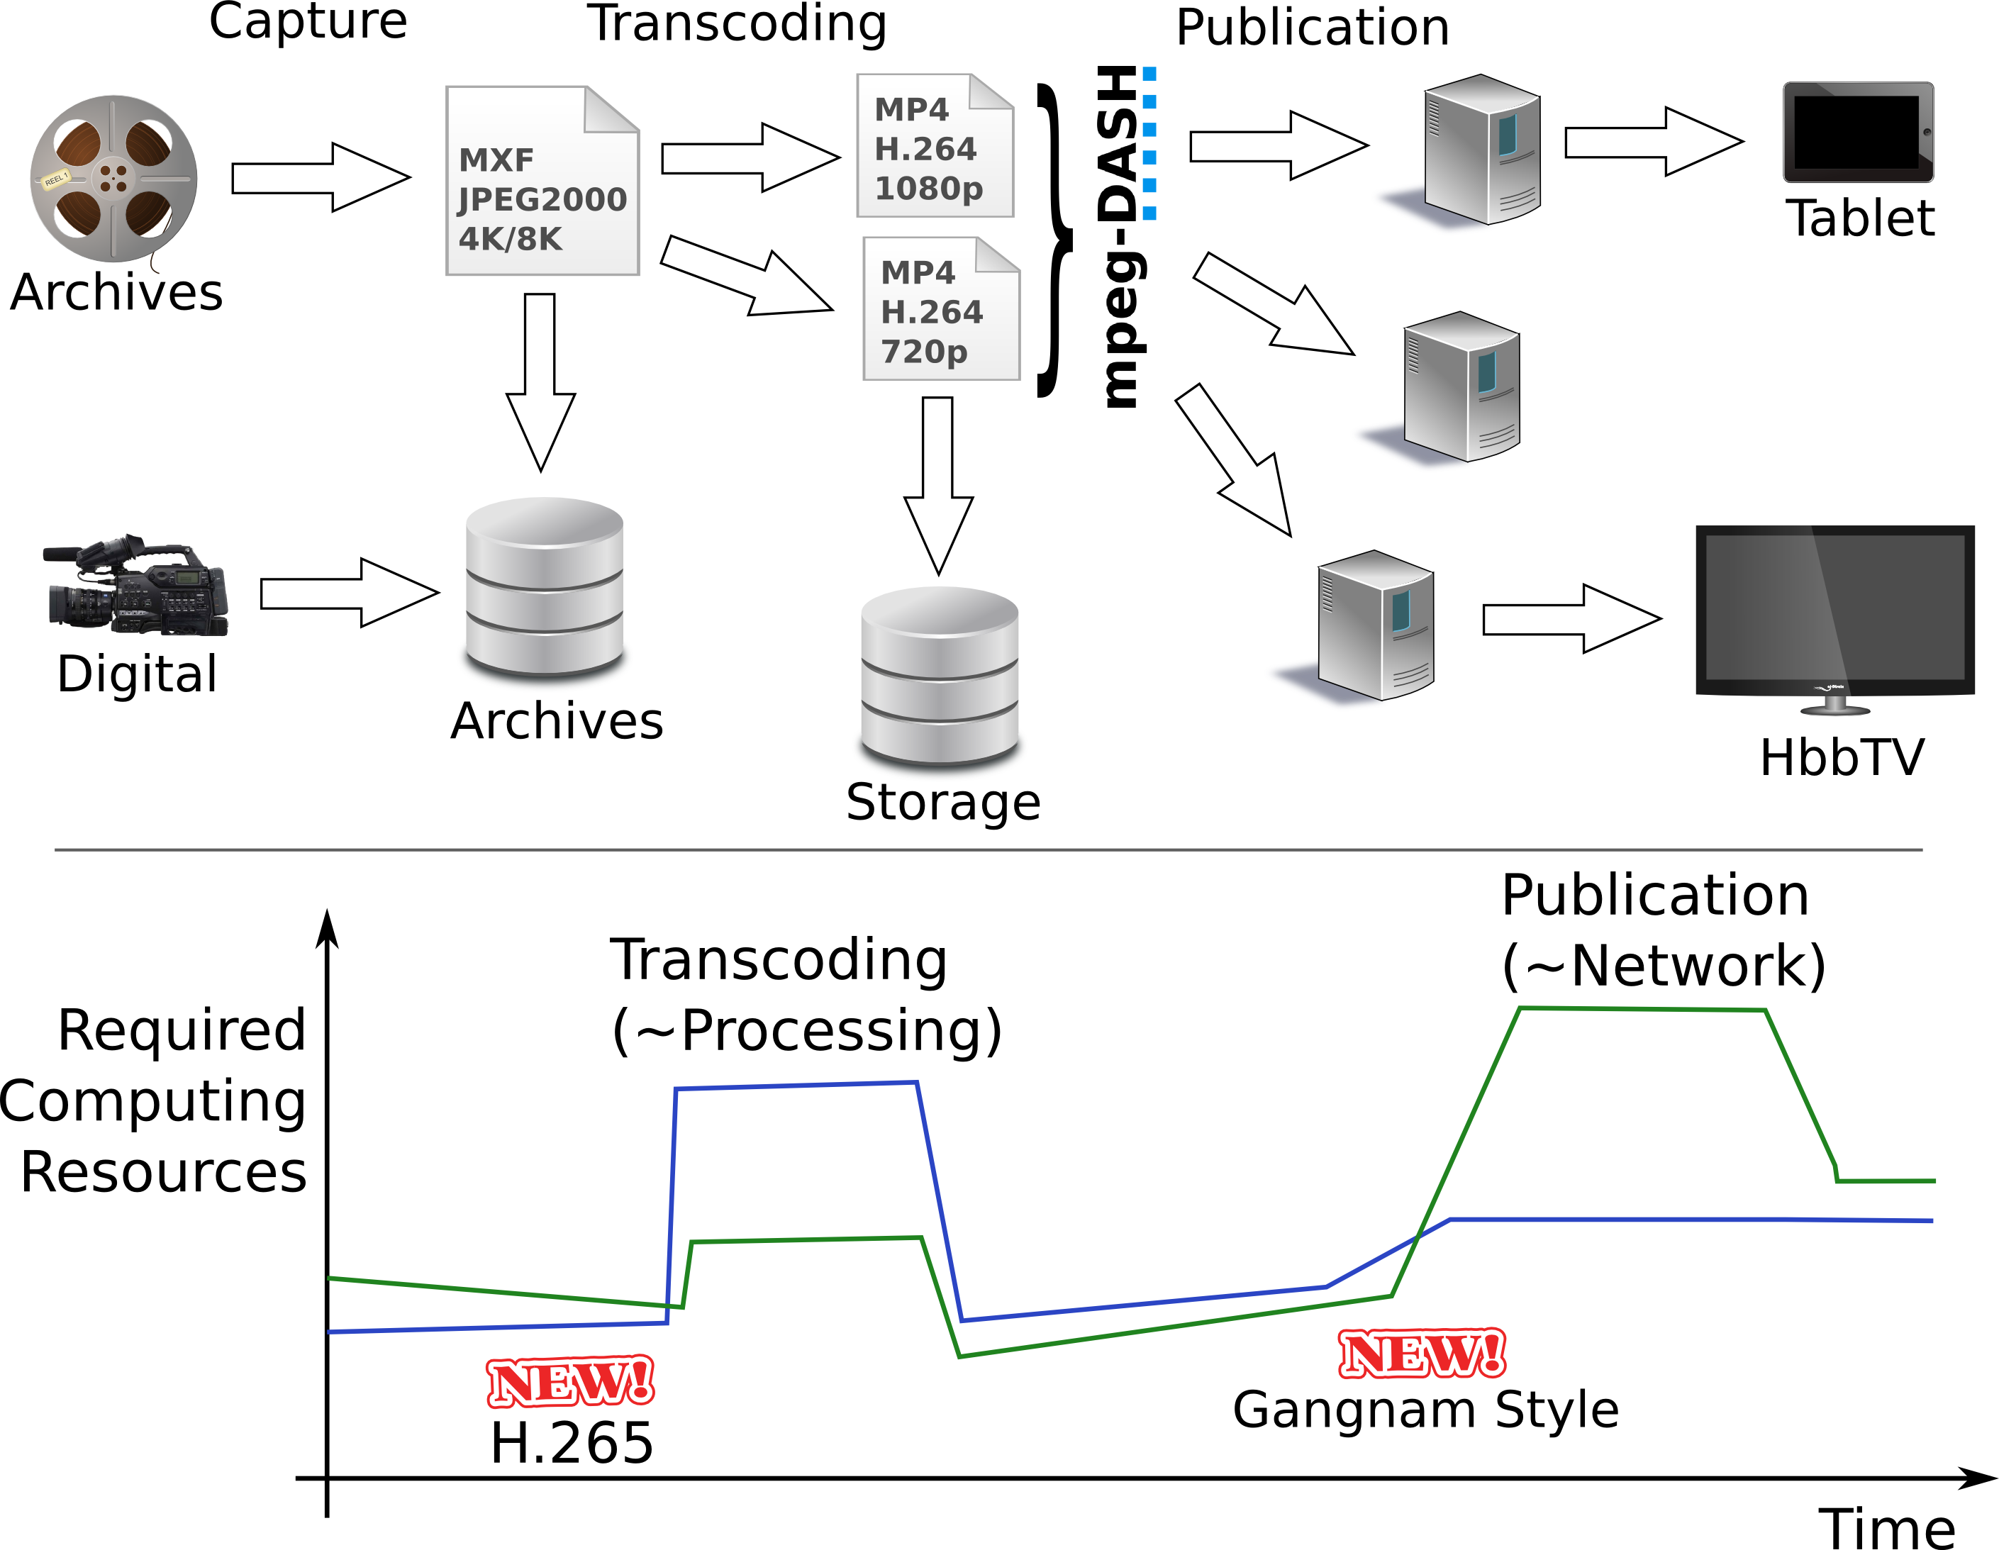
Introduction – Motivation

Slide 5
OSCIED
Providing a scalable OSS media platform to members of EBU
A platform based on cloud-era OSS technologies, dedicated to :
  Transcoding of a wide collection of medias to new formats
  Online publication of popular medias
A platform that is designed to allow :
  Deployment of services in-house, entreprise IT infrastructure
  Scaling of transcoding and publication points to public clouds (IaaS)
  Ease of scale-up or scale-down of services
  Separation of development, testing and production environments
  Future features or capabilities (MPEG-DASH, ...)

Slide 6
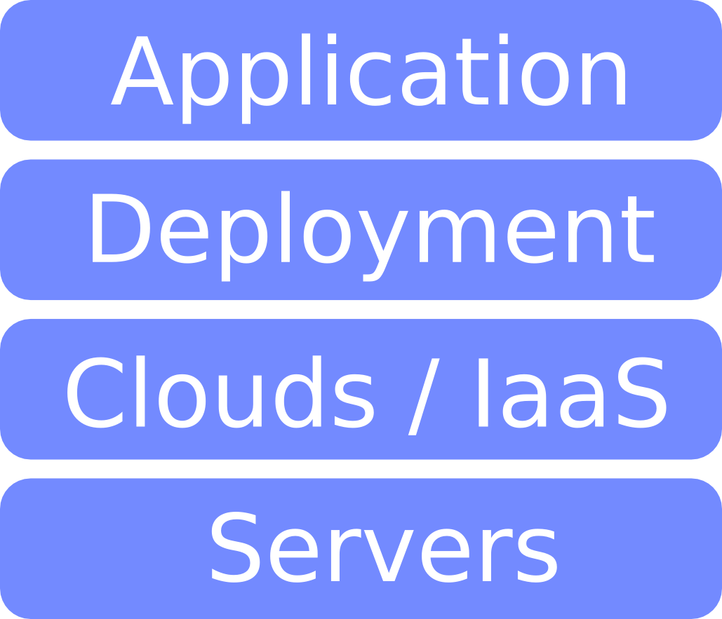
Layers of OSCIED (!= OSI)

Slide 7
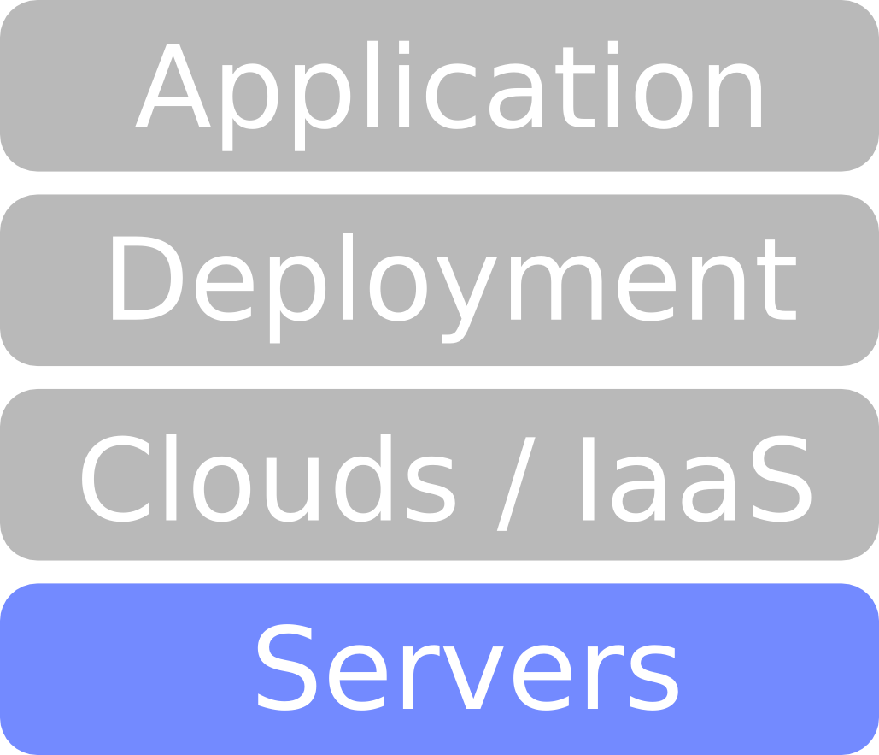
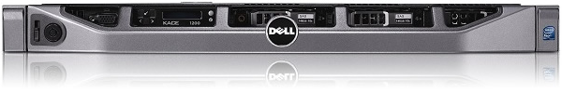
Servers Layer
A setup of 4x 1U servers chosen based on :
  Project's CAPEX (the cash)
  Optimization of configuration based on needs
  Ubuntu Server's certified HW list for Dell Servers
Dell PowerEdge R420
  2x Xeon E5-2430 2.20GHz, 15MB Cache, 7.2GT/s, 6C
  4x 4GB RDIMM 1333MT/s x8 Data Width
  HW RAID PERC H310 Mini + 2x 1TB 7.2K SATA

Slide 8
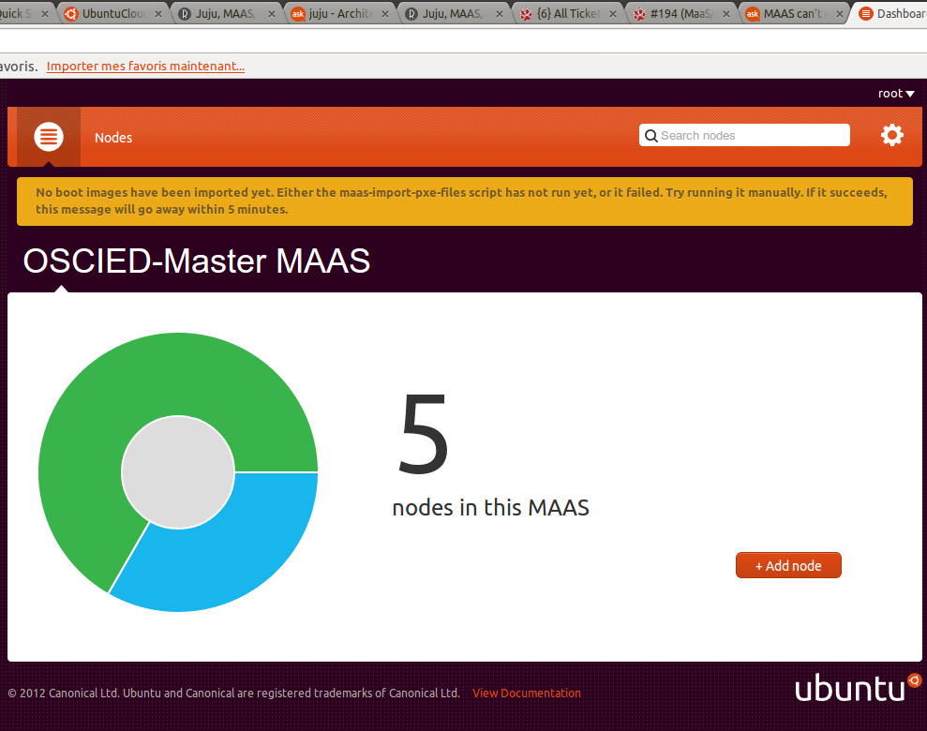
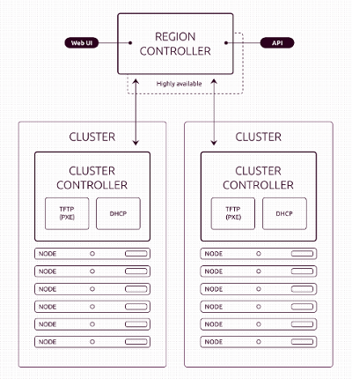
Servers Layer (MaaS)
Ease of servers provisionning (PXE install)
Driveable through an API (enable automation)
Developped to interact with JuJu

Slide 9
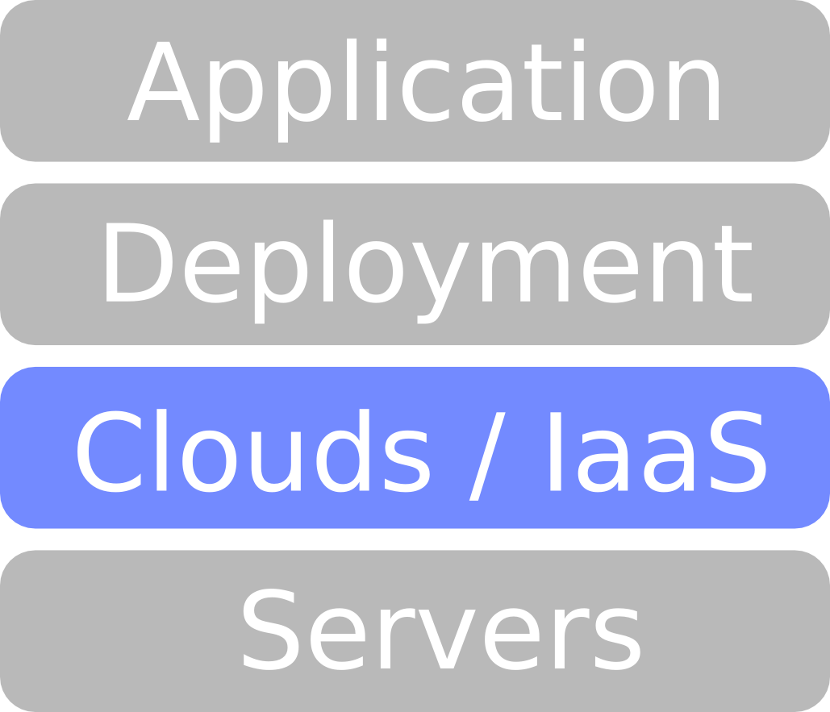
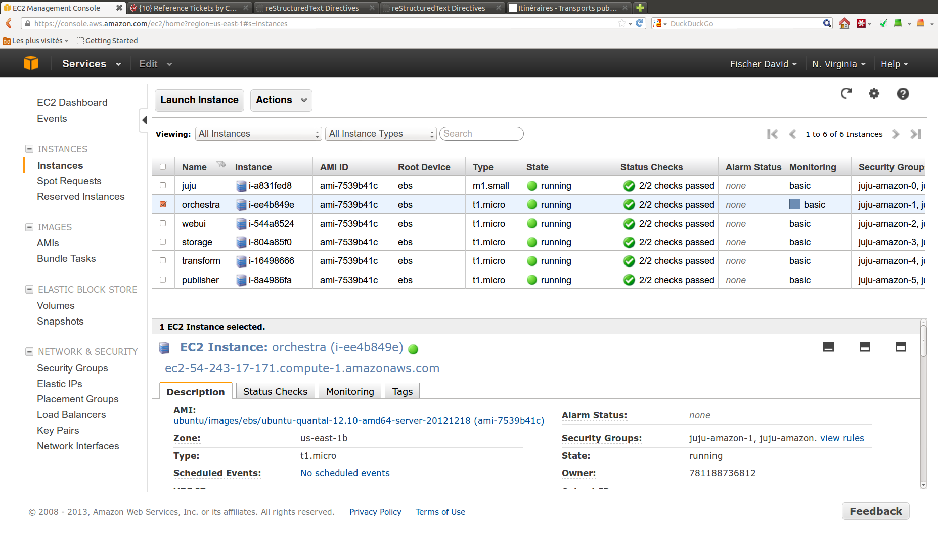
Clouds Layer (Amazon, ...)
« Amazon Elastic Compute Cloud (Amazon EC2) is a web service that provides resizable
compute capacity in the cloud. It is designed to make web-scale computing easier for
developers. »
Manageable through an API or WUI
Compute / network services :
  EC2 – Elastic Compute Cloud
  EMR – Cluster Hadoop
  Route 53 – DNS
Storage/CDN services :
  S3 – Simple Storage Service
  Glacier – Low-cost Archive Storage
  EBS – Elastic Block Storage
  CloudFront – Content Delivery Net.
Database services :
  RDS – Relational DB Services
  DynamoDB – NoSQL data store
Management services :
  AWS Management Console
VM Instances can be launched On-demand, Reserved (for 2 years) or Spot (if price below 0.1$/h).
Instances Type : Define #CPU, #MB RAM, iops ... $/h

Slide 10
Clouds Layer (Amazon, ...)
« Amazon Elastic Compute Cloud (Amazon EC2) is a web service that provides resizable
compute capacity in the cloud. It is designed to make web-scale computing easier for
developers. »
Manageable through an API or WUI
Compute / network services :
  EC2 – Elastic Compute Cloud
Storage/CDN services :
  S3 – Simple Storage Service
Database services :
Management services :
  AWS Management Console
VM Instances can be launched On-demand, Reserved (for 2 years) or Spot (if price below 0.1$/h).
Instances Type : Define #CPU, #MB RAM, iops ... $/h

Slide 11

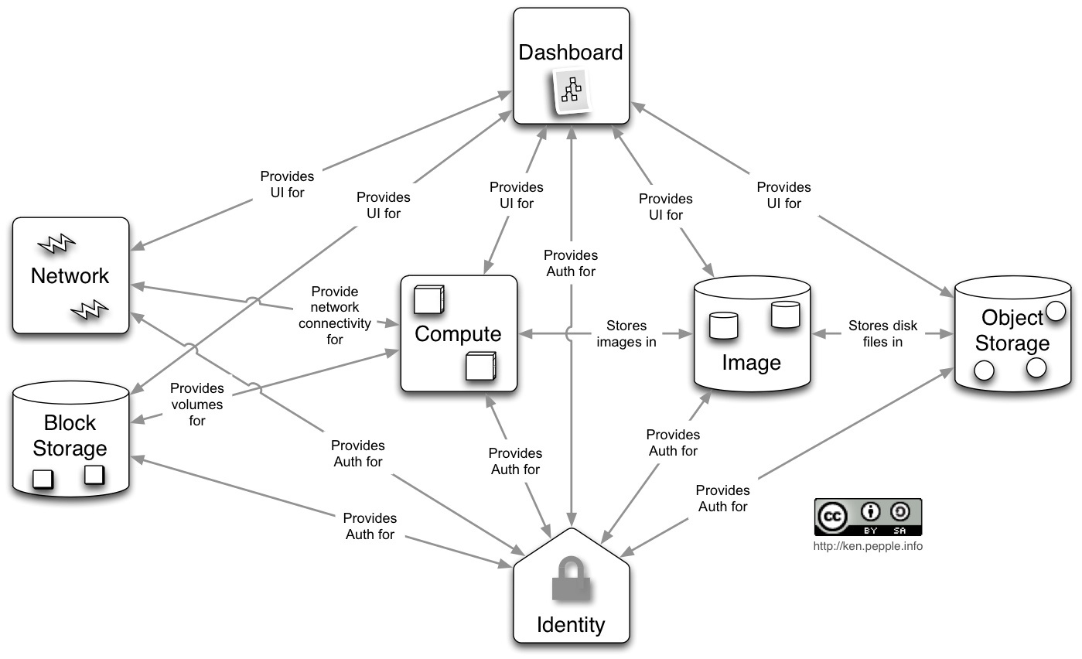

Clouds Layer (OpenStack)
Nova services
(compute, network, image ...)
Horizon
Rackspace's Swift
object storage
Quantum
Glance
AWS S3
compatible :
Ceph
GlusterFS
Swift
Cinder
Amazon EC2 compatible
Open-Source, wide community
Pluggeable design
(-) Documentation
Keystone
IaaS : Infrastructure-as-a-Service

Slide 12
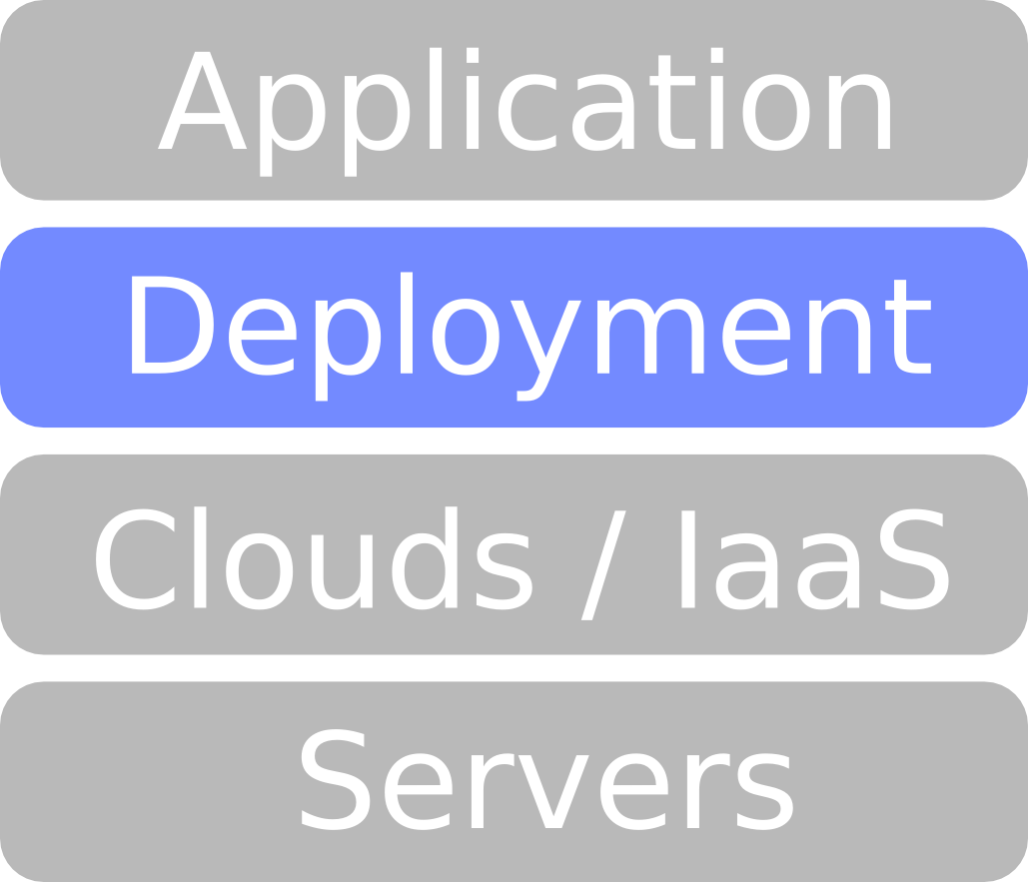
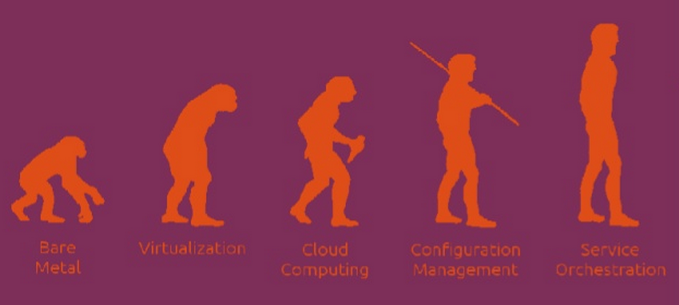
Services Orchestration ...
JuJu
(Chief, ...)
KVM, LXC
OpenStack
Servers
Copyright Hardik Dalwadi

Slide 13
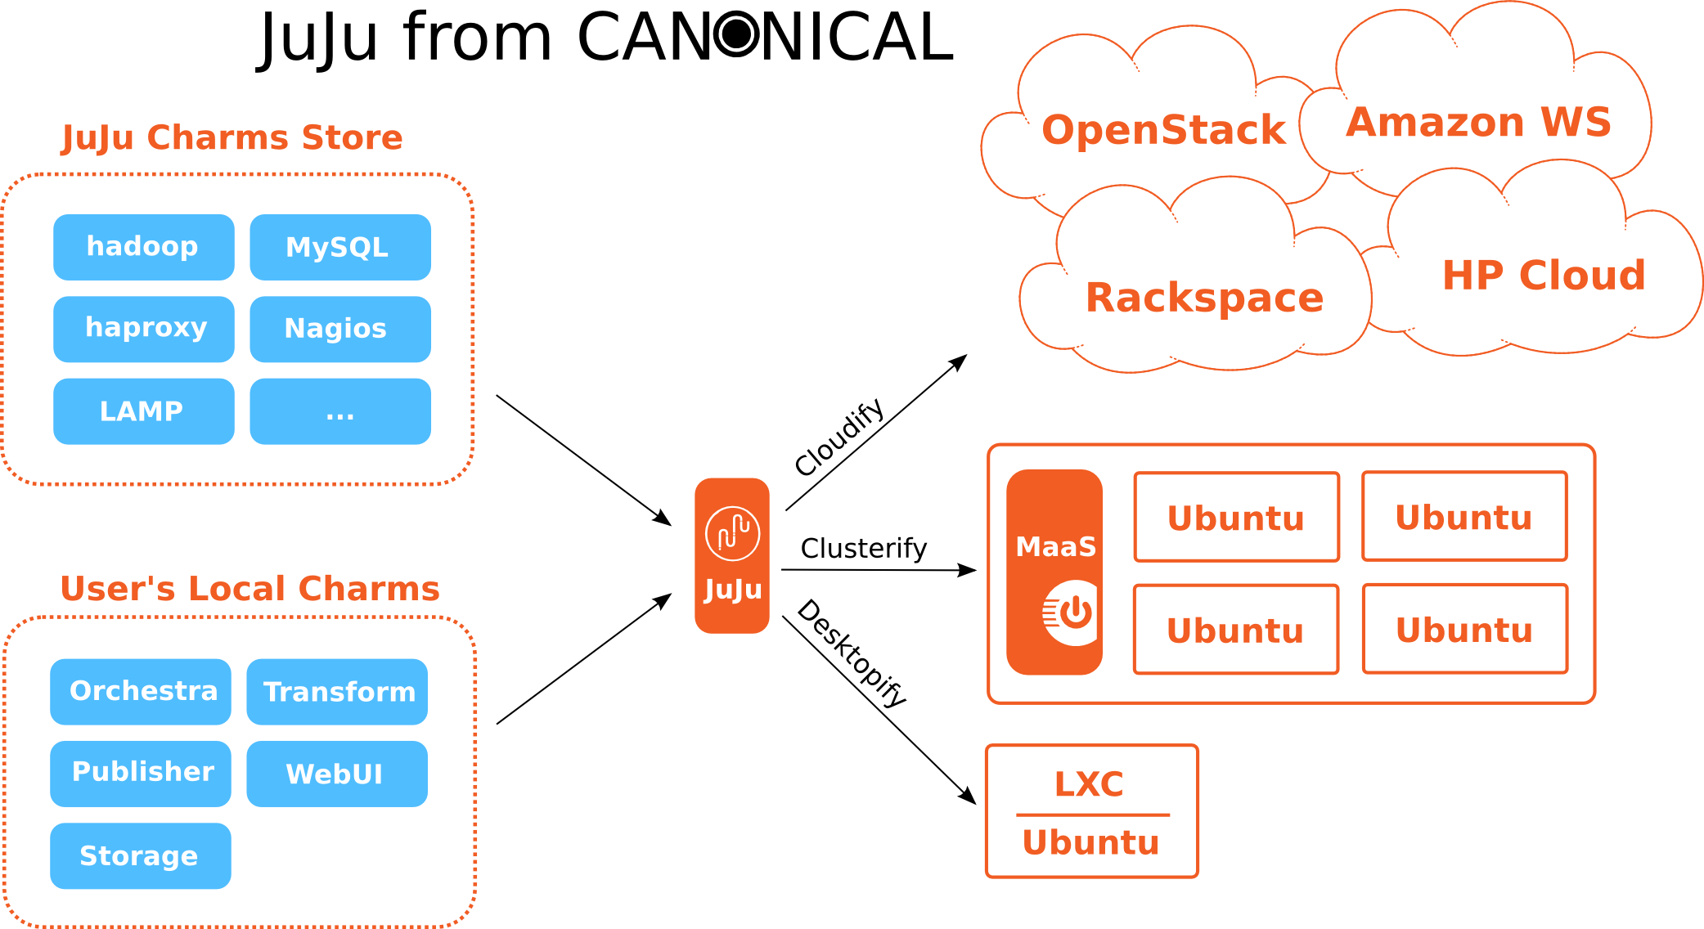
Services Orchestration ...
Services
Hosts

Slide 14
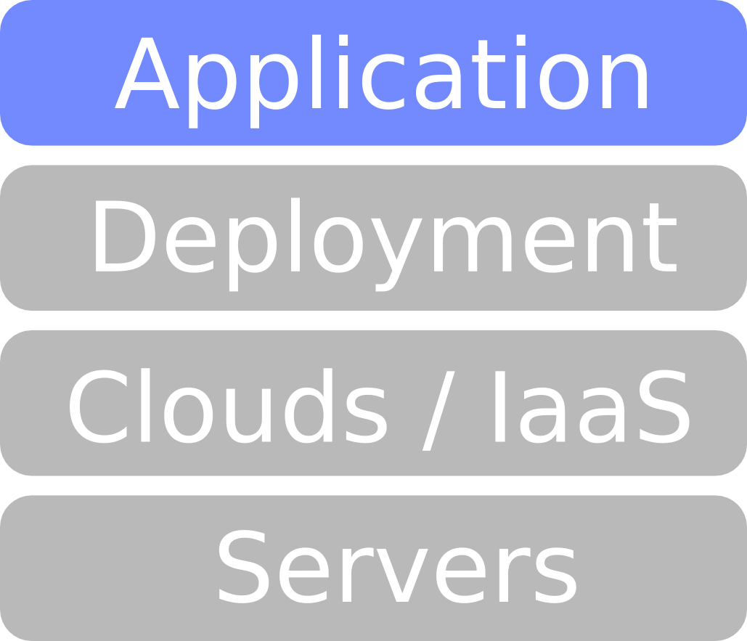
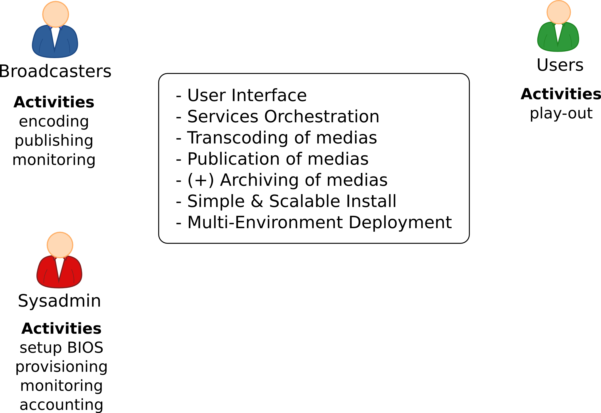
Design Process (1/6)
Design process steps
Listing of features based on uses-cases
Listing of actors and activities

Slide 15
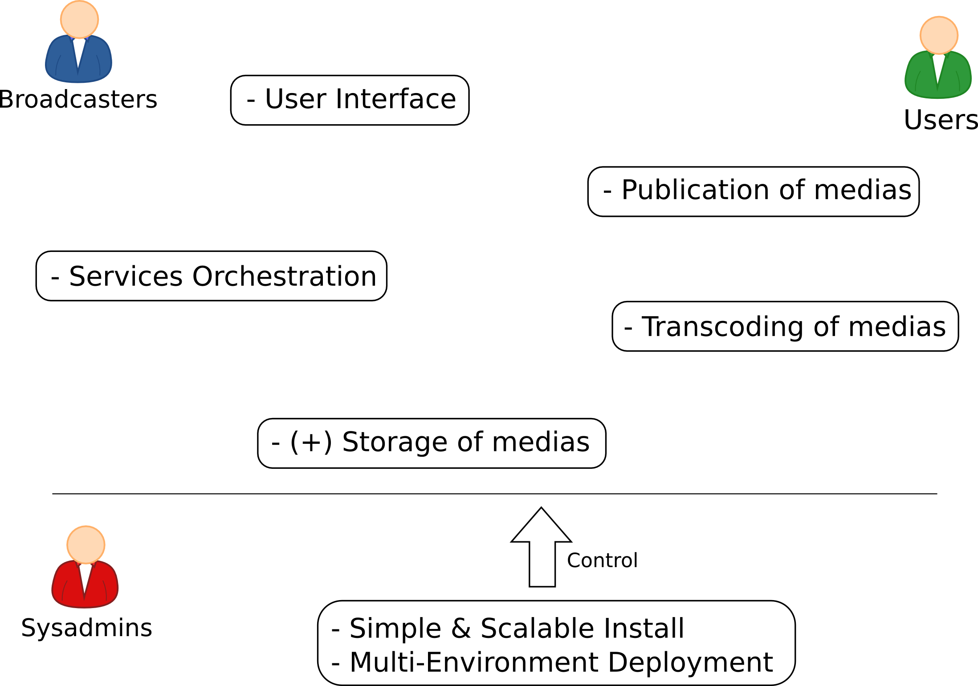
Design Process (2/6)
Design process steps
Separation of services into interconnected components
Selection of an OSS deployment tool (JuJu & MaaS)

Slide 16
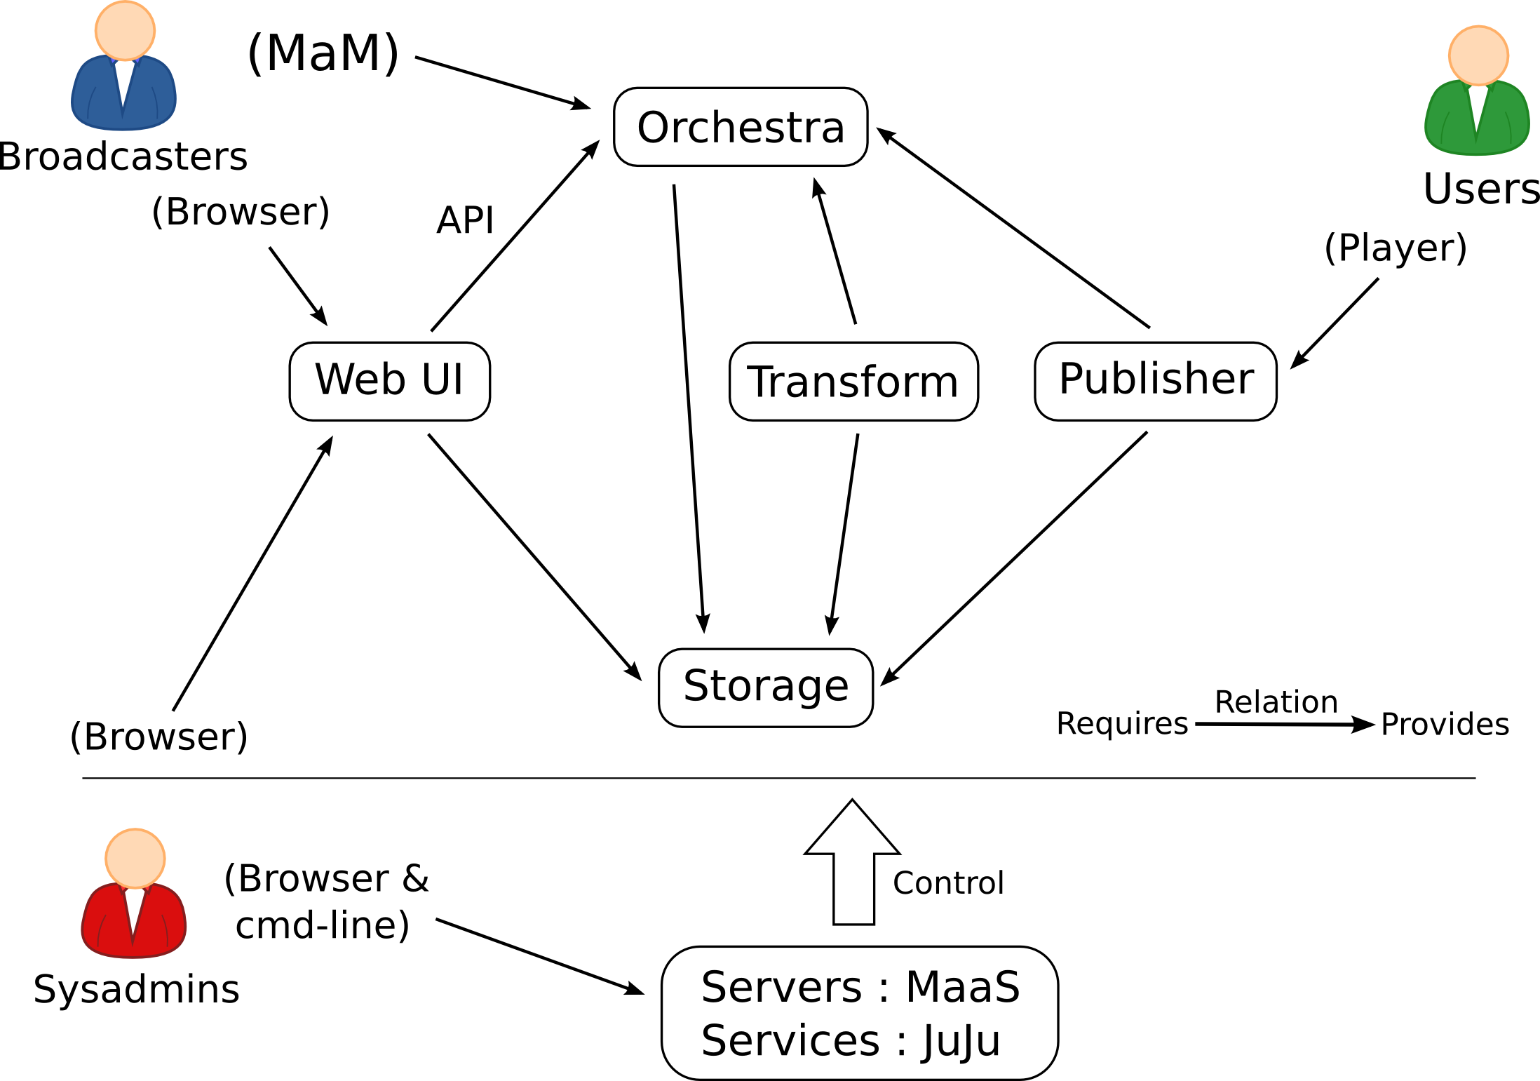
Design Process (3/6)
Design process steps
Encapsulation of services into Charms (+relations)
Selection of OSS sub-components (e.g. Flask)

Slide 17
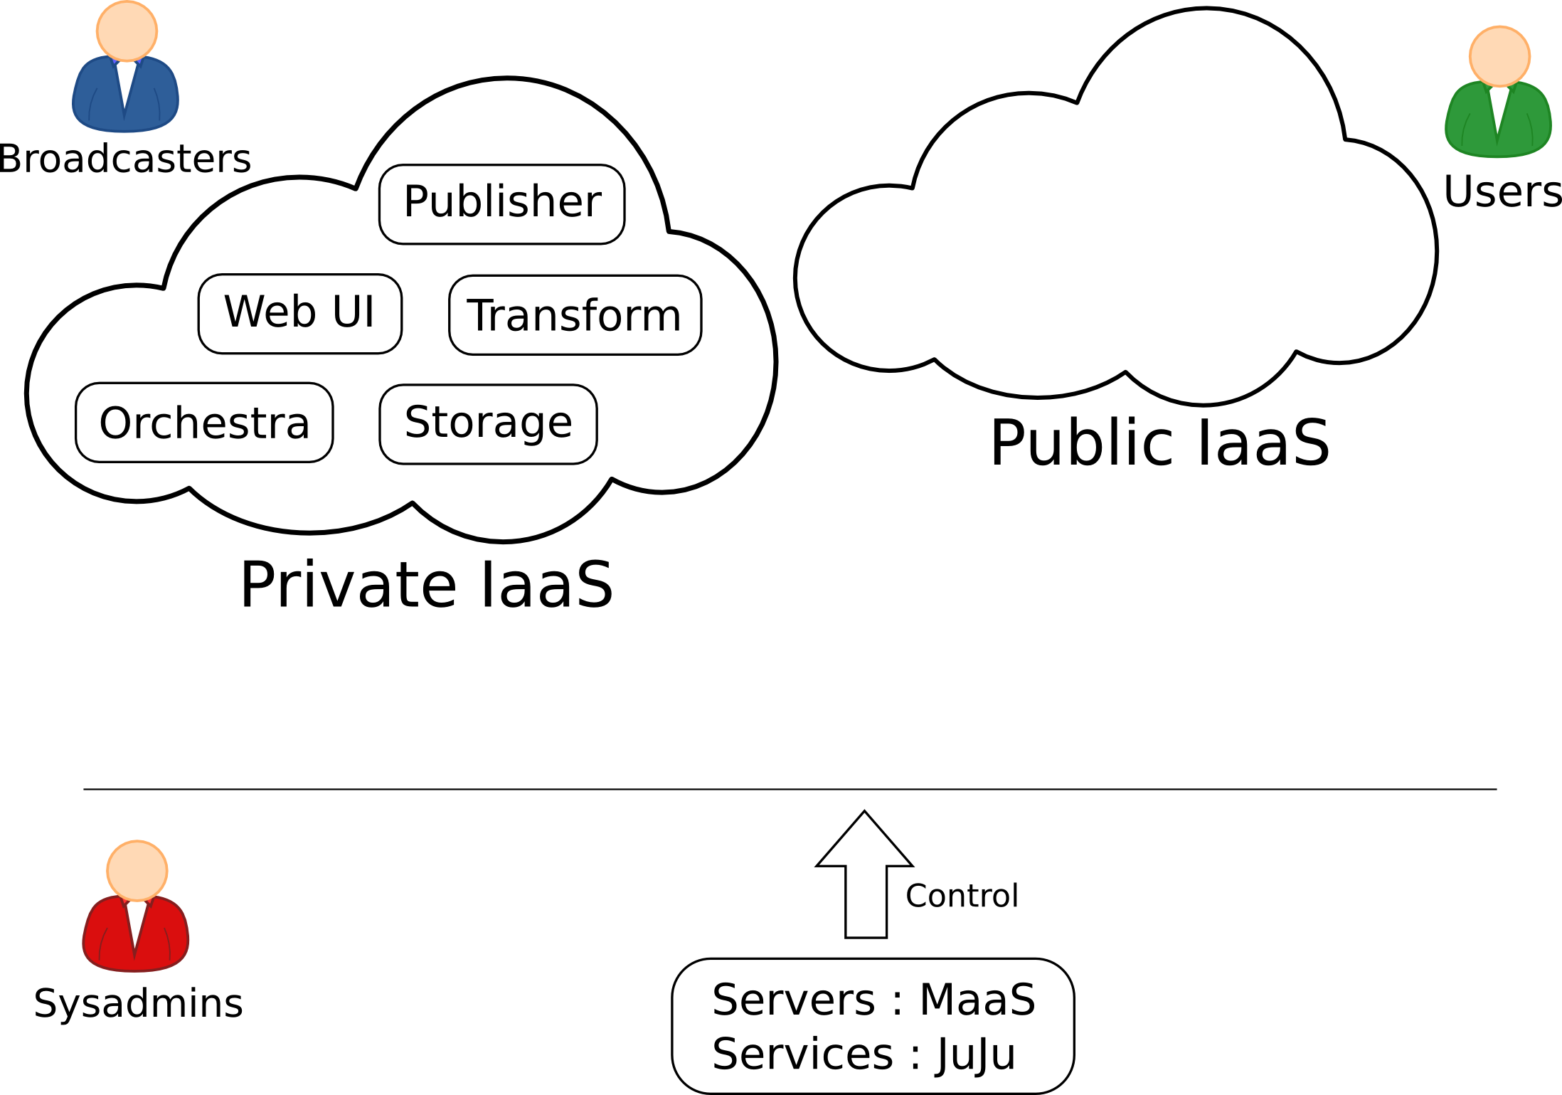
Design Process (4/6)
Design process steps
Development of charm's hooks
Deployment of charms for hooks test & debug

Slide 18
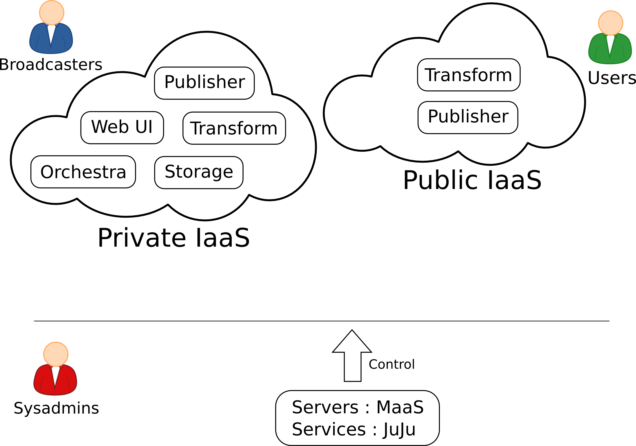
Design Process (5/6)
Design process steps
Adaptation of charms to allow // env. deployment
Development of application-level features

Slide 19
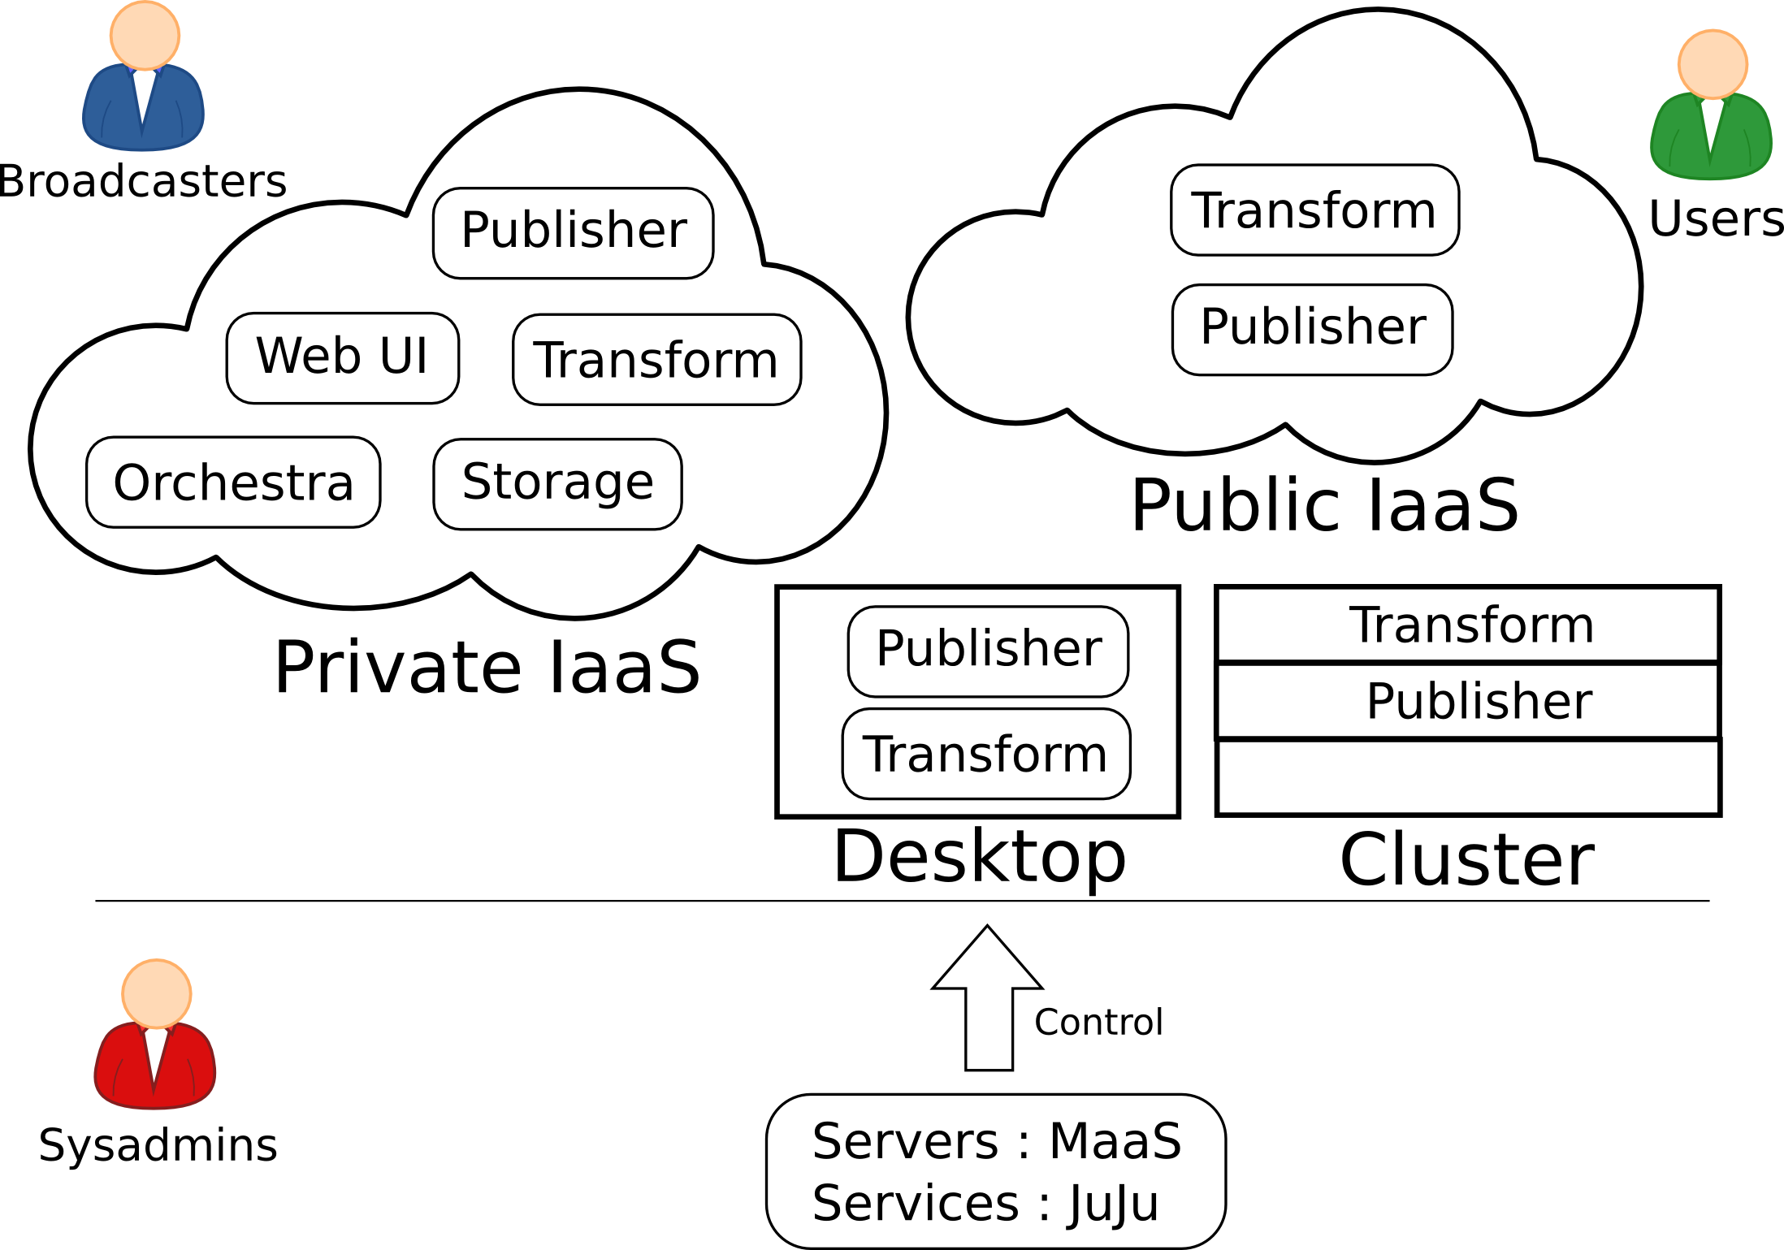
Design Process (6/6)
Design process steps
Improvements based on 1st demo EBU's feedback
Multi-environment setup for demo (+debug)

Slide 20
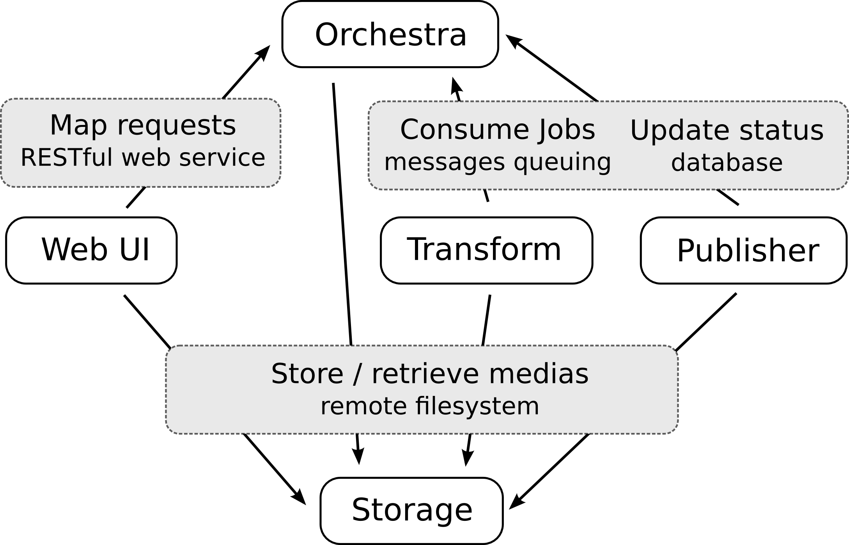
Application Architecture
Relation between components

Slide 21
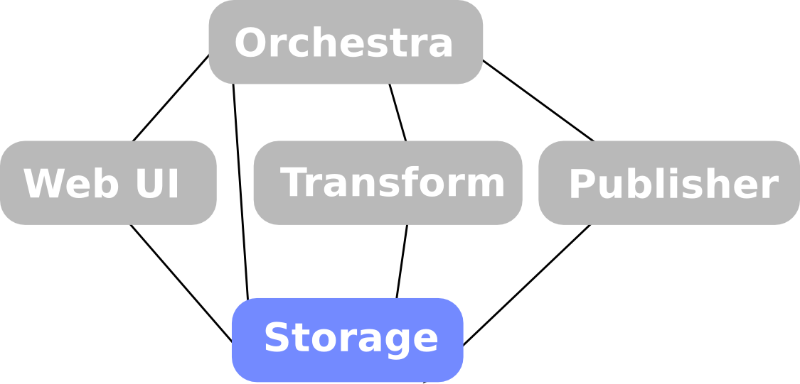
Application Architecture
Highly-available shared storage
Description | Kind of access OS API | Complex. | Regions | Stability Mgmt. | Scalability Security | Miscellaneous
Swift S3 storage | OS, HTTP S3 API | High | (?) | (?) (?) | High Proxy | Object < 5GB
Ceph (all-in-one) | FS, BS, OS S3 API | Medium | (?) | (?) (?) | High (?)
LS4 media storage | OS + metadata REST API | High | Yes | Unit test (?) | High (?) | No more updates
NFS filesystem | FS | Low | No | Stable Simple | Low Yes
GlusterFS | FS, OS, CIFS, HTTP, FTP S3, Swift API | Low | Yes | Stable Simple | High Yes | Most scalable filesystem
OS : Object storage
BS : Block storage
FS : Filesystem
Systèmes de fichiers distribués -
comparaison sur la grille Grid 5000
JF. Garcia, F. Lévigne, M. ...

Slide 22

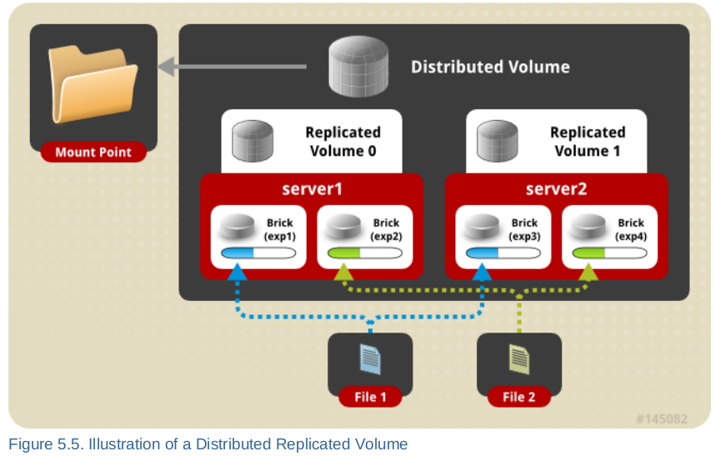
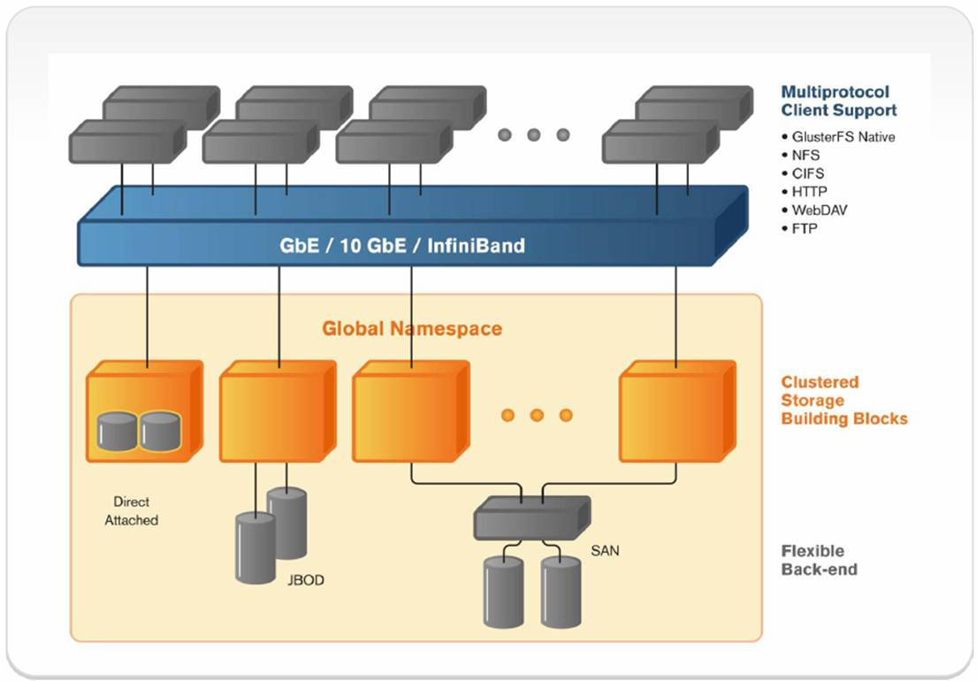
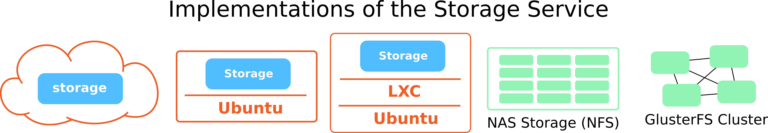
Application Architecture
Highly-available shared storage
Charm encapsulating a (simple) GlusterFS server

Slide 23
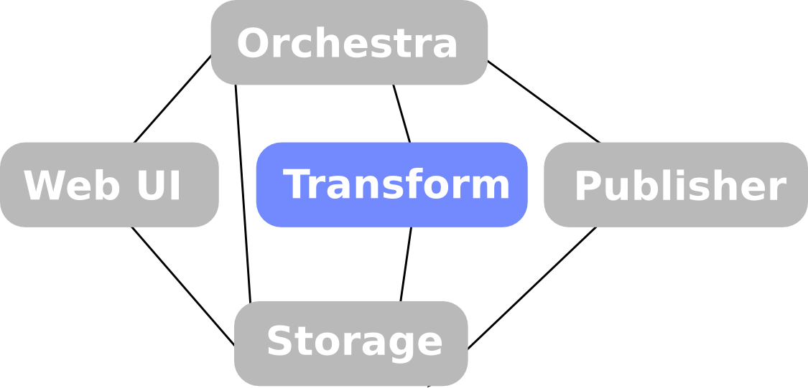
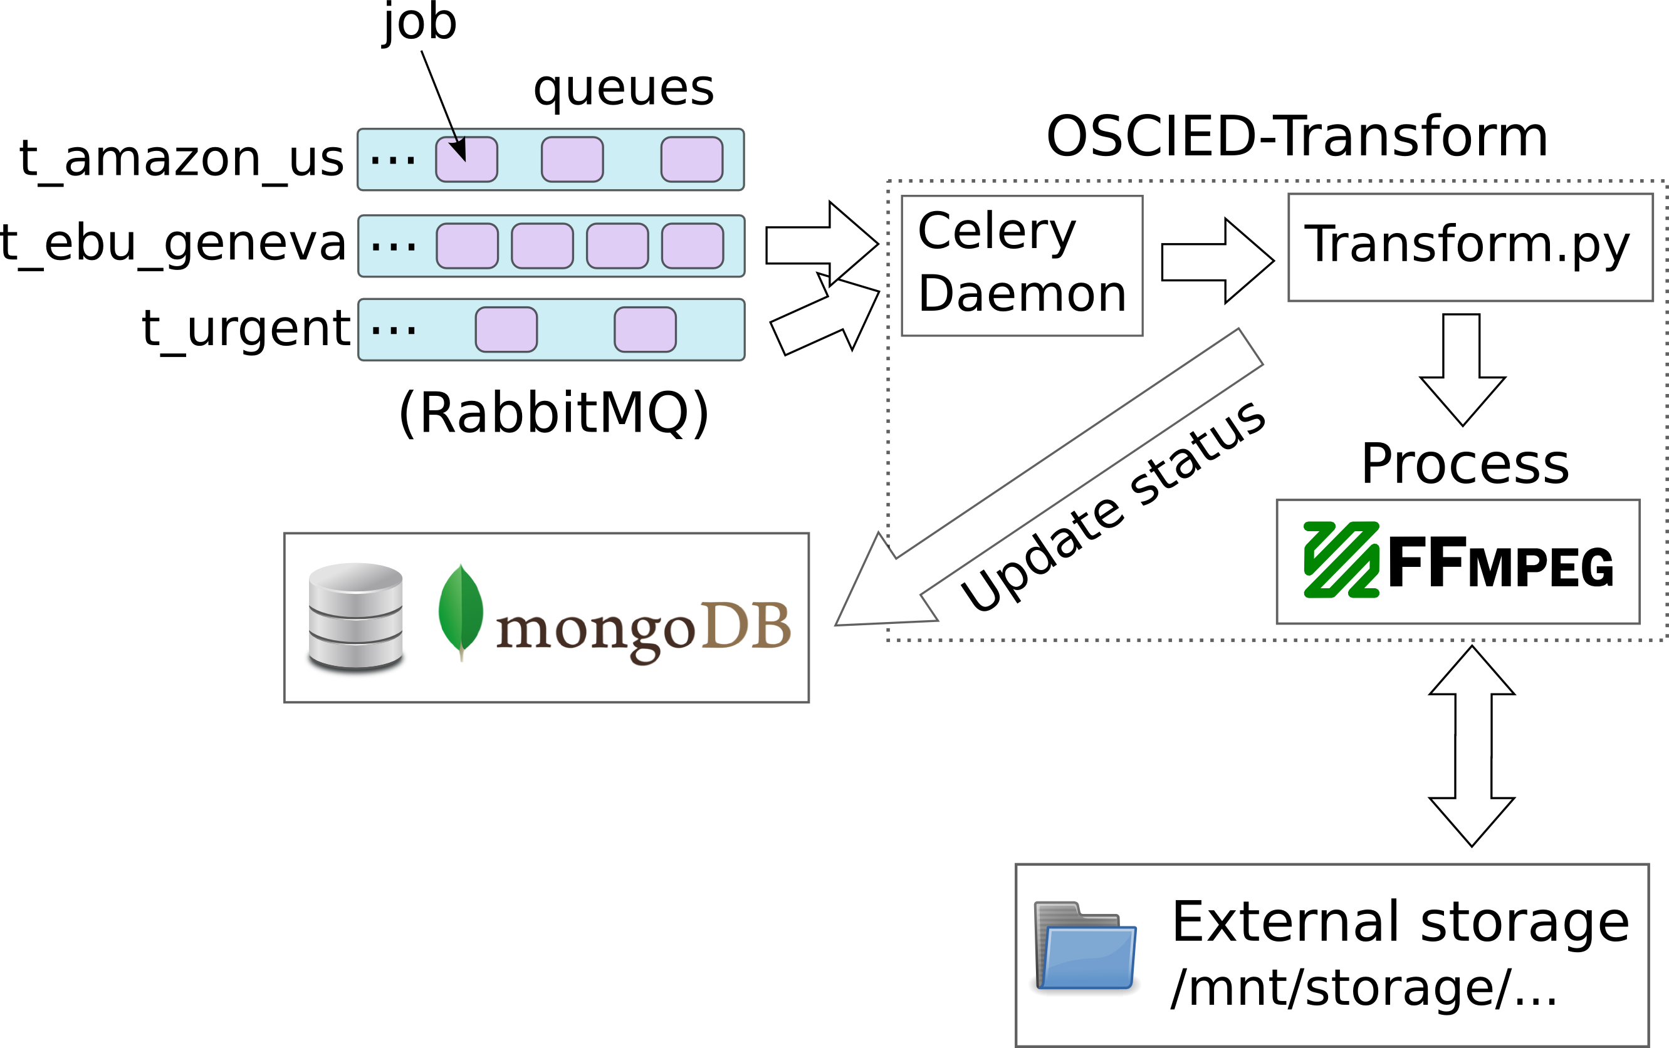
Application Architecture
Media transformation service

Slide 24
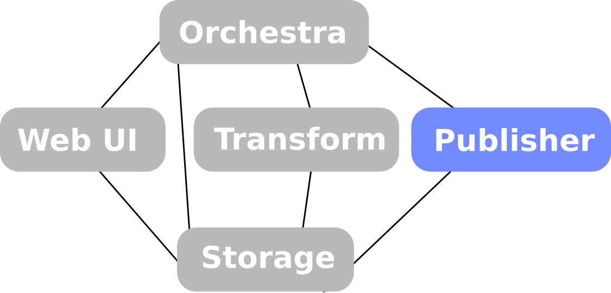
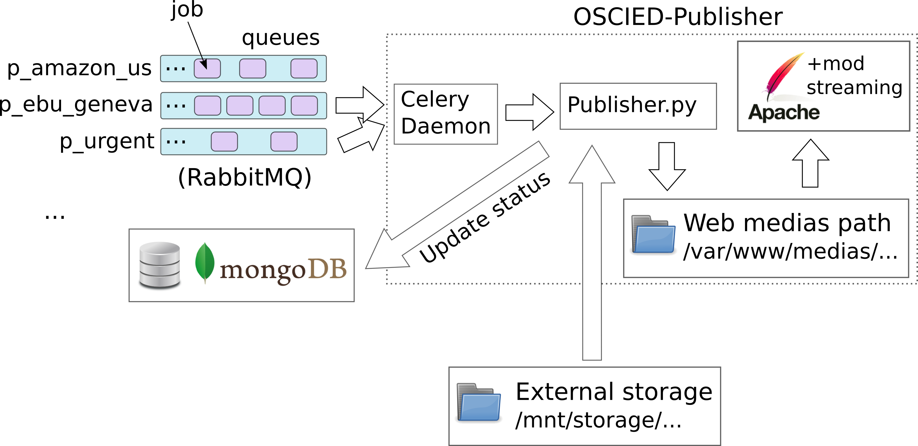
Application Architecture
Media publication service

Slide 25
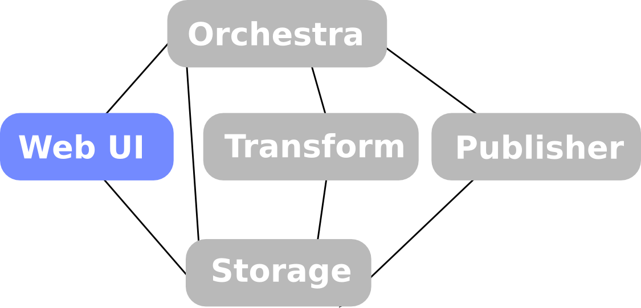
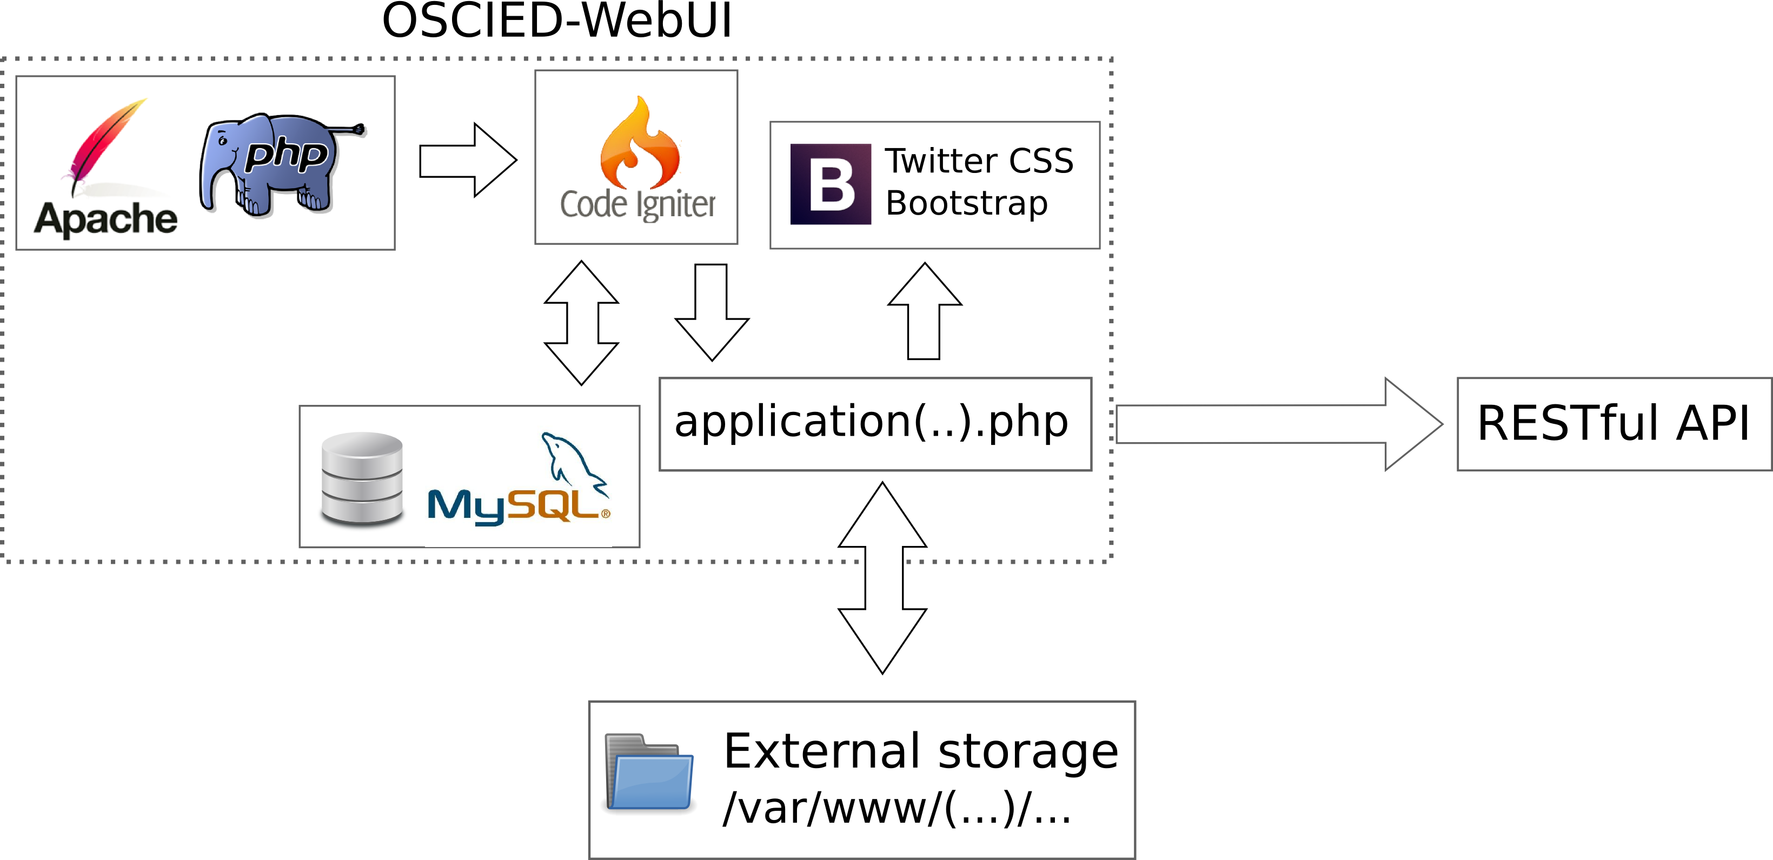
Application Architecture
User-friendly web user interface

Slide 26
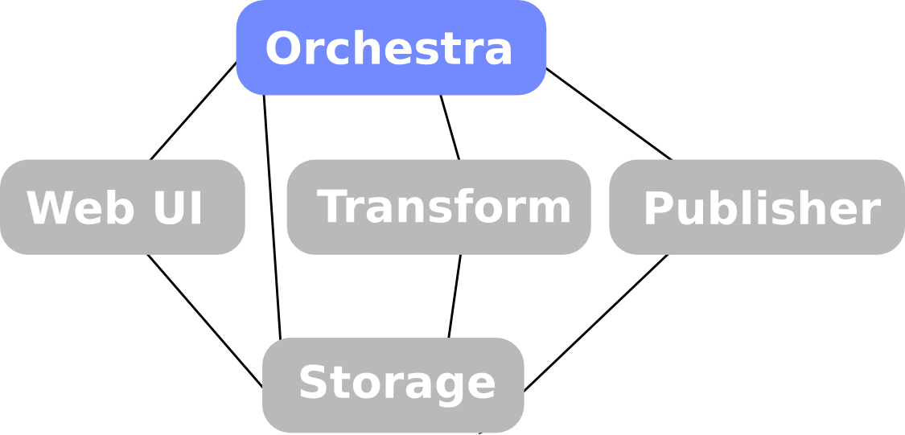
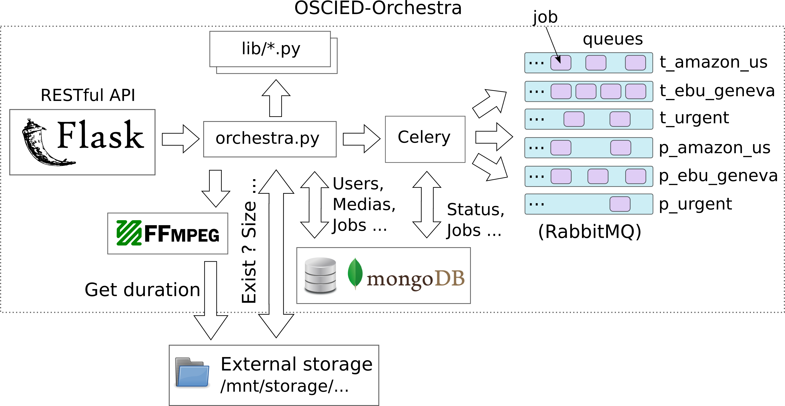
Application Architecture
The brain of OSCIED

Slide 27
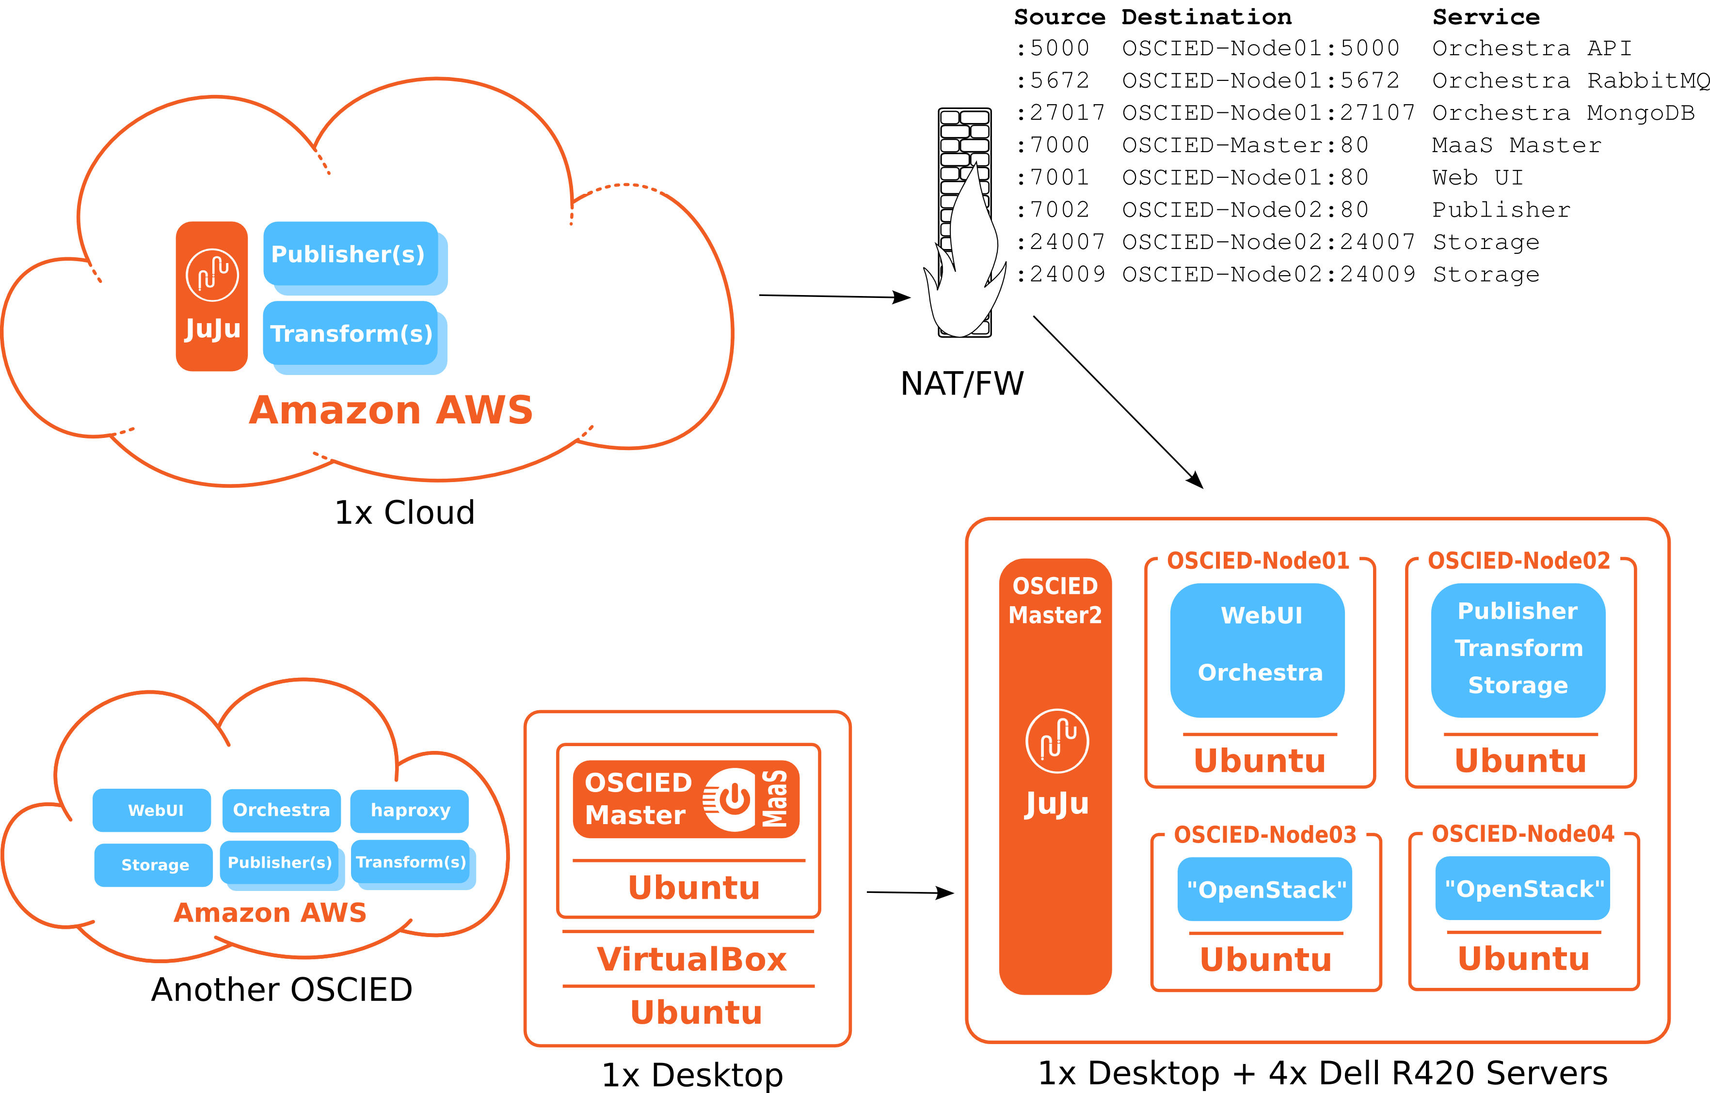
OSCIED D' Day Setup

Slide 28
Conclusion – Checklist
[OK] Providing a scalable OSS media platform to members of EBU
[OK] A platform based on cloud-era OSS technologies, dedicated to :
  [OK] Transcoding of a wide collection of medias to new formats
  [OK] Online publication of popular medias
[OK] A platform that is designed to allow :
  [OK] Deployment of services in-house, entreprise IT infrastructure
  [Bonus] Deployment into Clusters and Standalone Desktop Computers
  [Bonus] Can be interconnected to haproxy, nginx, Charms Store
  [OK] Scaling of transcoding and publication points to public clouds (IaaS)
  [OK] Ease of scale-up or scale-down of services
  [OK] Separation of development, testing and production environments
  [OK] Future features or capabilities (MPEG-DASH, …)
[OK] Setup of MaaS ([ ] → OpenStack)
[OK] Ticket management system (TRAC) + code versioning (SVN)

Slide 29
Conclusion – The Project
Setup OpenStack is a complex, time-taking task. Documentation is not synced with releases, ~breaks compatibility.
Canonical's MaaS and JuJu allow to deploy, connect and manage servers & services in a simple manner !
This demonstrator is an OSS media platform allowing EBU's members :
  To use in-house IT resources mixed with necessary amount of public cloud resources
  To easily adapt scale of transcoding and publication services
  To optimize costs of services :
    By adapting CAPEX / OPEX balance based on business needs
    By avoiding « vendor lock-in » to dedicated media services (SaaS) or even Cloud providers (IaaS)
  To test it, use it, even add missing features as it is Open-Source licensed
Developed application is designed to being simple to use but rather powerful :
  Deployment is made easy, thanks to JuJu and developed charm's hooks
  Is elastic, balance of private & public resources is easy and can be automated
  Proof of concept : Open-Source based Encoding and Distribution Platform

Slide 30
Future
OSCIED can grow into a full-fledged media platform with professional management layers :
  Enhancements and future features are already listed on TRAC.
  Improve security and avoid SPOF
  MPEG-DASH is the hottest feature
  Open Broadcast Encoder for delivering MPEG2-TS feeds
  Add of automatic scalability functions (e.g. based on business rules)
  Adding native imports of distribution files to reduce latency
OSCIED was and will be an opportunity for me to work on topics such as OSS, cloud, medias, cluster storage ... :)

Slide 31
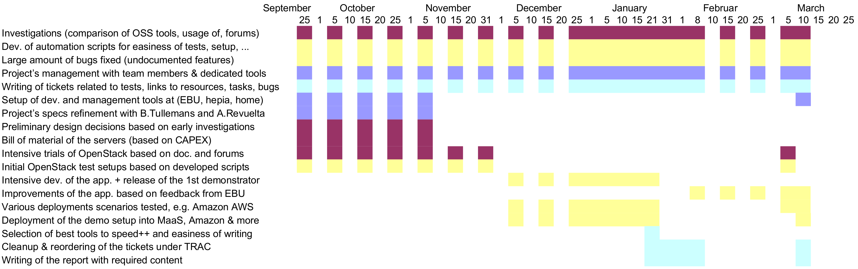
Master HES-SO MA - Planning
Project Management
Investigations
Developments & Tests
Documentation

Slide 32
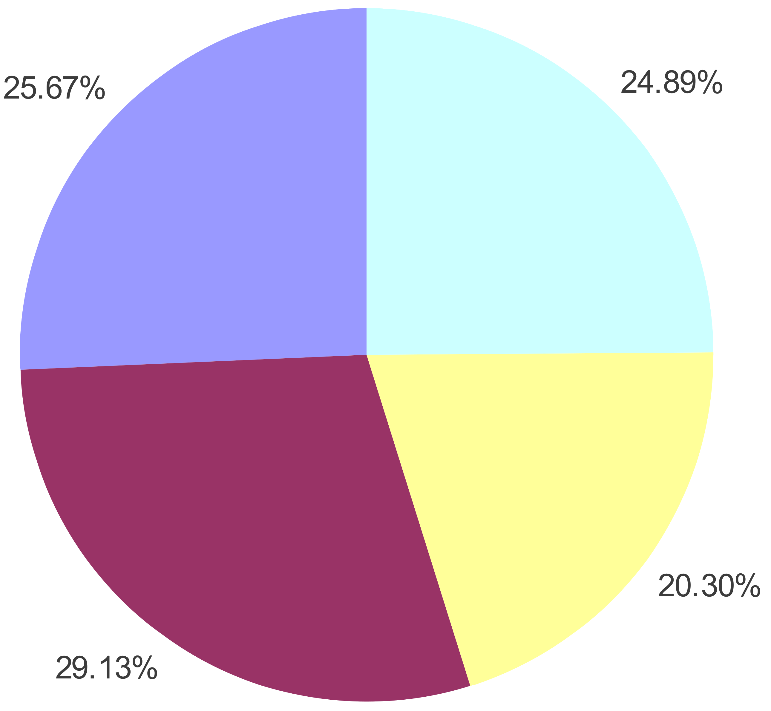
Master HES-SO MA - Skills
Project Management
  Meetings, mails
  Svn, TRAC tickets ...
  Goals refinement
Investigations
  Selection of OSS tools
  Design of OSCIED
  Forums & documentation
  Source-code decipher
Developments & Tests
  Scripting (automation)
    Setup of demo & tools
  Development (application)
    Charms hooks, ...
    Application-level logic
  Tests (deployment, debug)
Documentation
  Report (PDF + HTML)
  Presentation
  TRAC tickets
  Orchestra API
TIC Profile

Slide 33
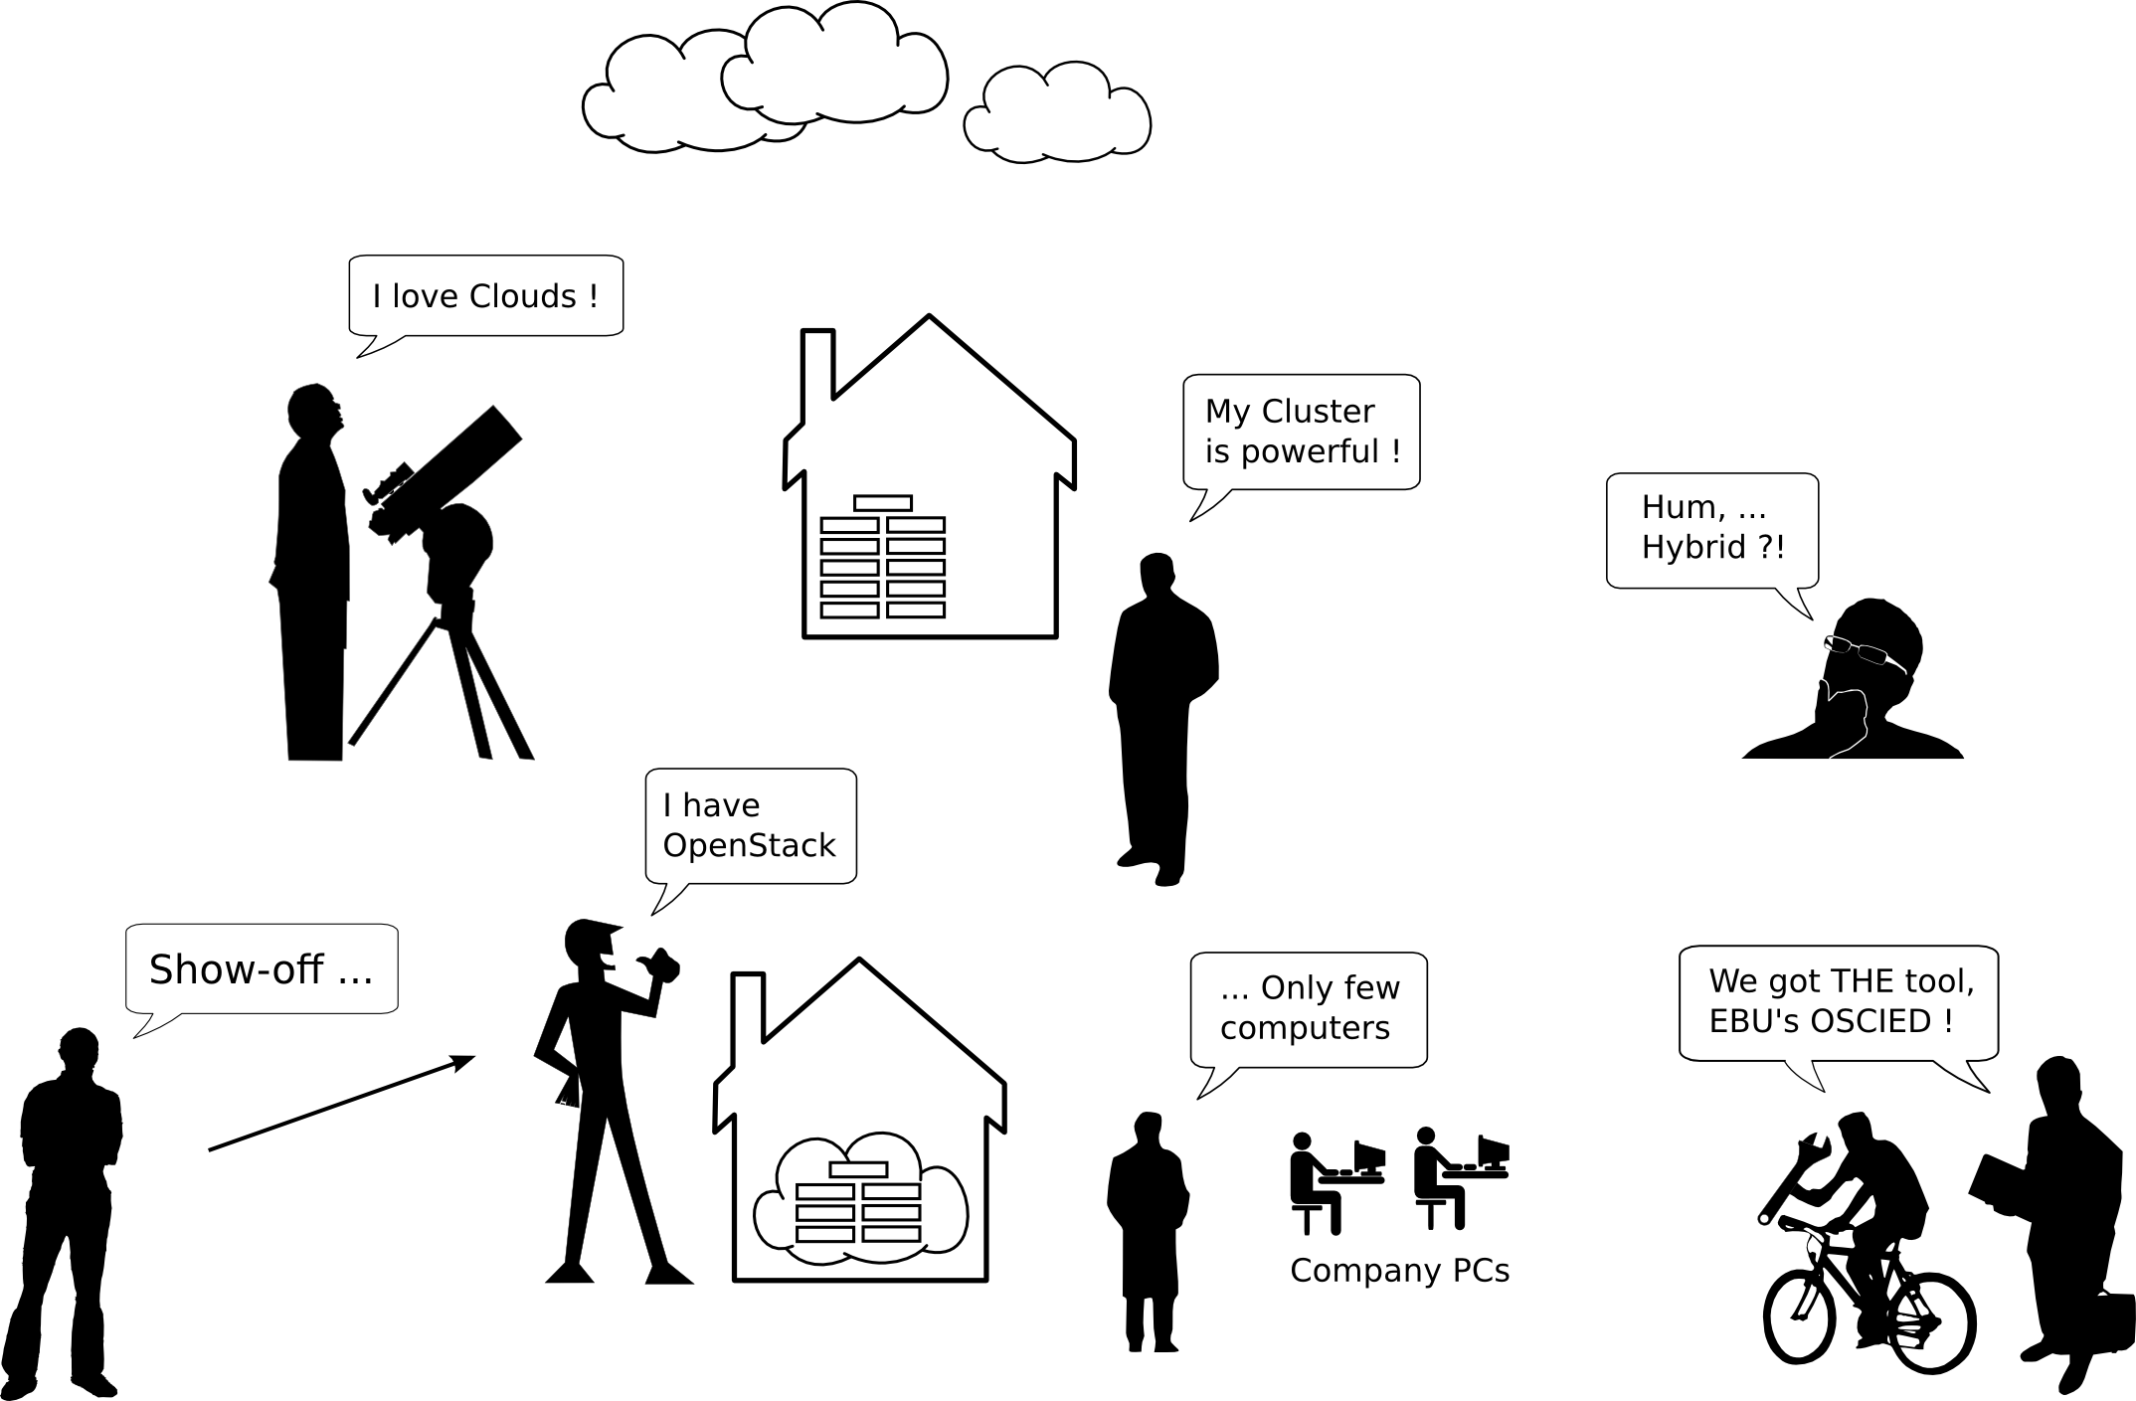
Questions & Answers

