Slide 1


360poll Exit Poll App
… seeing your votes count

Slide 2

Elections are here again!!!
Election times are very crucial times in Nigeria…
A time everyone want his voice to be heard.
A time when all votes should count…
Fairness, transparency, clarity.

Slide 3
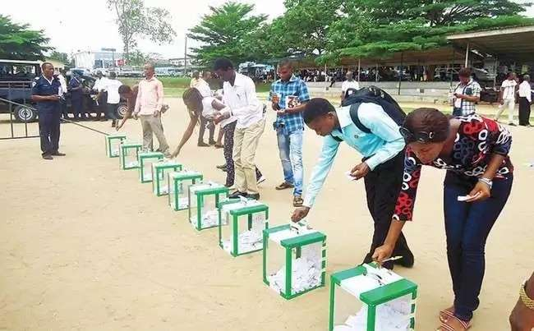
Problem
Citizens not being observers
No real time views of final count
No benchmark data for comparison
Dependence on final counts from head office.
Election Monitoring left for a few
Love your votes?

Slide 4
Problem
Benchmark for comparison
Little Election Monitoring
Little Access to pre-election results
Few electoral monitoring bodies
Over dependence on INEC for final results
INEC results can not be verified against independent data source

Slide 5



Solution
A software solution that allows voters to become election observers
by entering polling unit results as it is announced before it moves to head-quarters
Enter polling results
for polling unit
Real-time insights of votes from polling units
Compare final announced election results

Slide 6
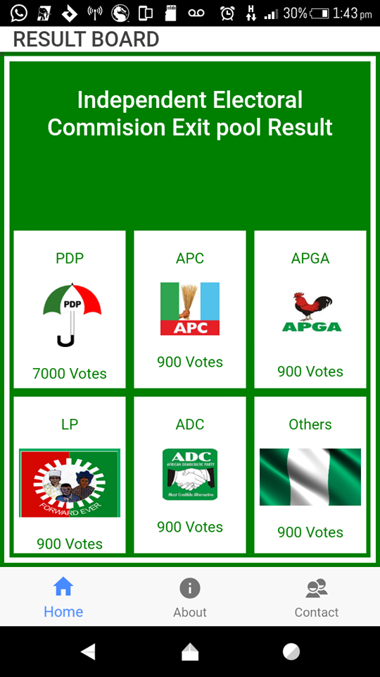
How it works
Electorates present at each polling unit enter the final polling results announced by the collating officer.
Dashboard : View Results

Slide 7
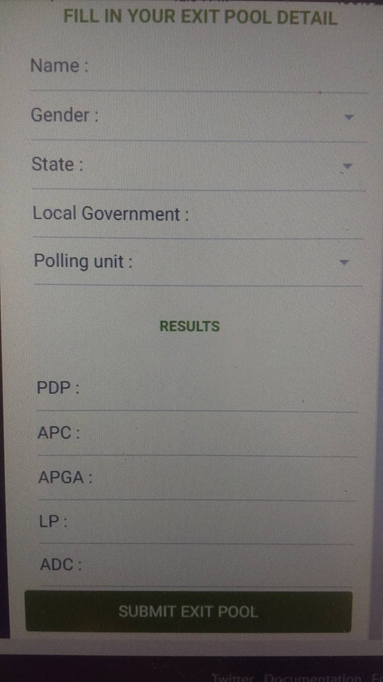
How it works
Electorates present at each polling unit enter the final polling results announced by the collating officer.
Response: Submit Responses

Slide 8
Technologies Used
Ionic Framework
Node.Js
Heroku Hosting
Scalability
Easy to deploy
Largest package manager in the world
Large number of modules for developement
Cross-Platform: Build once, deploy for all
Scalability
Free hosting
Robust support

Slide 9




Our team
Ebube Anya
Ifeanyi Njoku
Nwachukwu Chibuike
Solution Ibe
Team Lead
Front End Developer
Back End Developer
Business Strategist
Google Andela Certified Developer, Co-founder VotePro: an E-voting solutions company
JavaScript Developer, Robotics Engineer, Cross platform App Developer
Computer Scientist, Full stack developer.
Marketing and Business strategist, Digital Marketer, Social Scientist

Slide 10
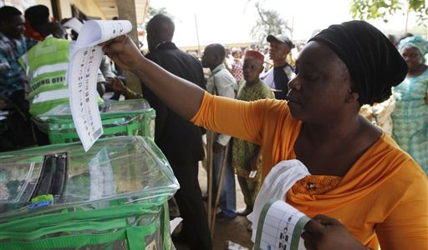
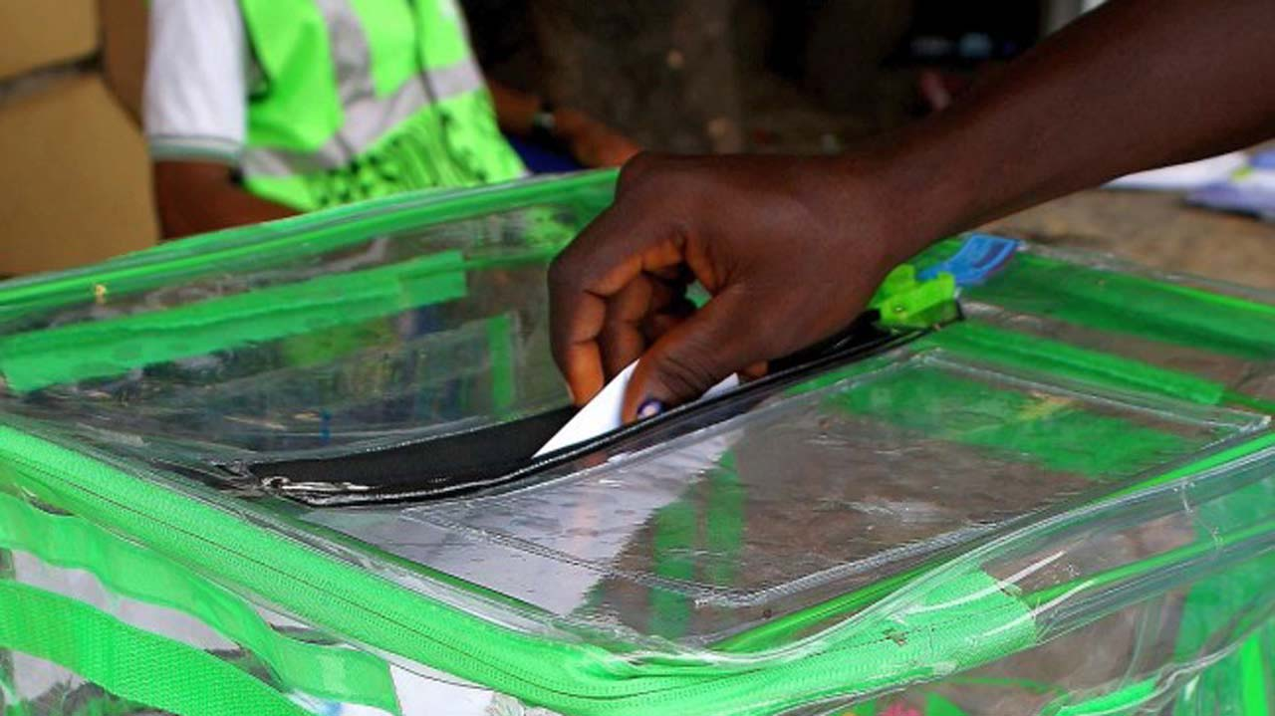
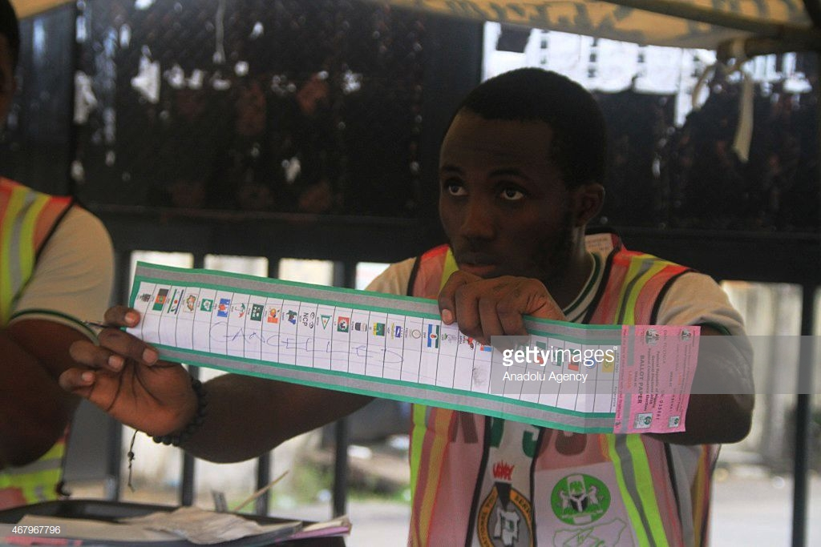


Love your Votes!!! Monitor your votes!!!

Slide 11

Thank you!
Email:
Phone:
Website:
info@360poll.ng
+234-703-081-7535
www.360polls.com

Slide 12
Justification
Citizens want to know how electoral processes are handled and are willingly to report
84.2 million registered voters
68,833,476
Voters
167,371,935
people have mobile phones
45 million people have access to the internet

