Slide 1

PowerShell for Everyone

Slide 2
Ed Buford
Method Computing
Ed@methodcomputing.com
574-216-7402
Slide deck at https://github.com/ebuford/CITN

Slide 3
What is PowerShell?
Command-line Shell
Scripting language
Automation platform
Object Oriented

Slide 4
Launch PowerShell
Don’t use ISE
Don’t run as Administrator
Click Start/Run and type PowerShell
Adjust Screen Buffer Size to 9999
Adjust the shell Font to be good for your eyes

Slide 5
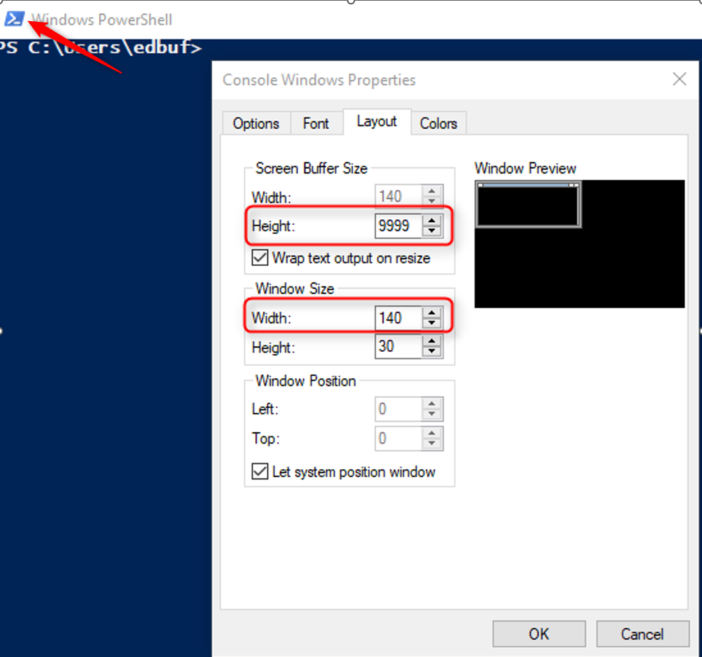

Slide 6
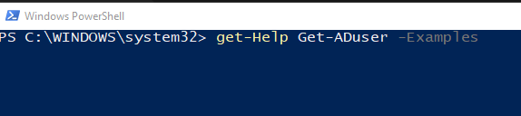
Getting Help
Update-Help (Run as Administrator)
Get-Help CommandName
-Detailed
-Full
-Examples
Notes:
You can open PowerShell and get help on ALL or some of your installed Modules.
For most people I would use the command:
Get-Help -Force
This will update all the modules (that are available) and install the latest help files.
Once you have help installed you can easily choose to find the help about commands by using the wildcard *
So
Get-Help *Service* will give you a list of all commands with services in the computer.
This is a good time to learn to TAB –
Practice hitting the TAB button as you’re working with this (or any) PowerShell Command.
Get-help Get-Service -Detailed
Get-help Get-Service -Examples
Get-help Get-Service -Full

Slide 7
Listing Commands
Get-Command
Get-Command Get*
Get-Command –Noun Service
Get-Command –Verb Set
Get-Command –Module ActiveDirectory

Slide 8
Modules
Collection of commands
Get-Module –ListAvailable
Import-Module ActiveDirectory

Slide 9
Learn to use TAB
Start typing the command you're looking for and then hit TAB
Cycle through options

Slide 10
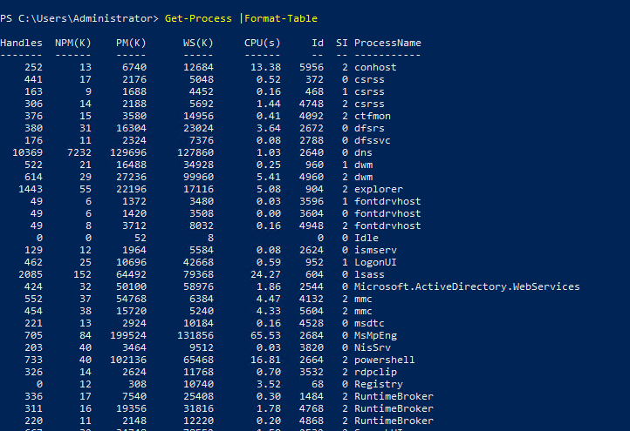
Output

Slide 11
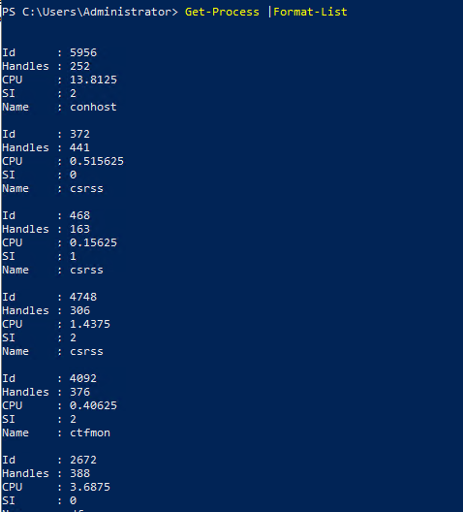

Slide 12
There is Power in the Pipe
The Pipeline allows you to take the Output of one command and apply to another command.
Get-Process |Export-Csv C:\source\Process.csv
Get-Mailbox |Get-MailboxStatistics
Get-Mailbox |Remove-Mailbox
Notes:
The Pipe allows you to take the results of one command and apply them to another command.

Slide 13
What is a Script?
A script can be basically any set of commands grouped in .PS1 file.
For example:
Get-ADUser –Filter * | Select Name,PasswordNeverExpires |Export-csv C:\Source\UserInfo.csv

Slide 14
Running Scripts
Execution Policy
AllSigned
RemoteSigned
Unrestricted
Bypass
Get-ExecutionPolicy Set-ExectutionPolicy RemoteSigned
Unblock-File -Path C:\source\ScaryScript.ps1

Slide 15
A few helpful tips
Count objects with this command ().count
(Get-Mailbox).count
(Get-Aduser –Filter *).count
(Get-Service | Where {$_.status –ne “running”}).count

Slide 16
A few helpful tips
Pipe output to your Clipboard
Get-Process | Clip
Get-ADUser –Filter * | Clip
Get-Mailbox | Get-MailboxStatistics | Clip

Slide 17
A few helpful tips
Restart the computer Restart-Computer
Shutdown computer Stop-Computer
Logoff Computer Logoff
Get Host Name Hostname

Slide 18
A few helpful tips
History of commands
Get-History
Start-Transcript

Slide 19
A few helpful tips
Export information to a CSV
Get-Process | Export-CSV c:\source\Proc.csv
Get-ADComputer – Filter * | Export-CSV c:\source\PCs.csv
Get-Mailbox | Get-MailboxStatistics | Export-CSV c:\source\mbx.csv

Slide 20
A few helpful tips

Slide 21
Useful Sites:
50 Office 365 Reports that you’ll find useful here
Adam the Automator articles here
PoweShell Team here

Slide 22
How to Keep Learning Powershell:
Use it!
https://docs.microsoft.com/en-us/shows/getstartedpowershell3/
https://docs.microsoft.com/en-us/powershell/scripting/install/installing-powershell?view=powershell-7.2

