Slide 1
Computer Organization & Design
Lecture / Lab-006
Logical Operations Using Integrated Circuits on Breadboard

Slide 2
Learning Objectives
The purpose of this lab is to understand the behavior of basic logic gates
Implementing NOT, AND, and OR gates using digital logic ICs on a breadboard.
Students will verify the truth tables by observing LED outputs.

Slide 3
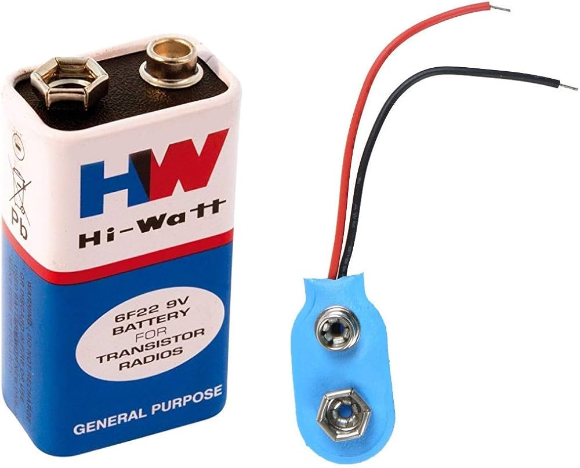
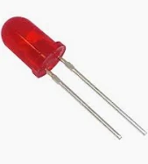
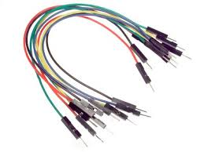
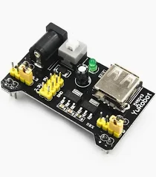
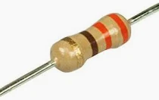
Materials
Breadboard
Jumper wires
5V power supply
LEDs
330Ω resistors
Breadboard power supply
Logic ICs:
Gate | IC
NOT | 7404
AND | 7408
OR | 7432

Slide 4
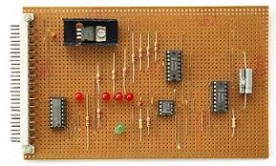
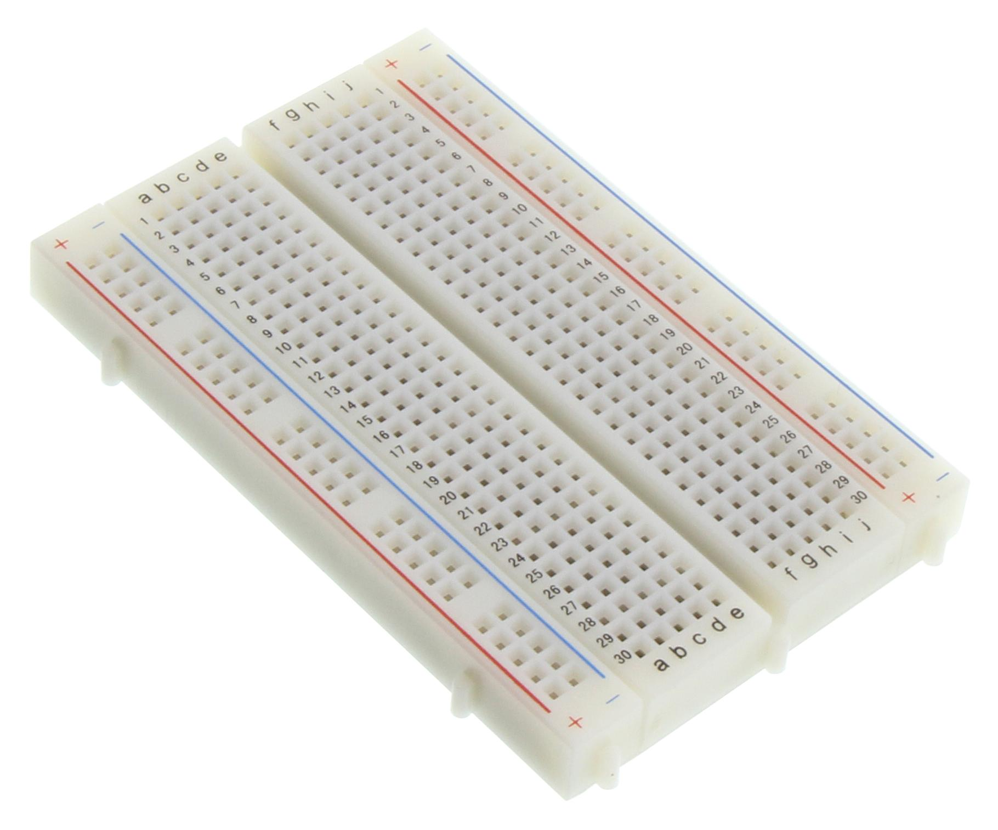
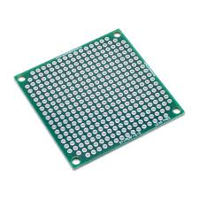
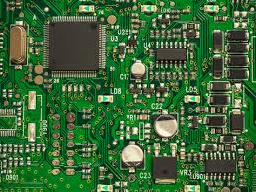
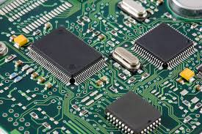
Component Description
Power rail
Breadboard
  Used to build and test circuits without soldering.
Power rails
  Red line → VCC (+ voltage)
  Blue line → GND
Terminal strips (middle area)
  The center section is where components go.
  Each row of 5 holes is connected horizontally:
  The center gap separates the two halves so you can place IC chips.
Center gap
  Used for ICs like logic chips.
  Pins on opposite sides are not connected, which prevents short circuits.
Components soldered on perfboard
Perfboard
Circuit Area
PCB fabrication
Copper coating
Photolithography
Chemical Etching
Board | Purpose | Connection method
Breadboard | Temporary testing | No soldering
Perfboard / Proto board | Permanent circuit | Solder components
PCB (Printed Circuit Board) | Professional design | Manufactured copper traces

Slide 5
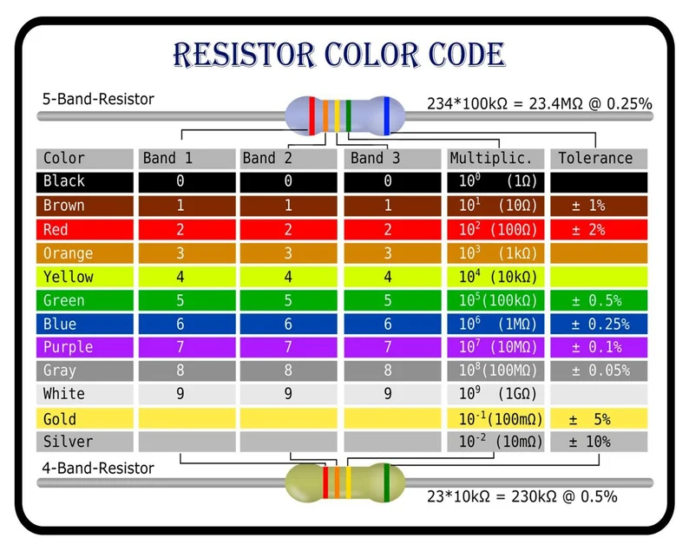
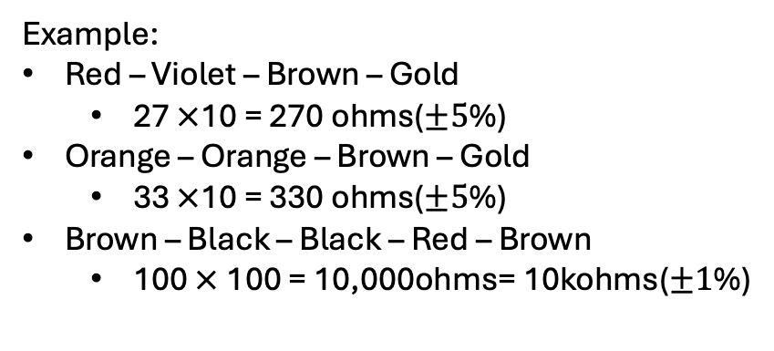
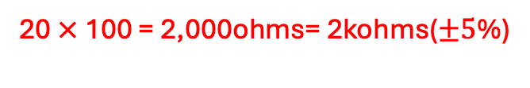
Component Description
Resistor color code
Order (left → right):
4-Band Resistor
  Digit₁ – Digit₂ – Multiplier – Tolerance
  5-Band Resistor
    Digit₁ – Digit₂ – Digit₃ – Multiplier – Tolerance
Example:
Red – Violet – Brown – Gold
  27 $×$10 = 270 ohms($±5$%)
Orange – Orange – Brown – Gold
  33 $×$10 = 330 ohms($±5$%)
Brown – Black – Black – Red – Brown
  100 $×$100 = 10,000ohms= 10kohms($±1$%)
What is readings of resistor with color code Red – Black – Red – Gold?
20 $×$100 = 2,000ohms= 2kohms($±5$%)

Slide 6
Component Description
LED (light emitting diode)
9v Battery
Terminal | Name | Function
Anode (+) | Positive | Connects to Vcc through a resistor
Cathode (−) | Negative | Connects to GND
Terminal | Symbol | Role
Positive | + | Supplies voltage
Negative | − | Return path (ground)
How to identify them
  Long leg → Anode (+)
  Short leg → Cathode (−)
Current flows:
Vcc → resistor → LED (anode → cathode) → GND
Example: Lighting an LED with a 9V battery
Use a resistor to limit current.
  +9V → 330Ω resistor → LED (long leg) → LED short leg → battery −
Recommended resistor:
  330 Ω – 1 kΩ
Without a resistor, the LED will draw too much current
and burn out immediately.

Slide 7
Component Description
Breadboard power supply module (MB102)
Jumper wires
  Connect components on a breadboard or
  between modules.
Part | Function
Barrel jack | Connect a 9V–12V DC adapter
USB port | Alternative power input
Voltage regulators | Output 5V or 3.3V
Jumpers (yellow pins) | Select 5V or 3.3V for each rail
Power switch | Turn power on/off
LED | Shows power is on
Type | Use
Male → Male | Breadboard to breadboard
Male → Female | Breadboard to module pins
Female → Female | Module to module
Input: 9V battery or 9–12V adapter
Output:
  5V (for most logic chips like 74LS)
  3.3V (for some sensors and microcontrollers)
A 9V battery can power it, but it drains quickly.
A 9V or 12V wall adapter works much better.

Slide 8
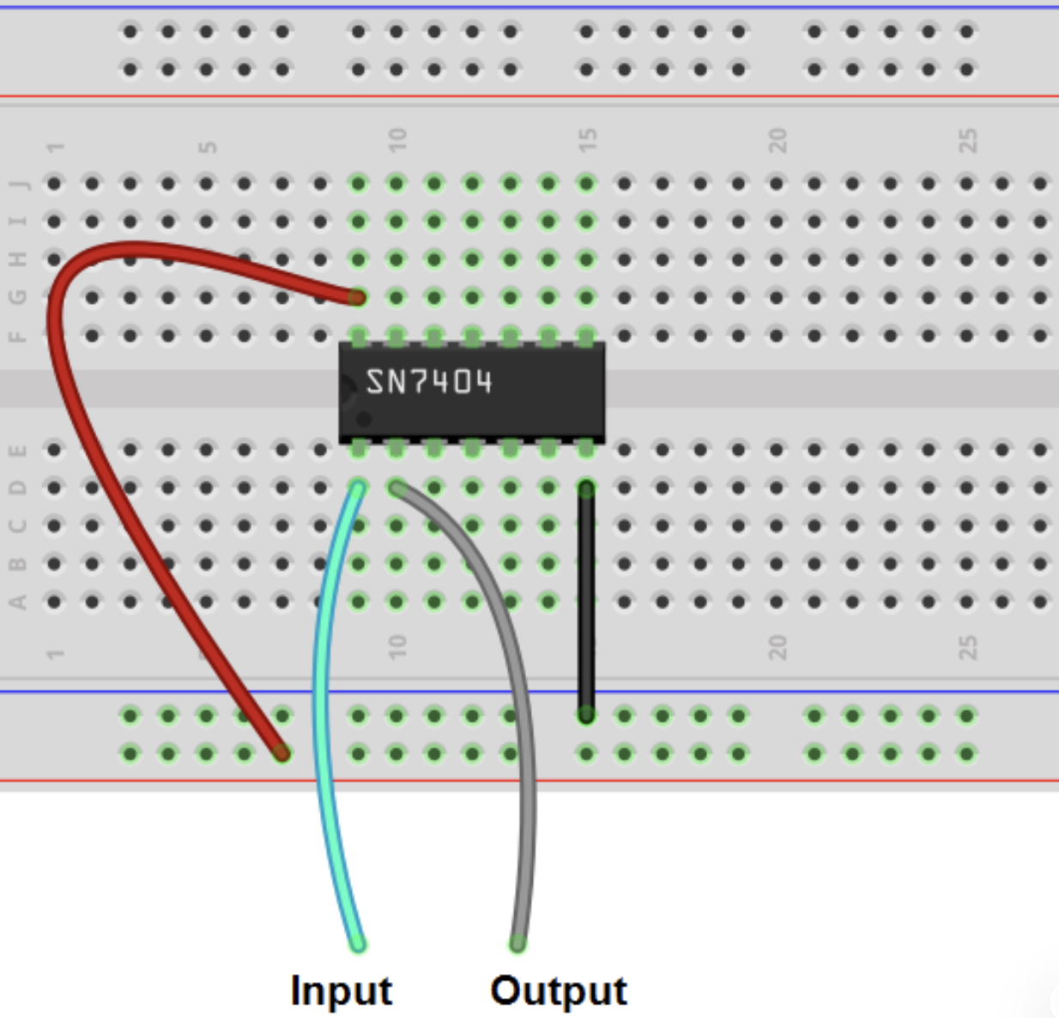
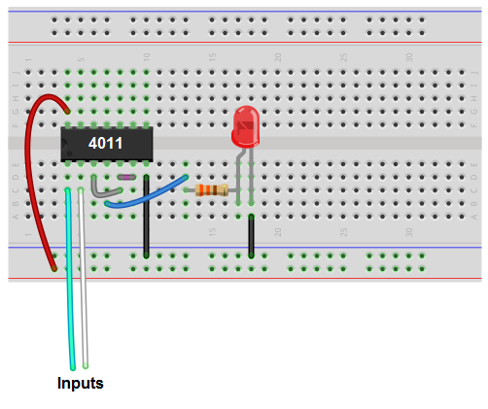
Part 1: Breadboard Power Setup
Connect 5V to the breadboard positive rail.
Connect GND to the ground rail.
Place the IC across the center gap of the breadboard.
For all 74xx ICs:
  Pin 14 → Vcc (5V)
  Pin 7 → GND
VCC
GND
VCC = where voltage comes from (+5V)->Power supply
GND = where curent returns (0V reference)->Ground
Current moves from VCC-> components->GND

Slide 9
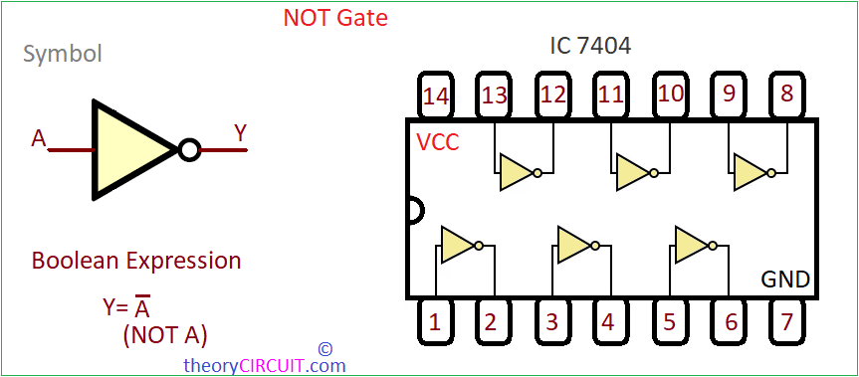
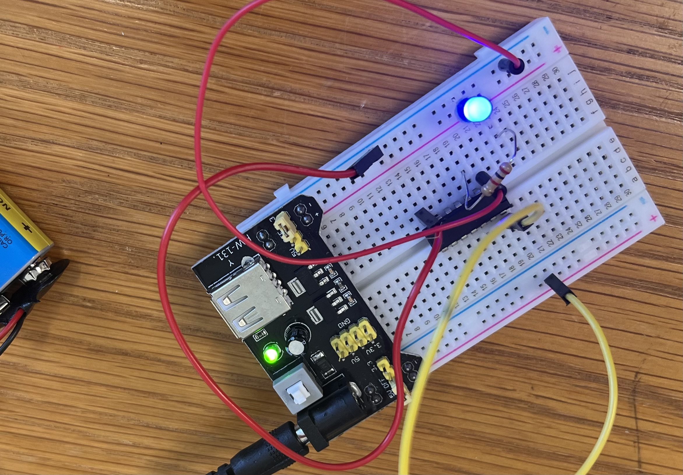
Part 2: NOT Gate (7404)
Gate behavior
A | NOT A
0 | 1
1 | 0
VCC
LED GLOWS
GND
OFF
Example pins
  Pin 1 → input A
  Pin 2 → output NOT A
Steps
  Connect pin 14 → 5V
  Connect pin 7 → GND
  Connect pin 1 → input switch
  Connect pin 2 → LED → resistor → GND
  Toggle the input and observe the output LED.
Expected behavior:
  Input LOW → LED ON
  Input HIGH → LED OFF

Slide 10
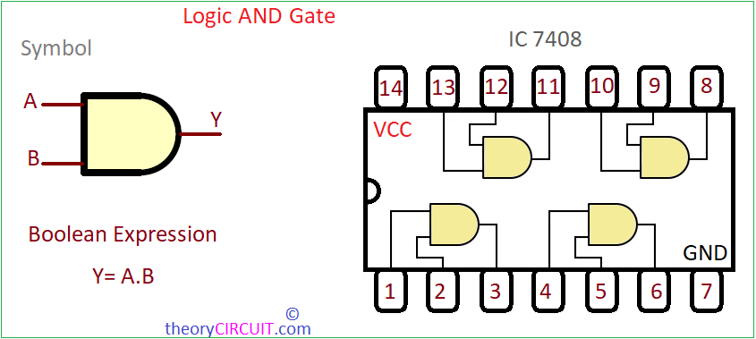
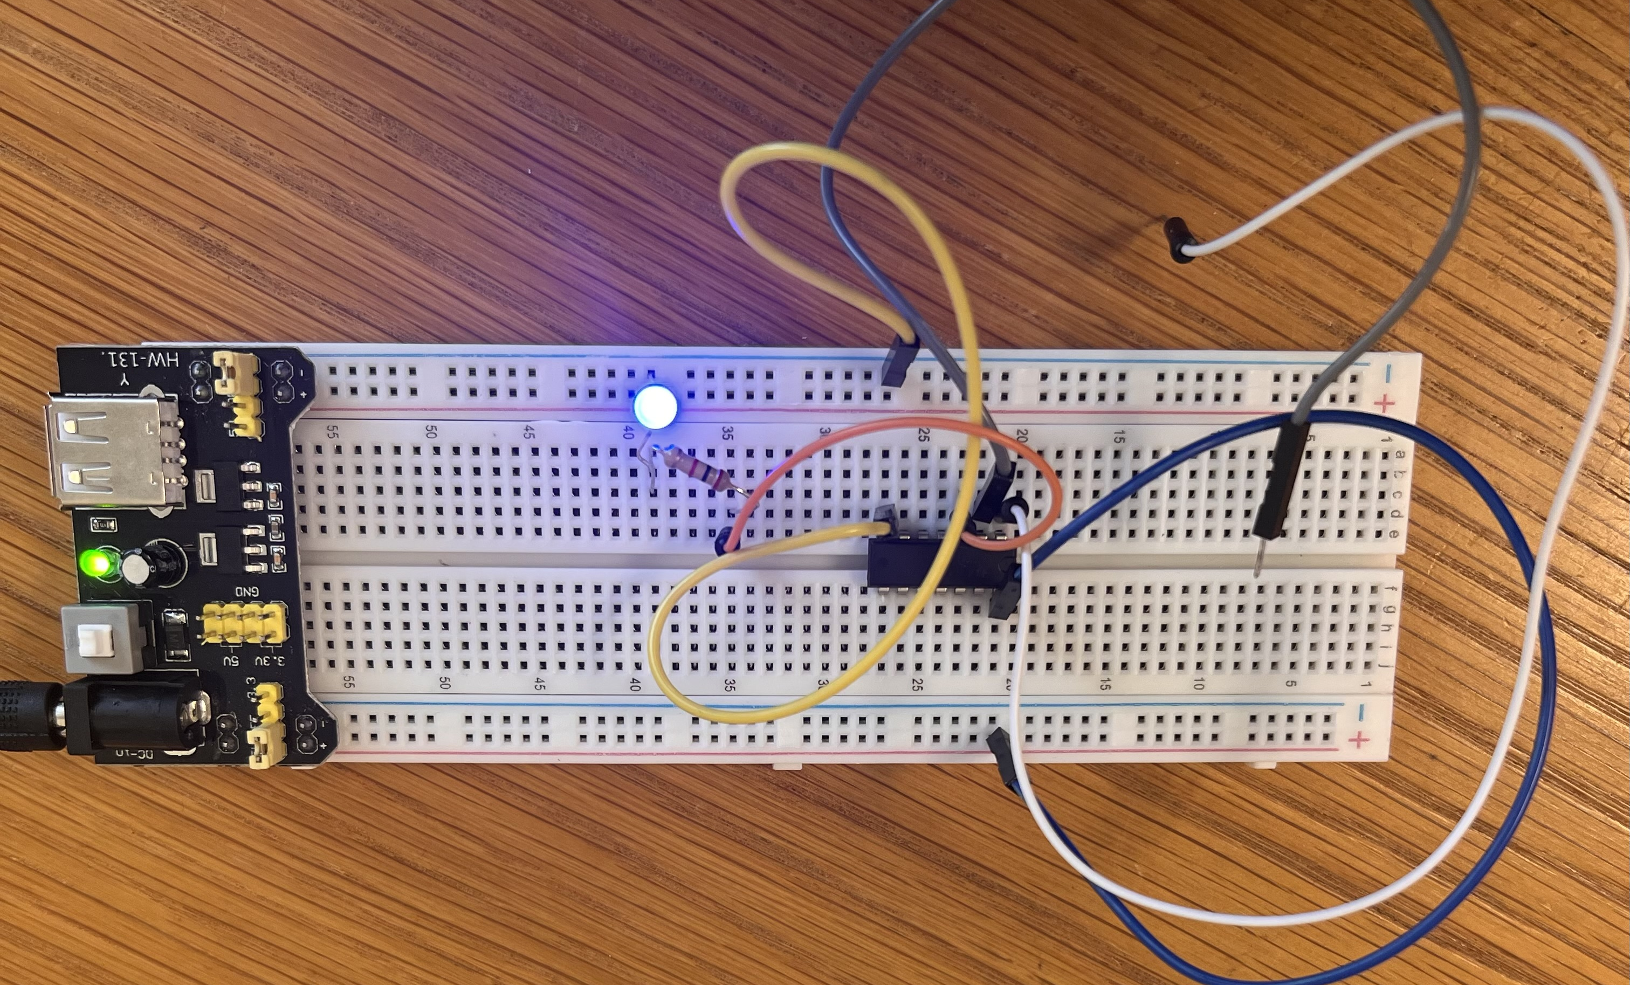
Part 3: AND Gate (7408)
Truth Table
A | B | A AND B
0 | 0 | 0
0 | 1 | 0
1 | 0 | 0
1 | 1 | 1
Gate pins
  Pin 1 → input A
  Pin 2 → input B
  Pin 3 → output
Steps
  Connect two input wires or switches to pins 1 and 2.
  Connect pin 3 → LED → resistor → GND.
  Test all input combinations.
  Only when A=1 and B=1 should the LED turn on.

Slide 11
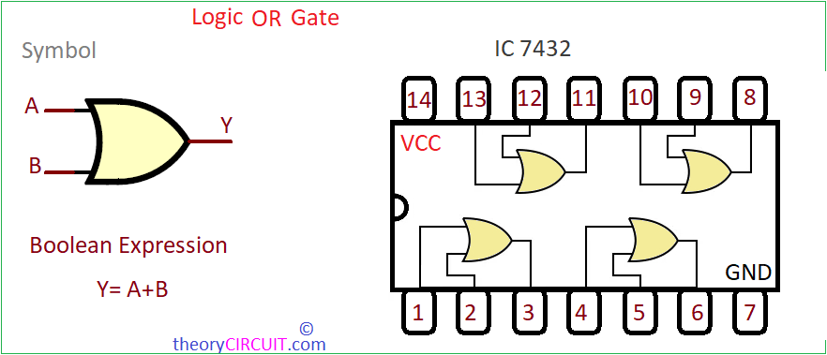
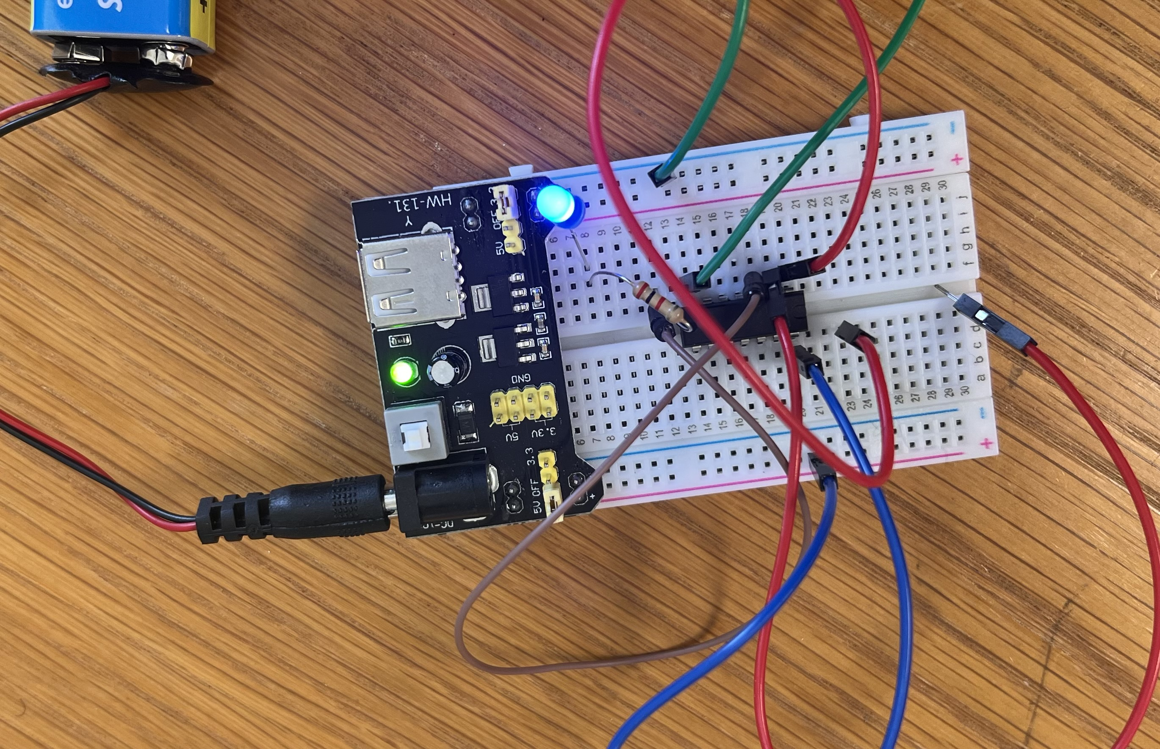
Part 4: OR Gate (7432)
Truth Table
A | B | A OR B
0 | 0 | 0
0 | 1 | 1
1 | 0 | 1
1 | 1 | 1
Gate pins
  Pin 1 → input A
  Pin 2 → input B
  Pin 3 → output
Steps
  Same setup as the AND gate but using the 7432 IC.
  LED should turn on if either input is HIGH.

Slide 12
Hardware Gates vs. MIPS Instructions
Gate | MIPS instruction
AND | and
OR | or
NOT | nor with $zero
Example:
  nor $t0, $t1, $zero # bitwise NOT

Slide 13
In-class Task/Assignment
Build NOT gate using IC 7404
Build AND gate using IC 7408
Build OR gate using IC 7432
Verify truth tables
Record observations
Deliverables
  Students must submit:
  Breadboard photo of each circuit
  Completed truth tables
  Short explanation of observed behavior
Example:
Gate | Input(s) | Output
NOT | 0 | 1
NOT | 1 | 0

