Slide 1
Computer Organization & Assembly Language
Lecture / Lab-005
Register Spilling in MIPS

Slide 2
Register Spilling in MIPS
Register Spilling: Temporarily saving register values to memory (stack)
so registers can be reused.
Why? CPU registers are limited.
$sp: Manages stack memory.
sw / lw: Save and restore register values.
Leaf & Non-Leaf: Register spilling can occur in both types of procedures.

Slide 3
Quick Check: Leaf vs. Non-Leaf Function
Leaf Function
  Does NOT call another function
  Does NOT need to save $ra
Non-Leaf Function
  Calls another function
  MUST save and restore $ra

Slide 4
Quick Check: Stack Pointer ($sp)
Holds address of top of stack
Stack is memory used for temporary saves
Stack grows downward (toward smaller addresses)
Allocate space:
  addiu $sp, $sp, -4
Save value:
  sw $t0, 0($sp)
Restore value:
  lw $t1, 0($sp)
Deallocate space:
  addiu $sp, $sp, 4

Slide 5
Stack Pointer ($sp)
It holds the address of the top of the current stack frame, and it changes when you allocate/free stack space.
.text
.globl main
main:
li $a0, 17
li $a1, 5
jal divmod
# print quotient ($v0)
move $a0, $v0
li $v0, 1
syscall
# exit
li $v0, 10
syscall
# leaf helper that prints newline
print_newline:
li $a0, 10
li $v0, 11
syscall
jr $ra
# divmod is NOT leaf anymore
#(it calls print_newline),
# so it must save/restore $ra.
divmod:
addi $sp, $sp, -4
sw $ra, 0($sp)
div $a0, $a1
mflo $v0
mfhi $v1
# jal writes the return address into $ra
jal print_newline
lw $ra, 0($sp)
addi $sp, $sp, 4
jr $ra
A leaf function is a function that
does not call any other function

Slide 6
Register Spilling Format
Saving and Restoring a Register
addiu $sp, $sp, -4 # Allocate 4 bytes
sw $t0, 0($sp) # Save $t0 on stack
# Reuse $t0 for another calculation
lw $t0, 0($sp) # Restore original value
addiu $sp, $sp, 4 # Deallocate stack space
Key takeaway: Register spilling allows the CPU to reuse registers without permanently losing
values that will be needed later.
Note that saving $ra in a non-leaf procedure preserves the return address; saving a temporary value to
free a register for reuse demonstrates register spilling.

Slide 7
Saving $ra vs. Register Spilling
Saving $ra (Preserving Return Address)
  sw $ra, 0($sp)
Done in non-leaf procedures to preserve the return address.
Necessary because another jal overwrites $ra.
Saving $ra | Register Spilling
Preserves the return address | Frees a register for reuse
Supports correct function returns | Supports register allocation
Common in non-leaf procedures | Possible in leaf and non-leaf procedures
2. Register Spilling
  sw $t0, 0($sp) # Save value
  # Reuse $t0
  lw $t0, 0($sp) # Restore value
Done to free a register for another calculation.
Can occur in both leaf and non-leaf procedures.

Slide 8
Register Spilling
When many variables are alive at the same time, registers may not be sufficient. The compiler spills
values to the stack.
# a in $a0, b in $a1, c in $a2, d in $a3
add $t0, $a0, $a1 # x = a + b
addiu $sp, $sp, -4 # allocate space
sw $t0, 0($sp) # spill x
add $t0, $a2, $a3 # y = c + d
lw $t1, 0($sp) # restore x
addiu $sp, $sp, 4 # deallocate space
mul $t2, $t1, $t0 # z = x * y
add $v0, $t2, $t1 # return z + x
jr $ra
C++ code idea (too many “live” variables at once)
  int f(int a, int b, int c, int d) {
  int x = a + b;
  int y = c + d;
  int z = x * y;
  return z + x; // x is needed again later
  }
Before spill:
<- $sp
After spill:
x
<- 0($sp)
<- $sp

Slide 9
Register Spilling
Given inputs a = 2, b = 3, c = 4, d = 5, write MIPS function f
that returns (a + b) (c + d) + (a + b) and demonstrate register
spilling by saving x = a + b on the stack, reusing a register, then reloading x.
#include <iostream>
using namespace std;
int f(int a, int b, int c, int d)
{
int x = a + b;
int y = c + d;
int z = x * y;
return z + x;
}
int main()
{
int result = f(2, 3, 4, 5);
cout << result << endl;
return 0;
}
Requirement: demonstrate register spilling by
(1) computing x = a+b into a temp register,
(2) saving x on the stack using $sp,
(3) reusing that temp register to compute y = c+d,
(4) reloading x from the stack,
(5) finishing z = x*y and return z + x.

Slide 10
Register Spilling
.data
newline: .asciiz "\n"
.text
.globl main
main:
  li $a0, 2
  li $a1, 3
  li $a2, 4
  li $a3, 5
  jal f
#print value
move $a0, $v0
li $v0, 1
syscall
#print newline
la $a0, newline
li $v0, 4
syscall
#exit
li $v0, 10
syscall
f:
  add $t0, $a1, $a0
  addiu $sp, $sp, -4 #make space
  sw $t0, 0($sp) #save x
  #reuse $t0, for y = c + d
  add $t0, $a2, $a3
  #reload x (restore)
  lw $t1, 0($sp) #t1 =x
  addiu $sp, $sp, 4 #pop space
  #z = x * y
  mul $t2, $t1, $t0 #$t2 = x*y
  #return z + x
  add $v0, $t2, $t1 #$v0 = z +x
  jr $ra
Occurs when registers are insufficient
Compiler saves value to stack
Later reloads value when needed
Stack acts as temporary overflow storage
Given inputs a = 2, b = 3, c = 4, d = 5, write MIPS function f
that returns (a + b) (c + d) + (a + b) and demonstrate register
spilling by saving x = a + b on the stack, reusing a register,
then reloading x.
  x = a + b;
  y = c + d;
  z = x * y;
  return z + x;
Requirement: demonstrate register spilling by
(1) computing x = a + b into a temp register,
(2) saving x on the stack using $sp,
(3) reusing that temp register to compute y = c + d,
(4) reloading x from the stack,
(5) finishing z = x * y and return z + x.

Slide 11
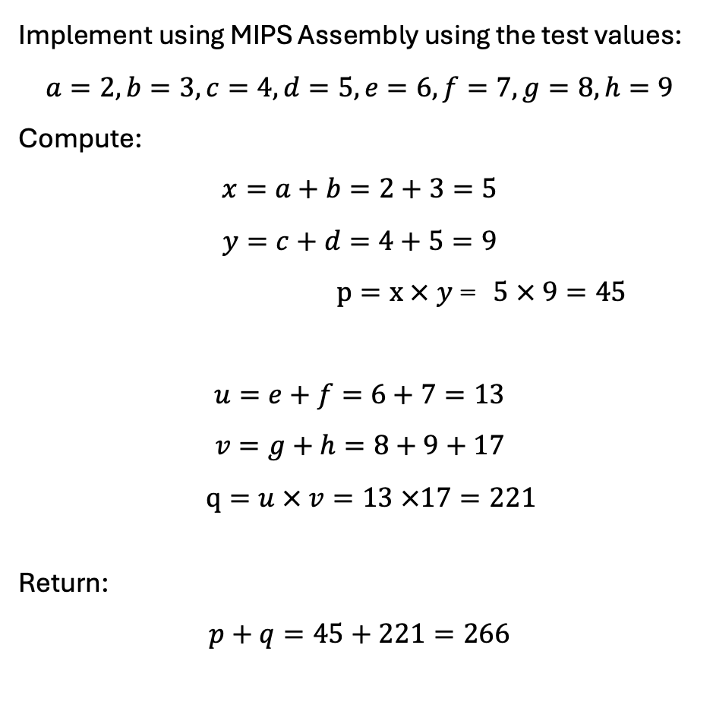
In Class Task
Implement using MIPS Assembly using the test values:
$$a=2, b=3, c=4, d=5, e=6, f=7, g=8, h=9$$
Compute:
$$x=a+b=2+3=5$$
$$y=c+d=4+5=9$$
$p=x × y$= $5 × 9=45$
$$u=e+f=6+7=13$$
$$v=g+h=8+9+17$$
$q=u × v=13 ×17=221$
Return:
$$p+q=45+221=266$$
C++ CODE
int calculate(int a, int b, int c, int d,
int e, int f, int g, int h)
{
int x = a + b;
int y = c + d;
int p = x * y;
int u = e + f;
int v = g + h;
int q = u * v;
return p + q;
}

Slide 12
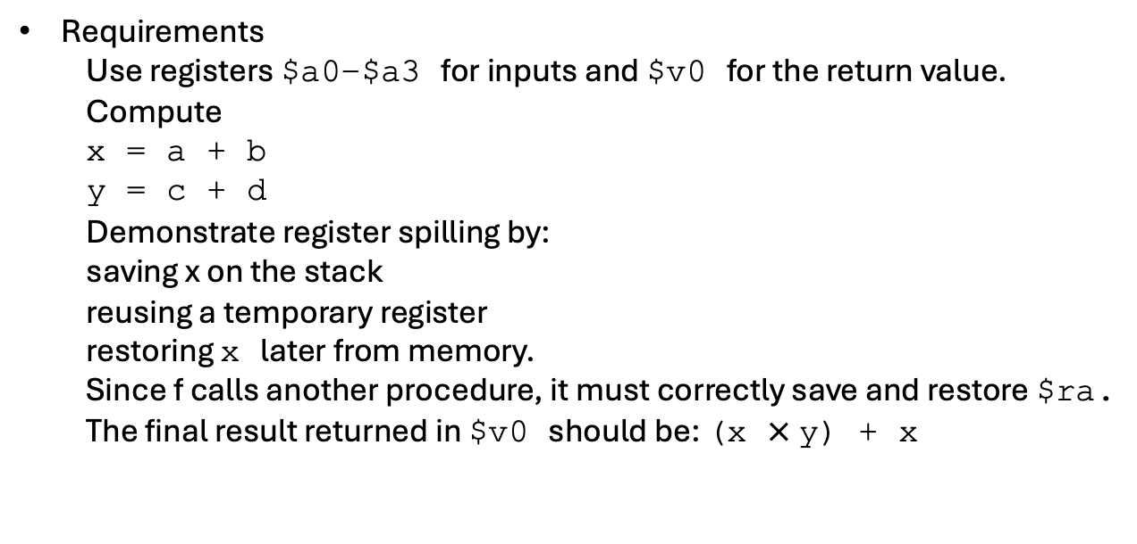
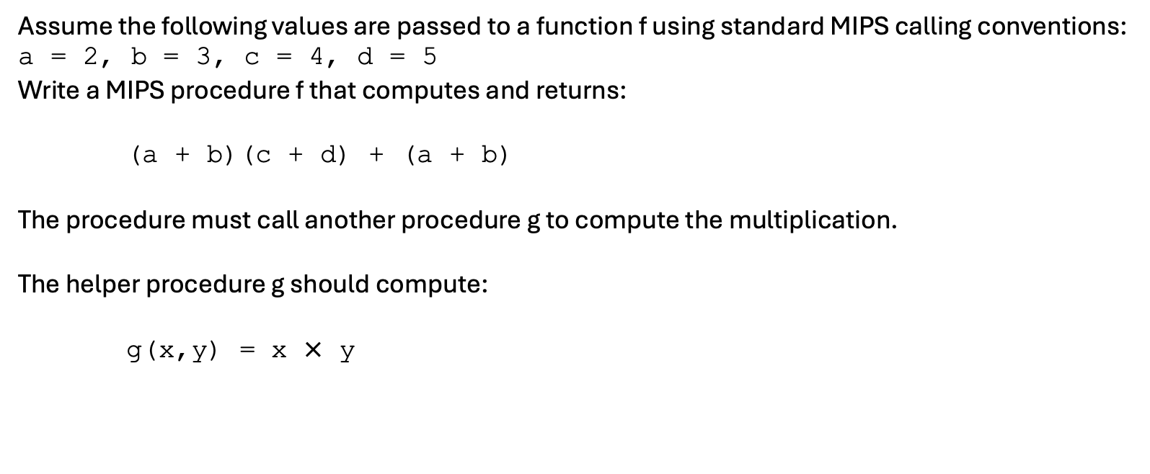
Non-Leaf Procedure and Register Spilling
Assume the following values are passed to a function f using standard MIPS calling conventions:
a = 2, b = 3, c = 4, d = 5
Write a MIPS procedure f that computes and returns:
(a + b)(c + d) + (a + b)
The procedure must call another procedure g to compute the multiplication.
The helper procedure g should compute:
g(x,y) = x $×$ y
Requirements
  Use registers $a0–$a3 for inputs and $v0 for the return value.
  Compute
  x = a + b
  y = c + d
  Demonstrate register spilling by:
  saving x on the stack
  reusing a temporary register
  restoring x later from memory.
  Since f calls another procedure, it must correctly save and restore $ra.
  The final result returned in $v0 should be: (x $×$y) + x
Expected Result
For the given inputs:
x = 5
y = 9
z = x*y = 45
return = z + x = 50

Slide 13
Non-Leaf Procedure and Register Spilling
C++ CODE:
#include <iostream>
using namespace std;
// Leaf function: performs multiplication
int g(int x, int y)
{
return x * y;
}
// Non-leaf function: calls another function (g)
int f(int a, int b, int c, int d)
{
int x = a + b;
int y = c + d;
int z = g(x, y);
return z + x;
}
int main()
{
int result = f(2, 3, 4, 5);
cout << result << endl;
return 0;
}

Slide 14
Non-Leaf Procedure and Register Spilling
f:
addiu $sp, $sp, -8
sw $ra, 4($sp) # save $ra
add $t0, $a0, $a1 # x = a + b
sw $t0, 0($sp) # spill x
add $t0, $a2, $a3 # y = c + d (reuse $t0)
lw $a0, 0($sp) # a0 = x
move $a1, $t0 # a1 = y
jal g # v0 = x*y
lw $t1, 0($sp) # reload x
add $v0, $v0, $t1 # v0 = x*y + x
lw $ra, 4($sp) # restore $ra
addiu $sp, $sp, 8
jr $ra
# g(x,y) = x*y (leaf)
g:
mul $v0, $a0, $a1
jr $ra
MIPS CODE:
.data
newline: .asciiz "\n"
.text
.globl main
main:
li $a0, 2
li $a1, 3
li $a2, 4
li $a3, 5
jal f
# print result in $v0
move $a0, $v0
li $v0, 1
syscall
# newline
la $a0, newline
li $v0, 4
syscall
# exit
li $v0, 10
syscall

Slide 15
In Class Task: Register Spilling in a Non-Leaf MIPS Procedure
Given C++ Program
Translate the following C++ program into MIPS assembly using QtSPIM.
  #include <iostream>
  using namespace std;
  // Leaf function
  int multiply(int x, int y)
  {
  return x * y;
  }
  // Non-leaf function
  int calculate(int a, int b, int c, int d)
  {
  int x = a + b;
  int y = c + d;
  int z = multiply(x, y);
  return z - x;
  }
  int main()
  {
  int result = calculate(3, 5, 4, 6);
  cout << result << endl;
  return 0;
  }

Slide 16
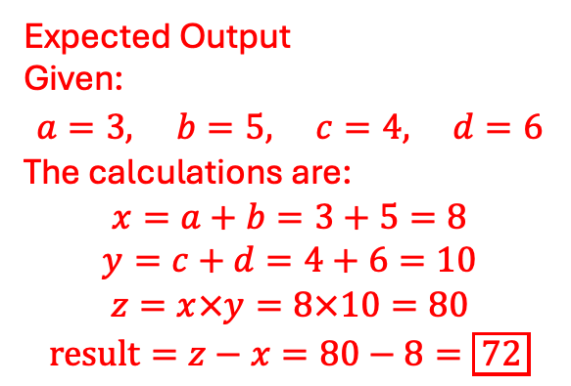
In Class Task: Register Spilling in a Non-Leaf MIPS Procedure
Requirements
Your MIPS program must:
Pass arguments: Use $a0–$a3 to pass the four arguments to calculate.
Compute x: Calculate x = a + b using a temporary register.
Demonstrate register spilling: Save x on the stack using $sp and sw, then reuse the same temporary register
to calculate y = c + d.
Implement a non-leaf procedure: calculate must call multiply using jal and correctly preserve its return address ($ra).
Implement a leaf procedure: multiply must multiply its two arguments and return the result in $v0.
Restore saved values: Reload x from the stack using lw after multiply returns, and restore $ra and $sp
before returning to main.
Print the result: Display the final result in the QtSPIM console.
Expected Output
Given:
$$a=3, b=5, c=4, d=6$$
The calculations are:
$$x=a+b=3+5=8$$
$$y=c+d=4+6=10$$
$$z=x×y=8×10=80$$
$$\text{result}=z−x=80−8=\boxed{72}$$

